Slide 1
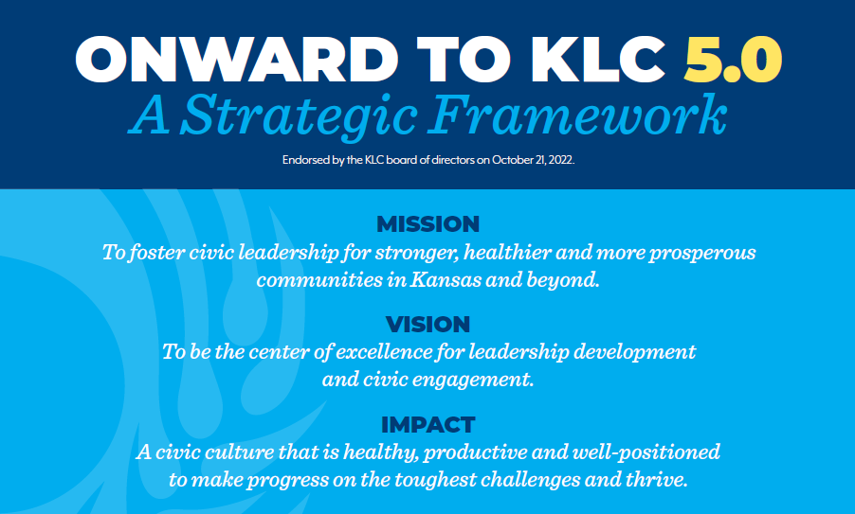

Slide 2
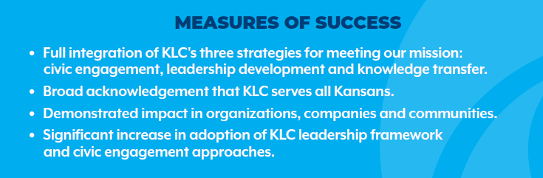

Slide 3
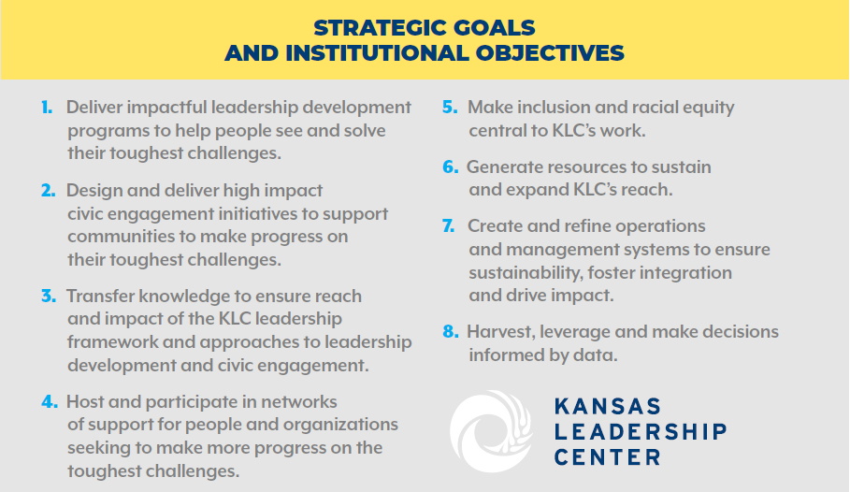


Slide 4
Some reasons DEI training doesn’t work
“Short-term educational interventions, in general, do not change people.”
Training can activate stereotypes in people’s minds rather than eliminate them.
Training can make people complacent.
Mandatory trainings make many white participants feel left out, angry, and resentful, decreasing their support for workplace diversity.
People don’t like to be told what to think and may rebel if they feel that they are being pressured to think a certain way.
Training models of “teaching people to be good” are based on the illusion that you can change people’s minds and behaviors solely by presenting them with new thoughts and information.
Source: David Brooks, NYT and YWBoston.org

Slide 5
What does work is:
Sustained, collective attention to purpose that results in changes to practices and policies.
People from diverse backgrounds collaborating to get work done.

Slide 6


Slide 7
Inclusion & Racial Equity Staff Development Objectives
Build staff and key contractor capacity to be equitable and inclusive in our approaches to civic engagement and eco-system building.
Build staff and key contractor capacity to apply equity-minded practices and approaches to leadership education institution.
Foster individual growth and team development through a series of conversations that support staff learning, curiosity, and sharing around DEI issues.

Slide 8
Interventions
Diversity and Inclusion in Ecosystem Building.
Inform our ability to design our engagements for the Heartland Together Project and provoke thinking related to other programs and activities.
Equity-mindedness in education.
Understand history and constructs that have led to current inequities;
Adopt shared definitions;
Use an equity-minded lens to diagnose KLC challenges related to strategic goal #5 and our vision for KLC 5.0
Brown-bag discussions facilitated by local DEI experts.

