Slide 1
Equitable Development Considerations
Dr. Dell Gines
Notes:
We designed this template so that each member of the project team has a set of slides with its own theme. Members, here’s how you add a new slide to just your set:
Mark where you want to add the slide: Select an existing one in the Thumbnails pane, click the New Slide button, then choose a layout. The new slide gets the same theme as the other slides in your set.
Careful! Don’t annoy your fellow presenters by accidentally changing their themes. That can happen if you choose a different theme from the Design tab, which changes all of the slides in the presentation to that look.

Slide 2
Topics
Defining economic development
  Various definitions
Diversity Equity and Inclusion
  Defining DEI
  Understanding the limitations of DEI
DEI in Economic Development
  How DEI in economic development is different than organizational DEI
Equitable Ecosystem building
  Defining Entrepreneurship Ecosystems

Slide 3
Defining economic development
Exercise #1 - 5 Minutes
How do YOU define economic development?

Slide 4
Defining Economic Development
Various Definitions
“The main goal of economic development is improving the economic well being of a community through efforts that entail job creation, job retention, tax base enhancements and quality of life.” (IEDC)
“The goals of economic development center on improving the quality of life of local citizens, improving equity in the population and ensuring that development is sustainable.” (Blair & Carroll, 2009)
“Local economic development may be defined as increases in the, “local economy’s capacity to create wealth for local residents.” (Feldman, 2014;Bartik, 2003).
“…those efforts by government to encourage new business investment in particular locales in the hopes of directly creating or retaining jobs, setting into motion the secondary multiplier, and enhancing and diversifying the tax base.” (Eisinger, 1988, p. 44)

Slide 5
Diversity Equity and Inclusion
Exercise #2 – 5 Minutes
Diversity is?
Equity is?
Inclusion is?

Slide 6
Diversity Equity and Inclusion
Defining DEI
Diversity refers to people’s “race, gender, religion, sexual orientation, ethnicity nationality, socioeconomic status, language, (dis)ability, age, religious commitment or political perspective.”
Equity promotes “justice, impartiality, and fairness within the procedure, processes, and distribution of resources by institutions or systems.”
Inclusion ensures people of all diverse backgrounds are welcome and have a seat at the table. This involves giving all employees the power to weigh in on important decisions and participate in development opportunities.
US Chamber

Slide 7
Diversity Equity and Inclusion
Defining DEI
Diversity, Equity & Inclusion (DEI) encompasses the symbiotic relationship, philosophy and culture of acknowledging, embracing, supporting, and accepting those of all racial, sexual, gender, religious and socioeconomic backgrounds, among other differentiators.
Inclusion Hub

Slide 8
Diversity Equity and Inclusion
Understanding the Limitations of DEI
Exercise #3 – Small group 10 minutes
What are the limitations of DEI?

Slide 9
Diversity Equity and Inclusion
Understanding the Limitations of DEI
Diversity is infinite
Boxes must be drawn, who has the power of drawing that box?
Practical resource constraints

Slide 10
Diversity Equity and Inclusion
Understanding the Limitations of DEI
Diversity is infinite
Practical resource constraints
Boxes must be drawn, who has the power of drawing that box?

Slide 11

Diversity Equity and Inclusion
Understanding the Limitations of DEI
Diversity is nearly unlimited – There are no limitations on how many ways you can define someone. All diversity ultimately is reduced to a unit of 1 because everyone is unique, and therefore has a unique experience.
Example – Black female -> Black female in the U.S. -> Black female in N.Y. -> Black Female in the Bronx -> Black Female in 10451 -> Black Female in 2401 3rd Ave, Bronx, NY apartments -> etc.

Slide 12
Diversity Equity and Inclusion
Limited Resources
Unlimited Diversity
The Problem of Scarcity
Understanding the Limitations of DEI
Practical resource constraints – In any given time, the number of resources available are limited, yet diversity is nearly unlimited.

Slide 13

Diversity Equity and Inclusion
Understanding the Limitations of DEI
Boxes must be drawn, who has the power of drawing that box?
This moves into issues about power, organizational structure and other considerations.

Slide 14
Diversity Equity and Inclusion
So, what IS it good for?
DEI is useful as an aspirational framework that causes us to continually review and seek to improve how we are treating people within various organizational contexts and systems.
Asking the questions such as:
“Who is in the room and who is not and why?”
“Are people being treated fairly in the room?”
“Are the people in the room given a voice in how the room is organized?”
Can be powerful in ensuring the organizations and systems are more empathetic, equitable, and empowering.

Slide 15
Defining Economic Development
My Definition
The main objectives of local economic development are to create and utilize policies, strategies, and programs to equitably improve the quality of life of the citizens in a community. To achieve these objectives, local developers use various techniques to create a sustainably thriving economy that promotes equitable distribution of economic growth and maintains or creates a place where citizens enjoy living, working, and playing.

Slide 16
DEI in Economic Development
Closed Systems vs Open Systems
Organizational DEI vs Economic Development Centered DEI are different.
ODEI functions in a relatively controlled environment, usually within a defined organizational objective (closed system).
EDDEI functions in a non-controlled environment, with many objectives that are often undefined (open system).
Closed
Open

Slide 17

DEI in Economic Development
What if a company is doing well with its DEI strategy, but the company itself is damaging the community where it draws its diverse populations from?

Slide 18
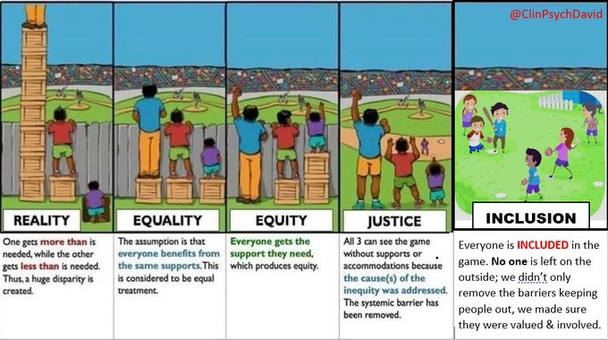
DEI in Economic Development
Closed Systems vs Open Systems
Organizational DEI vs Economic Development Centered DEI
Economic developers need to consider more things:
What if they want their own team?
What if they don’t want to play or watch?
What if they are included but are not good because they never had training?
What if they want to play a different sport?

Slide 19
DEI in Economic Development
Modifying the DEI framing questions
“Who are our programs, strategy and incentives geared to and who are they not geared to and why?”
“Are all communities in our area of responsibility being treated fairly when we make economic development decisions?”
“Are the communities impacted by the economic development decisions a critical part of the decision-making process?”

Slide 20
Defining economic development
Exercise #4 - 5 Minutes
How do YOU define entrepreneurship ecosystem building?

Slide 21
Equitable Entrepreneurship Ecosystem Building
Ecosystem building is an emergent economic development strategy. In other words, it is still being defined in more specific terms, and new practices and ways to consider using in economic development are occurring.
An entrepreneurship ecosystem is how communities are organized and connected to support or harm entrepreneurs as they start and grow companies.
There are two main pieces to an ecosystem the things in a community that support entrepreneurs, and how those things connect with each other and with entrepreneurs.

Slide 22
Equitable Entrepreneurship Ecosystem Building
Entrepreneurial Skills
Finances
Relationships
Culture
Physical and Digital Environment
Policy
Key Pieces of an Ecosystem
The following diagram shows the elements of and entrepreneurship ecosystem.
Three of the elements are assets an entrepreneur develops personally or uses.
The other three elements are environmental assets that support the entrepreneur.
How they are developed and connected determines the strength of the ecosystem.
Personal Assets
Environmental Assets

Slide 23
Equitable Entrepreneurship Ecosystem Building
Exercise #5 – Small groups 10 Minutes
Based upon the previous conversations on DEI, Economic Development and Entrepreneurship Ecosystems, how would you work to make entrepreneurship ecosystem building equitable in your communities?

Slide 24
Questions?

