Slide 2
US PREP
Technical Assistance
Residency Strategic Staffing
Districts & Education Preparation Programs
Pipeline to Leadership Strategic Staffing
Districts in partnership with Education Preparation Programs
Residency Transformation Education Preparation Programs in partnership with Districts

Slide 3
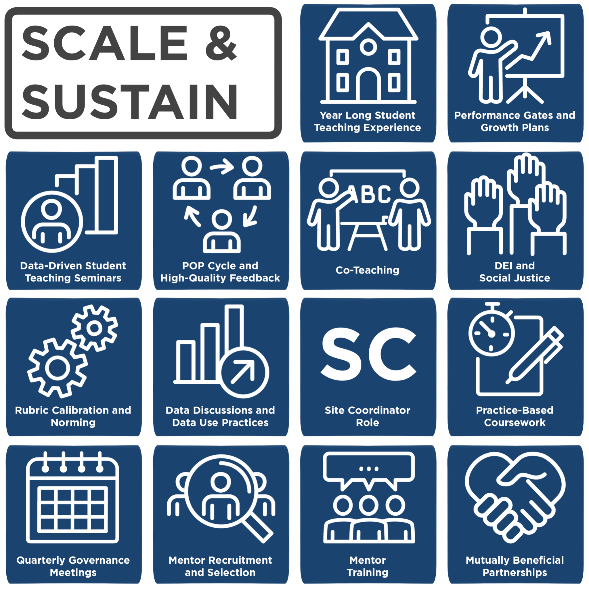
Residency Transformation Components
Year Long Student Teaching Experience
Performance Gates and Growth Plans
Data-Driven Student Teaching Course
POP Cycle and High-Quality Feedback
Co-Teaching
DEI & Social Justice
Rubric Calibration and Norming
Data Discussions and Data Use Practices
Site Coordinator Role
Practice-Based Coursework
Quarterly Governance Meetings
Mentor Recruitment and Selection
Mentor Training
Mutually Beneficial Partnerships
14 Components of a High-Quality Educator Preparation Program

Slide 4




Why are residencies important?
Provide sustained practice in a safe environment that is contextualized and deliberate with frequent self-reflective processes that reference others’ expert knowledge.
Quality residencies diminish the first-year learning curve novice teachers experience.
Intentionally designed residencies ensure districts have strong, qualified candidates for their high -needs positions and hard to staff schools.
Residency-prepared teachers remain in the profession.
Bank Street College of Education. (2017, September). Clearing the Path: Redesigning Teacher Preparation for the Public Good.

Slide 5
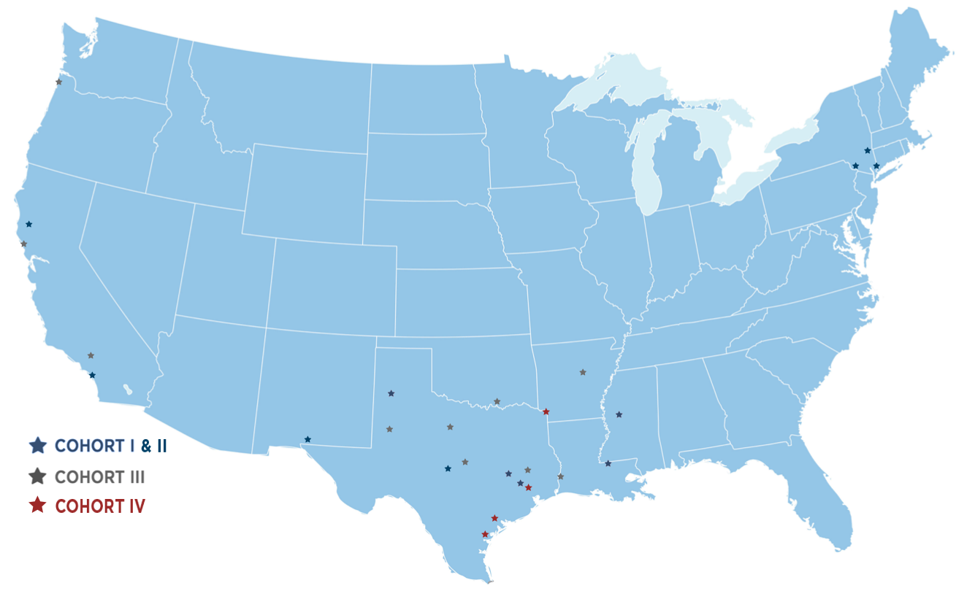
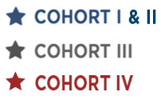
Portland State University
Brooklyn College
Lehman College
Touro College
University of the Pacific
Touro University California
CSU-San Marcos
University of Arkansas at Pine Bluff
San Diego State University
Texas Tech University
Texas A&M-Commerce
Texas A&M University - Texarkana
UT-Permian Basin
Tarleton State University
Jackson State University
University of Texas-El Paso
Texas State University
Southeastern Louisiana University
University of Texas-San Antonio
McNeese State University
University of Houston - Victoria
University of Houston-Downtown
University of Houston
Sam Houston State University
Texas A&M University - Corpus Christi
Prairie View A&M University

Slide 6
US PREP
Technical Assistance
Residency Strategic Staffing
Districts & Education Preparation Programs
Pipeline to Leadership Strategic Staffing
Districts in partnership with Education Preparation Programs
Residency Transformation Education Preparation Programs in partnership with Districts

Slide 7
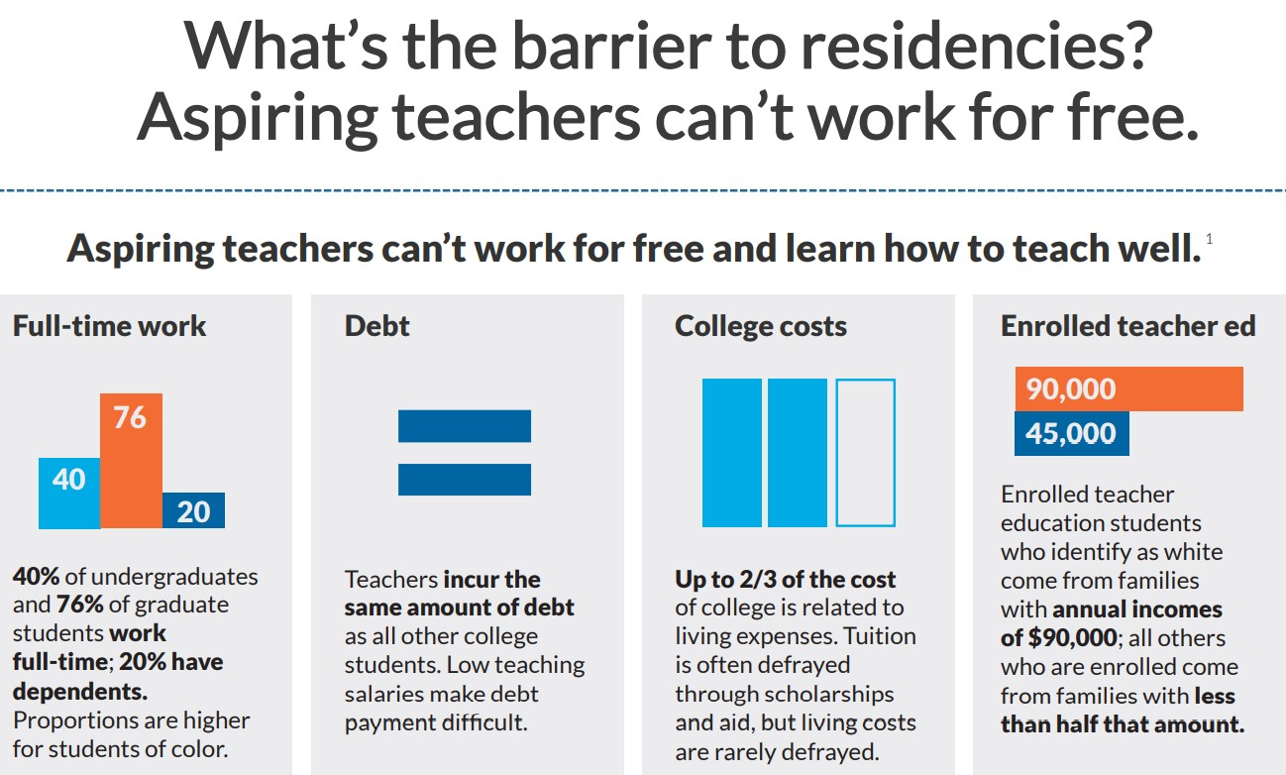
Research from the Field: Start with Sustainability
Copyright: “Residency Revolution: Funding High Quality Teacher Preparation” Bank Street: Prepared to Teach and WestEd, May 2021.

Slide 8
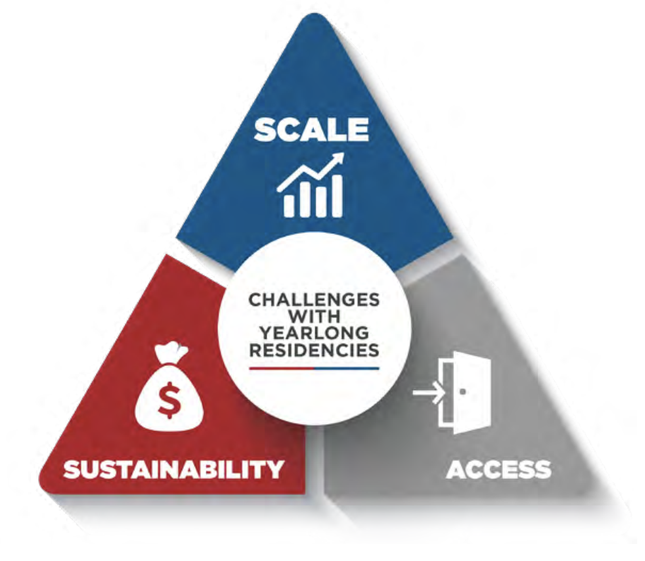
The Challenge of Access
What if residents could earn a wage while completing a high-quality residency?
Many candidates are responsible for their own means of paying for living expenses while they learn to teach.
This economic reality explains why over over 30% of aspiring teachers nationwide, matriculate through the growing ranks of quick-entry programs that provide salaries and benefits while pursuing certification.¹
1United States Department of Education, “2016 Title II Reports, National Teacher Preparation Data,” October 2018, https://bit.ly/2HpJeJa

Slide 9
What is Residency Strategic Staffing?
Strategic Staffing is a 2-year process in which a district and EPP commit to designing and implementing a paid year-long teacher residency program that is sustainably funded by reallocating district resources to compensate teacher residents who take on additional responsibilities in the district while completing a year-long teacher residency program.

Slide 10

Portland State University
Brooklyn College
Lehman College
Touro College
University of the Pacific
Touro University California
CSU-San Marcos
University of Arkansas at Pine Bluff
San Diego State University
Texas Tech University
Texas A&M-Commerce
Texas A&M University - Texarkana
UT-Permian Basin
Tarleton State University
Jackson State University
University of Texas-El Paso
Texas State University
Southeastern Louisiana University
University of Texas-San Antonio
McNeese State University
University of Houston - Victoria
University of Houston-Downtown
University of Houston
Sam Houston State University
Texas A&M University - Corpus Christi
Prairie View A&M University

Slide 11
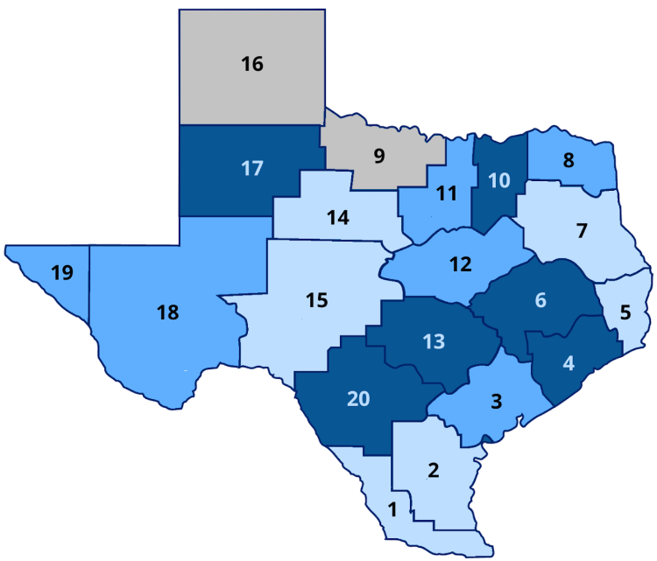
Residency Strategic Staffing Scale in Texas
Over 100 districts received a 3 year grant: $25,000 per resident + Residency Strategic Staffing TA
At the end of 3 years:
90% of districts planned to continue to pay residents from local district funds with 76% reporting feeling confident in a sustainable funding plan.
The average Resident Stipend was $18,773
The average Mentor Stipend was $2,913
Average number of residents per year: 8

Slide 12
Instructional Needs
STUDENT
SUPPORT
EXTENDING TEACHER REACH
REACHING
MORE
STUDENTS
FILLING
TEACHER VACANCIES
SUBSTITUTE
TEACHERS

Slide 13




Instructional Need: Substitutes
RESIDENTS AS SUBSTITUTE TEACHERS
Residency Model
Over 40 Texas Districts
4th ^{GRADE}
T
MT
MT
PAID Residency Model
Funding Reallocation Options:
Daily Sub Pay
Funding Reinvestment Examples:
Title 1 and Title 2
Recruitment Budget
Onboarding Budget
4th ^{GRADE}
T
MT
MT
R

Slide 14

Instructional Need: Extend Teachers’ Reach
RESIDENTS AS RELEASE TIME SUPPORT Example 1
Residency Model
Math
10 Texas Districts
MT
T
T
21
STUDENTS
21
STUDENTS
21
STUDENTS
21
STUDENTS
PAID Residency Model
Funding Reallocation Options:
Teacher Vacancies
Funding Reinvestment Examples:
Title 1 and Title 2
Recruitment & Onboard Budget
Instructional Coach & Interventionist Budget
Math
MT
T
T
28
STUDENTS
28
STUDENTS
28
STUDENTS
DISTRIBUTE
STUDENTS

Slide 15
US PREP
Technical Assistance
Residency Strategic Staffing
Districts & Education Preparation Programs
Pipeline to Leadership Strategic Staffing
Districts in partnership with Education Preparation Programs
Residency Transformation Education Preparation Programs in partnership with Districts

Slide 16




Research from the Field…
Source: Brown University &
US Dept of Ed
Interest in the teaching field amongst high school seniors and college freshman is at its lowest point in 50 years
Over 30% of aspiring teachers nationwide enroll in quick entry programs
Number of new teachers entering the profession has decreased by one-third over the last ten years
Teachers’ job satisfaction is at its lowest point in 50 years

Slide 17
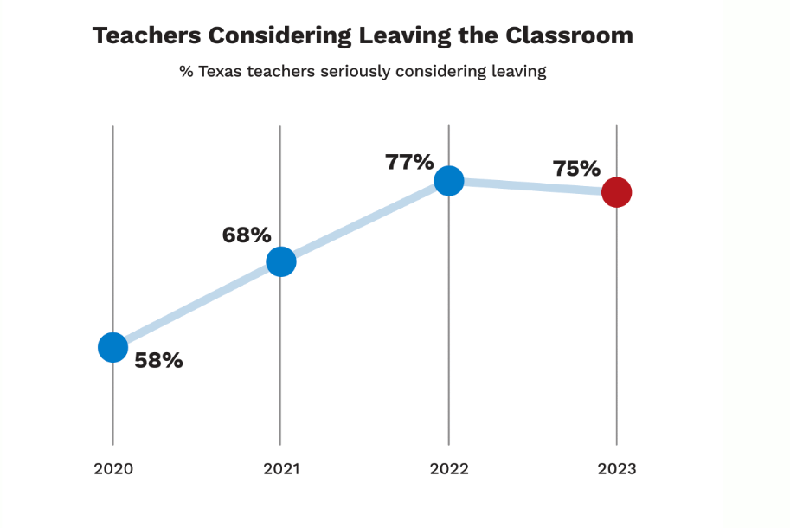
Source: Charles Butt Foundation

Slide 18
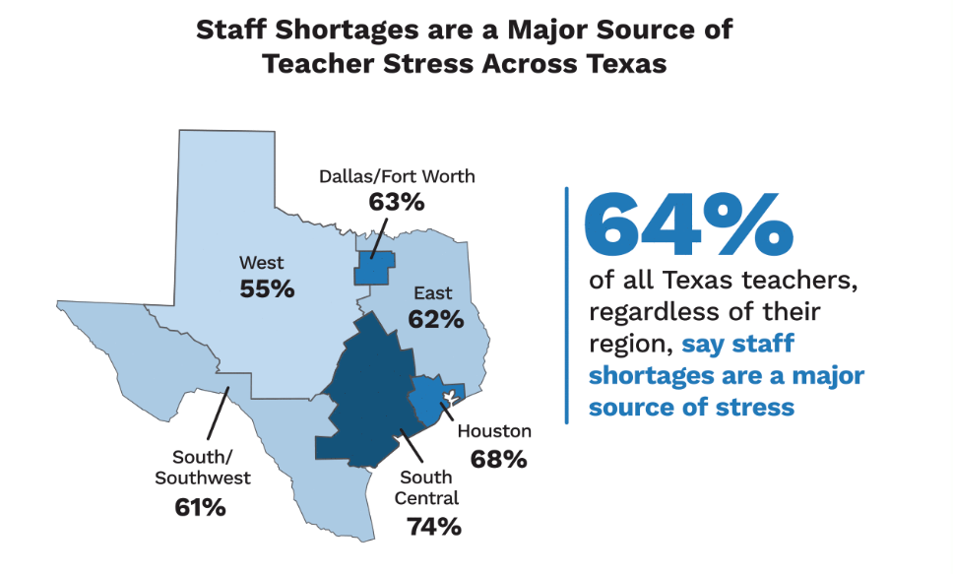
Source: Charles Butt Foundation

Slide 19
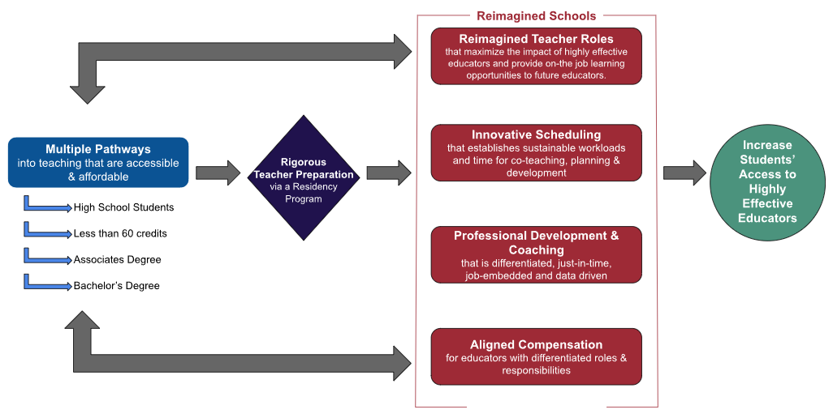
High Quality Teacher Ecosystem
Adapted from Education Resource Strategies

Slide 20
https://www.usprepnationalcenter.com/

