Slide 1
Significant Relief for Business Owners and Self-Employed
in the COVID-19 Pandemic Crisis
Presented by: Christopher P. Finney, Esq
Rebecca Simpson Heimlich, Esq
Stephen E. Imm, Esq.

Slide 2
disclaimer
Finney Law Firm LLC is presenting at this Empower U Ohio webinar. Your participation in and/or attendance at this webinar does not create an attorney-client relationship. This presentation, materials and webinar are not professional advice and are not intended as a substitute for professional legal advice.

Slide 3
topics we will cover
Overview of CARES Act
Grant/Loan Programs for Small Businesses and Self-Employed
Paycheck Protection Program: highlights, eligibility, amount, forgiveness, getting started, unsettled items
Economic Injury Disaster Loan program
Expanded Unemployment Benefits
Tax Relief to Businesses
Benefits to Individuals
Frequently Asked Questions
Questions?

Slide 4
Coronavirus Aid, Relief, and Economic Security Act
(CARES Act)
Signed into law on March 27, 2020
$2 trillion emergency spending bill
Provisions include:
Assistance for small businesses and self-employed
Loan/grant programs
Tax relief
Expanded unemployment benefits
Assistance to individuals
Direct payments
Expanded unemployment benefits
Loosening penalties for use of retirement funds
Tax relief

Slide 5
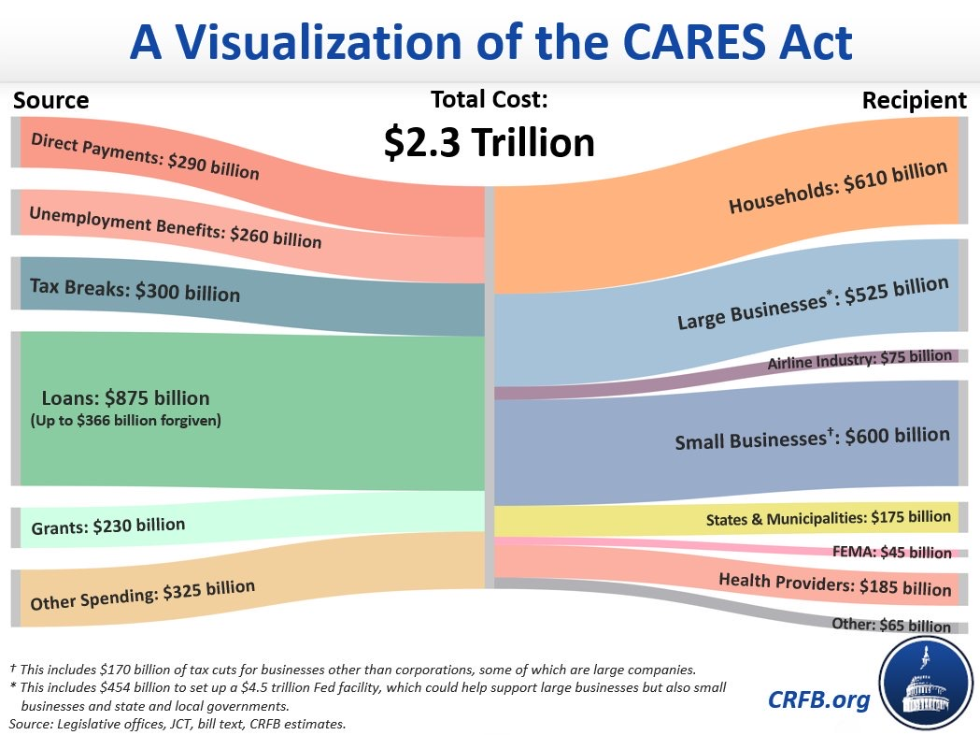
Coronavirus Aid, Relief, and Economic Security Act
(CARES Act)

Slide 6
NEW Grant/loan assistance to businesses and self-employed: Expansion of Small Business Administration Programs
In General:
The CARES Act expands two current Small Business Administration (SBA) loan programs by:
Loosening up qualification requirements, and
Expanding pool of eligible small businesses
Specifically:
Paycheck Protection Program (PPP)
An expansion of the current SBA 7(a) loan program
Labeled a loan program, but can operate as a generous grant program
Can provide small businesses up to 2.5 times their payroll
Economic Injury Disaster Loan programs (EIDL)
Expands types of entities eligible to receive up to $1.5 M in loans from SBA and/or loan guarantees

Slide 7
Paycheck protection program: program highlights
COST
There is no cost to apply
PURPOSE
Funding is meant to help retain workers, maintain payroll, and cover rent/mortgage/utility expenses
TIMEFRAME
The loan covers costs over the 8-week period after the loan is made
FORGIVENESS
Under certain guidelines the loan can be forgiven and essentially turned into a non-taxable grant
NO GURANTEE NEEDED
There is no personal guaranty required
NEED
Not required to show that you cannot get a loan elsewhere
FUNDING
PPP authorizes up to $349 billion in forgivable loans

Slide 8
Paycheck protection program: Who is eligible?
Small Businesses
Independent Contractors
Sole Proprietors
Self-Employed Individual
501(c)(3 and (c)(19)
Tribal business concern
SIZE: Must meet size requirement of fewer than 500 employees or otherwise satisfy SBA’s size requirement.

Slide 9
Paycheck protection program: how much can I borrow?
IN GENERAL: Loans can be for up to two months of your average monthly payroll costs from the last year plus an additional 25% of that amount. Loans are capped at $10M. In calculating your average monthly payroll, you must subtract you EXCLUDED PAYROLL COSTS from your INCLUDED PAYROLL COSTS.
INCLUDED COSTS
Salary, wages, commissions, or tips (capped at $100,000 annualized per employee)
Employee benefits including
Costs for vacation, parental, family, medical, or sick leave; allowance for separation or dismissal;
Payments required for the provisions of group health care benefits including insurance premiums; and
Payment of any retirement benefit; • State and local taxes assessed on compensation; and
For a sole proprietor or independent contractor: wages, commissions, income, or net earnings from self-employment, capped at $100,000 on an annualized basis for each employee.
EXCLUDED COSTS
Annual compensation in excess of $100,000 prorated for 2/1 to 6/30
Certain wages for which a credit is allowed under the Families First Coronavirus Response Act
Compensation for employees whose primary residence is outside of the U.S.
Income taxes, payroll taxes, railroad retirement taxes

Slide 10
Paycheck protection program: how can I get My loan forgiven?
According to the Treasury Department’s latest guidance
The loan amounts will be forgiven as long as:
The loan proceeds are used to cover payroll costs, and most mortgage interest, rent, and utility costs over the 8 week period after the loan is made; and
Employee and compensation levels are maintained
Payroll costs are capped at $100,000 on an annualized basis for each employee
Due to likely high subscription, it is anticipated that not more than 25% of the forgiven amount may be for non-payroll costs

Slide 11
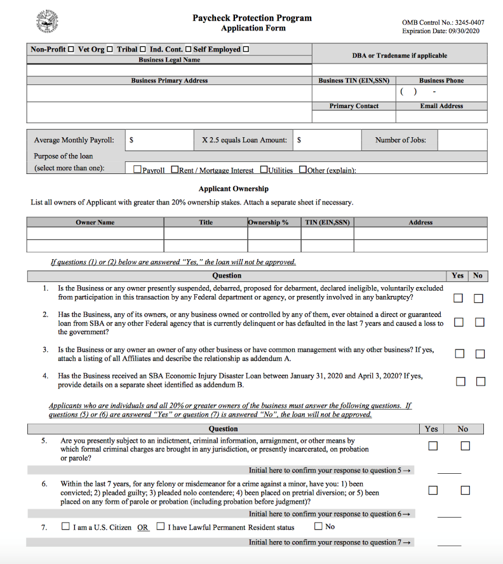
Paycheck protection program: getting started
How do I get started on applying for PPP?
GET STARTED NOW: Banks will likely be overwhelmed with applications and funds may run out
Call your banker
Call your own bank first
SBA approved banks:
The Huntington National Bank
Fifth Third Bank
US Bank
PNC Bank
Center Bank
First Financial Bank
People’s Bank (Marietta)
Application start dates
April 3, 2020, small businesses and sole proprietorships
April 10, 2020, independent contractors and self-employed individuals

Slide 12
Economic Injury Disaster Loan programs (EIDL): in General
The CARES Act expanded the SBA’s EIDL loan program and waived several EIDL loan requirements
Loan Program:
Unlike PPP, EIDL is a loan program that doesn’t provide loan forgiveness.
Provides small businesses with working capital loans of up to $2 million
$10,000 “loan advance:” Loan advance “[f]unds will be made available within three days of a successful application, and this loan advance will not have to be repaid.” – SBA COVID-19 website
CARES Act:
Loosened approval process
Waives requirement for rules relating to personal guarantees for amounts up to $200,000
Expanded eligibility
Waives requirement that must have been in business for a year
Waives requirement of showing that can not obtain a loan elsewhere

Slide 13
Economic Injury Disaster Loan programs (EIDL): WHAT TYPES OF
ENTITIES DOES IT BENEFIT
Examples
Rental Real Estate (commercial & residential): Can submit amount of lost rent due to COVID 19 to apply for a loan.
Nonprofits: Only 501(c)(3) and 501(c)(19) nonprofits qualify for PPP. EIDL covers all private nonprofits, including, for example trade associations, labor unions and social clubs.
Entities that will benefit most from EIDL are those who do not qualify for PPP

Slide 14
Economic Injury Disaster Loan programs (EIDL): getting started
How do I apply for EIDL? Apply online here… https://covid19relief.sba.gov/#/

Slide 15
Tax relief For Businesses Under CARES Act
Payroll Tax Refunds
Up to 50 percent of wages to employees
Employee Retention Tax Credit
If you’ve had to close or suspend operations, you may be eligible for tax credit and/or delay of Social Security taxes

Slide 16
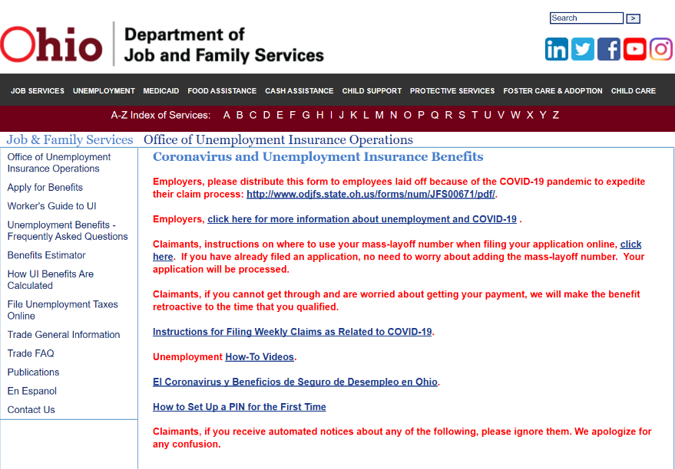
expansion of unemployment insurance Under Cares Act
Expansion of Eligibility:
Expanded eligibility to include self-employed and independent contractors who do not generally qualify for unemployment insurance
Those who get laid-off, contract COVID-19, or have to care for someone with COVID-19 are also eligible
Increased Funding and Payments:
Provides $250 billion in funding to expand benefits
Provides an additional $600 per week for four months in addition to what states typically pay.
How do I apply?
I am an employer. What do I tell my employees?
Both questions are answered online here…
http://jfs.ohio.gov/ouio/CoronavirusAndUI.stm

Slide 17
Benefits to Individuals
Direct Payments (in general)
Amount:
$1,200 to those who file as single and have adjusted gross income (AGI) of $75,000 or less. Rebate is decreased with AGI over $75,000.
$2,400 to those who file joint and have AGI of $150,000 or less. Rebate decreased for AGI over $150,000.
Phase-out: For single filers with an AGI of $99,000 and for joint filers at $198,000
Dependent children under 17: Eligible families will receive $500 per child
Expands Unemployment Benefits
Loosens Penalties for Use of Retirement Funds
Expands Tax Benefits of Charitable Contributions

Slide 18
frequently asked questions
Fact specific questions on what counts as payroll, for example:
I have commission-based employees. Do their commissions count for PPP? What if their commissions decrease because of COVID-19?
It is clear independent contractors can apply themselves for PPP, but can companies also claim funds paid to independent contractors?
What about owners of companies with employees who pay themselves out of profits rather than by salary?
What exactly will be forgiven?
What if after the 8 weeks, I need to layoff my employees?
What if the funds for PPP run out?

Slide 19
Thank you to empower u OHIO
Empower U Ohio is a volunteer organization that brings free educational courses to our community on a myriad of important topics through engaging speakers in person and online.
Please support Empower U and Fill The Truck:
https://www.empoweruohio.org/
https://www.fillthetruck.org/

Slide 20
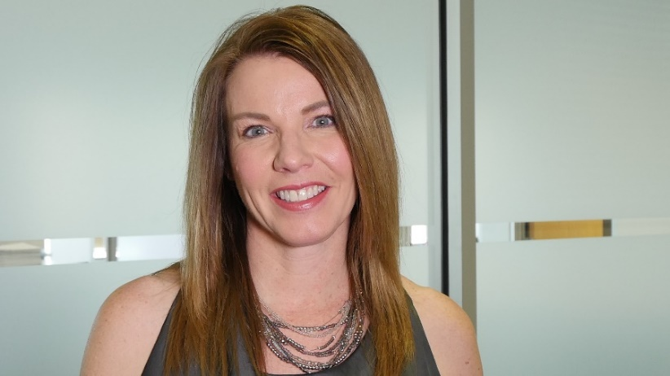
Finney Law Firm, LLC
513-943-6650
Chris@FinneyLawFirm.com
Rebecca@FinneyLawFirm.com
Stephen@FinneyLawFirm.com
www.finneylawfirm.com

