Slide 1
SARS-COV-19
June 2020
What We Now Know
Mike Wilson
Robert V. Bulas MD

Slide 2
Various Model Projections
Model | Date | US Forecasted Deaths
Imperial College – Unmitigated | March 16 | 2,200,000
Imperial College – Strong mitigation | March 16 | 192,000
Drs. Fauci/Birx - Various | March 31 | 100,000-240,000
IHME | April 2 | 93,531
IHME | April 5 | 81,766
IHME | April 8 | 60,145
IHME | April 27 | 74,073
IHME | May 4 | 134,475
IHME | May 18 | 143,357
IHME | June 6 | 165,960

Slide 3
Sanity Checking the Models
The Diamond Princess Example
3710 people isolated on a cruise liner and nearly all were tested
634 became infected over two weeks (17%)
7 died on the ship (1.1%)
USA Simple Scenarios – 330M people
Death rate could be much higher if hospitals get overwhelmed
Infection Rate | Death Rate | Projected Deaths
50% | 1% | 16,500,000
50% | .25% | 4,125,000
17% | 1% | 561,000
17% | .25% | 140,250
10% | 1% | 330,000
10% | .25% | 82,500
Notes:
Age adjusted expected death rate was actually 2.4%

Slide 4
Why Models Got it Wrong
Initial models were heavily based on data from China
Exponential growth models are very sensitive to starting assumptions
Universe of potential hosts
Rate of transmission
True death rate
Impact of mitigation measures

Slide 5
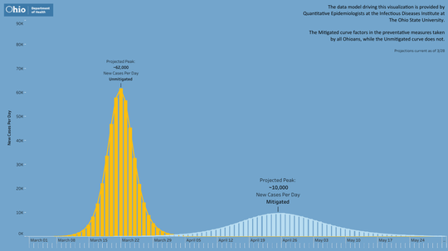
Notes:
3/28 – predicting a peak of 10k cases per day on April 25

Slide 6
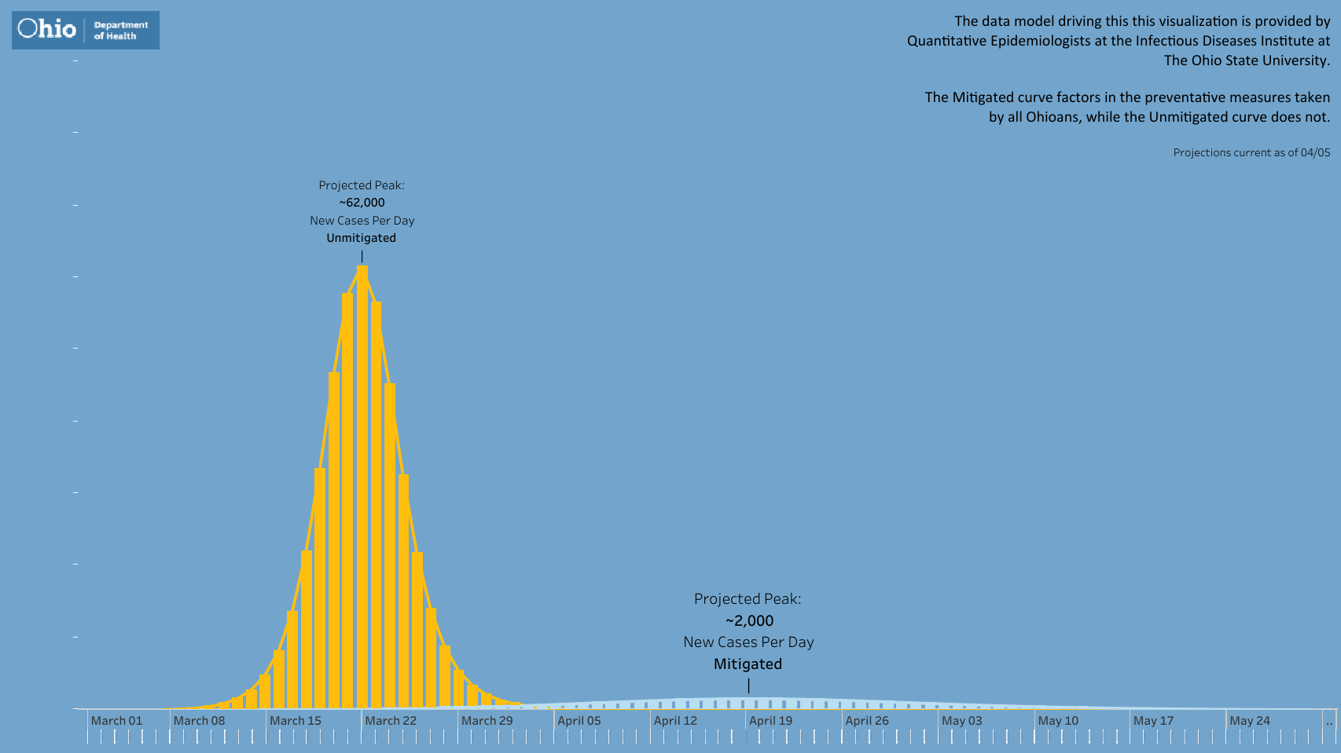
Notes:
By April 5th, we’d revised it downward to about 1600 cases per day on April 19th.

Slide 7
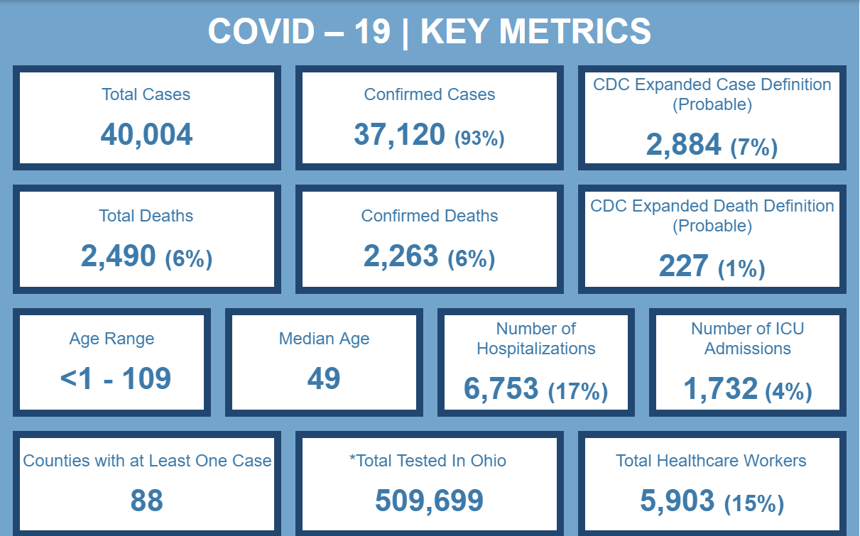
The Situation in Ohio – June 11
Notes:
Who’s getting tested – only the sickest
Low amount of “probable” cases – CDC definition
Affects death rates
Get the current day total 272
Hospital and ICU are cumulative, not current

Slide 8
Case, Hospitalization and Death Statistics
Age | Cases | Hosp. | Deaths | % of Cases | % of Hosp. | % of Deaths | % of Pop.
0-19 | 2000 | 100 | 0 | 5.0% | 1.5% | 0.0% | 24.8%
20-29 | 5789 | 270 | 8 | 14.5% | 4.0% | 0.3% | 13.4%
30-39 | 6529 | 432 | 16 | 16.3% | 6.4% | 0.6% | 12.5%
40-49 | 6283 | 665 | 38 | 15.7% | 9.8% | 1.5% | 12.0%
50-59 | 6519 | 1211 | 142 | 16.3% | 17.9% | 5.7% | 13.5%
60-69 | 5226 | 1492 | 348 | 13.1 | 22.1% | 14.0% | 12.4%
70-79 | 3482 | 1297 | 612 | 8.7% | 19.2% | 24.6% | 7.2%
80+ | 4147 | 1285 | 1326 | 10.4% | 19.0% | 53.3% | 4.2%
Notes:
Update

Slide 9
Hospitalization and Death Rates
Age | Cases | Hosp. | Deaths | Hosp. Rate | Death Rate
0-19 | 2000 | 100 | 0 | 5.0% | 0
20-29 | 5789 | 270 | 8 | 4.7% | 0.1%
30-39 | 6529 | 432 | 16 | 6.6% | 0.2%
40-49 | 6283 | 665 | 38 | 10.6% | 0.6%
50-59 | 6519 | 1211 | 142 | 18.6% | 2.2%
60-69 | 5226 | 1492 | 348 | 28.5% | 6.7%
70-79 | 3482 | 1297 | 612 | 37.2% | 17.6%
80+ | 4147 | 1285 | 1326 | 31.0% | 32.0%
Notes:
Update – death rate comparisons vs normal risks

Slide 10
Calculating the IFR
CFR: Case Fatality Rate (deaths / known cases) – Ohio is 6.2%
Can be Naïve or age-adjusted
IFR: Infection Fatality Rate (deaths / total infections) – can only be estimated
Diamond Princess CFR: 1.1%
Ohio’s Prison Experiment CFR: 1.2%
Various Estimates based on antibody testing: 0.1%-0.8%
CDC Best Current Estimate: 0.26%
Notes:
Define IFR, CFR
Diamond Princess
Ohio Prisons
CDC Estimate

Slide 11
Ohio Fatality Rates
Notes:
Define IFR, CFR
Diamond Princess
Ohio Prisons
CDC Estimate

Slide 12
Excess Mortality
Ohio 2018 All Causes Mortality: 124,264 (10,355 deaths/month)
Ohio COVID-19 Deaths to Date: 2,490
Ohio COVID-19 Deaths in nursing homes: 1,745 (71%)
Notes:
Define IFR, CFR
Diamond Princess
Ohio Prisons
CDC Estimate

Slide 13
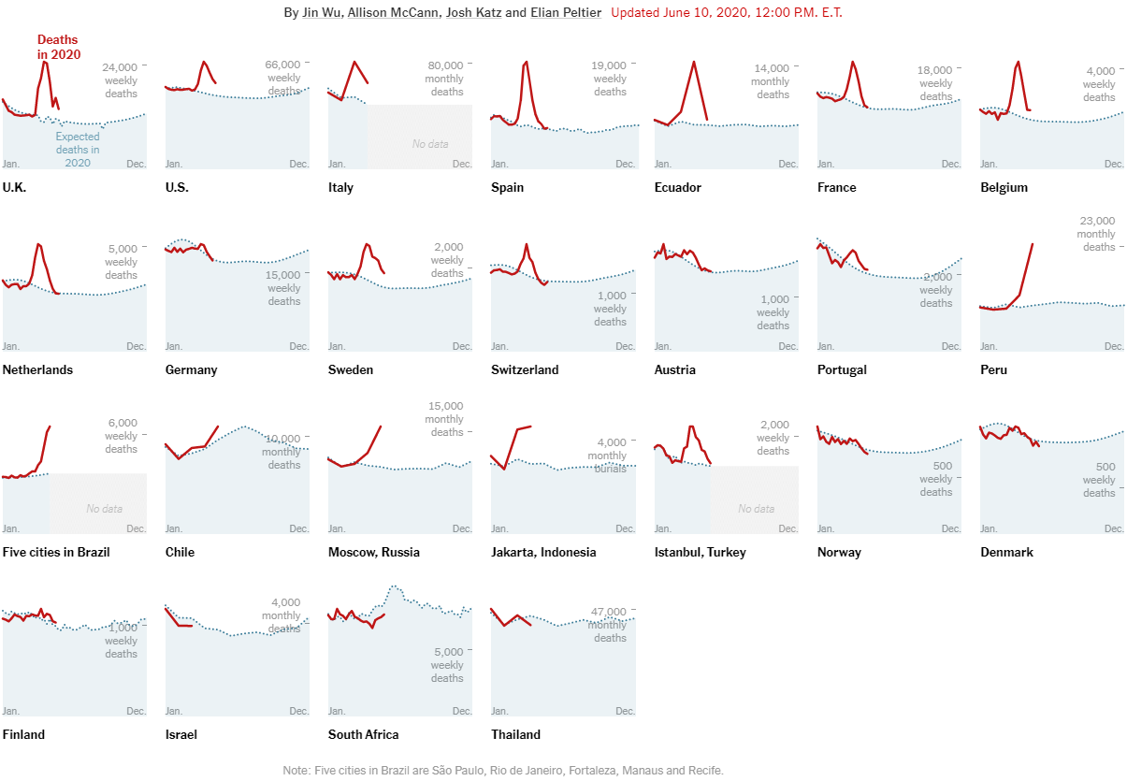

Slide 17
Notes:
Peak occurred April 4-7, but hard to trust the latest data – a bit of a reporting lag and it takes average of 14 days for the virus to kill

Slide 18
Notes:
Showing the revisions

Slide 19
Cases by reported date - today
Notes:
Insert current cases slide

Slide 20
Cases by Onset Date - today
Notes:
Insert current cases slide

Slide 21
Cases by Onset Date Prison Adjusted - today
Notes:
Insert current cases slide

Slide 22
Case Testing
Cases are no longer a good measure for trend analysis
Current data set includes both PCR testing and antibody testing – today’s new data reported 2 cases from February 1 and we have 20 cases even older
Testing availability has grown tremendously
Targeted testing of hot spots doesn’t represent the general spread of the virus
Notes:
PCR testing vs. antibody
Changes in testing availability
Targeted testing – growth in cases not reflecting spread

Slide 24
Hospitalizations by Admission date and current hospitalizations
Notes:
PCR testing vs. antibody
Changes in testing availability
Targeted testing – growth in cases not reflecting spread

Slide 25
Restart in other areas
Notes:
Experience in GA, WI, FL, CO as lockdowns are removed

Slide 26
SARS-COV-2 and COVID-19
What we were told in March 2020
Extremely contagious new coronavirus
Originated in a Chinese wet market in Wuhan
Spread to the USA and Europe in February
Causes severe pneumonia and ARDS
Wuhan lockdown was required to control spread
Models predict 1-2 million American deaths

Slide 27
SARS-COV-2
What we were told in March 2020
Very high fatality rate in the elderly and immunocompromised
American health care system will be overwhelmed and ventilators may be rationed
There is a PPE shortage due to Chinese supply chain
Masks should only be worn by health care professionals
Treatment is merely supportive until a vaccine is developed
Exponential viral growth can only be blunted with distancing, blanket closures, and ”stay at home” lockdowns.

Slide 28
SARS-COV-2
What we didn’t know in March 2020
The CDC had already botched the test kit development and had a monopoly via the FDA
The virus had actually entered the USA and Europe in December and early January (WHO and China)
Children and young adults rarely experience severe COVID-19.
The prevalence of asymptomatic COVID-19.
The fact that COVID-19 models were fatally flawed
The fact that the CDC pandemic protocol was devised in 2006 based on “modeling”and had never been utilized or tested.

Slide 29
SARS-COV-2
Pathophysiology
It invades cells via the ACE-2 receptors
ACE-2 receptors are prominent in the nose, throat, lungs, heart, kidneys, liver, and blood vessels
Causes cell death and causes intense inflammation : cytokine storm
May result in blood vessel wall inflammation and blood clot formation
Lungs: oxygen exchange impaired by a combination of dead cells, fluid leaking into air sacs, and clotting of lung arteries.
Heart: Inflammation, rhythm disturbances, blood vessel clotting
Kidneys/liver: can cause organ failure
Brain : blood vessel clotting can result in stroke
PIMS : may be associated with recent COVID-19, as with other infections

Slide 30
Treatment of COVID-19
What we know today
Prophylaxis : No proven prophylaxis yet (? Hydroxychloroquine)
Early infection : No proven treatment yet (? Hydroxychloroquine)
Shortness of breath/ low O2 levels
Treat within 6 hours of SOB onset with O2 and a multi-drug regimen
Antiinflammatory : Steroids and Actemra
Blood Thinner : Heparin
Antiviral : Remdesivir (or other)
Correct Vitamin D deficiency
+/- High Dose IV Vitamin C
+/- Hydroxychloroquine

Slide 31
Treatment of COVID-19
What we know today
Pulmonary Care
Supportive O2 therapy with shortness of breath or low O2 levels
Intermittent prone positioning
Intubation/Ventilator therapy as last line of defense
low pressure vs. high pressure ventilation

Slide 32
SARS-COV-2
What we know today…
After 3 months, the virus is now spreading slowly, despite widespread reduction in distancing
R is now under 1 (original Ro of 2.5-5) = shrinking
The infection fatality rate in those under 30 is under 0.1%
The infection fatality rate in those over 80 is up to 14%
Co-morbidities are almost always seen with severe COVID-19
Heart, lung, and kidney disease
HTN, Diabetes, Obesity

Slide 33
SARS-COV-2
What we know today…
Outdoor transmission is uncommon
Indoor transmission occurs despite 6 foot rule
Transmission may occur despite mask wearing
Masks likely decrease “viral transmission load”
Asymptomatic transmission resulting in symptomatic infection is very uncommon
Transmission by school age children to adults is extremely rare

Slide 34
SARS-COV-2 Transmission
What we know today…
Generally face to face indoor respiratory transmission
Cough, sneeze, 5 minutes of talking, prolonged breathing in an enclosed space, air flow pattern dependent
Social Distancing
History of “6 foot Rule”
2006 Bush Pandemic Working Group
2006 Dr. DA Henderson rebuttal
2007 CDC “Non-pharmacologial Intervention Policy”
The Truth about Indoor Distancing

Slide 35
SARS-COV-2
Coexisting with the virus today…
Vaccine is at least 6-12 months away
Convalescent plasma is effective
Current Ohio HC System threat level is very low
Health care system is non-stressed despite reopening
Declining test positivity rate 11% > 5.5% > 2%
Hospitalization rate negligible : acute care bed capacity 2.4%
Daily deaths near zero
Herd Immunity Threshold (HIT)
Viral transmission slowing at 7-20% immunity?

Slide 36
SARS-COV-2
Why are we coexisting so well today?
Spontaneous human behavior adaptation
Individual human susceptibility variation
Viral mutation/adaptation
Herd Immunity Threshold
Focus on the vulnerable

Slide 37
SARS-COV-2 : Summary
Ohio Policy Implications
Health
Viral threat <<< Negative health impact of Government Policy
Conclusion = Open fully now with guidance only
Economics
Conclusion = No scientific evidence to support continued business closures or social distance restrictions on ANY Ohio business, as of today, including outdoor mass gathering events.
Indoor mass gathering restrictions should also be removed by July 1, if hospitalization rates remain low over the next 2 weeks.

Slide 38
SARS-COV-2 What we know
Ohio Policy Implications
Public Schools
Is this a disease of children? No, and they aren’t asymptomatic spreaders to adults, either.
Is “6 Foot Social Distancing” effective or necessary in school classrooms? No and no.
Is student mask wearing feasible or necessary in school classrooms? No and no.
Policy impact on public school attendance/funding?
Conclusion = Open public schools now at full capacity and with no classroom distancing or mask wearing requirements

