Slide 1

Paycheck protection program: Loan forgiveness
Presented by: Christopher P. Finney, Esq
Rebecca Simpson Heimlich, Esq

Slide 2

disclaimer
Finney Law Firm LLC is presenting at this webinar. Your participation in and/or attendance at this webinar does not create an attorney-client relationship. This presentation, materials and webinar are not professional advice and are not intended as a substitute for professional legal advice.

Slide 3
topics we will cover
Overview of PPP and funds still available
PPP forgiveness
  New guidance and legislation
  Need Certification
  Calculation in general
  Details for calculation
    Eligible payroll costs
    Eligible non-payroll costs
    FTE equivalent reduction and safe harbor
    Salary/Wage reduction and safe harbor
    60% payroll requirement
  Process
Small Business Solutions Group

Slide 4
Paycheck protection program: program highlights/OVERVIEW
Funding:
  Originally $349 billion program
  $310 billion more as of 4/24
  Well over $100 billion left
Goals:
  Keep people working/paid
  Help with “payroll” and a few other expenses
  Some key elements
    Must have been in operation on 2/15/2020
    No cost to apply
    No personal guarantee required
    Not required to show you cannot get loan elsewhere
    Apply through your bank
    Must certify current economic uncertainty makes this loan request necessary to support the ongoing operations of the Applicant
Forgivable: Under certain guidelines forgivable & essentially become non-taxable grant
Small Businesses
Independent Contractors
Sole Proprietors
Self-Employed Individual
501(c)(3) and (c)(19)
Tribal business concern

Slide 5
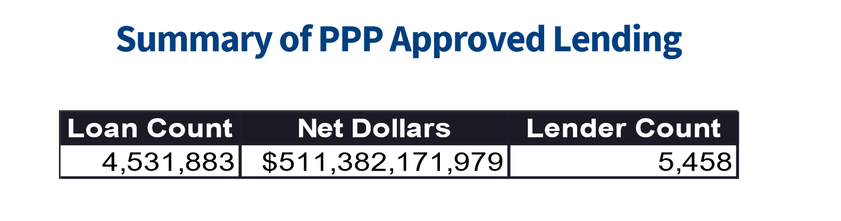
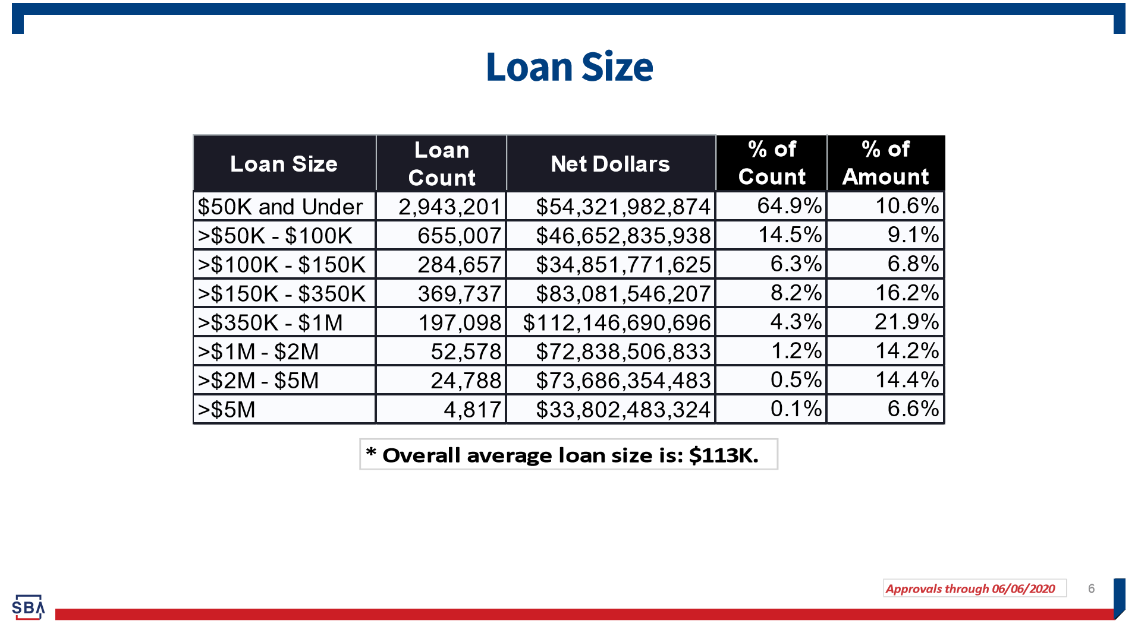
Grant/loan assistance to businesses and self-employed:
Current status
So far:
Overwhelming number of applications for first round
Funds left in second round and average loan size smaller
Differences among banks
Challenges with guidelines
Large publicly traded companies
https://home.treasury.gov/system/files/136/SBA-Paycheck-Protection-Program-Loan-Report-Round2.pdf

Slide 6
PPP fORGIVeNESS: NEW GUIDANCE then new legislation
New Guidance
PPP Forgiveness Application
New Interim Final Rule
Additions to FAQs
New Legislation: PPP Flexibility Act
Forgiveness Period – Extends from 8 weeks to 24
Required Payroll Percentage – Reduced from 75% to 60%
Loan Term – Extends from 2 years to 5 years; still 1% interest
Rehire
  Current Rehire Safe Harbor – Extends deadline from 6/30/20 to 12/31/20
  Codifies Rehire Exemption – Codifies FAQ guidance regarding documented, good faith attempt to rehire
  New Rehire Exemption – Forgiveness not reduced if good faith, documented inability to “return to same level of business activity” as prior to 2/15/20 due to sanitation, social distancing, and worker or customer safety
Loan Deferral Period – Generally extends until SBA compensates lender for forgiven amounts
Payroll Tax Deferral – Deferral open to all PPP borrowers. Previously, could only defer until PPP loan was forgiven
New Application/Guidance Needed

Slide 7
PPP fORGIVeNESS: need certification
Need Certification must have been made in good faith: Current economic uncertainty makes this loan request necessary to support the ongoing operations of the Applicant.
Safe Harbor for those who received less than $2 million in PPP funds
FAQ Question 46: How will SBA review borrowers’ required good-faith certification concerning the necessity of their loan request?
Answer: … SBA, in consultation with the Department of the Treasury, has determined that the following safe harbor will apply to SBA’s review of PPP loans with respect to this issue: Any borrower that, together with its affiliates, received PPP loans with an original principal amount of less than $2 million will be deemed to have made the required certification concerning the necessity of the loan request in good faith. …
Purpose of less than $2 million safe harbor
Less likely to have had access to adequate sources of liquidity than those with larger loans
As PPP borrowers with more limited resources work to retain and rehire employees, will provide greater economic certainty
Enables the SBA to focus its limited resources on larger loans, “where the compliance effort may yield higher returns”

Slide 8
PPP fORGIVeNESS: CALCULATION in general
Step 1: Calculate your qualifying payroll costs
Step 2: Calculate your qualifying non-payroll costs by category
    Business Mortgage Interest Payments
    Business Rent or Lease Payments
    Business Utility Payments
Step 3: Calculate any forgiveness adjustment for Salary/Hourly Wage reduction
Step 4: Calculate your FTE Reduction Quotient
Step 5: Reduce your qualifying costs by any FTE or Salary/Hourly Wage reductions to determine your “Modified Total”
    Add your qualifying payroll costs to your qualifying non-payroll costs, then subtract from that total any forgiveness adjustments for Salary/Hourly Wage Reductions
    Multiply your total from Step 5(1) by your FTE Reduction Quotient to get your “Modified Total”
Step 6: Divide your qualifying payroll costs (from Step 1) by 75% (or 60%) to determine your “Payroll Cost 75% (60%) Requirement Total”
Step 7: Determine your loan forgiveness amount, which is the lessor of your:
    PPP Loan Amount
    Modified Total
    Payroll Cost 75% (60%) Requirement Total

Slide 9
PPP fORGIVeNESS: eligible Payroll costs
Over what period are they measured?
    Covered Period – 8 (or 24) weeks after the first date on which you received PPP loan proceeds
    Alternative Covered Period – Borrowers with bi-weekly (or more frequent) payroll can use the Alternative Covered period, which begins on the first day of the first pay period following receipt of PPP loan proceeds.
  Note: If you chose the Alternative Covered Period, you must use that period each time it is allowed. In some calculations however, it is not allowed, so read to the Application carefully.
Paid or incurred?
  Includes payroll costs paid or incurred during the Covered Period or Alternative Covered Period
What is included?
  Cash compensation – the sum of gross salary, gross wages, gross tips, gross commissions, paid leave (vacation, family, medical or sick leave), and allowances for dismissal or separation paid or incurred during the Covered Period or the Alternative Payroll Covered Period. Also includes hazard pay and bonuses.
  Employer contributions for employee health insurance
  Employer contributions for employee retirement plans
  Amount paid by employer for state and local taxes assessed on employee compensation
What is not included?
  Leave covered by the Families First Coronavirus Response Act
  Annual salary for any employee over of $100,000, as prorated; so, capped at $15,385

Slide 10
PPP fORGIVeNESS: eligible Payroll costs caps for owner-employees
and self-employed
5/22/20 Interim Final Rule: Loan forgiveness for owner-employees and self-employed individuals’ payroll compensation is capped at the lesser of:
8/52 of 2019 compensation, OR
$15,385 per individual in total across all businesses.
Question: Impact of PPP Flexibility Act?
Owner-employees - Capped by the amount of 2019 employee cash compensation and employer retirement and health care contributions made on their behalf.
Schedule C filers - Capped by the amount of owner compensation replacement, calculated based on 2019 net profit (8/52 of Line 31 capped at $100,000).
General Partners - Capped by the amount of their 2019 net earnings from self-employment (reduced by claimed section 179 expense deduction, unreimbursed partnership expenses, and depletion from oil and gas properties) multiplied by 0.9235.
*No additional forgiveness for retirement or health insurance contributions for self-employed individuals, including Schedule C filers and general partners’ income.

Slide 11
PPP fORGIVeNESS: Eligible non-payroll costs
Mortgage Interest:
Payments of interest
On any business mortgage obligation on real or personal property
Obligation incurred before February 15, 2020
Rent:
Business rent or lease payments
For real or personal property
Pursuant to lease agreement in force before February 15, 2020
Utilities:
Business payments for a service for the distribution of electricity, gas, water, transportation, telephone, or internet access
For which service began before February 15, 2020
Paid or Incurred: Eligible non-payroll costs must be
Paid or incurred during the Covered Period;
Paid on or before the next billing date; and
Cannot exceed 25% (40%) of the total forgiveness amount

Slide 12
Ppp forgiveness: FTE equivalent reduction
Step 1: Select a Reference Period
2/15/20 to 6/30/19; or
1/1/20 to 2/29/20; or
For seasonal employers, either of the foregoing or a 12-week period between 5/1/19 and 9/15/19
Step 2:
Compare average FTE levels during Covered Period or Alternative Covered Period to Reference Period
If lower during Covered Period or Alternative Covered Period forgiveness is reduced proportionally by the percentage reduction in FTE employees
Example: If had 10 average FTE during Reference Period and 8 average FTE during Covered Period, average FTE declined 20%, so only 80% of otherwise eligible expenses are available for expenses.
In general: Reduction in FTE equivalent employees during the Covered Period or Alternative Covered Period reduces loan forgiveness by the same percentage as the percentage reduction in FTE employees, unless exception applies.

Slide 13
PPP fORGIVeNESS: FTE equivalent reduction SAFE HARBOR
FTE REDUCTION SAFE HARBOR: No loan forgiveness reduction based on level of FTE employees IF:
  Borrower reduced FTE employee levels in the period
    Beginning February 15, 2020, and
    Ending April 26, 2020
  AND, Borrower restored FTE employee levels
    By June 30, 2020 (December 31, 2020)
    To levels in Borrower’s pay period that included February 15, 2020
IMPORTANT EXCEPTIONS: Borrower may exclude any reduction in FTE equivalent headcount attributable to an individual employee under the following circumstances:
Offer to rehire or restore hours
  Good faith, written offer to rehire same employee for same salary and number of hours or to restore hours made during:
    Covered Period, or
    Alternative Covered Period
  For same salary/wages and number of hours as earned by employee “in the last pay period prior to the separation of reduction of hours.”
  Offer was rejected by employee
  Records documenting offer/rejection
  Informed applicable state unemployment office of rejection within 30 days
Fired/Resigned - Fired for cause; voluntarily resigned; voluntarily received a reduction in their hours

Slide 14
Ppp forgiveness: wage/salary reduction
Details
Reduction calculation performed on an employee by employee basis
Which employees to calculate
  Each new employee in 2020
  Each existing employee who was not paid more than the annualized equivalent of $100,000 in 2019
Reference Period – January 1, 2020 to March 31, 2020
Reduction calculation – Comparing each employees average annual salary/wages during Reference Period to average annual salary/wages during the Covered Period or Alternative Covered Period, must reduce forgiveness by total dollar amount of salary/wage reductions in excess of 25% of base salary/wages.
Example: Employee’s weekly salary was $1,000 during Reference Period, and was reduced to $700 weekly during Covered Period. The first 25% of reduction ($250) does not count against forgiveness, but the excess over 25% ($50) does. So the full reduction is $50 multiplied by 8 weeks, so $400 (or, 24 weeks).
In general: A reduction in an employee’s salary or wages in excess of 25% will generally result in a reduction in the loan forgiveness amount, unless an exception applies

Slide 15
PPP fORGIVeNESS: salary/wage reduction SAFE HARBOR
SALARY/WAGE REDUCTION SAFE HARBOR: No loan forgiveness reduction based on salary/wage reductions IF (calculated on an employee by employee basis):
  Borrower reduced salary/wage for a certain employee during the period
    Beginning February 15, 2020, and
    Ending April 26, 2020
  AND, Borrower restores that employee’s salary/wage
    By June 30, 2020 (December 31, 2020)
    To levels average salary/wage as of February 15, 2020
* To ensure that borrowers are not doubly penalized for FTE and wage/salary reductions: The salary/wage reduction applies only to the portion of the decline in employee salary and wages that is NOT attributable to an FTE reduction.

Slide 16
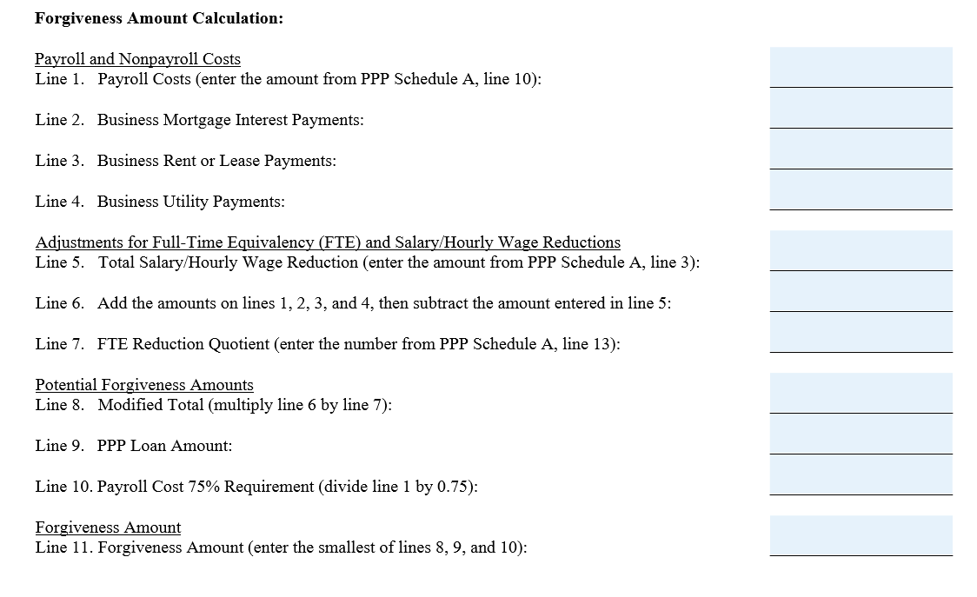
PPP fORGIVeNESS: 60% rule (formerly 75% Rule)
Calculation guidance was issued by Treasury/SBA prior to PPP Flexibility Act

Slide 17
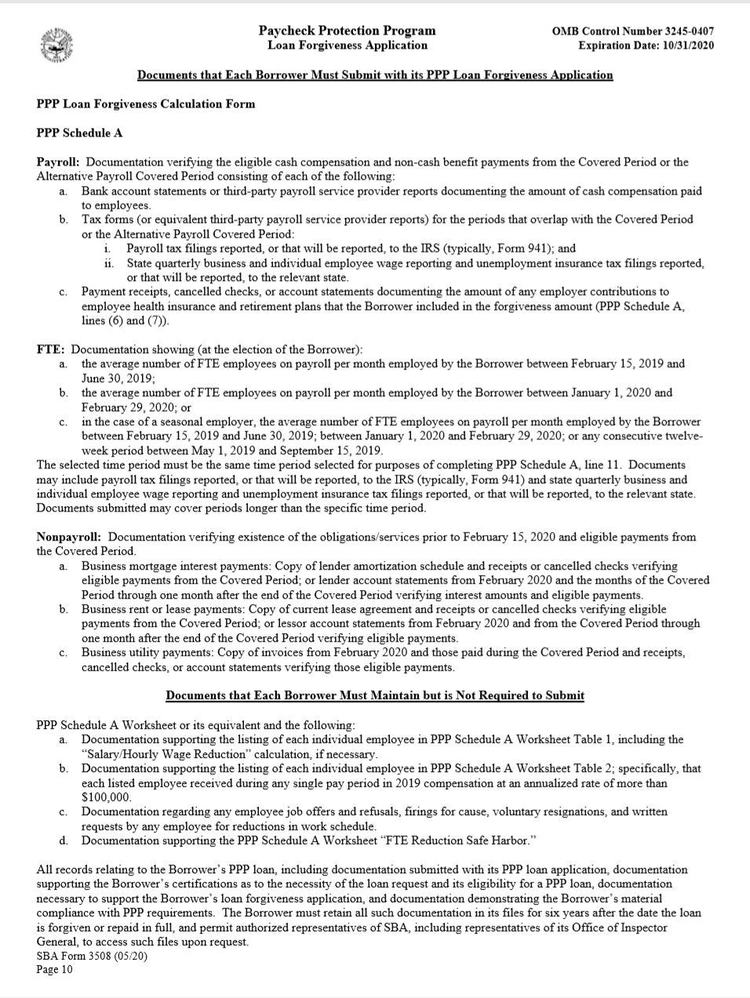
PPP fORGIVENESS: Process
https://home.treasury.gov/system/files/136/3245-0407-SBA-Form-3508-PPP-Forgiveness-Application.pdf
Application: Must submit the Paycheck Protection Program Loan Forgiveness Application to lender or the lender servicing the loan. Must submit:
  PPP Loan Forgiveness Calculation Form
  PPP Schedule A
  Several required documents (as outlined on p. 10)
Documents:
  Some have to be maintained but not submitted
  Must maintain all document for six years after loan forgive or repaid
Lender:
  Has 60 days from receipt of application to issue decision to SBA and to request payment from SBA
  SBA will review and submit payment to lender not later than 90 days after lender issues decision to SBA
  Any portion not forgiven must be repaid
  Lender will notify borrower of forgiveness amount
SBA:
  SBA will review some loans before lender decision
  SBA will issue further guidance on their review of loans

Slide 18

Small business solutions group
513-943-6650
Jane@FinneyLawFirm.com
Rebecca@FinneyLawFirm.com

Slide 19


Finney Law Firm, LLC
513-943-6650
Chris@FinneyLawFirm.com
Rebecca@FinneyLawFirm.com
www.finneylawfirm.com

