Slide 1
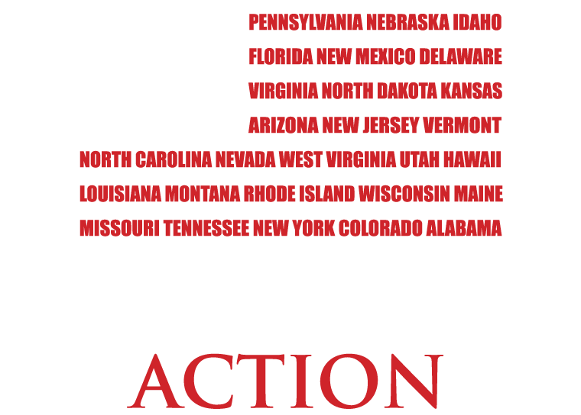
Notes:
Who here is happy with their Federal government? Anyone here concerned about the abuses of the federal government?
Well, you should be. The government has injected itself into regulating things they have no business controlling, there’s a massive imbalance between federal and state powers, and the spending and debt in this country is out of control.
But with the Convention of States Project there is hope! For the first time in many years, the people and the states have a chance to check the runaway train of the federal government.
Article V of the Constitution provides a way for the states to call a convention for the purpose of proposing amendments to the Constitution. Mark Levin has explained the Convention of States process in his bestselling book The Liberty Amendments, and now there’s an organization that is working to turn an Article V Convention of States into a reality.

Slide 2
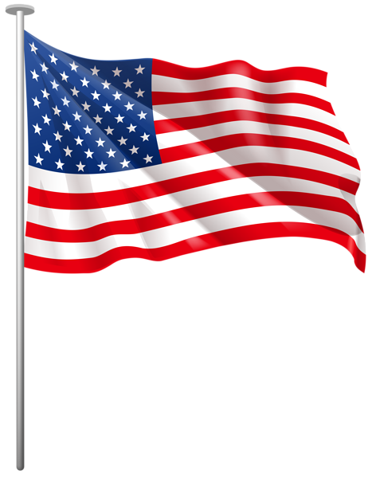

Slide 3

Who is the Convention of States Action? The Convention of States Project Was founded by Mark Meckler and Michael Farris in August 2013 with the purpose of informing and activating an informed citizenry in the use of Article V to restore and preserve limited government and maximum personal freedom and liberty
The Problem
The federal government is spending away our children’s livelihood.
We are facing a regulatory crisis
Congressional attacks on state sovereignty
Federal takeover of decision making
Our mission
To build a grassroots army of informed voters that will join us by signing the petition to urge and empower state legislators to call a Convention of States to propose amendments to the Constitution to curb the abuses of the federal government.
Notes:
There are four major abuses perpetrated by the federal government.
The Spending and Debt Crisis
The Regulatory Crisis
Congressional Attacks on State Sovereignty
Federal Takeover of the Decision-Making Process
These abuses are not mere instances of bad policy. They are driving us towards an age of "soft tyranny" in which the government does not shatter men's wills but instead slowly "softens and guides" them to a future designed by those same politicians.
The Convention of States Project is a non-partisan issue.
You know as well as I do that Washington, D.C., will never voluntarily relinquish meaningful power—no matter who is elected.
The only rational conclusion is this: that unless some political force outside of Washington, D.C., intervenes, the federal government will continue to bankrupt this nation, misappropriate the legitimate authority of the states, and destroy the liberty of the people.
Rather than securing the blessings of liberty for future generations, Washington, D.C., is on a path that will enslave our children and grandchildren to the debts of the past.

Slide 4
Why we need to act now!!!

Slide 5
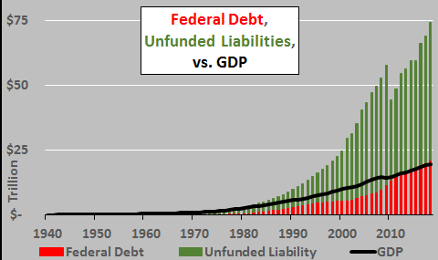
We continue to build a financial house of cards for our children and grandchildren. Our “hidden” debt is much greater than what is ordinarily called our national debt :

Slide 6
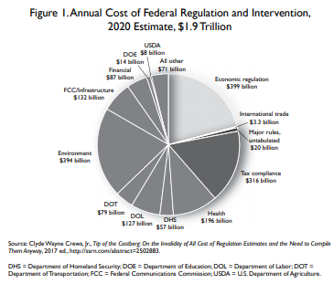
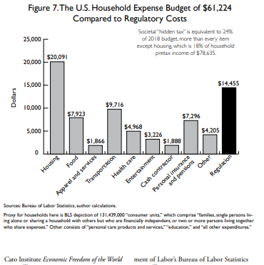
Cost of regulations, written mostly by unelected bureaucrats, in the US are approaching $2 Trillion per year which is nearly $15,000 per household (for perspective, note that this hidden tax is three times the average household cost of healthcare and double the average household cost of food)!

Slide 7
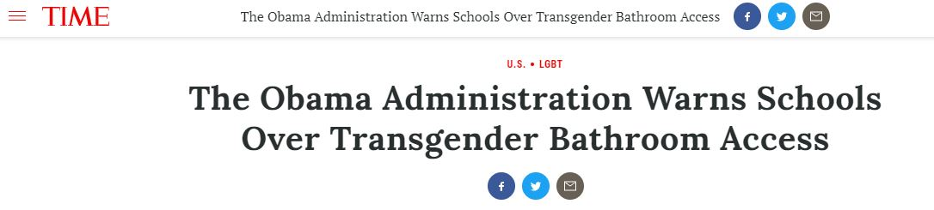
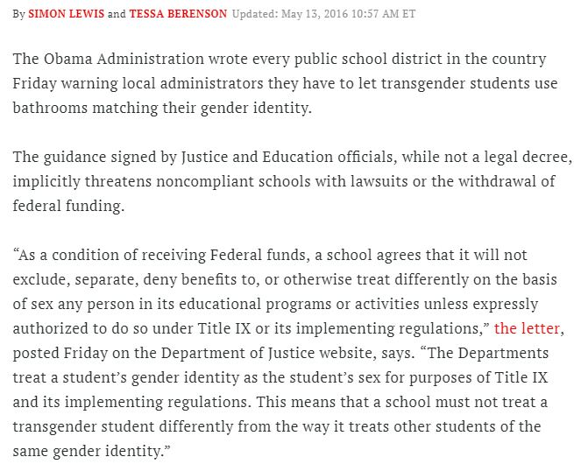
The Federal Government is mandating how we live our daily lives, clearly beyond the scope of the enumerated powers agreed to by the people that ratified the constitution.

Slide 8
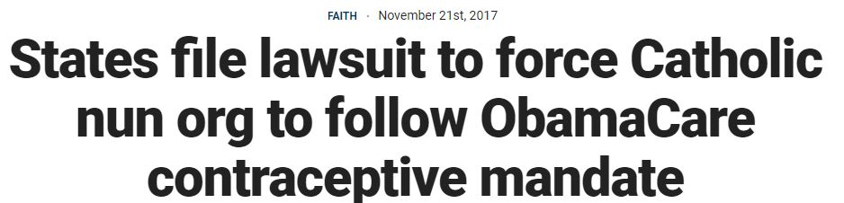
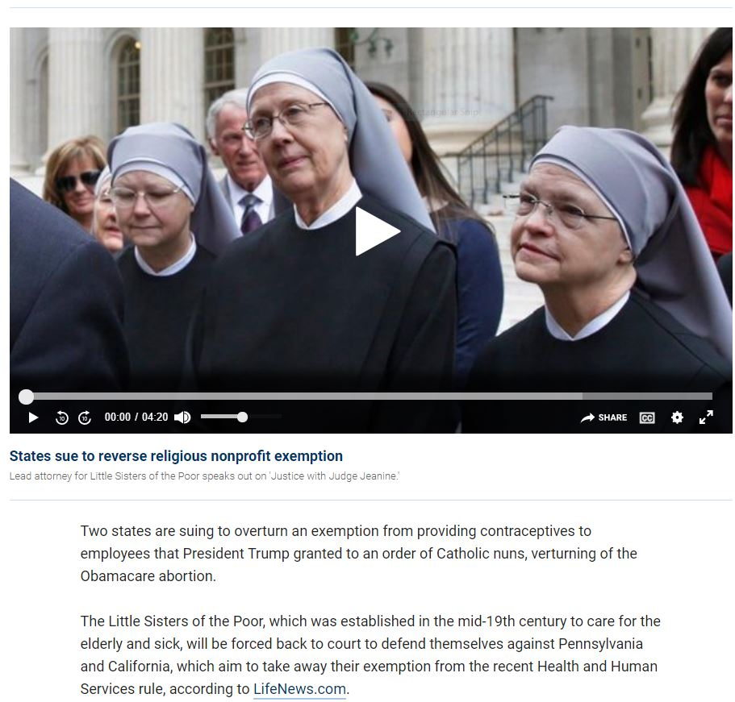
Another example of continuing outrageous national government over-reach

Slide 9
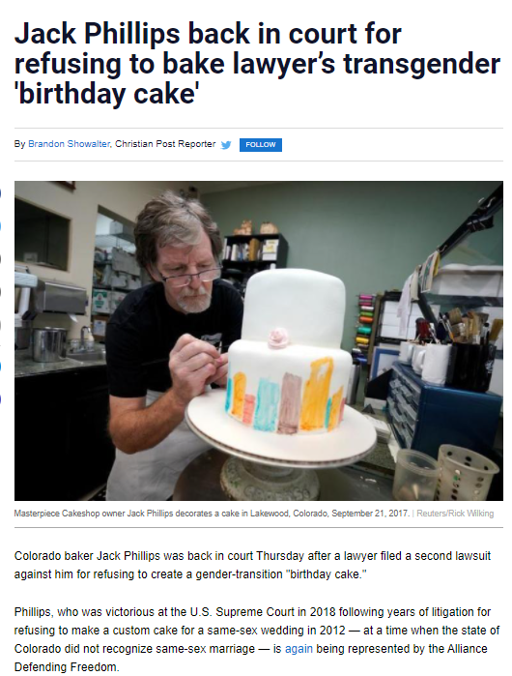
And another case where the usurpation of personal rights continues:

Slide 10
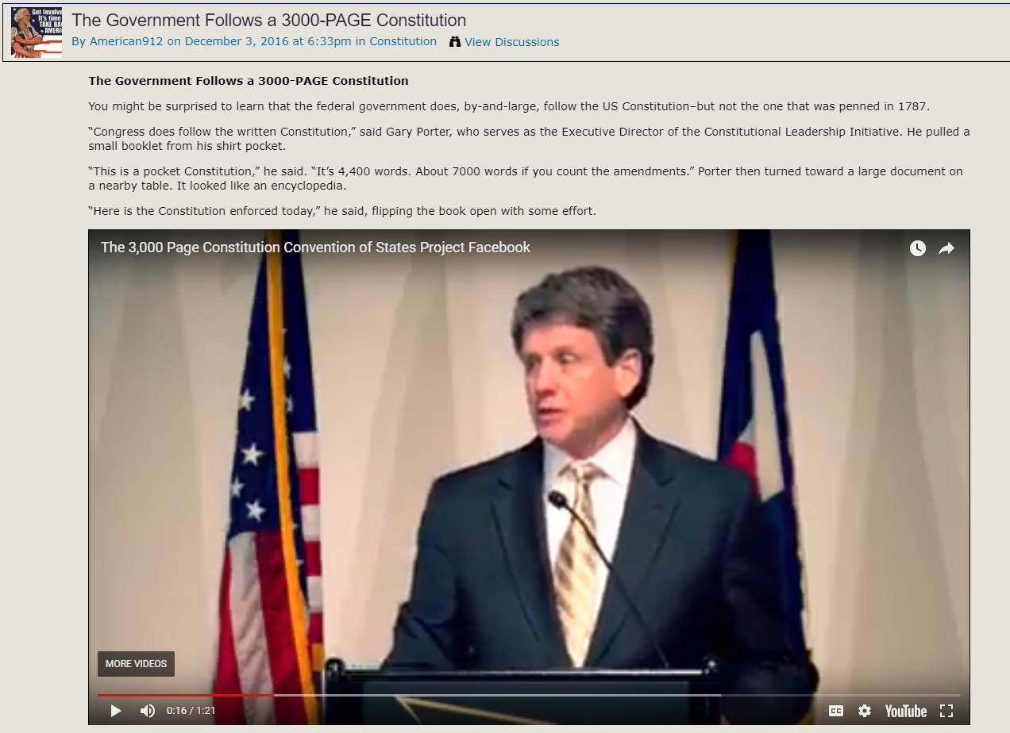

How does the national government get away with usurping powers not given to them by the people? By way of 100 years of progressive court decisions allowing expansion of the general welfare and commerce clause:

Slide 11
The Genesis of the Article V Movement
On September 15, 1787, two days prior to the finalization and signing of the Constitution, Virginia delegate George Mason objected to the committee of the whole that the then proposed amendment process provided that only the national legislature could propose amendments to the constitution. Mason said, according to Madison’s notes, that Mason “thought the plan of amending the Constitution exceptionable & dangerous. As the proposing of amendments is in both the modes to depend, in the first immediately, in the second, ultimately, on Congress, no amendments of the proper kind would ever be obtained by the people, if the Government should become oppressive, as he verily believed would be the case.” – James Madison’s Notes of The Convention

Slide 12
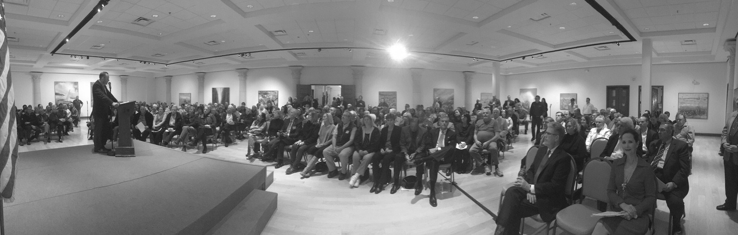
Article V Basics: There Are Two Methods to Propose Amendments to the Constitution

Slide 13
Article V – The First Method For Proposing Amendments
The Congress, whenever two thirds of both houses shall deem it necessary, shall propose amendments to this Constitution, or, on the application of the legislatures of two thirds of the several states, shall call a convention for proposing amendments, which, in either case, shall be valid to all intents and purposes, as part of this Constitution, when ratified by the legislatures of three fourths of the several states, or by conventions in three fourths thereof, as the one or the other mode of ratification may be proposed by the Congress

Slide 14
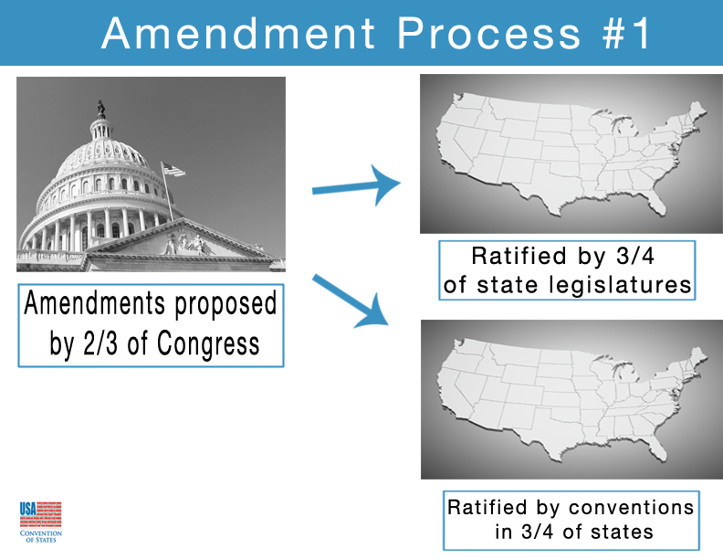
Notes:
The first method is for a bill to pass both houses of the Federal legislature, by a two-thirds majority in each.
Once the bill has passed both houses, it goes on to the states. This is the route taken by all current amendments.
Under this process the Constitution, then, spells out two paths for an amendment:
Ratification by state conventions (used only once)
Ratification by state legislatures (used all other times)

Slide 15
Article V – Second Method For Proposing Amendments
The Congress, whenever two thirds of both houses shall deem it necessary, shall propose amendments to this Constitution, or, on the application of the legislatures of two thirds of the several states, shall call a convention for proposing amendments, which, in either case, shall be valid to all intents and purposes, as part of this Constitution, when ratified by the legislatures of three fourths of the several states, or by conventions in three fourths thereof, as the one or the other mode of ratification may be proposed by the Congress

Slide 16
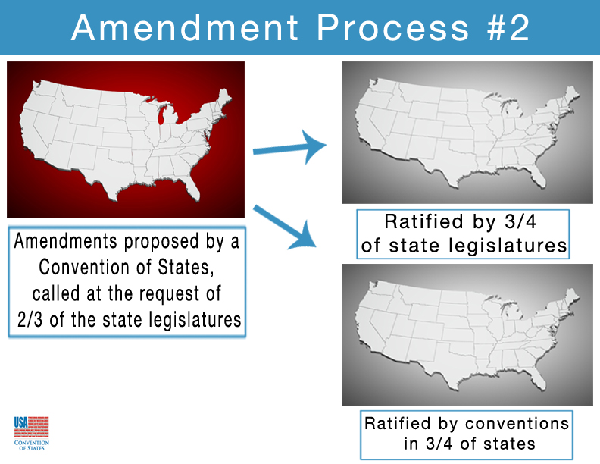
Notes:
The second method prescribed is for a Convention of States to be called by two-thirds of the legislatures of the States, and for that Convention to propose one or more amendments. These amendments are then sent to the states to be approved by three-fourths of the legislatures or conventions. This route is what we are striving for today.
Regardless of which of the two proposal routes is taken, the amendment must be ratified, or approved, by three-fourths of states. There are two ways to do this, too.
Amendments are sent to the legislatures of the states by default but the text of the amendment could specify whether the bill must be passed by the state legislatures or by a state convention. Again, only one amendment, the 21st, specified a convention.
In any case, passage by the legislature or convention is by simple majority.

Slide 17
An Article V Convention has no more power than Congress has any day that it is in session!
The Congress, whenever two thirds of both houses shall deem it necessary, shall propose amendments to this Constitution, or, on the application of the legislatures of two thirds of the several states, shall call a convention for proposing amendments, which, in either case, shall be valid to all intents and purposes, as part of this Constitution, when ratified by the legislatures of three fourths of the several states, or by conventions in three fourths thereof, as the one or the other mode of ratification may be proposed by the Congress

Slide 18
The Process for Method #2
34 states submit applications on the same topic.
Congress is required to call the convention.
States then select their delegates (commissioners) to represent their state at the amendatory convention.
At the amendatory convention commissioners debate, propose, and vote upon possible amendments to be proposed.
Proposed amendments are sent to Congress and then to the states for ratifications (by the legislatures or ratifying conventions, whichever method Congress chooses).
Only if 38 states ratify do the proposed amendments become part of the Constitution.
Notes:
Alexander Hamilton: “By the fifth article of the plan, the Congress will be obliged ‘on the application of the legislatures of two-thirds of the states to call a convention for proposing amendments which shall be valid, to all intents and purposes, as part of the Constitution, when ratified by the legislatures of three-fourth of the states, or by conventions in three-fourths thereof.’
“The words of this article are peremptory.
“The Congress ‘shall call a convention.’ Nothing in this particular is left to the discretion of that body…
“We may safely rely on the disposition of the State legislatures to erect barriers against the encroachments of the national authority.”

Slide 19
The purpose of the second amendment proposal clause was added was clearly to correct expected usurpations of power by the national government
The Founders knew the federal government might one day become drunk with the abuses of power
The most important check to national government power now that the state legislatures no longer appoint our Senators is Article V
Article V plainly states that the power conferred to an amendatory convention called by state legislatures is for the purpose of proposing amendments to the Constitution. Ratification is a later process that is done by the state legislatures or state ratifying conventions.
Notes:
George Mason warned that “no amendments of the proper kind would ever be obtained by the people, if the Government should become oppressive, as he verily believed would be the case.”

Slide 20
According to Madison’s notes the proposal to add the second mode of proposing amendments was passed at the convention “nem con” (unanimously, with no objections).
Besides Mason’s contemporaneous stated purpose for the convention clause how else do we know that it was the intent of those that wrote and ratified the Constitution that Article V protect us from a tyrannical national government?
Madison wrote the following forty-three years later:
“Should the provisions of the Constitution as here reviewed, be found not to secure the Government and rights of the States, against usurpations and abuses on the part of the United States, the final resort within the purview of the Constitution, lies in an amendment of the Constitution according to a process applicable by the states”
-James Madison to Edward Everett, August 28, 1830

Slide 21
And Alexander Hamilton wrote in Federalist 85 prior to ratification the following:
“the national rulers, whenever nine States concur, will have no option upon the subject. By the fifth article of the plan, the Congres will be obliged "on the application of the legislatures of two thirds of the States which at present amount to nine, to call a convention for proposing amendments, which shall be valid, to all intents and purposes, as part of the Constitution, when ratified by the legislatures of three fourths of the States, or by conventions in three fourths thereof.'' The words of this article are peremptory. The Congress "shall call a convention.'' Nothing in this particular is left to the discretion of that body. And of consequence, all the declamation about the disinclination to a change vanishes in air. Nor however difficult it may be supposed to unite two thirds or three fourths of the State legislatures, in amendments which may affect local interests, can there be any room to apprehend any such difficulty in a union on points which are merely relative to the general liberty or security of the people. We may safely rely on the disposition of the State legislatures to erect barriers against the encroachments of the national authority.”

Slide 22
After 8 years as president in the belly of a then much smaller beast George Washington wrote this in his farewell address in 1796:
“The necessity of reciprocal checks in the exercise of political power, by dividing and distributing it into different depositaries, and constituting each the guardian of the public weal against invasions by the others, has been evinced by experiments ancient and modern; some of them in our country and under our own eyes. To preserve them must be as necessary as to institute them. If, in the opinion of the people, the distribution or modification of the constitutional powers be in any particular wrong, let it be corrected by an amendment in the way which the Constitution designates.”

Slide 23
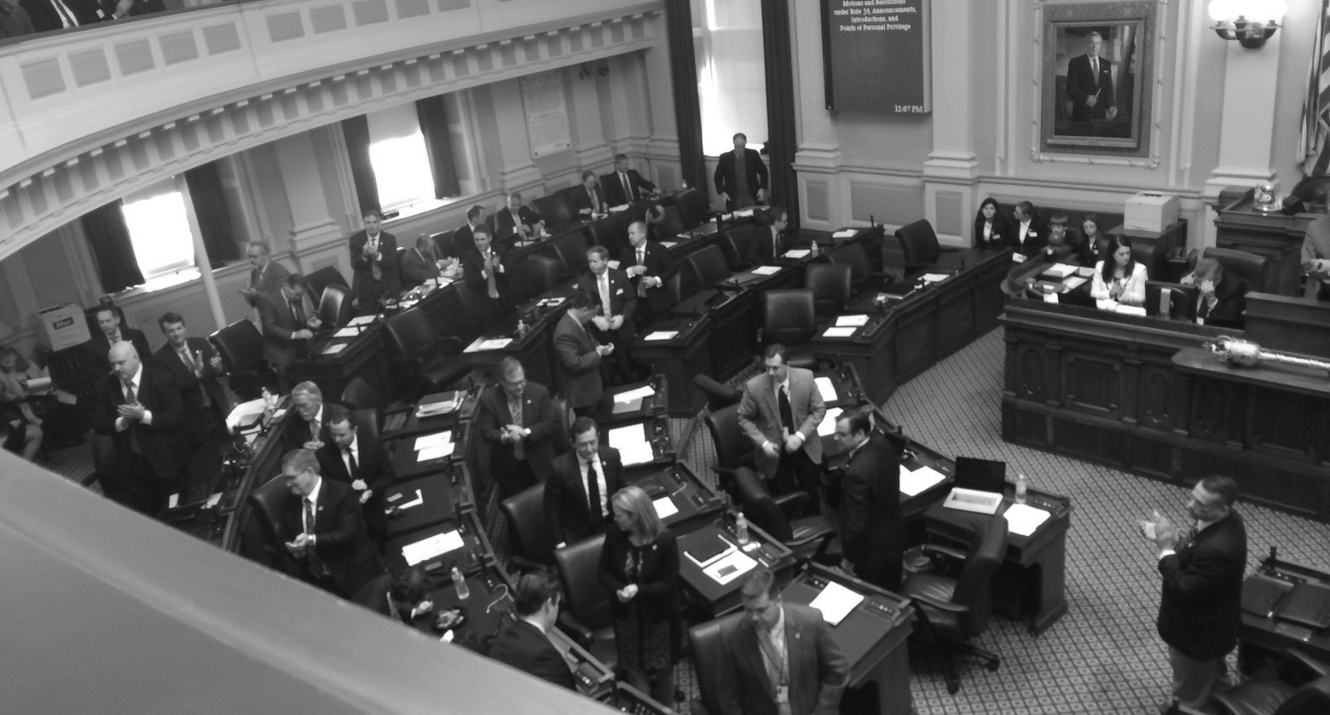
How Our Proposal is Different
Virginia House of Delegates give Michael Farris and Tom Coburn a standing ovation!
Unique Application Strategy - Strong Grassroots Support

Slide 24
Two Goals Separate Our Plan From Other Article V Organizations
Mission 1
Develop a grass roots organization to inform other citizens that our state legislators can be our champions in the preservation of self-governance and ask our state legislators to support an Article V convention for particular topics rather than a particular amendment.
A balanced budget amendment alone will not restore limits on our runaway national government.
The COSP resolution gives the amendatory convention the power to deliberate on three general topics:
Fiscal Restraints on the national government
Limiting the power and jurisdiction of the national government
Term Limits for national government officials
Notes:
Impose Fiscal Restraints on the Federal Government,
Limit the Power and Jurisdiction of the Federal Government,
and Impose Term Limits on its Officials
Possible amendments:
A balanced budget amendment
Original Intent of the General Welfare Clause
Original Intent of the Commerce Clause
A prohibition of using international treaties and law to govern the domestic law of the United States
A limitation on using Executive Orders and federal regulations to enact lawsImposing term limits on Congress and the Supreme Court
Placing an upper limit on federal taxation
Requiring the sunset of all existing federal taxes and a super-majority vote to replace them with new, fairer taxes

Slide 25
Mission 2 – Our job is not done with merely passing the Convention of States Project Resolution. We must continue to inform and enlist our fellow citizens to support eventual proposal and ratification of the proper amendments needed to effectively restore limitations to national government power

Slide 26
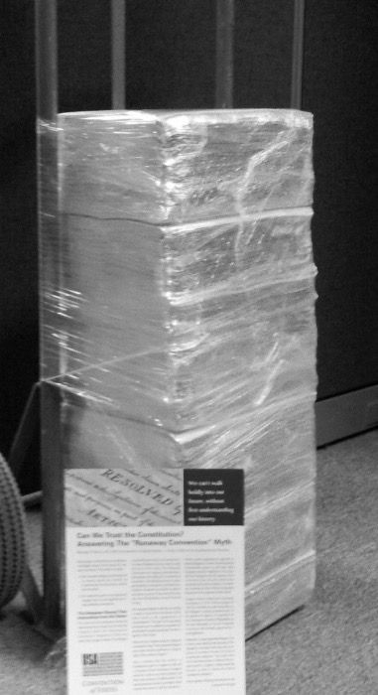
Momentum is Building: The people have the power to restore and preserve our freedom from an oppressive national government.
Over 5 million supporters nationwide.
In 2021, our resolution is currently active in 21 states and pending in others.
Fifteen states have passed the resolution, and counting…
Florida
Georgia
Alaska
Alabama
Tennessee
Indiana
Oklahoma
Louisiana
Arizona
North Dakota
Texas
Missouri
Arkansas
Utah
Mississippi
Reintroduction in Ohio pending, formerly was SJR2 in Ohio
Missouri petitions, ready for delivery!

Slide 27
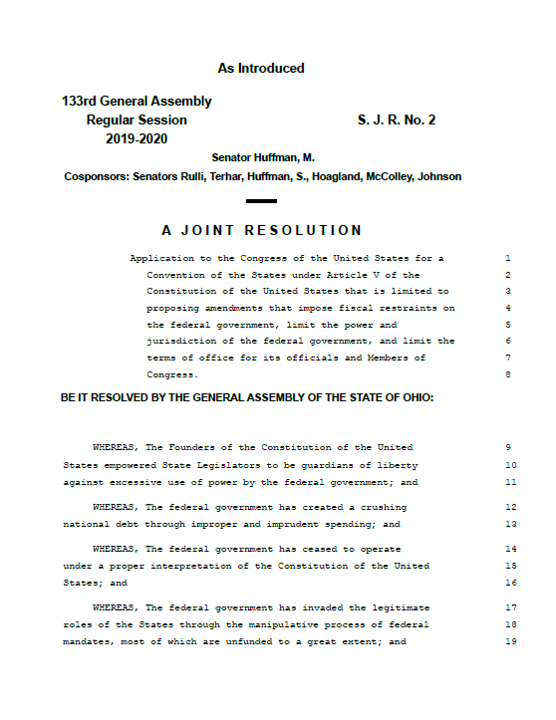
The COSP resolution in Ohio
Release of of the previously introduced SJR2 reintroduction into the Ohio Legislature is now pending:

Slide 28
“The Ohio General Assembly hereby applies to Congress, under the provisions of Article V of the Constitution of the United States, for the calling of a Convention of the States limited to proposing amendments that:
impose fiscal restraints on the federal government
limit the power and jurisdiction of the federal government
limit the terms of office for its officials and Members of Congress of the United States; “

Slide 29
The resolution has fail-safe limitations to the powers of congress regarding the convention:
“The Ohio General Assembly adopts this resolution expressly subject to reservations, understandings, and declarations, as described in this resolution below
confers no power to the Congress other than the power to call such a Convention;
this ministerial duty consists solely of the authority to name a reasonable time and place for the initial meeting of a Convention
The Congress of the United States shall perform its ministerial duty of calling a Convention of the States for proposing amendments only upon the receipt of applications for a Convention of the States for the substantially same purpose as this application from two-thirds of the legislatures of the several States”

Slide 30
Limitations on Congress in SJR2 continue:
“The Congress of the United States does not have the power or authority to determine any rules for the governing of a Convention of the States for proposing amendments called pursuant to Article V of the Constitution of the United States”
“The Congress of the United States does not have the power to set the number of delegates to be sent by any State to such a Convention, nor does it have the power to name delegates to such a Convention;”
“The power to name delegates remains exclusively within the authority of the legislatures of the several States;”

Slide 31
SJR2 also clearly states the expected limits on the powers of the Convention:
“By definition, a Convention of the States means that the States shall vote on the basis of one state, one vote”
“A Convention of the States for proposing amendments to the Constitution of the United States convened pursuant to this application shall be limited to consideration of the topics specified herein and no other;”
“This application is made with the express understanding that an amendment that in any way seeks to amend, modify, or repeal any provision of the Bill of Rights shall not be authorized for consideration at any stage”
“This application shall be void ab initio if ever used at any stage to consider any change to any provision of the Bill of Rights”
“The Ohio General Assembly may provide further instructions to its delegates and may recall its delegates at any time for a breach of a duty or a violation of the instructions provided;”

Slide 32
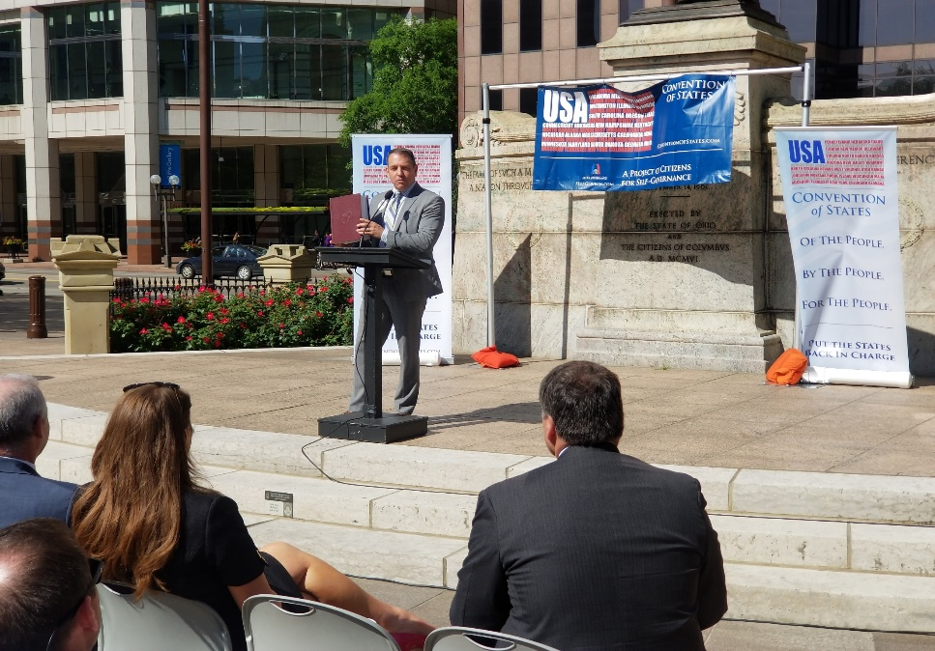
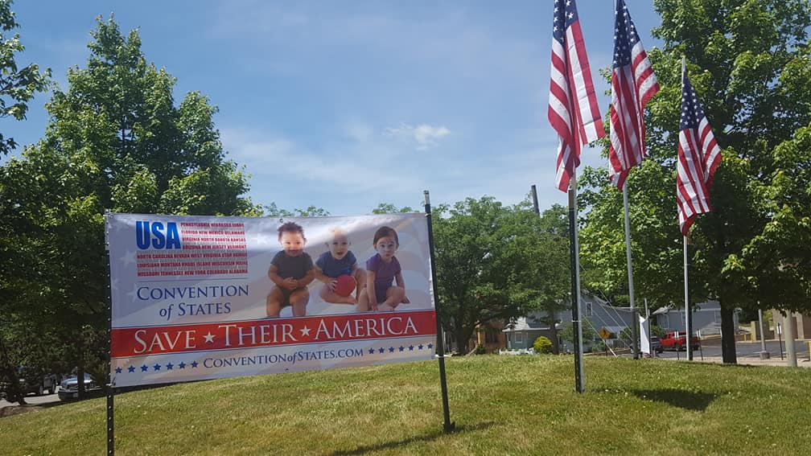
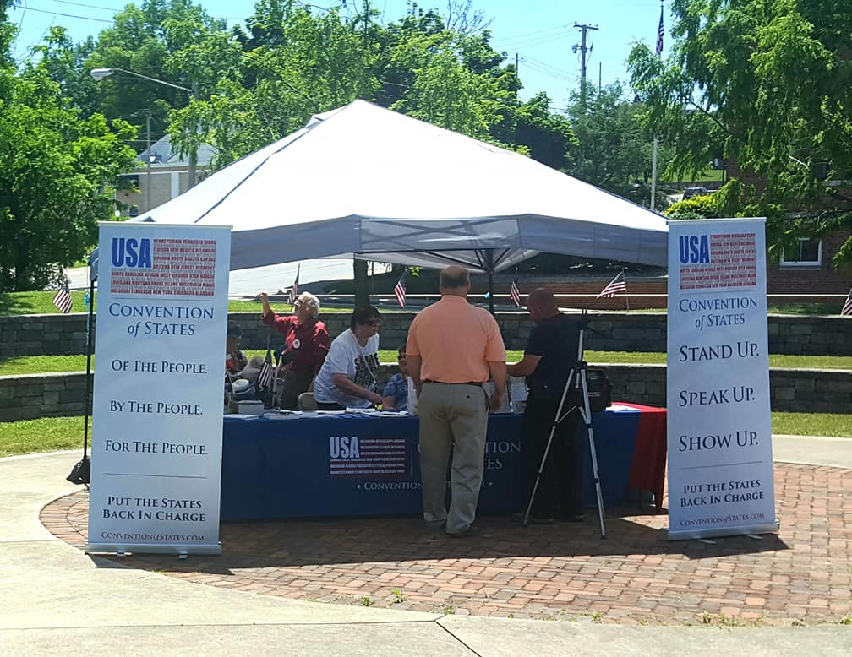
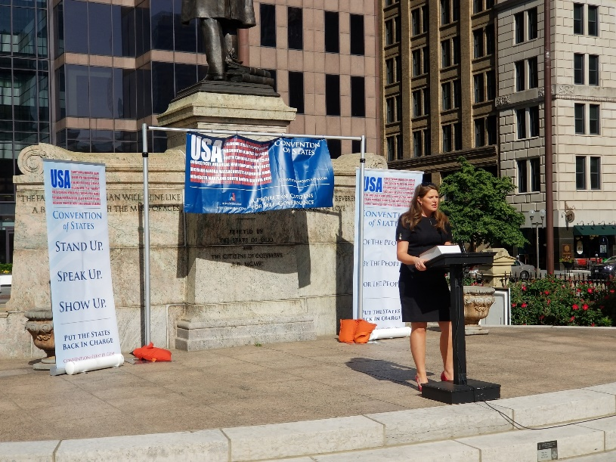
The Grassroots In Ohio

Slide 33
Convention of States Project Ohio Organizational Structure 75,000 petition signers – 5,400 leaders/volunteers
State support organization:
State Director
State Grass root Coordinators, East and West Division
State Communications Coordinator – Writer/publishers, Videographers
Legislative Liaison Team
State Coalitions Director – Coalition Coordinators
Regional Teams
Regional Captains, Six Regions
Regional Events Coordinator, Six Regions
Regional Speaker/Spokesman, Six Regions
Regional Media Coordinator, Six Regions
Regional Trainer Developer, Six Regions
At least one district captain per State house legislative district
Volunteers
Notes:
conventionofstates.com
cosaction.com
have the resources that YOU need to be successful!

Slide 34
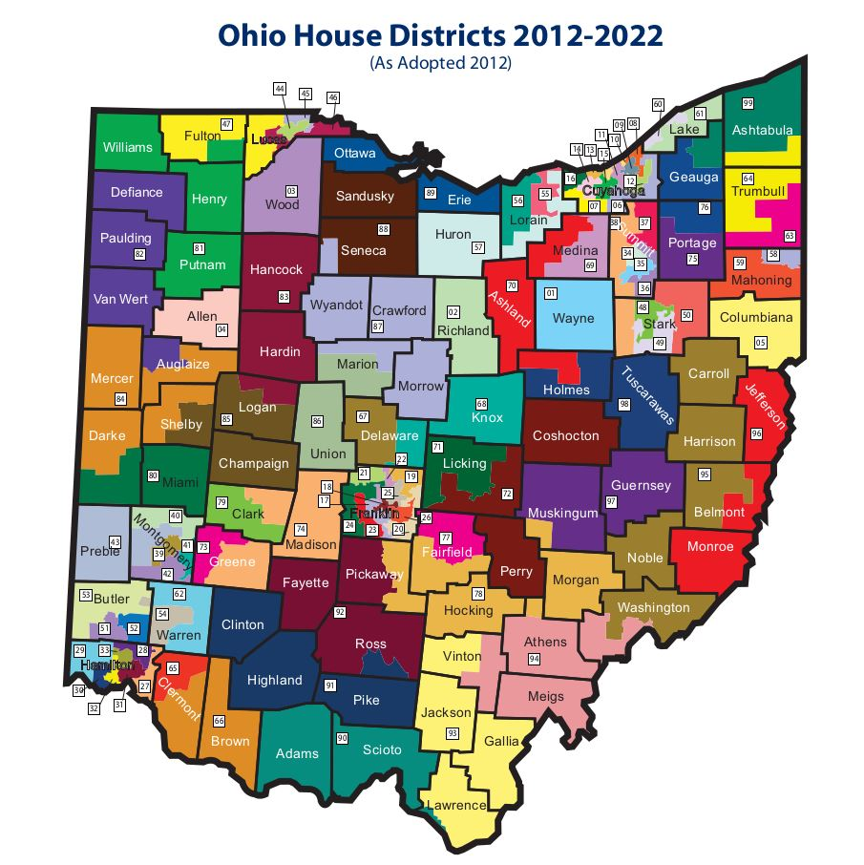

Slide 35
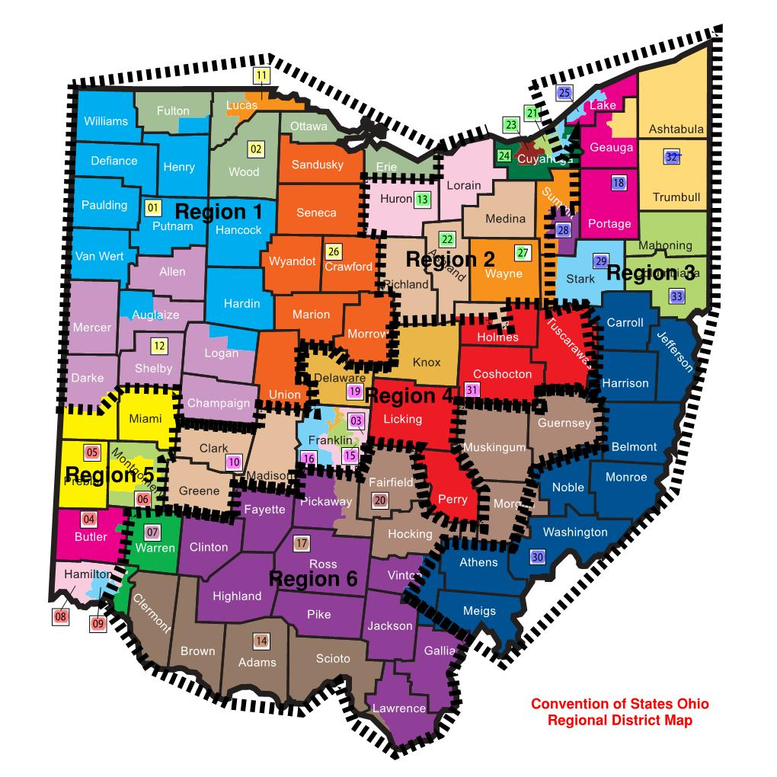

Slide 36
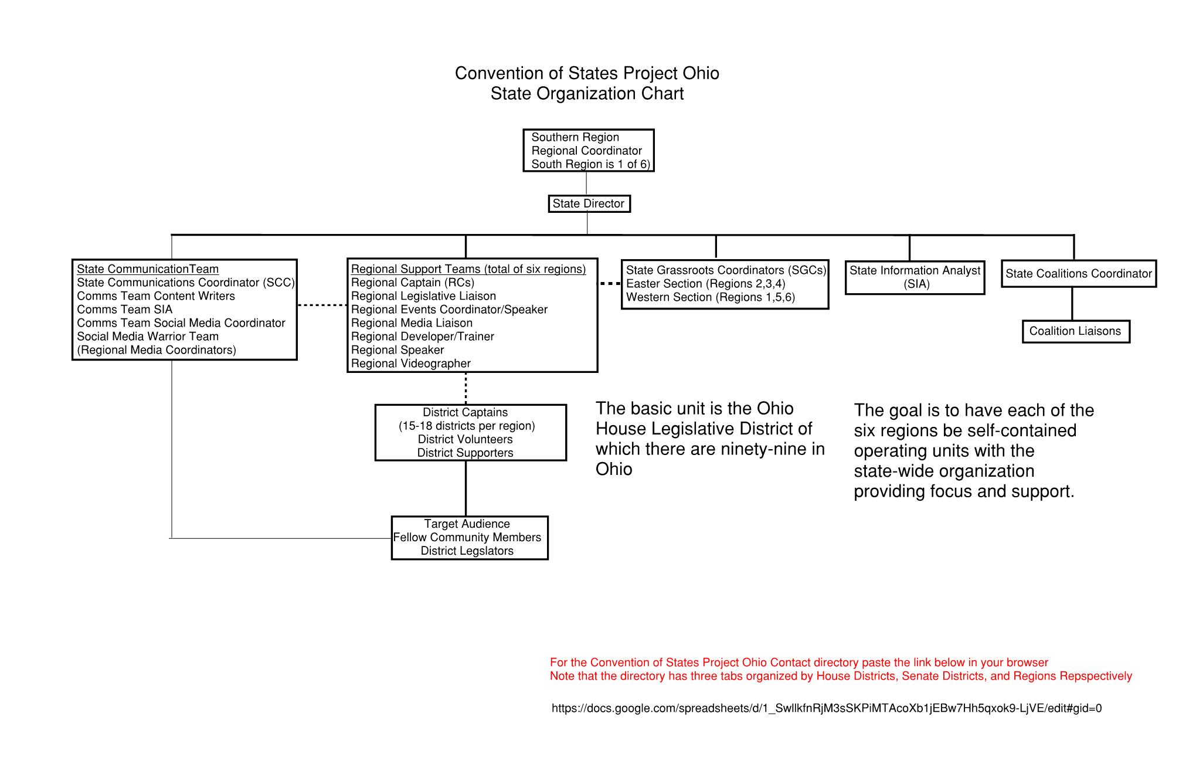
https://docs.google.com/spreadsheets/d/1_SwllkfnRjM3sSKPiMTAcoXb1jEBw7Hh5qxok9-LjVE/edit?ts=5b464933#gid=0

Slide 37
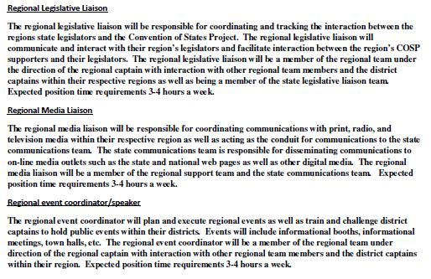
Regional Support Leader Roles

Slide 38
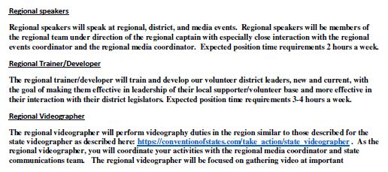
Regional Support Leaders Roles (cont.)

Slide 39
Learning Resources
Tuesday night leader/volunteer webinars
Self-paced on-line learning at COSUniversity
Weekly position conference calls
Position slack channels
Position best practice manuals
Mentoring by more experienced leaders
Web site resource pages
FAQ from the Wisconsin Grandson’s of Liberty
Multiple books, including:
“Far From Unworkable” – Timothy Dake
“The Liberty Amendments” – Mark Levin
“Smashing the DC Monopoly” – Senator Tom Coburn
“The Law of Article V” – Robert G. Natelson

Slide 40
How you can help
Sign the Petition
Become a leader (hit the “Take Action” tab at our website)
We are actively looking for members of the regional support teams, district captains in open districts, and members of district captain leadership teams
Take advantage of self-paced activist training at COSUniversity
Become a Volunteer (live and on-line training every Tuesday)
Recruit supporters by informing your friends, neighbors, family of how the goals of the COSP can protect and restore our individual liberty
Call and email your state legislators
Help with local events/coordination of fellow volunteers and supporters.
Self-paced on-line activist instruction at COSUniversity

Slide 41
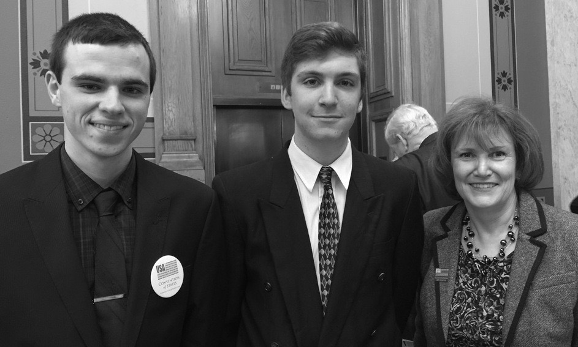

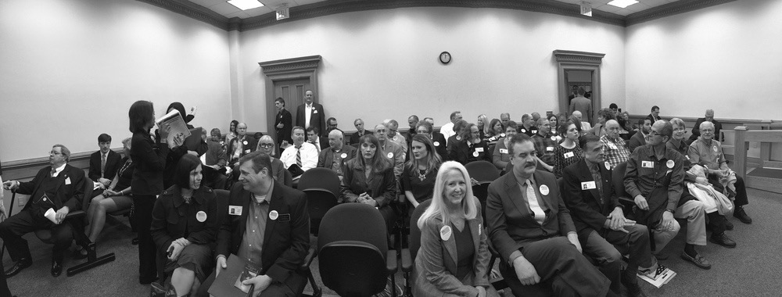
Thank you. Become a COSP Volunteer Leader Today!
Notes:
Text “JOINCOS” to the number: 68398 to join our COS team.
We NEED YOU to help, in any way that you can! Thank you for working with us, to restore Constitutional Liberty- for our children and grandchildren!

Slide 42
Who are the Convention of States Projects Opponents?

Slide 43
To paraphrase what Ronald Reagan once said of liberals:
“The trouble with our Liberal (and I am sorry to add here in this case, our conservative) friends, is not that they're ignorant; it's just that they know so much that isn't so.”

Slide 44
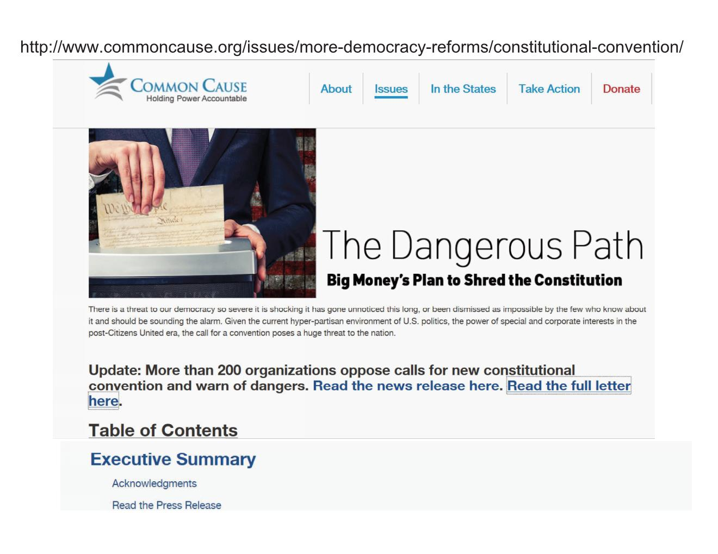
Progressive Organizations like the 230 organizations that signed the Common Cause’s Petition against an Article V convention
https://www.commoncause.org/wp-content/uploads/legacy/issues/more-democracy-reforms/constitutional-convention/constitutional-rights-and.pdf

Slide 45
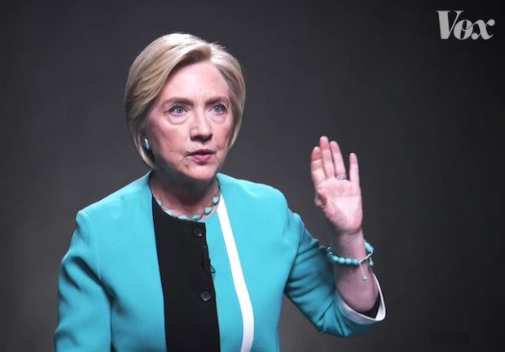
Progressive Politicians
https://twitter.com/podsaveamerica/status/907619887496945664?lang=en

Slide 46

Right Wing Groups like the John Birch Society and The Eagle Forum

Slide 47
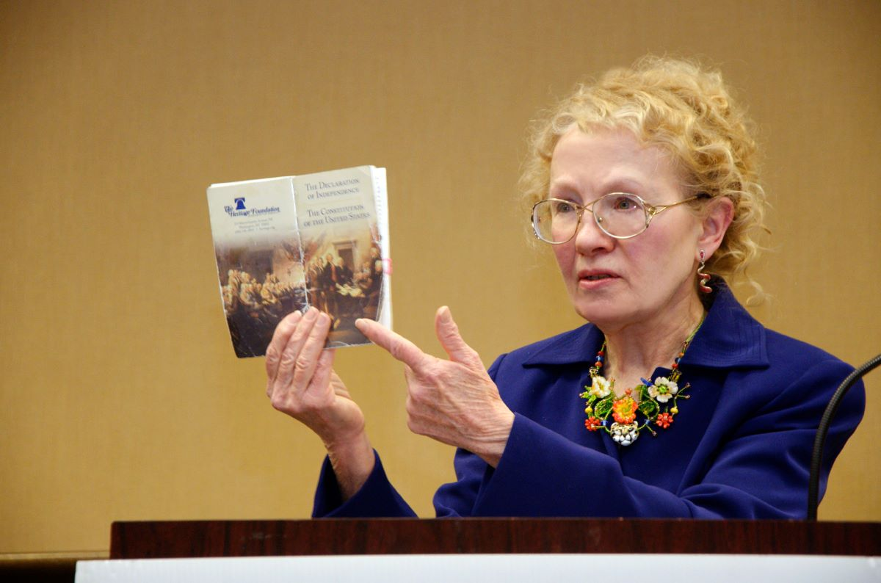
Self-Proclaimed Constitutional Experts

Slide 48
Our legal board of reference:
Randy E. Barnett is the Carmack Waterhouse Professor of Legal Theory at the Georgetown University Law Center.
Charles J. Cooper is a founding member and chairman of Cooper & Kirk, PLLC.
Dr. John C. Eastman is the Henry Salvatori Professor of Law & Community Service at Chapman University Fowler School of Law.
Michael Farris, head of the Convention of States Project, is the Chancellor of Patrick Henry College and Chairman of the Home School Legal Defense Association.
Robert P. George holds Princeton's celebrated McCormick Chair in Jurisprudence and is the founding director of the James Madison Program in American Ideals and Institutions.
C. Boyden Gray is the founding partner of Boyden Gray & Associates, in Washington, D.C.. Prior to founding his law firm, Ambassador Gray served our nation in various capacities
Mark Levin is one of America's preeminent conservative commentators and constitutional lawyers. Mark is the author of several New York Times bestselling books including Men in Black (2007), Liberty and Tyranny (2010), Ameritopia (2012) and The Liberty Amendments (2013).
Andrew McCarthy is a bestselling author, a Senior Fellow at National Review Institute, and a contributing editor at National Review

Slide 49
Some of our endorsers:
Senator Tom Coburn
Mark Levin
Sean Hannity
Glenn Beck
Senator Ron Paul
Senator Jim Demint
Senator Ben Sasse
Senator Ron Paul
Senator Jim Talent
Senator Marco Rubio
Rep. Jeff Duncan
Rep. Louis Gohmert
Rep. Ralph Norman
Rep. William Timmons
L. Colonel Alan West
Governor Ron DeSantis
Governor Greg Abbott
Governor Sarah Palin
Governor Mike Huckabee
Governor Bobby Jindal
Governor Jeb Bush
Pete Hegseth
Ben Shapiro
Charlie Kirk
James Dobson
Steve Hilton
James O’Keefe
Pete Coors
Michael Farris
Ken Cuccinelli
Morton Blackwell
Pete Coors
Dr. Ben Carson
Steve Deace
Eric Metaxas
David Barton
Lawrence Jones
L. Colonel Bill Cowan
Lawrence Reed
David Horowittz
James O’Keefe

Slide 50
The truth is that we are merely asking our state legislatures to do just what the plain text of Article V says is their prerogative, that is to direct Congress to: “call a convention for proposing amendments” This is the only power granted to the convention!
Our opponents first tactic is to try to scare people by telling them that we are trying to call a constitutional convention to rewrite the constitution (Con-con).

Slide 51
This is false, an Article V convention of states to propose amendments have only the power granted to it in Article V, merely the power to propose amendments; the commissioners have only the latitude delegated to them by their respective states to say otherwise is false scaremongering. Ratification of any amendments that are proposed are only valid upon subsequent approval of 38 state legislatures or 38 state ratification conventions.
Next, they falsely claim that all inter-state conventions have plenipotentiary or plenary powers.

Slide 52
Historical citations demonstrating that the in the founding era conventions were limit to the topics of their commissions:
Letters from James Madison to Thomas Jefferson regarding the Annapolis Convention:
“A Quorum of the deputies appointed by the Assembly for a Commercial Convention had a meeting at Richmond shortly after I left it, and the Attorney tells me, it has been agreed to propose Annapolis for the place” – March 18,1786
“Many Gentlemen, both within & without Congs, wish to make this Meeting subservient to a plenipotentiary Convention for amending the Confederation. Tho' my wishes are in favor of such an event, yet I despair so much of its accomplishment at the present crisis that I do not extend my views beyond a commercial Reform. To speak the truth I almost despair even of this.” – August 12, 1786.

Slide 53
And from the convention at Annapolis (attended by Madison and Hamilton), addressed to the states and copied to the Confederation Congress:
“To the Honorable, The Legislatures of Virginia, Delaware, Pennsylvania, New Jersey, and New York–assembled at Annapolis, humbly beg leave to report.”………….“Under this impression, Your Commissioners, with the most respectful deference, beg leave to suggest their unanimous conviction that it may essentially tend to advance the interests of the union if the States, by whom they have been respectively delegated, would themselves concur, and use their endeavors to procure the concurrence of the other States, in the appointment of Commissioners, to meet at Philadelphia on the second Monday in May next, to take into consideration the situation of the United States, to devise such further provisions as shall appear to them necessary to render the constitution of the Federal Government adequate to the exigencies of the Union”

Slide 54
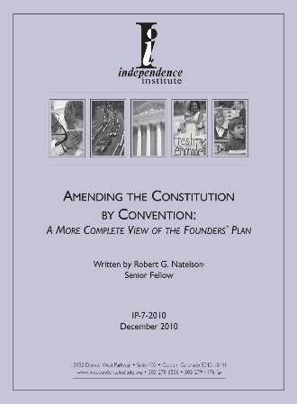
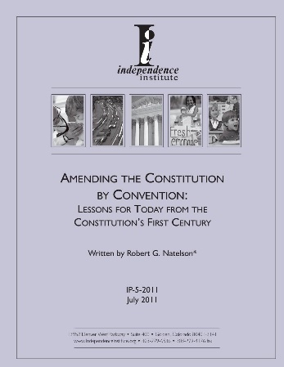
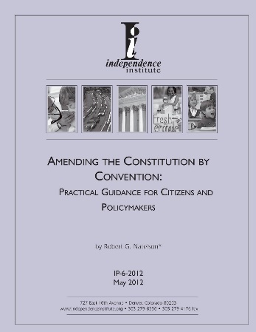
“Although there were many intercolonial conventions earlier in the century, the initial multi-government convention of the Founding Era was the First Continental Congress (1774), which despite being denoted a “Congress,” both qualified as a convention and was understood to be one. There were at least ten interstate conventions held between the Declaration of Independence and 1787: two in Providence, Rhode Island (1776-77 and 1781); one in Springfield, Massachusetts (1777); one in York Town, Pennsylvania (1777); one in New Haven, Connecticut (1778); two in Hartford, Connecticut (1779 and 1780); one in Philadelphia (1780), one in Boston (1780),and one in Annapolis(1786).”
And also from peer-reviewed scholarship describing the nature of interstate conventions in the founding era from scholars such as Rob Natelson.

Slide 55
Next opponents will typically claim that the convention of 1787 was a runaway because it ignored the directions given to it by the Confederation Congress that it was merely to amend the Articles of Confederation.
The truth is, that the convention was, as were all conventions of the period, called by the states, not by Congress. In fact, the Articles of Confederation granted no power to the Confederation Congress to call conventions. Conventions were called by states by way of their own sovereignty that was reserved in Article II of the Articles of Confederation where it was written:
“Each state retains its sovereignty, freedom, and independence, and every power, jurisdiction, and right, which is not by this Confederation expressly delegated to the United States, in Congress assembled.”

Slide 56
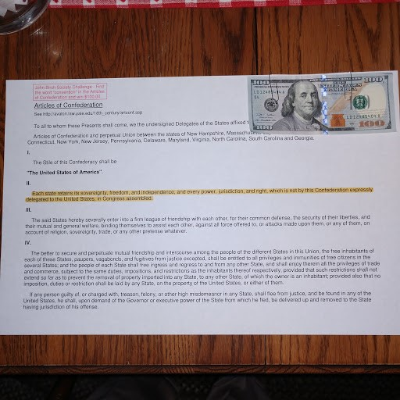
The John Birch Challenge Find the word convention in the Articles of Confederation and win $100.00

Slide 57
“To the Honorable, The Legislatures of Virginia, Delaware, Pennsylvania, New Jersey, and New York–assembled at Annapolis, humbly beg leave to report.”………….“Under this impression, Your Commissioners, with the most respectful deference, beg leave to suggest their unanimous conviction that it may essentially tend to advance the interests of the union if the States, by whom they have been respectively delegated, would themselves concur, and use their endeavors to procure the concurrence of the other States, in the appointment of Commissioners, to meet at Philadelphia on the second Monday in May next, to take into consideration the situation of the United States, to devise such further provisions as shall appear to them necessary to render the constitution of the Federal Government adequate to the exigencies of the Union”
Indeed, this can be seen by again examining the resolution written in Annapolis (shown earlier) that asked their respective state legislatures to call for a convention with expanded powers, not the Confederation Congress, and to ask the other state legislatures to do so as well:

Slide 58
It was understood by the commissioners at the Annapolis Convention to be a request for broad powers to fix the problems of the weak confederation government as can be seen by this letter from James Madison (who was serving in the Virginia Legislature) to Thomas Jefferson on December 4, 1786, regarding the Virginia Legislatures resolution calling for a convention, almost six months prior to the Grand Convention (see an excerpt from Madison’s letter below: (see https://founders.archives.gov/documents/Jefferson/01-10-02-0431)
“The recommendation from the Meeting at Annapolis of a plenipotentiary Convention in Philada. in May next has been well received by the Assembly here. Indeed the evidence of dangerous defects in the Confederation has at length proselyted the most obstinate adversaries to a reform. The unanimous sanction given by the Assembly to the inclosed compliance with the Recommendation marks sufficiently the revolution of sentiment which the experience of one year has effected in this country. The deputies are not yet appointed. It is expected that Genl. Washington, the present Govr. E. Randolph Esqr. and the late one Mr. Henry will be of the number.”

Slide 59
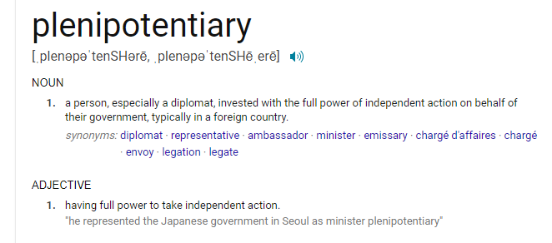

Slide 60
The “inclosed compliance” from the Virginia Legislature that Madison sent Jefferson:
Resolution of the House of Delegates, 3 Nov. 1786: “Resolved unanimously, That an act ought to pass, in conformity to the report of the Commissioners assembled at Annapolis on the 14th of September last, for appointing Commissioners on the part of this State, to meet Commissioners on the part of the other States, in Convention at Philadelphia, on the second Monday in May next, with powers to devise such further provision as shall appear to them necessary to render the constitution of the fædral government adequate to the exigencies of the Union; and to report such an act for that purpose to the United States in Congress assembled, as when agreed to by them, and afterwards confirmed by the Legislatures of every State, will effectually provide for the same.”

Slide 61
Six states wrote resolutions giving their delegations broad powers to fix the national government before the Confederation Congress wrote a “recommendation” that the states call a convention:
Most states wrote resolutions giving the convention broad powers to “to devise such further provisions as shall appear to them necessary to render the constitution of the Federal Government adequate to the exigencies of the Union”, just as was suggested at the convention at Annapolis.

Slide 62
Virginia, November 23, 1786 (broad instructions)
“That seven Commissioners be appointed by joint ballot of both Houses of Assembly, who, or any three of them, are hereby authorized as Deputies from this Commonwealth, to meet such Deputies as may be appointed and authorized by other States, to assemble in Convention at Philadelphia, as above recommended, and to join with them in devising and discussing all such alterations and further provisions, as may be necessary to render the Federal Constitution adequate to the exigencies of the Union; and in reporting such an Act for that purpose, to the United States in Congress, as, when agreed to by them, and duly confirmed by the several States, will effectually provide for the same.”
http://csac.history.wisc.edu/delegate_inst2.pdf.

Slide 63
2. New Jersey, November 24, 1786 (broad instructions)
“for the purpose of taking into consideration the state of the Union as to trade and other important objects, and of devising such further provisions as shall appear necessary to render the Constitution of the federal government adequate to the exigencies thereof.”
http://csac.history.wisc.edu/delegate_inst3.pdf
3. Pennsylvania, December 30, 1786 (broad instructions)
“and to join with them in devising, deliberating on, and discussing all such alterations and further provisions as may be necessary to render the foederal constitution fully adequate to the exigencies of the Union;”
http://csac.history.wisc.edu/delegate_inst4.pdf
4. North Carolina, January 6, 1787 (broad instructions)
“meet and confer with such Deputies as may be appointed by the other states for similar purposes, and with them to discuss and decide upon the most effectual means to remove the defects of our foederal union, and to procure the enlarged purposes which it was intended to effect, and that they report such an act to the General Assembly of this state, as when agreed to by them, will effectually provide for the same.”
http://csac.history.wisc.edu/delegate_inst5.pdf

Slide 64
5. Delaware, February 3, 1787 (broad instructions)
“ Whereas the General Assembly of this State are fully convinced of the Necessity of revising the Foederal Constitution, and adding thereto such further Provisions as may render the same more adequate to the Exigencies of the Union;
http://csac.history.wisc.edu/delegate_inst6.pdf
6. Georgia, February 10, 1787 (broad instructions)
“and to join with them in devising and discussing all such alterations and farther provisions, as may be necessary to render the federal constitution adequate to the exigencies of the union,”
http://csac.history.wisc.edu/delegate_inst7.pdf

Slide 65
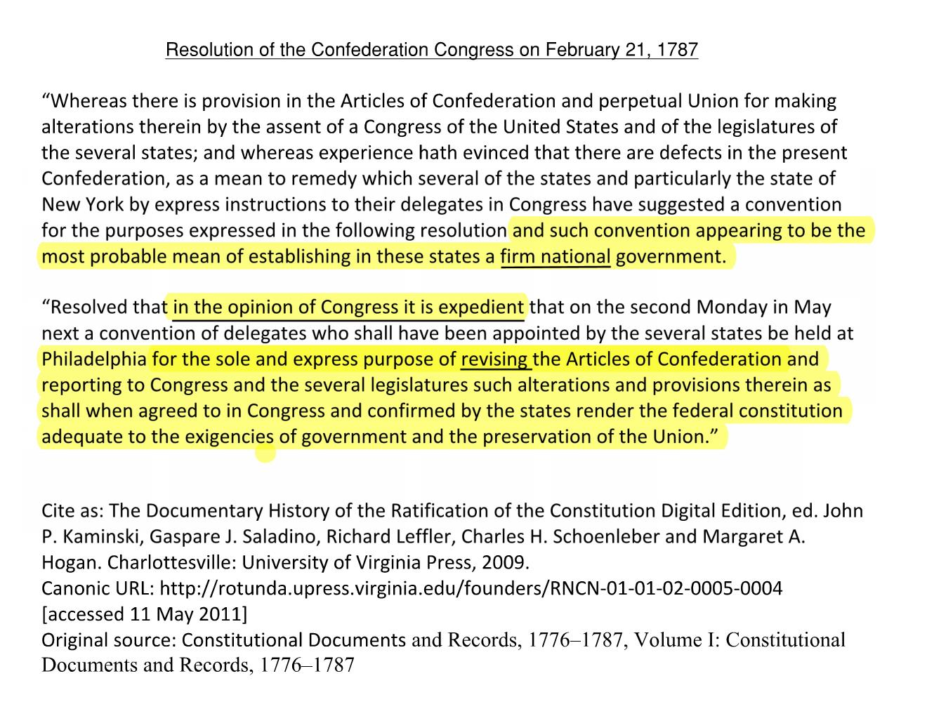
Finally, after six states had already called for a convention, the Confederation Congress wrote a recommendatory resolution (passed by a bare majority of one, recommending that a convention would be “expedient”, but with in doing so attempted to narrow the scope of the convention’s powers:

Slide 66
Madison wrote in his notes (and a subsequent letter to Virginia Governor Randolph) that New York delegation purposefully had the recommendatory resolution written to be more limited than those already proposed by six states
“The Report coincided with the opinion held at Annapolis that the Confederation needed amendments and that the proposed Convention was the most eligible means of effecting them. The objections which seemed to prevail agst. the recommendation of the Convention by Congress, were with some 1. that it tended to weaken the federal authority by lending its sanction to an extraconstitutional mode of proceeding—with others 2. that the interposition of Congs. would be considered by the jealous as betraying an ambitious wish to get power into their hands by any plan whatever that might present itself. Subsequent to the Report, the Delegates from N. York recd. instructions from its Legislature to move in Congress for a recommendation of a Convention; and those from Massts. had, it appeared, recd. information which led them to suppose it was becoming the disposition of the Legislature of that State to send deputies to the proposed Convention in case Congs. should give their sanction to it. There was reason to believe however from the Language of the instruction from N York that her object was to obtain a new Convention, under the sanction of Congs. rather than to accede to the one on foot, or perhaps by dividing the plans of the States in their appointments to frustrate all of them. The latter suspicion is in some degree countenanced by their refusal of the Impost a few days before the instruction passed, and by their other marks of an unfederal disposition.3

Slide 67
After the recommendation of congress that the states call a convention, but one with more limited powers, two states wrote more restrictive resolutions in accordance with those written by the Confederation Congress:
7. New York, February 26-28, 1787 (narrow instructions)
“for the sole and express purpose of revising the Articles of Confederation and reporting to Congress, and to the several legislatures, such alterations and provisions therein, as shall, when agreed to in Congress, and confirmed by the several states, render the federal constitution adequate to the exigencies of government and the preservation of the Union”
http://csac.history.wisc.edu/delegate_inst10.pdf
8. Massachusetts, February 22-April 9, 1787 (narrow instructions)
“for the sole & express purpose of revising the articles of Confederation, and reporting to Congress & the several Legislatures, such alterations & provisions therein, as shall when agreed to in Congress, and confirmed by the States, render the federal Constitution adequate to the exigences of Government; & the preservation of the Union”…. and …. “they are hereby instructed not to accede to any alterations or additions that may be proposed to be made in the present Article of Confederation, which may appear to them, not to consist with the true republican Spirit and Genius of the Said Confederation”
http://csac.history.wisc.edu/delegate_inst11.pdf

Slide 68
But the remaining states (less Rhode Island who did not participate) continued to write resolutions giving broader powers to their delegations to do more than merely recommend amendments to the AOC.
9. South Carolina, March 8, 1787
“join with such deputies or commissioners, they being duly authorised and impowered in devising and discussing all such alterations, clauses, articles and provisions as may be thought necessary to render the foederal constitution entirely adequate to the actual situation and future good government of the confederated states”
http://csac.history.wisc.edu/delegate_inst12.pdf
10. Connecticut, May 17, 1787
“to act in said Convention, and to discuss upon such Alterations and Provisions, agreeable to the general Principles of Republican Government, as they shall think proper, to render the foederal Constitution adequate to the Exigencies of Government, and the Preservation of the Union”
http://csac.history.wisc.edu/delegate_inst13.pdf

Slide 69
And Maryland and New Hampshire continued the broader language of the earlier state legislature calls:
11. Maryland, May 26, 1787
“for the purpose of revising the federal system, and to join with them in considering such alterations, and further provisions, as may be necessary to render the federal constitution adequate to the exigencies of the union”
http://csac.history.wisc.edu/delegate_inst14.pdf
12.New Hampshire, June 27, 1787
“and with them to discuss and decide upon the most effectual means to remedy the defects of our federal union; and to procure, and secure, the enlarged purposes which it was intended to effect”
http://csac.history.wisc.edu/delegate_inst15.pdf

Slide 70
Contemporaneous correspondence indicates that there was a broad understanding that the convention would be considering broad solutions to the deficiencies of the AOC. Washington wanted nothing to do with the convention if it did not intend to address the core problems with the AOC.
George Washington to James Madison, March 31, 1787 (two months prior to the convention):
“It gives me pleasure to hear that there is a probability of a full Representation of the States in Convention, but if the delegates come to it under fetters, the salutary ends proposed will in my opinion be greatly embarrassed & retarded, if not altogether defeated. I am anxious to know how this matter really is, as my wish is, that the Convention may adopt no temporising expedient, but probe the defects of the Constitution to the bottom, and provide radical cures, whether they are agreed to or not.” A conduct like this, will stamp wisdom and dignity on the proceedings, and be looked to as a luminary, which sooner or later will shed its influence.”

Slide 71
Madison assures Washington that the intent is for the convention to do what needs to be done to fix the problems with the central government
James Madison to George Washington, April 16, 1787 (a month prior to the convention):
“I have been honoured with your letter of the 31 of March, and find with much pleasure that your views of the reform which ought to be pursued by the Convention, give a sanction to those which I have entertained. Temporizing applications will dishonor the Councils which propose them, and may foment the internal malignity of the disease, at the same time that they produce an ostensible palliation of it. Radical attempts, although unsuccessful, will at least justify the authors of them.”
https://founders.archives.gov/?q=Project%3A%22Madison%20Papers%22&s=1511311111&r=19&sr=washington

Slide 72
And from delegate George Mason to his son regarding discussions of many of the delegates a few days prior to the start of the convention, which started on May 25th.
George Mason to George Mason Jr., May 20, 1787:
The most prevalent idea in the principal States seems to be a total alteration of the present federal system, and substituting a great national council or parliament, consisting of two branches of the legislature, founded upon the principles of equal proportionate representation, with full legislative powers upon all the subjects of the Union; and an executive: and to make the several State legislatures subordinate to the national, by giving the latter the power of a negative upon all such laws as they shall judge contrary to the interest of the federal Union. It is easy to foresee that there will be much difficulty in organizing a government upon this great scale, and at the same time reserving to the State legislatures a sufficient portion of power for promoting and securing the prosperity and happiness of their respective citizens; yet with a proper degree of coolness, liberality and candor (very rare commodities by the bye), I doubt not but it may be effected.
http://teachingamericanhistory.org/library/document/george-mason-to-george-mason-jr-2/

Slide 73
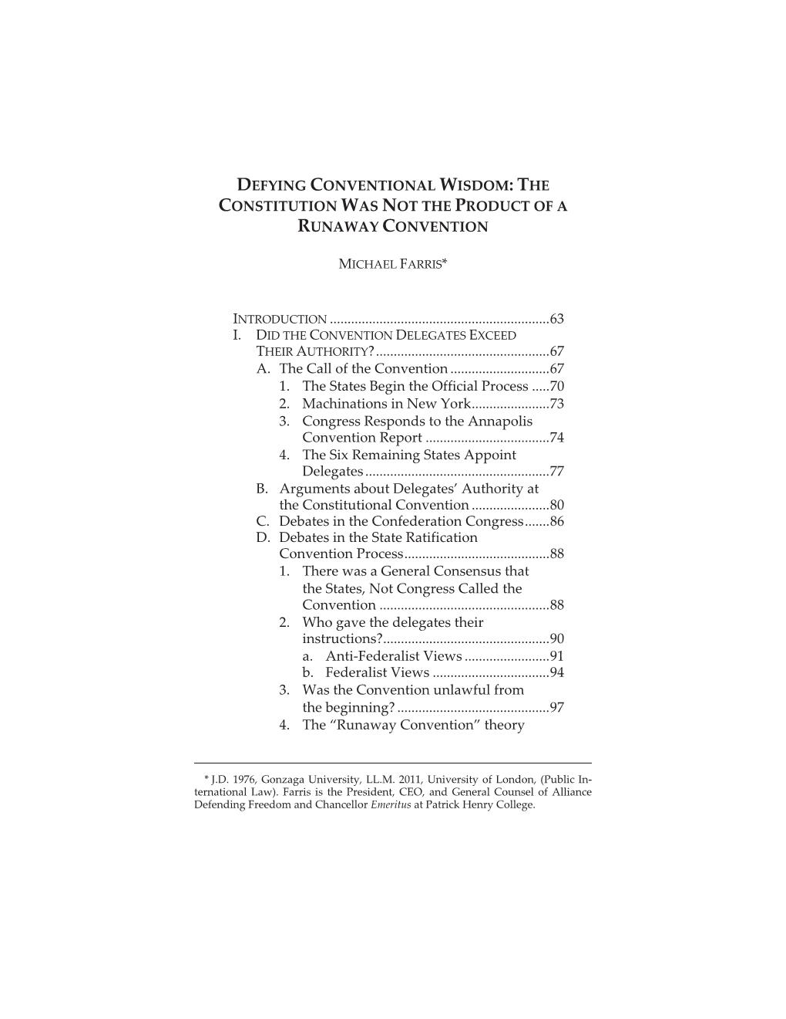
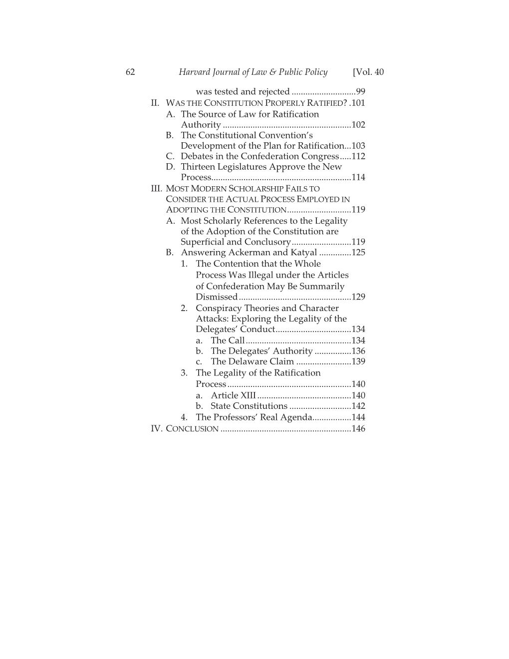
For more details visit the link below to read Michael Farris’ peer reviewed treatise on the topic in the Harvard Journal of Law & Public Policy :
http://www.harvard-jlpp.com/wp-content/uploads/2017/03/Farris_FINAL.pdf

Slide 74
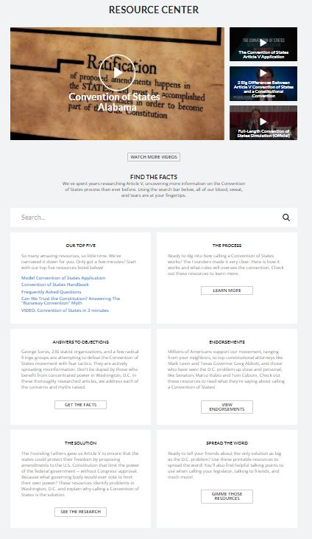
And you can find additional resources to aid in countering this and other objections at the COSP website at “https://conventionof states.com/resources and also at our on-line learning resourse at COSUniversity
https://conventionofstates.com/resources
Request for resources and/or questions can be directed to me at:
michael.mowry@cosaction.com

