Slide 1
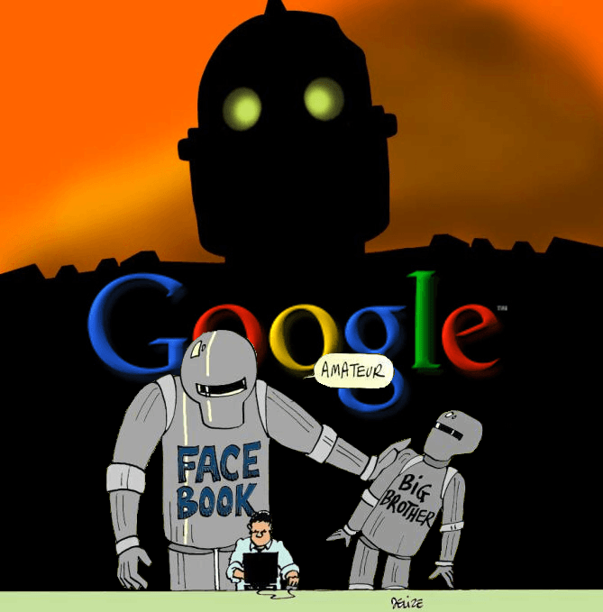
PriVACy UNDER ATTACK
Dave Hatter

Slide 2
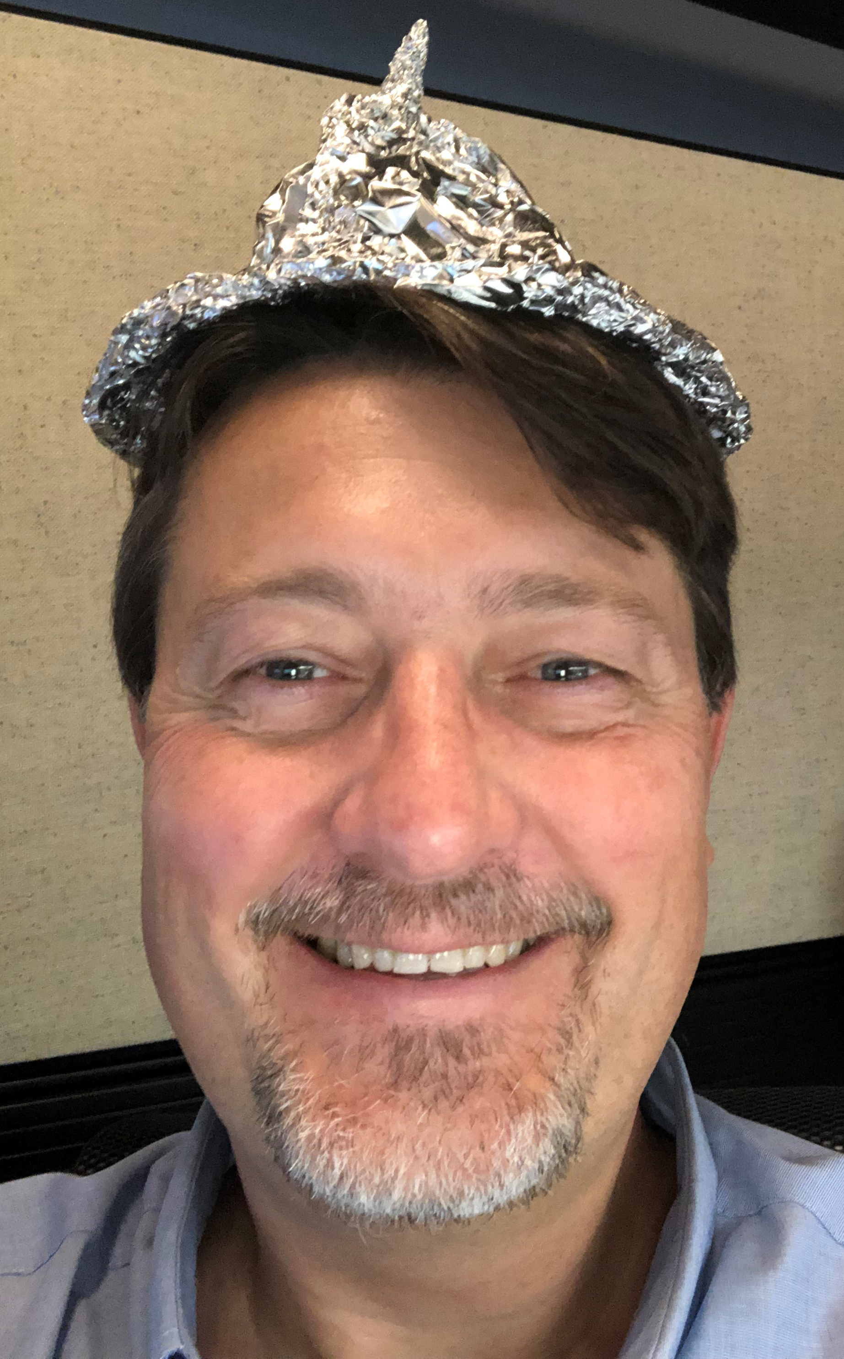
“Doomsday” Dave
“Privacy is one of the biggest problems in this
new electronic age” – Andy Grove
“We believe the customer should be in control of their own information. You might like these so-called free services, but we don’t think they’re worth having your email, your search history and now even your family photos data mined and sold off for God knows what advertising purpose. And we think some day, customers will see this for what it is.” – Tim Cook
If you’re not paying with money, you’re paying with data. You’re the product NOT the customer

Slide 3
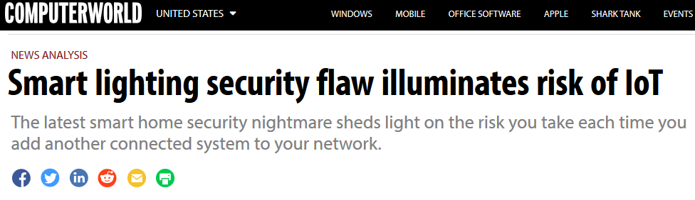
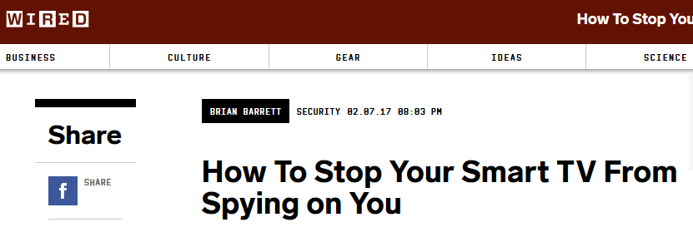
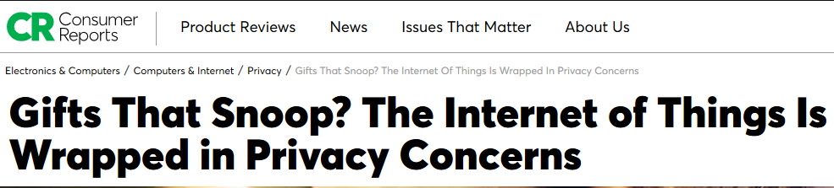
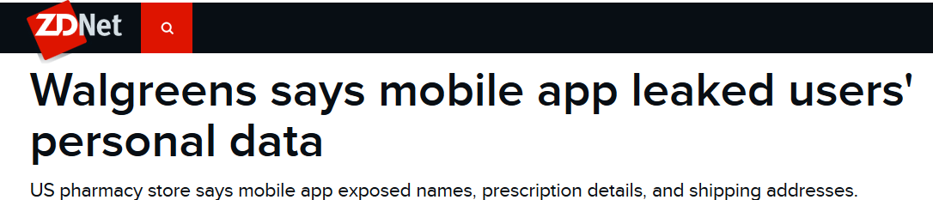
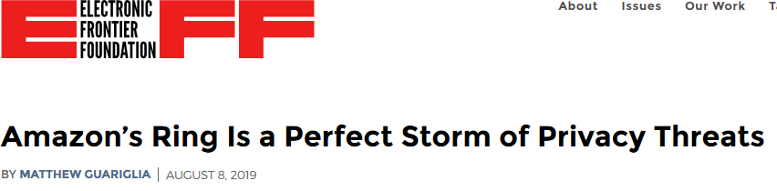
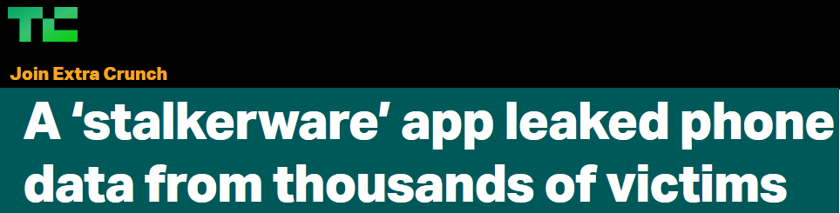
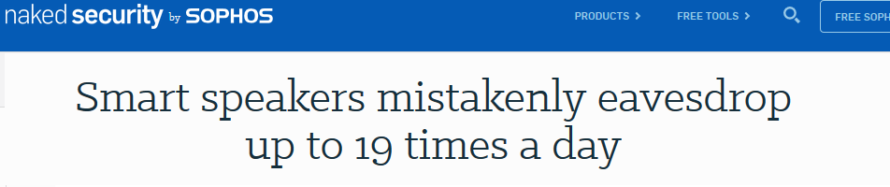
Ripped from the headlines

Slide 4
My goals today
Educate you
Motivate you
Provide actionable advice you can implement

Slide 5
Privacy vs security
Privacy: Control of your personal information and how it’s used
Security: how your personal information is protected
https://us.norton.com/internetsecurity-privacy-privacy-vs-security-whats-the-difference.html
Notes:
Your privacy and security are maintained. The bank uses your information to open your account and provide you with products and services. They go on to protect that data.
Your privacy is compromised, and your security is maintained. The bank sells some of your information to a marketer. Note: You may have agreed to this in the bank’s privacy disclosure. The result? Your personal information is in more hands than you may have wanted.
Both your privacy and security are compromised. The bank gets hit by a data breach. Cybercriminals penetrate a bank database, a security breach. Your information is exposed and could be sold on the dark web. Your privacy is gone. You could become the victim of cyber fraud and identity theft.

Slide 6
Privacy myths
It’s impossible maintain some privacy in today’s world
My data (or the data I have access to) isn’t valuable
I have to be a technical wizard to protect myself
Attacks are sophisticated or technically complex
New software and devices are secure out-of-the-box

Slide 7
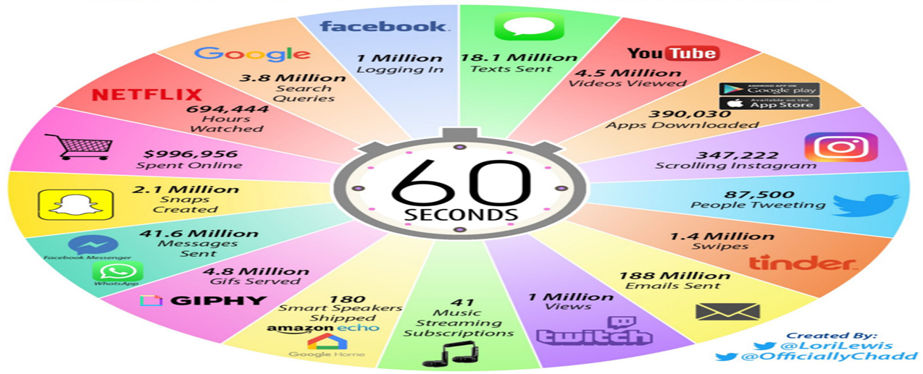
2019 Internet Minute
Notes:
“Over 2.5 quintillion bytes of data are created every single day, and it’s only going to grow from there. By 2020, it’s estimated that 1.7MB of data will be created every second for every person on earth.” – Sixth Annual Domo report

Slide 8
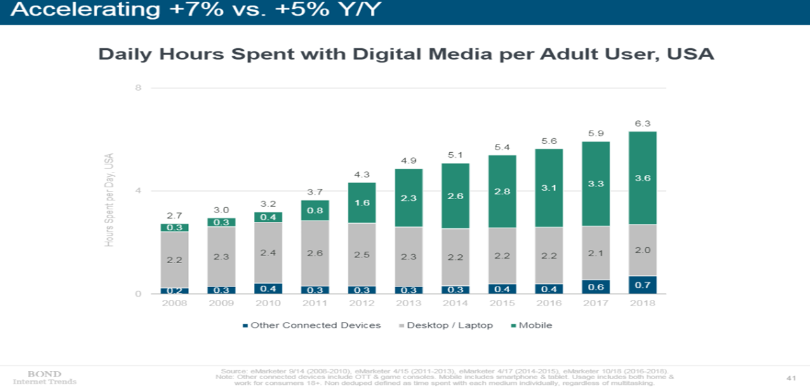
More data is being created

Slide 9
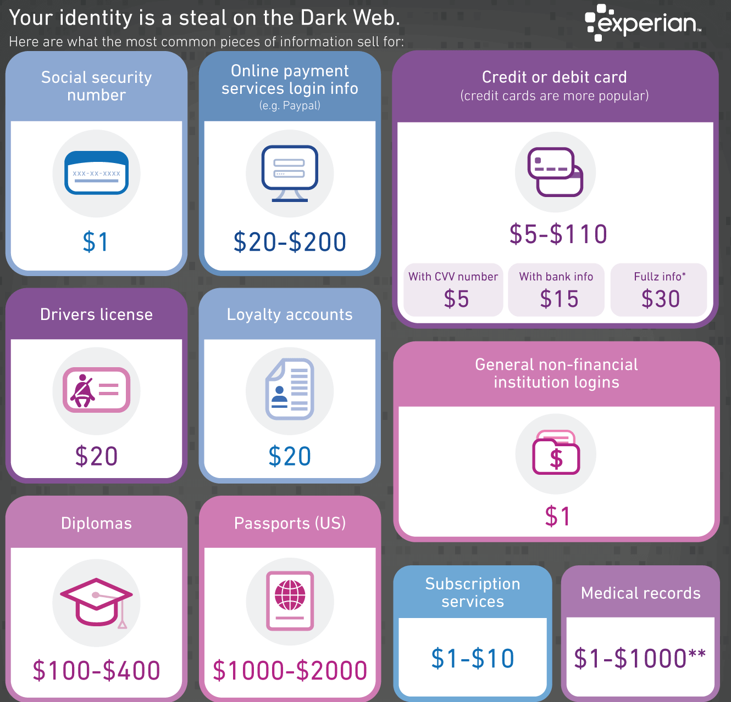
Data is increasingly valuable

Slide 10
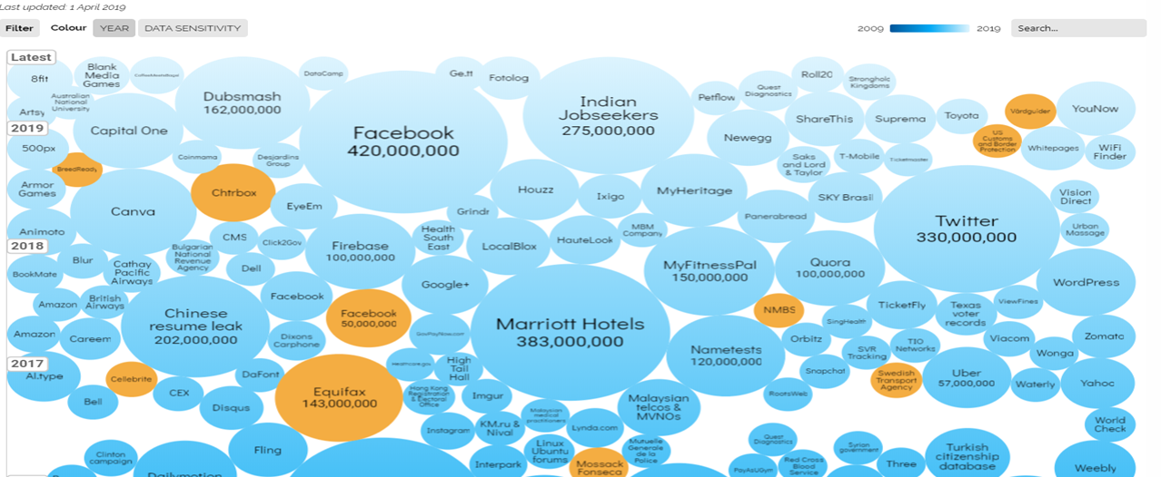
Biggest breaches and hacks so far
https://informationisbeautiful.net/visualizations/worlds-biggest-data-breaches-hacks/
Notes:
September 2019 – 531 million records leaked

Slide 11
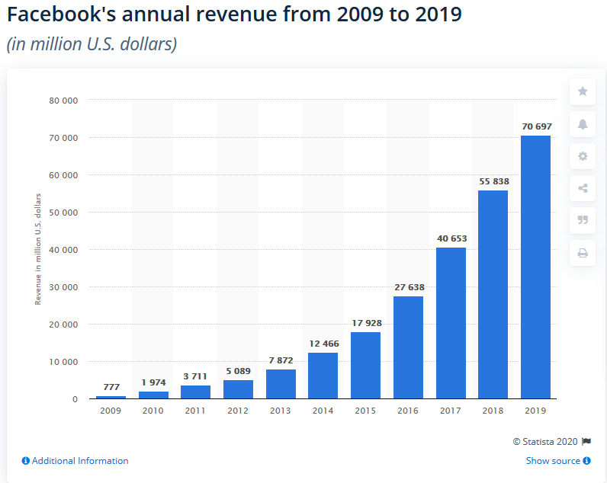
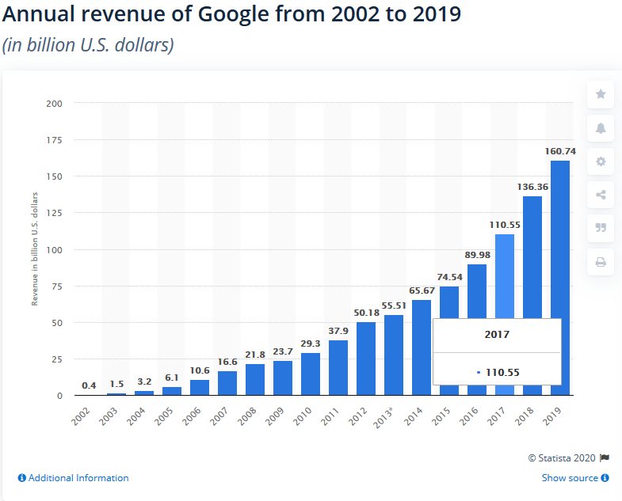
Data is increasingly valuable

Slide 12
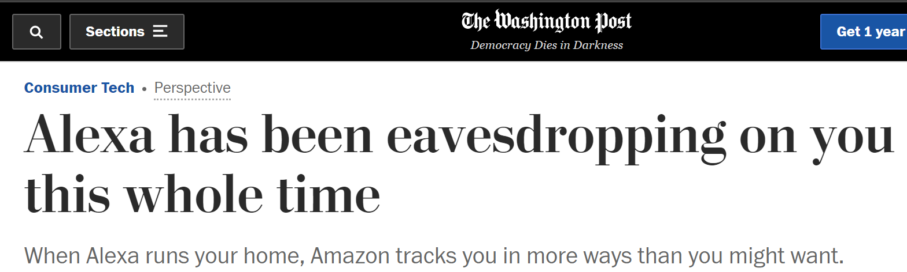
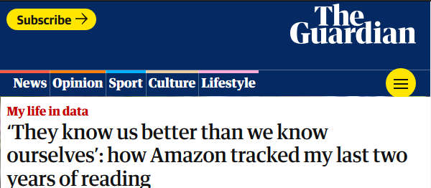
Who does Amazon Own?
AWS
Whole Foods
Ring
Zappos
PillPack
Twitch
Kiva
Audible

Slide 13
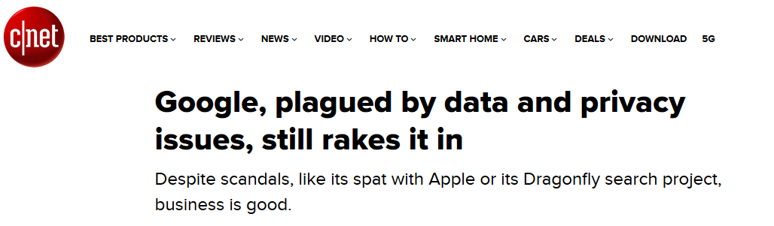
Who does Alphabet (Google) Own?
Android
Blogger
Docs
Fitbit
Gmail
Picasa
Nest
YouTube
Boston Dynamics
Zagat
Notes:
Many smart-speaker owners don’t realize it, but Amazon keeps a copy of everything Alexa records after it hears its name. Apple’s Siri, and until recently Google’s Assistant, by default also keep recordings to help train their artificial intelligences.

Slide 14
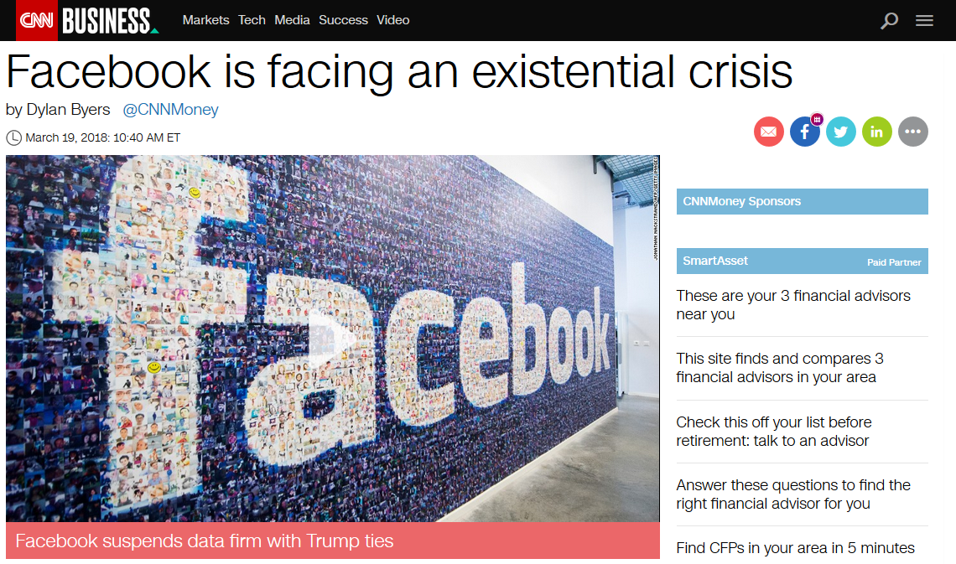
Who does Facebook Own?
Instagram
WhatsApp
Oculus VR

Slide 15
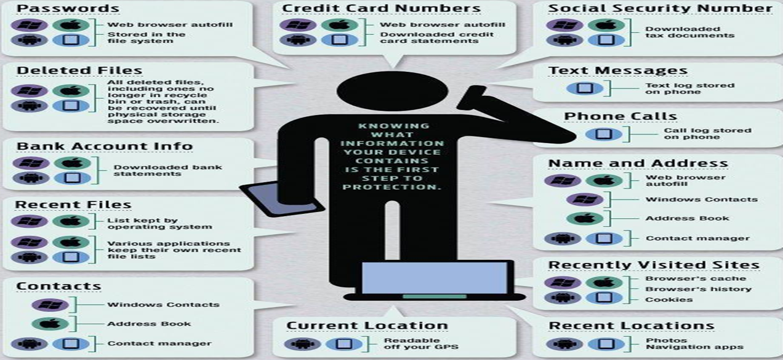
What your devices know about you
https://www.thecybersecurityhub.com/

Slide 16
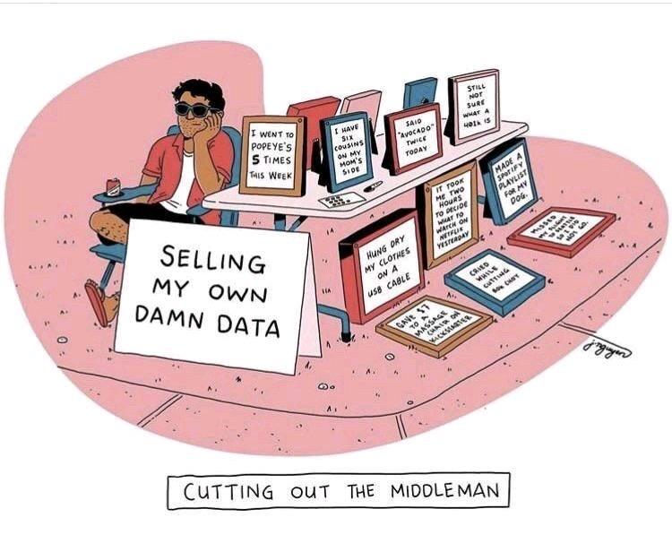
Eliminate the middle man?
https://www.thecybersecurityhub.com/

Slide 17
Internet of Things (IoT) background
  “The Internet of Things (IoT) refers to the capability of everyday devices to connect to other devices and people through the existing Internet infrastructure. Devices connect and communicate in many ways. They are able to communicate with consumers, collect and transmit data to companies, and compile large amounts of data for third parties.” – EPIC
  In 1982 the first device connected to the Internet was a Coca-Cola vending machine that could control the temperature of the machine and keep track of inventory
  The term “Internet of Things” was coined by Kevin Ashton in 1999

Slide 18
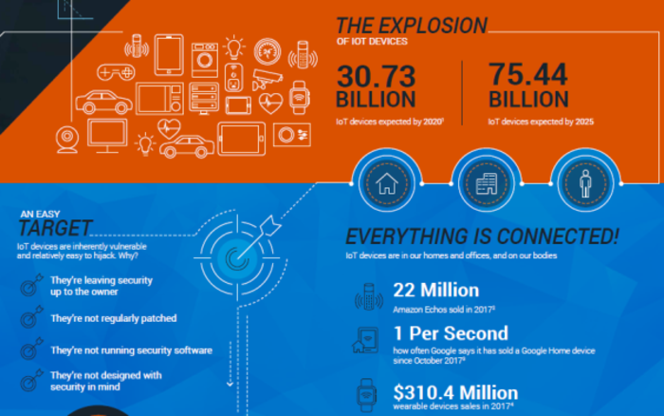
The attack surface grows daily
Notes:
At work and at home

Slide 19
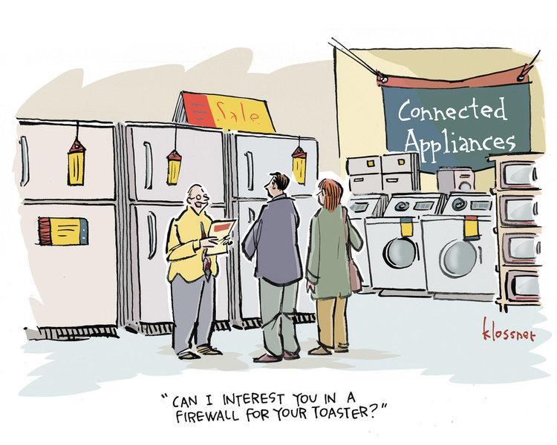
The attack surface grows daily
Notes:
At work and at home

Slide 20
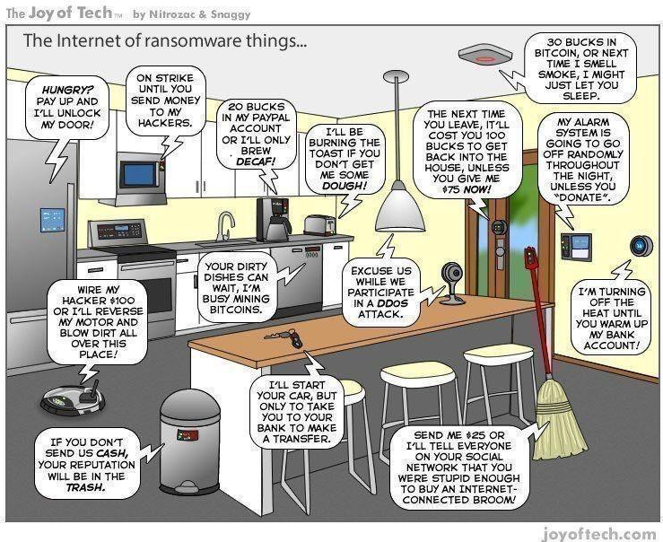
The attack surface grows daily
Notes:
Understand risks/rewards before adding them to your network

Slide 21
IoT = Asbestos
  Mikko Hyppönen, CTO at F-Secure said the IoT revolution is "taking everything else online" and eventually "anything that uses electricity will be online"
  Hyppönen warned about the proliferation of IoT devices: "What’s happening right now, around us, I guess would be characterized as IT asbestos“
  D2: Disconnect and discard

Slide 22
Glossary
Cookies: files dropped by websites to track you
Web beacons: covert tracking mechanism for websites
Browser fingerprinting: A technique to identify you based on unique characteristics of your device
Encryption: encoding data to make ir undecipherable without a key
VPN: Virtual Private Network
Data exhaust: Data emitted from systems you use
Digital Footprint: information available about you
OSINT: Open Source intelligence
Metadata: Data that describes other data

Slide 23
What information is collected?
  Location data
  Email metadata and content
  Text message metadata and content
  Phone call metadata and content
  Browser history
  Contact information
  Photo metadata and content
  Video metadata and content
  Sensor information and metadata

Slide 24
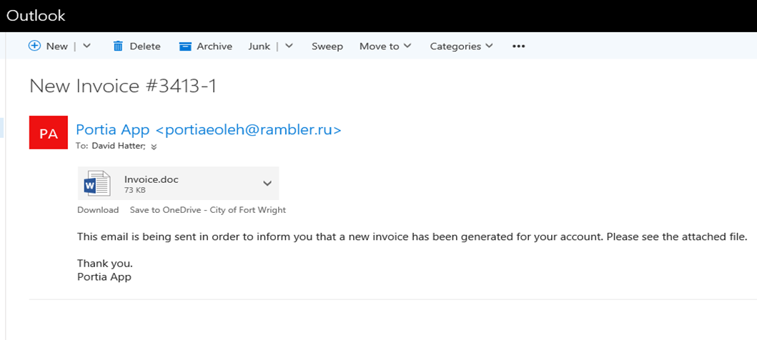
Privacy Threats: Phishing

Slide 25
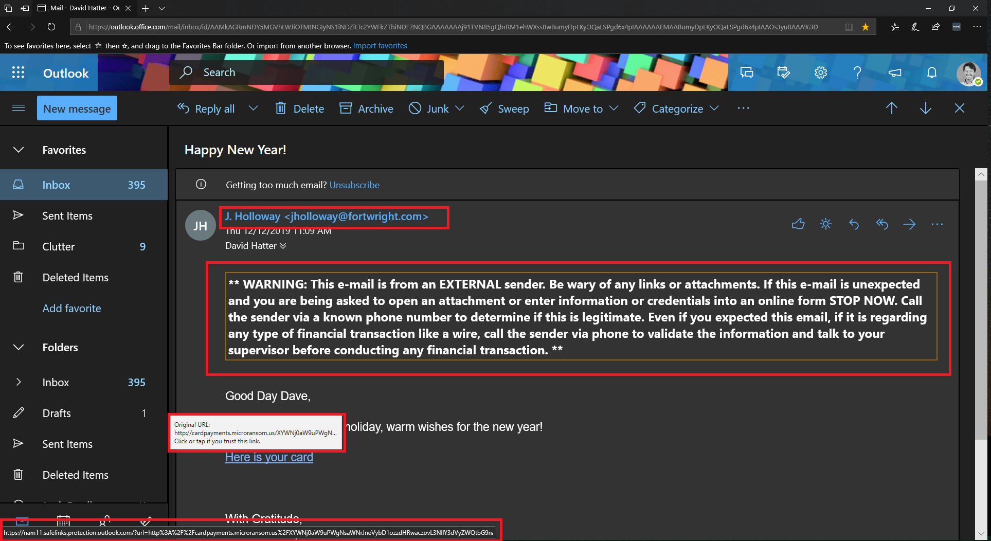
Privacy Threats: Phishing

Slide 26

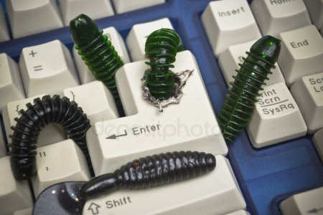
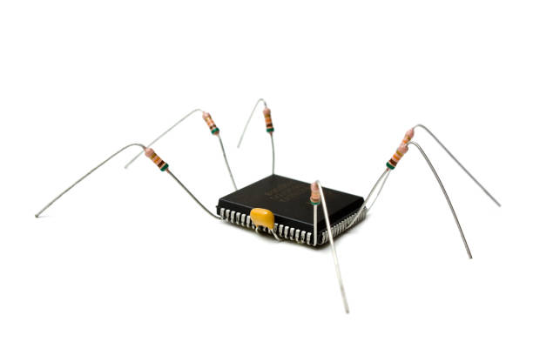
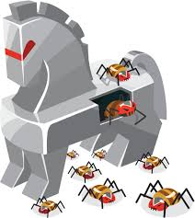

Privacy Threats: Malware
  Viruses
  Worms
  Keystroke Loggers
  Adware
  Bots
  Zombies
  Rootkits
  Crypto miners
Notes:
Adware – istock
Beware macros

Slide 27
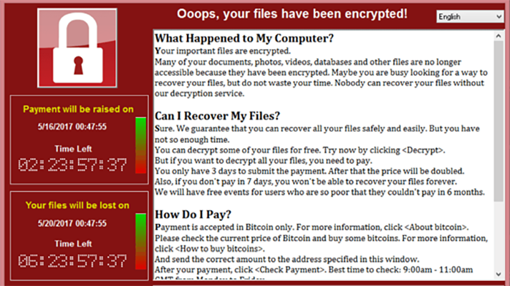
Privacy Threats: Ransomware
  Malware that encrypts data and demands a ransom
    “The losses from ransomware attacks have increased significantly, according to complaints received by IC3 and FBI case information. Although state and local governments have been particularly visible targets for ransomware attacks, ransomware actors have also targeted health care organizations, industrial companies, and the transportation sector.” - FBI
  Delivered many ways:
      Phishing
      Infected web sites
      Compromised devices
Notes:
“Ransomware is more about manipulating vulnerabilities in human psychology than the adversary's technological sophistication” - James Scott
FBI: Don’t pay the ransom
https://www.nomoreransom.org/

Slide 28
Privacy Threats: Unpatched Software
  A Ponemon Institute survey found 57% of security breaches were due to vulnerabilities in unpatched software
  34% of these cybercrime victims were aware of holes but didn’t patch them in time.
  37% of breach victims don’t perform regular scans to find vulnerabilities in their own systems
    Patching gaps are an issue:
      Some IT teams are unaware of the updates that are available
      Some know these updates are available, but don’t have the resources or strategies implement the patches

Slide 29
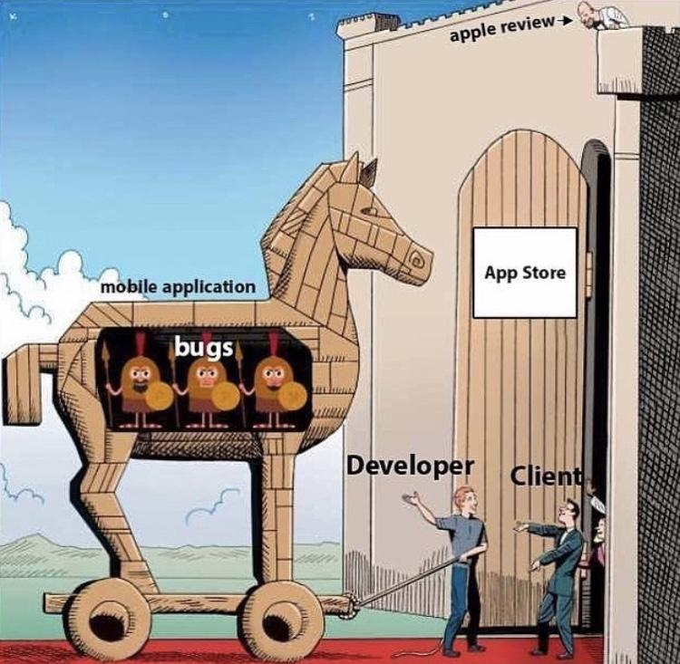
Privacy Threats: “Free” software
  Many “free” apps are thinly veiled malware
  172 malicious apps hosted on
  Google Play were installed more
  than 335 million times in
  September of 2019 and have been found
  in the Apple store too
  Delete apps you no longer need
  Do your homework and vet apps carefully
Notes:
Google also said it removed 700,000 bad apps in 2017
ZDNet, Cnet, PCMagazine, Consumer Reports
Read reviews
If you’re not paying with money you’re paying with data, You’re the product NOT the customer

Slide 30
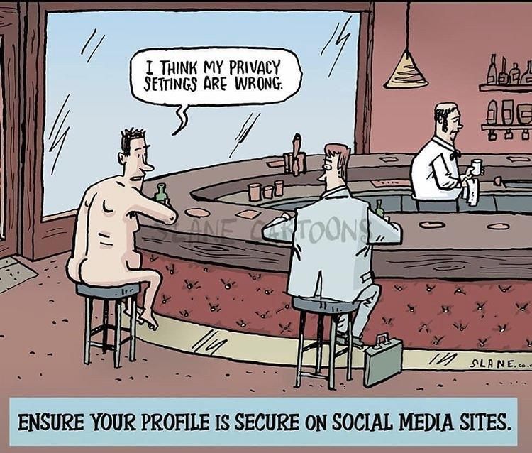
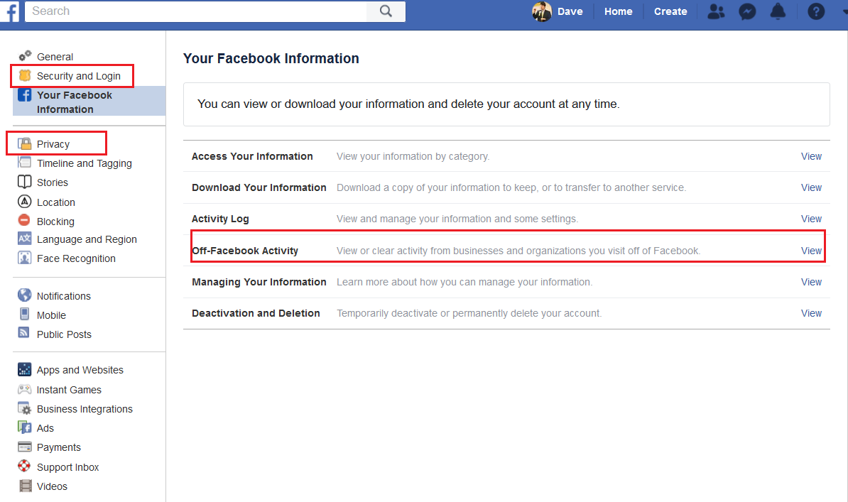
Privacy Threats: Social Media
  Your “privacy” settings do not
  guarantee privacy
  Your data may be sold
  Your data my be breached

Slide 31
Threats: Mobile Devices
  Patching issues
  Misconfiguration
  Apps steal data / leak data
  Malware
  Sensitive data loss

Slide 32
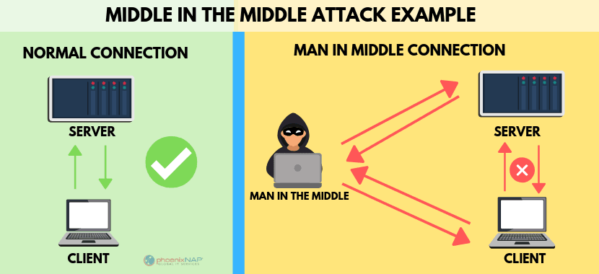
Threats: Public Wi-Fi
  Information can be stolen
  Malware can be planted
  Use a VPN
  Use a hotspot on your mobile phone
https://phoenixnap.com/blog/man-in-the-middle-attacks-prevention
Notes:
“We’re concerned that people are trading security for convenience…People are doing things on free Wi-Fi that are really alarming” ― Doug Shadel

Slide 33
Defenses: General
  Ask “Do I really need this?”
  Carefully vet vendors and products
  Change the default credentials
  Use a strong credentials and a password manager application
  Enable Multi-Factor Authentication (MFA) everywhere
Notes:
Microsoft and Google have both recently indicated the MFA can stop 99% of all automated attacks

Slide 34
Defenses: General
  Install Software patches & firmware updates regularly
  Use Anti-Malware / End Point protection
  Use a firewall
  Disable services when not needed
  Use Encryption (at rest and in motion)
    BitLocker
    VPN
    Email
Notes:
Zero trust basically means to trust no one, or thing online and so verify the identity of everyone or everything.
Ohio Enacts Cybersecurity Safe Harbor Law
https://www.alstonprivacy.com/ohio-enacts-cybersecurity-safe-harbor-law/

Slide 35
Defenses: Choose Privacy
  Ditch Android for iOS
    iOS is more secure
    Apple is a product company, not a data company
    Apple has made privacy and security a priority
    Ditch any apps not absolutely essential
    Configure your device for privacy: https://spreadprivacy.com/device-privacy-protection/

Slide 36
Defenses: Choose Privacy
  Ditch Chrome for a privacy friendly browser
    Firefox - https://www.mozilla.org/en-US/firefox/new/
    Brave - https://brave.com
    Tor - https://www.torproject.org/

Slide 37
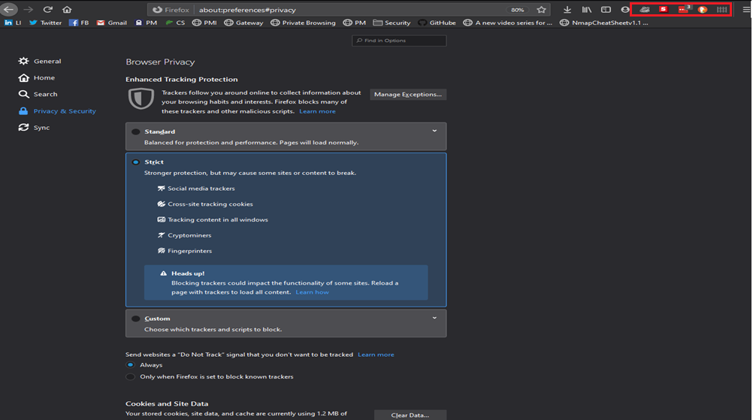
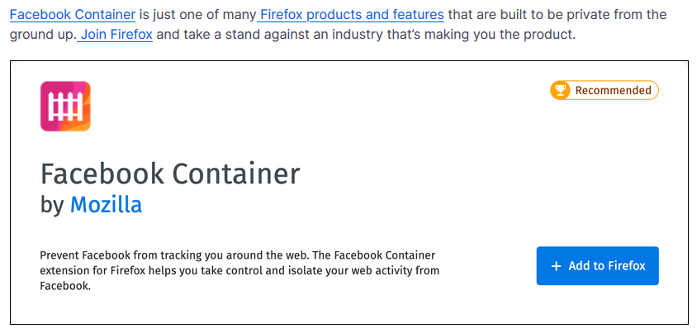
Defenses: Choose Privacy
  Lock your browser down

Slide 38
Defenses: Choose Privacy
  Ditch Gmail for privacy friendly email:
    ProtonMail - https://mail.protonmail.com
    Tutanota - https://tutanota.com/
    Fastmail - https://www.fastmail.com/

Slide 39
Defenses: Choose Privacy
  Ditch Google, use DuckDuckGo: http://www.duckduckgo.com
  Use a trusted VPN like NordVPN: https://nordvpn.com/
  Ditch Messenger, Use Signal: https://www.signal.org/
  Ditch Dropbox, Use Sync: https://www.sync.com/?_m=3kl&sscid=21k4_j7njz
  Use sites like PCMag, CNET, ZDNet and/or ConsumerReports to vet apps

Slide 40
Takeaways
If you’re not paying with money, you’re paying with data. You’re the product NOT the customer
Your data is valuable, “they” want it
New laws like CCPA may improve the situation
You can make wise choices to limit your digital footprint

Slide 41
Follow these folks
    Bruce Schneier:@schneierblog
    Kevin Mitnick: @kevinmitnick
    US-CERT: @USCERT_gov
    SecurityWeek: @SecurityWeek
    Center for Internet Security: @CISecurity
    MSRC: @msftsecresponse
    Intrust IT: @IntrustIT
    MSRC: @msftsecresponse
    Microsoft Secure: @msftsecurity
    RSA: @RSAsecurity
    Mikko Hypponen: @mikko
    Brian Krebs: @briankrebs
    CSOnline: @CSOonline
    Me: @DaveHatter

Slide 42
Additional Resources
    www.mcaffee.com
    www.grisoft.com
    www.symantec.com
    www.twofactorauth.org
    www.safer-networking.org
    www.zonealarm.com
    www.webopedia.com
    www.hackerwatch.org
    www.haveibeenpwned.com
    www.twofactorauth.org
    www.knowbe4.com
    www.antiphishing.org
    www.microsoft.com/security
    www.idtheftcenter.org/facts.shtml
    www.ftc.gov/bcp/conline/pubs/alerts/phishingalrt.htm
    www.ic3.gov/default.aspx
    enterprise.verizon.com/resources/reports/dbir/
    www.sans.org/critical-security-controls/
    https://www.us-cert.gov/ncas/current-activity/2019/11/06/cisa-launches-cyber-essentials-small-businesses-and-small-sltt
    www.nist.gov/cyberframework
    https://www.cisecurity.org/blog/cyber-hygiene-guidance-for-windows-10/
    www.ftc.gov/tips-advice/business-center/small-businesses/cybersecurity
    https://www.pcmag.com/roundup/256703/the-best-antivirus-protection
    https://www.pcmag.com/roundup/296955/the-best-vpn-services

Slide 43

Q & A
    Just because you’re paranoid, it doesn’t mean they’re NOT out to get you.

Slide 44
Thank You!
Dave Hatter
linkedin.com/in/davehatter
twitter.com/davehatter
www.youtube.com/user/davidlhatter
Catch my Tech Friday spot live on 55KRC at 6:30 AM every Friday on 550 AM or http://www.55krc.com

