Slide 1
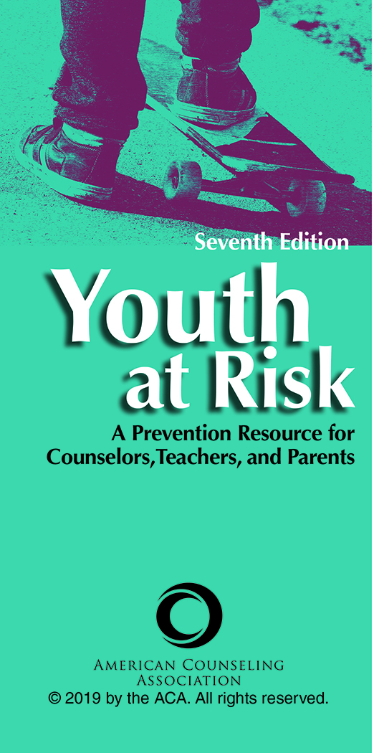
Chapter 11
A Future in Jeopardy: Sexuality Issues in Adolescence
Melinda Haley
Catherine M. Perusse

Slide 2

Introduction
Erik Erikson theorized in his model of psychosocial development that adolescents between the ages of 12 and 18 need to achieve a sense of identity in many areas, such as occupation, sex roles, politics, and religion.
This time of adolescent exploration and identity formation may also include sexual awakening and exploration.

Slide 3
Teen Pregnancy
Adolescent pregnancy is a global problem.
Today’s adolescents live in a sexualized world in which sexual images can be easily obtained via social media, which can serve to place pressure on adolescents to have sex.

Slide 4
Teen Pregnancy
Adolescent pregnancy has been and continues to be a significant social problem in the United States.
Current estimates suggest that there was an overall decline in childbirth in the United States among women ages 15 to 19 from 1991 to 2013.
However, data still suggest that teenagers in the United States remain at a greater risk for conceiving than their peers from other industrialized nations.

Slide 5
Teen Pregnancy
Risk Factors
Rate of teen sexual activity
Quality of parental supervision
Effects of poverty
Childhood trauma
Parental relationships
Pregnancy intentions
Pubertal development
Alcohol and drug use

Slide 6
Teen Pregnancy
Risk Factors
Raised by a single parent with low educational attainment and low income
Peer pressure
Quality of the romantic relationship
Coming from marginalized or socially vulnerable groups
Social media

Slide 7
Teen Pregnancy
Resiliency Factors
Having a positive attitude
Having a social support system
Being active in school
Being employed
Having goals for the future
Having high self-esteem

Slide 8
Teen Pregnancy
Approaches to Prevention
Individual
Education
Skill development (e.g., how to put on a condom)
Sex and contraceptive counseling
Sex education focused on gender roles
Facilitating contraception negotiating skills

Slide 9
Teen Pregnancy
Approaches to Prevention
Family
Enhancement of parenting skills
Facilitation of parent–child relationships
Support for parent communication around sex

Slide 10
Teen Pregnancy
Approaches to Prevention
School
Allow youth to be invested in planning preventions.
Institute peer-led sex education programs.
Institute sexual education programs.
Increase awareness of the importance of finishing education.
Encourage high school graduation.

Slide 11
Teen Pregnancy
Approaches to Prevention
School
Facilitate career exploration.
Discuss negative consequences of early sexual activity.
Teach problem-solving, decision-making, and social skills.
Use culturally relevant messages about sexual behavior.

Slide 12
Teen Pregnancy
Approaches to Prevention
Community
Focus on more than one of the sexual antecedents that lead to unintended teen pregnancy.
Ground the curriculum in a theoretical orientation that has been demonstrated to explain and reduce sexually risky behavior.

Slide 13
Teen Pregnancy
Approaches to Prevention
Community
Specify both the risk and protective factors to be modified by curriculum activities.
Provide both basic and current information about the risks of unprotected sex and contraceptive methods.
Include activities that address peer pressure.

Slide 14
Teen Pregnancy
Approaches to Prevention
Community
Provide modeling and demonstrate effective communication skills (e.g., negotiation and refusal skills).
Use a variety of teaching methods designed to reach different learning styles.
Use behavioral goals, teaching methods, and materials appropriate for participants’ age, sexual experience, and cultural background.

Slide 15
Teen Pregnancy
Approaches to Prevention
Community
Train all health professionals who work with adolescents to screen for high risk and help teens develop protective factors.
Ensure that sessions last long enough to complete important activities.

Slide 16
Rape, Date Rape, and
Sexual Exploitation of Minors
Rape and date rape are increasing in the U.S. population.
18.3% of women and 1.4% of men report experiencing rape in their lifetimes.
42% of females report being raped before the age of 18.

Slide 17
Rape, Date Rape, and
Sexual Exploitation of Minors
Although heterosexuals, homosexuals, males, and females can commit rape, sexual assault, and dating violence, it is more common for a heterosexual male to be the abuser and a heterosexual female to be the victim.
Date rape is the most common form of rape in the 14 to 17 age group.

Slide 18
Rape, Date Rape, and
Sexual Exploitation of Minors
Risk Factors
Consumption of alcohol or drugs
High use of tobacco
High levels of consensual sexual activity
Having many sex partners
Early age of first date
Losing virginity at a young age
History of sexual abuse

Slide 19
Rape, Date Rape, and
Sexual Exploitation of Minors
Risk Factors
Being socially isolated
Having poor peer relationships
Problems adjusting to school
Poor interpersonal control
Low self-esteem
Depression
Having considered or attempted suicide

Slide 20
Rape, Date Rape, and
Sexual Exploitation of Minors
Risk Factors
High emotionality
Coming from an abusive home
Parental aggression
Attitudes and beliefs condoning dating violence
Belief in rape stereotypes
Incidence rate of community and school violence
Level of satisfaction in the relationship

Slide 21
Rape, Date Rape, and
Sexual Exploitation of Minors
Risk Factors
Seriousness and length of the dating relationship
Relationship conflict
Bullying
Cyberbullying
Being isolated from others in a dating situation

Slide 22
Rape, Date Rape, and
Sexual Exploitation of Minors
Approaches to Prevention
Individual
Prevention programs need to encourage the empowerment of females.
Build bystander intervention skills.
Build healthy relationship skills and expectations.
Discuss positive norms related to gender, sexuality, and the acceptability of violence.

Slide 23
Rape, Date Rape, and
Sexual Exploitation of Minors
Approaches to Prevention
Individual
Review strategies effective with men.
Discuss expectations about male and female roles and interactions.
Enhance the communication and conflict resolution skills of each gender.

Slide 24
Rape, Date Rape, and
Sexual Exploitation of Minors
Approaches to Prevention
Family
Parents are often a teen’s greatest protective factor.
Model healthy beliefs and behaviors.
Set clear standards.
Keep the lines of communication open.
Create a safe place for the teen to come to talk.
Look for behavioral cues that a teen may be a victim.

Slide 25
Rape, Date Rape, and
Sexual Exploitation of Minors
Approaches to Prevention
School
Provide psychoeducational material that helps women recognize the warning signs of male aggression and teen dating violence.
Infuse the curriculum with information about rape and assault.
Challenge societal gender-role expectations.
Provide information and education about date rape drugs.

Slide 26
Rape, Date Rape, and
Sexual Exploitation of Minors
Approaches to Prevention
Community
Using better lighting in parking structures and parking lots.
Trim shrubbery to improve visibility.
Develop statutory rape laws.
Challenge social norms regarding rape.

Slide 27
AIDS and Other Sexually
Transmitted Diseases (STDs)
Centers for Disease Control and Prevention (CDC) statistics suggest that the incidence of STD acquisition in the United States is increasing dramatically.
In the 2015 Youth Risk Behavior Surveillance System, the CDC found that 41% of students had already engaged in sexual relations, and 43% of those had not used protection against STDs.
In 2016, chlamydia was the most commonly reported STD in the United States.

Slide 28
AIDS and Other STDs
Risk Factors
Early age of sexual debut
Number of sex partners
Inconsistent or incorrect use of condoms
Living in a rural area
Experimentation with alcohol and other substances

Slide 29
AIDS and Other STDs
Risk Factors
Unprotected anal sex
Race/ethnicity
Sociodemographic conditions
Behavioral issues

Slide 30
AIDS and Other STDs
Approaches to Prevention
Individual
Programs focused on teens abstaining from oral, anal, and vaginal intercourse
Choosing low-risk sexual partners
Discussing one’s sexual history with new partners
Having monogamous relationships
Programs aimed at teaching teens to consistently use a male latex condom during heterosexual and homosexual intercourse

Slide 31
AIDS and Other STDs
Approaches to Prevention
Family
Parent–child communication
  Talk calmly and often about sex.
  Avoid giving a lecture.
  Listen to your teen and answer his or her questions as openly and honestly as possible.
  Discuss the issues of STDs and prevention and different forms of sexuality.
  Talk about where teens can get access to contraceptives and health care services.

Slide 32
AIDS and Other STDs
Approaches to Prevention
School
Curriculum-based sex and STD/HIV education programs
  Review the characteristics of an effective STD prevention curriculum in schools.

Slide 33
AIDS and Other STDs
Approaches to Prevention
Community
Review the following:
Recommendations of the Sexuality Information and Education Council of the United States
Recommendations of the National Institutes of Health
CDC guidelines for getting more youth to participate in community prevention agencies

