Slide 1
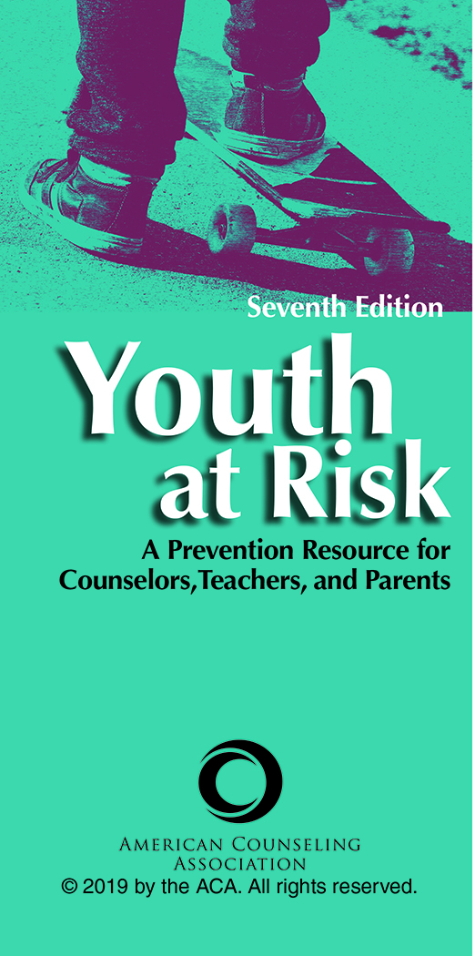
Chapter 5
“Will I Ever Measure Up?” Problems of Self-Esteem
Mary H. Guindon
Jessica J. Lane

Slide 2

Problem Definition
Low self-esteem is a critical factor in at-risk behavior.
A review of the literature supports the belief that negative self-esteem affects behavior in negative or destructive ways.

Slide 3
Definitions of Self-Esteem
Self-esteem refers to subjective evaluations of worth.
These value judgments develop through personal success or failure experiences, interactions with others, maturation, heredity, and social learning and are formulated from an individual’s perspective.
Self-esteem affects motivation and behavior as well as physical and mental well-being.

Slide 4
Definitions of Self-Esteem
Self-esteem is the subjective part of self-concept, the evaluation of self and behaviors based on an individual’s perceptions of personal experiences and feedback from significant others.
A sense of competence and achievement appear to be basic elements of self-esteem.

Slide 5
Definitions of Self-Esteem
Self-esteem is not, however, a univariate variable. Referred to as a self-esteem system it is considered to be both general (global) and selective (specific or situation).
Thus, self-esteem can be a state (global) or a trait (selective).

Slide 6
Definitions of Self-Esteem
Self-esteem exists on a continuum from low to high.
It can be conceptualized as curvilinear; optimal self-esteem is neither too high nor too low.
Medium self-esteem may be most adaptive and may more effectively enable healthy living than either low or inappropriately high self-esteem.

Slide 7
Definitions of Self-Esteem
Global Self-Esteem: An overall estimate of general self-worth
Selective Self-Esteem: An evaluation of specific and constituent traits or qualities or both within the self, at times situationally variable and transitory, that are weighted and combined into an overall evaluation of self, or global self-esteem

Slide 8
Definitions of Self-Esteem
Collective Self-Esteem: The positive aspect of the self-concept resulting from identification as a member of one or more social groups
Contingent Self-Esteem: The belief that one’s self-worth is dependent on measuring up to perceived external standards and expectations

Slide 9
Definitions of Self-Esteem
Implicit Self-Esteem: Unconscious self-evaluations
Explicit Self-Esteem: Is conscious and involves the need for positive self-presentation
Self-Esteem Lability: Trait self-esteem, one’s excessive reactions to everyday stressors and positive occurrences

Slide 10
Causal Factors
People with high self-esteem are signiﬁcantly, substantially happier than other people.
They are also less likely to be depressed, either in general or speciﬁcally in response to stressful, traumatic events.

Slide 11
Causal Factors
Parental, individual, social, psychological, physical, environmental, and cultural influences affect self-esteem.
They all contribute to its development to the extent that each or all of these influences are valued or devalued by significant others whose feedback is both verbal and nonverbal, is both overt and covert, and dramatically affects how children and adolescents see themselves.

Slide 12
Self-Esteem Development
Self-esteem as the evaluation part of the self-concept develops from the first years of life and arises from experiences and reactions to them.
Inherited physical characteristics, such as physique and appearance as well as abilities and disabilities, may influence self-esteem by affecting others’ perceptions and behavior.

Slide 13
Self-Esteem Development
Maturation affects not only the mastery of developmental tasks but others’ reactions to the child or adolescent.
Self-esteem is still in its early stages of development when a child enters elementary school.
At approximately ages 5 to 8, children begin to understand additional areas of competence.

Slide 14
Self-Esteem Development
Children learn social roles, self-regulation, and self-control.
Research over the years has proposed that at-risk youth are deprived of social support critical to healthy self-esteem development.
At ages 6 to 12, parental influence, although still strong, begins to lessen in favor of social relationships.

Slide 15
Self-Esteem Development
Locus of control is strongly correlated with self-esteem.
The mediating effect of ethnic group membership and collective self-esteem may counterbalance the adverse effects of majority group rejection.
Young adolescents become more peer focused as they compare their behavior with others’ and adjust their self-perceptions according to the feedback they receive.

Slide 16
Self-Esteem Development
Peer acceptance is vitally important and can have a substantial effect on self-esteem.
As girls enter adolescence, self-esteem lowers and they may experience negative impacts.
Society imposes strong gender-based role behaviors that continue to have an impact on self-esteem long after adolescence.

Slide 17
Social Influences
Self-concept is heavily influenced by social context.
A person with a history of being devalued is most likely to have low self-esteem.
Connectedness is central to the development of self-esteem.

Slide 18
Impact of Social Media
Societal norms are increasingly influenced by mass media.
Social media has an inordinate influence on both selective and global self-esteem.
Adolescents routinely use technology and social media to connect. Yet their ability to connect socially with peers looks very different from that of previous generations.
Bullying and cyberaggression

Slide 19
Approaches to Prevention
Individual Strategies
Interventions must occur at an early age on multiple levels.
Positive feedback from important others
Positive role models
Volunteering, attending workshops, learning life skills

Slide 20
Approaches to Prevention
Individual Strategies
The Physical Domain: Levels of self-esteem are linked to many elements of the physical self.
  Exercise and physical fitness
  Sports

Slide 21
Approaches to Prevention
Family Strategies and Support
Belongingness influences self-esteem levels.
Parenting is a critical type of social support.
  Parenting classes
  Support groups

Slide 22
Approaches to Prevention
School Strategies
Educators are in a critical position to impact healthy self-esteem development in students.
Teachers can give positive but realistic feedback to all of their students so that they learn and internalize a legitimate sense of accomplishment and worth.
Role of the school counselor

Slide 23
Approaches to Prevention
School Strategies
Academic Strategies: Children who experience academic problems early in life are at risk for later problems, such as antisocial behavior.
  Teachers’ unconditional acceptance of students
  Tutoring
  Pairing with mentors
  Support positive peer relationships

Slide 24
Approaches to Prevention
School Strategies
Cognitive Behavior Strategies: Self-evaluations are difficult to change the longer they exist unchallenged.
  Help students make realistic self-evaluations.
  Highlight successes.
  Provide experiences for success.
  Challenge irrational beliefs.
  Provide validation and teach positive affirmations.

Slide 25
Approaches to Prevention
Community Programs
Boys & Girls Clubs of America
YMCA Achievers programs
YMCA Leaders Clubs
Big Brothers Big Sisters of America
YMCA Youth Development Services
YMCA Achievement Gap
Boys & Girls Club CareerLaunch
Step Up

