Slide 1
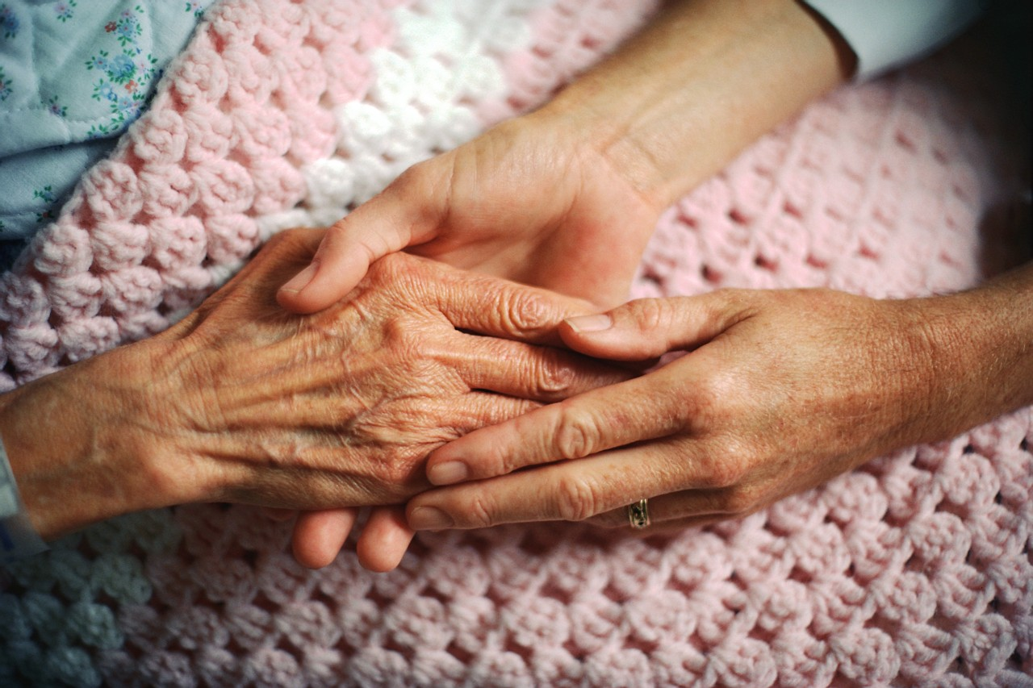
Locating Yourself in the Story: Exploring the Therapeutic Impact on Elderly Sexuality
Angela Shubert, MEd, LPC

Slide 2
Agenda:
Pretest
Introductions—Getting to Know You!
Mini-group Discussion
PowerPoint Presentation
Posttest
Discussion

Slide 3
Topics to Cover:
Sexual behavior of the elderly
Effects of aging on sexuality
Impact of illness and death on sexuality
Effects of education, therapy, and counseling on elderly
Clinician attitudes toward elderly sexuality

Slide 4
Pretest….

Slide 5
Mini-Group Time !!!!
Discuss possible stereotypes of elderly sexuality

Slide 6
Identify stereotypes of elderly sexuality
Societal
Personal

Slide 7
Discuss the effects of stereotypes on elderly sexuality
Societal
Personal

Slide 8
Impact of illness and death on sexuality
Societal
Personal

Slide 9
Death and Illness
Individuals with living spouses or intimate partners report higher rates of masturbation, intercourse, and intimacy satisfaction than individuals who have lost their partner.
Some individuals report feeling a lack of desire as a result of the death of a spouse.
Subjects who rated their health as poor were less likely to be sexually active and more likely to report sexual problems.

Slide 10
Explore effects of aging on sexuality
Societal
Personal

Slide 11
Aging and Sexuality Study
73% of Americans aged 57 to 64 reported being sexually active.
53% of those aged 65 to 74 reported being sexually active.
26% of those aged 75 to 85 reported being sexually active.

Slide 12
Aging and Sexuality
Men
  Impotence
  Premature climax
  Ageist thinking toward own sexuality
  Anxiety about performance
Women
  Low sexual desire
  Vaginal dryness
  Displeasure, pain
  Inability to climax
  Ageist thinking toward own sexuality
Lindau et al., 2007

Slide 13
Impact of Therapeutic Alliance on Willingness to Sexually Express Self

Slide 14
Red Sheet
Scenario 1 - Grace
You are a 60-year-old female who has recently been diagnosed with ovarian cancer. Although you are currently undergoing chemotherapy, you’re still very concerned about being intimate with your partner. Before cancer, you enjoyed love making 2–3 times a month and always cuddled in the evening. Now, it is difficult to be touched at times, although you yearn to be close.

Slide 15
Scenario 2 - Rose
You are an 82-year-old widow who is currently living in an assisted living facility. Although you were hesitant to go, you were no longer able to walk without falling. Your family suggested the living facility after your partner passed away. Recently you found yourself desiring to be connected to another. There is a woman you have recently found an interest in. Your family members find out that you are interested in another woman and insult your judgment. At the facility, staff members are not necessarily optimistic either, as they suggest kissing and hand-holding to be inappropriate.

Slide 16
Scenario 3 - Stella
You are an 89-year-old female who spends a great deal of time reminiscing about past lovers. You find yourself to be perfectly content with your life story and often participate in self- pleasuring as a means to connect with yourself and feel sexual. Vaginal lubrication has been a problem for the past decade, but you find lubricants helpful and accommodating. Only recently have you had difficulty pleasuring yourself because of severe arthritis. You wish to explore different avenues for assistance, but no one seems to be comfortable enough to engage in the conversation. The resources appear nonexistent.

Slide 17
Scenario 4 - Richard
You are a 73-year-old male who lives at a nursing facility with your wife, who is bed-ridden and lives off a ventilator. You have been grieving over the loss of connection with your wife and only wish for her to pass peacefully. After a year, the intimate emptiness you feel brings you great loneliness, but you do not know what to do and feel there is no one to talk to about your feelings.

Slide 18
Scenario 5 - Amos
You are a 92-year-old male who still lives at home with the assistance of a live-in nurse. You have no desire to self-pleasure and haven’t been able to maintain an erection for the past 10 years. These two factors do not matter because the only thing you crave is intimacy. You only desire someone to embrace and, once again feel the warm to vibrant sensation of another human being. Who is there to aid you in achieving your desire?

Slide 19
Afterthoughts of Pretest

Slide 20
Questions

