Slide 1
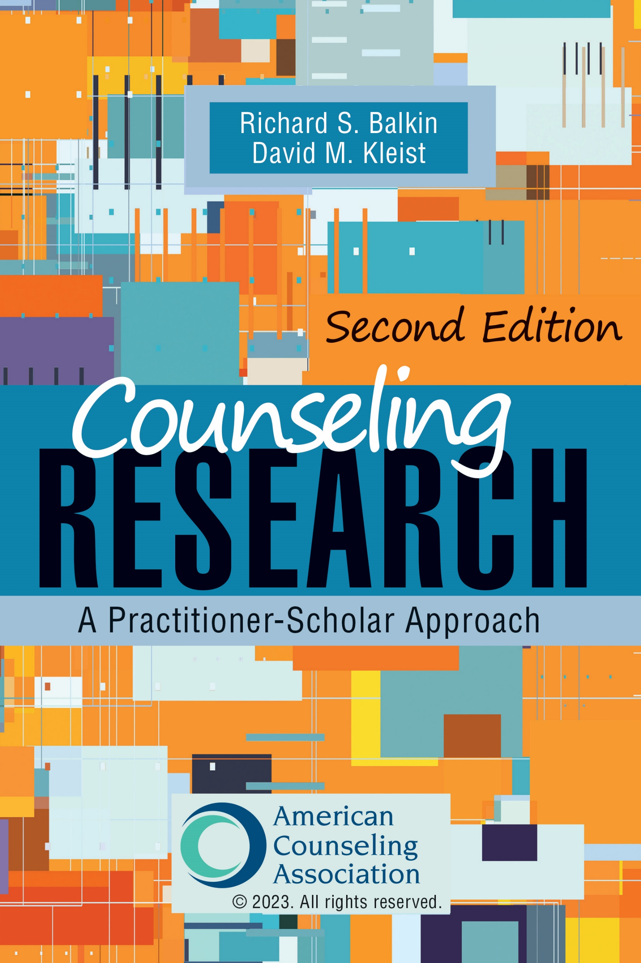
Chapter 6
Examining Relationships
ALL IMAGES IN THIS PRESENTATION ARE FROM MICROSOFT OFFICE 365, POWERPOINT 16

Slide 2

In this chapter, we will cover…
Correlational designs
Evaluation tools
Procedures
Statistical and practical significance

Slide 3

WHY CONDUCT CORRELATIONAL RESEARCH?

Slide 4
ELEMENTS OF CORRELATIONAL RESEARCH

Slide 5
Elements of correlational research
Independent variable is not manipulated.
Most is based on an assumption of linearity.
Criterion variables
  Replace dependent variable(s)
  Represent what is being predicted
Predictor variables
  Replace independent variable(s)
  Refer to phenomena that relate to or predict the criterion variable

Slide 6
CORRELATION ANALYSES

Slide 7
Pearson’s r
Pearson product-moment correlation coefficient
Expression of a linear relationship between two variables

Slide 8
Regression procedures
Examine a linear relationship between variables or sets of variables to establish a prediction model
Predictor variable(s) predict values of a criterion variable
Demonstrate theoretical relationships between or among values

Slide 9
Simple regression
Tests the linear relationship between a predictor variable and a criterion variable (one of each)
Extends the analysis of Pearson’s r to include a prediction model
R² is presented to identify the amount of variance accounted for in the model and serves as a measure of effect size
  Small = .02
  Medium = .13
  Large = .26

Slide 10
Multiple regression
Multiple regression extends the analysis of simple regression to include a model with multiple predictor variables
Used to examine the linear relationship between a set of predictor variables and a criterion variable
Two levels of reporting:
  Evaluation of the model and statistically significance
  Evaluation of the relationship of each predictor variable to the criterion variable

Slide 11
Moderation and mediation
Moderation essentially refers to an interaction
Mediation is used to explain the relationship between a predictor variable and criterion variable

Slide 12
Chi-square
Conducted to determine if there is a relationship when two variables are categorical
Correlation coefficients:
  At or below .10 are considered LOW
  At .30 are considered MODERATE
  At or greater than .50 are considered LARGE

Slide 13
Logistic regression
Used when the dependent variable is dichotomous
The predictors are generally continuous
Uses a chi-square (χ²)
Effect size can be explained through the interpretation of an odds ratio

Slide 14
DESIGNING CORRELATIONAL RESEARCH

Slide 15
Designing correlational research
The researcher is primarily interested in the relationships between or among variables
The variables in the study are generally continuous
Variable selection should be based on theory
Connections made between or among variables make sense theoretically and statistically

Slide 16
SUMMARY
The statistical and practical significance should be reported.
The theoretical relationship is more important when evaluating the association between or among variables.
Correlational research is inherently tied to theory.

