Slide 1
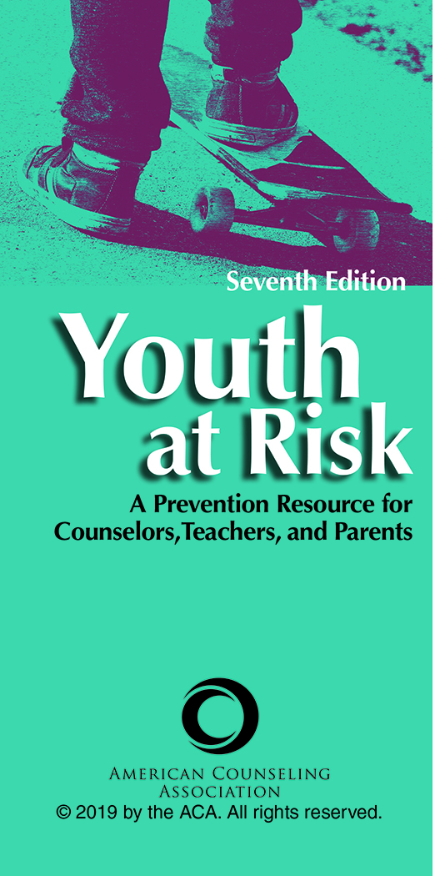
Chapter 3
Resilience: Individual, Family, School, and Community Perspectives
Rolla E. Lewis

Slide 2

Resilience
The family of phenomena referred to as resilience challenges the negative assumptions found in deficit-focused models.
Resilience results from good outcomes in spite of exposure to risk.
The issue becomes one of creating healthy systems that invite youth to participate in meaningful activities rather than repairing individuals who have been overcome and damaged by risks.

Slide 3
Key Research
Many researchers view resilience as a process rather than as a trait.
Currently the majority of research on resilience focuses on an individual-level analysis, but there are efforts to move resilience research toward systems and ecological approaches.

Slide 4
Key Research
Key research points to resilience as an evolving construct that is understood in multiple ways.
A notable body of resilience research and practice has at its heart the radical notion that resilience is a capacity all youth have for healthy development and successful learning.

Slide 5
Key Research
Resilience is a self-righting capacity fostered transactionally in the presence of certain environmental supports.
Resilience is an end product of buffering processes that does not eliminate risk.
There is no denial that risk exists; a key point in this chapter is to show that resilience and covitality exist along with risk and comorbidity.

Slide 6
Resilience Defined
Given the diversity within the resilience literature, this chapter defines resilience as a dynamic developmental process of healthy human development growing out of nurturing relationships that support social, academic, and vocational competence and the self-righting capacity to spring back from exposure to adversity and other environmental stressors.

Slide 7
Resilience Defined
Resilience is a relational self-righting process that can be strengthened by individuals and supported in just social systems.
Resilience does not occur in a social vacuum, and it may emerge at different developmental stages.
More often than not resilience entails having a positive relationship with a caring teacher or an adult mentor.

Slide 8
Factors
There are multiple factors influencing the developmental trajectories of youth and many explanations for the difficulties youth face.
Merely identifying risks and causal factors does not work to help youth develop in positive ways.
Identifying risks does not translate into strategies for reducing those risks.

Slide 9
Effective Practices
The effective practices fostering resilience point to
Nurturing positive relationships within supportive systems
Helping clients tap strengths within themselves

Slide 10
Effective Practices
The effective practices fostering resilience point to
Recognizing that alternative stories are available in every situation
Supporting covitality constructs and measures system wide as a means of providing schools with a common language

Slide 11
Professional Possibilities
Begin by being an ally to youth.
Believe in the capacity of youth to contribute to their communities.
Foster youth emotional competence, engaged living, belief in self, and belief in others.
Conduct action research that invites youth to be coresearchers and helps them to become engaged in bringing about the world they want to live in via active systems change.

Slide 12
Professional Possibilities
Pathways include
Confronting structural inequities
Instilling a sense of hope and recognizing students’ self-righting capabilities
Developing a common language such as covitality for students, parents, and educators to use when talking about youth and community development

Slide 13
Emmy E. Werner: The Mother of Resilience
The life-span, cross-cultural studies conducted by Emmy E. Werner and her colleagues have concluded that resilience is the natural human capacity for self-righting.
Werner and Smith’s (1992) transactional–ecological model of human development posits that people are active, self-righting organisms continuously adapting to their environment.

Slide 14
Emmy E. Werner: The Mother of Resilience
Werner’s longitudinal research results led researchers to conclude that it was unusual for more than half of their cohort to develop serious disabilities or persistent problems, even those children exposed to potent risk factors.
The results also showed that most delinquent youth do not develop into career criminals.

Slide 15
Emmy E. Werner: The Mother of Resilience
Werner and Smith (1992) found that resilience is not something that is fixed and concrete but a quality that is enhanced by protective buffers that appear to transcend ethnic, social class, and geographical boundaries.
Individual variability has to be taken into account, but the majority of resilient youth have a variety of internal or external protective factors.

Slide 16
Emmy E. Werner: The Mother of Resilience
At each developmental stage, there is an opportunity for protective factors (personal competencies and sources of support) to counterbalance the negative weight exerted by adverse experiences.
Werner and Smith (1992) asserted that the protective factors within the individual, family, and community have a more profound impact on the lives of youth than risk factors.

Slide 17
Emmy E. Werner: The Mother of Resilience
Second chance opportunities were usually found at major life transitions.
Such opportunities enabled high-risk individuals to rebound and are frequently found in adult education programs, military service, active participation in a church community, or a supportive friend or spouse.

Slide 18
Discourses of Risk, Racism,
Poverty, and Careers
We are biological, social, and psychological beings embedded in discourses that describe our ecorelational experience, understanding, and actions.
Such discourses are culturally and ecologically embedded.

Slide 19
Discourses of Risk, Racism,
Poverty, and Careers
Exploring discourse patterns enables counselors to understand how both clients and professionals are shaped by a variety of discourses in their lives.
Understanding discourses opens the opportunity for teachers and counselors to launch themselves beyond their taken-for-granted world by listening to learn and by hearing people as experts on their own experiences.

Slide 20
Discourses of Risk, Racism,
Poverty, and Careers
Risk Discourse
The discourse regarding troubled families, schools, and communities binds problems to individuals.
An alternative discourse would not place the problem in people; rather, problems would be described as interactive processes constructed in specific ecorelational locations.

Slide 21
Discourses of Risk, Racism,
Poverty, and Careers
Racism Discourse
Professionals and those they serve are woven into a racist social fabric.
Counselors, teachers, parents, and other core providers are challenged to understand how dominant discourses affect how their clients’ stories are heard, understood, and responded to.

Slide 22
Discourses of Risk, Racism,
Poverty, and Careers
Poverty Discourse
While recognizing that there are multiple dimensions to poverty besides having financial need, the poverty discourse reveals social location and social distancing.
Such discrimination allows for the conscious and unconscious marginalization of the poor as expendable, and it results in undeserving individuals who are viewed as uneducated, unmotivated, lazy, unpleasant, angry, and stupid.

Slide 23
Discourses of Risk, Racism,
Poverty, and Careers
Careers Discourse
A meaningful careers dialogue begins with hopes and dreams.
It is crucial for adults to recognize that embedded in any careers discourse are assumptions about the nature of work, career opportunities, corporate power, political power, social comparisons, material accumulation, consumerism, leisure, and so on.

Slide 24
Approaches to Fostering Resilience
Covitality
The covitality construct emerged to describe the co-occurrence of human strengths, resilience, and positive human development in the positive psychology literature.
Covitality describes the co-occurrence of positive constructs that encompass health and positive functioning across life domains.

Slide 25
Approaches to Fostering Resilience
Lifescaping Action Research
Like landscaping and gardening, lifescaping action research is a continuous and never-ending process of being actively engaged in bringing about the beauty you want to come to life.
  Griffin’s (2017) Write Way intervention
  Maibaum’s (2017) system-level appreciative inquiry intervention

Slide 26
Resilience With Youth With Disabilities
Youth with disabilities may require specific interventions in addition to enhancing school-wide protective processes, such as designing multidisciplinary and multimodal teams to address the needs of the whole person.

Slide 27
Resilience With Youth With Disabilities
Individualized education programs can identify and maximize strengths without eliminating the need to detect and accommodate weaknesses that add to risk, and remediation efforts can be directed toward building up youth competence.
  Macfarlane’s (1998) approach for Maori special education students in New Zealand

