Slide 1
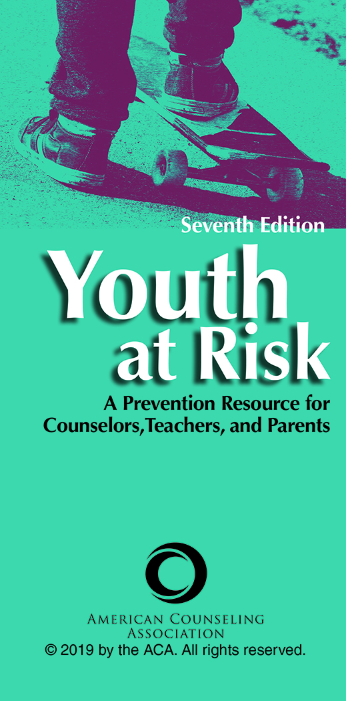
Chapter 4
The Impact of Dysfunctional Family Dynamics on Children and Adolescents
Cass Dykeman

Slide 2

Introduction
Pianta and Walsh (1996) defined the term at-risk status as the likelihood that a given youth will attain a specific outcome given certain conditions.
Ample evidence exists that family dynamics play a major role in problem behaviors in youth.
The level of dysfunction in families can vary widely. Moreover, the severity of at-risk status runs parallel to the severity of family dysfunction.

Slide 3
Problem Definition
When examining the level of dysfunction in family dynamics, it is possible to classify families at either the moderate dysfunction level or the severe dysfunction level.
This classification is important because the severity level determines the appropriate interventions to be used.

Slide 4
Problem Definition
Moderate Dysfunction
In families at the moderate dysfunction level, each parent presents an appropriate image to the outside world. Hence, it is difficult to believe that there may be severe problems with one of the children.
However, below the surface and hidden from community views are problems that the family is not willing to reveal. The at-risk youth becomes the not-so-popular messenger, letting the community know that the family has secrets and is not perfect.

Slide 5
Problem Definition
Severe Dysfunction
In the family at the severe dysfunction level, one or more adults may exhibit many at-risk behaviors, such as substance abuse.
In work with severely dysfunctional families, adults may often be found to be functioning at a less capable level than their children. This collapse of adult–child differentiation in functioning limits the extent to which one can effectively intervene in the life of an at-risk child.

Slide 6
Causal Factors
Before working with at-risk youth, one must understand how dysfunctional family dynamics can lead to destructive behavioral patterns in youth.
Dysfunctional family dynamics create a noxious emotional atmosphere for at-risk youth. Such an atmosphere produces severe personal stress and emotional upheaval.

Slide 7
Causal Factors
Moreover, this highly charged emotional atmosphere causes the at-risk youth to accommodate his or her behavior in such a way as to reduce the internal stress and upheaval.
Accommodating the stress and upheaval creates problem behaviors such as poor school performance depression, anorexia, loss of control, and myriad other at-risk behaviors.

Slide 8
Causal Factors
Specific Family Factors
At-Risk Adults Parenting: The problematic behaviors of the at-risk youth and his or her at-risk parents may differ, but the end goals of these separate behaviors typically run parallel.
Parental Conflict: A direct relationship exists between both verbal and nonverbal parent conflict and at-risk behavior in children.

Slide 9
Causal Factors
Specific Family Factors
Family Denial: Denial is acted out in two ways within families. The first way denial is enacted is by burying one’s head in the sand, that is, ignoring the reality of the situation. The second way denial is enacted is by pointing fingers.
Parentification of Children: This pattern occurs when parents give responsibilities and privileges to younger children that would be more appropriate for older children or adults.

Slide 10
Causal Factors
Serious Illness and Disability: Serious illness and disability can catapult a family into a trauma response and affect its ability to maintain healthy coping.

Slide 11
Child Maltreatment
Socioeconomic Status (SES)
Children in low-SES families (i.e., with an annual household income of less than $15,000) are 5 times more likely to suffer some form of maltreatment than children not in low-SES families.
Children in low-SES households were 8 times more likely to experience physical neglect.

Slide 12
Child Maltreatment
Family Structure
The highest rate of maltreatment occurred among children living with one parent who had an unmarried partner (not the child’s parent) in the household.
Children in this category are 8 times more likely to experience maltreatment than children living with two married biological parents.

Slide 13
Child Maltreatment
Metropolitan Status
In every maltreatment category, rural children experienced higher rates of maltreatment (68 per 1,000 overall) than their urban counterparts (31 per 1,000 overall). More than any other statistic, this one reveals the higher at-risk status of rural youth.

Slide 14
Child Maltreatment
Types of Trauma
Abuse is an issue of control and power, whether it is perpetrated within or outside of the family. The impact of physical and sexual abuse is directly related to intensity, the amount of coercion, and the level of conflict involved.
Webb (2015) distinguished between two kinds of trauma. A single traumatic event in an otherwise normal life is called Type I trauma, and prolonged and repeated trauma is called Type II trauma.

Slide 15
Child Maltreatment
Different Behavioral Readouts of Trauma
When observing children suspected of being maltreated, one needs to understand the form their trauma and symptoms take.
Children will exhibit the impact of abuse and neglect through either internalized or externalized behaviors.

Slide 16
Child Maltreatment
Effects of Physical Abuse
Physically abused children have deficits in gross motor development, speech, and language.
The impact of physical abuse includes psychic trauma, chaos, rejection, deprivation, distorted parental perceptions, and unrealistic expectations. Further disruptions to family life occur with hospitalizations, separation, foster placement, and frequent home changes.

Slide 17
Child Maltreatment
Effects of Sexual Abuse
The impact of child sexual abuse can be measured along a continuum from neutral to very negative. At its extreme, the effects of sexual abuse manifest in dissociation.
The term dissociation refers to “a disruption of and/or discontinuity in the normal, subjective integration of one or more aspects of psychological functioning, including—but not limited to—memory, identity, consciousness, perception, and motor control” (Spiegel et al., 2011, p. E19)

Slide 18
Child Maltreatment
Effects of Sexual Abuse
Externalized and internalized behaviors
Boundary issues
Displays private parts
Sexual interest
Sexual intrusiveness
Sexual knowledge

Slide 19
Child Maltreatment
Effects of Neglect
The dynamics of neglect differ markedly from those of physical or sexual abuse.
The main difference is the attention received by the parents. The attention associated with abuse is inappropriate, excessive, harsh, and damaging, but the parent is still involved with the child.

Slide 20
Child Maltreatment
Effects of Neglect
Neglecting parents do the opposite.
For example, they fail to stimulate or interact on an emotional or a physical level. In extreme cases, it is as though the parent does not know the child exists.

Slide 21
Child Maltreatment
Effects of Neglect
The effects of child neglect and deprivation occur across all levels of development, including social, affective, physical, emotional, behavioral, and cognitive levels.
  Stress resistance
  Youth sex offenders

Slide 22
Approaches to Prevention
Family Level
The family role of the at-risk youth
The impact of malevolent family dynamics
Families and chance of at-risk behavior
Postabuse family intervention
Parent monitoring of face-to-face interactions

Slide 23
Approaches to Prevention
School Level
Preservice/In-Service Needs
  Parent Consultation
  Referral and Networking
  Professional Comportment
  Curriculum-Based Interventions
  Mentoring Programs
  Physical and Sexual Abuse Education for Children

Slide 24
Approaches to Prevention
Community Level
Parent Education
  STEP program
  Community capacity building
  Education on family dynamics
  Community-wide networking

Slide 25
Adaptations to Diversity
By 2020, persons of color will represent the majority of children in the United States younger than age 18.
Use culturally appropriate approaches such as Szapocznik’s brief structural family therapy.
The effective counselor selects interventions that privilege the client’s worldview over his or her own.

Slide 26
Impact of Social Media
The deleterious effects of social media use on youth have been widely reported.
Yet although more than 90% of youth use social media, roughly only a third of parents ever engage in any type of monitoring of this use.
The best monitoring outcomes come from coparent agreement on specific media restrictions.

