Slide 1
Debunking the Myths of age
David W. Hart, MS

Slide 2
Debunking the myths of age
As a result of this activity students will:
Develop a clearer understanding of how negative perceptions and stereotypes of aging affect clinical work with older adult clients.
Develop a conceptualization of the aging process that includes empirically supported models of successful aging that contrast with conventional descriptions of age.
Debunk dominant cultural myths regarding age.

Slide 3
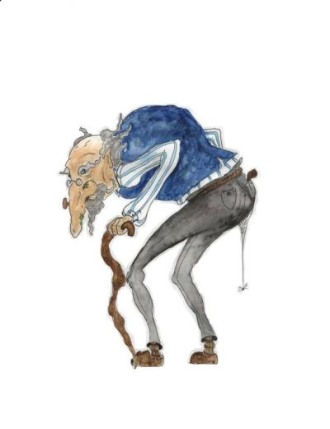
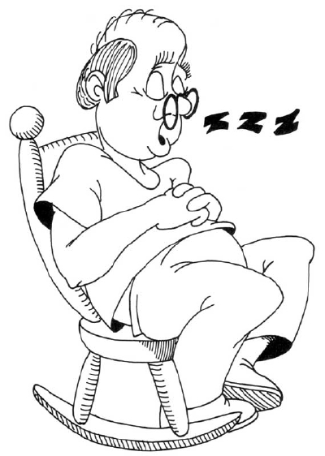
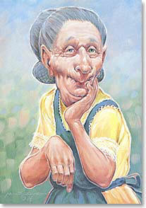
Aging Stereotypes
How does popular culture, and maybe you, describe the stereotypical older adult?

Slide 4
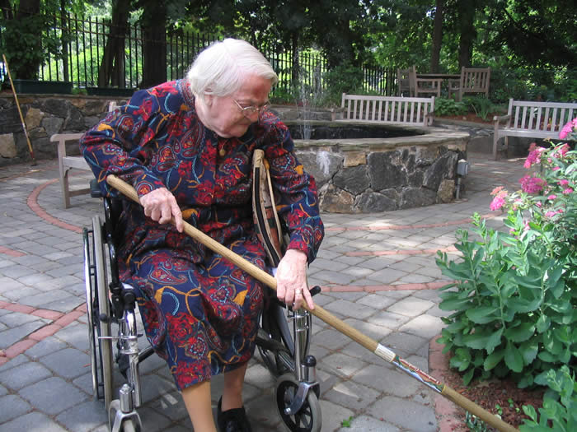
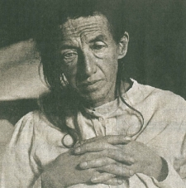
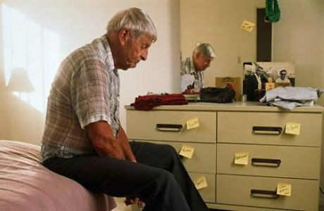

Slide 5
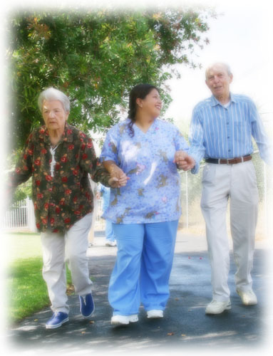
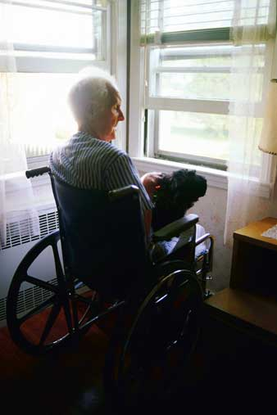
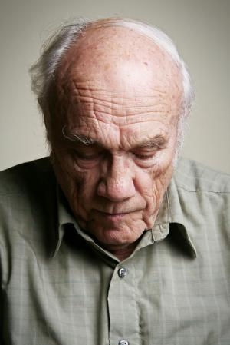

Slide 6
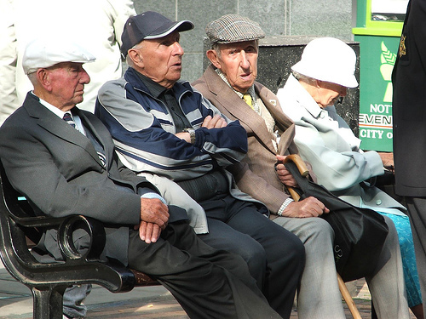
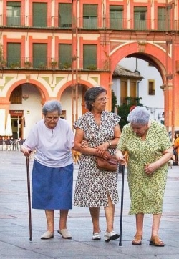


Slide 7
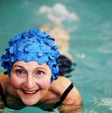

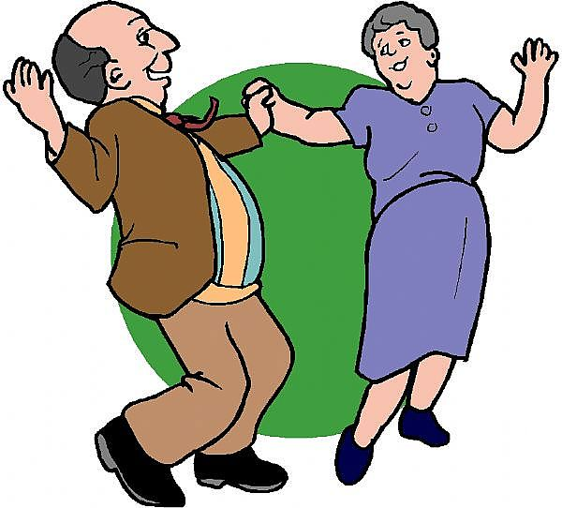
Can aging look like this? How do you perceive old age?

Slide 8

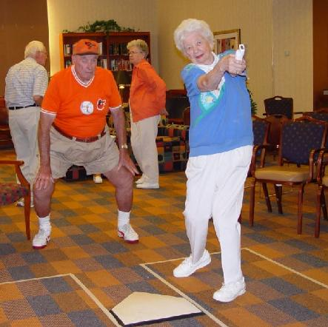


Slide 9
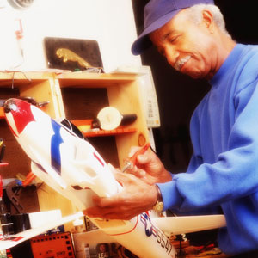
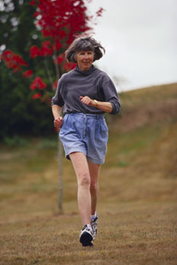


Slide 10
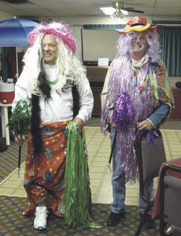
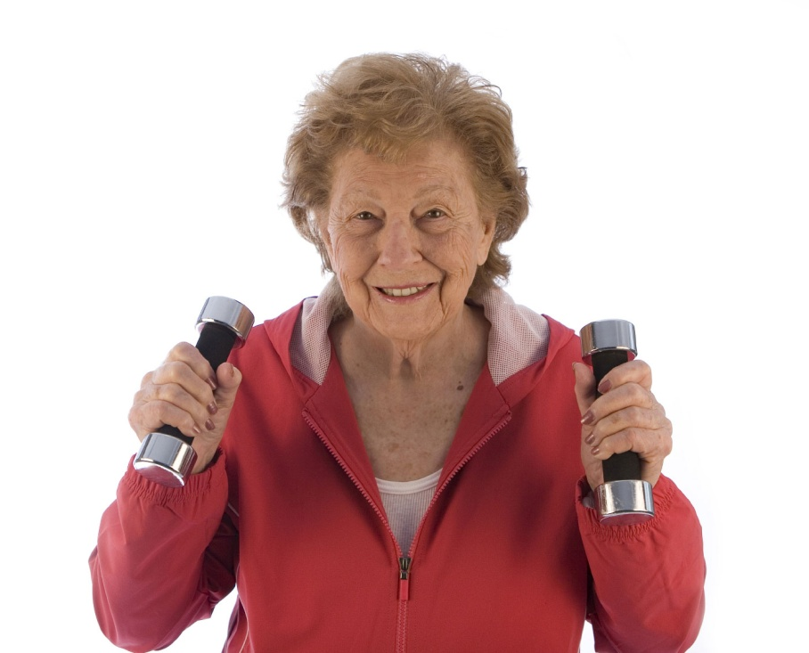


Slide 11
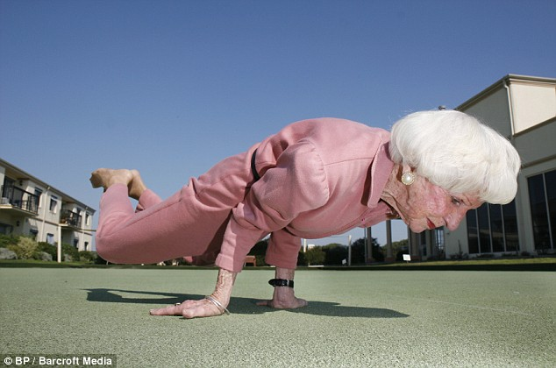
Successful Aging: You define it
How is age described by the dominant culture in the United States?
Create a list of negative perceptions of age identified as a result of participating in this activity.
Create a list of attributes related to successful aging, identified as a result of participating in this activity.

Slide 12
Successful Aging – Multiple definitions
Successful Aging
The Study of Adult Development
Community Dwelling Older Adults Study
The MacArthur Foundation Study
Notes:
No definitive answer to the debate on successful aging
Many paths lead to successful aging - no right way to grow old
How can we make the journey past 50 one we will be glad we made?

Slide 13
Successful aging:
Debunking the myths of age
Definition 1: The Study of Adult Development
  Positive, successful aging reflects vital reaction to change, to disease, and to conflict.
  When you think of successful aging, think of joy.
Definition 2: The MacArthur Study on Successful Aging
  Successful aging is the ability to maintain three key characteristics:
    Low risk of disease and disease-related disability,
    High mental and physical function,
    Active engagement with life.

Slide 14

Successful aging:
Debunking the myths of age
Definition 3: The Senior Definition
  Friends – the more the better in terms of health and well-being.
  Active participation in activities
  Frequent visits with family
  All of the above equals better everyday functioning and greater resilience.

Slide 15
How about all of the above?
Mind
Spirit
Successful
Aging
Body

Slide 16
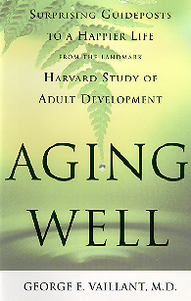
The harvard school of public health study of adult development
Longest longitudinal study of adult life ever conducted:
  68 years following three groups of men and women from adolescence into late life to identify the predictors of healthy aging.
  Study identified a number of variables that predict successful aging, including strong marriages and social relationships.

Slide 17
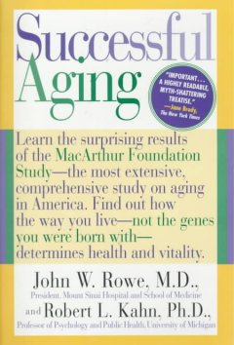
The Macarthur foundation study on successful aging
A seminal long-term research study consisting of 16 multidisciplinary scientists.
Multiple research projects studied over 1,000 high-functioning older adults for 8 years to determine the factors of successful physical and mental aging.

Slide 18
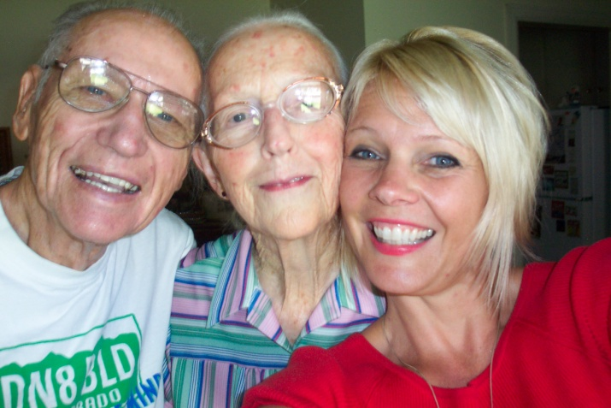
The Older adult study – The american journal of geriatric psychiatry
Study participants included 205 community-dwelling adults older than age 60 who resided in four different sites.
92% of the participants rated themselves as successful agers by completing a self-rated questionnaire survey.
(Depp & Jeste, 2006)

Slide 19
Debunking the myths of old age

Slide 20
Myth 1: To be old is to be sick
MacArthur Studies and other research show us that older people are much more likely to age well than to become decrepit and dependent.
Only 5.2% of older people reside in a nursing home, a figure that decreased from 6.3% in 1982.
Of those studied aged 65–74 in 1994, a full 89% reported no disability whatsoever.
Of study participants between the ages of 75–84, 73% still reported no disability.
Even after age 85, 40% of the study population reported to be fully functional.
Rowe & Kahn, 1998

Slide 21
Myth 2:
You can’t teach an old dog new tricks
Fears of age-related loss can sometimes be exaggerated.
Current estimates signal that no more than 13% of all older adults, aged 65+, are dementia patients.
Research has demonstrated a remarkable and enduring capacity of the older brain to originate synaptic connections, absorb data, and acquire new skills.
Memory enhancement is a direct result of concentration and selective attention – and can be improved with intent.
Rowe & Kahn, 1998

Slide 22
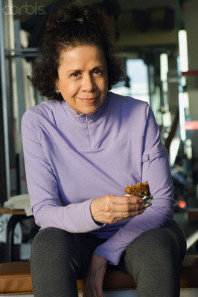
Myth 3: The horse is out of the barn
Nature is remarkably forgiving.
It’s never too late for older adults to change their habits.
When obese middle-aged and older men lose 10% of their body fat, they reduce their risk factors for cardiovascular disease significantly.
In 5 years, an ex-smoker is not much more likely to have heart disease than a person who has never smoked.
Rowe & Kahn, 1998

Slide 23
Myth 4: The secret to successful aging is to choose your parents wisely
When determining what factors promote long life, it is essential to distinguish familial habits and experiences from genes.
The strongest influence of heredity on aging relates to genetic diseases that can shorten life, such as numerous forms of cancer, high cholesterol, and so forth.
MacArthur studies show that the environment and lifestyle have a powerful impact on the likelihood of actually developing chronic disorders.
Rowe & Kahn, 1998

Slide 24
Myth 5:
The elderly don’t pull their own weight
As people age, their productive activities are increasingly unpaid.
Almost all older men and women are productive in this sense:
  One third work for pay.
  One third work as volunteers.
  Others provide informal, much-needed assistance to family members, friends, and neighbors.
Among nonworkers aged 50–59, almost half would prefer to work.
  Among those 60–64, more than one third agree.
  Rowe & Kahn, 1998

Slide 25

Debunking the myths of age statement of goals
As a result of this activity, how has your perception of the aging process shifted?
How will your expanded understanding of successful aging affect your clinical work with older adult clients?
How will you continue to strengthen your competency in working with the older adult client? What steps will you take to make your competency a reality? What might get in your way?

