Slide 1
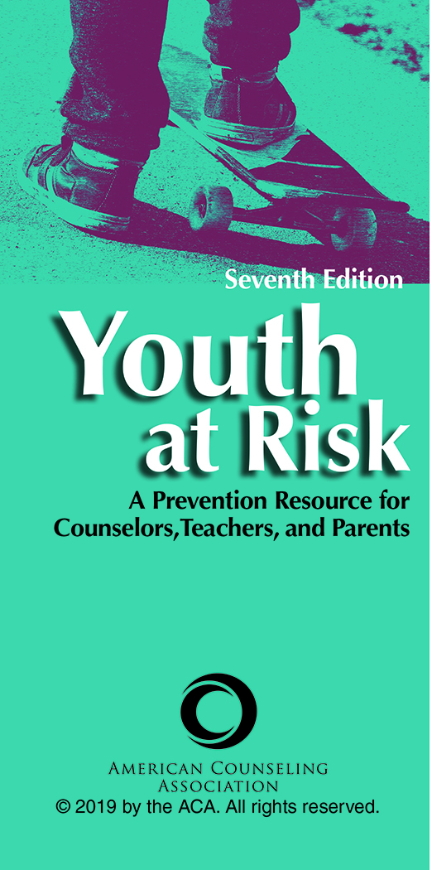
Chapter 7
Stress and Trauma: Coping in Today’s Society
Savitri V. Dixon-Saxon
J. Kelly Coker

Slide 2

Introduction
In recent years, much has been written about the stressors experienced by youth and emerging adults, especially in the age of social media and changing social norms and expectations.
The accepted stressors that have been studied and written about, such as peer pressure, cognitive and physical changes due to puberty, family and peer conflict, and depression, are still factors to consider when working with youth and stress.

Slide 3
Introduction
The image of a carefree childhood void of stress and trauma has dominated our cultural view of youth for most of this century.
Since the mid-1980s, however, there has been an increasing awareness that children and adolescents experience stress and trauma.

Slide 4
Problem Definition
There is no uniformly agreed-on definition of the stress concept among researchers.
Until recently, an additional complication in understanding stress in youth has been that most research has been conducted exclusively with adults.

Slide 5
Problem Definition
A child’s age and developmental level impact response and recovery to stress and trauma and should be accounted for in both assessment and treatment.

Slide 6
Perspectives on Stress and Traumatic Stress
The stress concept has historically been conceptualized from three major perspectives:
  Stimulus-oriented views
  Response-oriented views
  Stress as a transaction between person and environment
  Adolescence is also a time that can be marked by resilience; altruism; and the experiencing of normative, non-crisis-oriented stressors.

Slide 7
Perspectives on Stress and Traumatic Stress
Stimulus-Oriented Views
From this perspective, the focus is on stress as a specific stimulus.
Research that has defined stress from a life-event perspective (divorce, death in the family) falls under this view.

Slide 8
Perspectives on Stress and Traumatic Stress
Stimulus-Oriented Views
The ability to cope with stimulus-oriented stressors is a key component in understanding how young people approach stressful events in their lives.
Understanding the potential stimuli that can lead to a stress response (either positive or negative) can be an important part of helping children and adolescents understand how to cope with their stress response.

Slide 9
Perspectives on Stress and Traumatic Stress
Response-Oriented Views
After several decades of work around the stress concept, Hans Selye (1974, 1993) asserted that stress is the organism’s physiological response to external stressors.
Selye conceived of stress as having three distinct phases: alarm, resistance, and exhaustion. This sequence was termed the general adaptation syndrome.

Slide 10
Perspectives on Stress and Traumatic Stress
Response-Oriented Views
According to Katz, Sprang, and Cooke (2012), the stress response in children and adolescents is significantly affected by the exhaustion phase outlined in the cycle above.
Children and adolescents who have difficulty regulating the body’s systems in a time of stress experience allostatic load, which is a chronic dysregulation of physiological systems.

Slide 11
Perspectives on Stress and Traumatic Stress
Response-Oriented Views
A high external stress burden that leads to an allostatic load state has been correlated with several issues, including disordered eating behavior, violence, and adolescent alcohol use.
An increase in healthy behaviors, such as exercising and eating well, has been shown to reduce allostatic load in children.

Slide 12
Perspectives on Stress and Traumatic Stress
Stress as a Transaction Between
Person and Environment
How the person views the stressfulness of the environmental event; whether the event is seen as threatening or nonthreatening, desirable or undesirable, controllable or uncontrollable; and whether the person believes that coping resources are readily available for dealing with the events are significant in this perspective.

Slide 13
Perspectives on Stress and Traumatic Stress
Stress as a Transaction Between
Person and Environment
Knowing that a person is experiencing either emotions resulting from harms, losses, and threats (anger, anxiety, fear) or emotions resulting from benefits (joy, pride) in response to stress is very useful and says a lot more about how a troubled person–environment relationship is being coped with than when the subjective experience of emotion is omitted.

Slide 14
Causal Factors
It is exceedingly difficult to pinpoint exact causal factors relating stress to certain emotional or behavioral outcomes.
This is particularly true for children and adolescents, as developmental changes interact with stressors to produce varied outcomes in coping responses.

Slide 15
Causal Factors
Life-Event Stressors
Life-event stressors have a significant impact on youth, particularly adolescents.
Certain life conditions, like poverty, sleep and food deprivation, predispositions for mental illness, self-esteem and self-concept, and living in high-stress families or communities, make children more vulnerable to the adverse effects of stress than others.

Slide 16
Causal Factors
Traumatic Stress
A new grouping called “Trauma- and Stressor-Related Disorders” was added to the Diagnostic and Statistical Manual of Mental Disorders (5th ed.).
The most extreme and disruptive stressors youth face are traumatic events that result from some human action, such as violence, or a natural disaster.
The defining characteristics of trauma are that the event is perceived as a potential threat to survival and that on a subjective level the event is experienced as uncontrollable or unpredictable.

Slide 17
Causal Factors
Traumatic Stress
Therefore, it becomes imperative that mental health professionals understand and can distinguish the difference between normal developmental coping skills and those that impair the healthy developmental process.

Slide 18
Causal Factors
Other stressors experienced by youth include
Natural Disasters
Home and Family Stress
Chronic Illness
Child and Family Abuse
Divorce and Partnership Dissolution
Economic Stress

Slide 19
Causal Factors
Other stressors experienced by youth include
Military Life
Homelessness
School Stress
Sexual Identity/Gender Expression
Interpersonal Stress
Technology and Social Media

Slide 20
Individual Protective Factors
We define protective factors as those values, beliefs, attitudes, experiences, and relationships that improve an individual’s safety and lessen an individual’s vulnerability to stimuli.
Coping and resilience: Coping describes any strategies an individual uses, behaviorally or cognitively, that are aimed at reducing and eliminating the effect of stressors.
    Primary and secondary coping

Slide 21
Individual Protective Factors
Another protective factor for youth is psychosocial identity development around race and ethnicity, particularly for those youth who experience racism-related and acculturative stress.
Racial identity development is the developmental and culturally informed process by which a person develops an identity as a racial being in society and an understanding of what it means to be a racial being in society.

Slide 22
Individual Protective Factors
Racial socialization
Ethnic identity is also a protective factor against stress.

Slide 23
Individual Protective Factors
Family: Connectedness, Family Support, and Spirituality
For many youth, a sense of connection with others, especially others who share their experiences and understand their worldview, is a significant protective factor against stress.
Peer support

Slide 24
Individual Protective Factors
School
Klingman (2001) developed a five-step approach to school-based intervention for large-scale traumatic events:
    Anticipatory Guidance
    Primary Preventive Interventions
    Early Indicated Preventive Interventions
    Indicated Prevention Programming
    Tertiary Preventive Interventions

Slide 25
Individual Protective Factors
Community: Community-based mental health providers who are equipped with empirically validated prevention and intervention strategies are able to support children and adolescents who are exposed to traumatic events and are at risk for experiencing posttraumatic stress disorder and other trauma- and stress-related symptoms.
Advocacy: One of the most important roles counselors can play in preventing stress for youth is that of advocate.

Slide 26
Intervention
Immersion experiences
Technological resources
Mentoring and support
Mindfulness practices
Culturally and contextually relevant interventions

