Slide 1
Reacting to the Past
Spring 2019 Workshop
Game Masters:
Elissa Auerbach, Holly Croft, Peggy Elliott, Aran MacKinnon, Brantley Nicholson, Jaclyn Queen, Bill Risch, Jim Schiffman,

Slide 2

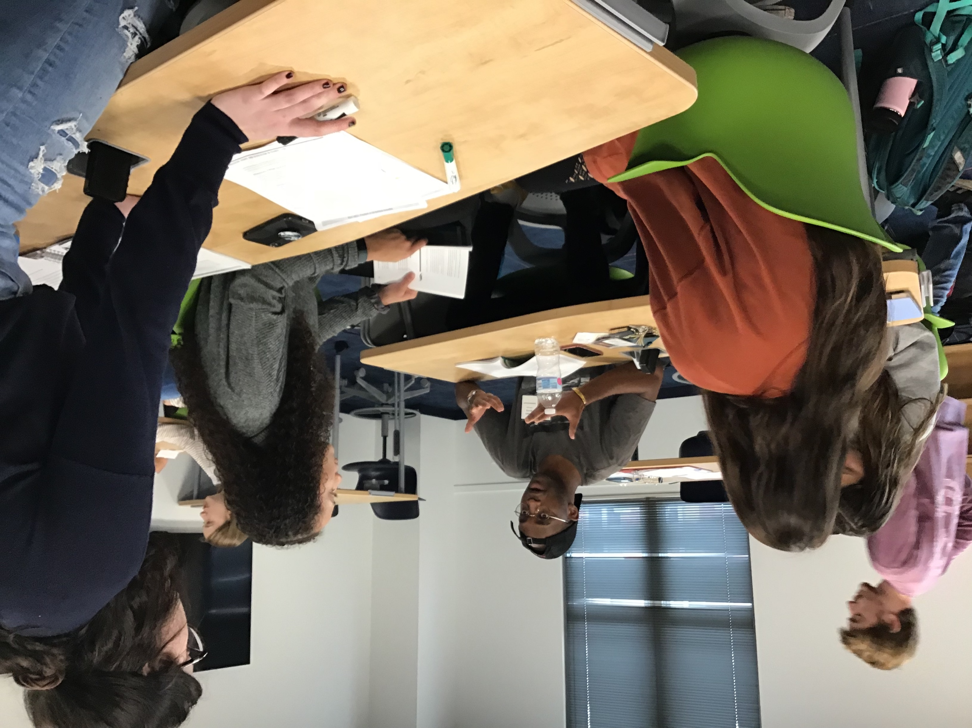
What is Reacting to the Past?
Readings
Critical thinking, problem solving
Group work
Collaborative interaction, teamwork
Oral Presentations
Persuasive speaking, research, negotiation
Writings
Persuasive writing, empathy, negotiation

Slide 3
Preparing for the game:
General guidelines
Game Master:
  Download the GM book (free on Barnard RTTP website)
  Prepare students with background readings
  Introduce speaking and – as desired – writing aids →
Students:
  Read the game book for historical context
  Understand the primary documents and their relationship to the characters
  Read and assimilate role sheet; begin to put your character into the context

Slide 4
Preparing for the game: Readings
Critical thinking, problem solving
Game prep:
Readings
Guidelines
Schedules
Read your rolesheet carefully to situate your character!
Understand your background
Understand your objectives
  List them out and prioritize them
  Begin to think about allies
  Keep them a secret!!!
Understand your faction
  Who are the other members?
  Where do you fit in?
Develop a list of potential allies
Add image from historical database

Slide 5




Preparation – Texts
Textbooks
Primary sources
ECCO; EBCO; library orientation; other
Speech, writing rubrics
Handouts:
  Role sheets
  Game Master’s Newsletter

Slide 6
Preparing for the game:
Oral Presentations
Persuasive speaking, teamwork, negotiation
Speeches
Consult the session schedules for your topics;
Begin compiling sources;
Write a rough draft;
Practice out loud for timing, ease of presentation;
  Watch Lily Lamboy videos on You Tube
Review rubric for key components;
Make final revisions
Place in D2L file → Assignments/Speech

Slide 7
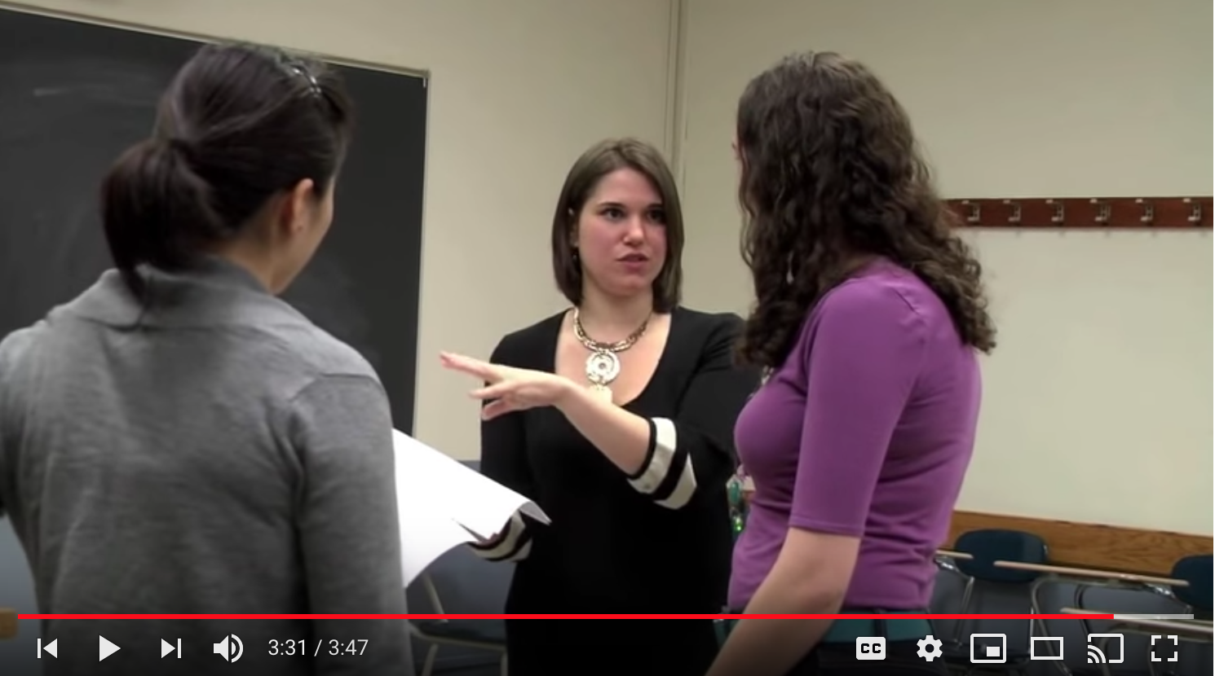
Lily Lamboy videos
Videos to assist with Public Speaking
  Intro and Set Up
  Eye Contact
  Posture
  Gestures
  Pacing
  Fluency
  Volume
  Tone
https://www.youtube.com/playlist?list=PLmeMTbv3jElgDY4JCpbzFWc5xwZqqGEDJ

Slide 8
A Critical Thinking Guideline:
The following is not an outline but a critical thinking illustration of how claims are backed up by reasons supported by evidence.
An INTRODUCTION which
Establishes common ground between audience & writer
Presents the problem and convinces audience of its significance
States the CLAIM
REASON 1
--Evidence
REASON 2 (3, 4, etc.)
--Evidence
CONSIDERATION OF COUNTER-ARGUMENTS (at appropriate point)
--Grant or Rebuttal
CONCLUSION
A clear structure sharpens your message. When you submit your essay, be sure that it contains a real introduction and a real conclusion, surrounding a body in which you develop your main points. But sometimes you have nothing to say, or you do not want to reveal your thoughts to members of opposing political factions. If you have nothing to say, or if you wish to confuse the reader and conceal your real purpose, you should employ a complicated, convoluted structure or none at all. Only use this type of structure if it truly advances the goals of your faction in the game, but understand that confusing the indeterminates may hinder your goals.

Slide 9
Setting up the game; historical context
The game begins at a specific moment representing a historic point of decision or change (i.e. drafting the French Constitution, gathering for protests in 1919 NYC, convening of the retribution courts in South Africa).
You cannot change the history of events that came before this date (see timeline pp 15-18);
You do not know the events that come after this date;
You are familiar with the core texts that have been written and circulated (primary documents).

Slide 10
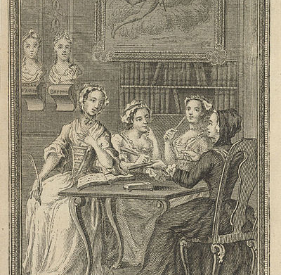
During the game …
Key learning objectives
Communication is key!!!
Persuasive writing
Public speaking
Critical thinking
Teamwork
Negotiation
Problem solving
Collaboration
Adapting to changing circumstances
Working under pressure to meet deadlines

Slide 11
During the game…
Students preside over class sessions;
Players sit in the appropriate section (see p. 52);
Speakers respect the “podium rule” (p. 11);
Everyone supports their faction;
Everyone courts the indeterminates.
Review the readings:
  Make sure that you review materials as you prepare for debates, speeches, and journals.
Know the guidelines:
  Read the game book regularly;
  Understand the rules (and the opportunities!)
Be present and participate:
  Your faction is counting on you and your votes;
  Simply voting is not participating!

Slide 12
Class Participation Rubric
Class Participation Rubric : French Revolution Game:
A: Attended all or most of the time. Participated frequently. Participation almost always addressed pertinent issues, and demonstrated a clear understanding of the dynamics of the game. Participation frequently or always integrated readings into the arguments made by the character, demonstrated a clear sense of the student’s “character” and the way that character would have reacted to game events. In general, convincingly demonstrated thorough understanding of the game and the readings.
B: Attended all or most of the time. Participated frequently. Participation usually addressed pertinent issues regarding the game. Readings not always integrated into the arguments made during the games, or didn’t always demonstrate complete understandings of the readings.
C: Attended all or most of the time. Participated reasonably often, but participation indicated lack of complete understanding of the game and seldom cited readings OR participated occasionally, but in ways that demonstrated clear understanding of the course of the game and used the ideas of the readings successfully in addressing game issues.
D: Attended most of the time, but seldom participated. Participation indicated little understanding of the game or of the readings upon which the game was based.
F: Rarely attended, said little, openly ignored game or game requirements.
NOTE: Participation means speaking, not voting.

Slide 13
Let’s play!
Individual role review;
Topic for the day is announced; find your faction and start strategizing;
Debate, speeches, protests, and other interruptions;
Vote on the question: bomb the church?
Debriefing/ Q & A

