Slide 1
Introduction to Spark

Slide 2
MapReduce enables big data analytics using large, unreliable clusters
Rooms to further improvement with MapReduce
- iterative algorithms,
- interactive ad-hoc queries

Slide 3
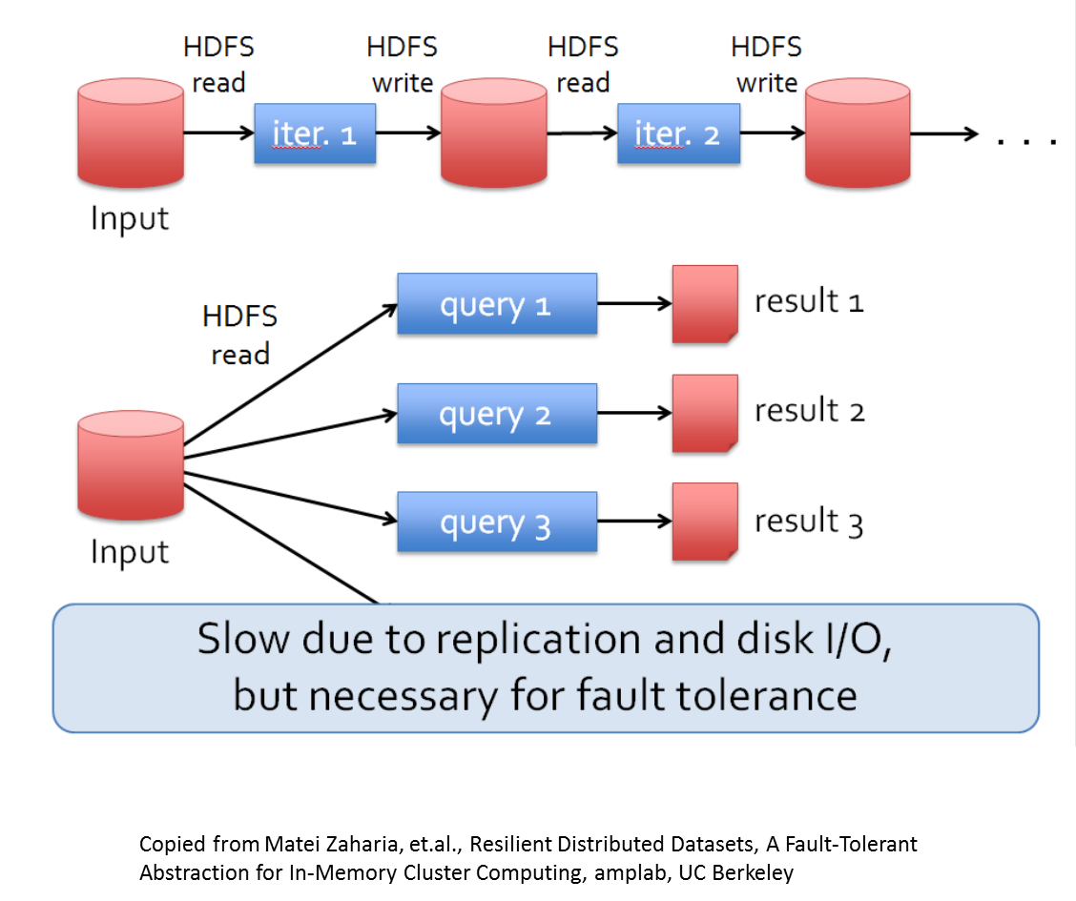

Slide 4
In another words, MapReduce lacks efficient primitives for data sharing
This is where Spark comes into the picture – instead of load the data from disk for every query, why not do In-Memory data sharing?

Slide 5
Here is how Spark addresses this issue: Resilient Distributed Datasets (RDDs)
RDD allows apps to keep working sets in memory for reuse.

Slide 6
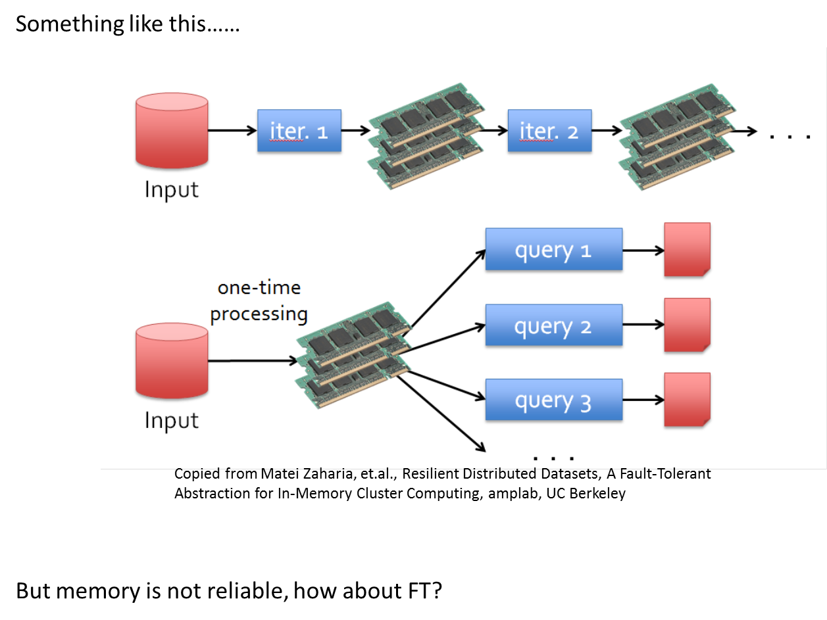

Slide 7
Spark’s solution: Resilient Distributed Datasets (RDDs)
  Immutable, partitioned collections of objects
  Created through parallel transformations on data in stable storage
  Can be cached for efficient reuse.
Cited from Matei Zahria, Spark fast, interactive, language-integrated cluster computing, amplab, UC Berkeley

Slide 8
Spark API
Spark provides API to support the following languages: Scala, Java, Python, R
Data Operations
  Transformations
  actions

Slide 9
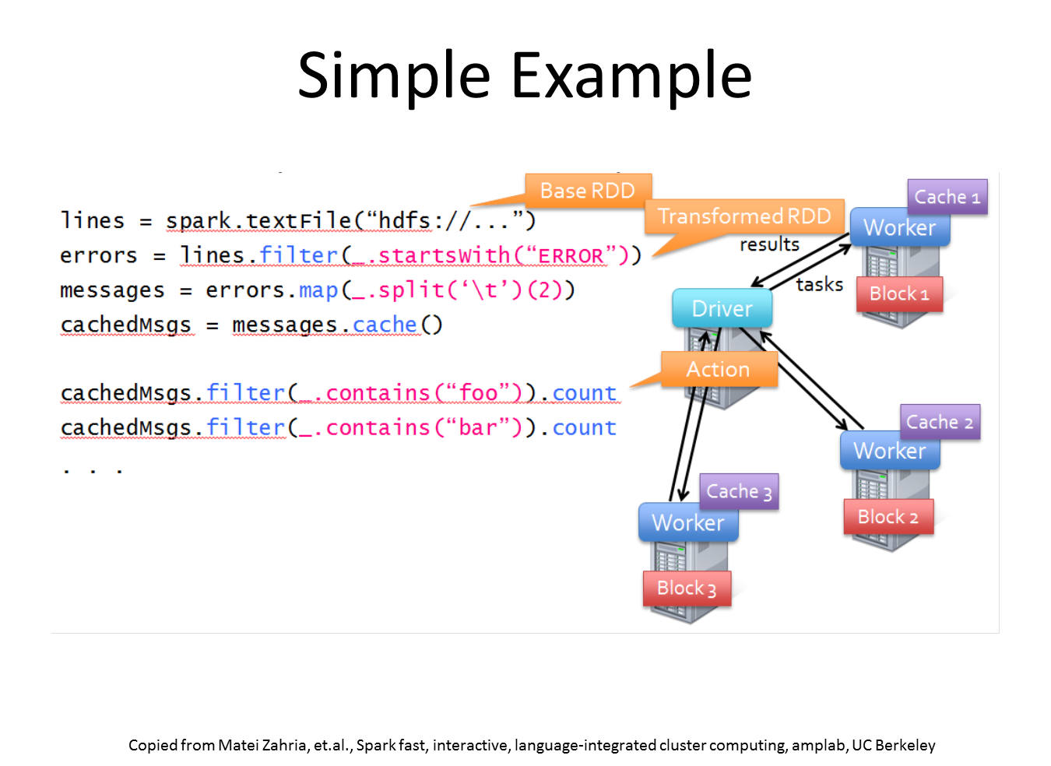

Slide 10
val data = spark.textFile(...).map(readPoint).cache()
var w = Vector.random(D)
for (i <- 1 to ITERATIONS) {
val gradient = data.map(p =>
(1 / (1 + exp(-p.y*(w dot p.x))) - 1) * p.y * p.x
).reduce(_ + _)
w -= gradient
}
println("Final w: " + w)
Copied from Matei Zahria, et.al., Spark fast, interactive, language-integrated cluster computing, amplab, UC Berkeley

Slide 11
WordCount
val counts = sc.textFile(“hdfs://…”).flatMap(line=>line.split(“”)).map(word=>(word, 1L)).reduceByKey(_+_)

Slide 12
