Slide 1
YARN

Slide 2
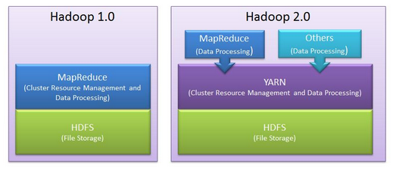
How Hadoop 1.0 vs 2.0
http://itsmyxprience.blogspot.com/2015/08/apache-hadoop-mapreduce.html

Slide 3
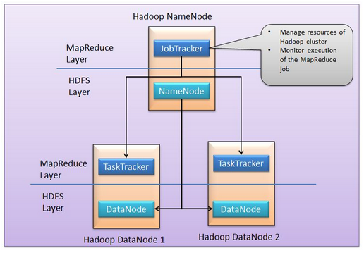
http://itsmyxprience.blogspot.com/2015/08/apache-hadoop-mapreduce.html

Slide 4
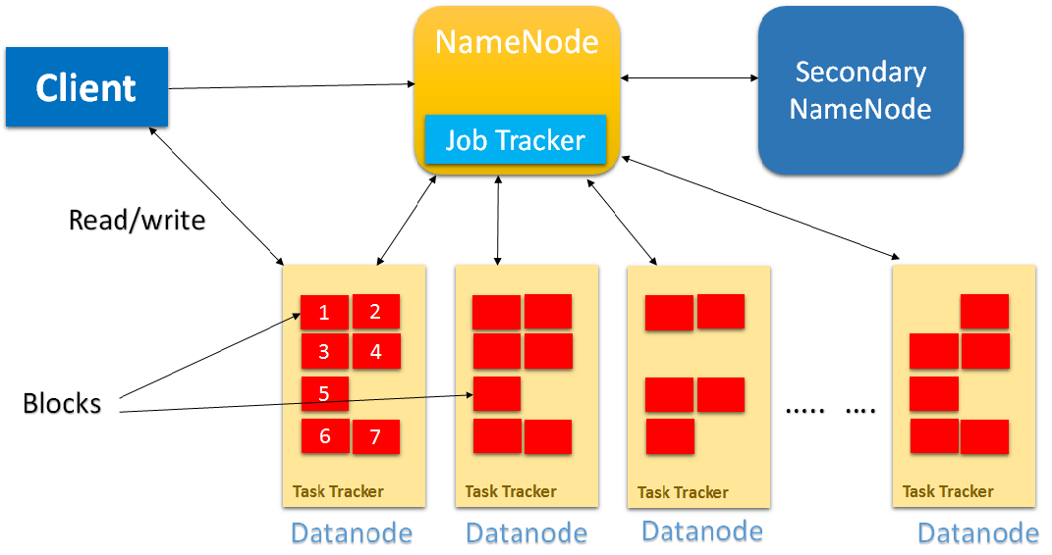
https://bigdatainnovation.blogspot.com/2014/09/hadoop-10-vs-hadoop-20.html

Slide 5
Issues:
  JobTracker is a single point of failure. Any failure kills all queued or running jobs
  A single JobTracker becomes a bottleneck for scalability (Hadoop 1 cannot have a cluster size of more than 4000 nodes and cannot run more than 40000 concurrent tasks)
  Hadoop 1 can only support Mapreduce jobs

Slide 6
YARN
https://www.youtube.com/watch?v=fCoivEBDmYA

Slide 7
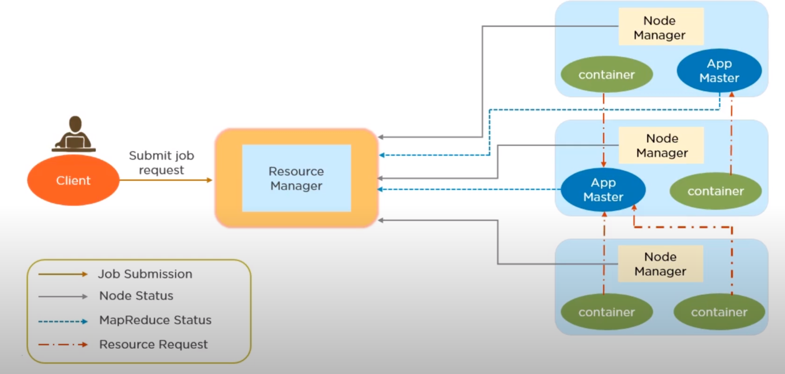
https://www.youtube.com/watch?v=fCoivEBDmYA

Slide 8
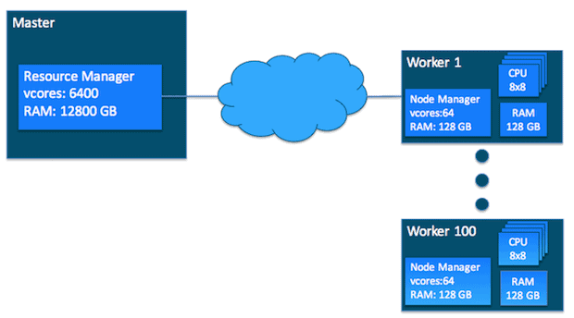
https://blog.cloudera.com/untangling-apache-hadoop-yarn-part-1-cluster-and-yarn-basics/

Slide 9
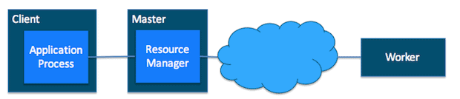
Job Working Process
1. The client submits a job to the ResourceManager of the Hadoop cluster

Slide 10
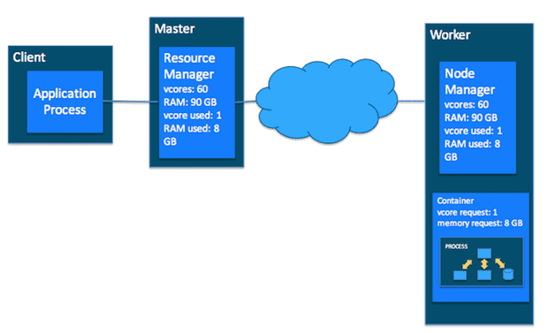
2. The ResourceManager makes a single container request on behalf of the application:

Slide 11
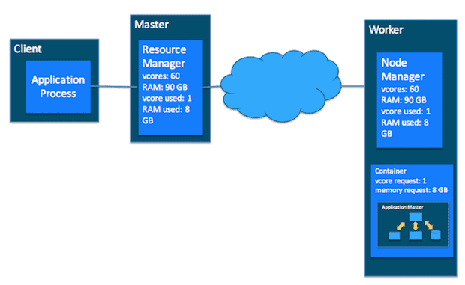
3. The ApplicationMaster starts running within that container

Slide 12
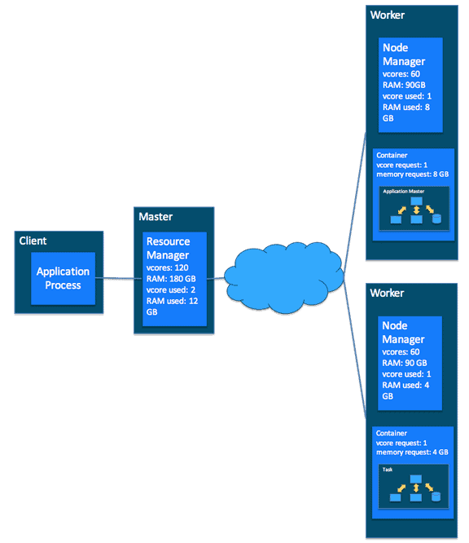
4. The ApplicationMaster requests subsequent containers from the ResourceManager that are allocated to run tasks for the application. Those task containers communicate with ApplicationMaster for the job status.

Slide 13
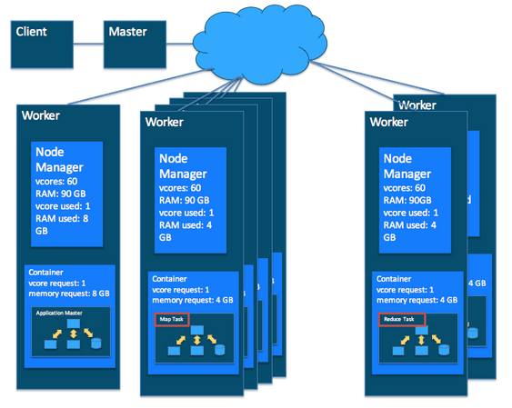
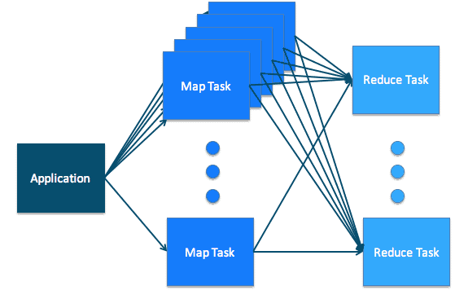
Example: A MapReduce Job

