Slide 1
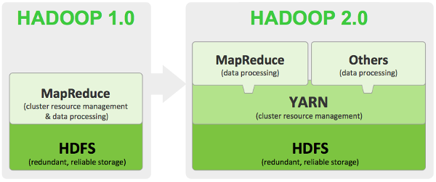
MapReduce Introduction

Slide 2

MapReduce Programming Model – Mappers and Reducers
In MapReduce, the programmer defines a mapper and a reducer with the following signatures:
Implicit between the map and reduce phases is shuffle, sort, and group by operation on intermediate keys.
Output key-value pairs from each reducer are written persistently back onto the distributed file system.

Slide 3
WordCount Example
Given the following file that contains two documents
#input file
1 Algorithm design with MapReduce
2 MapReduce Algorithm
3 MapReduce Algorithm Implmentation
4 Hadoop Implementation of Hadoop
We would like to count the frequency of each uniqe word in this file.

Slide 5
Two blocks of the input file
Computing node 1: Invoke map function on each key value pair
Computing node 2: Invoke map function on each key value pair
#iblock 1
1 Algorithm design with MapReduce
2 MapReduce Algorithm
#iblock 2
1 MapReduce Algorithm implementattion
2 Hadoop implmentation of MapReduce
(algorithm, 1), (design, 1), (with, 1), (MapReduce, 1) (MapReduce, 1), (algorithm, 1), (implementation, 1)
(MapReduce, 1), (algorithm, 1) (Hadoop, 1), (implementation, 1), (of, 1), (MapReduce, 1)
Shuffle and Sort
(algorithm, [1, 1, 1]), (desgin, [1]), (with, [1]), (MapReduce, [1, 1, 1, 1]), (implementation, [1, 1]), (Hadoop, [1], (of, [1])
(implementation, [1, 1]), (MapReduce, [1, 1, 1, 1]), (of, [1]), (with, [1])
Computing node 4 – Reducer 2: : Invoke reduce function on each pair
(algorithm, [1, 1, 1]), (desgin, [1]), (Hadoop, [1])
Computing node 3 – Reducer 1: Invoke reduce function on each pair
(algorithm, 3), (design, 1), (Hadoop, 1)
(implementation, 2), (MapReduce, 4), (of, 1), (with, 1)

