Slide 1
Introduction to Zookeeper

Slide 2
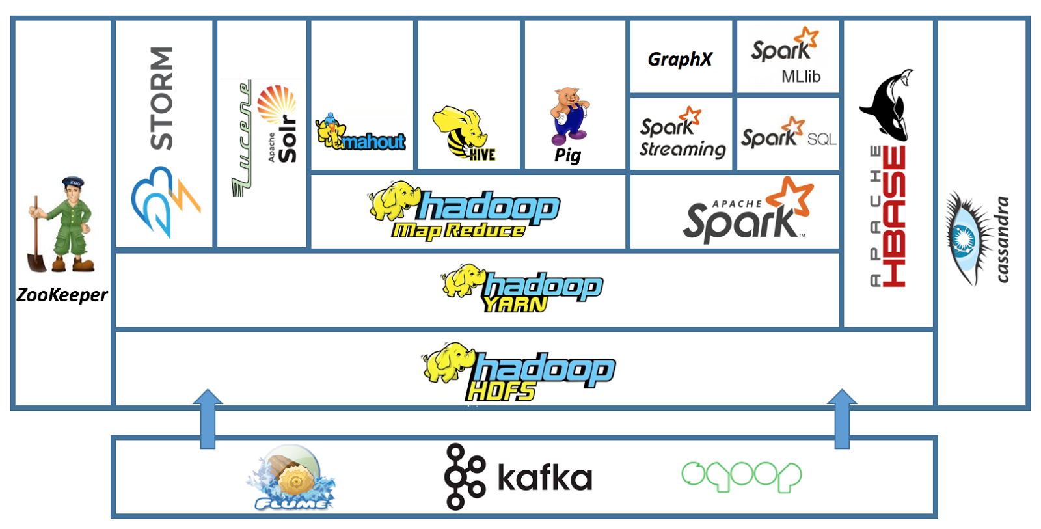

Slide 3
What is zookeeper
Zookeeper is a centralized coordination service that coordinates distributed applications across a cluster.
How Zookeeper coordinates distributed applications?
It allows a distributed application to coordinate processes across the cluster with each other through a shared hierarchical name space of data registers

Slide 4
HBase
  Use ZooKeeper for master election, server lease management, and coordination between servers
Yarn
  Use ZooKeeper for high availability of ResourceManager
HDFS
  Use Zookeeper for Namenode failover process
Flume
  Configuration Managmement

Slide 5
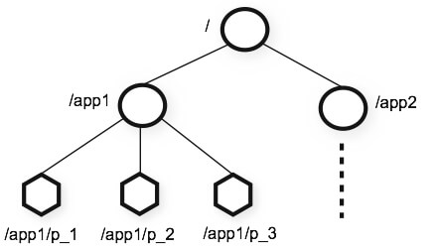
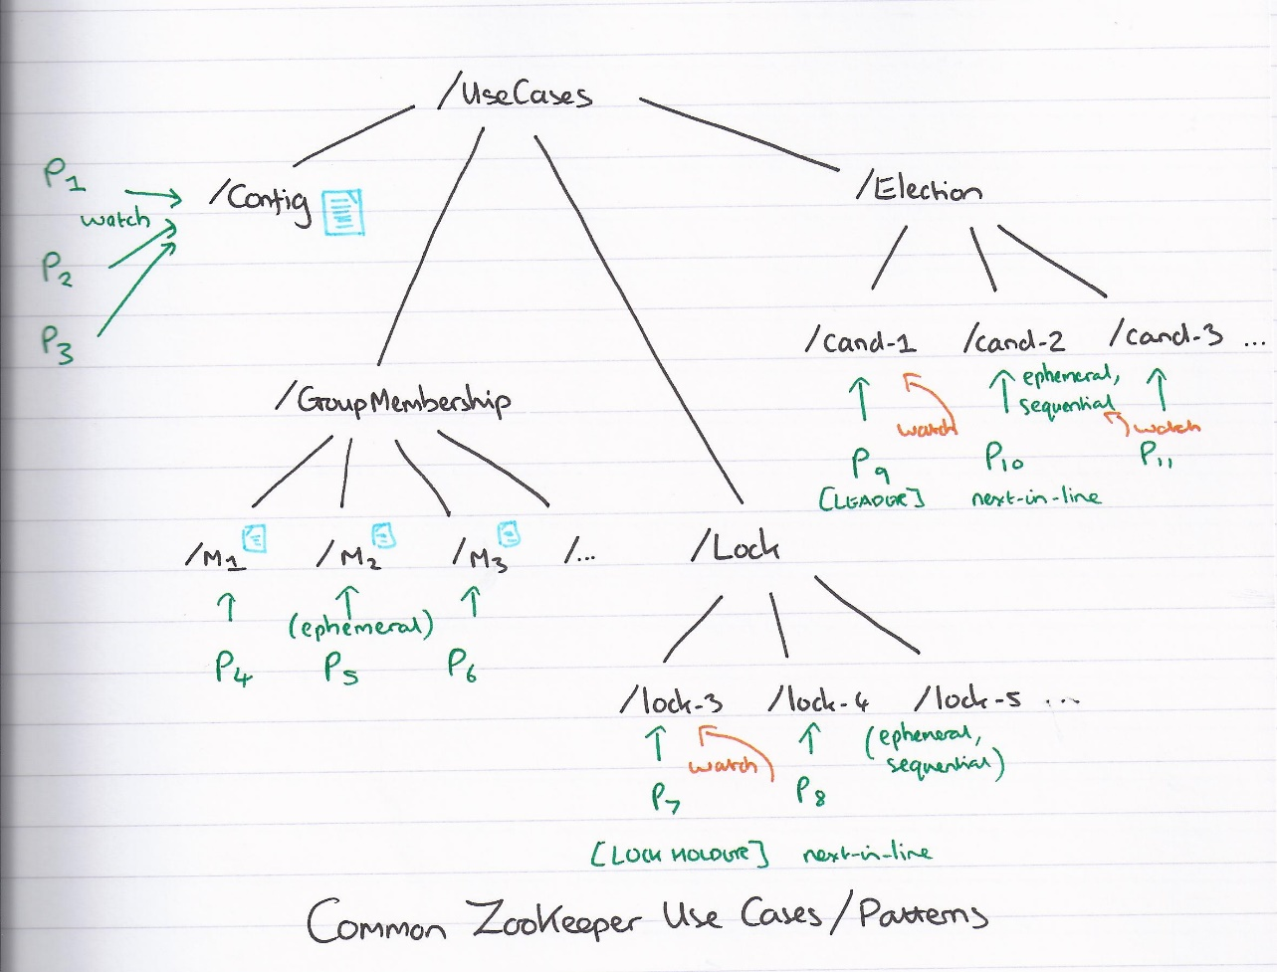
The Data Model of Zookeeper
Znode: Persistent, Ephemeral, Sequential
https://blog.acolyer.org/wp-content/uploads/2015/01/zookeeper.jpg

Slide 6
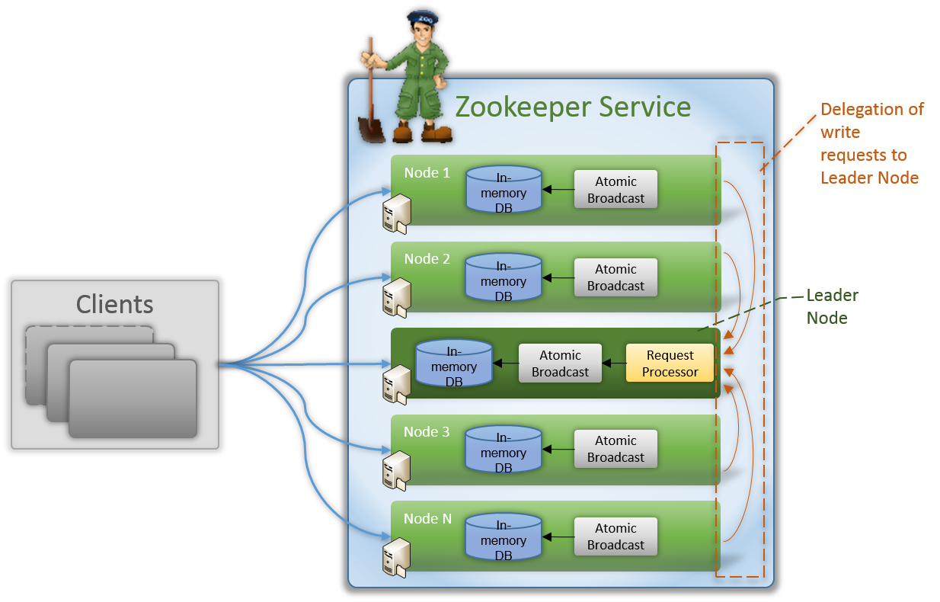
The Architecture of Zookeeper

Slide 7
If a client wants to read a particular znode, it sends a read request to the node with the znode path and the node returns the requested znode by getting it from its own database. For this reason, reads are fast in ZooKeeper ensemble.
If a client wants to store data in the ZooKeeper ensemble, it sends the znode path and the data to the server. The connected server will forward the request to the leader and then the leader will reissue the writing request to all the followers. If only a majority of the nodes respond successfully, then the write request will succeed and a successful return code will be sent to the client. Otherwise, the write request will fail. The strict majority of nodes is called as Quorum.

Slide 8
The Workflow of Zookeeper
A client tries to connect to a server to perform read/write operations
If the server doesn’t acknowledge the request, the client tries to connect to another server
If a server accept the request, a session is established and a session id is assigned to the client. The server then sends an acknowledge to the client
The client sends signals to the server at an interval (called heartbeat) specifying that client is alive.
The client then performs read/write operations on the server.
When ensemble doesn’t receive heartbeats from a client for more than a period specified at the starting of the service, it decides that the client died and the session timeouts, and the ephemeral znodes created during that session get deleted.

Slide 9
Watches – when a client reading a particular znode, it can set watches with Zookeeper. Then watches send a notification to the registered client for any of the znode changes.

Slide 10
Functions provided by zookeeper
  Configuration management
  Group membership
  Synchronization
    Competition
    Lock
  Leader election

Slide 11
