Slide 1
HBase Database Design

Slide 2
Scenario 1
Assume we need to design a database for an ecommerce website.
- Items
- Users
- Users like items

Slide 3
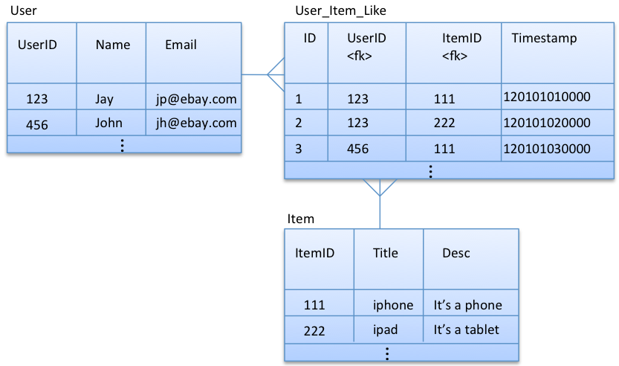
We first start with ER analysis

Slide 4
Query Needs 1
Assume our application needs the following queries:
  Get user by user id
  Get item by item id
  Get all the item ids that a particular user id likes
  Get all the user ids who like a particular item id

Slide 5
Design Solution 1: Build A Separate Table for Each Foreign Key
User
Item
 | U_Info
UserID (RowKey) | Name | Email | …
123 | Jay | jay@ebay.com
 | I_Info
ItemID (RowKey) | Title | Decription | …
111 | iPhone | It is a phone
Item_Liked_By
User_Likes
 | Liked_By
ItemID (RowKey) | 123 | 456 | …
111 | 120101010000 | 120101030000
 | Likes
UserID (RowKey) | 111 | 222 | …
123 | 120101010000 | 120101020000

Slide 6
This model supports all the following queries
  Get user by user id
  Get item by item id
  Get all the item ids that a particular user id likes
  Get all the user ids who like a particular item id

Slide 7
Query needs 2
Assume our application needs the following queries:
  Get user by user id
  Get item by item id
  Get all the item ids and titles that a particular user id likes
  Get all the user id and names who like a particular item id

Slide 8
Design Solution 1 updates: Further de-normalization into relationship tables
User
Item
 | U_Info
UserID (RowKey) | Name | Email | …
123 | Jay | jay@ebay.com
 | I_Info
ItemID (RowKey) | Title | Decription | …
111 | iPhone | It is a phone
Item_Liked_By
User_Liking
 | Liked_By
ItemID (RowKey) | 123 | 456 | …
111 | 120101010000: Jay | 120101030000: John
 | Liking
UserID (RowKey) | 111 | 222 | …
123 | 120101010000: Iphone | 120101020000: Ipad

Slide 9
In this model, title and username are de-normalized in relationship tables (Item_liked_by and User_liking) respectively. This allows us to efficiently query all the item titles liked by a given user, and all the user names who like a given item.

Slide 10
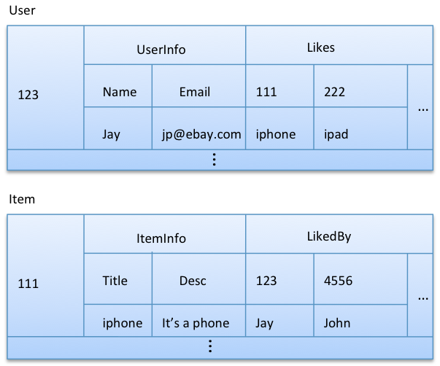
Design Solution 2: De-normalizing Relationship into Entity Tables

Slide 11
Another query needs ?
What if we want to get all the information (title, desc, price, etc.) about the items liked by a given user?
But we need to ask ourselves whether we really need this query, particularly for this use case. Once a user login, the application can show all the item titles that a user likes and pull additional information only when the user asks for it (by clicking on a title). So, it’s better not to do extreme de-normalization for this use case.

Slide 12
Summarizing
STEP 1: ER Analysis - Initial design
STEP 2: Query Needs – Adjust designs

Slide 13
Scenario 2
Design a HBase Model for Simplified Twitter System
  Users
  Tweets
  User tweets
  User follows user

Slide 14
ER Analysis
m
1
m
USERS
Tweets
n
UName Email Picture …
TID Meg TimeStamp UName (f_key)
Following
Uname (f_key) Fname (f_key) Timestamp

Slide 16
Query needs
Get a user record by username
Get all the usernames that follows a given username
Get the usernames that are followed by a given username
Get a tweet from a tweet ID
Get a timeline of a specific user’s tweets

Slide 17
User_Info Tweets
Username email picture T1110, T2210, T3333 ….
04/15/2021/tt

