Slide 1
Spark and Yarn

Slide 2
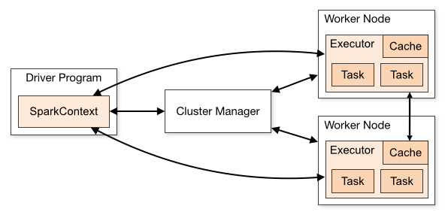
Spark Standalone
Driver
Cluster Manager
file
A simple cluster manager included with Spark
Executor1
p1
Executor3
P3
Executor2
P2
https://sujithjay.com/spark/with-yarn

Slide 3
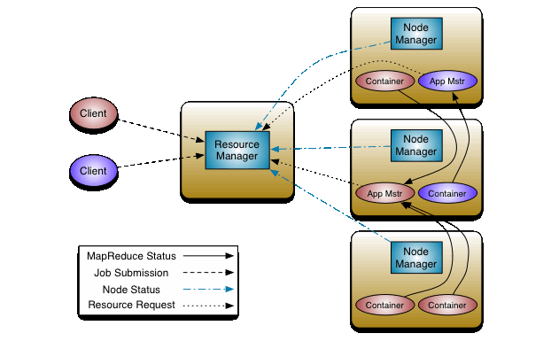
Recall YARN
Executor 1
Other server 1
Other server 2
1280 M - 128M
Other server 3
Executor 2
https://sujithjay.com/spark/with-yarn

Slide 4
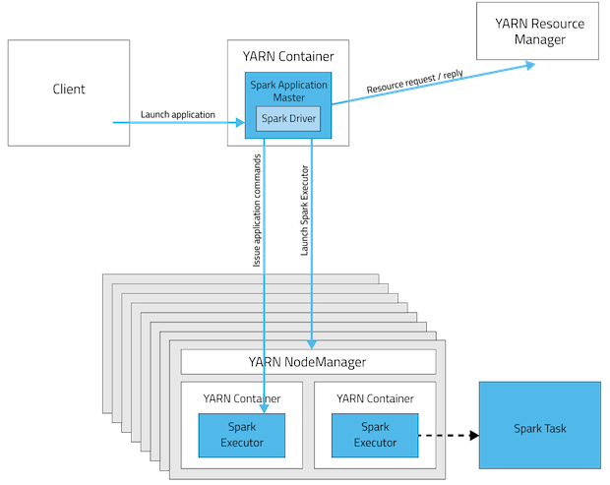
https://sujithjay.com/spark/with-yarn

