Slide 1
Spark Hands On

Slide 2
Example 1: Analyzing the Log.
val file = sc.textFile("hdfs://sandbox-hdp.hortonworks.com:8020/tmp/littlelog.csv")
file.collect().foreach(println)
val fltr = file.filter(_.length > 0)
val keys = fltr.map(_.split(",")).map(a => a(5))
val stateCnt = keys.map(key => (key,1))
stateCnt.collect().foreach(println)
val lastMap = stateCnt.countByKey

Slide 3
Put Interactive Scala Statement in a File
Run the file on scala shell
scala> :load logAnalyzer.scala

Slide 4
Wordcount example
var count = file.flatMap(Record=>Record.split(" ")).map(W=>(W, 1L)).reduceByKey(_+_).collect

Slide 5
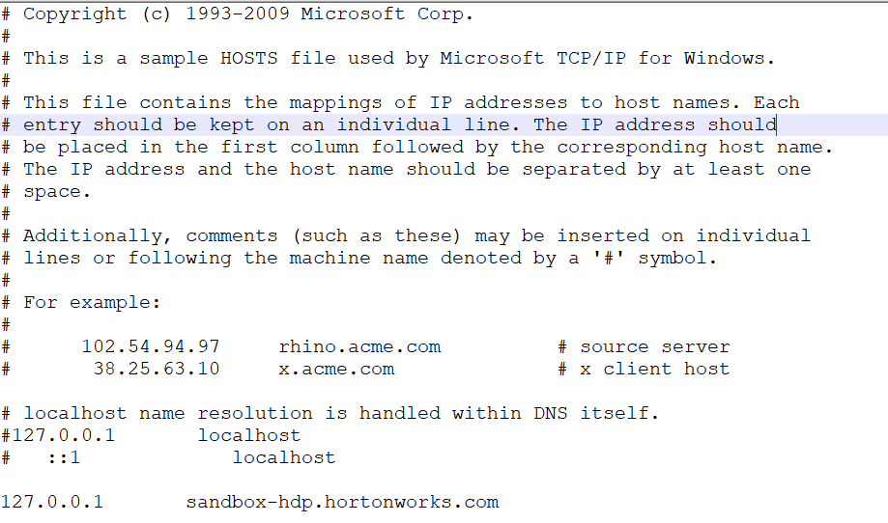
Appendix
Edit hosts file
Go to C:\Windows\System32\drivers\etc

Slide 6
Load littlelog.csv to hdfs
  hadoop fs -put /tmp/littlelog.csv /tmp/

