Slide 1

Ch.05 - Displays

Slide 2
Optoelectronics
Optoelectronics: Study and application of electronic devices that produce, detect and control light
Optoelectronic devices are electrical-to-optical or optical-to-electrical signal converters, or are devices that use such converters in their operation
Optoelectronics is based on the quantum mechanical effects of light on semiconductor materials

Slide 3
Working principle of Light emitting devices
Light- emitting devices, such as lamps and light- emitting diodes (LEDs), create EM waves (e.g., light) by using an electric current to excite electrons into higher energy levels
When an electron changes energy levels, a photon is emitted
Notes:
https://en.wikipedia.org/wiki/Sound

Slide 4
Wave-Particle Duality and the Photoelectric Effect
  Light-detecting devices are designed to take incoming EM waves and convert them into electrical signals
  This is usually accomplished by using EM waves to liberate/free bound electrons from atoms of semiconductor materials. These ‘free’ electrons result in electrical signals

Slide 5
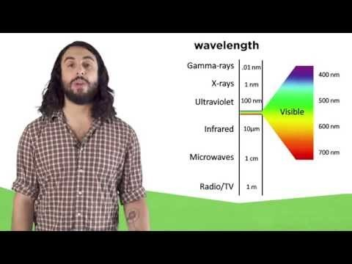
Wave-Particle Duality and the Photoelectric Effect
  https://www.youtube.com/watch?v=MFPKwu5vugg
Notes:
https://en.wikipedia.org/wiki/Sound

Slide 6
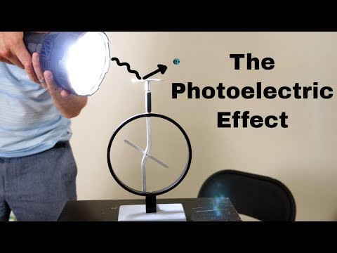
Wave-Particle Duality and the Photoelectric Effect
  https://www.youtube.com/watch?v=oYnp0WZDhYQ
Notes:
https://en.wikipedia.org/wiki/Sound

Slide 7
EM waves display wave-particle duality
Concept in quantum mechanics that states that all particles exhibit a wave nature and vice versa
Albert Einstein wrote:[1]
“It seems as though we must use sometimes the one theory and sometimes the other, while at times we may use either. We are faced with a new kind of difficulty. We have two contradictory pictures of reality; separately neither of them fully explains the phenomena of light, but together they do.”
Notes:
[1]. Albert Einstein, Leopold Infeld (1938). The Evolution of Physics: The Growth of Ideas from Early Concepts to Relativity and Quanta. Cambridge University Press. Bibcode:1938epgi.book.....E. Quoted in Harrison, David (2002). "Complementarity and the Copenhagen Interpretation of Quantum Mechanics". UPSCALE. Dept. of Physics, U. of Toronto. Retrieved 2008-06-21.

Slide 8
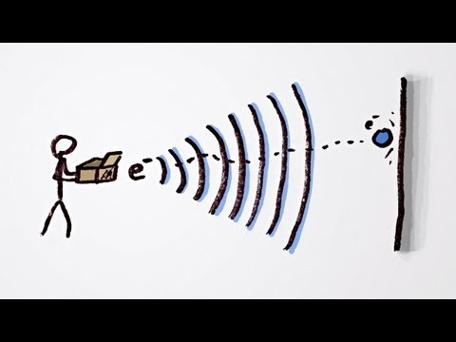

Wave-Particle duality using analogy
https://www.youtube.com/watch?v=Q_h4IoPJXZw
https://www.youtube.com/watch?v=_riIY-v2Ym8
Notes:
https://upload.wikimedia.org/wikipedia/commons/e/e4/Wave-particle_duality.ogv

Slide 9
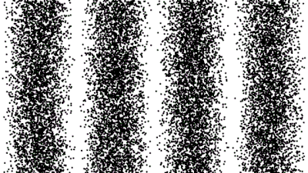
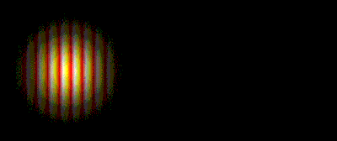
Visualization of wave-particle duality
https://upload.wikimedia.org/wikipedia/commons/e/e4/Wave-particle_duality.ogv
A quantum particle is represented by a wave packet.
Particle impacts make visible the interference pattern of waves.
Photon (a wave packet) is a short "burst" or "envelope" of localized wave that travels as a unit/particle
Notes:
https://upload.wikimedia.org/wikipedia/commons/e/e4/Wave-particle_duality.ogv

Slide 10
Photon
Photons are the elemental units of electromagnetic radiation
White light, for example, is composed of a number of different kinds of photons; some are blue photons, some are red photons, etc.
It is important to note that there is no such thing as a white photon. Instead, when the combination of the various colored photons interacts with our eye, our brain perceives what we call white light.

Slide 11
Quantum Mechanics and Classical Mechanics
Quantum mechanics is a fundamental theory in physics that provides a description of the physical properties of nature at the scale of atoms and subatomic particles
Classical mechanics is a collection of theories that existed before the advent of quantum mechanics
  - It describes many aspects of nature at an ordinary (macroscopic) scale, but is not sufficient for describing them at small (atomic and subatomic) scales
  Most theories in classical mechanics can be derived from quantum mechanics as an approximation valid at large (macroscopic) scale
Notes:
https://en.wikipedia.org/wiki/Sound

Slide 12
Quantum Mechanics and Classical Mechanics
Quantum mechanics differs from classical physics in that energy, momentum, angular momentum, and other quantities are restricted to discrete values (quantized values)
Objects have characteristics of both particles and waves (wave–particle duality)
There are limits to how accurately the value of a physical quantity can be predicted prior to its measurement (the uncertainty principle)
Quantum Mechanics for Dummies, https://www.youtube.com/watch?v=JP9KP-fwFhk

Slide 13
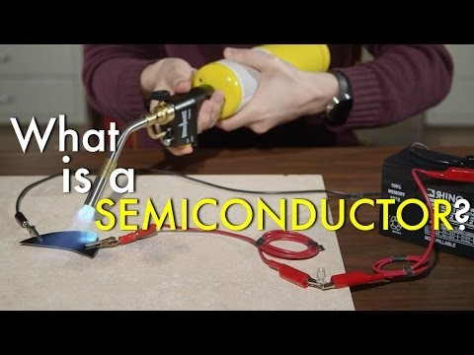
What Is A Semiconductor?
https://www.youtube.com/watch?v=gUmDVe6C-BU
Notes:
https://en.wikipedia.org/wiki/Sound

Slide 14
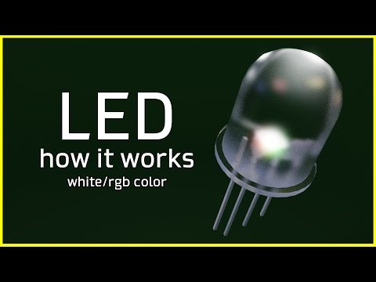
How does an LED works?
https://www.youtube.com/watch?v=9BDTtcRMxpA
Notes:
https://en.wikipedia.org/wiki/Sound

Slide 15
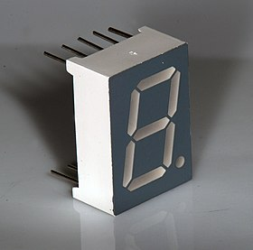
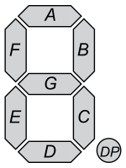
LED Displays
LED displays come in three basic configurations:
          1) numeric (numbers)
          2) alphanumeric (numbers and letters)
          3) dot-matrix forms
Numeric LED aka 7-segment displays
Consist of seven LED segments
Seven-segment LED displays are most frequently used to generate numbers (0–9)
They also can be used to display hexadecimal (0–9, A, B, C, D, E, F)
Notes:
https://en.wikipedia.org/wiki/Seven-segment_display

Slide 16
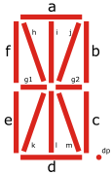
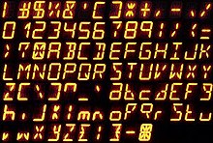
14-segment LED Displays
The 14-segment, 16-segment used for alphanumeric displays
Expansion of the 7-segment display, having an additional four diagonal and two vertical segments with the middle horizontal segment broken in half
Notes:
https://en.wikipedia.org/wiki/Fourteen-segment_display

Slide 17
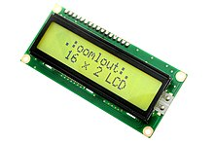
Dot-matrix LED Displays
Dot matrix display is both alphanumeric and graphic—you can display unique characters and simple graphics
A 16×2-character dot matrix display, where each character is made from a grid of 5×7 dots
A dot matrix is a 2D matrix of dots that can represent images, symbols, or characters
Here images are estimated using a discrete set of dots
The more dots that are used, the more clear and accurate the image representation is
Used for electronic displays, such as computer monitors and LED screens
Notes:
https://en.wikipedia.org/wiki/Seven-segment_display

Slide 18
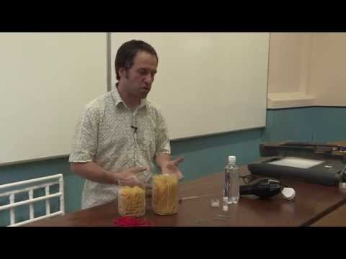
What are Liquid Crystal Molecules?
Materials that display both liquid and crystals characteristics depending on external parameters
https://www.youtube.com/watch?v=iJks-gapzkk

Slide 19
Liquid-Crystal Displays
LCDs are ideal for low-power applications
One disadvantage with LCDs is their slow switching speeds (the time it takes for a new digit/character to appear)
Three types of LCDs
Reflective LCD: Uses a backmirror and instead of using electric current to generate light, it uses light that is already externally present (such as sunlight, room lighting)
Transmissive LCD: uses a backlight that “transmits/diffuses” through front layers of LCD
Transflector LCD: combination of (1) and (2)

Slide 20
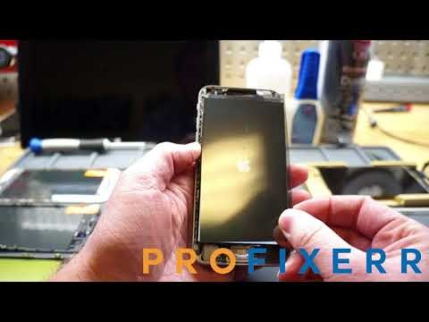
Liquid-Crystal Displays
A LCD is a passive device: This means that instead of using electric current to generate light, it uses light that is already externally present (such as sunlight, room lighting, backlight)
A backlight is a form of illumination used in LCDs. It is usually the first layer from the back of LCD
Light modulators then vary the amount of light reaching the eye, by blocking/modifying its passage through the LCD material. For example, a polarizing filter can block the backlight light to produce dark regions in LCD
How does a Polarizer work?
One disadvantage with LCDs is their slow switching speeds (the time it takes for a new digit/character to appear)

Slide 21
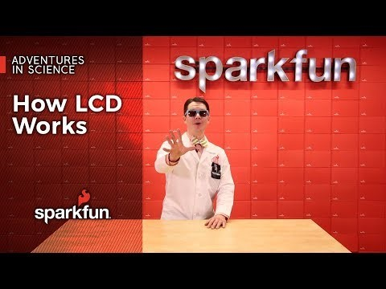
How an LCD Works
https://www.youtube.com/watch?v=VbdhbyiHX-s

