Slide 1
Spark Machine Learning (2)

Slide 2
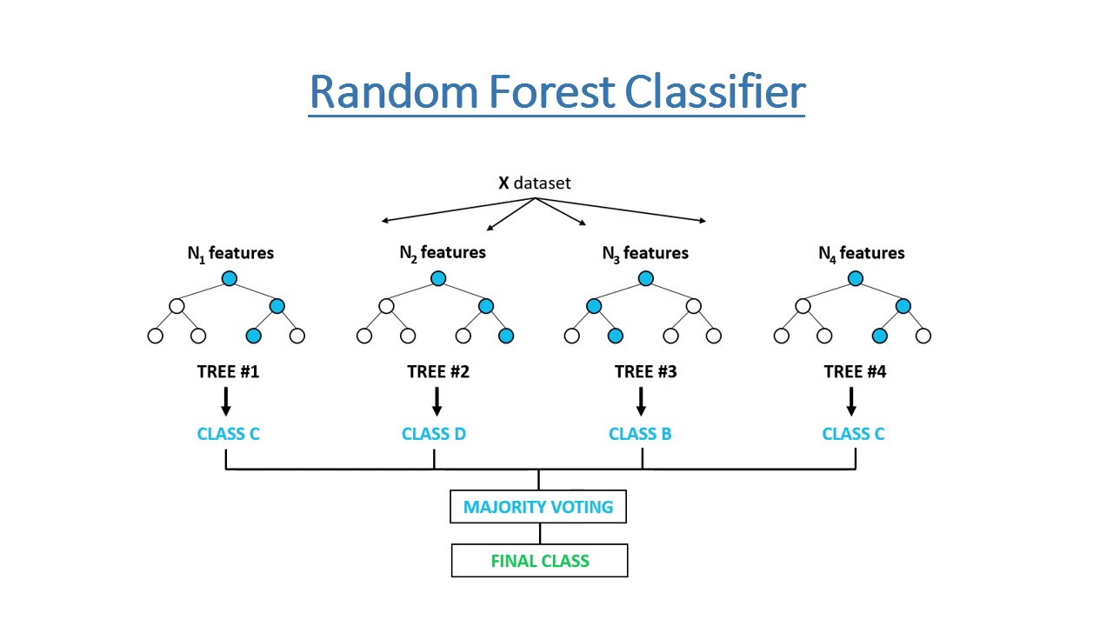
Create the machine learning model
import org.apache.spark.ml.classification.RandomForestClassifier
import org.apache.spark.ml.tuning.{ParamGridBuilder, TrainValidationSplit, CrossValidator}
import org.apache.spark.ml.evaluation.MulticlassClassificationEvaluator
// create the model
val rf = new RandomForestClassifier()
[f1, f2, f3…fn], label
10000…0000
00000…1..00
https://www.youtube.com/watch?v=goPiwckWE9M

Slide 3
Create the parameter grid
// create the param grid
val paramGrid = new ParamGridBuilder().
addGrid(rf.numTrees,Array(20,50,100)).
build()

Slide 4
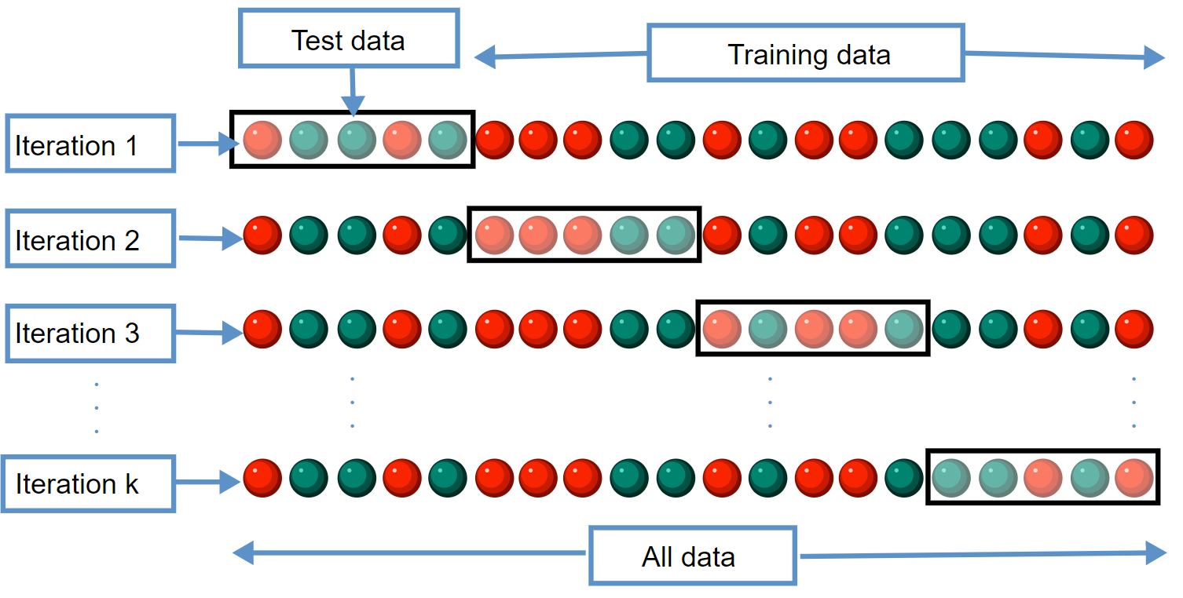
Cross-Validation
20, 50, 100
K-Cross-Validation
3
5 – Cross –Validation
10 – Cross -Validation
// create cross val object, define scoring metric
val cv = new CrossValidator().
setEstimator(rf).
setEvaluator(new MulticlassClassificationEvaluator().setMetricName("weightedRecall")).
setEstimatorParamMaps(paramGrid).
setNumFolds(10).
setParallelism(2)
// You can then treat this object as the model and use fit on it.
val model = cv.fit(training)
https://upload.wikimedia.org/wikipedia/commons/b/b5/K-fold_cross_validation_EN.svg

Slide 5
Apply to test data
val results = model.transform(test).select("features", "label", "prediction")

Slide 6
Evaluation on Testing Data
Actual labels
not certified (0) certified (1)
99622 295
1053 894
import org.apache.spark.mllib.evaluation.MulticlassMetrics
import org.apache.spark.mllib.evaluation.BinaryClassificationMetrics
val predictionAndLabels = results.
select($"prediction",$"label").
as[(Double, Double)].
rdd
// Instantiate a new metrics objects
val bMetrics = new BinaryClassificationMetrics(predictionAndLabels)
val mMetrics = new MulticlassMetrics(predictionAndLabels)
val labels = mMetrics.labels
// Print out the Confusion matrix
println("Confusion matrix:")
println(mMetrics.confusionMatrix)
0
1
Predicted labels

