Slide 1
Introduction to HBASE

Slide 2
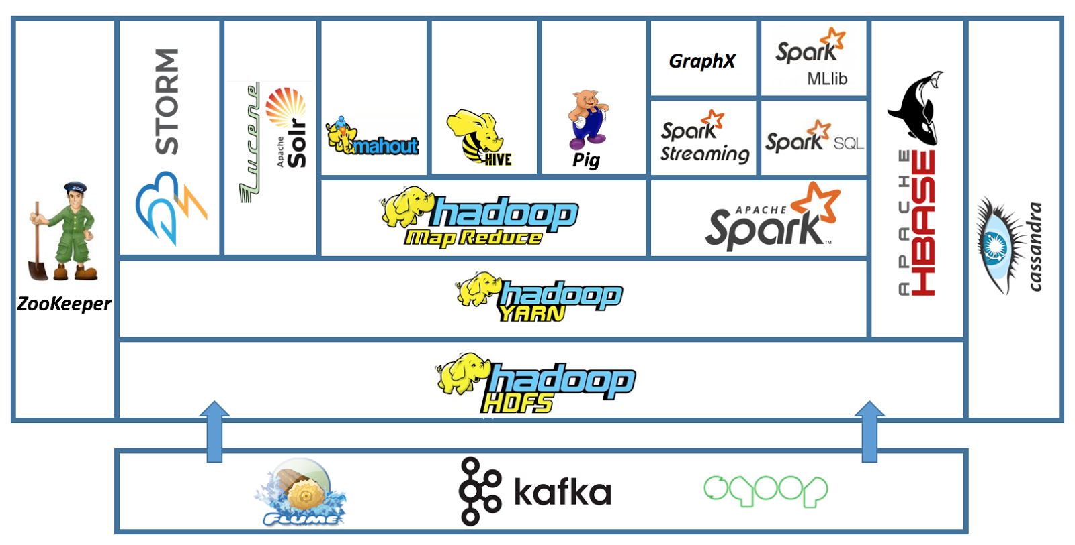

Slide 3
Why HBase
“Anybody who wants to keep data within an HDFS environment and wants to do anything other than brute-force reading of the entire file system needs to look at HBase. If you need random access, you have to have HBase."- said Gartner analyst Merv Adrian.
HBase is a NoSQL, column oriented database built on top of hadoop to overcome the drawbacks of HDFS as it allows fast random writes and reads in an optimized way.

Slide 4
HBASE Real Use Cases
Pinerest runs 38 Hbase clusters, some of which handling up to 5 million operations every second.
Boibibo uses Hbase for customer profiling
Facebook Messenger uses Hbase
Flurry, Adobe Explorys…

Slide 5
HBase Basics
Hbase provides real-time read or write access to high volume of structured or unstructured data. (3V – Velocity, Volume, Variety)
It builds upon HDFS and is more like a “Data Store” than “Database”
Not RDBMS – No (secondary indexes, triggers, SQL)
It was originally Google Big Table, designed for real-time big data applications: Fast, scalable, reliable and fault tolerant
NoSQL: No SQL - > Not Only SQL

Slide 6
HBase Data Model
HBase Table - Logic collection of rows stored in individual partitions known as Regions
HBase Row – Instance of data in a table
RowKey – Every entry in an HBase table is identified and indexed by a Rowkey
Columns – For every RowKey, an unlimited number of attributes can be stored
Column family – Data in rows is grouped together as column families and all columns are stored in a low level storage file known as HFile

Slide 7
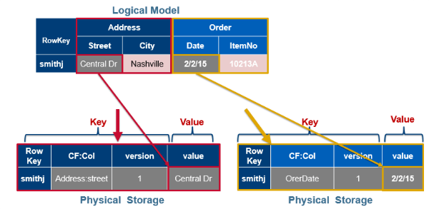
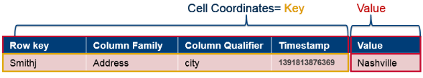
Table:Row:Family:Column:Timestamp ➔ Value
https://www.corejavaguru.com/bigdata/hbase-tutorial/data-model

Slide 8
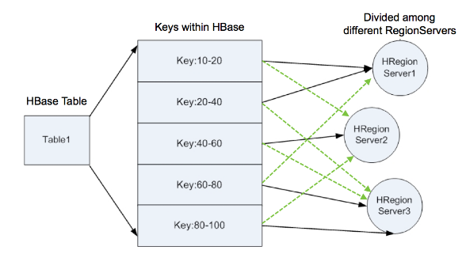
HBase Architecture
Region – A continuous, sorted set of rows that are stored together is refereed to as a region (subset of table data)
https://docs.cloudera.com/HDPDocuments/HDP2/HDP-2.1.7/bk_system-admin-guide/content/sysadminguides_ha-HBase-regions-regionservers.html

Slide 9
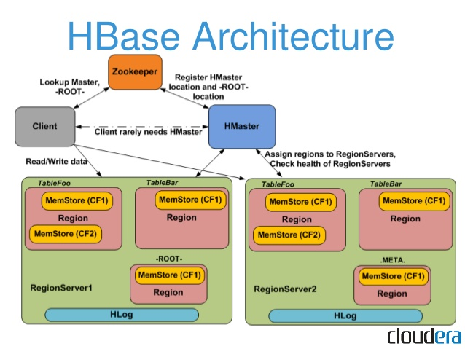

Slide 10
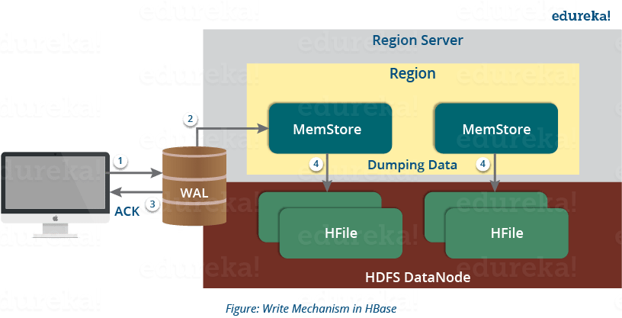
Memstore and HFile
  Before a permanent write, a write buffer where HBase accumulates data in memory is what we call the MemStore.
  While the MemStore fills up, its contents flush to disk to form an HFile.
  It forms a new file on every flush, rather than writing to an existing HFile.
  Basically, for HBase, the HFile is the underlying storage format.
  Per column family, there is one MemStore. It is possible that one column family can have multiple HFiles, but not vice versa.
https://www.edureka.co/blog/hbase-architecture/

Slide 11
Components of Apache HBase Architecture
(HMaster, ZooKeeper, Region Servers)
HMaster – Master Node of HBase
  HBase HMaster performs DDL operations (create and delete tables) and assigns regions to the Region servers as you can see in the above image.
  It coordinates and manages the Region Server (similar as NameNode manages DataNode in HDFS).
  It monitors all the Region Server’s instances in the cluster (with the help of Zookeeper) and performs recovery activities whenever any Region Server is down.
  It provides an interface for creating, deleting and updating tables.

Slide 12
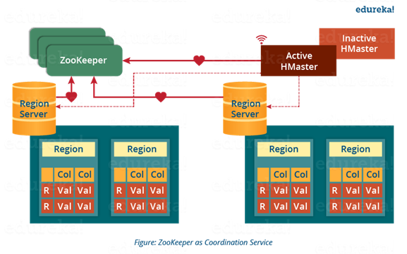
Zookeeper
  ZooKeeper - a centralized coordinator
  HMaster and Region servers are registered with ZooKeeper service

Slide 13
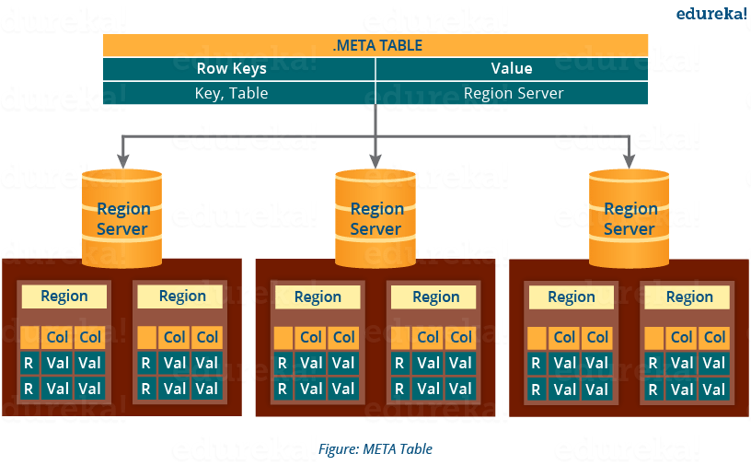
  Zookeeper also maintains the .META Server’s path, which helps any client in searching for any region. The Client first has to check with .META Server in which Region Server a region belongs, and it gets the path of that Region Server.
https://www.edureka.co/blog/hbase-architecture/

Slide 14
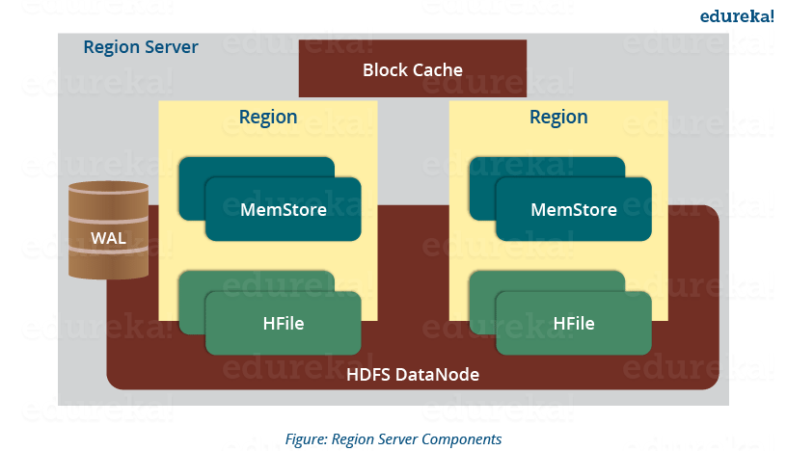
Region Servers – A Region Server maintains various regions running on the top of HDFS
  WAL: Write Ahead Log (WAL) is a file attached to every Region Server inside the distributed environment. The WAL stores the new data that hasn’t been persisted or committed to the permanent storage. It is used in case of failure to recover the data sets.
  Block Cache: Block Cache resides in the top of Region Server. It stores the frequently read data in the memory. If the data in BlockCache is least recently used, then that data is removed from BlockCache.
  MemStore: cache stores all the incoming data before committing it to the disk. There is one MemStore for each column family in a region.
  HFile: MemStore commits the data to HFile when the size of MemStore exceeds.
https://www.edureka.co/blog/hbase-architecture/

Slide 15
How Search Initializes in HBase?
The client retrieves the location of the META table from the ZooKeeper.
The client then requests for the location of the Region Server of corresponding row key from the META table to access it. The client caches this information with the location of the META Table.
Then it will get the row location by requesting from the corresponding Region Server.
For future references, the client uses its cache to retrieve the location of previously read row key’s Region Server. Then the client will not refer to the META table, until and unless there is a miss because the region is shifted or moved. Then it will again request to the META server and update the cache.

Slide 16
Hbase Write Mechanism
https://www.edureka.co/blog/hbase-architecture/
Step 1: Whenever the client has a write request, the client writes the data to the WAL (Write Ahead Log).
Step 2: Once data is written to the WAL, then it is copied to the MemStore.
Step 3: Once the data is placed in MemStore, then the client receives the acknowledgment.
Step 4: When the MemStore reaches the threshold, it dumps or commits the data into a HFile.

Slide 17
Hbase Read Mechanism
First the client retrieves the location of the Region Server from .META Server if the client does not have it in its cache memory. Then it goes through the sequential steps as follows:
For reading the data, the scanner first looks for the Row cell in Block cache. Here all the recently read key value pairs are stored.
If Scanner fails to find the required result, it moves to the MemStore, as this is the write cache memory. There, it searches for the most recently written files, which has not been dumped yet in HFile.
At last, it loads the data from Hfile to block cache.

Slide 18
Compaction
HBase combines HFiles to reduce the storage and reduce the number of disk seeks needed for a read. This process is called compaction. There are two types of compaction as you can see in the above image.
  Minor Compaction: HBase automatically picks smaller HFiles and recommits them to bigger HFiles as shown in the above image.
  Major Compaction: As illustrated in the above image, in Major compaction, HBase merges and recommits the smaller HFiles of a region to a new HFile. In this process, the same column families are placed together in the new HFile. It drops deleted and expired cell in this process. It increases read performance.

Slide 19
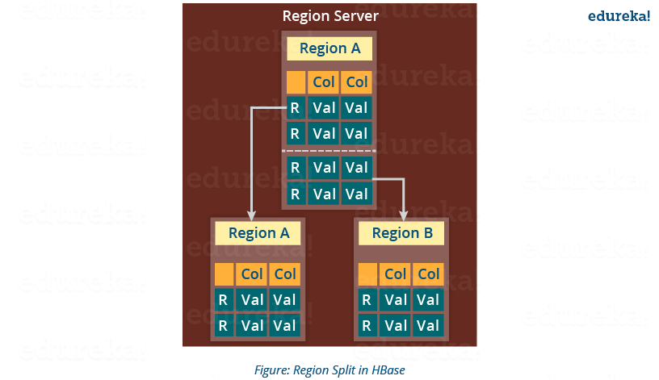
Region Split
Whenever a region becomes large, it is divided into two child regions,
Each region represents exactly a half of the parent region. Then this split is reported to the HMaster.
This is handled by the same Region Server until the HMaster allocates them to a new Region Server for load balancing.
https://www.edureka.co/blog/hbase-architecture/

Slide 20
HBase Crash and Data Recovery
Whenever a Region Server fails, ZooKeeper notifies to the HMaster about the failure.
Then HMaster distributes and allocates the regions of crashed Region Server to other active Region Servers. To recover the data of the MemStore of the failed Region Server, the HMaster distributes the WAL to all the Region Servers.
Each Region Server re-executes the WAL to build the MemStore for that failed region’s column family.
The data is written in chronological order (in a timely order) in WAL. So, after all the Region Servers executes the WAL, the MemStore data for all column family is recovered.

