Slide 1
Physics in Robotics
Lecture 01
PSCI 1102
08/12/2022

Slide 2
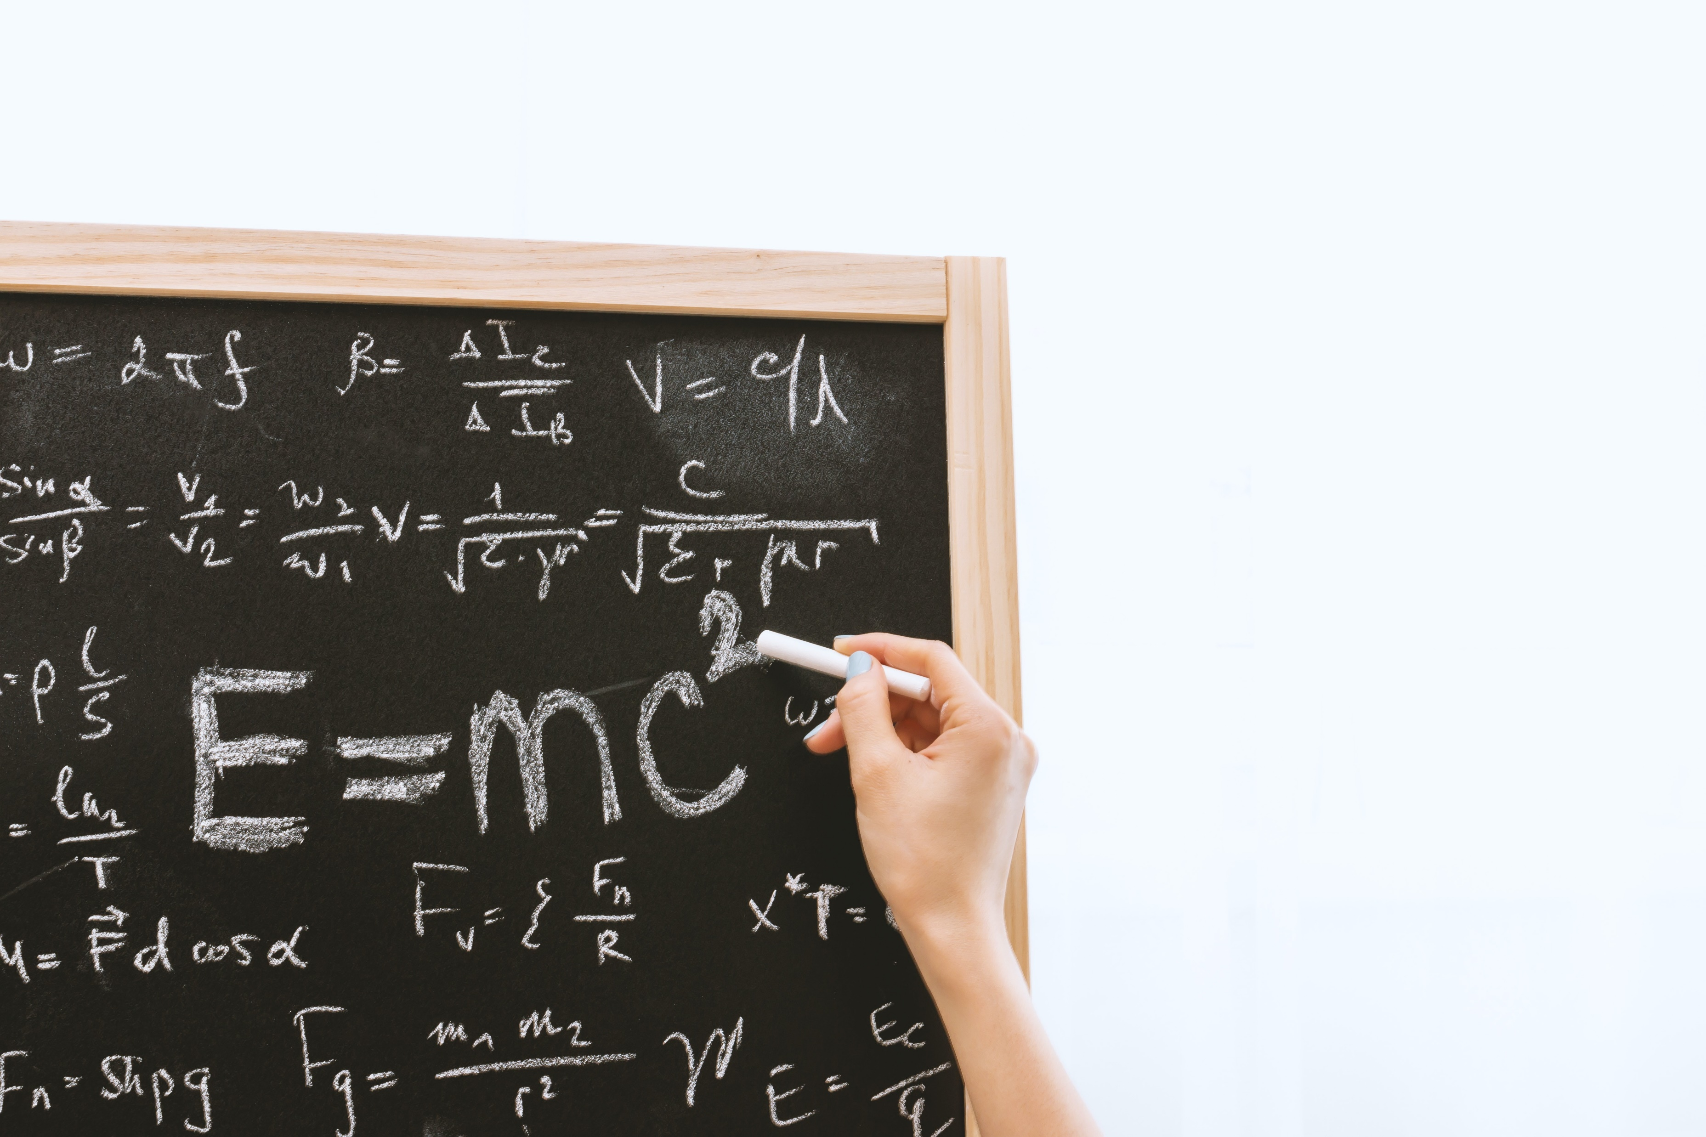

Science
Life science: Biology
Natural Science: Physics, Chemistry, and Astronomy

Slide 3

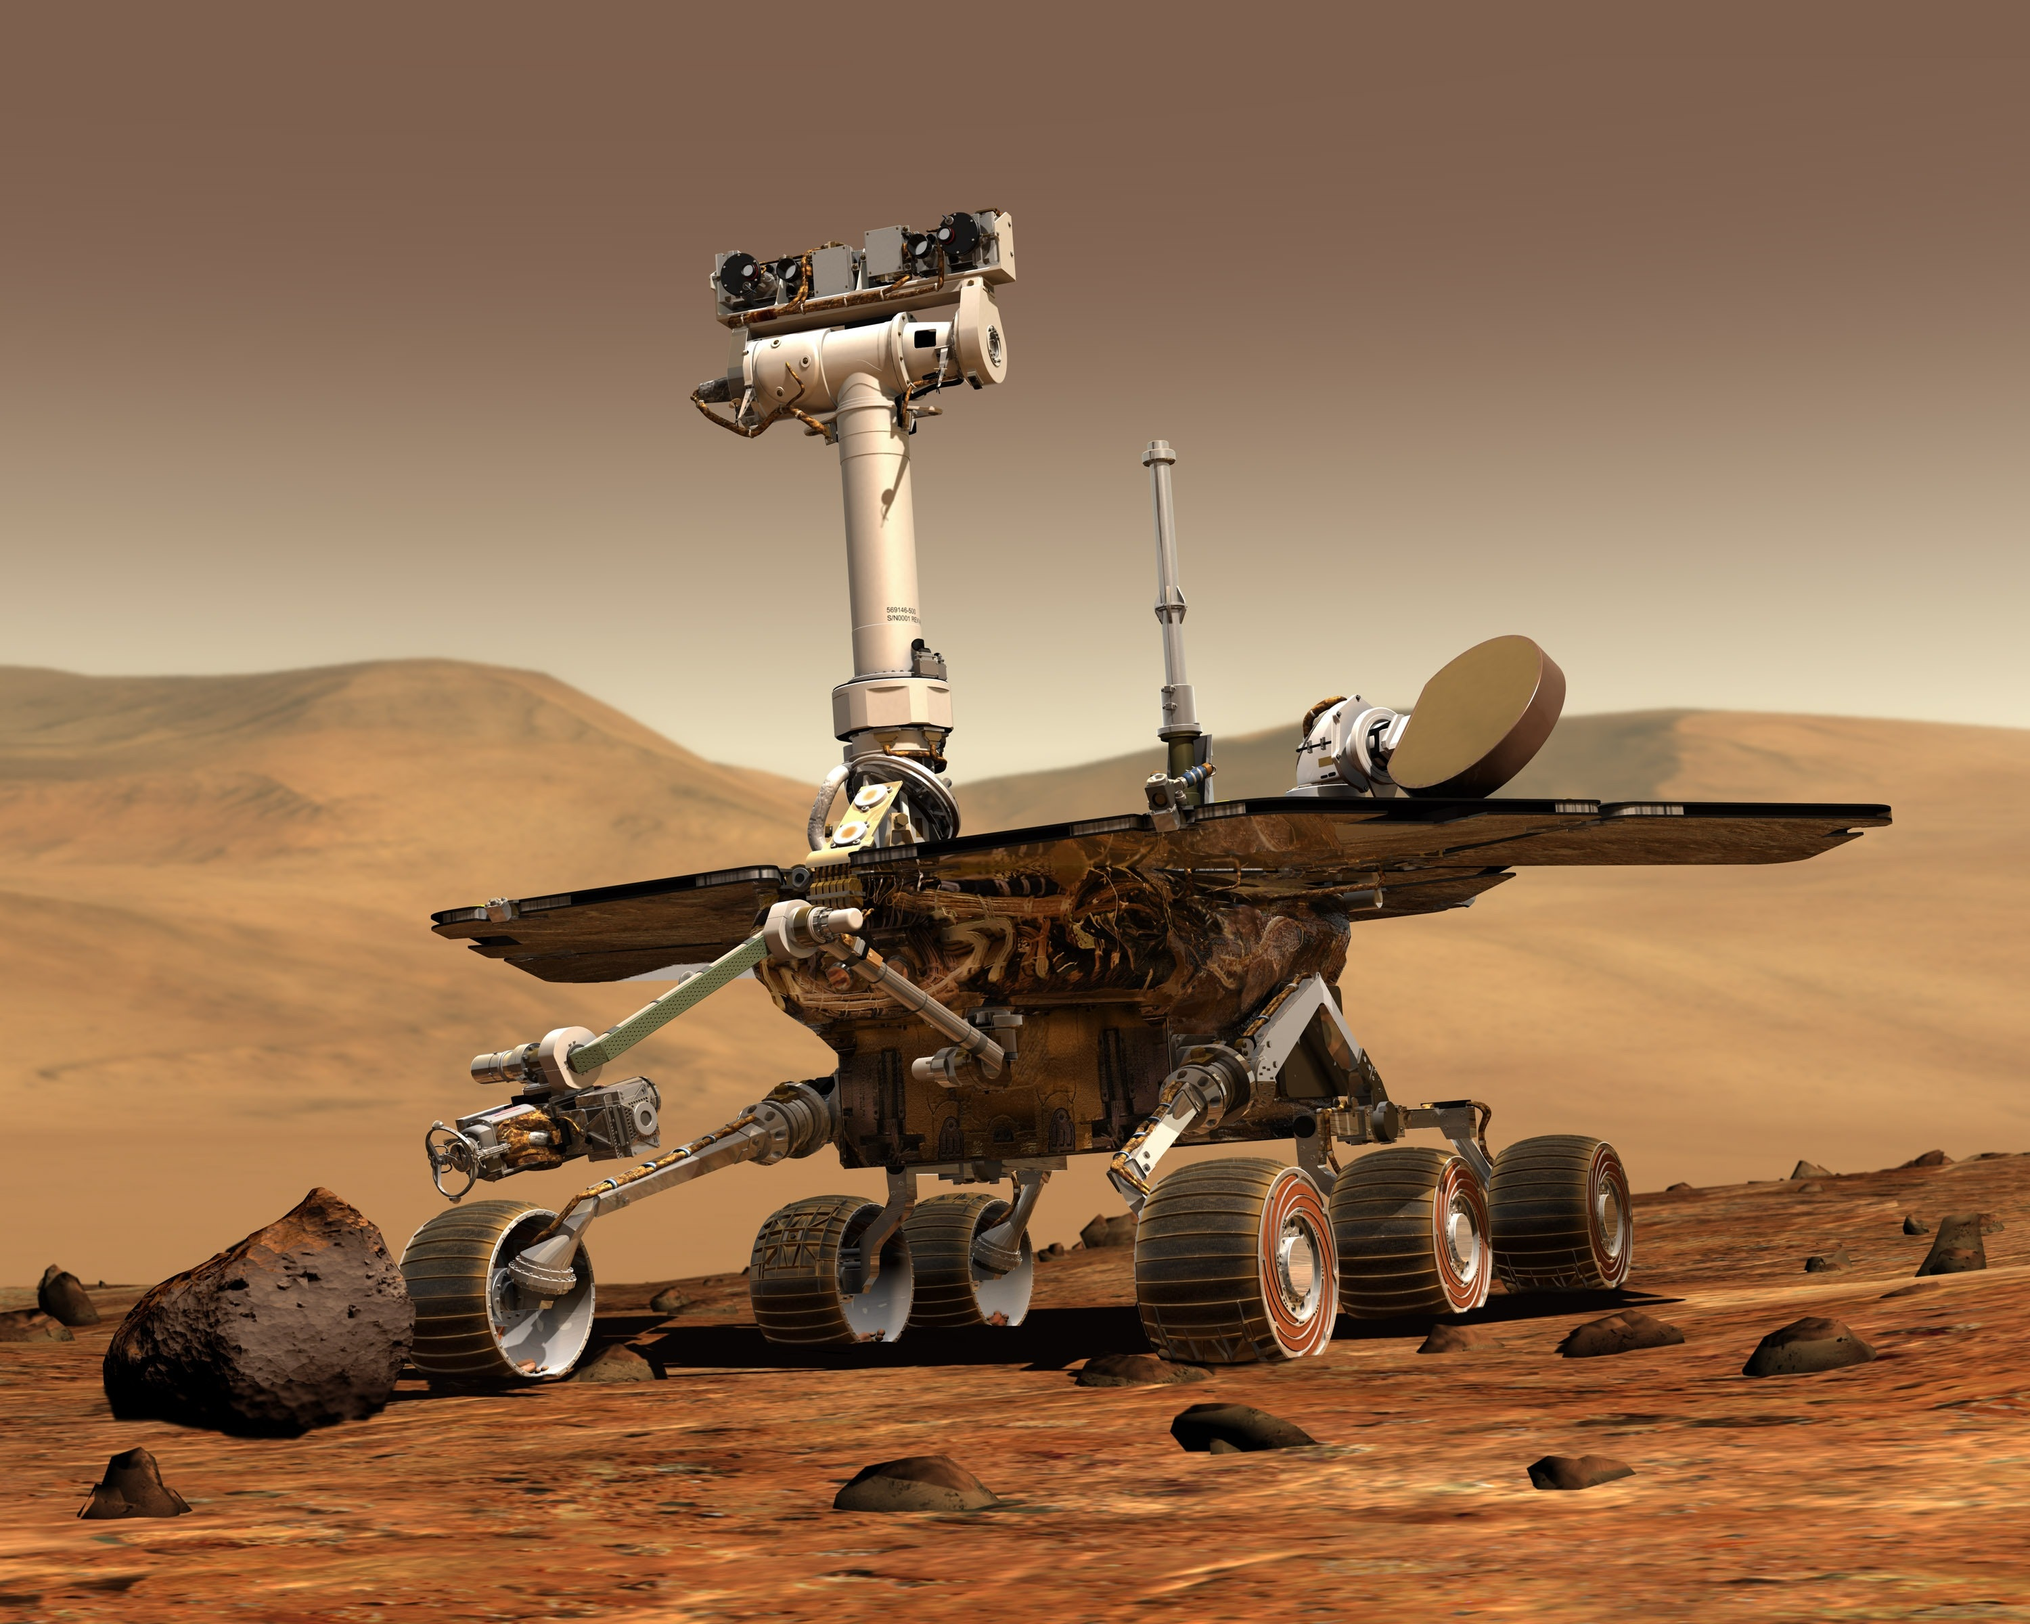
Technology and Engineering
Computer Science: AI
Engineering: Mechanical, Electrical, Aerospace, Chemical, etc.

Slide 4
Inter-relationships between science, technology and robotics
Science contributes to technology in the following ways
  New knowledge serves as a direct source of ideas for new technological ideas
  Source of tools and techniques for more efficient engineering design and knowledge
  Research instrumentation, laboratory techniques and analytical methods
  Practice of research as a source for development of new human skills and capabilities
  Creation of a knowledge base that becomes increasingly important in the assessment of technology
  Knowledge base that enables more efficient strategies of applied research and development

Slide 5
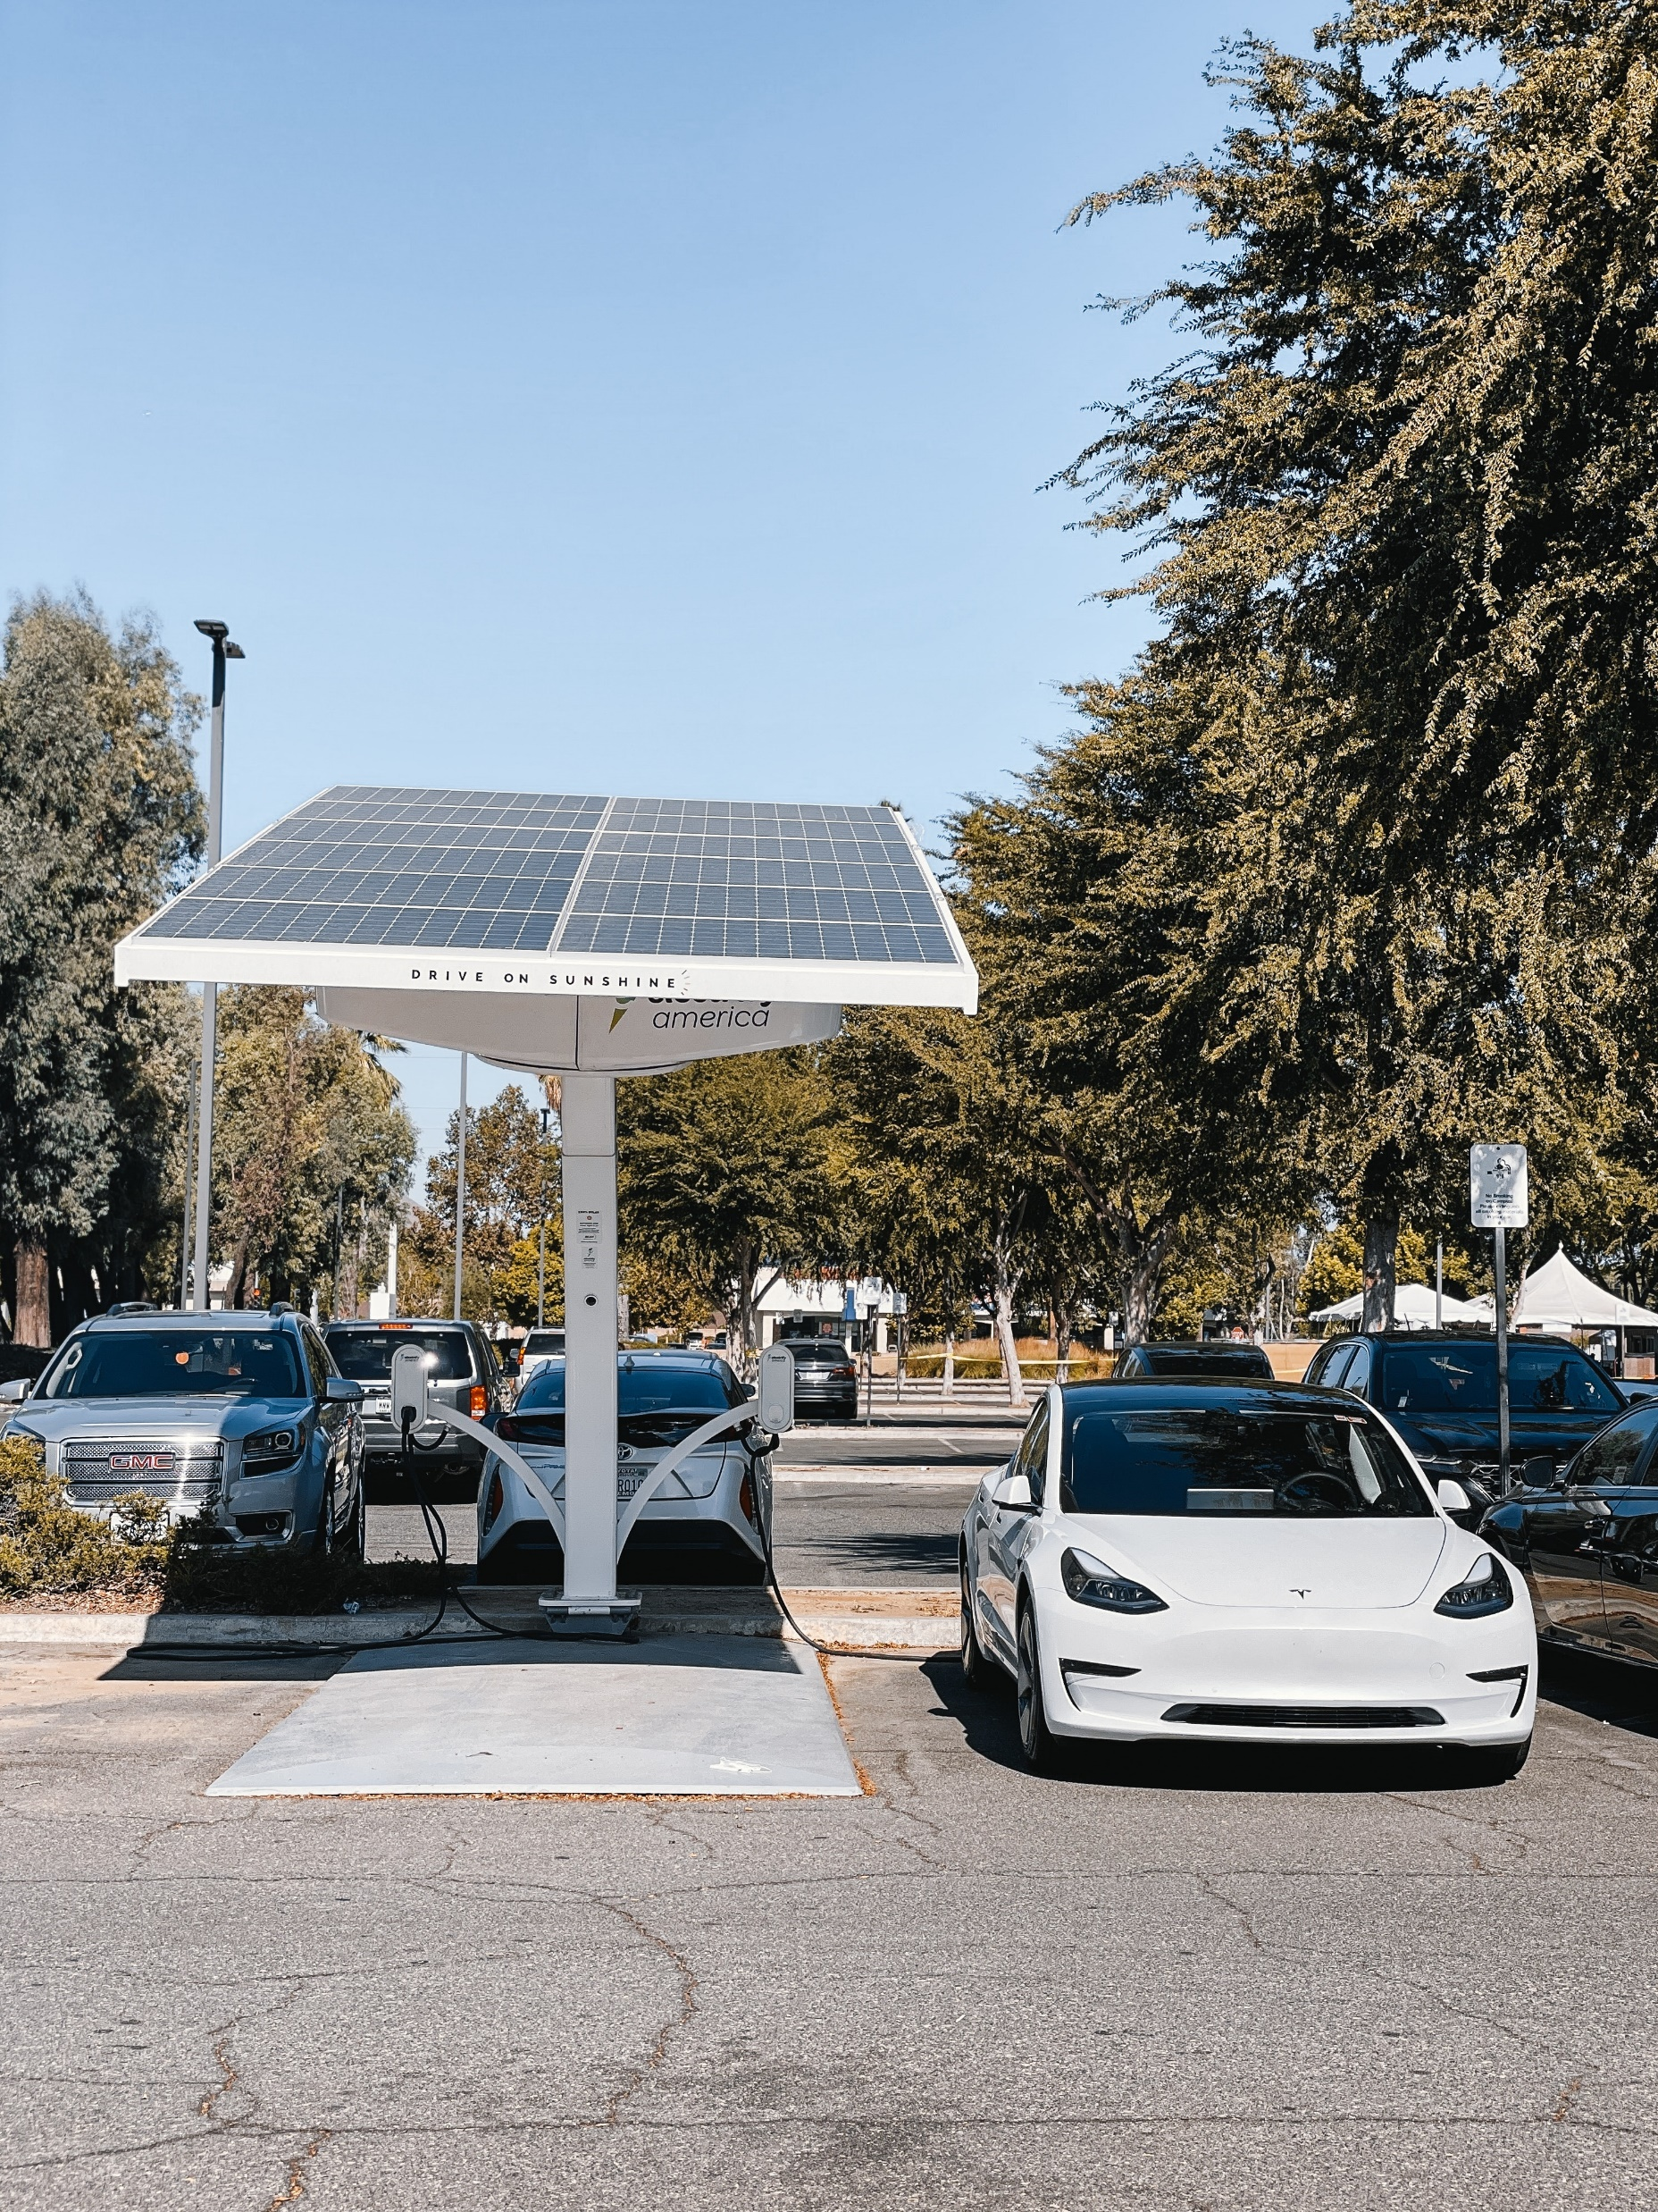
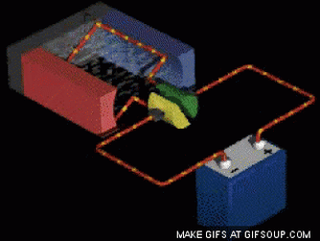
Inter-relationships between science, technology and robotics: Historical
(Chapter 15 (P)
Magnetic Lorentz force; Faraday
https://www.youtube.com/watch?v=nRDVm5rn_2A

Slide 6

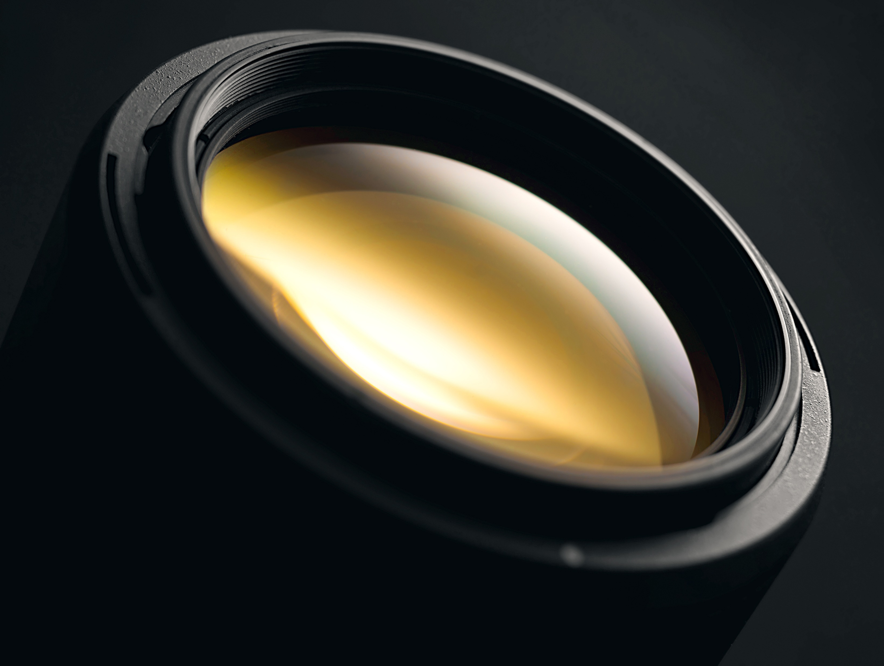
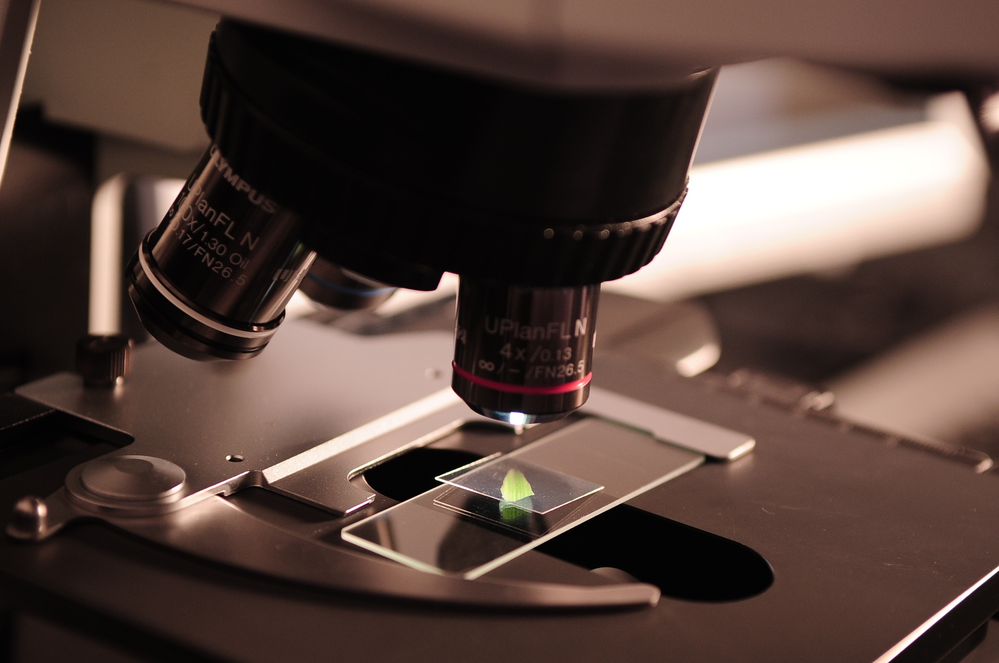
Astronomy
Biology
Theory of Geomatical Optics

Slide 7
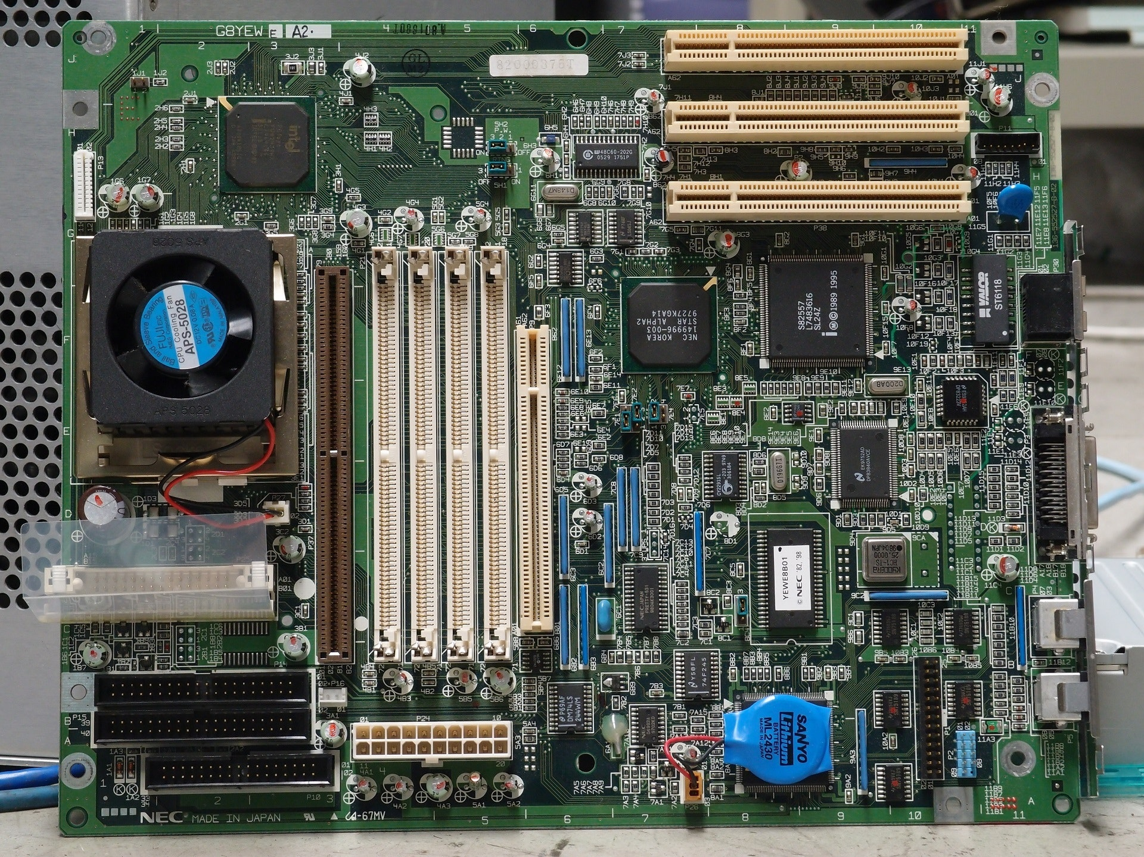
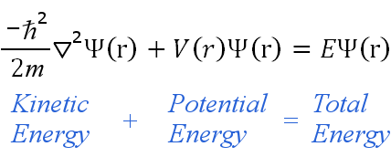
Quantum Physics
Integrated Circuit

Slide 8
Faraday Law of Induction; documentary
https://www.youtube.com/watch?v=V64toYdH9hU&t=1243s
From 12.30 mins to 18.14 mins

Slide 9
Physics (Scientific) Theories
Must be testable
Must be continually tested: repeatability
Should be simple: Occam’s razor
Should be elegant: Einstein’s field equation
Scientific theories can be proven wrong, but none of them can be proven right with 100%.

Slide 10
Observation
Theory
Prediction

Slide 11
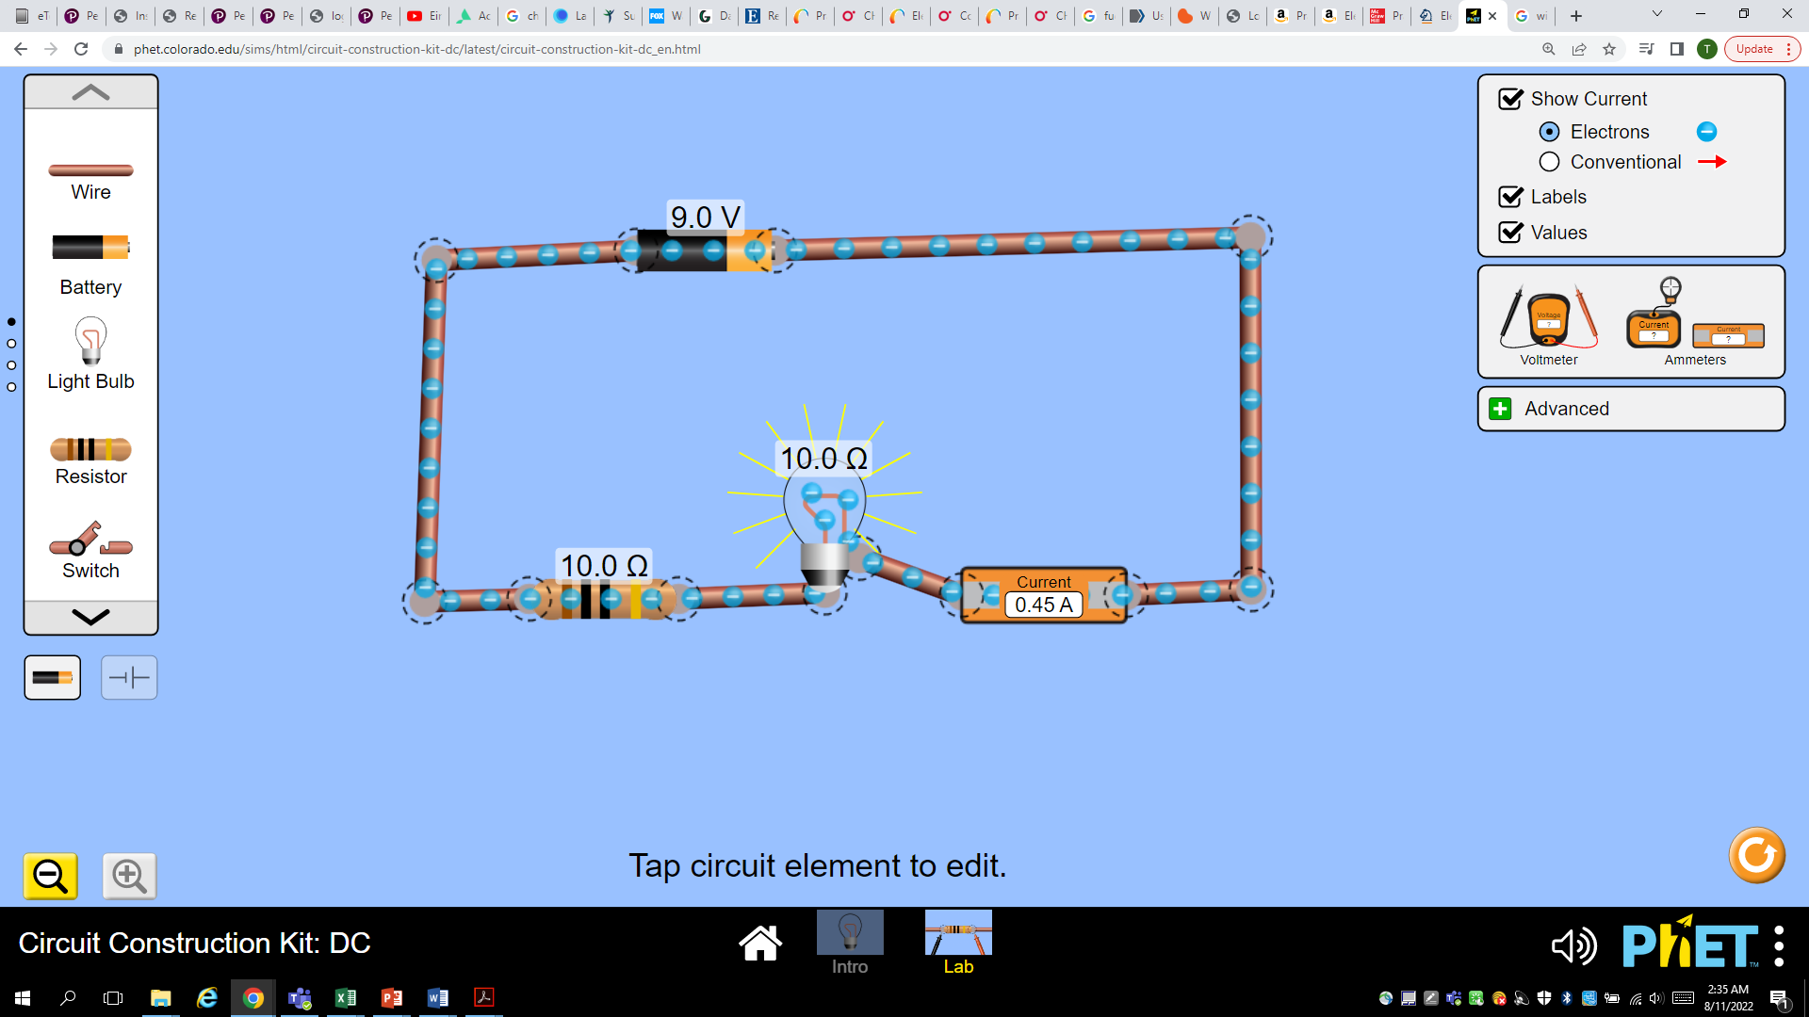
Physics: Electricity

Slide 12
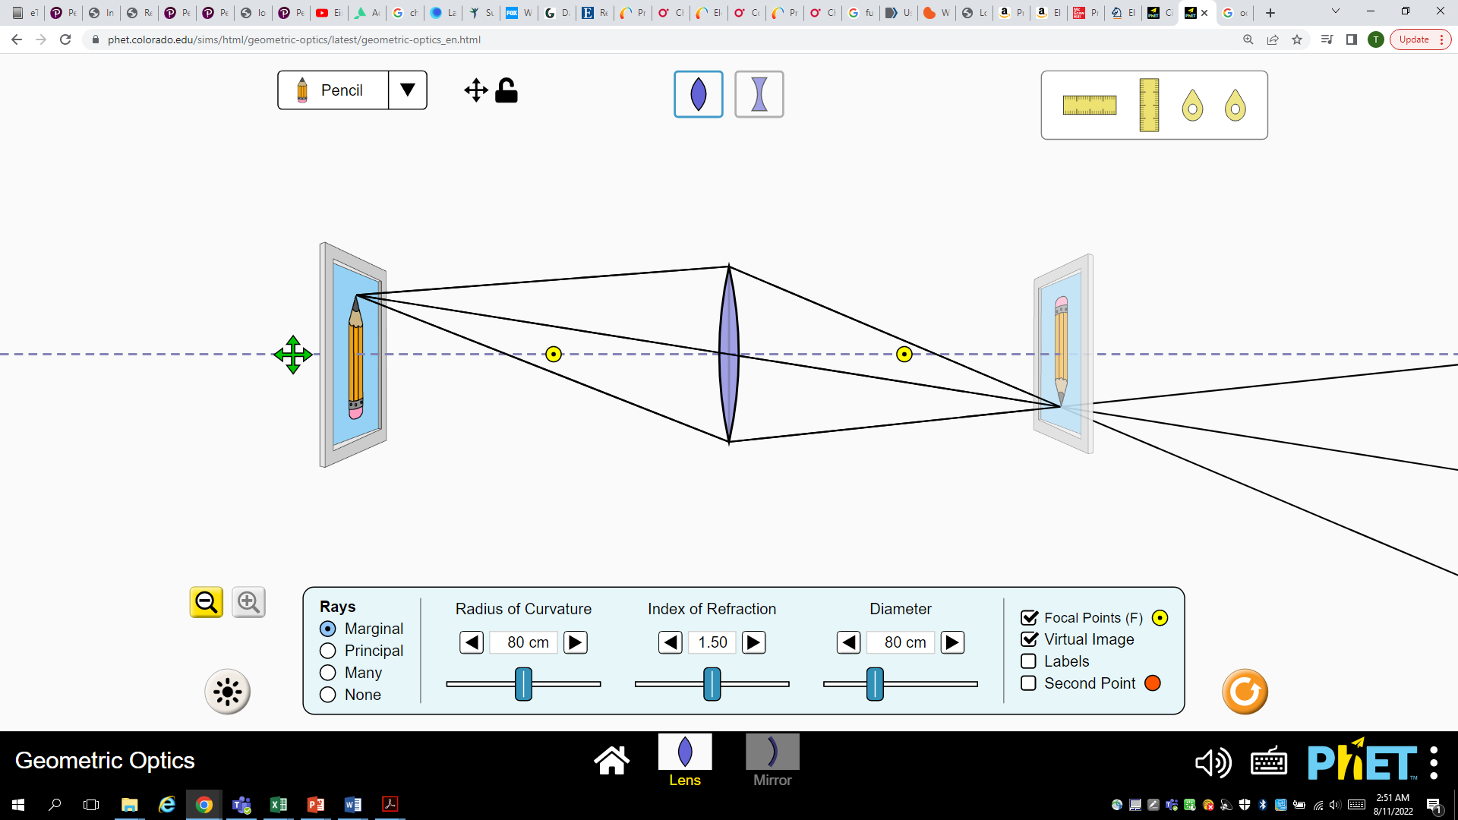
Physics: Optics

Slide 13
Technology
LED: Light Emitting Diode
Display systems: LCD (Liquid Crystal Display), OLED
Sensors: Sonar sensor, Temperature sensor, and so on
Motors: AC motor, DC motor, servo motor, stepper motor

Slide 14
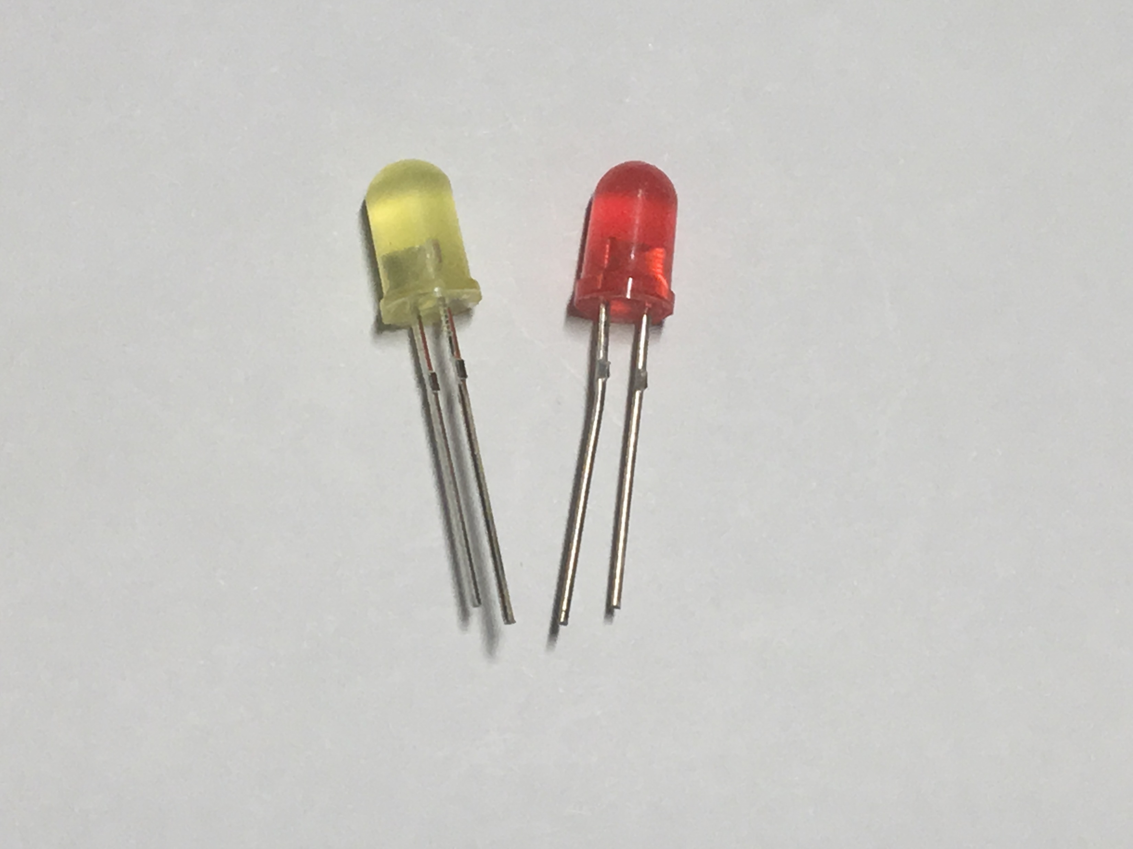
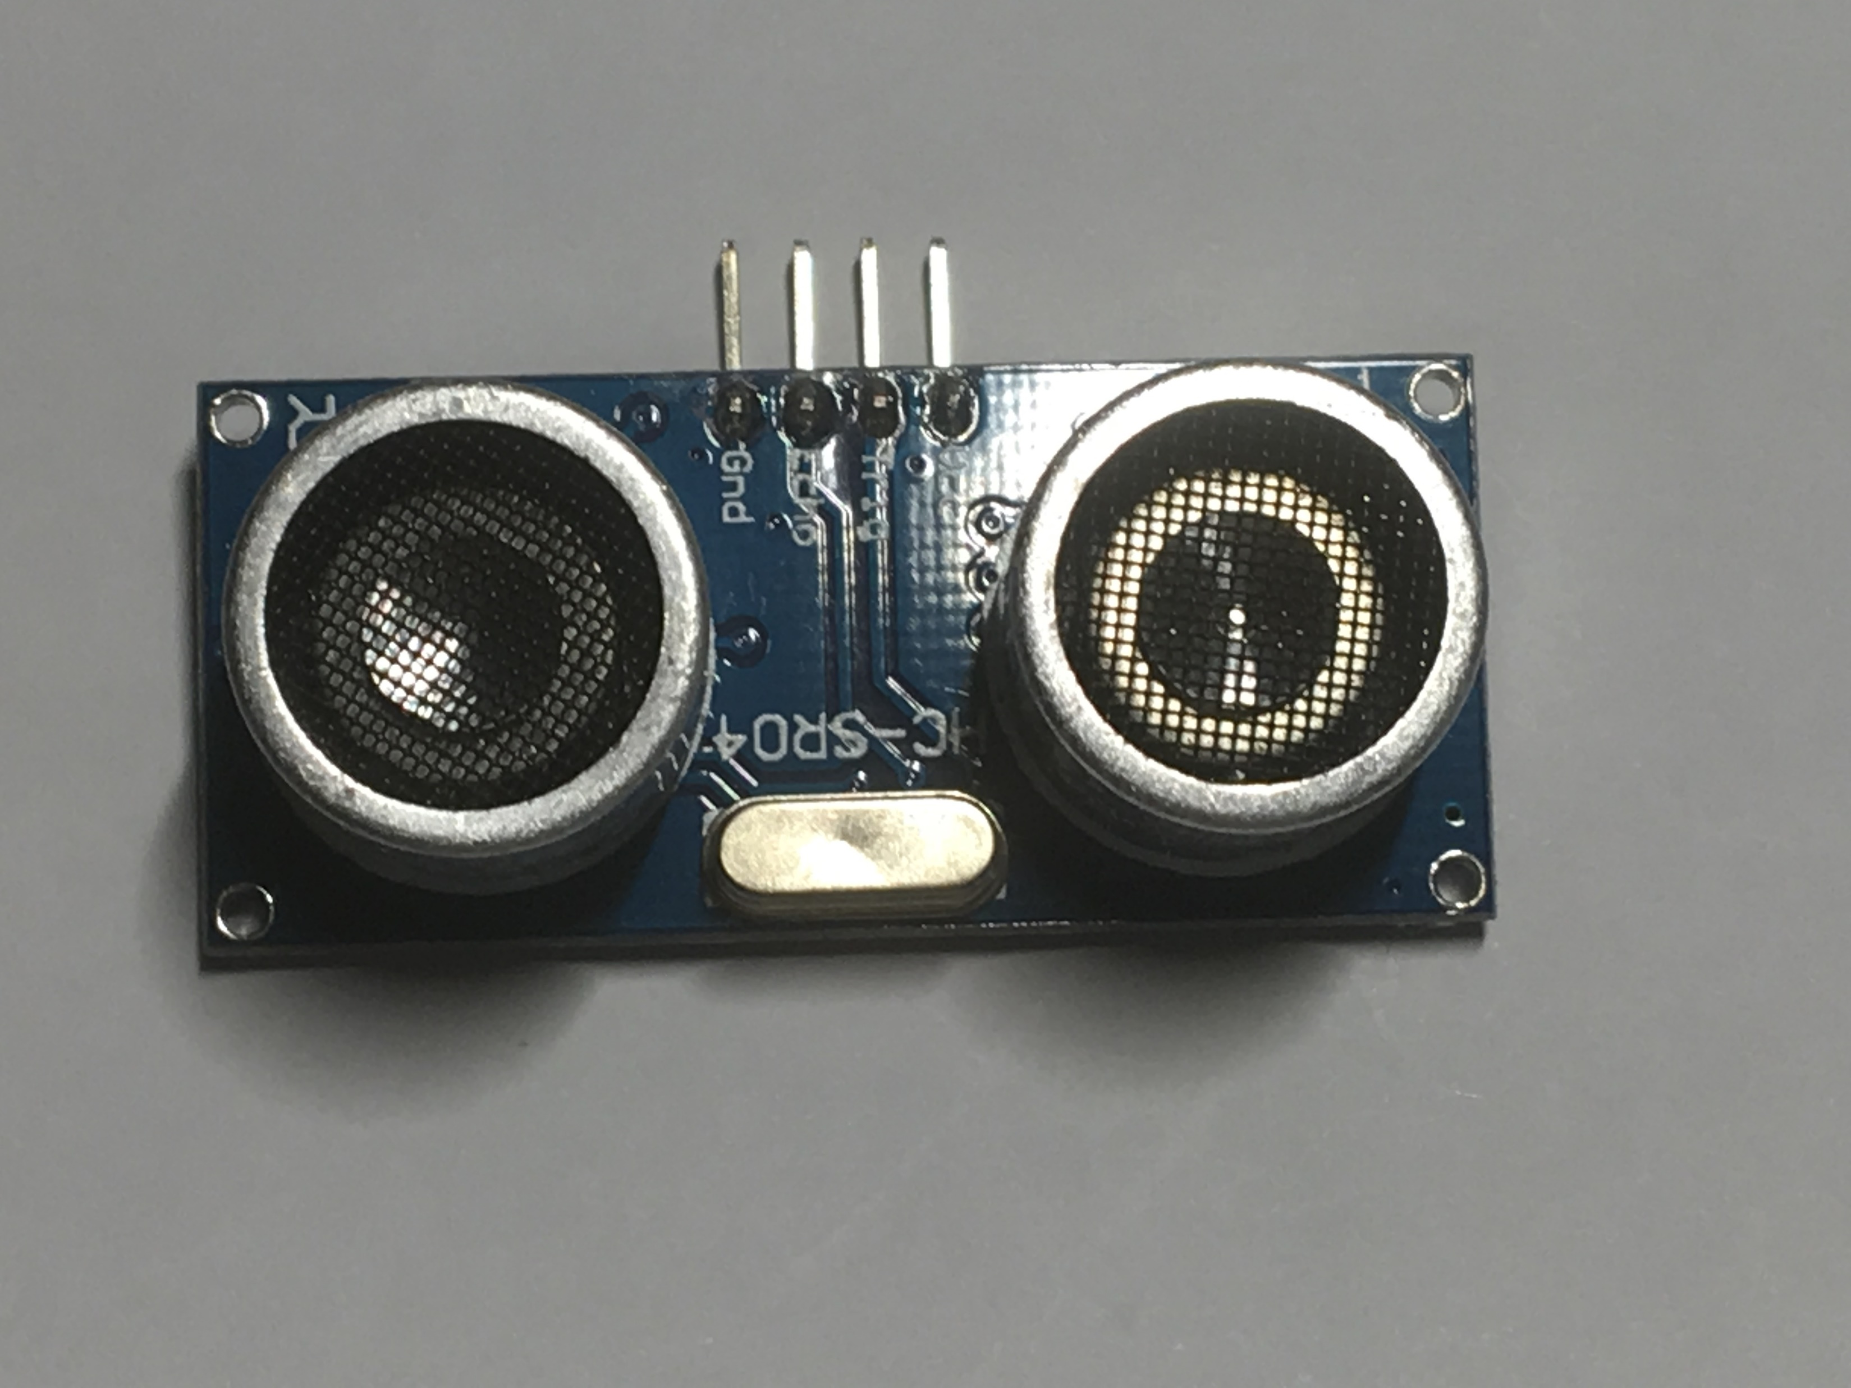
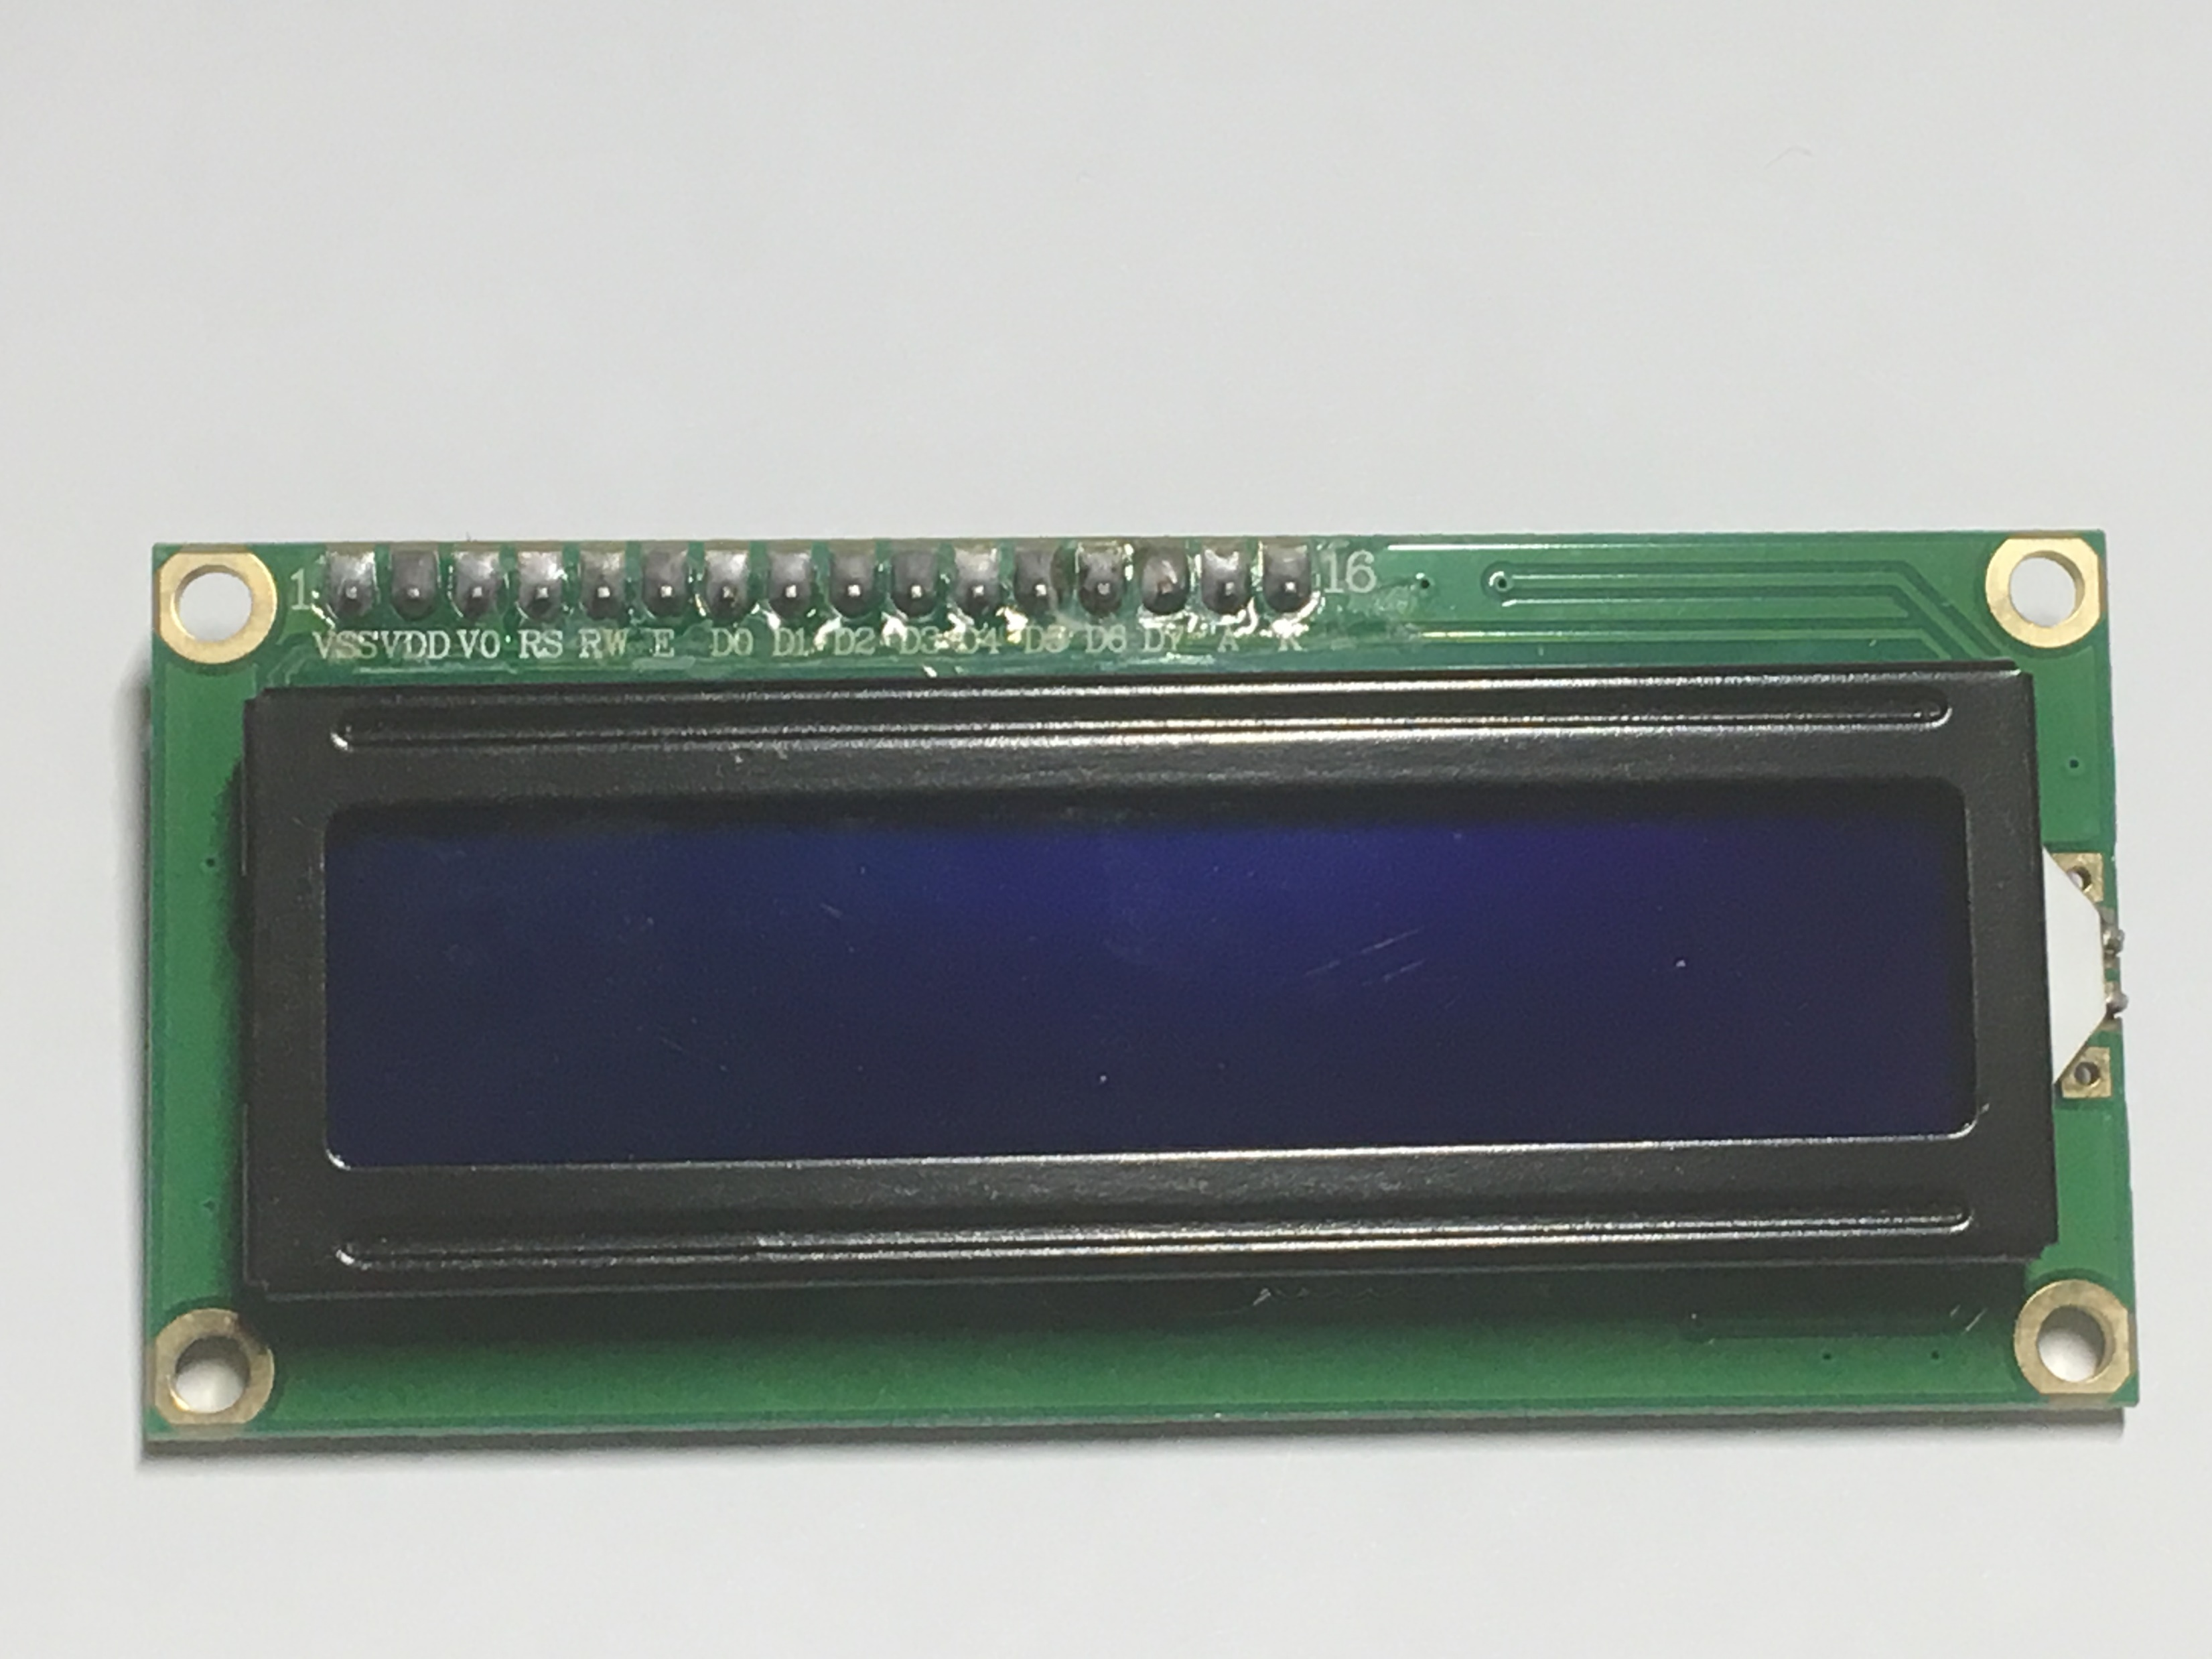
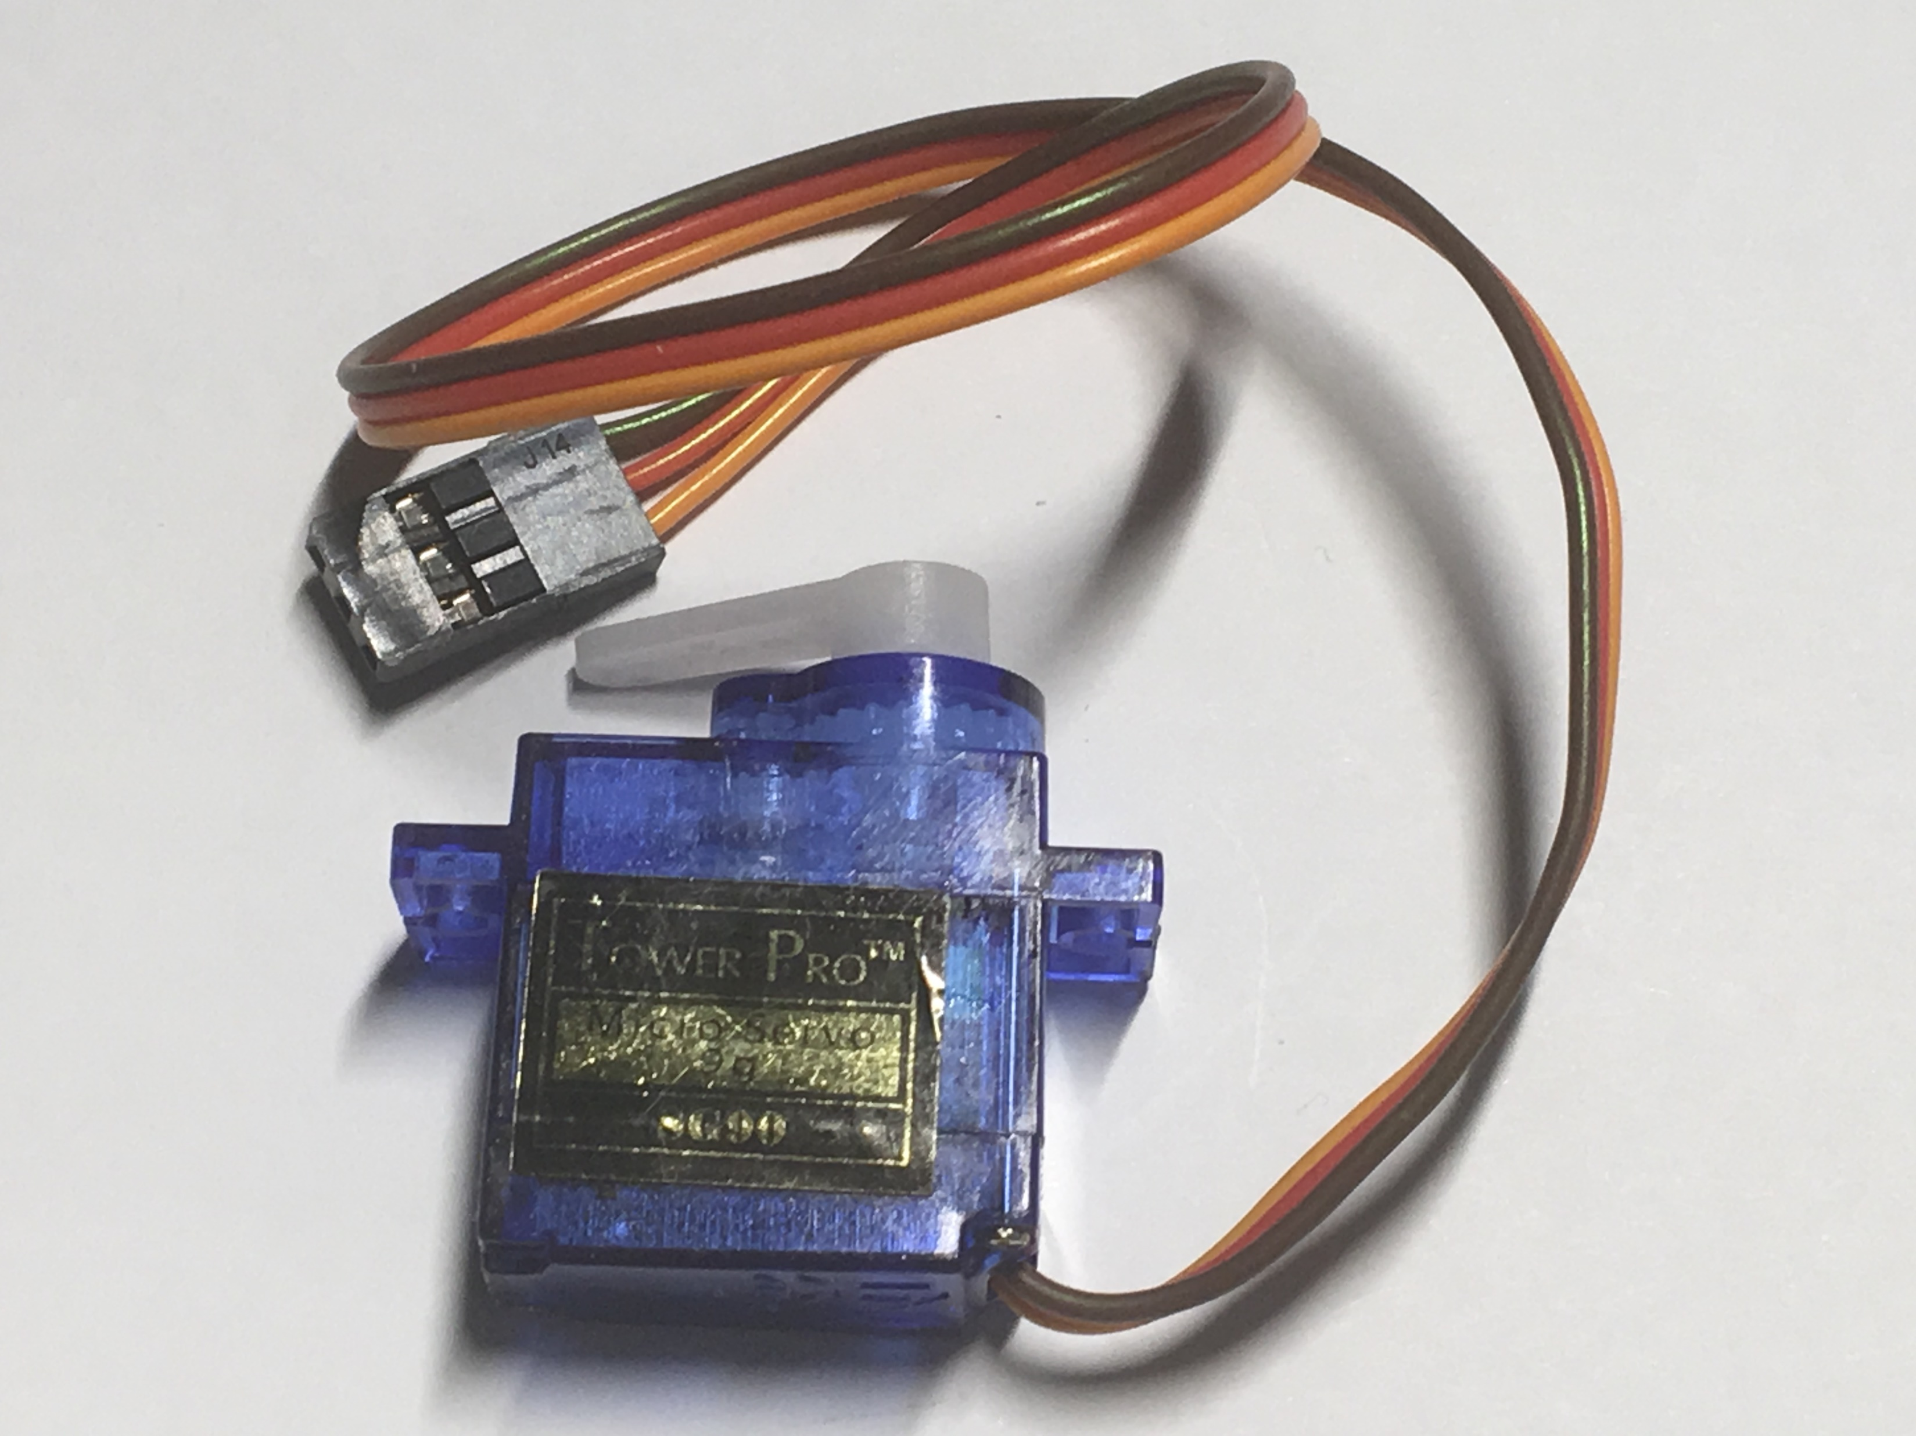
HC-SRC04 Sonar sensor
LED
Servo motor
LCD display

Slide 15
Tinkercad Circuit and PheT Simulators
Tindercad Circuit: Electronics circuit simulator
  You need to make your own account with Tinkercad circuit
PheT: Physics simulator

Slide 16
Background Knowledge
      Boolean algebra: Logic gates (AND, OR, XOR gates)
      Algebra, one equation one unknown: one dimensional equation (y = mx +b)
      Plots basics: Scientific analysis

Slide 17
Boolean Logic Gates
0 | 0 | 0
0 | 1 | 0
1 | 0 | 0
1 | 1 | 1
AND
0 | 0 | 0
0 | 1 | 1
1 | 0 | 1
1 | 1 | 1
OR
0 | 0 | 0
0 | 1 | 1
1 | 0 | 1
1 | 1 | 0
XOR

Slide 18
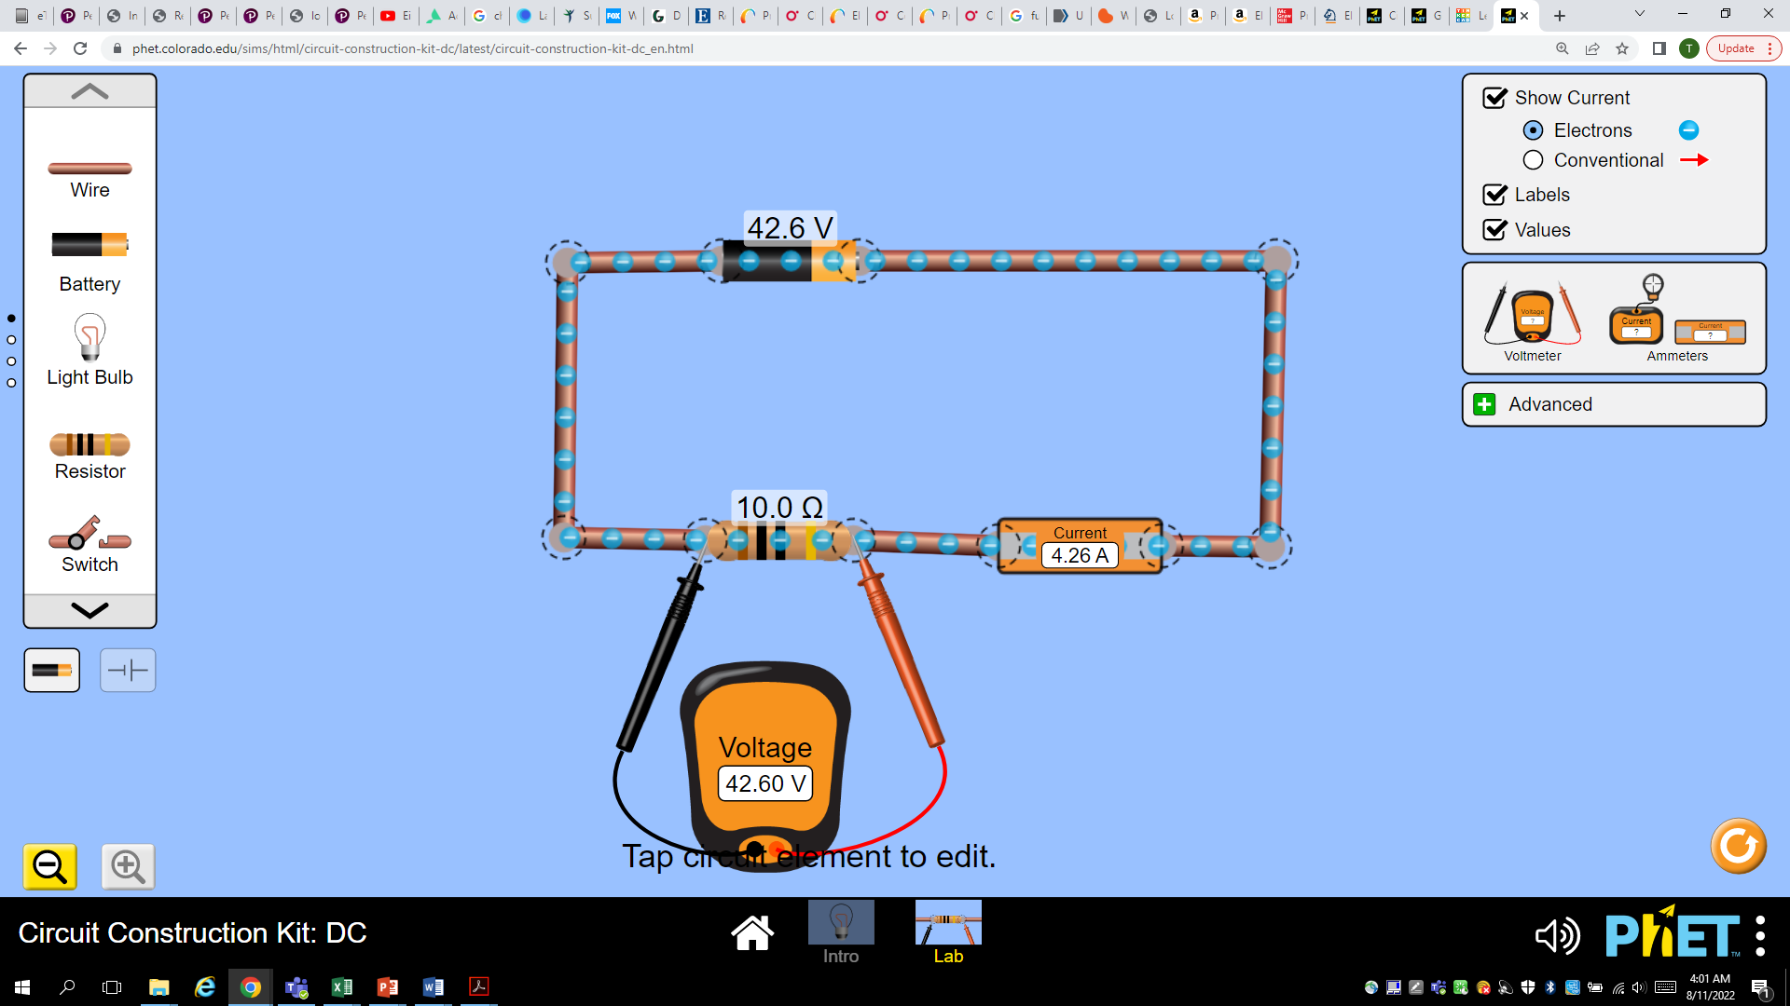

Slide 19
Plot: Perfect world
Current (Amp) | Potential (volt)
0.90 | 9.00
1.10 | 11.00
1.50 | 15.00
3.90 | 39.00
4.26 | 42.60

Slide 20
Plot: Real world
Current (Amp) | Potential (volt)
0.92 | 9.00
1.20 | 11.00
1.35 | 15.00
3.83 | 39.00
4.30 | 42.60

Slide 21
References
The Relationship Between Science and Technology: Brook, Harvey, 1994, Research Policy, Volume 23, Issue 5
Pixel Free photos: https://www.pexels.com/search/science%20and%20technology/
StockFreeImages by Dreamstime: https://www.stockfreeimages.com/p1/electric-motor.html
Gfycat: https://gfycat.com/gifs/search/electric+motor
Tinkercad Circuit
PheT

