Slide 1
Physics in Robotics
Lecture 02
PSCI 1102
08/19/2022

Slide 2
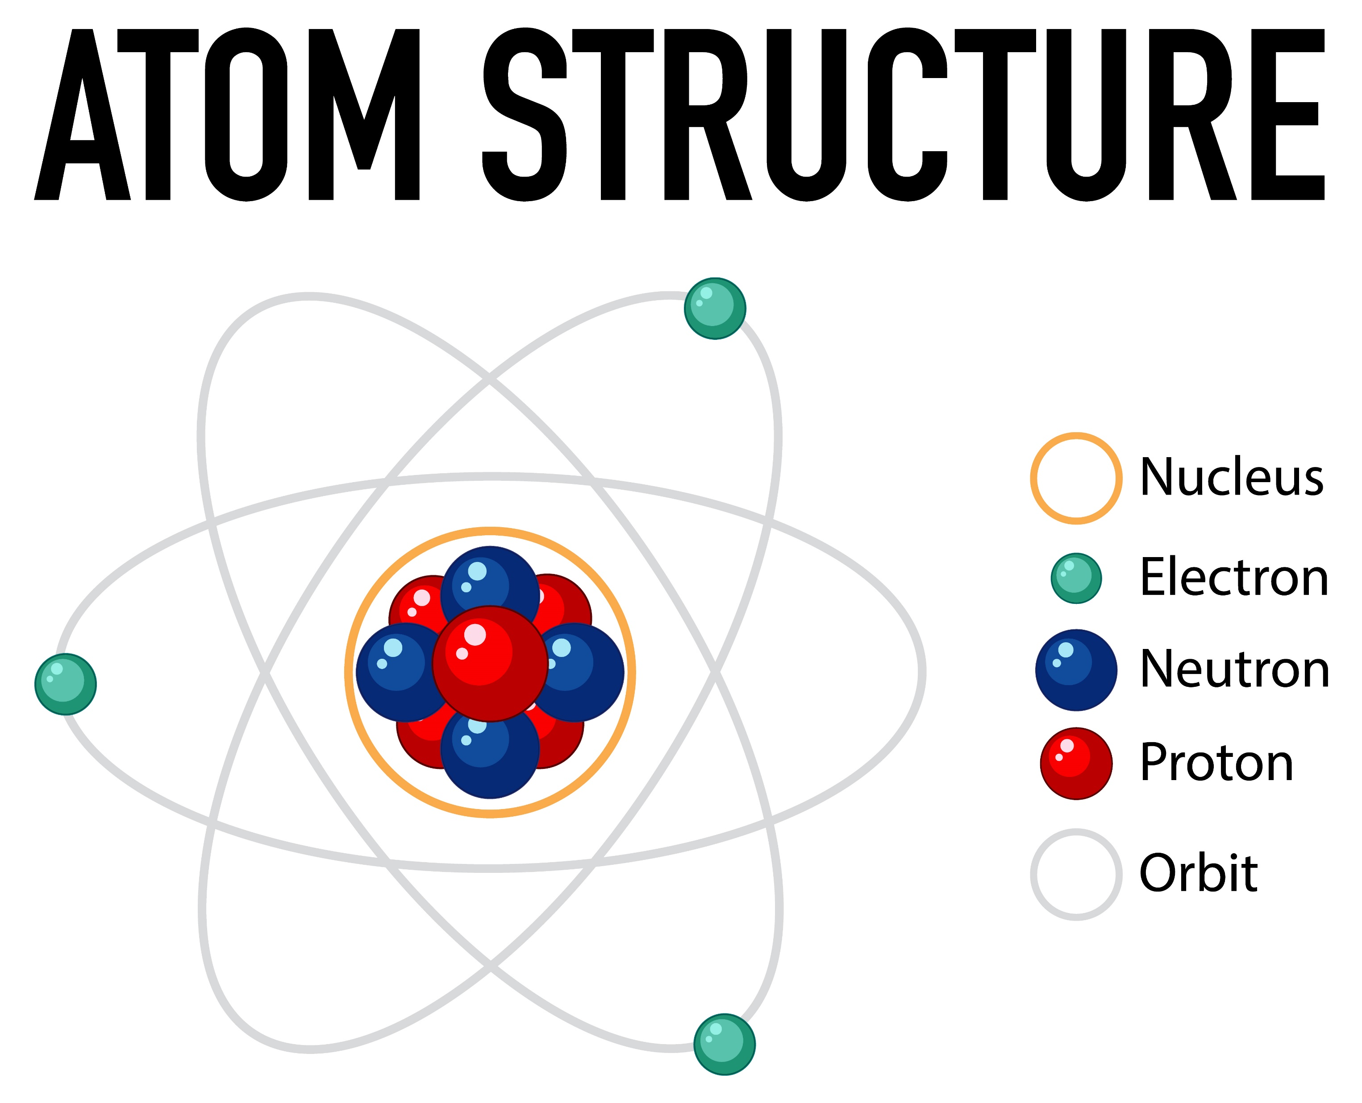
Theory of Electronics
Particles | Charges
Electron | Negative
Proton | Positive
Neutron | Neutral

Slide 3
Electric Current, Voltage, and Resistance
Ohm’s Law: Section 2.12 in P
V = I * R
V: Voltage [volt; V]
I: Current [Ampere; A]
R: Resistance [Ohm: Ω]

Slide 4
Current (section 2.2 in P)
Electric current is the total charge per unit time: I = Q/t
Electron charge is –Q and proton charge is +Q.
Q_{electron} = -1.602 x 10⁻¹⁹ C
Q_{proton} = +1.602 x 10⁻¹⁹ C
The unit of current is [A].

Slide 5
Current and direction of electron
+
-
Current direction
+
-
Electron direction

Slide 6
Check your understanding 01:
When a circuit carries 5.0 A, how much electrons pass through a given point for 3 seconds?

Slide 7
Check your understanding 01: Answer
When a circuit carries 5.0 A, how much electrons pass through a given point for 2.5 seconds?
I = Q/t
Q = I * t
= (5.0 A) * (2.5 sec) = 12.5 C
# of electrons = Q/(1.602 x 10⁻¹⁹ C)
= (12.5 C)/(1.602 x 10⁻¹⁹ C)
= 7.8 x 10¹⁹ electrons

Slide 8
Voltage and Electric Power (section 2.3 in P)
To get electrical current to flow from one point to another, a voltage must exist between the two points.
EMF (Electromotive Force): Potential (voltage) source from a battery or power supply
Power is defined as total energy per unit time (Power = Energy/time)
Voltage = Power/current: 1 volt = 1watt/1amp
Power = Voltage * current: P = v*I
Flashlight
Schematic Diagram

Slide 9
Check your understanding 02:
Our 9.0 v flashlight circuit draws 0.9 A. How much power does the flashlight use?

Slide 10
Check your understanding 02: Answer
Our 9.0 v flashlight circuit draws 0.9 A. How much power has the flashlight been used?
P = V* I = (9.0) * (0.9) = 8.1 watts

Slide 11
Resistance and Resistivity (Sec 2.5 in P)
R = V/I (equ. 2.4 in P)
The resistance of a wire depends on its dimensions and the resistivity of its material.
R = (ρL)/A : (resistivity * Length)/Area
Conductivity = 1/resistivity : σ = 1/ ρ
Length
Area

Slide 12
Resistivity Activity
Length
Area

Slide 13
Electric Grounds (Sec. 2.10 in P)
You need to define a point in the circuit to be a 0 volt reference point. This reference point called the ground.

Slide 14
AC and DC
AC: Alternating Current: e.g. 120 Volt house outlet
DC: Direct Current: e.g. Regular battery
-
+

Slide 15
PheT simulation
Workbook 01

Slide 16
References
1. Freepik: https://www.freepik.com/vectors/scientific-illustration'>Scientific illustration vector created by brgfx - www.freepik.com</a>

