Slide 1

Fauvism (1898-1906)

Slide 2
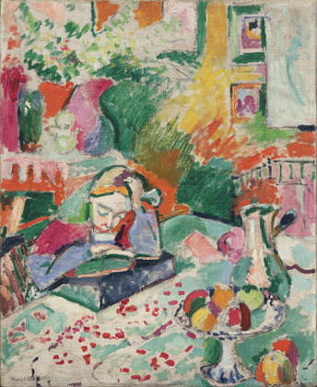
Henri Matisse. Interior with a Young Girl (Girl Reading). Paris 1905-06
MoMA Fauvism Theme
Notes:
Share this information with your students:
Matisse wrote about his work:
Expression to my way of thinking does not consist of the passion mirrored upon a human face or betrayed by a violent gesture. The whole arrangement of the picture is expressive. The place occupied by figures or objects, the empty spaces around them, the proportions, everything plays a part. Composition is the art of arranging in a decorative manner the various elements at the painter’s disposal for the expression of his feelings. In a picture, every part will be visible and will play the role conferred upon it… A work of art must be harmonious in its entirety; for superfluous details would, in the mind of the beholder, encroach upon the essential elements.
– Henri Matisse. Notes of a Painter (New York: E. P. Dutton, 1978), 36.
What is your reaction to Matisse’s statement? Does it change your initial impressions of this painting? How so?
Henri Matisse. Interior with a Young Girl (Girl Reading). Paris 1905-06.
Oil on canvas, 28 5/8 x 23 1/2" (72.7 x 59.7 cm).
Fractional gift of Mr. and Mrs. David Rockefeller.
© 2012 Succession H. Matisse, Paris / Artists Rights Society (ARS), New York 79.1991

Slide 3
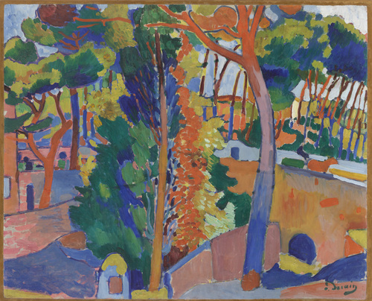
André Derain. Bridge Over the River Riou, 1906
MoMA Fauvism Theme
Notes:
Share this information with your students:
In 1905 André Derain joined Henri Matisse in Collioure, a popular vacation spot in the south of France. Derain sent a letter from Collioure to his fellow painter Maurice Vlaminck, saying that he had discovered “… a new concept of light which consists in the following: the negation of shadow. Here, the light is very strong, the shadows very clear.” [From Charles Harrison and Paul Wood. Art in Theory: 1900-2000 (Oxford: Blackwell Publishing 2003), 64.]
Do you see any evidence of the influence Derain wrote about in this painting, created a year later?
André Derain. Bridge over the Riou. 1906
Oil on canvas, 32 1/2 x 40" (82.6 x 101.6 cm).
The William S. Paley Collection.
© 2012 Artists Rights Society (ARS), New York / ADAGP, Paris
SPC66.1990

Slide 4
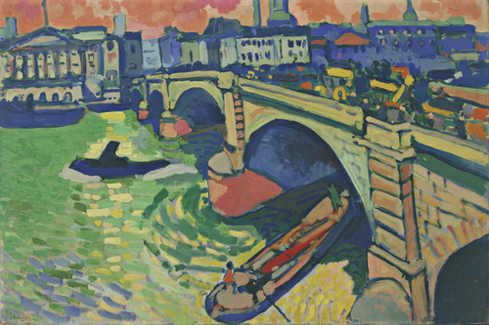
André Derain. London Bridge. 1906
MoMA Fauvism Theme
Notes:
Share this information with your students:
In 1905, French painter André Derain was commissioned by his art dealer Ambroise Vollard to paint views of London . Derain set up his easel outdoors and went to work. The subject of this landscape, the London Bridge, was one of several bridges built across the Thames River as part of a larger movement to construct grand new architectural projects and public works around the city center. London Bridge is one of about thirty paintings Derain produced over his two month stay, all depicting activity on or around the Thames.
It’s not surprising that Derain’s art dealer was interested in views of London. Nineteenth-century London saw a huge growth in population as mechanical industry, especially the building of railways, took hold. Derain saw the changes and created a portrait of London that was radically different from anything done by previous painters of the city.. The artist later recalled: “Fauvism was our ordeal by fire. It was the era of photography . This may have influenced us and played a part in our reaction against anything resembling a snapshot of life. No matter how far we moved away from things, it was never far enough. Colors became charges of dynamite.” [1]
At the time Derain painted this image, the wide Thames River served an essential role in London’s industry. The waterway served as an artery connecting the city along its length, as a connector to the British canal system, and as a linkage to the Port of London where goods could be transported for international trade. Today, it remains a major tourist destination.
Despite London’s intense activity, Derain sought to create images of calm and tranquility. The year he made this painting, he wrote a letter to fellow painter Henri Matisse, which said: “I sincerely believe that we ought to aim for calm. . . . This calm is something of which we can be certain. Beauty, then, ought to be an aspiration towards this calm.” [2]
André Derain. London Bridge. 1906
Oil on canvas, 26 x 39" (66 x 99.1 cm).
Gift of Mr. and Mrs. Charles Zadok.
© 2011 Artists Rights Society (ARS), New York / ADAGP, Paris
195.1952
[1] Duthuit, George. The Fauvist Painters. (New York, NY : Wittenborn, Schultz, 1950), 29.
[2] André Derain, January 1906, quoted in Judi Freeman, The Fauve Landscape (Los Angeles: Los Angeles County Museum of Art, 1990), 85.

Slide 5
Let’s compare Derain’s bridges
André Derain. London Bridge, 1906
André Derain. Bridge Over the River Riou, 1906
How are these paintings similar? How are they different?
MoMA Fauvism Theme
Notes:
Share this information with your students:
These two paintings are both of bridges, painted in the same year. One is a city bridge, the other in a more rural location. What other similarities and differences can you find?
André Derain. London Bridge. 1906
Oil on canvas, 26 x 39" (66 x 99.1 cm).
Gift of Mr. and Mrs. Charles Zadok.
© 2011 Artists Rights Society (ARS), New York / ADAGP, Paris
195.1952
André Derain. Bridge over the Riou. 1906
Oil on canvas, 32 1/2 x 40" (82.6 x 101.6 cm).
The William S. Paley Collection.
© 2012 Artists Rights Society (ARS), New York / ADAGP, Paris
SPC66.1990

Slide 6
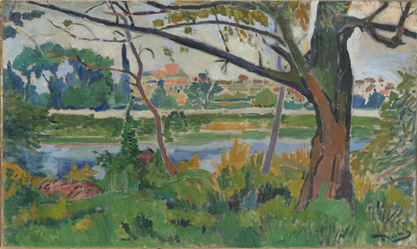
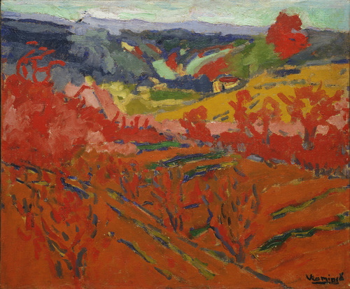
Let’s compare Derain and Vlaminck
André Derain. The Seine at Chatou. 1906
Maurice Vlaminck. Autumn Landscape,. c. 1905
How are these paintings similar?
How are they different?
MoMA Fauvism Theme
Notes:
Share this information with your students:
André Derain and Maurice Vlaminck lived and worked in Chatou in the beginning of the 1900s (now a suburb of Paris). In 1905, when Vlaminck painted Autumn Landscape, he was experimenting with "deconstruction," using paint in streaks and dabs to convey a sense of motion. Does Derain’s painting share a sense of motion? Both of these paintings represent countryside, but at different seasons. What other similarities and differences can you find?
Maurice Vllaminck also painted “the Seine at Chatou,” now at the Metropolitan Museum of Art http://www.metmuseum.org/toah/works-of-art/1999.363.84
André Derain. The Seine at Chatou. 1906
Oil on canvas, 32 1/2 x 40" (82.6 x 101.6 cm).
The William S. Paley Collection.
© 2012 Artists Rights Society (ARS), New York / ADAGP, Paris
SPC66.1990
Maurice Vlaminck. Autumn Landscape. c. 1905
Oil on canvas, 18 1/4 x 21 3/4" (46.2 x 55.2 cm).
Gift of Nate B. and Frances Spingold.
© 2012 Artists Rights Society (ARS), New York / ADAGP, Paris
80.1958

Slide 7
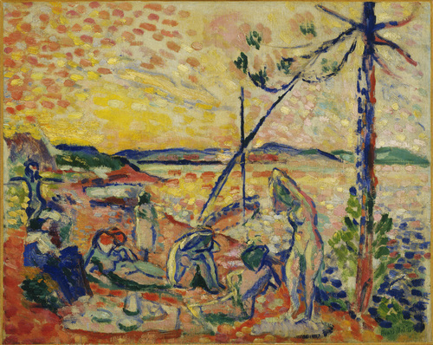
Henri Matisse. Study for “Luxe, calme et volupté,” 1904
MoMA Fauvism Theme
Notes:
Share this information with your students:
Matisse said, "What I dream of is an art of balance, of purity and serenity, devoid of troubling or depressing subject matter." Do you think this painting exhibits Matisse’s dream? If Matisse dreamt of subject matter that is devoid of trouble, what about the way he painted his subject matter? Can that be said to be devoid of trouble given the time period and culture that Matisse was working in? Why or why not? Can you find evidence for your opinions in the painting?
Henri Matisse. Study for "Luxe, calme et volupté“. 1904.
Oil on canvas, 12 7/8 x 16" (32.7 x 40.6 cm).
Mrs. John Hay Whitney Bequest.
© 2012 Succession H. Matisse, Paris / Artists Rights Society (ARS), New York
582.1998
Quote from Henri Matisse, "Notes of a Painter," in Matisse: His Art and His Public, 1951; repr. Herschel B. Chipp, Theories on Modern Art (Berkeley: University of California Press, 1968), 130.

Slide 8
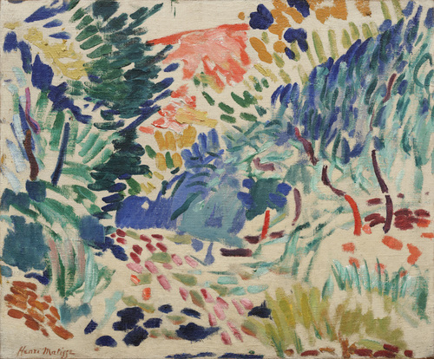
Henri Matisse. Landscape at Collioure. 1906
MoMA Fauvism Theme
Notes:
Share this information with your students:
Matisse scholar John Elderfield wrote that the landscapes Matisse painted in the summer of 1905 were "wilder, more reckless than any subsequently produced in his career. In the works of that period color speaks for itself with a directness previously unknown in Western painting, and speaks directly too of the emotional response to the natural world that required changing the color of this world the better to render that emotion.” Can you find examples where “color speaks for itself” in this painting?
Henri Matisse. Landscape at Collioure. 1905
Oil on canvas, 15 1/4 x 18 3/8" (38.8 x 46.6 cm).
Gift and bequest of Louise Reinhardt Smith.
© 2012 Succession H. Matisse, Paris/Artists Rights Society (ARS), New York
364.1990
Quote from John Elderfield in Museum of Modern Art. Major Work by Matisse, Gift of Mrs. Bertram Smith, on View at the Museum of Modern Art. New York: MoMA, 10 Aug. 1990. Print. Available online: http://www.moma.org/docs/press_archives/6838/releases/MOMA_1990_0089_92.pdf?2010

