Slide 1
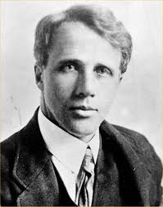
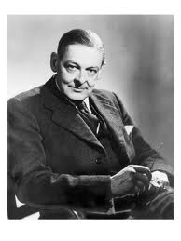
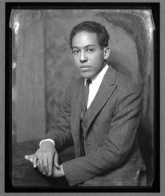
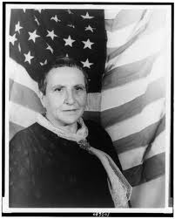
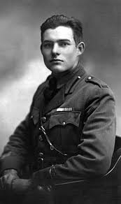
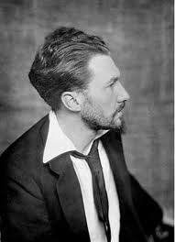
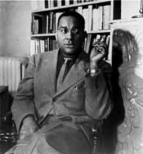
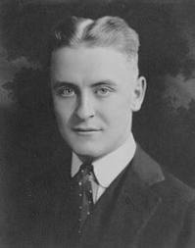
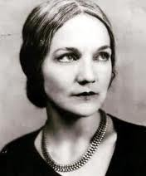
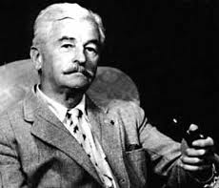
The Modern Period in American Literature
1915-1945
Dr. Karen Rose

Slide 2
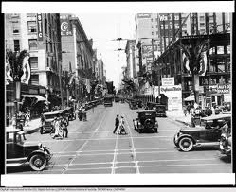
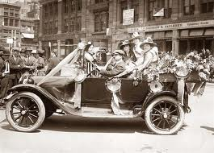
Many historians argue that America’s cultural coming of age occurs during this time.
The artistic innovations of Modernism are viewed as a response to dramatic historical, cultural, and economic events.

Slide 3

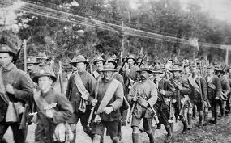
Significant Events of the Modern Period
1914 – World War I begins. President Wilson declares America’s neutrality.
1917 – The U.S. enters World War I to “make the world safe for democracy.”
1918 – World War I ends
8.7 million people died for reasons many people could not understand

Slide 4
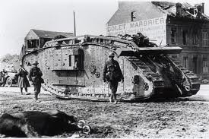
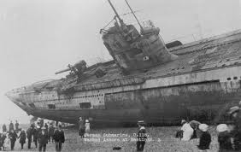

Before World War I, people believed that technology was a sign of progress and that it would help to serve humanity. The horrors of technology applied to warfare, however, highlighted the ambiguities of “progress.”
Machine guns, tanks, submarines, airplanes, flame throwers, and poison gas
proved that technology could be used for mass violence.

Slide 5
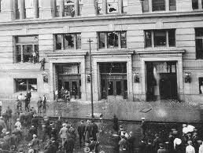
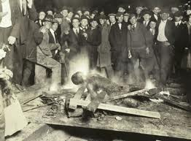
1919 – Riots motivated by racial tensions erupt in American cities during the
“Red-Summer of 1919.”
The worst riots occurred in Chicago after a black teenager was stoned to death for swimming in a whites only Lake Michigan beach. Blacks retaliated, and whites reacted. After over a week of violence, 38 people were killed, 537 were injured, and over 1,000 were left homeless.

Slide 6
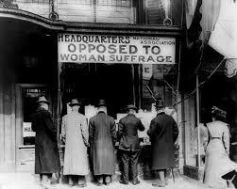
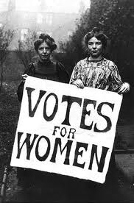
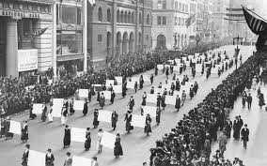
1920 – The Nineteenth Amendment gave women the right to vote.

Slide 7
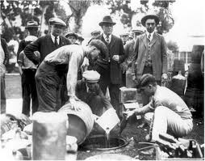
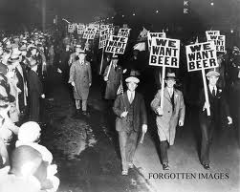
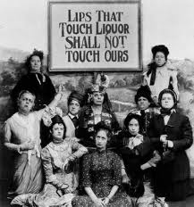
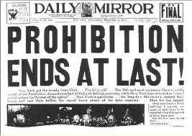
  1920 - Prohibition begins after the Eighteenth Amendment forbids the “manufacture, sale, or transportation of intoxicating liquors.”
  1933 – The Eighteenth Amendment is repealed.

Slide 8
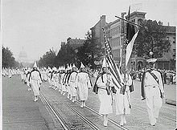
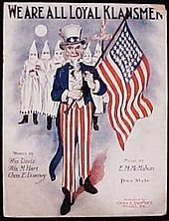
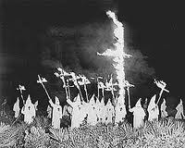
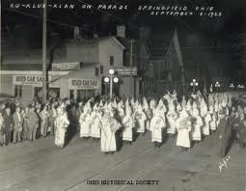
1923 – Ku Klux Klan membership rises to a reported 4 million.

Slide 9
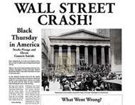
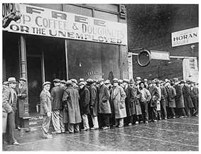
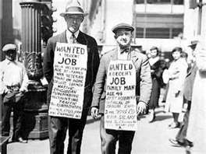
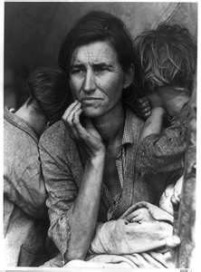

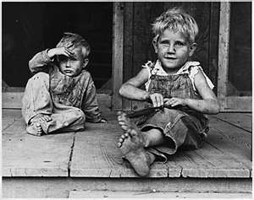
1929 – The U.S. Stock Market crashes
1930s – The Great Depression

Slide 10
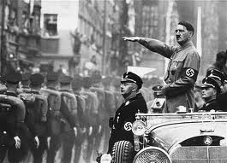
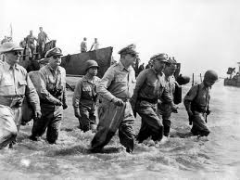
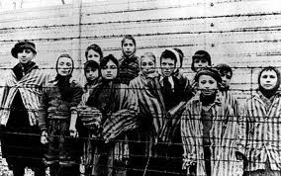
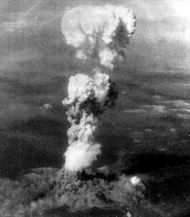
1939 – France and England declare war on Germany when Hitler invades Poland. World War II begins.
1941 - Japan attacks Pearl harbor, and America enters WWII.
  1942 - President Roosevelt initiates the Manhattan Project, a research and development project to build the atomic bomb.
  1945 - Allied troops liberate German concentration camps,
  American bombers drop napalm in Tokyo, the U.S. drops
  atomic bombs on Hiroshima and Nagasaki, Japan
  surrenders, World War II ends.

Slide 11
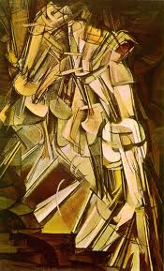
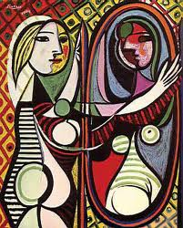
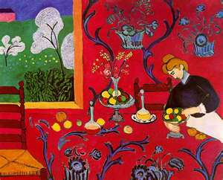
The events that took place during these tumultuous times had a deep and wide-ranging impact on aesthetic sensibility.
Artists felt that traditional art forms could no longer express the modern psychological state of dislocation, alienation, anxiety.

Slide 12
Literary Modernism’s most significant feature is:
Experimentation
Style
Subject Matter
The phrase “make it new,” attributed to Ezra Pound, became a rallying cry for writers who participated in this cultural movement

Slide 13
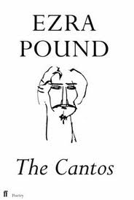
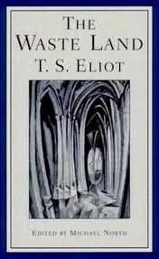
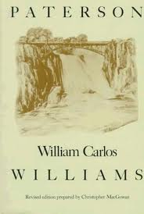
The Style of Literary Modernism.
Modernism’s literary forms are innovative and, often, challenging.
Writers were willing to disrupt traditional notions of order, sequence, and unity. They risked a certain amount of incoherence for the sake of experimentation.
Instead of predictable rhymes and forms, Modern poetry is sometimes chaotic, as if to mirror the randomness of modern life and to challenge the reader’s notion of order. While doing the reading for week 4, Ezra Pound, William Carlos Williams, T.S. Eliot, and Gertrude Stein will give you a sense of Modern poetry’s experimentation with style

Slide 14
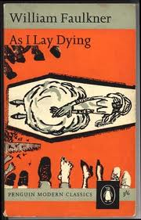
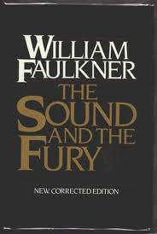
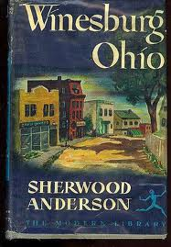
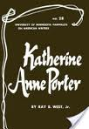
The Style of Literary Modernism
Stream of consciousness is a style that some Modern writers use to portray the inner workings of a character’s mind.
Writers catalog or describe the character’s thoughts, impressions, emotions, and ideas in rapid succession and without any interpretation or explanation by an outside narrator.
Writers who employ this style believe that it more accurately represents the confused and sometimes random jumps of the human mind.

Slide 15
The Subject Matter of Literary Modernism
Alienation
Existentialism
Primitivism
The Harlem Renaissance

Slide 16
Alienation
During the Modern period, many young Americans felt like outsiders within their own culture. It was difficult for them to come to terms with the unnecessary suffering and enormous loss of life caused by war. Many artists were also troubled by the racism and sexism that was prevalent in American culture.
This helps explain why many Modernists experimented with their own styles, rather than tap into the traditional literary forms of their culture.
The pervasive sense of alienation that many writers felt led them to leave the U.S. and live in “voluntary exile” in England and Europe.
Often referred to as “expatriates,” writers as diverse as Gertrude Stein, Ernest Hemingway, T.S. Eliot, Ezra Pound, Robert Frost, Langston Hughes, and Sherwood Anderson spent years living abroad.
In fact, some of them never returned home to the U.S.

Slide 17
Alienation
“You are all a lost generation.”
-Gertrude Stein
(quoted by Ernest Hemingway as an epigraph to his 1926 novel, The Sun Also Rises)

Slide 18

Existentialism
Many modernists rejected traditional philosophical and religious systems of belief in favor of Existentialism, which suggests a meaningless, chaotic, Godless world.
Existentialists believe that the individual has the sole responsibility for giving his/her own life meaning and living life passionately and sincerely, in spite of many obstacles and distractions including despair, angst, absurdity, boredom, and death.

Slide 19
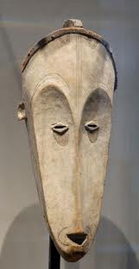
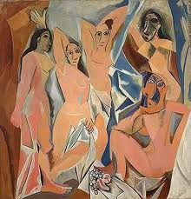
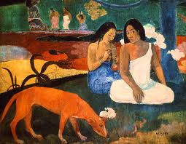
Primitivism
Modernists were inspired by Native American and African American art. The obsession with so-called “primitive” material and attitudes was fueled by an exploding interest in Freudian and Jungian psychology. Both Freud and Jung discussed “hidden,” subconscious motives, and the “primitive” appeared to offer a setting to explore their theories of psychology and sexuality.
The “primitive” was appealing because it seemed to represent a world unaffected by the constraints of modernity.

Slide 20




Harlem Renaissance
During the 1920s, Harlem – an area in upper Manhattan, New York -- became the national center of African American culture: theater, music, dance, and literature.
The Harlem Renaissance refers to the period just after WWI to the Depression when African American writers produced a tremendous amount of literary work.
Writers of the Harlem Renaissance express disillusionment with America and its promises. Their disappointment was fueled by the continued racial strife and outbursts of prejudice and violence.

Slide 21


In conclusion, Modernism was a massive movement that included a broad range of authors, styles, and themes.
It was a revolt against the conservative values of Realism.
Modernism underscored the abstract, unconventional, largely uncertain ethic brought on by rapidly changing technology and dramatic cultural shifts.
Due to the richness of the art and literature produced during this time, it is sometimes referred to as the 20th Century Renaissance.
Due to the richness of the art and literature produced during this period, it
is often referred to as the Twentieth Century Renaissance.

