Slide 1

Cubism

Slide 2
Cubism
MoMA What is Modern Art?

Slide 3
Questions
How did Cubists push the boundaries of ‘traditional’ still lifes and portraits?
What was new and different in their approach to painting?
MoMA What is Modern Art?

Slide 4
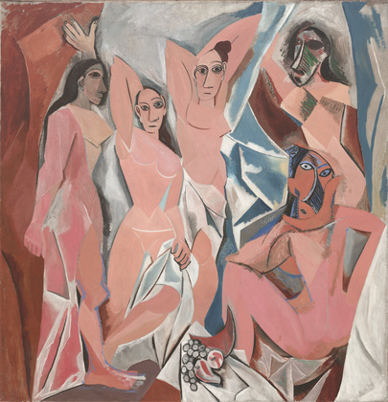
Now, let’s take a close look at Les Demoiselles d’Avignon by Picasso.
Describe what makes these figures so unconventional.
What do you notice about the setting? Do the fractured planes make the setting difficult to identify?
How did this work break with tradition?
How might this work of art have been controversial at the time it was painted?
Pablo Picasso. Les Demoiselles d'Avignon. Paris, June-July 1907
MoMA What is Modern Art?
Notes:
Share this information with your students:
Do you notice flat, splintered planes and geometric shapes? Influences from a non-Western culture?
Give your class a few minutes to look at Les Demoiselles d’Avignon. Ask them to describe what they see in the work. Have them observe the figures carefully, noting what each is doing and comparing them to each other. Ask your students to describe the figures’ body language, facial expressions, and relationships to each other. Picasso based this work on a memory he had of a brothel on Avignon Street in Barcelona, Spain that he had visited when he was a young man. The size of this work is 8 feet tall by 7’8’’ wide. Have your students imagine how the size effects how the viewer interprets the work.

Slide 5
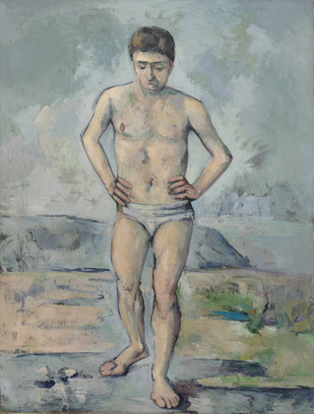
Let’s compare these two paintings.
Paul Cézanne. The Bather. c. 1885
Pablo Picasso. Les Demoiselles d'Avignon. Paris, June-July 1907
MoMA What is Modern Art?
Notes:
Share this information with your students:
How is The Bather different from Les Demoiselles d’Avignon? How is it similar? What makes Les Demoiselles d’Avignon an early Cubist work of art? In your opinion, which painting is more modern? Explain.
To help organize the conversation, ask students to first describe what they notice about each work’s formal aspects: composition, color, line, shape, and painting style. Then ask, do you notice anything ‘new’ or ‘modern’ in either painting? What makes Les Demoiselles d’Avignon an early Cubist work of art? (geometric shapes, breaking the figure up into multiple perspectives)

Slide 6
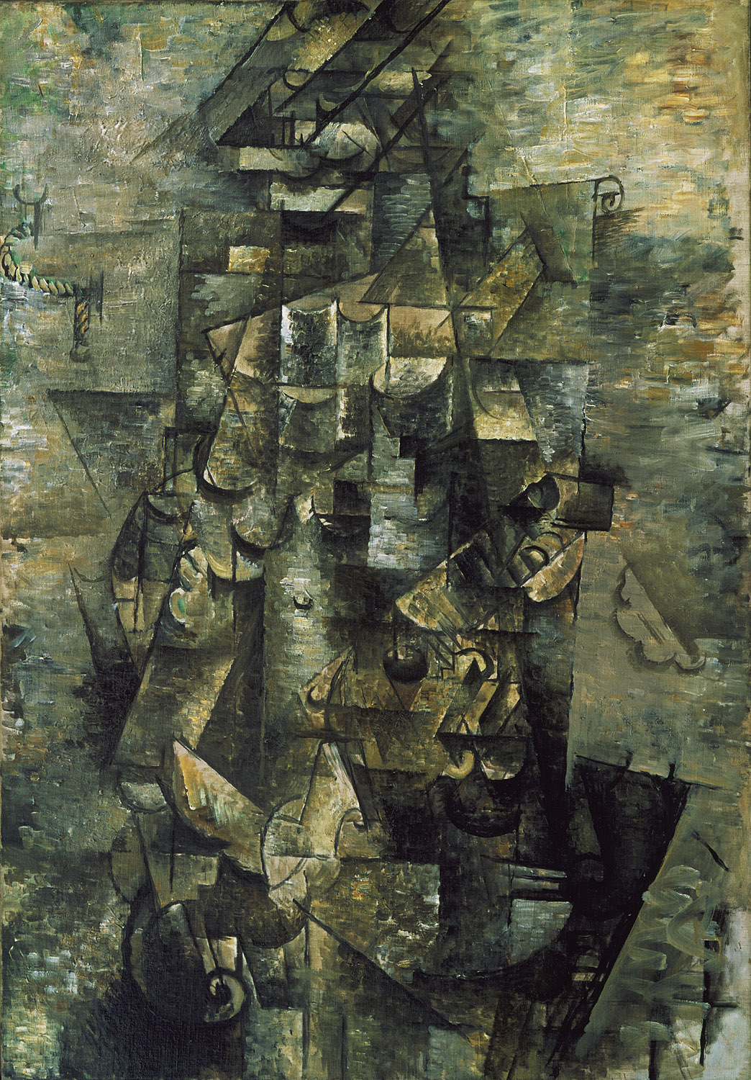
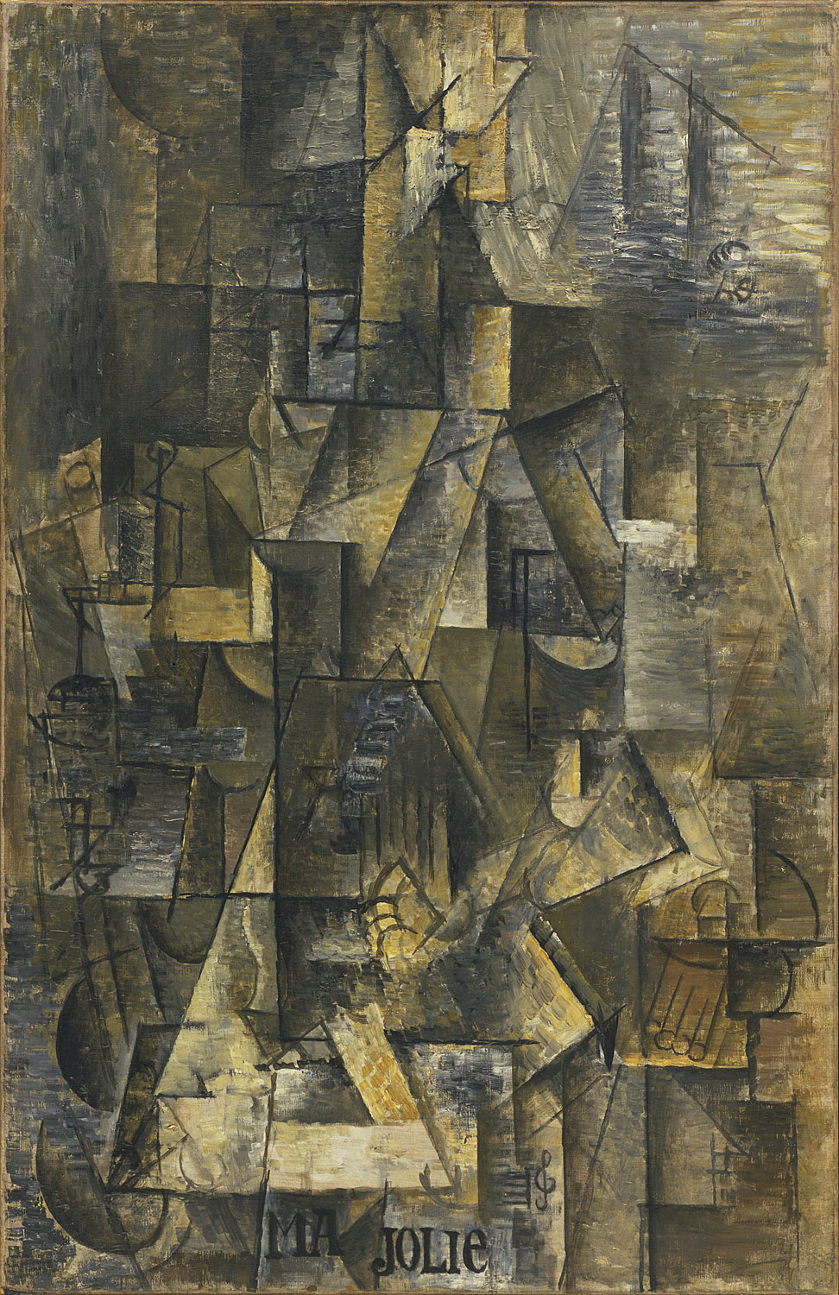
Compare and contrast two Cubist paintings by friends, Georges Braque and Pablo Picasso. Look at all of the different angles.
Georges Braque. Man with a Guitar. 1911
Pablo Picasso. Ma Jolie. 1911–12
MoMA What is Modern Art?
Notes:
Share this information with your students:
Each painting contains a figure and a guitar. Try to have your students identify the figure and any other realistic parts. (Braque’s on the left has a rope on a nail in the upper left corner.) Both artists deliberately used muted colors so that the viewer would notice the angles, shapes, and composition rather than the color. Picasso and Braque worked so closely together that many people had trouble distinguishing their work. The two artists often left signatures off their canvases, signing the back rather than the front, in order to encourage confusion.

Slide 7
Braque is on the left, Picasso is on the right. Can you find the figure in each?
Georges Braque. Man with a Guitar. 1911
Pablo Picasso. Ma Jolie. 1911–12
MoMA What is Modern Art?
Notes:
Share this information with your students:
Picasso and Braque worked so closely together that many people had trouble distinguishing their work. The two artists often left signatures off their canvases, signing the back rather than the front, in order to encourage confusion. Braque described their relationship as that of two mountaineers roped together.

Slide 8
Georges Braque. Man with a Guitar. 1911
MoMA What is Modern Art?

Slide 9
Pablo Picasso. Ma Jolie. 1911–12
MoMA What is Modern Art?

Slide 10
Questions
Why were the Cubist artists considered so radical at the time?
How did Cubism lay the groundwork for abstract art?
MoMA What is Modern Art?
Notes:
Share this information with your students:
The Cubists developed a visual language of geometric planes and compressed space that rejected the conventions of perspective and representation. Cubist works challenged viewers to understand a subject broken down into its geometrical components often represented from several angles at once.

