Slide 1

Dada (1916-1922)

Slide 2
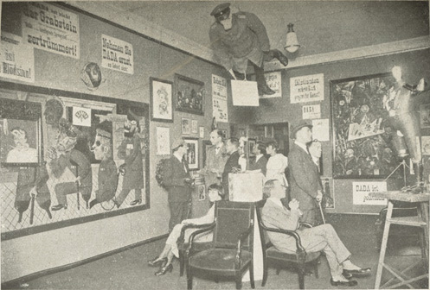
The first gallery of the First International Dada Fair. This photo was taken in the room of fine art dealer Dr. Otto Burchard. Berlin, Germany, June 30-August 25, 1920.
MoMA Dada Theme
Notes:
Share this information with your students:
Dada emerged during World War I (1914-1918)-- a conflict that claimed the lives of eight million soldiers and an estimated equal number of civilians. For the disillusioned artists of Dada, the war merely confirmed the bankruptcy of social, political, and economic structures that permitted and supported such violence. From 1916 until the mid 1920s, a loose network of Dada artists in Zurich, New York, Cologne, Hanover, and Paris declared an all-out assault against not only conventional definitions of art but rational thought itself. “The beginnings of Dada,“ poet Tristan Tzara recalled, “were not the beginnings of art, but of disgust.”
Dada affiliates did not share a common style or practice so much as the wish, as expressed by French artist Jean (Hans) Arp, “to destroy the hoaxes of reason and to discover an unreasoned order.”
In Dada, visual art was considered secondary-- useful as a means of communication, but of less importance than the ideas they communicated. "For us, art is not an end in itself,” wrote Dada poet Hugo Ball, “but it is an opportunity for the true perception and criticism of the times we live in.” Artists affiliated with Dada were nevertheless experimental in the ways they made art, provocatively re-imagining what art and art-making could be. They used unorthodox materials and chance procedures, infusing their work with spontaneity and irreverence.
The climax of Berlin Dada was the International Dada Fair of 1920, the central symbol of which was a dummy of a German officer with the head of a pig that hung from the ceiling of the main gallery.
This photo was taken in the room of the fine art dealer, Dr. Burchard, Berlin, June 5, 1920. From left to right: Hausmann, Hanna Höch, Dr Burchard, Baader, W. Hetzfelde, the wife, Dr. Oz, George Grosz, John Heartfield. Reproduction opposite page 128 from the book, "Dada Almanach; im Auftrag des Zentralamts der Deutschen Dada-Bewegung," by Richard Huelsenbeck.

Slide 3
Marcel Duchamp and the Readymade
MoMA Dada Theme

Slide 4
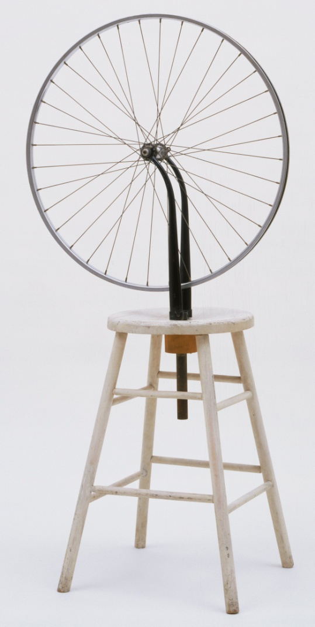
Take a moment to think about what makes something a work of art.
Does Marcel Duchamp’s sculpture fulfill any of your criteria for something to be called a work of art?
Marcel Duchamp. Bicycle Wheel. New York, 1951 (third version, after lost original of 1913).
MoMA Dada Theme
Notes:
Share this information with your students:
Take a moment to think about what makes something a work of art. What is art supposed to accomplish? Who is it for? Does Marcel Duchamp’s sculpture fulfill any of your criteria for something to be called a work of art?
Support your observations with visual evidence. Duchamp made this work by fastening a bicycle wheel to a kitchen stool, rendering these two functional objects unusable. Notice that there is no tire on the bicycle wheel.
To challenge accepted notions of art, Duchamp selected mass-produced, often functional objects from everyday life for his artworks, which he called Readymades. He did this to shift viewers’ engagement with a work of art from what he called the “retinal” (there to please the eye) to the “intellectual” (“in the service of the mind.”). By doing so, Duchamp subverted the traditional notion that beauty is a defining characteristic of art.
Bicycle Wheel is the third version of this work. The first, now lost, was made in 1913, almost forty years earlier. Because the materials Duchamp selected to be Readymades were mass-produced, he did not consider any Readymade to be “original.”
Marcel Duchamp. Bicycle Wheel. New York, 1951 (third version, after lost original of 1913).
Metal wheel mounted on painted wood stool, 51 x 25 x 16 1/2" (129.5 x 63.5 x 41.9 cm).
The Sidney and Harriet Janis Collection.
© 2012 Artists Rights Society (ARS), New York/ADAGP, Paris/Estate of Marcel Duchamp

Slide 5
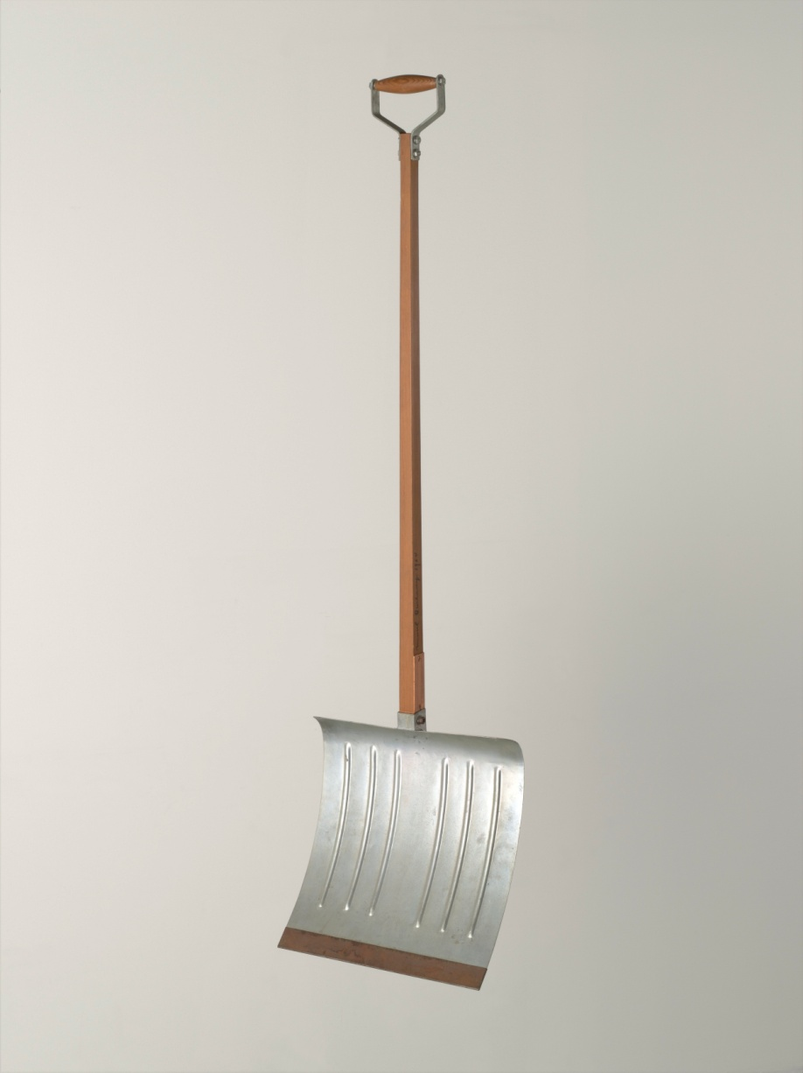
Marcel Duchamp. In Advance of the Broken Arm. August 1964 (fourth version, after lost original of November 1915).
MoMA Dada Theme
Notes:
Share this information with your students:
In Advance of a Broken Arm presumes that the viewer knows clearing snow with a shovel can prevent a fall that might result in a broken arm. The playfulness of Duchamp’s title is a hallmark of conceptual art, a movement he is considered to have pioneered.
Marcel Duchamp. In Advance of the Broken Arm. August 1964 (fourth version, after lost original of November 1915). Wood and galvanized-iron snow shovel, 52" (132 cm) high. Gift of The Jerry and Emily Spiegel Family Foundation. © 2012 Artists Rights Society (ARS), New York/ADAGP, Paris/Estate of Marcel Duchamp

Slide 6
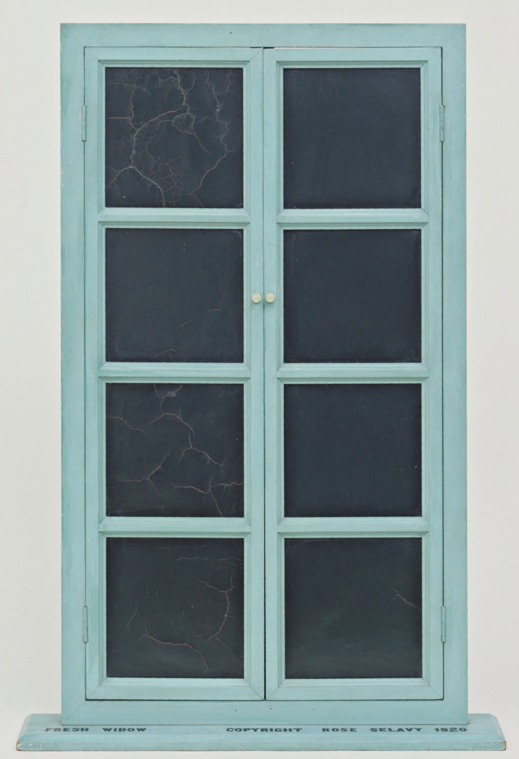
Marcel Duchamp. Fresh Widow. 1920.
MoMA Dada Theme
Notes:
Share this information with your students:
Constructed by a carpenter in accordance with Duchamp's instructions, Fresh Widow is a reduced scale version of the standard double-door French window. Duchamp was fascinated by themes of sight and perception; here, the expectation of a view is thwarted by black leather pieces, which Duchamp insisted “be shined everyday like shoes.”
Puns and wordplay were also central within Duchamp’s work. With the change of three letters, Duchamp transforms the inanimate "French window" into the title "Fresh Widow," a punning reference to the recently-made widows of World War I fighters.
An inscription at the base reads "COPYRIGHT ROSE SELAVY 1920," making it the first work to be signed by Duchamp’s female alter ego Rose Sélavy (later spelled Rrose).
Marcel Duchamp. Fresh Widow. 1920. Miniature French window, painted wood frame, and panes of glass covered with black leather, 30 1/2 x 17 5/8" (77.5 x 44.8 cm), on wood sill 3/4 x 21 x 4" (1.9 x 53.4 x 10.2 cm). Katherine S. Dreier Bequest.
© 2012 Artists Rights Society (ARS), New York/ADAGP, Paris/Estate of Marcel Duchamp

Slide 7
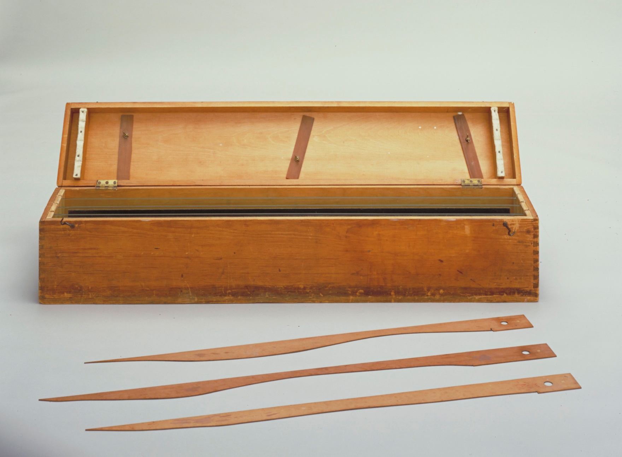
Marcel Duchamp. 3 Standard Stoppages. 1913–14.
MoMA Dada Theme
Notes:
Share this information with your students:
Read this note aloud, which describes the parameters by which Duchamp created this work: "If a straight horizontal thread one meter long falls from a height of one meter onto a horizontal plane twisting as it pleases [it] creates a new image of the unit of length."
Duchamp dropped three one-meter long threads from the height of one meter onto three stretched canvases. The threads were then adhered to the canvases, preserving the random curves they assumed upon landing. Cut along the threads' profiles, the canvases served as templates for three draftsman’s straightedges—wood tools that retain the length of the meter but paradoxically “standardize” the accidental curve.
Marcel Duchamp. 3 Standard Stoppages. 1913–14. Wood box 11 1/8 x 50 7/8 x 9" (28.2 x 129.2 x 22.7 cm), with three threads 39 3/8" (100 cm), glued to three painted canvas strips 5 1/4 x 47 1/4" (13.3 x 120 cm), each mounted on a glass panel 7 1/4 x 49 3/8 x 1/4" (18.4 x 125.4 x 0.6 cm), three wood slats 2 1/2 x 43 x 1/8" (6.2 x 109.2 x 0.2 cm), shaped along one edge to match the curves of the threads. Katherine S. Dreier Bequest. © 2012 Artists Rights Society (ARS), New York/ADAGP, Paris/Estate of Marcel Duchamp

Slide 8
Chance Creations: Collage, Photomontage, and Assemblage
MoMA Dada Theme

Slide 9
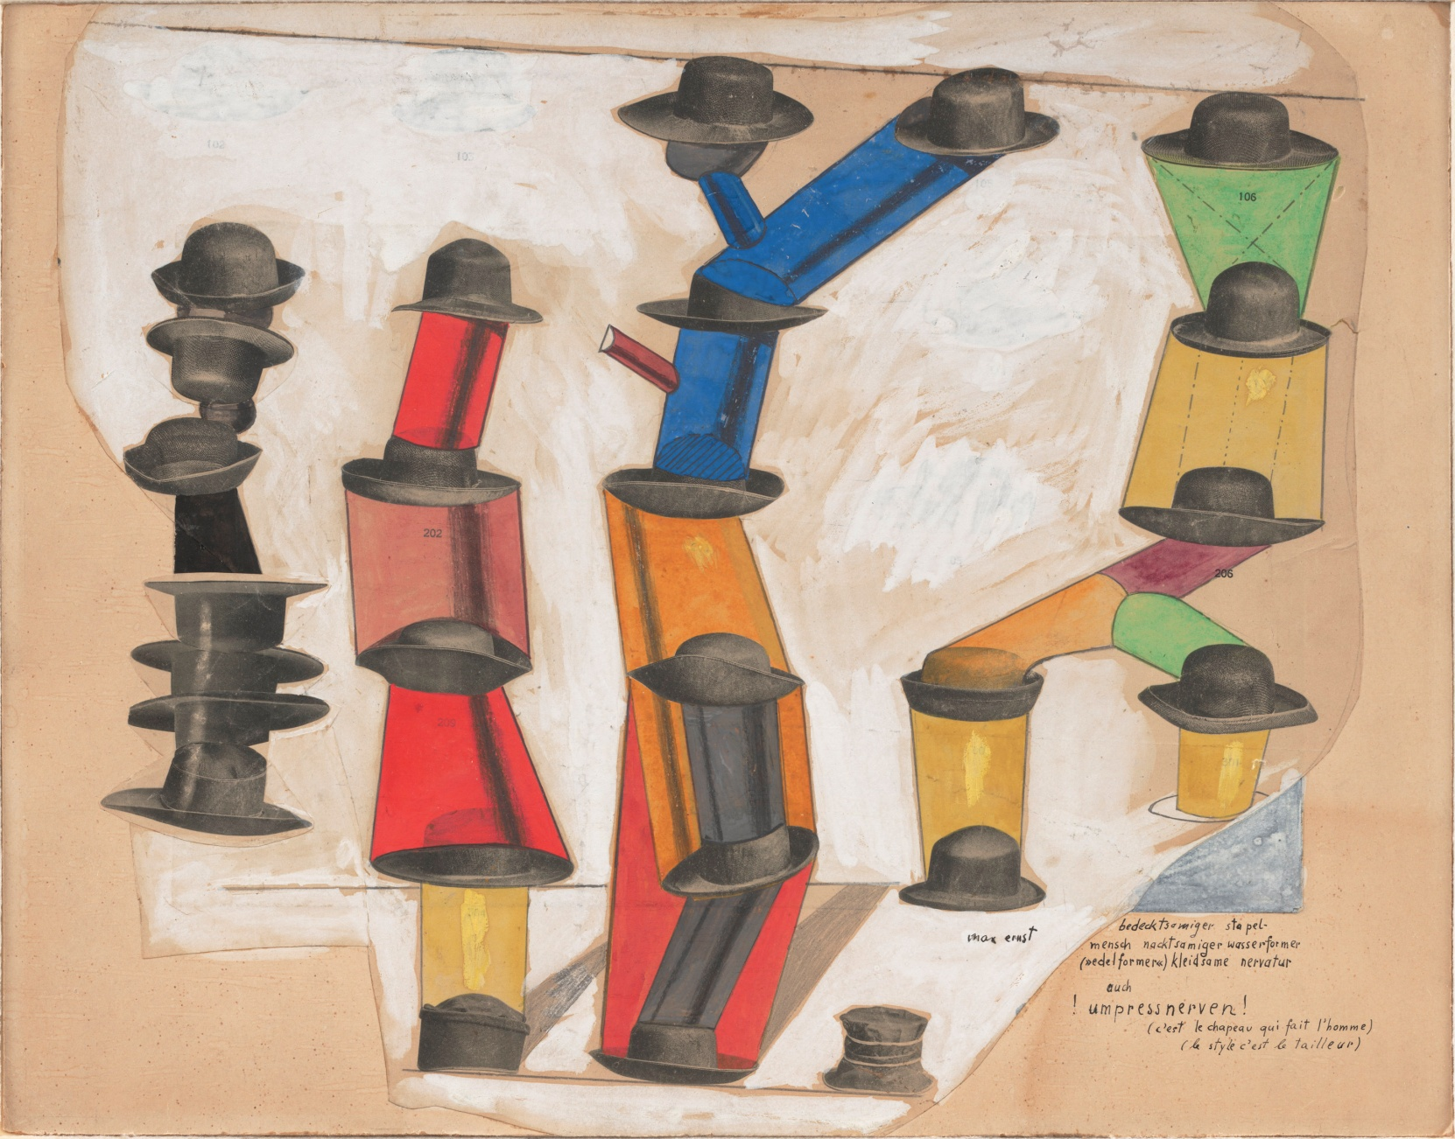
Max Ernst. The Hat Makes the Man. 1920.
MoMA Dada Theme
Notes:
Share this information with your students:
In The Hat Makes the Man, Ernst cut, pasted, and stacked images of men’s hats clipped from a sales catalogue. The suggestively phallic towers and tongue-in-cheek title were likely inspired by Sigmund Freud’s book The Joke and It’s Relation to the Unconscious (1905), in which the famed psychoanalyst identified the hat as a common symbol representing repressed desire. The visual pun adds new and bawdy spin to the cliché inscribed on the work, "C'est le chapeau qui fait l'homme" ("The hat makes the man").
To artists in the Dada circle, irrationality and chance occurrences had more value than rational thought and ordered ideas. To abandon oneself to the laws of chance was to subvert those elements that had long defined artistic practice-- craft, control, and intentionality. Chance, accident, and improvisation figured prominently in the creation of flat collages and three-dimensional assemblages. Closely related photomontages (also known as a photocollages) consisted entirely of found photographic images.
Ask your students to describe what objects, images, and texts they have on the walls of their bedrooms or on bulletin boards. Ask them to consider what these objects and their arrangement reveal about them as individuals. Have your students name similarities and differences between school bulletin boards and their own walls or bulletin boards at home with respect to choice of content and how it is arranged.
This is a work by Max Ernst. Ask your students to imagine how this picture was made. To help students explain what they are seeing, it may be useful to introduce them to the term “collage.”
Collage is the technique and resulting work of art in which fragments of paper and other materials are arranged and glued to a supporting surface.
Max Ernst. The Hat Makes the Man. 1920.
Gouache, pencil, oil, and ink on cut-and-pasted printed paper on paper, 13 7/8 x 17 3/4" (35.2 x 45.1 cm). Purchase.
© 2012 Artists Rights Society (ARS), New York/ADAGP, Paris

Slide 10
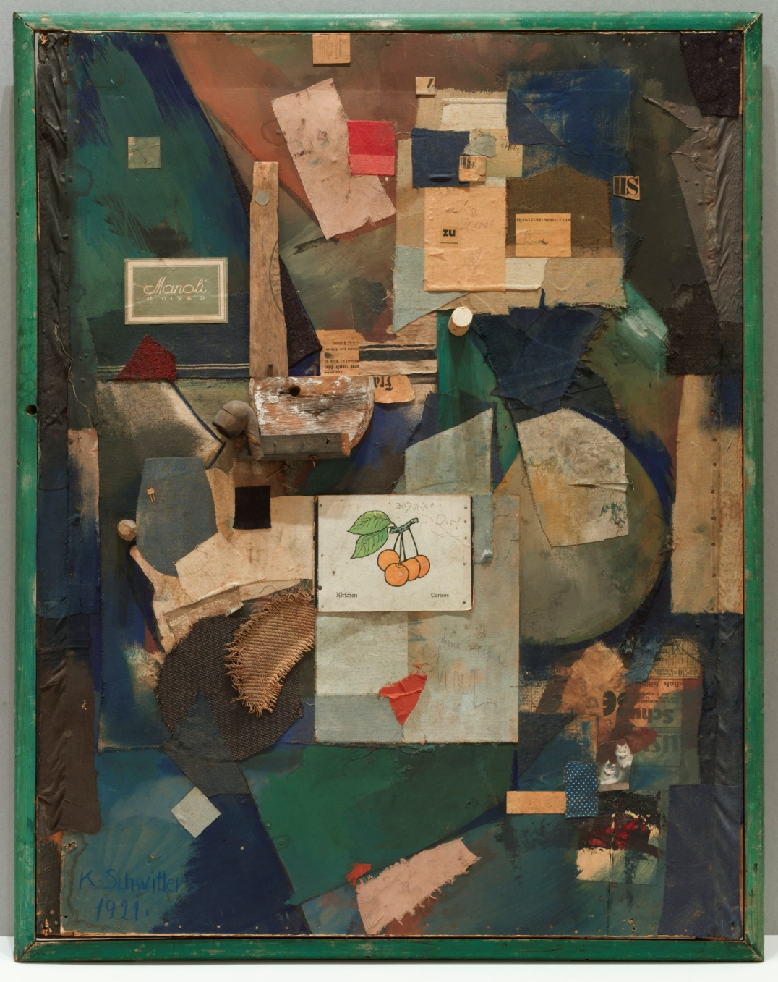
Kurt Schwitters. Merz Picture 32 A. The Cherry Picture. 1921.
MoMA Dada Theme
Notes:
Share this information with your students:
Give your class a couple of minutes to look at Merz Picture 32A (The Cherry Picture) by Kurt Schwitters. Ask your students to describe what they see. Ask them to consider composition, color, material, and images. Ask your students to imagine how this picture was made.
Schwitters made this work from scraps and objects he collected from the streets of his hometown of Hannover, Germany. Although he scavenged the fragments, Schwitters carefully composed and affixed them with glue and nails to a painted board to make this collage.
Schwitters was trained as a painter, but as World War I came to an end he adopted collage as his preferred process, saying, “[. . .] everything had broken down in any case and new things had to be made out of the fragments.” Merz Picture 32A (The Cherry Picture) belongs to the so-called Merz series, a term Schwitters derived from a syllable of the German word “Kommerz” (commerce), which he included in one of his early collage paintings. Schwitters stated that with his Merz project he aimed “to create connections, preferably between everything in this world.”
Ask your students: What connections can you draw between the fragments? How might the elements be related?
Kurt Schwitters. Merz Picture 32 A. The Cherry Picture. 1921. Cut-and-pasted colored and printed paper, cloth, wood, metal, cork, oil, pencil, and ink on paperboard, 36 1/8 x 27 3/4" (91.8 x 70.5 cm). Mr. and Mrs. A. Atwater Kent, Jr. Fund. © 2012 Artists Rights Society (ARS), New York/VG Bild-Kunst, Bonn

Slide 11
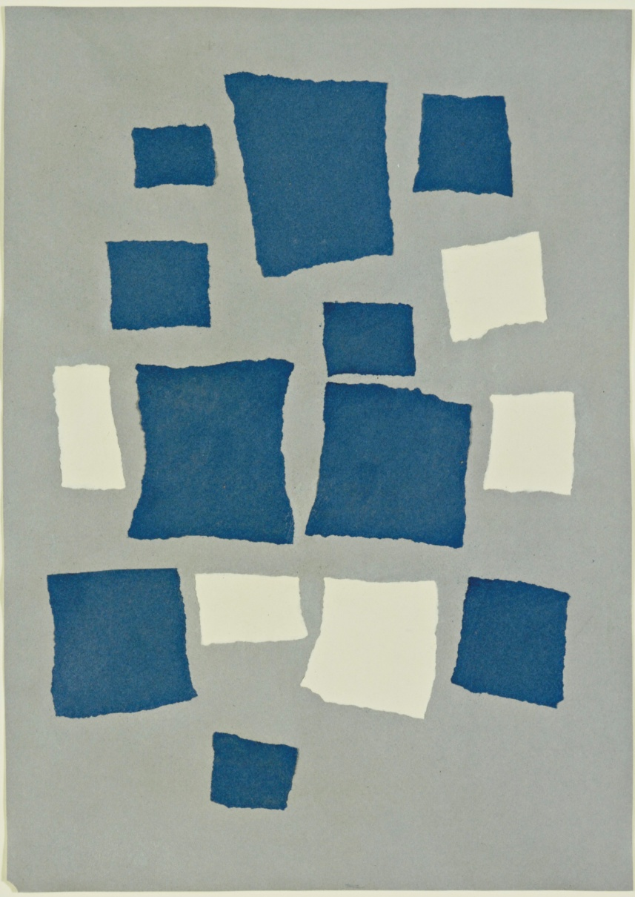
Jean (Hans) Arp. Untitled (Collage with Squares Arranged According to the Laws of Chance. 1916–17.
MoMA Dada Theme
Notes:
Share this information with your students:
Inform your students of the title of this work, and read aloud the following passage by Arp’s friend and fellow artist Hans Richter. Apparently, Arp, frustrated with a drawing he had been working on for some time,
[. . .] finally tore it up, and let the pieces flutter to the floor of his studio[. . . .] Some time
later he happened to notice these same scraps of paper as they lay on the floor, and was
struck by the pattern they formed. It had all the expressive power that he had tried in vain
to achieve. How meaningful! How telling! Chance movements of his hand and of the fluttering
scraps of paper had achieved what all his efforts had failed to achieve, namely
expression. He accepted this challenge from chance as a decision of fate and carefully
pasted the scraps down in the pattern which chance had determined.
There are accounts that Arp may have occasionally undermined chance and arranged the squares himself.
Based on your evaluation of the composition, do you believe that the artist made this work using chance? Why or why not?
Using visual evidence, ask your students to compare Merz 32A and Collage with Squares Arranged According to the Laws of Chance. How are they similar and how are they different?
Jean (Hans) Arp. Untitled (Collage with Squares Arranged According to the Laws of Chance. 1916–17. Torn-and-pasted paper and colored paper on colored paper, 19 1/8 x 13 5/8" (48.5 x 34.6 cm). Purchase. © 2012 Artists Rights Society (ARS), New York/VG Bild-Kunst, Bonn

Slide 12
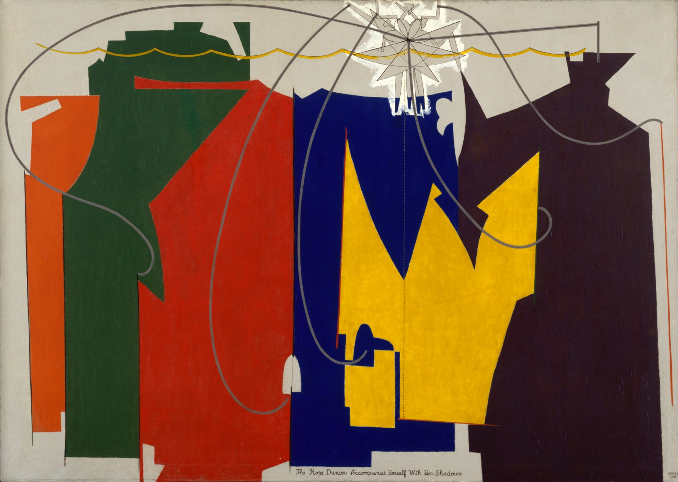
Man Ray. The Rope Dancer Accompanies Herself with Her Shadows. 1916.
MoMA Dada Theme
Notes:
Share this information with your students:
Though executed entirely in oil paint, The Rope Dancer Accompanies Herself with Her Shadows grew out of Man Ray’s numerous collage experiments. The work’s original composition was inspired by the view of a tightrope dancer in a vaudeville performance.
Man Ray. The Rope Dancer Accompanies Herself with Her Shadows. 1916.
Oil on canvas, 52" x 6' 1 3/8" (132.1 x 186.4 cm).
Gift of G. David Thompson.
© 2012 Man Ray Trust/Artists Rights Society (ARS), New York / ADAGP, Paris

Slide 13
Marcel Duchamp. 3 Standard Stoppages. 1913–14.
MoMA Dada Theme
Notes:
Share this information with your students:
Read this note aloud, which describes the parameters by which Duchamp created this work: "If a straight horizontal thread one meter long falls from a height of one meter onto a horizontal plane twisting as it pleases [it] creates a new image of the unit of length."
Duchamp dropped three one-meter long threads from the height of one meter onto three stretched canvases. The threads were then adhered to the canvases, preserving the random curves they assumed upon landing. Cut along the threads' profiles, the canvases served as templates for three draftsman’s straightedges—wood tools that retain the length of the meter but paradoxically “standardize” the accidental curve.
Marcel Duchamp. 3 Standard Stoppages. 1913–14. Wood box 11 1/8 x 50 7/8 x 9" (28.2 x 129.2 x 22.7 cm), with three threads 39 3/8" (100 cm), glued to three painted canvas strips 5 1/4 x 47 1/4" (13.3 x 120 cm), each mounted on a glass panel 7 1/4 x 49 3/8 x 1/4" (18.4 x 125.4 x 0.6 cm), three wood slats 2 1/2 x 43 x 1/8" (6.2 x 109.2 x 0.2 cm), shaped along one edge to match the curves of the threads. Katherine S. Dreier Bequest. © 2012 Artists Rights Society (ARS), New York/ADAGP, Paris/Estate of Marcel Duchamp

Slide 14
Artistic Collaboration
MoMA Dada Theme

Slide 15
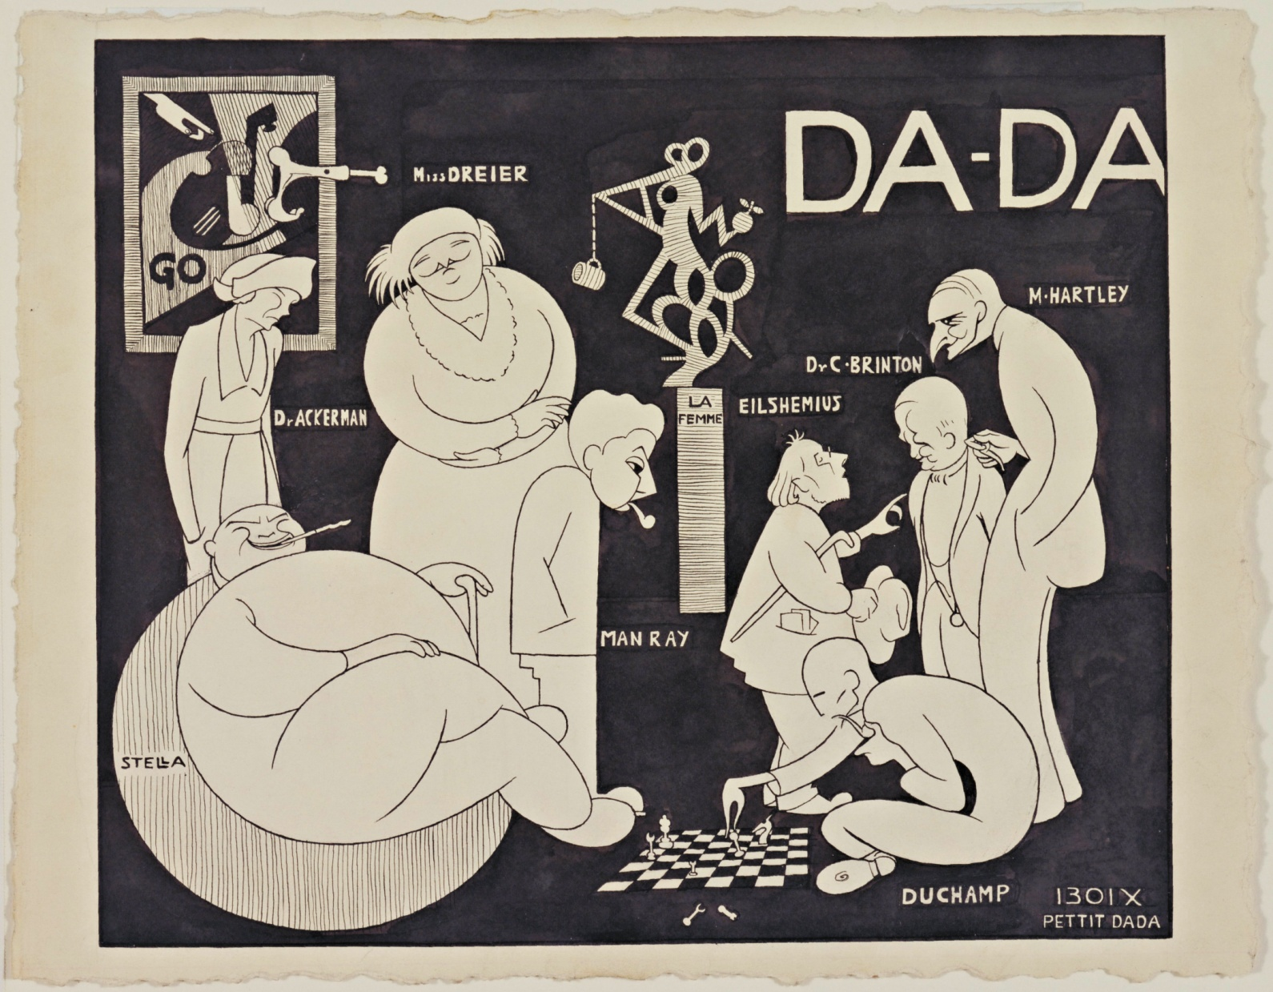
Richard Boix. Da-da (New York Dada Group). 1921.
MoMA Dada Theme
Notes:
Share this information with your students:
The spirit of performance, play, and collaboration remained central to Dada. Dadaists believed that the value of art lay not in the work produced, but in the act of making, and sharing that act with others.
Richard Boix. Da-da (New York Dada Group). 1921.
Ink on paper. 11 1/4" x 14 1/2" (28.6 x 36.8 cm).
Katherine S. Dreier Bequest

Slide 16
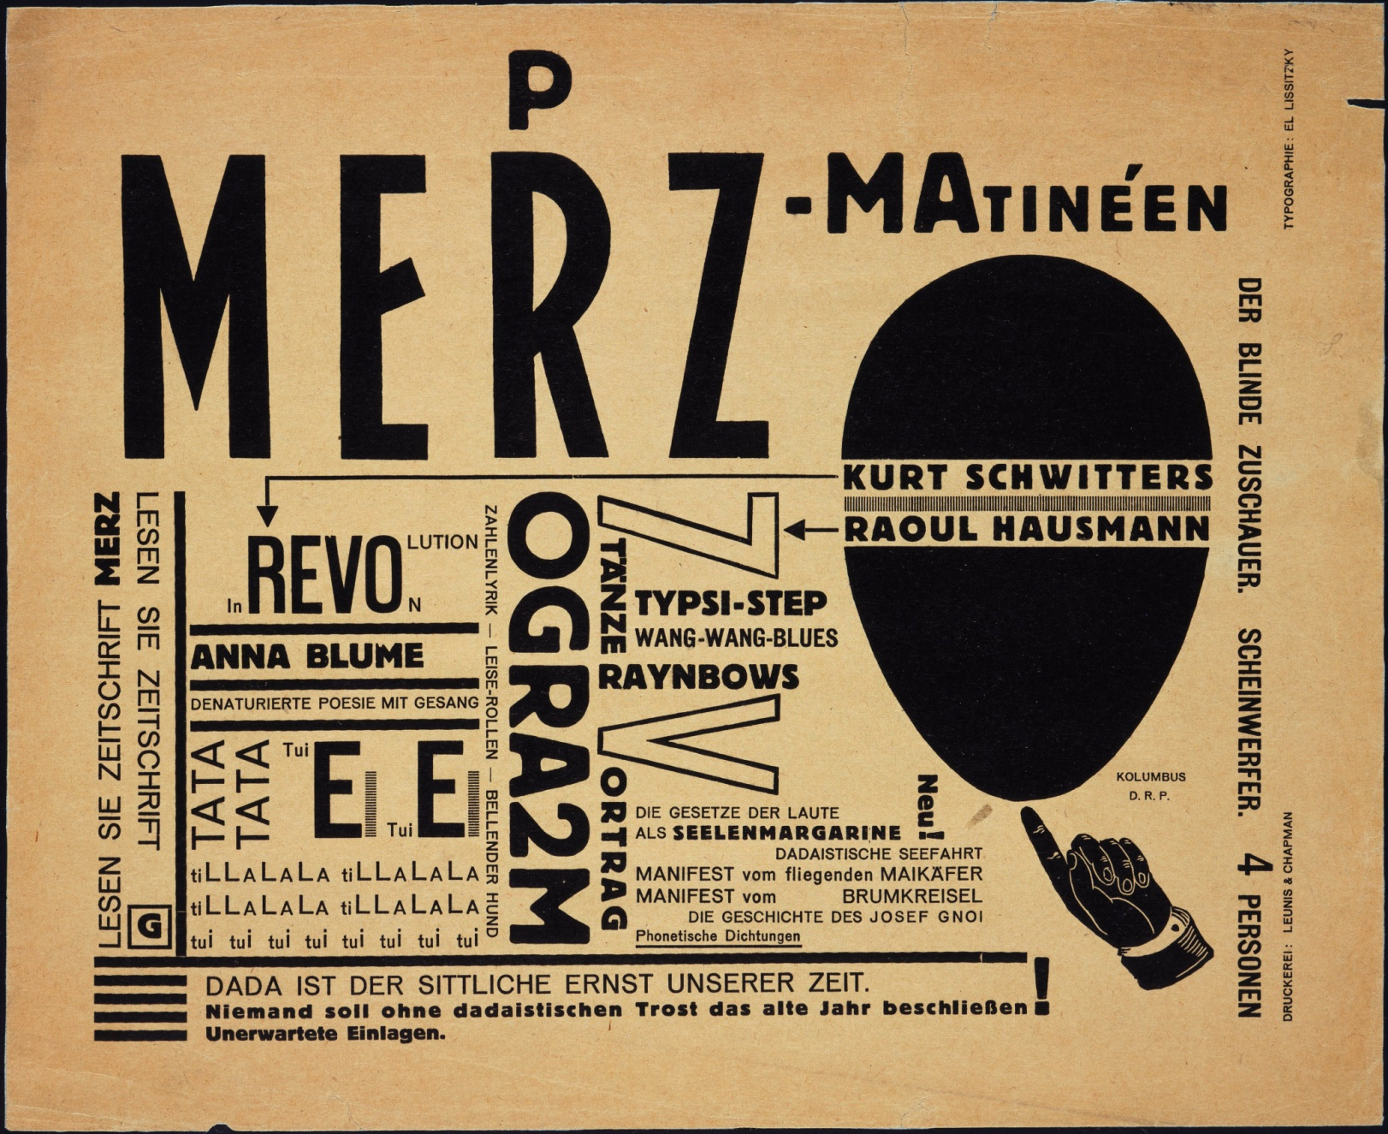
El Lissitzky. Cabaret Voltaire Program for Merz-Matinéen. 1923.
MoMA Dada Theme
Notes:
Share this information with your students:
The Cabaret Voltaire nightclub was launched in Zurich in February 1916 by a group of poets and artists including those mentioned on this program -- Raoul Haussman, Kurt Schwitters and El Lissitzky, who laid out its dynamic typography.
Cabaret Voltaire programs, such as the matinee advertised on this leaflet designed by El Lissitzky, promised not only experimental poetry, lectures, improvisational dance and music, but a variety of Dada pranks from which the audience was not immune. According to the program, this event featured a reading of Schwitter’s poem Anna Blume.
El Lissitzky. Cabaret Voltaire Program for Merz-Matinéen. 1923.
Publisher: Robert & Chapman Leunis, Publishers. Letterpress, 9 x 11" (22.9 x 27.9 cm).
Jan Tschichold Collection, Gift of Philip Johnson.
© 2012 Artists Rights Society (ARS), New York/VG Bild-Kunst, Bonn

Slide 17
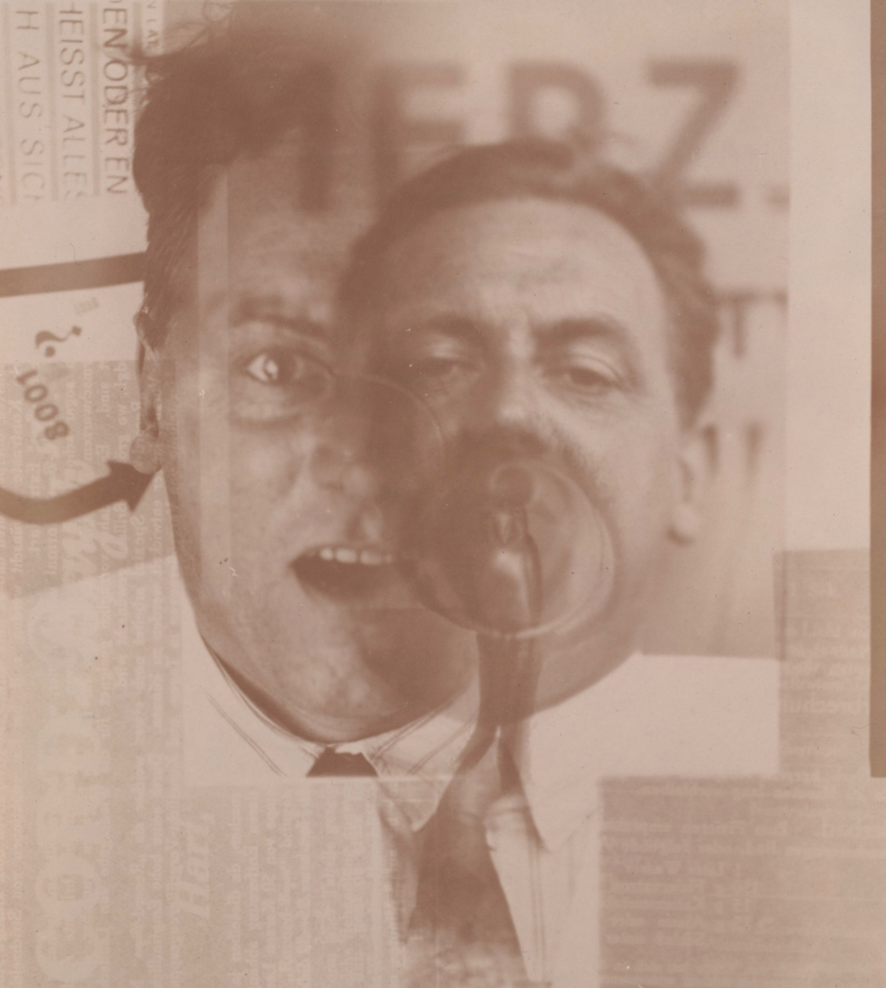
El Lissitzky. Kurt Schwitters. c. 1924.
MoMA Dada Theme
Notes:
Share this information with your students:
In 1922 Lissitzky traveled from his native Russia to Weimar, Germany, where he met Kurt Schwitters at a conference for progressive artists. Lissitsky’s fragmented double portrait of Schwitters, made by montaging negatives during the developing process, is indicative of the artists’ close collaboration, which lasted until Lissitzky returned to Russia in 1925.
Lissitzky imparted to Schwitters an interest in the crisp geometry of Russian design, while Schwitters exposed Lissitzky to the photomontage process with which this work was made.
El Lissitzky. Kurt Schwitters. c. 1924.
Gelatin silver printing-out-paper print, 4 3/16 x 3 11/16" (10.6 x 9.4 cm).
Thomas Walther Collection. Purchase.
© 2012 Artists Rights Society (ARS), New York/VG Bild-Kunst, Bonn

Slide 18
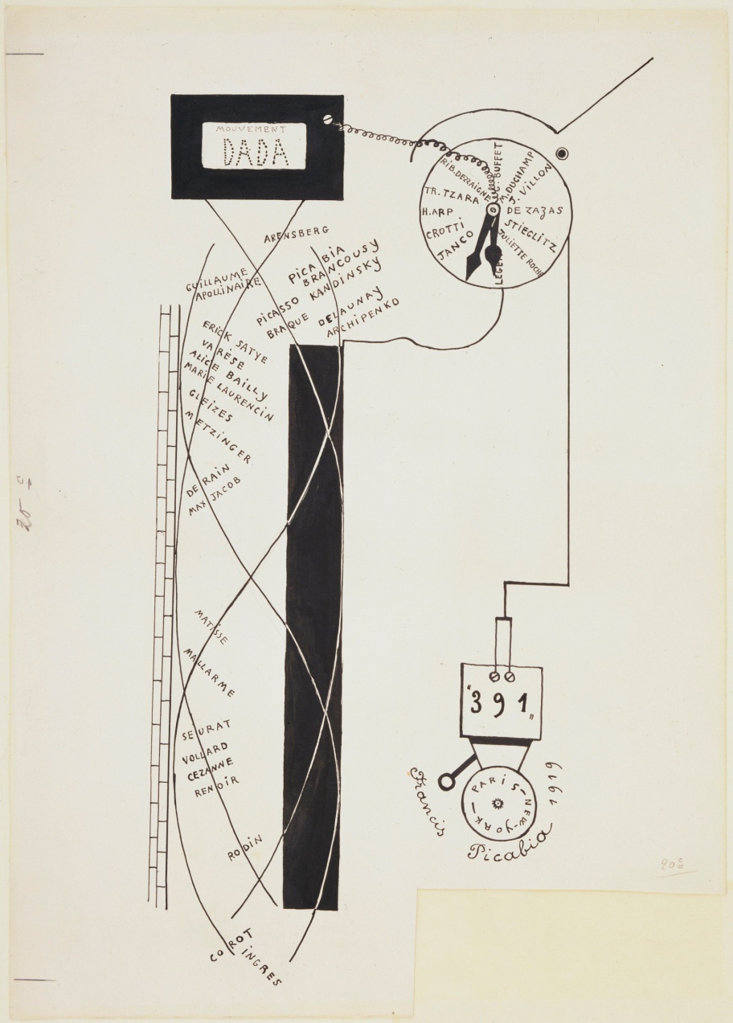
Francis Picabia. Dada Movement. 1919.
MoMA Dada Theme
Notes:
Share this information with your students:
This Picabia drawing imagines the inner workings of a Dada alarm clock, plots the flow of the current of modern art, beginning with 18th century French history painter Jean-Auguste-Dominique Ingres to 391, Picabia's own Dada magazine.
For those not mechanically inclined, Picabia offered this facetious glimpse of the inner workings of his Dada machine, excerpted from a lengthier explanation: “[…]Around the top of the active, positive (and therefore antitraditional) pole is an international cluster of innovative early twentieth–century artists, headed (of course) by Picabia himself. This positive pole directly connects with the Dada clock. The negative pole of French modernism, however, has to pass through the Dada transformer before it can be wired up to that inner circle. (Even then the wiring job looks amateur and not entirely convincing, but apparently it works.) When thus connected, the circuit is completed; the clock can start ticking, and the bell that was made in Paris and New York can begin to sound.”
Francis Picabia. Dada Movement. 1919.
Ink on paper, 20 1/8 x 14 1/4" (51.1 x 36.2 cm).
Purchase.
© 2012 Artists Rights Society (ARS), New York/ADAGP, Paris

Slide 19
Word Play
MoMA Dada Theme

Slide 20
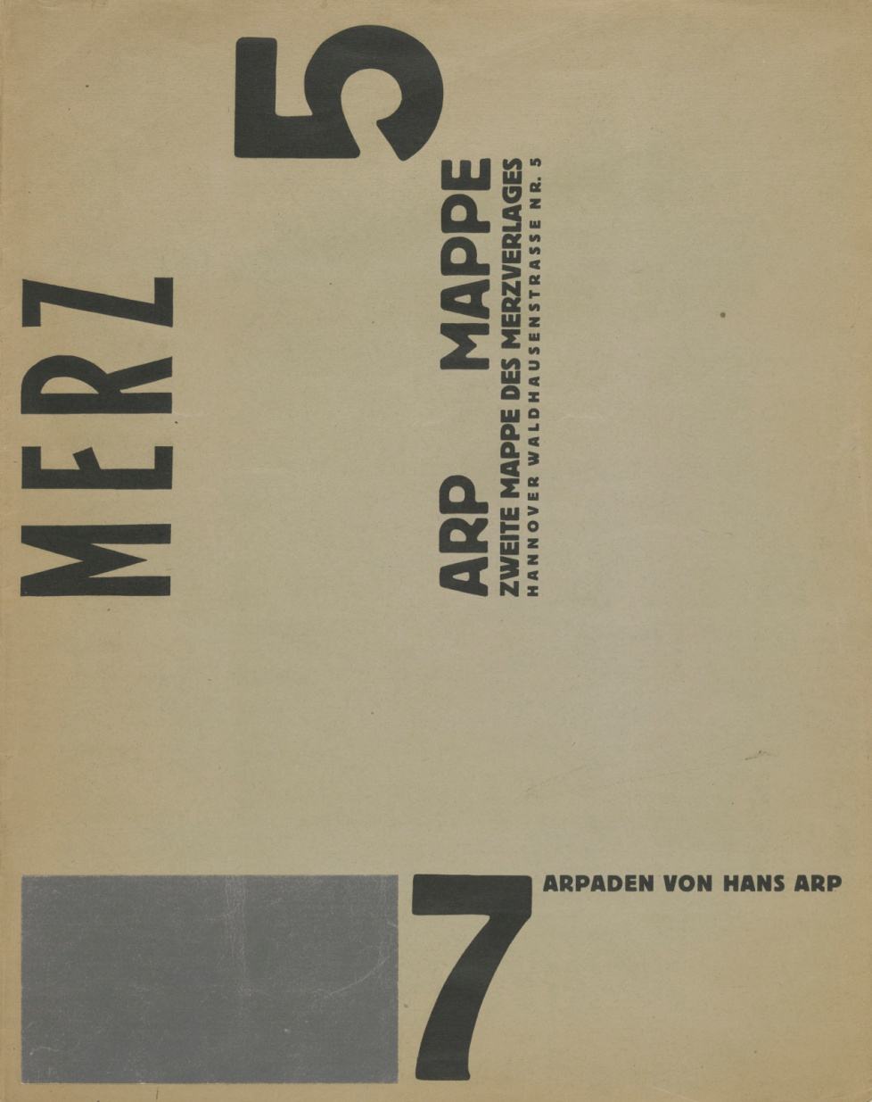
Jean (Hans) Arp. Merz 5, Arp Mappe: 7 Arpaden (Arp Portfolio: 7 Arpades). 1923.
MoMA Dada Theme
Notes:
Share this information with your students:
To liberate text and speech from conventional rules of spelling, grammar, and punctuation, Dadaists unleashed an arsenal of puns, word play, and experimental poems and literature. Some Dada artists turned words and letters into abstract forms, stripping them of their legibility. Such experiments were meant to expose the arbitrary relationship between words and their meanings.
This is the cover of Jean (Hans) Arp’s portfolio 7 Arpaden.
Jean (Hans) Arp. Merz 5, Arp Mappe: 7 Arpaden (Arp Portfolio: 7 Arpades). 1923.
Letterpress with collage addition, cover: 18 1/8 x 14 5/16" (46 x 36.3 cm); composition (front cover): 17 1/16 x 13 1/4" (43.4 x 33.6 cm); composition (back cover): 3 5/8 x 3 3/8" (9.2 x 8.5 cm). Publisher: Merzverlag (Kurt Schwitters), Hannover, Germany. Printer: unknown. Edition: 50. Gift of J. B. Neumann.
© 2012 Artists Rights Society (ARS), New York/VG Bild-Kunst, Bonn

Slide 21
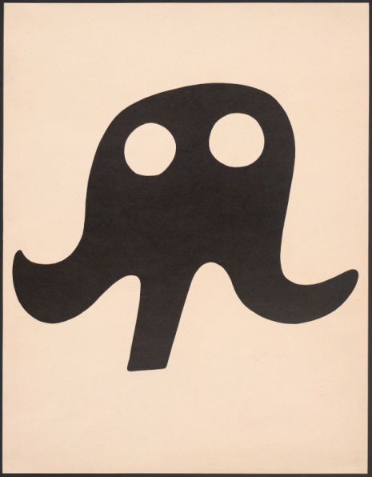
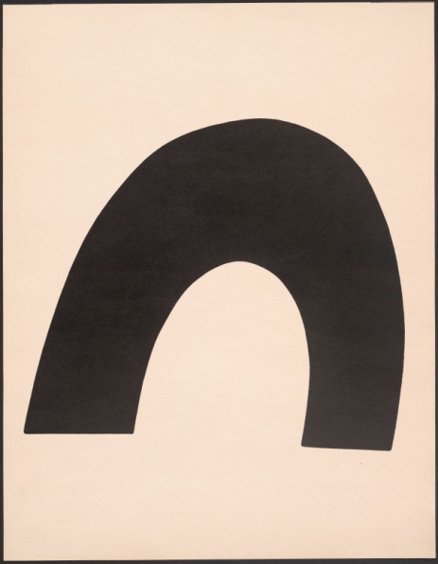
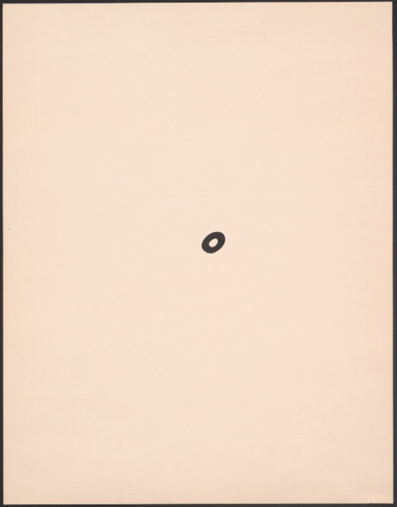
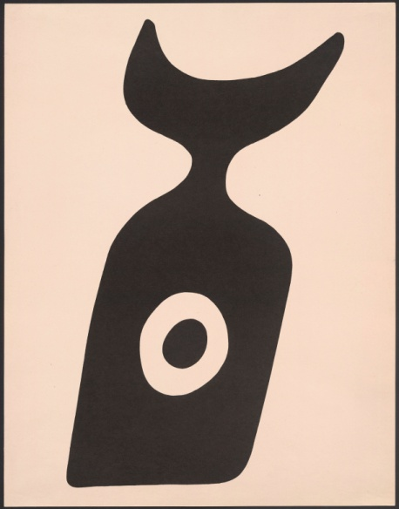
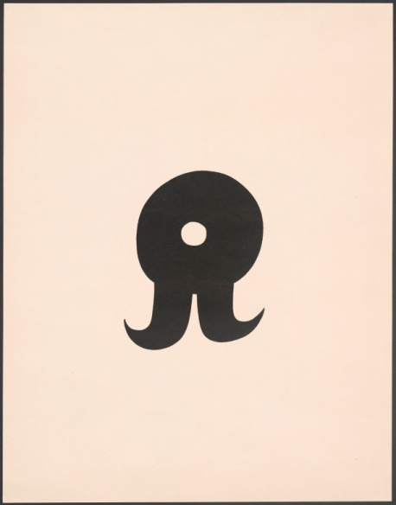
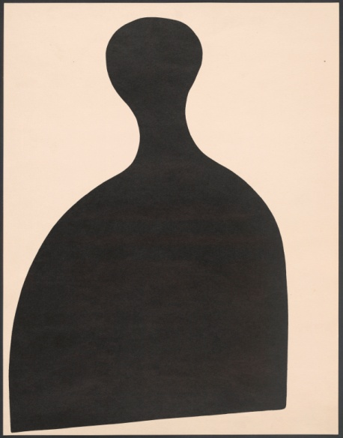
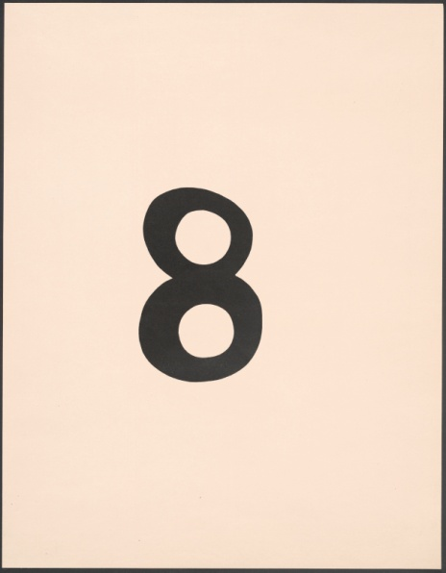
Jean (Hans) Arp. Merz 5, Arp Mappe: 7 Arpaden (Arp Portfolio: 7 Arpades). 1923.
TOP ROW (Left to Right)
1 Schnurrhut (Mustachehat)
2 Das Meer (The Sea)
3 Ein Nabel (One Navel)
4 Die Nabelflasche (The Navelbottle)
BOTTOM ROW (Left to Right)
5 Schnurruhr (Mustachewatch)
6 Eierschläger (Eggbeater)
7 Arabische Acht (Arabic Eight)
MoMA Dada Theme
Notes:
Share this information with your students:
In these seven lithographs, Arp created a series of simple but evocative "object pictures" that combine allusions to the body and everyday things—Mustache Hat, One Navel, The Sea, Arabic Eight, The Navel Bottle, Mustache Watch, Eggbeater. Each sign evokes familiar letter or number form.
Ask your students to name the familiar figures, numbers, and letters they see in these Arpaden.
Jean (Hans) Arp. Merz 5, Arp Mappe: 7 Arpaden (Arp Portfolio: 7 Arpades). 1923.
Letterpress with collage addition, cover: 18 1/8 x 14 5/16" (46 x 36.3 cm); composition (front cover): 17 1/16 x 13 1/4" (43.4 x 33.6 cm); composition (back cover): 3 5/8 x 3 3/8" (9.2 x 8.5 cm). Publisher: Merzverlag (Kurt Schwitters), Hannover, Germany. Printer: unknown. Edition: 50. Gift of J. B. Neumann.
© 2012 Artists Rights Society (ARS), New York/VG Bild-Kunst, Bonn

Slide 22
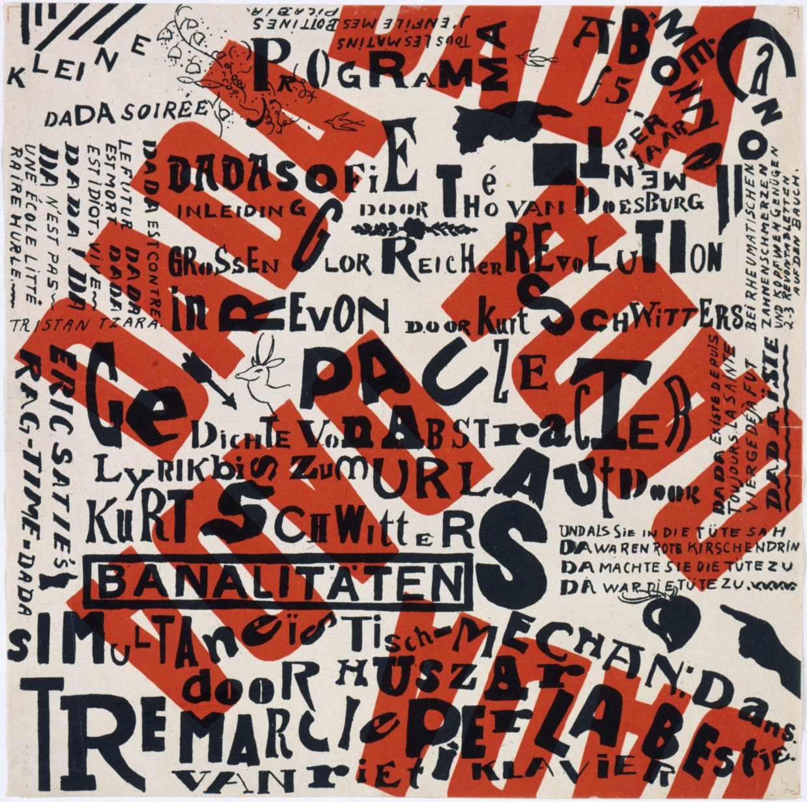
Théo van Doesburg and Kurt Schwitters. Kleine Dada Soirée (Small Dada Evening). 1922.
MoMA Dada Theme
Notes:
Share this information with your students:
In 1923, Schwitters and van Doesburg embarked on a tour of Holland, their so-called “Dada Campaign” to introduce local artists to Dada through a series of evening lectures, and performances.
The poster’s incongruous appearance accurately reflects the tenor of many Dada evenings, which often commenced with mock-serious lectures interrupted by barking audience members, absurd Dada jokes and skits, and experimental poems. This evening’s events include a prelude of “Dadawisdom” by van Doesburg, “abstract poems declaimed as loudly as possible” by Schwitters, and ragtime music by composer Erik Satie.
Théo van Doesburg and Kurt Schwitters. Kleine Dada Soirée (Small Dada Evening). 1922.
Lithograph, sheet: 11 7/8 x 11 7/8" (30.2 x 30.2 cm).
Gift of Philip Johnson.
© 2012 Artists Rights Society (ARS), New York/VG Bild-Kunst, Bonn

Slide 23
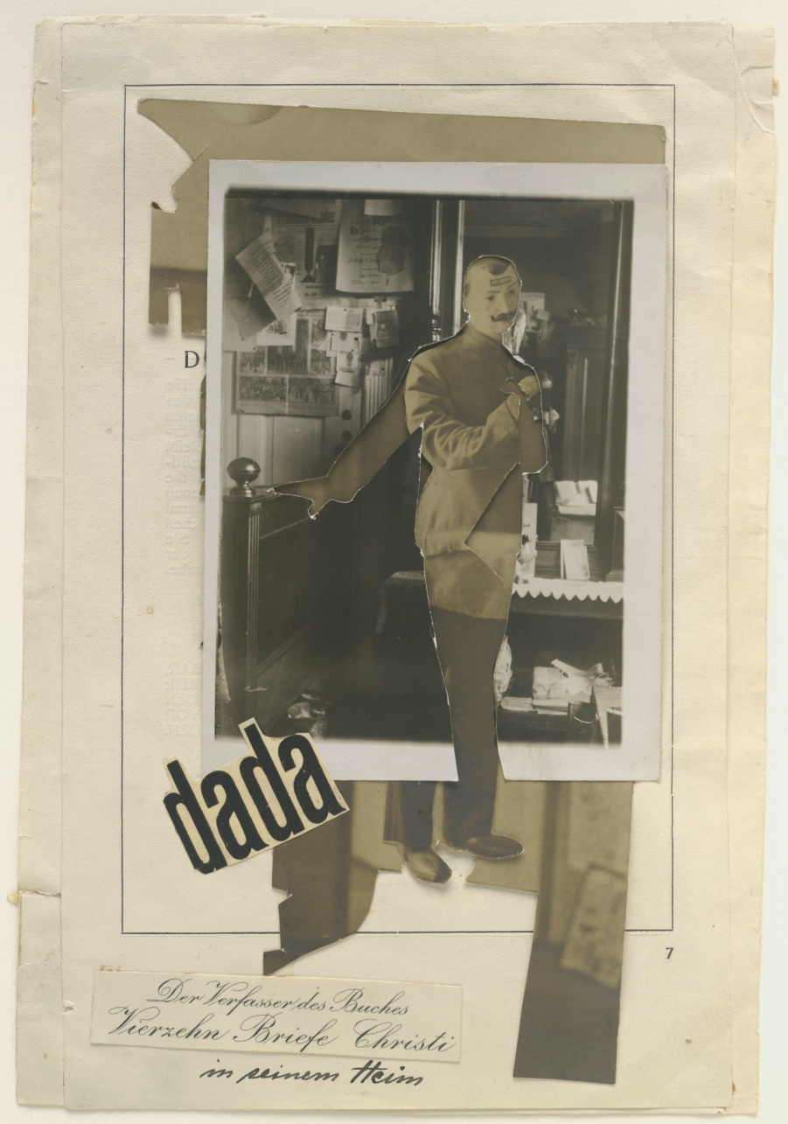
Johannes Baader. The Author of the Book "Fourteen Letters of Christ" in His Home. 1920.
MoMA Dada Theme
Notes:
Share this information with your students:
In this photomontage, Baader depicts a home cluttered with books, photographs, and on the wall, pinned-up Dada ephemera. Baader layered fragments of at least two distinct photographs to construct this work. A section of the top photograph is cut away, revealing the image of a mannequin in military garb—the same dummy Baader had exhibited at the First International Dada Fair in Berlin. This persona, which Baader called the “Oberdada” (“chief dada”), was a parody of Germany’s high-ranking military officials.
Johannes Baader. The Author of the Book "Fourteen Letters of Christ" in His Home. 1920.
Cut-and-pasted gelatin silver prints, cut-and-pasted printed paper, and ink on book pages, 8 1/2 x 5 3/4" (21.6 x 14.6 cm).
Purchase

Slide 24
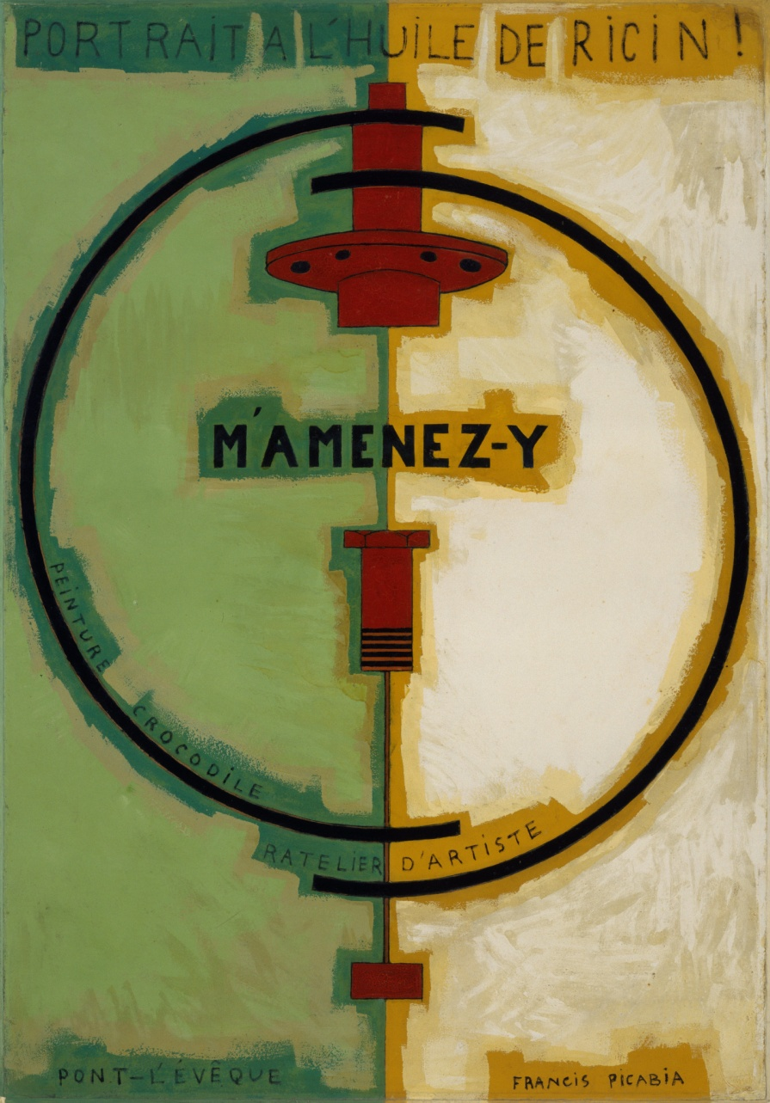
Francis Picabia. M’Amenez-y. 1919–20.
MoMA Dada Theme
Notes:
Share this information with your students:
This work delivers a barrage of puns and word plays on familiar art terms. Linseed oil (l’huile de lin) is a commonly used binder in oil paint, but an inscription at the top proclaims this portrait a product of a toxic substance called castor oil (l’huile de Ricin). Another inscription reads Ratelier d’artiste (the artist’s false teeth), a play on atelier d’artiste (artist’s studio). Peinture crocodile (Crocodile painting) associates art with the hypocrisy of crocodile tears.
The vaguely mechanical imagery reflects Picabia’s interest in optical devices and other machines, including the automobile, whose function is evoked in the title phrase “M’Amenez-y” (Take me there).
Francis Picabia. M’Amenez-y. 1919–20.
Oil on cardboard, 50 3/4 x 35 3/8" (129.2 x 89.8 cm).
Helena Rubinstein Fund.
© 2012 Artists Rights Society (ARS), New York/ADAGP, Paris

