Slide 1

Pop Art

Slide 2
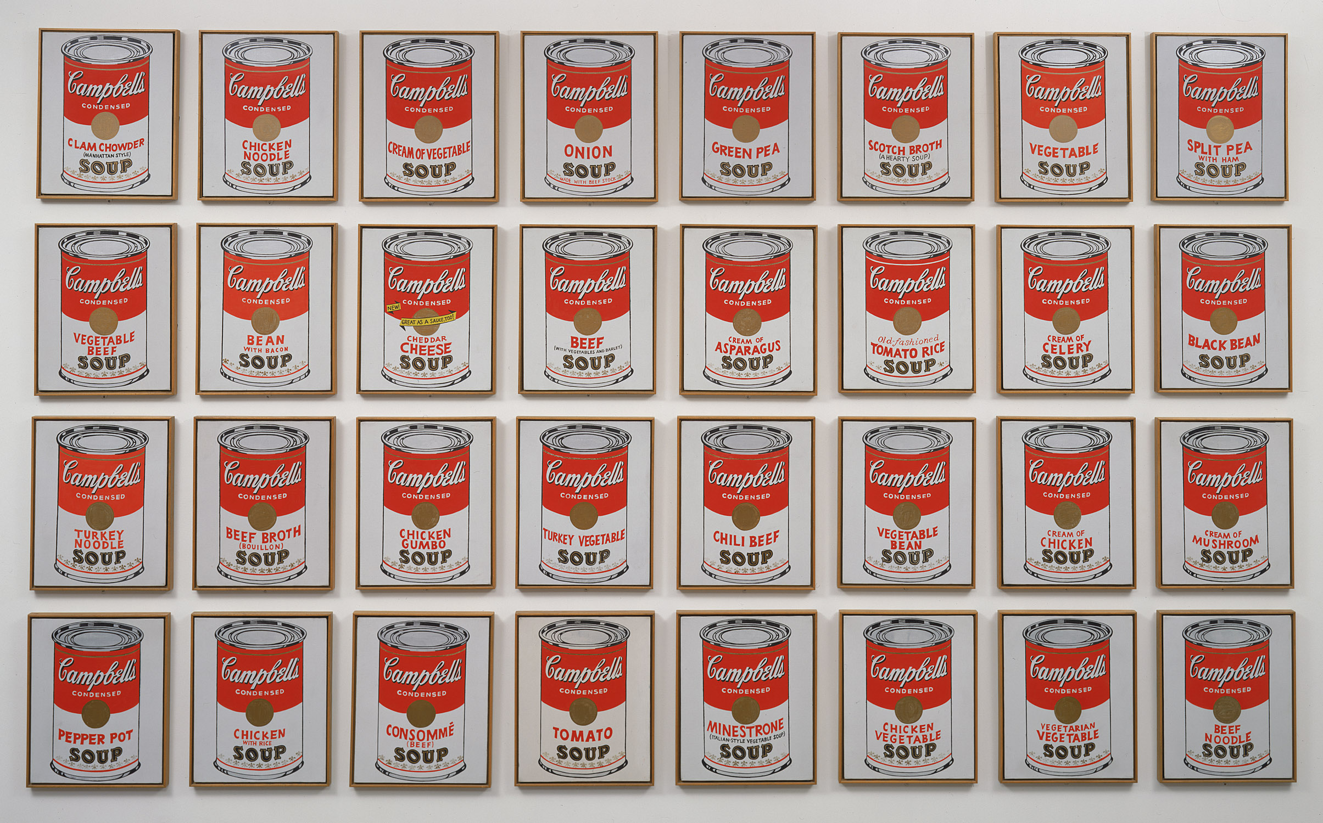
Let’s look at Campbell’s Soup Cans by Andy Warhol.
Andy Warhol. Campbell’s Soup Cans. 1962.
MoMA Pop Art Theme
Notes:
Share this information with your students:
By late 1950s and early 1960s, a “cultural revolution” was underway, led by the activists, thinkers, and artists who sought to rethink and even overturn what was, in their eyes, a stifling social order ruled by conformity. The Vietnam War incited mass protests, the Civil Rights Movement sought equality for African Americans, and the women’s liberation movement gained momentum.
It was in this climate of turbulence, experimentation, and consumerism that a new generation of artists emerged in Britain and America in the mid- to late-1950s. Pop artists began to look for inspiration in the world around them, representing—and, at times, making art directly from—everyday items, consumer goods, and mass media.
Pop artists like Andy Warhol and Roy Lichtenstein were very aware of the past. They sought to connect fine art traditions with pop culture elements from television, advertisements, films, and cartoons. At the same time, their work challenged traditional boundaries between media, combining painted gestures with photography and printmaking; combining handmade and readymade or mass-produced elements; and combining objects, images, and sometimes text to make new meanings.
Andy Warhol. Campbell's Soup Cans. 1962
Synthetic polymer paint on 32 canvases, each canvas 20 x 16" (50.8 x 40.6 cm). Partial gift of Irving Blum. Additional funding provided by Nelson A. Rockefeller Bequest, gift of Mr. and Mrs. William A. M. Burden, Abby Aldrich Rockefeller Fund, gift of Nina and Gordon Bunshaft in honor of Henry Moore, Lillie P. Bliss Bequest, Philip Johnson Fund, Frances R. Keech Bequest, gift of Mrs. Bliss Parkinson, and Florence B. Wesley Bequest (all by exchange).
© 2012 Andy Warhol Foundation/ARS, NY/TM Licensed by Campbell's Soup Co. All rights reserved

Slide 3
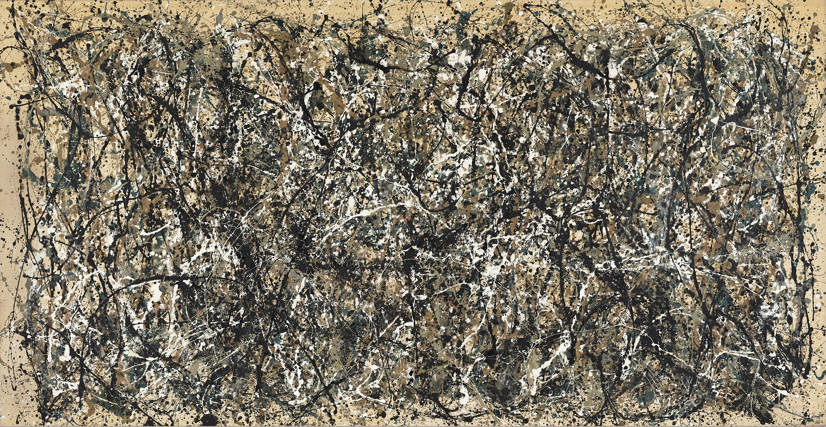
Let’s compare these works by Andy Warhol and Jackson Pollock.
Andy Warhol. Campbell’s Soup Cans. 1962.
Jackson Pollock. One: Number 31, 1950.1950.
MoMA Pop Art Theme
Notes:
Share this information with your students:
Pop Artists adopted commercial methods like silkscreening, or produced multiples of works, downplaying the artist's hand and subverting the idea of originality—in marked contrast with the highly expressive, large-scale abstract works of the Abstract Expressionists whose work had dominated postwar American art. Pop artists favored realism, everyday (and even mundane) imagery, and heavy doses of irony and wit.
Andy Warhol. Campbell's Soup Cans. 1962
Synthetic polymer paint on 32 canvases, each canvas 20 x 16" (50.8 x 40.6 cm). Partial gift of Irving Blum. Additional funding provided by Nelson A. Rockefeller Bequest, gift of Mr. and Mrs. William A. M. Burden, Abby Aldrich Rockefeller Fund, gift of Nina and Gordon Bunshaft in honor of Henry Moore, Lillie P. Bliss Bequest, Philip Johnson Fund, Frances R. Keech Bequest, gift of Mrs. Bliss Parkinson, and Florence B. Wesley Bequest (all by exchange).
© 2012 Andy Warhol Foundation/ARS, NY/TM Licensed by Campbell's Soup Co. All rights reserved
Jackson Pollock. One: Number 31, 1950. 1950.
Oil and enamel paint on canvas, 8' 10" x 17' 5 5/8" (269.5 x 530.8 cm). Sidney and Harriet Janis Collection Fund (by exchange).
© 2012 Pollock-Krasner Foundation/Artists Rights Society (ARS), New York

Slide 4
Appropriation
MoMA Pop Art Theme

Slide 5
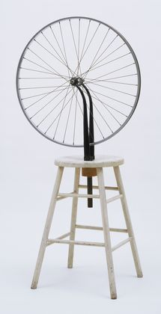
What is appropriation? Let’s take a look at Marcel Duchamp’s Bicycle Wheel.
The concept of appropriation—borrowing images or objects to make art—began in the early 20th century with Dada artists like Marcel Duchamp.
In your opinion, is this art? Why or why not?
How did Duchamp’s act of appropriating two distinct objects create something new?
Marcel Duchamp. Bicycle Wheel. 1951 (third version, after lost original of 1913)
MoMA Pop Art Theme
Notes:
Share this information with your students:
The concept of appropriation—borrowing images or objects to make art—began in the early 20th century with Dada artists like Marcel Duchamp.
Bicycle Wheel is Duchamp’s first Readymade—class of objects that he invented to challenge assumptions about what constitutes a work of art.
Here Duchamp chose two mass-produced parts—a bicycle wheel and a kitchen stool—and put them together in an assemblage, creating a sort of nonfunctional machine. By simply selecting prefabricated items and calling them art, he subverted established notions of the artist’s craft and the viewer's aesthetic experience. The 1913 Bicycle Wheel was lost, but nearly four decades later Duchamp assembled a replacement from newly found prefabricated parts, indicating that the later version was as valid as the original
Marcel Duchamp. Bicycle Wheel. New York, 1951 (third version, after lost original of 1913)
Metal wheel mounted on painted wood stool, 51 x 25 x 16 1/2" (129.5 x 63.5 x 41.9 cm). The Sidney and Harriet Janis Collection.
© 2012 Artists Rights Society (ARS), New York / ADAGP, Paris / Estate of Marcel Duchamp

Slide 6
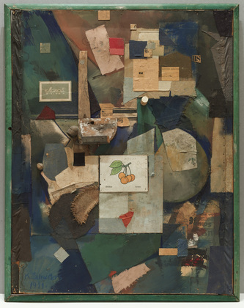
Long before Pop Art, artists of the Dada movement were using everyday materials.
Dada artist Kurt Schwitters combined bits and pieces of tossed off culture in artworks known as assemblages.
What kinds of found objects can you name in this work of art?
In your opinion, can art be made of anything at all?
Kurt Schwitters. Merz Picture 32 A. The Cherry Picture. 1921
MoMA Pop Art Theme
Notes:
Share this information with your students:
Dada artist Kurt Schwitters combined discarded cultural fragments in artworks known as assemblages. Schwitters created the illusion of depth by placing those papers with darker components behind those that are lighter in aspect.
The brightest piece of paper, in the center of the composition, shows an eye-catching cluster of red cherries and the printed German and French words for the fruit. In the winter of 1918–19 Schwitters had collected bits of newspaper, candy wrappers, and other debris, and began making the collages and assemblages for which he is best known today. The Cherry Picture belongs to a group of these works he called Merz, a nonsensical word that he made up by cutting a scrap from a newspaper: the second syllable of the German word Kommerz, or commerce. The picture contains a cork, bits of wood, a wooden pipe, burlap, a card with a drawing of cherries, and newspapers.
Kurt Schwitters. Merz Picture 32 A. The Cherry Picture. 1921.
Cut-and-pasted colored and printed paper, cloth, wood, metal, cork, oil, pencil, and ink on paperboard, 36 1/8 x 27 3/4" (91.8 x 70.5 cm). Mr. and Mrs. A. Atwater Kent, Jr. Fund.
© 2012 Artists Rights Society (ARS), New York / VG Bild-Kunst, Bonn
27.1954

Slide 7
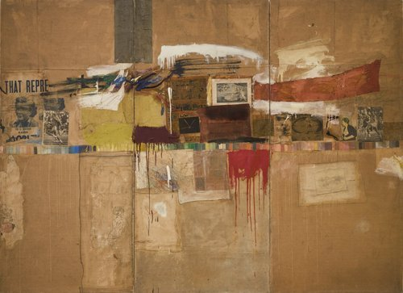
Let’s take a look at Rebus by Robert Rauschenberg
Robert Rauschenberg. Rebus. 1955
MoMA Pop Art Theme
Notes:
Share this information with your students:
Robert Rauschenberg’s ‘Combines’ similarly integrated 3-dimensional found objects with 2-dimensional painting. Rebus belongs to a body of work Rauschenberg produced between 1954 and 1964, integrating three-dimensional objects with two-dimensional painting. Jasper Johns coined the term Combine for such works, which he described as painting playing the game of sculpture. Made from layers of everyday materials found in the neighborhood of his lower Manhattan studio (comic strips, political posters, fabric, and drawings), this work maintains a flatter, sparser surface than most Combines. Rauschenberg hoped viewers would look closely and consider the multiplicity of relationships between words and images, beauty and ugliness, and art and non-art.
Robert Rauschenberg. Rebus. 1955
Oil, synthetic polymer paint, pencil, crayon, pastel, cut-and-pasted printed and painted papers, and fabric on canvas mounted and stapled to fabric, three panels, 8' x 10' 11 1/8" (243.8 x 333.1 cm). Partial and promised gift of Jo Carole and Ronald S. Lauder and purchase. Art
© Robert Rauschenberg/ Licensed by VAGA, New York, NY

Slide 8
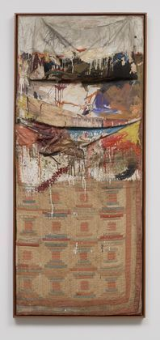
Now let’s look at Rauschenberg’s Bed
Bed is one of Robert Rauschenberg's first Combines, the artist's term for his technique of attaching cast–off items to a traditional support.
Could Bed be considered a self-portrait of the artist? Why or why not?
How is it different than a traditional self-portrait?
Robert Rauschenberg. Bed. 1955
MoMA Pop Art Theme
Notes:
Share this information with your students:
It is rumored that one day Robert Rauschenberg woke up and decided to use his bed as his painting canvas.
Bed is one of Robert Rauschenberg's first combines, the artist's term for his technique of attaching cast-off items, such as tires or old furniture, to a traditional support. In this case he framed a well–worn pillow, sheet, and quilt, scribbled on them with pencil, and splashed them with paint, in a style reminiscent of Abstract Expressionism. Legend has it that these bedclothes are Rauschenberg's own. The work is thus as personal as a self-portrait, or more so, a quality consistent with Rauschenberg’s statement, "Painting relates to both art and life.... (I try to act in that gap between the two.)” He claimed he "wanted something other than what I could make myself and I wanted to use the surprise and the collectiveness and the generosity of finding surprises. And if it wasn't a surprise at first, by the time I got through with it, it was. So the object itself was changed by its context and therefore it became a new thing.”
Robert Rauschenberg. Bed. 1955. Oil and pencil on pillow, quilt, and sheet on wood supports, 6' 3 1/4" x 31 1/2" x 8" (191.1 x 80 x 20.3 cm). Gift of Leo Castelli in honor of Alfred H. Barr, Jr. © 2012 Robert Rauschenberg
79.1989

Slide 9
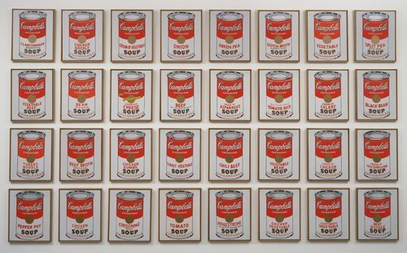
Andy Warhol. Campbell’s Soup Cans. 1962
Why do you think Andy Warhol chose Campbell’s Soup Cans as a subject?
Why do you think he included so many canvases?
MoMA Pop Art Theme
Notes:
Share this information with your students:
The 1960s brought a new generation of artists interested in exploring their world as the subject of art. Thus, Pop art was born. When Warhol first exhibited Campbell’s Soup Cans, in 1962, each of the thirty-two canvases rested on a shelf mounted on the wall, like groceries in a store. The number of paintings corresponds to the varieties of soup then sold by the Campbell Soup Company. Warhol assigned a different soup variety to each, checking them off on a product list supplied by Campbell once their “portraits” were completed.
Campbell's Soup Cans
Andy Warhol (American, 1928–1987)
1962. Synthetic polymer paint on thirty-two canvases, Each canvas 20 x 16" (50.8 x 40.6 cm). Partial gift of Irving Blum
Additional funding provided by Nelson A. Rockefeller Bequest, gift of Mr. and Mrs. William A. M. Burden, Abby Aldrich Rockefeller Fund, gift of Nina and Gordon Bunshaft in honor of Henry Moore, Lillie P. Bliss Bequest, Philip Johnson Fund, Frances R. Keech Bequest, gift of Mrs. Bliss Parkinson, and Florence B. Wesley Bequest (all by exchange). © 2012 Andy Warhol Foundation / ARS, NY / TM Licensed by Campbell's Soup Co. All rights reserved.
476.1996.1-32

Slide 10
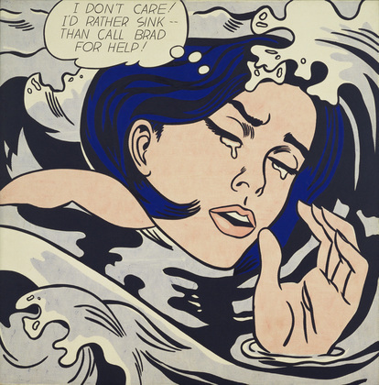
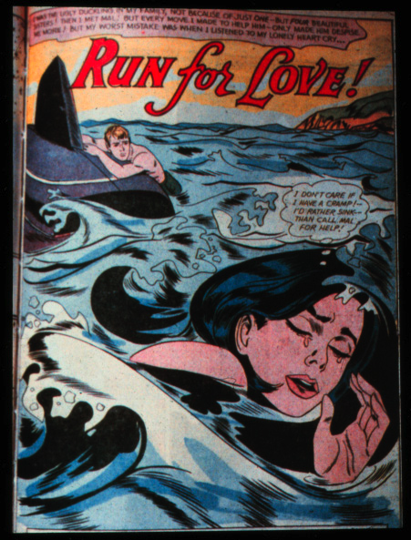
How do artists like Lichtenstein transform their pop culture sources?
Roy Lichtenstein. Drowning Girl. 1963
DC Comics. Cover illustration for the comic story “Run for Love!”, from Secret Love #83 , 1962.
How does the painting differ from the original?
How does the meaning change?
MoMA Pop Art Theme
Notes:
Share this information with your students:
Roy Lichtenstein was another Pop artist who appropriated popular culture as the subject of his art. Comics were Lichtenstein’s interest. Lichtenstein found sources for many of his early paintings in comic books. The source for this work is "Run for Love!" published by DC Comics in 1962. In the original illustration, the drowning girl's boyfriend appears in the background, clinging to a capsized boat. Lichtenstein cropped the image dramatically, showing the girl alone, encircled by a threatening wave. He shortened the caption from "I don't care if I have a cramp!" to the ambiguous "I don't care!” In addition to appropriating the melodramatic content of comics, Lichtenstein manually simulated the Benday dots used in the mechanical reproduction of images.
Roy Lichtenstein. Drowning Girl. 1963
Oil and synthetic polymer paint on canvas, 67 5/8 x 66 3/4" (171.6 x 169.5 cm). Philip Johnson Fund (by exchange) and gift of Mr. and Mrs. Bagley Wright
DC Comics. Cover illustration for the comic story “Run for Love!”
From Secret Love #83 , 1962.

Slide 11
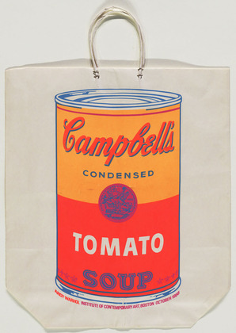
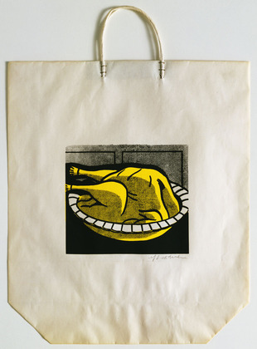
Art or advertising? What do you think?
Andy Warhol. Campbell’s Tomato Soup Shopping Bag. 1966.
Roy Lichtenstein. Turkey Shopping Bag. 1964
MoMA Pop Art Theme
Notes:
Share this information with your students:
Pop artists like Andy Warhol and Roy Lichtenstein were very aware of the past. They sought to connect fine art traditions with pop culture elements from television, advertisements, films, and cartoons. At the same time, their work challenged traditional boundaries between media, combining painted gestures with photography and printmaking, handmade and readymade or mass-produced elements, and objects, images, and sometimes text to make new meanings.
Andy Warhol. Campbell's Tomato Soup Shopping Bag. 1966
Silkscreen, 24 x 17" (61 x 43 cm). Given anonymously.
© 2012 Andy Warhol Foundation / ARS, NY / TM Licensed by Campbell's Soup Co. All rights reserved.
Roy Lichtenstein. Turkey Shopping Bag. 1964.
Screenprint on shopping bag with handles, Composition: 7 1/2 x 9" (19.1 x 22.8 cm); sheet (irreg.): 19 5/16 x 16 15/16" (49 x 43 cm). Publisher: Bianchini Gallery, New York. Printer: Ben Birillo, New York. Edition: approx. 125. Gift of Jo Carole and Ronald S. Lauder.
© Estate of Roy Lichtenstein

Slide 12
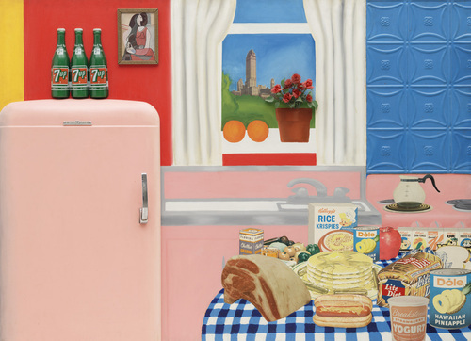
Let’s take a look at Still Life #30 by Tom Wesselmann
What is going on in this picture?
Which objects are ‘real’, collaged or painted?
How do these juxtapositions create visual tension and balance?
Tom Wesselmann. Still Life #30. 1963
MoMA Pop Art Theme
Notes:
Share this information with your students:
Painter Tom Wesselmann loved to construct complicated juxtapositions. In his series of still-lifes, Wesselmann appropriated images from magazines and collaged them directly onto the surface of his paintings, concentrating on the juxtaposition of objects, colors and textures. As well, he experimented with assemblage. Still Life #30 is a giant still-life composed of a table laden with food balanced by a pink icebox door, 7-Up bottles, and window.
Wesselmann remarked, “This kind of relationship helps establish a momentum throughout the picture… At first glance my pictures seem well behaved, as if –that is a still life, O.K. But these things have such crazy give-and-take that I feel they get really very wild.” Interview with G. Swenson, ARTnews, 1964, p. 44
Tom Wesselmann. Still Life #30. April 1963
Oil, enamel and synthetic polymer paint on composition board with collage of printed advertisements, plastic flowers, refrigerator door, plastic replicas of 7-Up bottles, glazed and framed color reproduction, and stamped metal, 48 1/2 x 66 x 4" (122 x 167.5 x 10 cm).
Gift of Philip Johnson

Slide 13
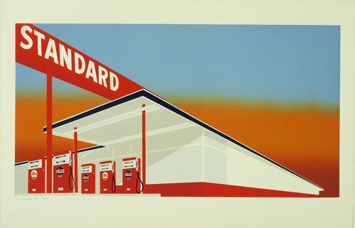
Let’s take a look at Standard Station by Ed Ruscha
Edward Ruscha. Standard Station. 1966
MoMA Pop Art Theme
Notes:
Share this information with your students:
The gasoline station is Ruscha's most iconic image. He began experimenting with the subject in his first artist's book, Twentysix Gasoline Stations (1963), which reproduces a series of banal photographs the artist took while driving on Route 66 between Los Angeles and his hometown of Oklahoma City. That year, converting an otherwise ordinary locale into a dramatic, even mysterious symbol of the American vernacular landscape, Ruscha created a monumental painting titled Standard Station, Amarillo, Texas, based on one of the photographs but with a radically foreshortened composition.
Edward Ruscha. Standard Station. 1966
Screenprint, composition: 19 5/8 x 36 15/16" (49.6 x 93.8 cm); sheet: 25 5/8 x 39 15/16" (65.1 x 101.5 cm).
Publisher: Audrey Sabol, Villanova, Penn.. Printer: Art Krebs Screen Studio, Los Angeles. Edition: 50. John B. Turner Fund.
© 2012 Edward Ruscha

Slide 14
Let’s take a look at Standard Station by Ed Ruscha
What do you notice in Standard Station?
Have you ever seen a gas station like this one?
How does the color help to tell the story?
Edward Ruscha. Standard Station. 1966
MoMA Pop Art Theme
Notes:
Share this information with your students:
The gasoline station is Ruscha's most iconic image. He began experimenting with the subject in his first artist's book, Twentysix Gasoline Stations (1963), which reproduces a series of banal photographs the artist took while driving on Route 66 between Los Angeles and his hometown of Oklahoma City. That year, converting an otherwise ordinary locale into a dramatic, even mysterious symbol of the American vernacular landscape, Ruscha created a monumental painting titled Standard Station, Amarillo, Texas, based on one of the photographs but with a radically foreshortened composition.
Edward Ruscha. Standard Station. 1966
Screenprint, composition: 19 5/8 x 36 15/16" (49.6 x 93.8 cm); sheet: 25 5/8 x 39 15/16" (65.1 x 101.5 cm). Publisher: Audrey Sabol, Villanova, Penn.. Printer: Art Krebs Screen Studio, Los Angeles. Edition: 50. John B. Turner Fund.
© 2012 Edward Ruscha

Slide 15
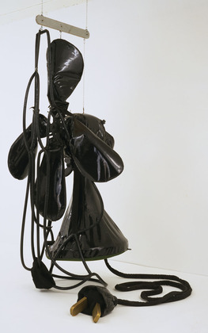
Let’s take a look at this sculpture by Claes Oldenburg
Can you guess what this is?
How do you think it was made?
How are the materials different from more traditional sculptures?
Claes Oldenburg. Giant Soft Fan. 1966-67
MoMA Pop Art Theme
Notes:
Share this information with your students:
At first glance, this sculpture may not appear to represent an ordinary plug-in table fan. The object’s size is greatly exaggerated, ad its scale is comically disproportionate to the room. Deflated and unable to stand on its own, it must be suspended from wires in the ceiling. Rendered in soft black vinyl, the body and blades sag and droop beneath their own weight.
Claes Oldenburg made many giant objects, both humorous and disorienting in their scale. Giant Soft Fan is made of vinyl, wood, metal, and plastic. Like Oldenburg’s other soft sculptures, Giant Soft Fan was carefully planned before it was hand sewn by his wife, Pat Oldenburg.
Claes Oldenburg. Giant Soft Fan. 1966-67
Vinyl filled with foam rubber, wood, metal, and plastic tubing, Fan, approximately 10' x 58 7/8" x 61 7/8" (305 x 149.5 x 157.1 cm), plus cord and plug 24' 3 1/4" (739.6 cm) long.
The Sidney and Harriet Janis Collection.
© 2012 Claes Oldenburg

Slide 16
Celebrity
MoMA Pop Art Theme

Slide 17
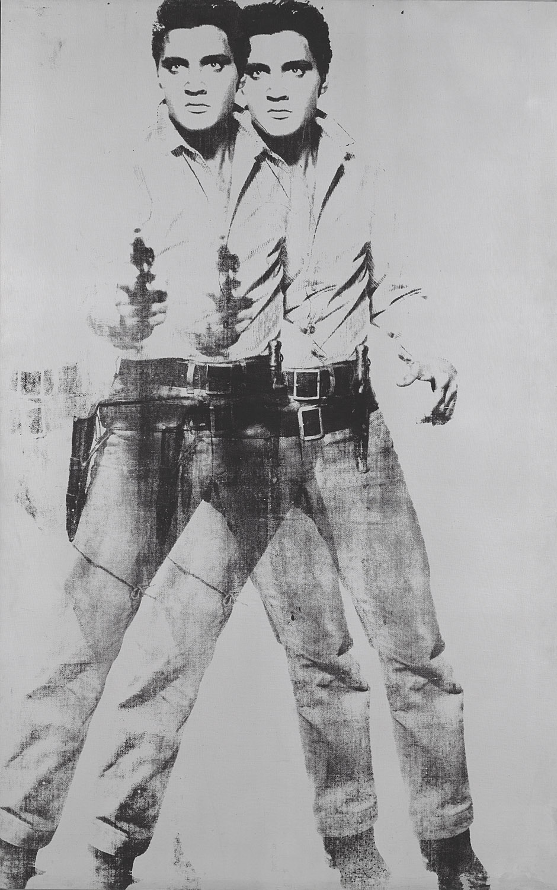
Let’s look at Double Elvis by Andy Warhol
Look closely at this life-size image of Elvis Presley.
What do you notice?
What visual effect do you think Warhol was trying to create?
Andy Warhol. Double Elvis. 1963
MoMA Pop Art Theme
Notes:
Share this information with your students:
Andy Warhol’s Double Elvis achieves a strobe effect, emulating a film strip or the passage of time. By layering two images of Elvis one over the other, Warhol creates an illusion of movement. The image source is unknown, though it was supposedly taken from a publicity still from Don Siegel’s Western, Flaming Star (1960). Warhol’s shimmery, opaque background achieved with silver spray paint, allowed him to easily mask and silkscreen multiple images on top of each other. He created a long line of Elvises that were originally displayed as one long painting and were later cut into multiple paintings. The artist’s interest in film might explain why he created Elvis in double—the singer/actor appears to be moving back and forth, as if in a film strip.
Andy Warhol. Double Elvis. 1963
Silkscreen ink on synthetic polymer paint on canvas, 6' 11" x 53" (210.8 x 134.6 cm). Gift of the Jerry and Emily Spiegel Family Foundation in honor of Kirk Varnedoe. © 2012 Andy Warhol Foundation for the Visual Arts / Artists Rights Society (ARS), New York

Slide 18
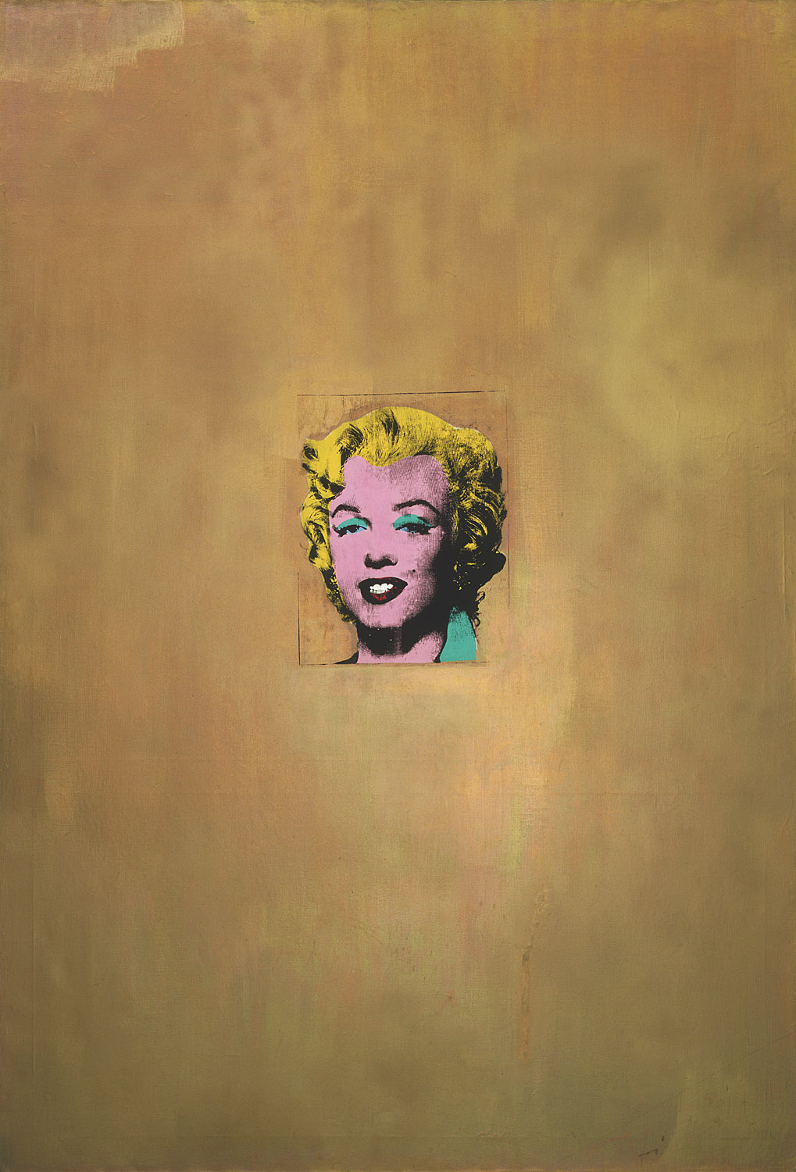
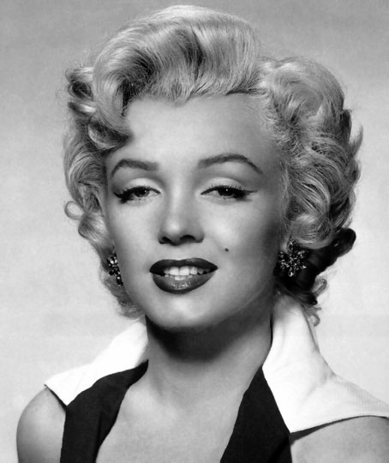
Let’s look at Gold Marilyn by Andy Warhol
Do you think this is a tribute painting to Marilyn Monroe? Why or why not?
Why do you think Warhol chose gold for the background?
What might that color signify?
Andy Warhol. Gold Marilyn. 1962
Original publicity still for the 1953 film Niagara.
MoMA Pop Art Theme
Notes:
Share this information with your students:
Soon after her tragic death in 1962, Warhol made a series of paintings paying tribute to Marilyn Monroe, the film star and sex symbol who had captured America’s imagination in films like Gentlemen Prefer Blondes and How to Marry a Millionaire. Warhol based this portrait on a publicity still from the 1953 film Niagara.
He painted the background solid gold before silkscreening her face in the center of the canvas, creating a slick, commercial look. The gold background and centered figure are reminiscent of Christian icon paintings—perfectly fitting for a tribute to such a prominent cultural icon.
Original publicity still for the 1953 film Niagara.
SOURCE: http://blogs.vassar.edu/fllaceducation/files/2011/06/marilyn-portrait.jpeg
Andy Warhol. Gold Marilyn. 1962
Silkscreen ink on synthetic polymer paint on canvas, 6' 11 1/4" x 57" (211.4 x 144.7 cm). Gift of Philip Johnson.
© 2012 Andy Warhol Foundation for the Visual Arts / Artists Rights Society (ARS), New York

Slide 19
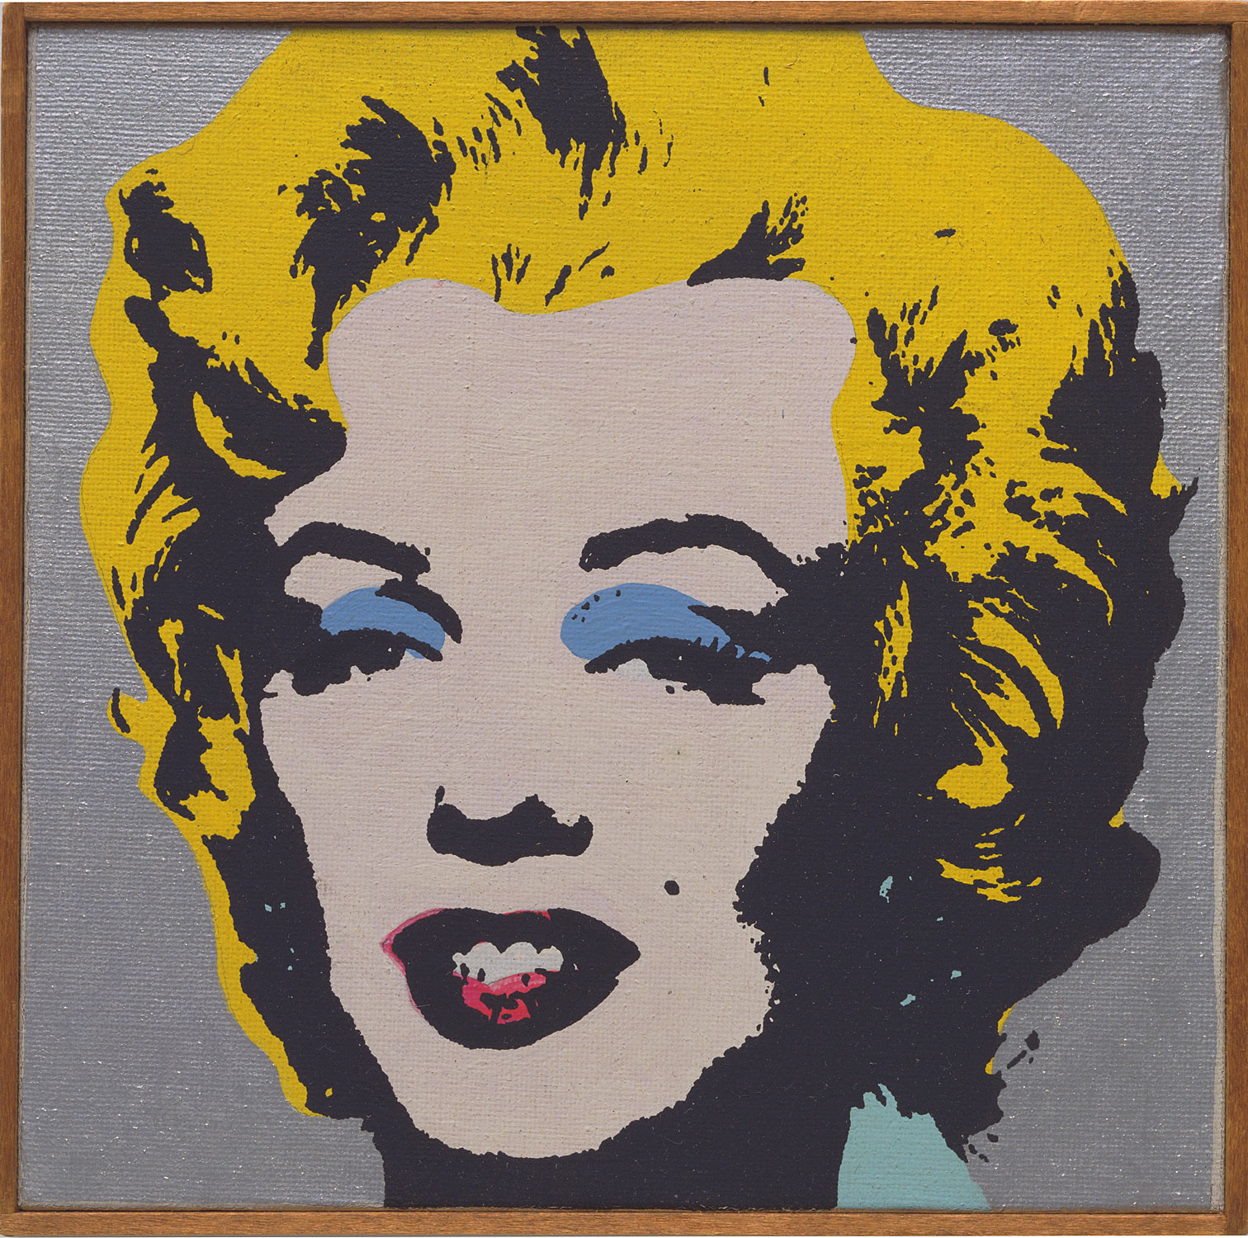
Let’s look at Andy Warhol “Marilyn Monroe”, 1964 by Richard Pettibone
What do you think about Pettibone’s process of ‘borrowing’ art to make his own?
Do you consider this art? Why or why not?
Richard Pettibone. Andy Warhol, "Marilyn Monroe," 1964. 1968
MoMA Pop Art Theme
Notes:
Share this information with your students:
Richard Pettibone’s, Andy Warhol, “Marilyn Monroe,” 1964 is a small silkscreened ‘replica’ of Warhol’s 1962 famed silkscreened portrait of Marilyn Monroe. Seeing art as a ‘readymade’—or an object for creative opportunity, Pettibone appropriates others’ artwork to explore authorship. His versions are scaled down to an art magazine size. This piece is only 5 inches tall.
Richard Pettibone. Andy Warhol, "Marilyn Monroe," 1964. 1968
Silkscreen ink on canvas, 5 1/4 x 5 1/4" (13.3 x 13.3 cm).
Frances R. Keech Bequest

Slide 20
Let’s compare Warhol’s Gold Marilyn to Pettibone’s miniature ‘art replica’
What do you think Pettibone’s artistic project of creating smaller ‘art replicas’ is about?
Do you think Warhol minded? Why or why not?
Richard Pettibone. Andy Warhol, "Marilyn Monroe," 1964. 1968.
Andy Warhol. Gold Marilyn. 1962
MoMA Pop Art Theme
Notes:
Share this information with your students:
He painted the background solid gold before silkscreening her face in the center of the canvas, creating a slick, commercial look. The gold background and centered figure are reminiscent of Christian icon paintings—perfectly fitting for a tribute to such a prominent cultural icon.
Andy Warhol. Gold Marilyn. 1962
Silkscreen ink on synthetic polymer paint on canvas, 6' 11 1/4" x 57" (211.4 x 144.7 cm). Gift of Philip Johnson.
© 2012 Andy Warhol Foundation for the Visual Arts / Artists Rights Society (ARS), New York
Richard Pettibone. Andy Warhol, "Marilyn Monroe," 1964.
1968.
Silkscreen ink on canvas, 5 1/4 x 5 1/4" (13.3 x 13.3 cm).
Frances R. Keech Bequest

Slide 21
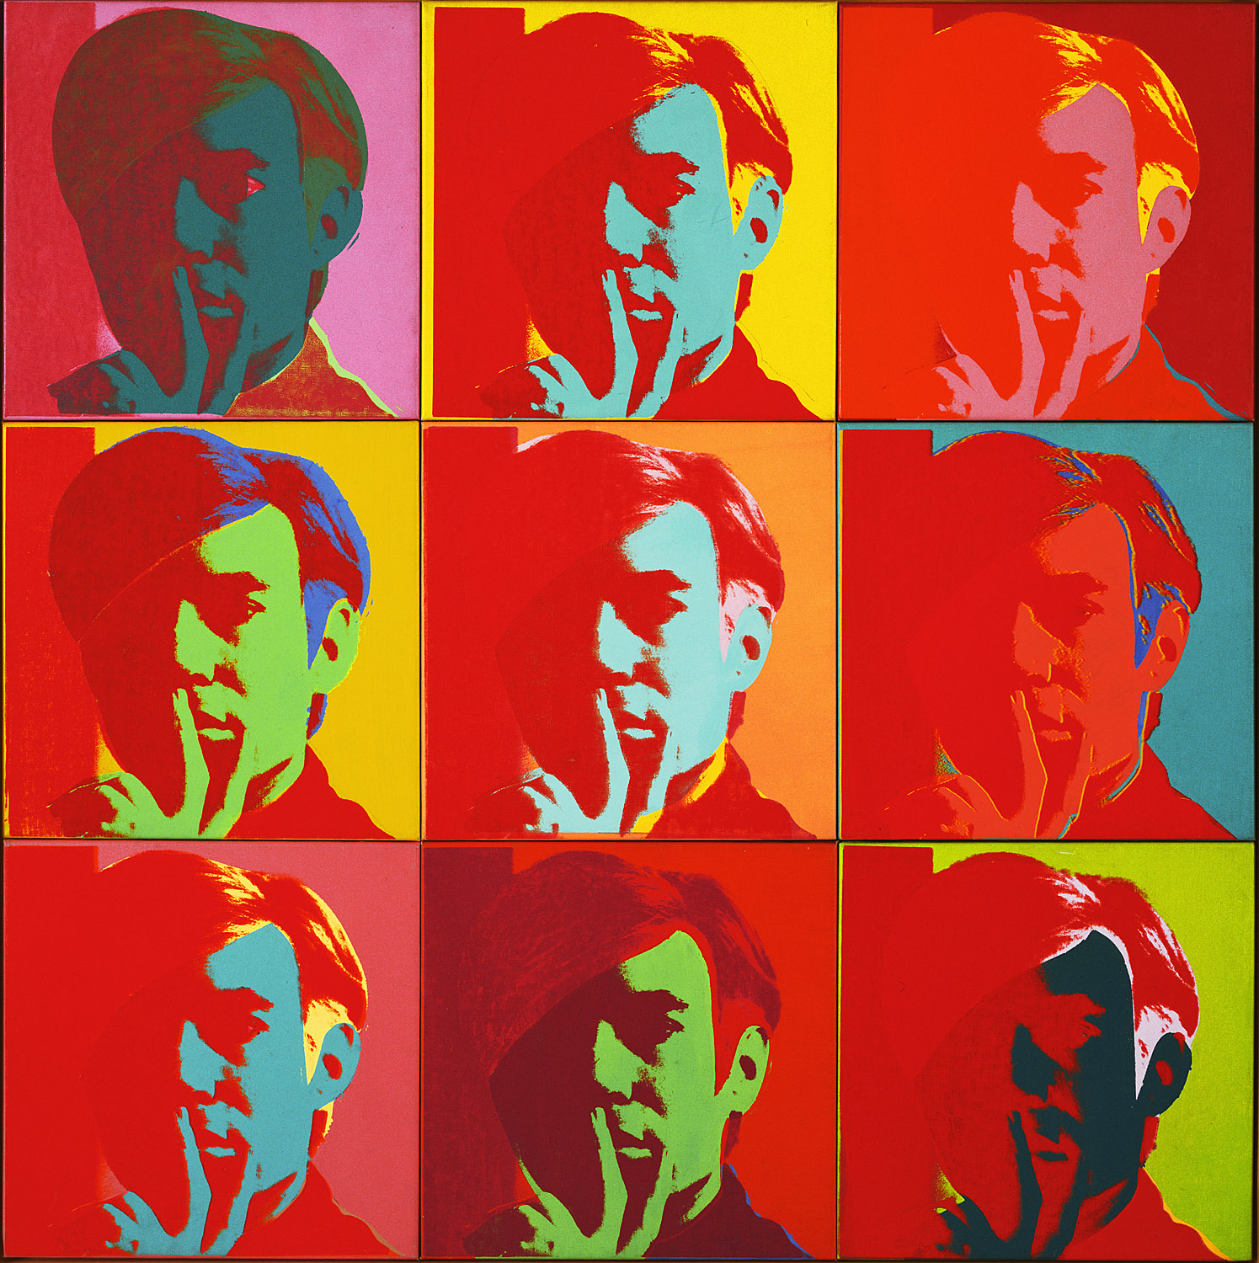
Let’s look at Self-Portrait by Andy Warhol
Can you identify all of the different colors and color combinations Warhol used in the self-portrait grid?
What visual affect does the repeated image have on your perception of Warhol?
Do you think Warhol was emulating other media? Why or why not?
Andy Warhol. Self-Portrait. 1966.
MoMA Pop Art Theme
Notes:
Share this information with your students:
Andy Warhol rose to celebrity status during the early to mid-1960s while creating portraits of cultural icons and images of commercial products, and hobnobbing with the cultural ‘elite.’ Self-Portrait, 1966 was constructed in what would become one of Warhol’s signature styles—the repeated, silkscreened grid of highly saturated color. An expert colorist, Warhol juxtaposed primary and secondary colors as well as different hues of the same color to evoke mystery and mood. Primary reds, turquoise blues, and yellows dominate while contrasting with secondary greens, oranges, pink, and burgundy. In time, Warhol’s self-portraits became as famous as the iconic portraits of Marilyn Monroe or Elizabeth Taylor—the artist had become a celebrity.
Andy Warhol. Self-Portrait. 1966
Silkscreen ink on synthetic polymer paint on nine canvases, Each canvas 22 1/2 x 22 1/2" (57.2 x 57.2 cm), overall 67 5/8 x 67 5/8" (171.7 x 171.7 cm). Gift of Philip Johnson.
© 2012 Andy Warhol Foundation for the Visual Arts / Artists Rights Society (ARS), New York

Slide 22
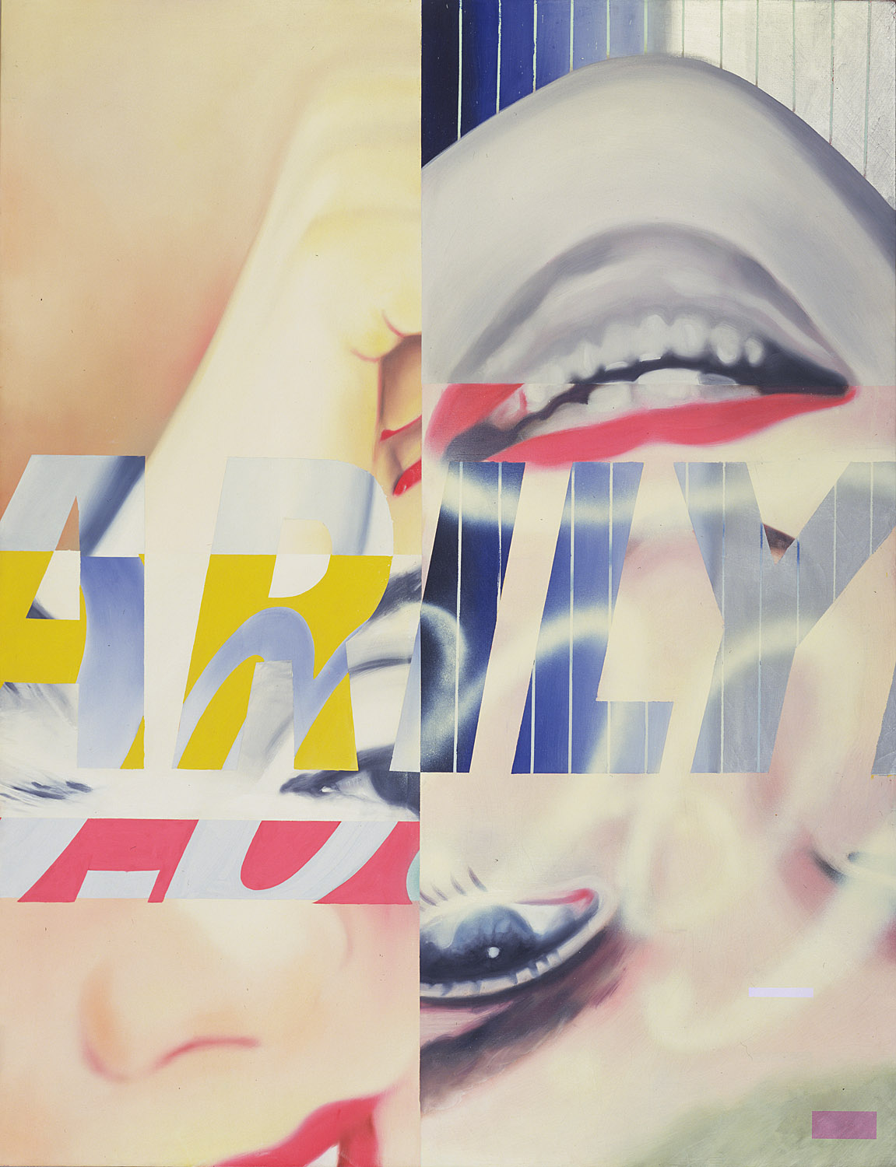
Let’s look at Marilyn Monroe I by James Rosenquist
James Rosenquist. Marilyn Monroe, I. 1962.
MoMA Pop Art Theme
Notes:
Share this information with your students:
Captivated by the death of screen icon and sex symbol Marilyn Monroe like so many other Pop artists, James Rosenquist created a stylized, fragmented and inverted portrait of Monroe. Hyper-real, upside down body parts are covered with Marilyn’s name and the popular soda brand: Coca-Cola.
“Painting is probably more exciting than advertising – so why shouldn’t it be done with that power and gusto, that impact …When I use a combination of fragments of things, the fragments or objects or real things are caustic to one another, and the title is also caustic to the fragments…” (ARTnews, 1964) By fragmenting Monroe’s image and combining her with two very popular ‘products’—Marilyn and Coca-Cola, Rosenquist comments on how the late actress’ life and career had been co-opted and consumed by her superstar status.
James Rosenquist. Marilyn Monroe, I. 1962
Oil and spray enamel on canvas, 7' 9" x 6' 1/4" (236.2 x 183.3 cm). The Sidney and Harriet Janis Collection.
© 2012 James Rosenquist/Licensed by VAGA, New York, NY

Slide 23
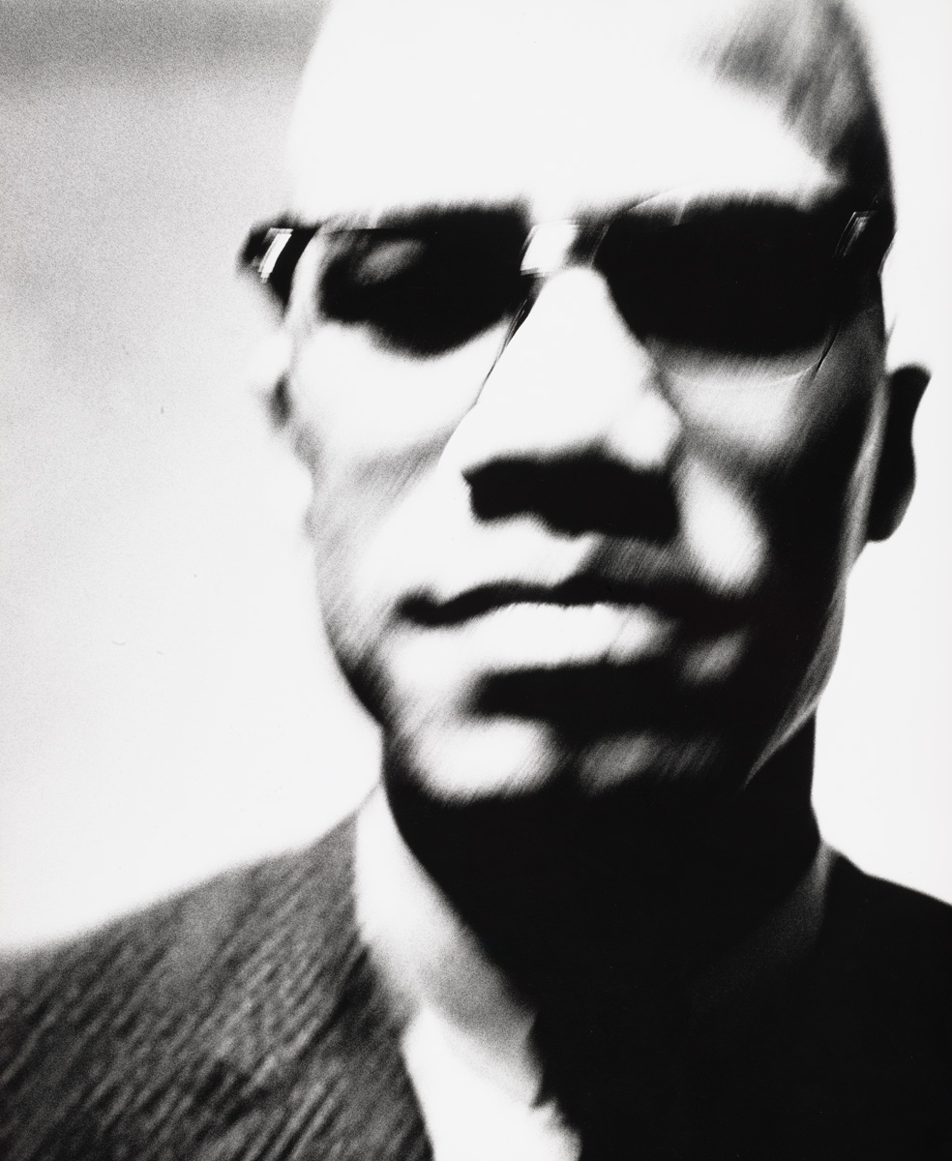
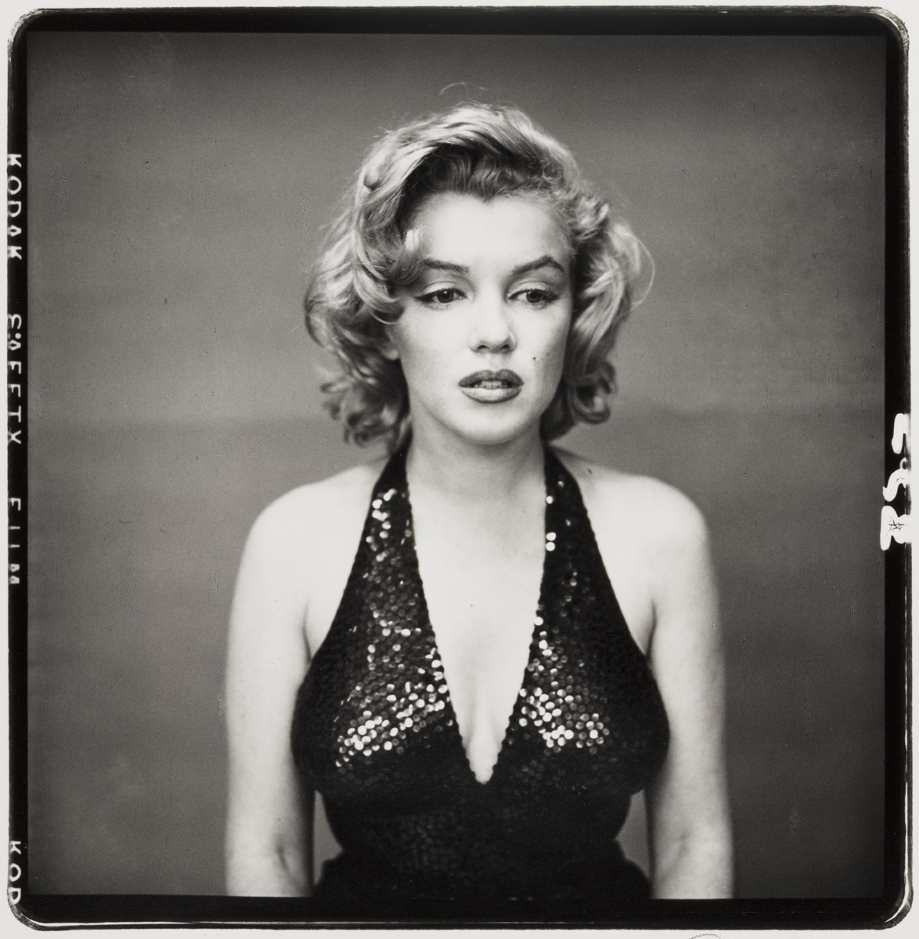
Let’s compare two celebrity portraits by Richard Avedon
Richard Avedon. Malcolm X, Black Nationalist leader. New York. 1963
Richard Avedon. Marilyn Monroe, actress, New York. May 6, 1957
MoMA Pop Art Theme
Notes:
Share this information with your students:
Photographer Richard Avedon photographed fashion models for Harpers Bazaar magazine from 1945 - 65. He also created hundreds of portraits of famous and ordinary people, portraying contrasting levels of American society.
How did the photographer capture each subject’s personality?
Richard Avedon. Malcolm X, Black Nationalist leader, New York. March 27, 1963
Gelatin silver print, 19 3/4 x 15 7/8" (50.2 x 40.4 cm)
The Family of Man Fund
© 2012 The Richard Avedon Foundation
Richard Avedon. Marilyn Monroe, actress, New York. May 6, 1957
Gelatin silver print, printed 1989, 7 15/16 x 7 13/16" (20.2 x 19.8 cm)
Carl Jacobs Fund
© 2012 The Richard Avedon Foundation

Slide 24
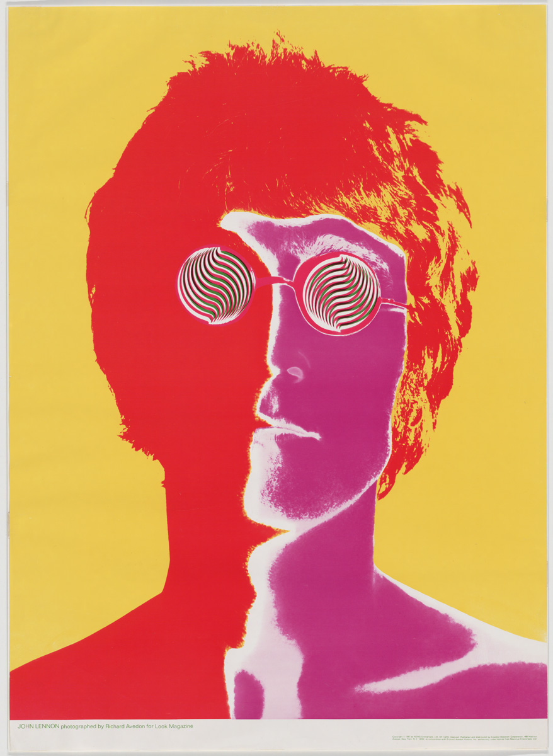
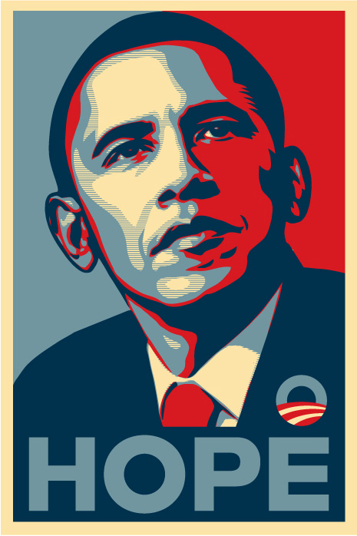
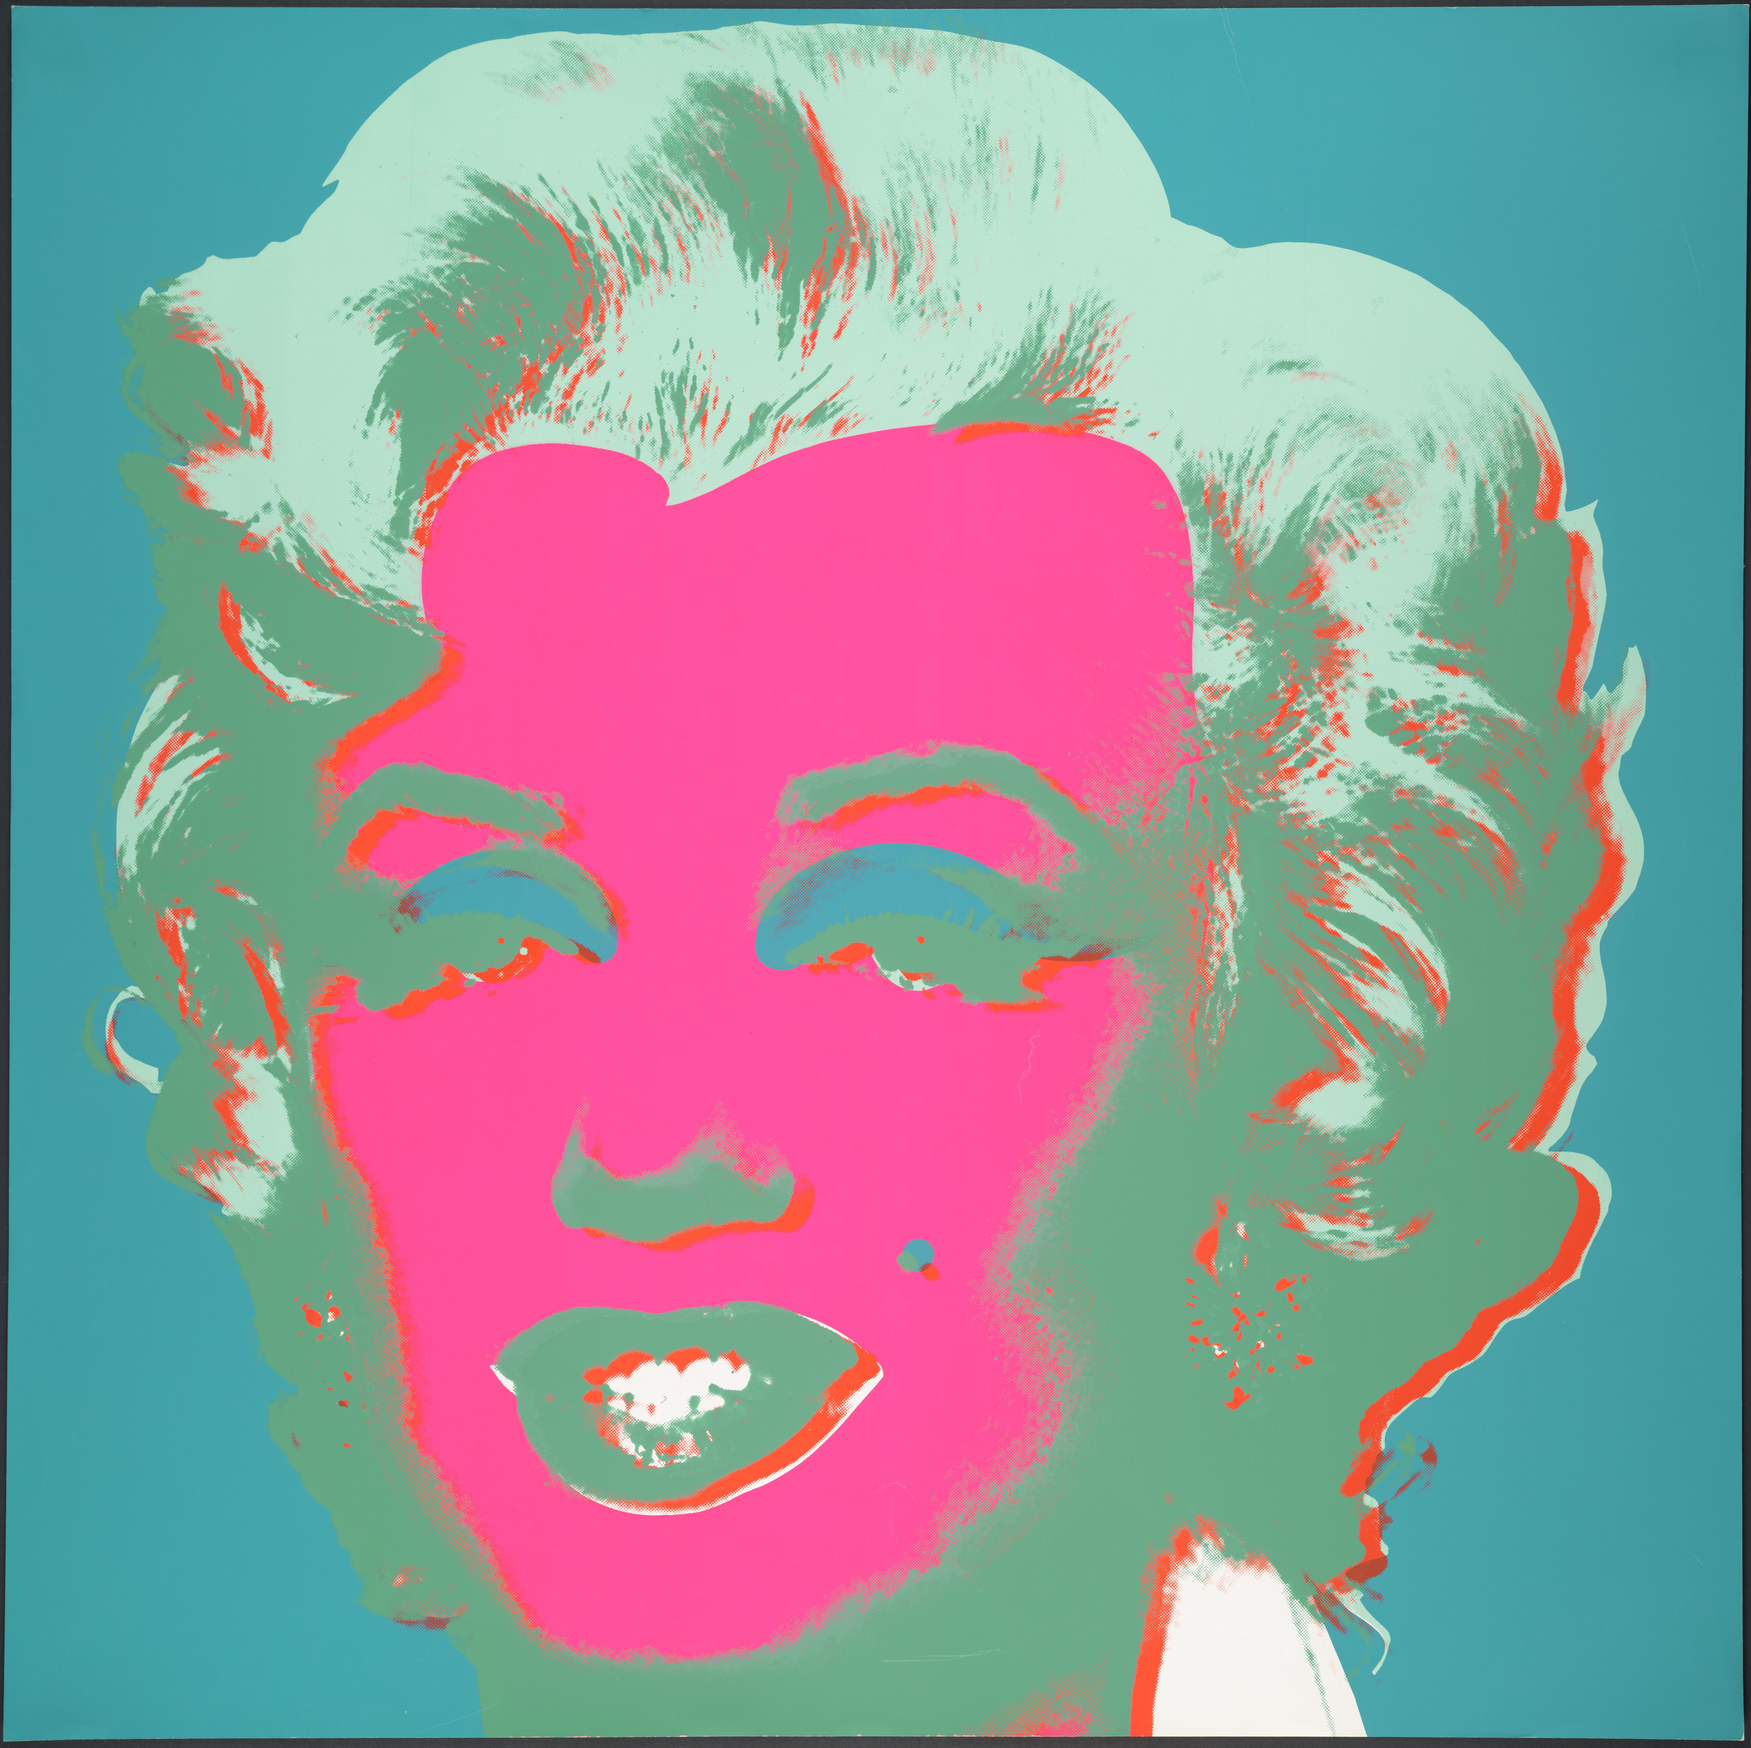
Let’s compare these celebrity portraits from the 1960s to today
Andy Warhol. Untitled from Marilyn Monroe (Marilyn). 1967
Richard Avedon. John Lennon. 1967
Sheppard Fairey. Barack Obama "Hope" poster. 2008
MoMA Pop Art Theme
Notes:
Share this information with your students:
Think about how Americans have come to admire celebrities.
Do you think celebrities are important to society? Why or why not?
If you were to make a portrait of a person you admire, what visual elements would it contain?
Richard Avedon. John Lennon. 1967
Offset lithograph, 31 x 22 1/2" (78.8 x 57 cm). Gift of the designer. © 2012 The Richard Avedon Foundation
Sheppard Fairey. Barack Obama "Hope" poster. 2008
SOURCE: http://en.wikipedia.org/wiki/File:Barack_Obama_Hope_poster.jpg
Andy Warhol. Untitled from Marilyn Monroe (Marilyn). 1967
One from a portfolio of ten screenprints, Composition and sheet: 36 x 36" (91.5 x 91.5 cm)
Gift of Mr. David Whitney
© 2012 Andy Warhol Foundation for the Visual Arts / Artists Rights Society (ARS), New York

