Slide 1

What is Modern Art?

Slide 2
Questions
The Museum of Modern Art collects work made after 1880, when the atmosphere was ripe for avant-garde artists to take their work in new, unexpected, and ‘modern’ directions.
How did ‘modern’ artists challenge the notion that art must realistically depict the world?
MoMA What is Modern Art?
Notes:
Share this information with your students:
Avant-garde means French for “advanced guard,” this term is used in English to describe a group that is innovative, experimental, and inventive in its technique or ideology, particularly in the realms of culture, politics, and the arts.
Modern can mean related to current times, but it can also indicate a relationship to a particular set of ideas that, at the time of their development, were new or even experimental.

Slide 3
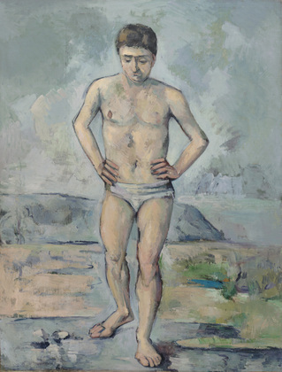
Many artists explored dreams, symbolism, and personal iconography as ways to depict their experiences.
Cézanne captures a sense of emotional ambiguity or uncertainty in The Bather that could be considered typical of the modern experience.
Look at the figure. What do you notice about his stance and gaze?
Do you think Cézanne painted from real life or a from a photograph? (another modern technique)
Paul Cézanne. The Bather. c. 1885.
MoMA What is Modern Art?
Notes:
Share this information with your students:
Cézanne captures a sense of emotional ambiguity or uncertainty in The Bather that could be considered typical of the modern experience.
Set against a barren, ambiguous backdrop, it is hard to tell where the painting takes place and who the person is. This uncertainty is one of the reasons why The Bather is considered to be a modern painting. Instead of telling a story or representing a specific place, the painting seems to capture a sense of ambiguity or uncertainty that is typical of the modern experience. Cézanne painted from a photograph of a man standing in a studio in a bathing suit rather than from something that he had seen in real life. This was a decidedly modern technique that became popular with modern artists.

Slide 4
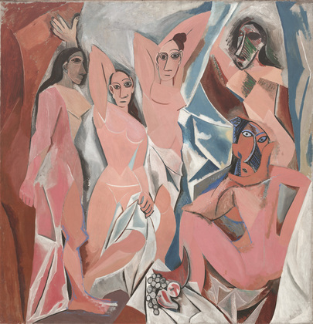
Modern artists also experimented with the expressive use of color, non-traditional materials, and new techniques and mediums.
Picasso invented a new way of painting called Cubism because of its geometric forms.
What do you notice about the figures and the setting? Do the fractured planes make the setting difficult to identify?
What else do you think is ‘modern’ about this picture?
Pablo Picasso. Les Demoiselles d'Avignon. Paris, June-July 1907
MoMA What is Modern Art?
Notes:
Share this information with your students:
Give your class a few minutes to look at Les Demoiselles d’Avignon. Ask them to describe what they see in the work. Have them observe the figures carefully, noting what each is doing and comparing them to each other. Ask your students to describe the figures’ body language, facial expressions, and relationships to each other. Picasso based this work on a memory he had of a brothel on Avignon Street in Barcelona, Spain that he had visited when he was a young man. The size of this work is 8 feet tall by 7’8’’ wide. Have your students imagine how the size effects how the viewer interprets the work.
4

Slide 5
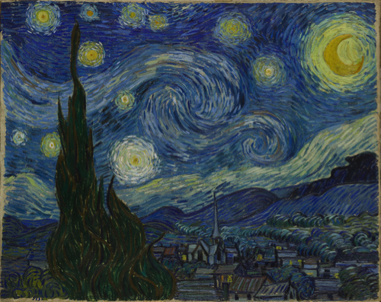
Modern artists also expressed the symbolic, by depicting scenes and places that evoked an inner mood rather than a realistic landscape.
Take a moment to notice how van Gogh used small brush strokes and color to create The Starry Night’s moving sky.
What might the shimmering stars, moon, and swirling night air symbolize to van Gogh? What mood or feeling do you think van Gogh was trying to convey?
Vincent van Gogh. The Starry Night. June 1889
MoMA What is Modern Art?
Notes:
Share this information with your students:
Van Gogh’s landscape might be considered Symbolist because its imagery is evoking an inner mood rather than a realistic landscape. (Symbolism rejects traditional iconography and replaces it with subjects that express ideas beyond the literal objects depicted.)
What might the bright stars, swirling night air and moon symbolize to van Gogh?
Ask students to share DESCRIPTIVE words and compare them to the other list. How many words are the same, how many are different?

Slide 6
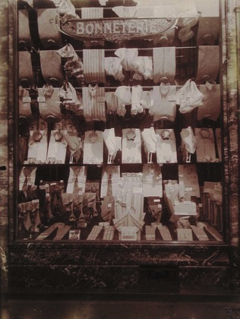
The invention of photography in the 1830’s introduced a new method for depicting and reinterpreting the world.
Atget documented Paris for 30 years, capturing the culture and modern architecture of this vibrant and artistic city.
How do you think this picture captures the concept of a‘modern’ city?
Eugène Atget. Chemiserie, Boulevard de Strasbourg. c.1900.
MoMA What is Modern Art?
Notes:
Share this information with your students:
Eugène Atget spent thirty years documenting Paris in the early twentieth century, eventually creating over 10,000 images. Atget’s fascination with Paris’ streets led him to create series of shop windows, street scenes, parks, buildings, monuments, and people. In Chemiserie, Boulevard de Strasbourg, Atget captures the façade of shirt shop, whose symmetrical window display ‘documents’ Parisian fashion. The composition relies on both the Atget’s framing and the perfection of the window display.

Slide 7
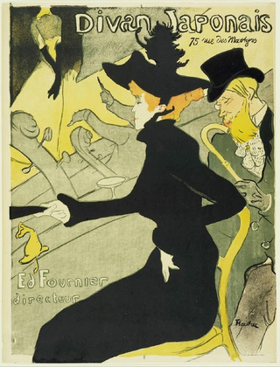
Innovations in printing gave artists the ability to replicate an image over and over again, encouraging them to design posters advertising cabarets, art salons, musical concerts, and readings.
Toulouse-Lautrec's posters were noteworthy for their simplified and abstracted designs. In Divan Japonais, he depicts a well-known Parisian cabaret singer, Jane Avril.
Is this art or is this advertising? What do you think?
Henri de Toulouse-Lautrec. Divan Japonais (Japanese Settee). 1893
MoMA What is Modern Art?
Notes:
Share this information with your students:
Whether advertising a product, like the new paper form of confetti, or entertainers in a well-known can-can troupe, Toulouse-Lautrec's posters were noteworthy for their highly simplified and abstracted designs. Inspired by Japanese woodblock prints, the artist incorporated diagonal perspectives, abrupt cropping, patterns of vivid, flat color, and sinuous lines to achieve an immediacy and directness that went far beyond the illustrative charm of other poster makers of the day.
The owner of the cabaret depicted in Divan Japonais (Japanese Settee), commissioned Toulouse-Lautrec to make this poster to celebrate the cabaret’s reopening after it had been refurbished. The three figures in the poster were good friends of the artist-- prominent members of the Parisian performance and literary scene who would have been widely recognized by audiences of the day.

Slide 8
Questions
Can you rename all of the ways in which modern artists expressed a new modern sentiment through their works of art?
MoMA What is Modern Art?

Slide 9
Painting Modern Life
MoMA What is Modern Art?

Slide 10
Questions
How did early modern artists push the boundaries of ‘traditional’ art?
What kinds of choices did they make to break with tradition and try something new?
MoMA What is Modern Art?

Slide 11
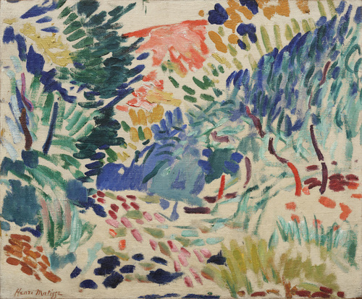
Henri Matisse used color to capture the emotion of places in landscapes that were considered ‘wild’ and ‘reckless’.
Does this landscape look or feel wild to you? What do you see that makes you say that?
What mood or feeling was the artist trying to evoke?
How did Matisse achieve this feeling?
Henri Matisse. Landscape at Collioure. 1905
MoMA What is Modern Art?
Notes:
Share this information with your students:
Landscape at Collioure represents the moment at which Matisse began to use a more instinctive, spontaneous way of painting that was unparalleled among his contemporaries. The landscapes he painted in the summer of 1905 were "wilder, more reckless than any subsequently produced in his career," according to Matisse scholar, John Elderfield.
In Landscape at Collioure, Matisse applied oil paint onto an unprimed raw canvas, using paint sometimes directly from the tube and often with quick, sketchy strokes. Despite the fact that some of the canvas was left untouched, showing raw material between the strokes of paint, this painting is considered a “finished” work.
How do you know when a painting, sculpture, or other work of art is finished?

Slide 12
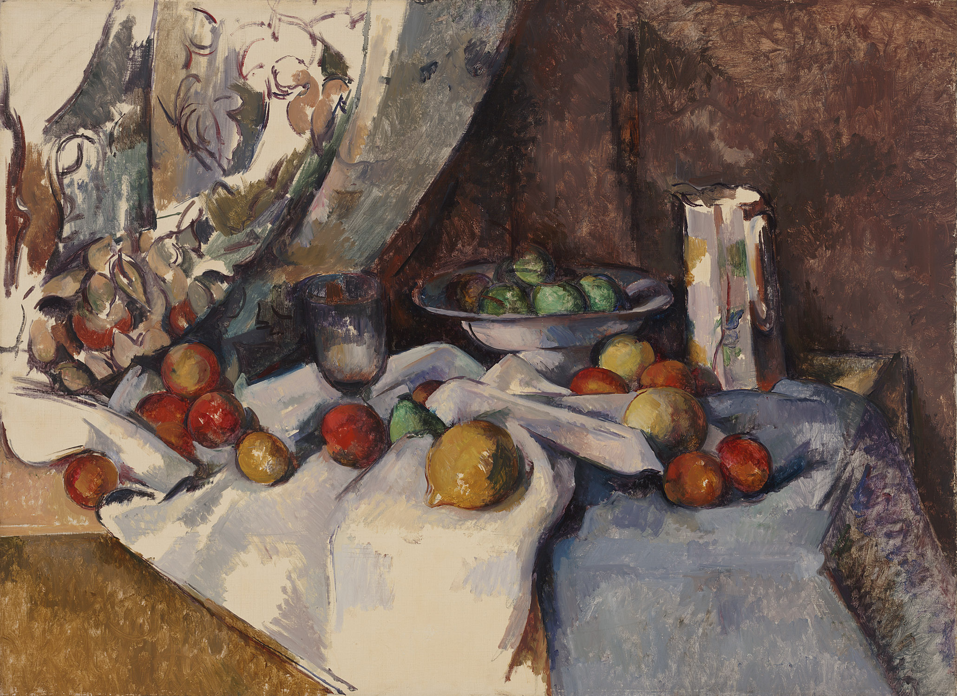
A master of perspective and light, Cézanne painted from real life in order to ‘realize his sensations’.
What do you notice about the objects on the table?
What do you notice about the background?
What do you notice about the perspective?
Paul Cézanne. Still Life with Apples. 1895–98
MoMA What is Modern Art?
Notes:
Share this information with your students:
Cézanne consistently draws attention to the quality of the paint and canvas—never aiming for illusion. For example, the edges of the fruit in the bowl are undefined and appear to shift. Rules of perspective, too, are broken; the right corner of the table tilts
forward, and is not aligned with the left side. Some areas of canvas are left bare, and others, like the drape of the tablecloth, appear unfinished. Still Life with Apples is more than an imitation of life—it is an exploration of seeing and the very nature of painting.

Slide 13
Paul Cézanne. Still Life with Apples. 1895–98
MoMA What is Modern Art?
Notes:
Share this information with your students:
Cézanne consistently draws attention to the quality of the paint and canvas—never aiming for illusion. For example, the edges of the fruit in the bowl are undefined and appear to shift. Rules of perspective, too, are broken; the right corner of the table tilts forward, and is not aligned with the left side. Some areas of canvas are left bare, and others, like the drape of the tablecloth, appear unfinished. Still Life with Apples is more than an imitation of life—it is an exploration of seeing and the very nature of painting.

Slide 14
Take a close look at The Bather, by Paul Cézanne.
Look at the figure. What do you notice about his stance and gaze?
Do you think Cézanne painted from real life or a from a photograph? (another modern technique)
Why do you think this was considered one of the first ‘modern’ paintings?
Paul Cézanne. The Bather. c. 1885.
MoMA What is Modern Art?
Notes:
Share this information with your students:
Cézanne captures a sense of emotional ambiguity or uncertainty in The Bather that could be considered typical of the modern experience.
Set against a barren, ambiguous backdrop, it is hard to tell where the painting takes place and who the person is. This uncertainty is one of the reasons why The Bather is considered to be a modern painting. Instead of telling a story or representing a specific place, the painting seems to capture a sense of ambiguity or uncertainty that is typical of the modern experience. Cézanne painted from a photograph of a man standing in a studio in a bathing suit rather than from something that he had seen in real life. This was a decidedly modern technique that became popular with modern artists.

Slide 15
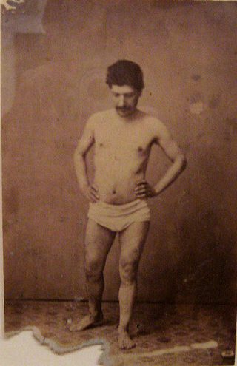
Cézanne painted from a photograph rather than something he had seen in real life…a decidedly modern act.
What do you notice about the photo?
Can you see how Cézanne captured the model’s stance and gaze in the painting?
Do you think Cézanne painted the background before or after he painted the figure?
Artist Unknown. Standing Model, c. 1860-80.
Paul Cézanne. The Bather.
c. 1885.
MoMA What is Modern Art?
Notes:
Share this information with your students:
Cézanne painted from a photograph of a man standing in a studio in a bathing suit rather than from something that he had seen in real life. The act of painting from a photograph, rather than life was decidedly modern at the time. In 1884, only a year before Cézanne made The Bather, inventor George Eastman developed a method for photographing on film, rather than plates. The technique, which eliminated the need to carry toxic chemicals and cumbersome glass plates, helped make photography available to the masses. Within a few years, it became common practice for painters, including Cézanne, and later Picasso, to include photography as part of their painting process.

Slide 16
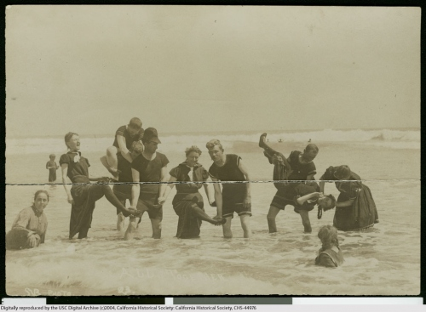
Let’s compare The Bather with this photograph taken at the beach.
What similarities do you notice?
What differences?
Shirley V. Bacon ca. 1900, courtesy of California Historical Society Collection, 1860-1960.
MoMA What is Modern Art?
Notes:
Share this information with your students:
The photograph above, taken by Shirley V. Bacon, shows a group of bathers posing in Long Beach, California, around 1900.

Slide 17
Questions
Why do you think these artists’ choices were considered so modern at the time?
MoMA What is Modern Art?

Slide 18
Cubism
MoMA What is Modern Art?

Slide 19
Questions
How did Cubists push the boundaries of ‘traditional’ still lifes and portraits?
What was new and different in their approach to painting?
MoMA What is Modern Art?

Slide 20
Now, let’s take a close look at Les Demoiselles d’Avignon by Picasso.
Describe what makes these figures so unconventional.
What do you notice about the setting? Do the fractured planes make the setting difficult to identify?
How did this work break with tradition?
How might this work of art have been controversial at the time it was painted?
Pablo Picasso. Les Demoiselles d'Avignon. Paris, June-July 1907
MoMA What is Modern Art?
Notes:
Share this information with your students:
Do you notice flat, splintered planes and geometric shapes? Influences from a non-Western culture?
Give your class a few minutes to look at Les Demoiselles d’Avignon. Ask them to describe what they see in the work. Have them observe the figures carefully, noting what each is doing and comparing them to each other. Ask your students to describe the figures’ body language, facial expressions, and relationships to each other. Picasso based this work on a memory he had of a brothel on Avignon Street in Barcelona, Spain that he had visited when he was a young man. The size of this work is 8 feet tall by 7’8’’ wide. Have your students imagine how the size effects how the viewer interprets the work.

Slide 21
Let’s compare these two paintings.
Paul Cézanne. The Bather. c. 1885
Pablo Picasso. Les Demoiselles d'Avignon. Paris, June-July 1907
MoMA What is Modern Art?
Notes:
Share this information with your students:
How is The Bather different from Les Demoiselles d’Avignon? How is it similar? What makes Les Demoiselles d’Avignon an early Cubist work of art? In your opinion, which painting is more modern? Explain.
To help organize the conversation, ask students to first describe what they notice about each work’s formal aspects: composition, color, line, shape, and painting style. Then ask, do you notice anything ‘new’ or ‘modern’ in either painting? What makes Les Demoiselles d’Avignon an early Cubist work of art? (geometric shapes, breaking the figure up into multiple perspectives)

Slide 22
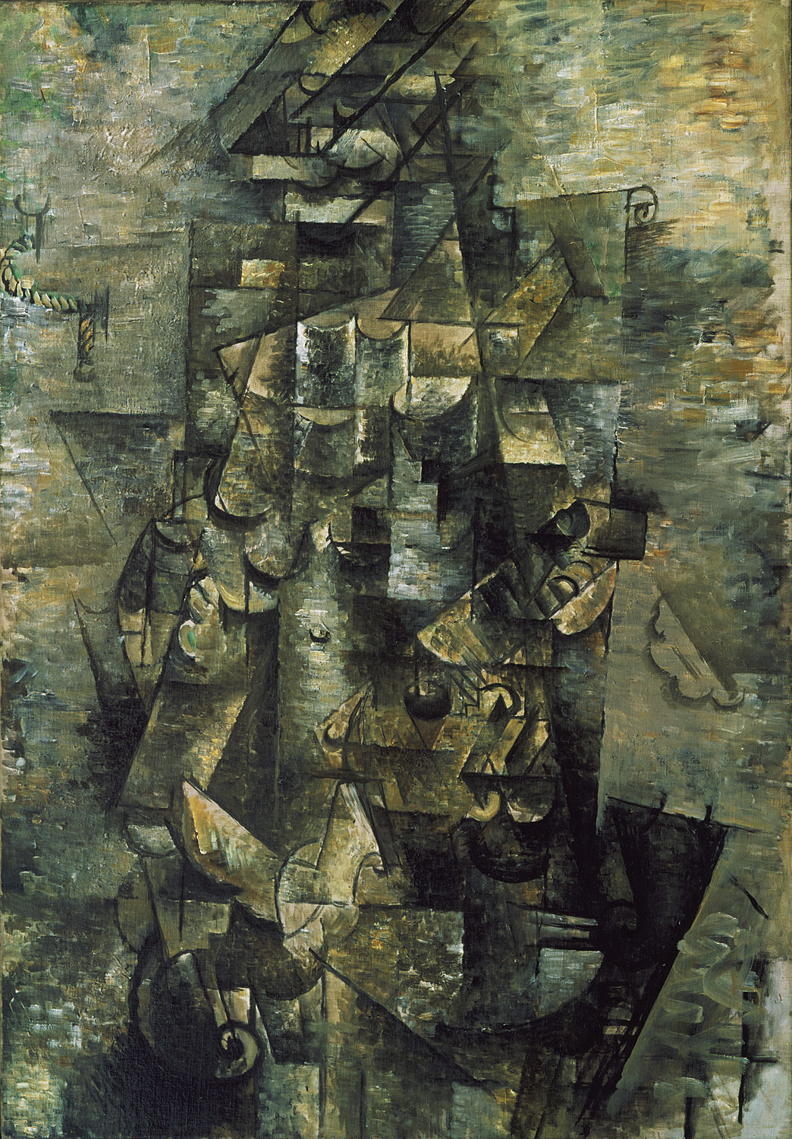
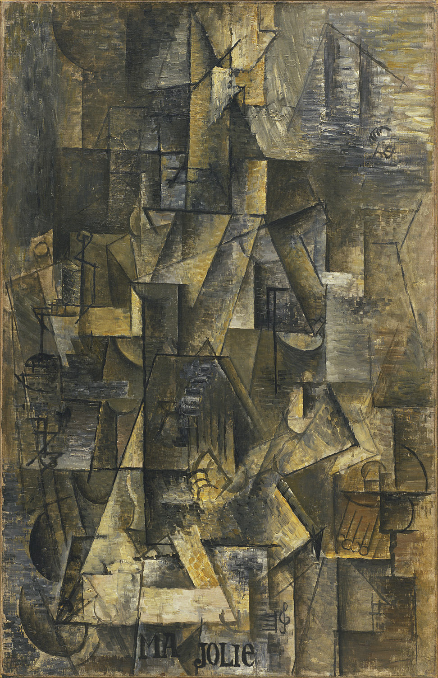
Compare and contrast two Cubist paintings by friends, Georges Braque and Pablo Picasso. Look at all of the different angles.
Georges Braque. Man with a Guitar. 1911
Pablo Picasso. Ma Jolie. 1911–12
MoMA What is Modern Art?
Notes:
Share this information with your students:
Each painting contains a figure and a guitar. Try to have your students identify the figure and any other realistic parts. (Braque’s on the left has a rope on a nail in the upper left corner.) Both artists deliberately used muted colors so that the viewer would notice the angles, shapes, and composition rather than the color. Picasso and Braque worked so closely together that many people had trouble distinguishing their work. The two artists often left signatures off their canvases, signing the back rather than the front, in order to encourage confusion.

Slide 23
Braque is on the left, Picasso is on the right. Can you find the figure in each?
Georges Braque. Man with a Guitar. 1911
Pablo Picasso. Ma Jolie. 1911–12
MoMA What is Modern Art?
Notes:
Share this information with your students:
Picasso and Braque worked so closely together that many people had trouble distinguishing their work. The two artists often left signatures off their canvases, signing the back rather than the front, in order to encourage confusion. Braque described their relationship as that of two mountaineers roped together.

Slide 24
Georges Braque. Man with a Guitar. 1911
MoMA What is Modern Art?

Slide 25
Pablo Picasso. Ma Jolie. 1911–12
MoMA What is Modern Art?

Slide 26
Questions
Why were the Cubist artists considered so radical at the time?
How did Cubism lay the groundwork for abstract art?
MoMA What is Modern Art?
Notes:
Share this information with your students:
The Cubists developed a visual language of geometric planes and compressed space that rejected the conventions of perspective and representation. Cubist works challenged viewers to understand a subject broken down into its geometrical components often represented from several angles at once.

Slide 27
Rise of the Modern City
MoMA What is Modern Art?

Slide 28
Questions
How did art, architecture, and design give rise to the ‘modern’ city?
How did artists, architects and designers both create modern space, as well as document it?
MoMA What is Modern Art?
Notes:
Share this information with your students:
Artists at the end of the nineteenth century began to explore their interior worlds, creating symbolic landscapes full of mood and mystery. Rather than rendering their worlds with realistic precision as in done the past, modern artists experimented with painting techniques to convey their interior feelings, or psychological space.

Slide 29
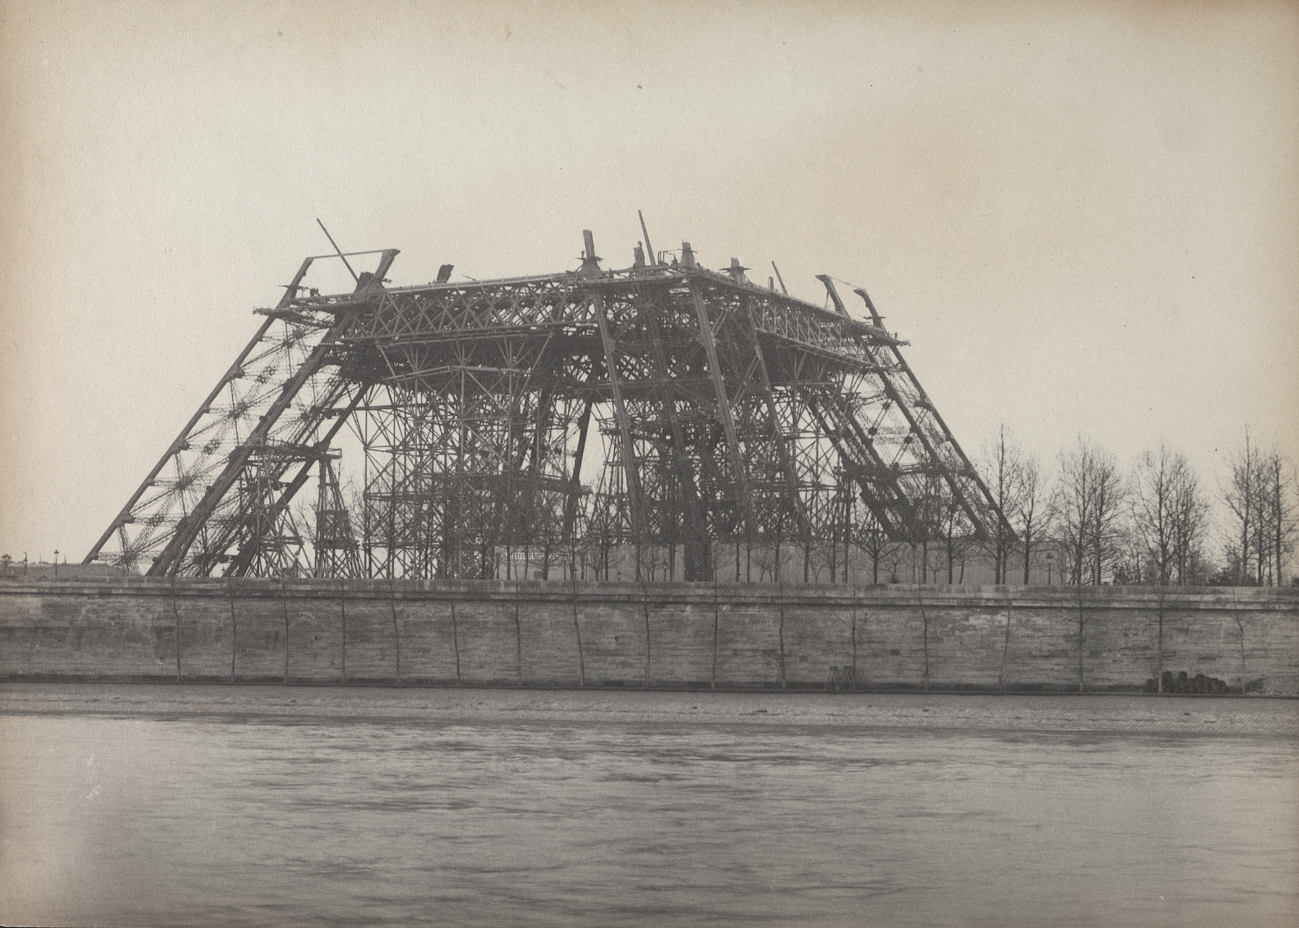
H. Blancard documented the building of the Eiffel Tower in 1888. At the time, the Tour Eiffel was a controversial ‘modern’ structure.
How would you characterize the Eiffel Tower?
Would you consider it a modern building? Why or why not?
Why do you think it was so controversial at the time it was constructed?
Hippolyte Blancard. Untitled (construction of the Eiffel Tower). February 1889
MoMA What is Modern Art?
Notes:
Share this information with your students:
The Eiffel Tower was named for Gustave Eiffel, who founded and developed a company specializing in metal structural work. There was a strong reaction to the Tower from the general public, some of whom thought it was unsightly and a “stain” on the Paris cityscape. One critic called it “a truly tragic street lamp.” Many artists, however, embraced the Eiffel Tower as a symbol of the new modern age.

Slide 30
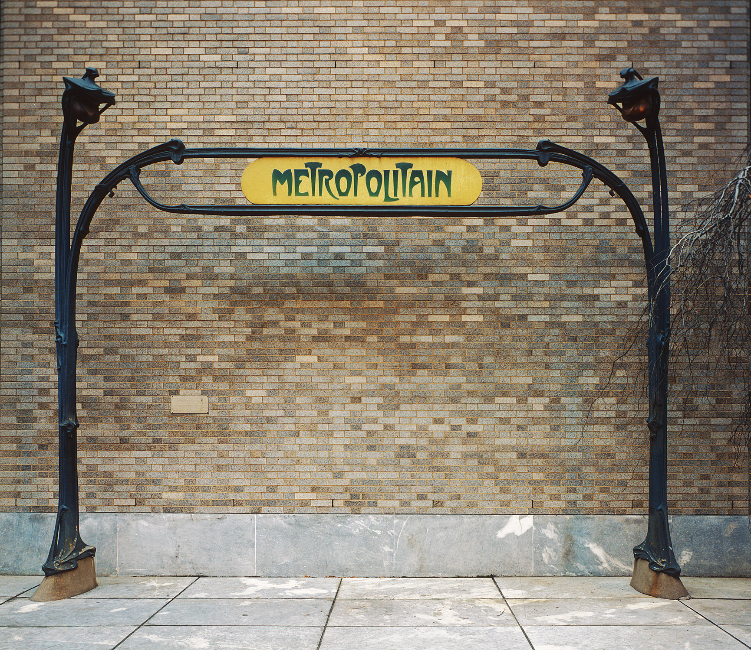
Hector Guimard produced 141 Métro Gates for the city of Paris to make riding the subway appealing to Parisians.
What do you notice about the gate’s design?
How do you think Guimard was able to make so many gates?
How was this design modern?
Hector Guimard. Entrance Gate to Paris Subway (Métropolitain) Station, Paris, France. c. 1900
MoMA What is Modern Art?
Notes:
Share this information with your students:
The object is an entryway to the Paris Metro subway system made in 1900, the year that the subway was completed. The Parisian architect and designer Hector Guimard was commissioned to make Entrance Gate to Paris Subway, not only in order to mark the entry to the new subway but to help make this new mode of transportation appealing to Parisians. Ask your students to consider how Guimard designed the entryway so that it would stand out. The style is Art Nouveau, which means it is influenced by nature, plants, and natural forms.

Slide 31
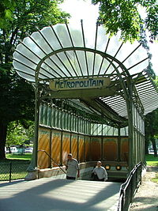
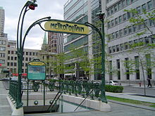
What can you notice about the few remaining Guimard Métro gates?
Port Dauphine and Abesses Gates in Paris
Guimard Gate now in Montreal
MoMA What is Modern Art?
Notes:
Share this information with your students:
Guimard’s gates with glass roofs were called édicules (kiosks). Guimard is known for being an innovative and curious personality, but at the same time he was a pioneer when it came to all things industrial and standardized – he wanted his art and architecture to be widely seen and experienced.

Slide 32
Eugène Atget documented Paris for nearly 30 years, capturing the rich culture of the modern city.
What is going on in this photograph?
How do you think this picture captures the concept of a ‘modern’ city?
Do you think Atget meant for it to be a work of art? Why or why not?
Eugène Atget. Chemiserie, Boulevard de Strasbourg. c.1900
MoMA What is Modern Art?
Notes:
Share this information with your students:
Eugène Atget spent thirty years documenting Paris in the early twentieth century, eventually creating over 10,000 images. Atget’s fascination with Paris’ streets led him to create series of shop windows, street scenes, parks, buildings, monuments, and people. In Chemiserie, Boulevard de Strasbourg, Atget captures the facade of ashirt shop, whose symmetrical window display ‘documents’ Parisian fashion. The composition relies on both Atget’s framing and the perfection of the window display.

Slide 33
Modern Landscapes
MoMA What is Modern Art?

Slide 34
Questions
How do artists convey a sense of place, atmosphere, or environment in a landscape painting?
How do artists use new painting techniques to express mood and interior feelings in their landscapes?
MoMA What is Modern Art?
Notes:
Share this information with your students:
Artists at the end of the nineteenth century began to explore their interior worlds, creating symbolic landscapes full of mood and mystery. Rather than rendering their worlds with realistic precision as in done the past, modern artists experimented with painting techniques to convey their interior feelings, or psychological space.

Slide 35
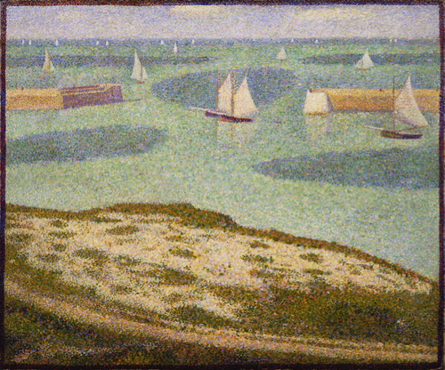
Take a close look at Port-en-Bessin, Entrance to the Harbor, by Seurat.
What is going on in the foreground, the middle ground and the background?
What is the mood of this place?
Georges-Pierre Seurat. Port-en-Bessin, Entrance to the Harbor. 1888
MoMA What is Modern Art?
Notes:
Share this information with your students:
Ask students to notice what is going on in the foreground, the middle ground and the background.
What is the mood of this place? Write down 5 - 10 words that describe this image.
Once they have their words, ask them to do a pair/share to explain why they chose those words.
Share the words with the class/write the words on the board and discuss (as a group).

Slide 36
Now, take a close look at The Starry Night, by van Gogh.
How is it similar to Port-en-Bessin? How is it different? What details do you notice?
Why might this be considered a ‘Symbolist’ work of art?
Vincent van Gogh. The Starry Night. June 1889
MoMA What is Modern Art?
Notes:
Share this information with your students:
Ask students to notice what is going on in the foreground, the middle ground and the background.
What is the mood of this place? Write down 5 - 10 words that describe this image.
Once they have their words, ask them to do a pair/share to explain why they chose those words.
Share the words with the class/write the words on the board and discuss (as a group).

Slide 37
Let’s compare Seurat and van Gogh
Georges-Pierre Seurat. Port-en-Bessin, Entrance to the Harbor. 1888
Vincent van Gogh. The Starry Night. June 1889
How are these paintings similar?
How are they different?
MoMA What is Modern Art?

Slide 38
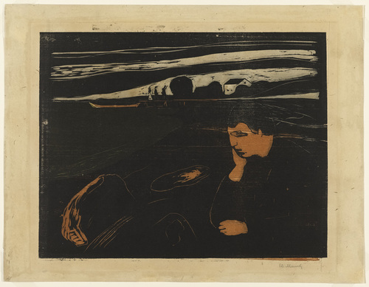
Now, take a close look at Melankoli III (Melancholy III), by Munch.
What is happening with the figure in this landscape? What mood is being conveyed?
Would the mood be the same without the figure? Why or why not?
Edvard Munch. Melankoli III (Melancholy III). 1896
MoMA What is Modern Art?
Notes:
Share this information with your students:
At the edge of the sea, Munch’s brooding figure contemplates his relationship to nature and love. Munch visited this place on the shore in real life. He made several versions of the same image, a lone figure consumed in melancholy while looking out at the sea.
Ask students to notice what is going on in the foreground, the middle ground and the background.
What is happening with the figure in this landscape? What mood is being conveyed?
Would the mood be the same without the figure? Why or why not?
Write 5 - 10 words that describe this image. Compare the lists.

Slide 39
Questions
Now that you have generated descriptive words for each image, use them to have a conversation with a partner:
How did these modern painters convey a sense of mood or interior, psychological space in their landscapes?
MoMA What is Modern Art?

Slide 40
Portraits
MoMA What is Modern Art?

Slide 41
Questions
Why do artists make portraits?
How do artists convey the personality and spirit of a person in a portrait?
What constitutes a ‘modern’ portrait?
MoMA What is Modern Art?

Slide 42
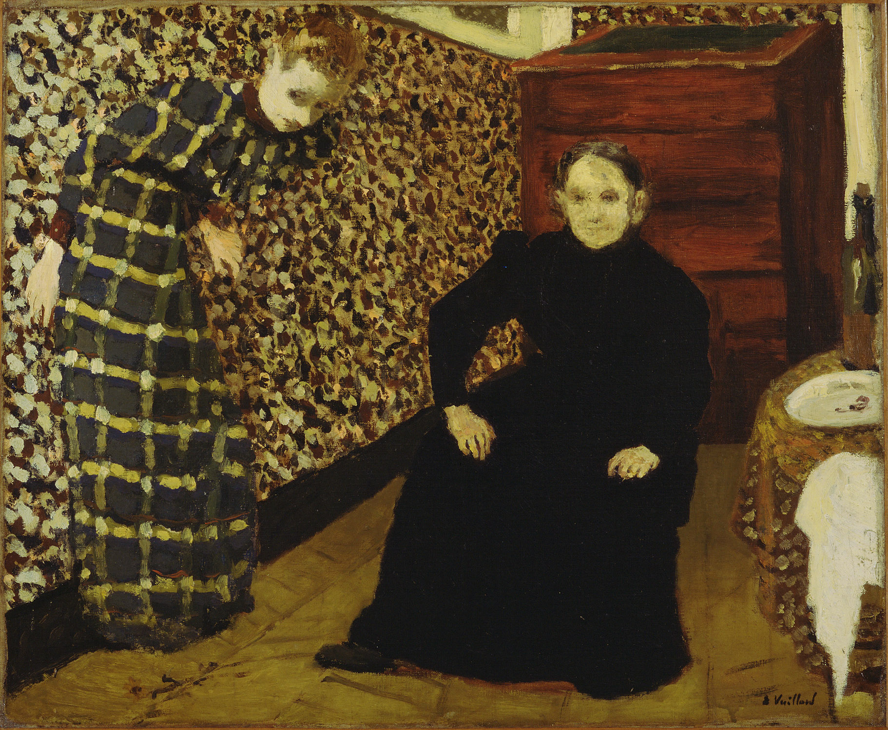
Let’s study Interior, Mother and Sister of the Artist by Vuillard.
What is going on in this portrait?
Who or what is the focal point in this picture?
What is the feeling or mood?
What do you think makes this a ‘modern’portrait?
Édouard Vuillard. Interior, Mother and Sister of the Artist. 1893
MoMA What is Modern Art?
Notes:
Share this information with your students:
Unlike traditional portraiture, Édouard Vuillard was not as interested in recording his subjects’ precise likenesses as in capturing the nature of their relationship and environment. Vuillard’s mother and sister both lived and worked as seamstresses and are depicted in their home. The casual setting, with its extreme angles and patterns, creates a slightly claustrophobic space that feels as if it might fall in on the dominant Madame Vuillard.
What is going on in this portrait? Who or what is the focal point in this picture? What is the feeling or mood? What do you think makes this a ‘modern’portrait?

Slide 43
Édouard Vuillard. Interior, Mother and Sister of the Artist. 1893
MoMA What is Modern Art?

Slide 44
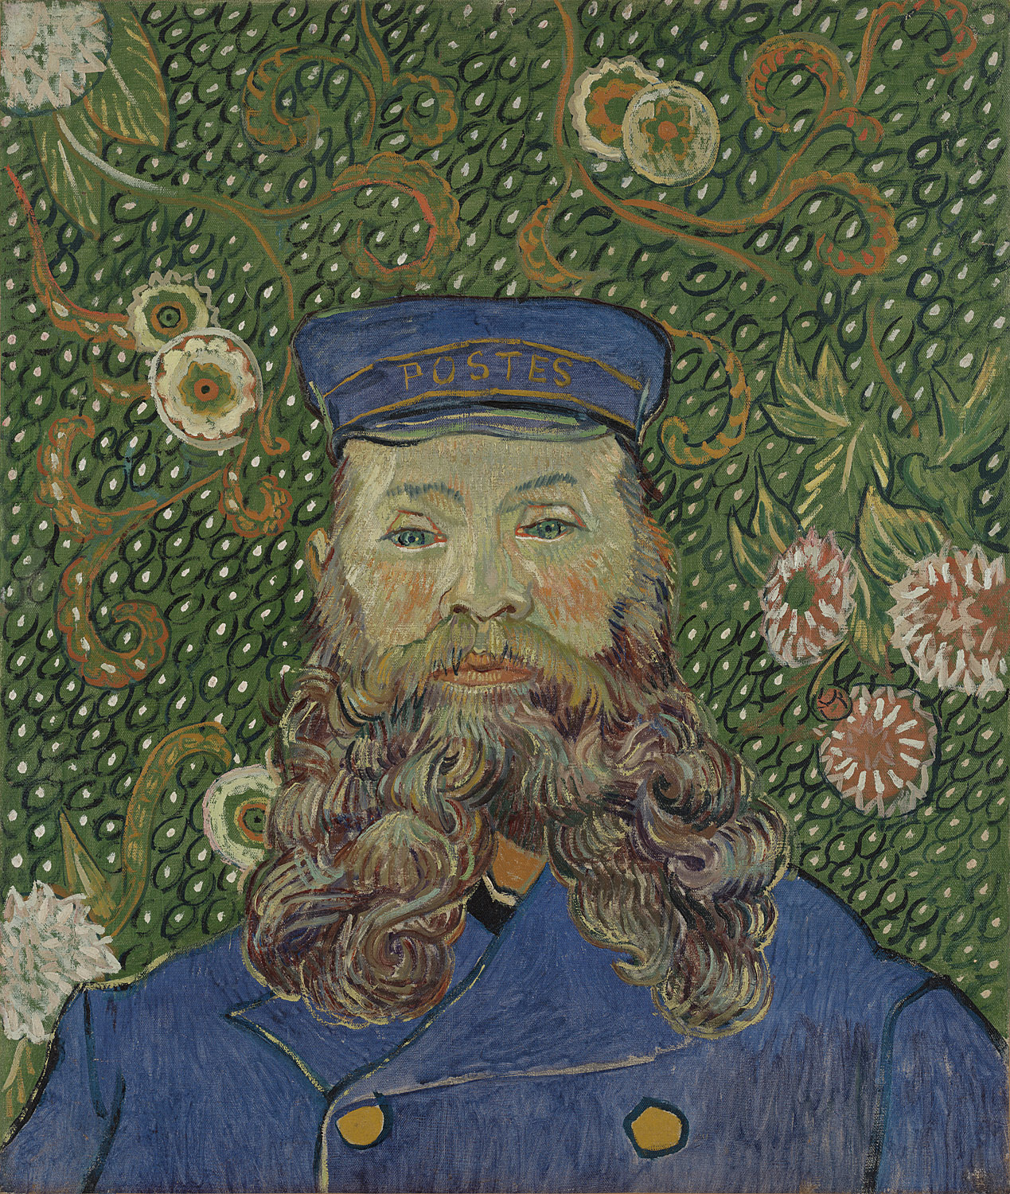
Let’s take a close look at Portrait of Joseph Roulin by van Gogh.
What details do you notice in this portrait?
What details do you notice in the background?
Why might this be considered a symbolist portrait?
Vincent van Gogh. Portrait of Joseph Roulin. 1889
MoMA What is Modern Art?
Notes:
Share this information with your students:
This portrait might be considered Symbolist because its background is not realistic. It uses color and flowers to frame its subject. Van Gogh’s subject in this painting, Joseph Roulin, worked for a post office in the French town of Arles. Van Gogh and Roulin lived on the same street and became close friends. This picture, which van Gogh boasted of having completed this picture quickly, in a single session. Some scholars think that this portrait was not painted from life but rather from memory or from previous portraits.

Slide 45
Vincent van Gogh. Portrait of Joseph Roulin. 1889
MoMA What is Modern Art?

Slide 46
Questions
How do artists convey the personality and spirit of a person in a portrait?
Are portraits still important today? Why or why not?
MoMA What is Modern Art?

Slide 47
Popular Culture
MoMA What is Modern Art?

Slide 48
Questions
How did modern artists employ both artistic talents and inventive techniques (printing) to advance popular culture?
How do artists influence popular culture and vice versa?
MoMA What is Modern Art?
Notes:
Share this information with your students:
The end of the nineteenth century in France is known as the Belle Époque (“beautiful age”), in part because of the high cultural development that occurred at that time. Entertainment for the general public was a fairly new phenomenon. Artists, writers and patrons frequented Parisian cabarets, where singers and dancers enjoyed growing acclaim for their talents. Meanwhile, artists created images in a variety of mediums and techniques of celebrities and of audiences enjoying popular culture. Innovations in printing allowed artists to replicate an image over and over again, encouraging them to design posters advertising cabarets, art salons, musical concerts, and readings.

Slide 49
Let’s study Divan Japonais by Toulouse-Lautrec
What is going on in this image?
What kinds of lines and shapes do you notice?
Who or what is the focal point in this image?
What do you think this poster was used for?
Henri de Toulouse-Lautrec. Divan Japonais (Japanese Settee). 1893
MoMA What is Modern Art?
Notes:
Share this information with your students:
Whether advertising a product, like the new paper form of confetti, or entertainers in a well-known can-can troupe, Toulouse-Lautrec's posters were noteworthy for their highly simplified and abstracted designs. Inspired by Japanese woodblock prints, the artist incorporated diagonal perspectives, abrupt cropping, patterns of vivid, flat color, and sinuous lines to achieve an immediacy and directness that went far beyond the illustrative charm of other poster makers of the day. The owner of the cabaret depicted in the work, the Divan Japonais, commissioned Toulouse-Lautrec to make this poster to celebrate the cabaret’s reopening after it had been refurbished. The three figures in the poster were good friends of the artist-- prominent members of the Parisian performance and literary scene who would have been widely recognized by audiences of the day.

Slide 50
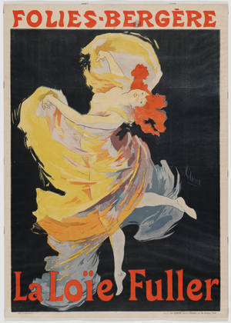
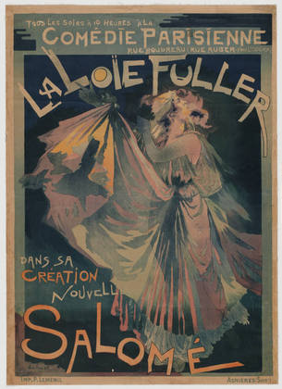
Compare other posters from the time period. Do you see a style emerging?
Jules Chéret. Folies-Bergère, La Loïe Fuller. 1893
Georges De Feure. Comedie Parisienne, La Loïe Fuller Dans Sa Création Nouvelle, Salomé. 1900
MoMA What is Modern Art?
Notes:
Share this information with your students:
Ask students to find similarities. What are the conventions the artists use? (similar text treatment, dark background,
colorful figure with motion as central focal point, etc.) Who might the audience be for these poster ads?

Slide 51
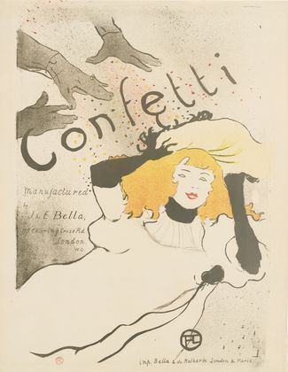

Compare and contrast Toulouse-Lautrec’s poster with Toy Story 3.
Henri de Toulouse-Lautrec, Confetti. 1894
Disney Pixar’s Toy Story 3 Poster. 2010
MoMA What is Modern Art?
Notes:
Share this information with your students:
Ask students to find similarities—figure size & placement/gesture/costume, font size & placement, etc. What are the conventions the artist/graphic designer use? How have contemporary ads changed? How have they stayed the same?

Slide 52
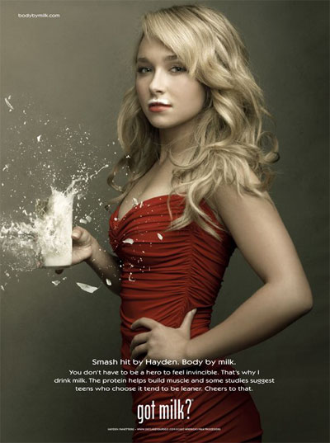
What is the link between celebrity and advertising? What is the link between art and advertising?
Jules Cheret. Folies-Bergère, La Loïe Fuller. 1893
Got Milk? print advertisement
MoMA What is Modern Art?
Notes:
Share this information with your students:
Lithographed posters proliferated during the 1890s due to technical advances in color printing and the relaxation of laws restricting the placement of posters. Artists’ brilliant posters, made as advertisements, captured the vibrant appeal of the prosperous Belle Époque in France. Compare this poster to a contemporary advertisement for milk.

Slide 53
Questions
Can you see how modern artists influenced a century of advertising?
Do you think the artists were aware of how ‘avant-garde’ they were at the time?
MoMA What is Modern Art?

