Slide 1
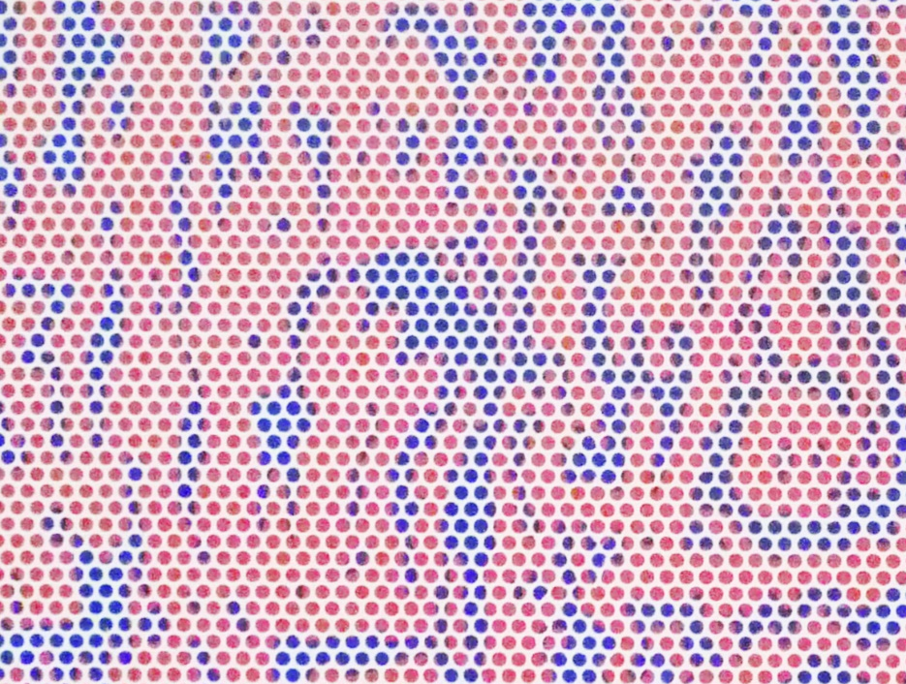
POP ART
Roy Lichtenstein, Rouen Cathedral Set V, 1969, oil and magna on canvas, at SFMOMA. Author: Steven Zucker, Cropped from original, Source: Flickr, License: CC BY-NC-SA 2.0

Slide 2
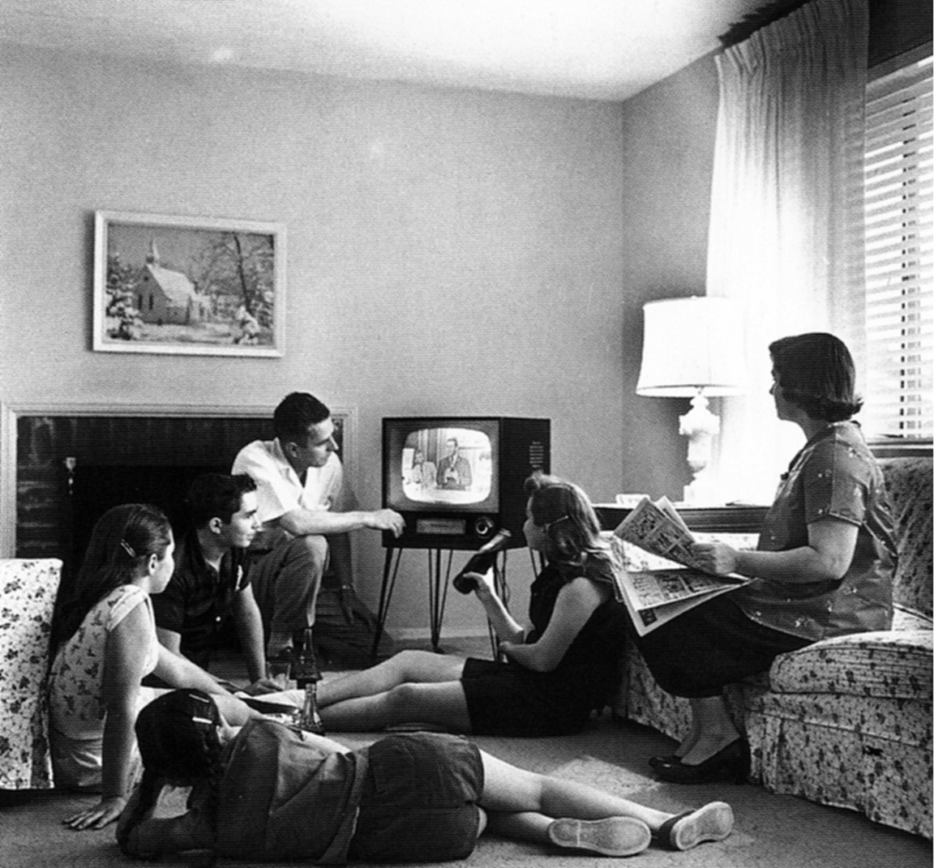
Pop Art arose from a world in which modern mass visual culture, including television, films, and advertising, was defining the standards of beauty.
Family watching television, 1958
Author: Evert F. Baumgardner
Source: Wikimedia Commons
License: Public Domain

Slide 3
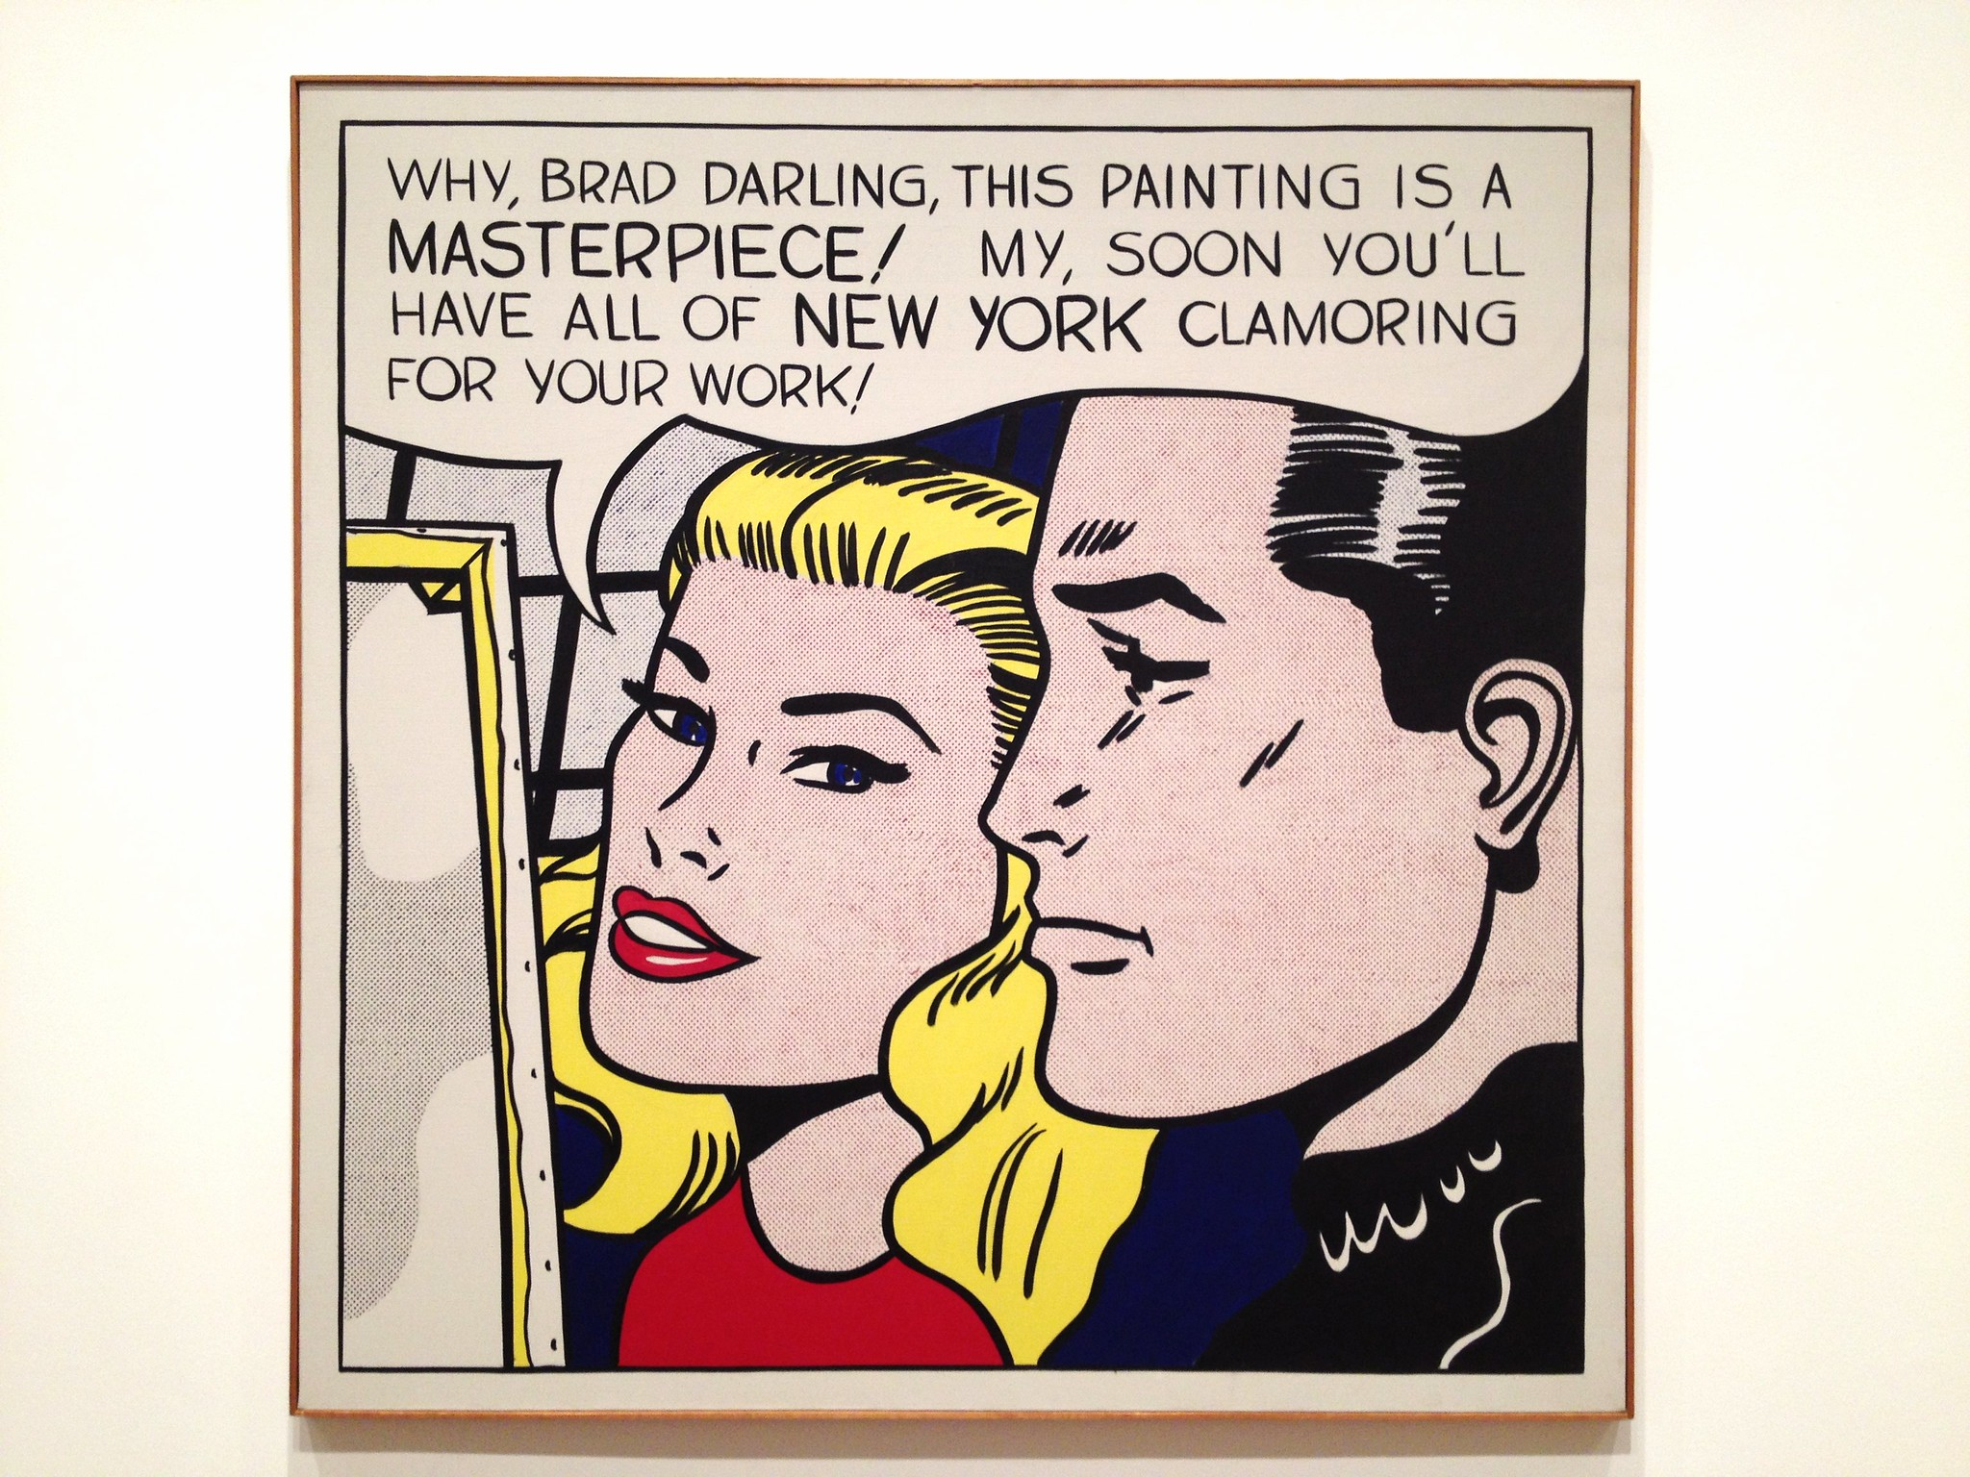
Art galleries were crowded with works of art exploring high-minded ideas about form, truth, and the primal unconscious.
When Pop artist Roy Lichtenstein was asked if he considers himself anti-experimental, he answered:
“I think so, and anti-contemplative, anti-nuance, anti-getting-away-from-the-tyranny-of-the-rectangle, anti-movement-and-light, anti-mystery, anti-paint-quality, anti-Zen, and anti all of those brilliant ideas of preceding movements which everyone understands so thoroughly.”
Roy Lichtenstein, Masterpiece, 1962.
Retrospective at Art Institute Chicago, Author: Arcticpenguin, Source: Flickr, License: CC-NC 2.0
© Estate of Roy Lichtenstein

Slide 4
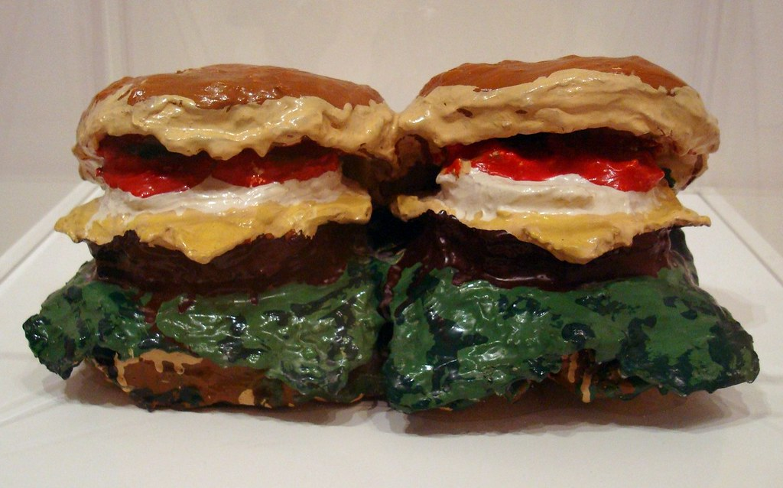
Pop Art looked out into the world. It identified and explored the kinds of images consumed, and favored, by the general population. The Pop artists appropriated images from their contemporary visual culture, elevating and highlighting the kinds of lowbrow cultural imagery previously excluded from the world of fine arts.
Claes Oldenburg, Two Cheeseburgers, with everything, 1962. Burlap soaked in plaster, painted with enamel.
Author: Neil R, Source: Flickr, License: CC BY-NC 2.0

Slide 5
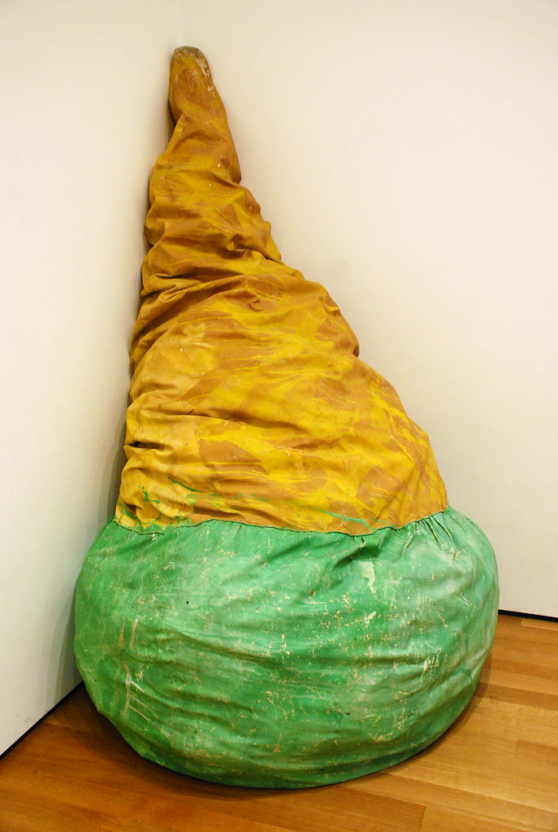
In his epic poetic ode for Pop Art, called I am for…, artist Claes Oldenburg writes:
“…I am for an art that grows up not knowing it is art at all, an art given the chance of having a starting point of zero.
I am for an art that embroils itself with the everyday crap and still comes out on top.
I am for an art that imitates the human, that is comic, if necessary, or violent, or whatever is necessary.
I am for all art that takes its form from the lines of life itself, that twists and extends and accumulates and spits and drips, and is heavy and coarse and blunt and sweet and stupid as life itself…”
Claes Oldenburg, Floor Cone, 1962. At MoMA.
Author: Adam Fagen, Source: Flickr, License: CC BY-NC-SA 2.0

Slide 6
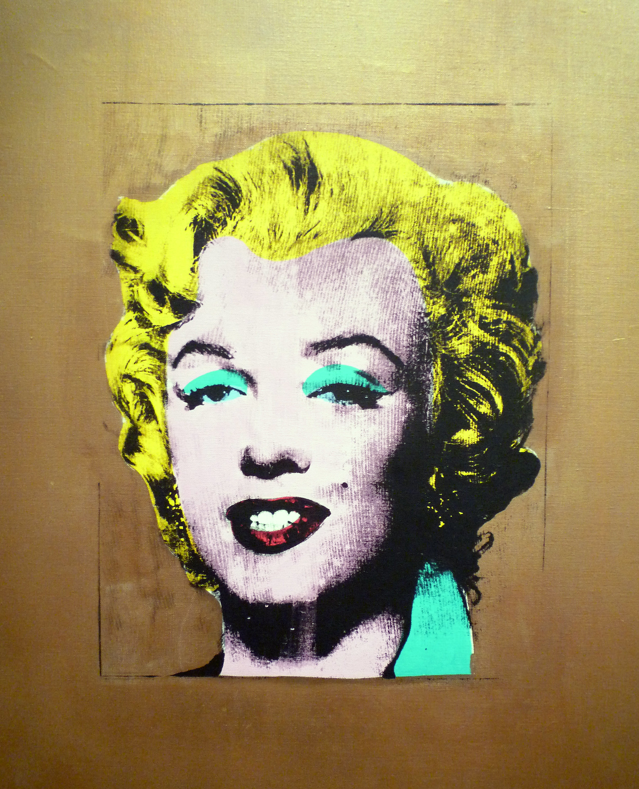
Pop Art sought out the true icons of mid-20th century America:
celebrities, products, and mass media.
Andy Warhol, Gold Marilyn Monroe, 1962.
Silkscreen on canvas, On view at MoMA. Author: Steven Zucker, Source: Flickr, License: CC BY-NC-SA 2.0

Slide 7
ANDY WARHOL
Andy Warhol, Gold Marilyn Monroe, 1962.
Silkscreen on canvas, On view at MoMA. Author: Steven Zucker, Cropped from original, Source: Flickr, License: CC BY-NC-SA 2.0

Slide 8
Andy Warhol was fascinated by contemporary icons, fame, and consumerism.
Both a friend to many celebrities and a celebrity in his own right, Andy Warhol built a cult of fame around himself.
Andy Warhol, Gold Marilyn Monroe, 1962.
Silkscreen on canvas, On view at MoMA. Author: Steven Zucker, Source: Flickr, License: CC BY-NC-SA 2.0

Slide 9
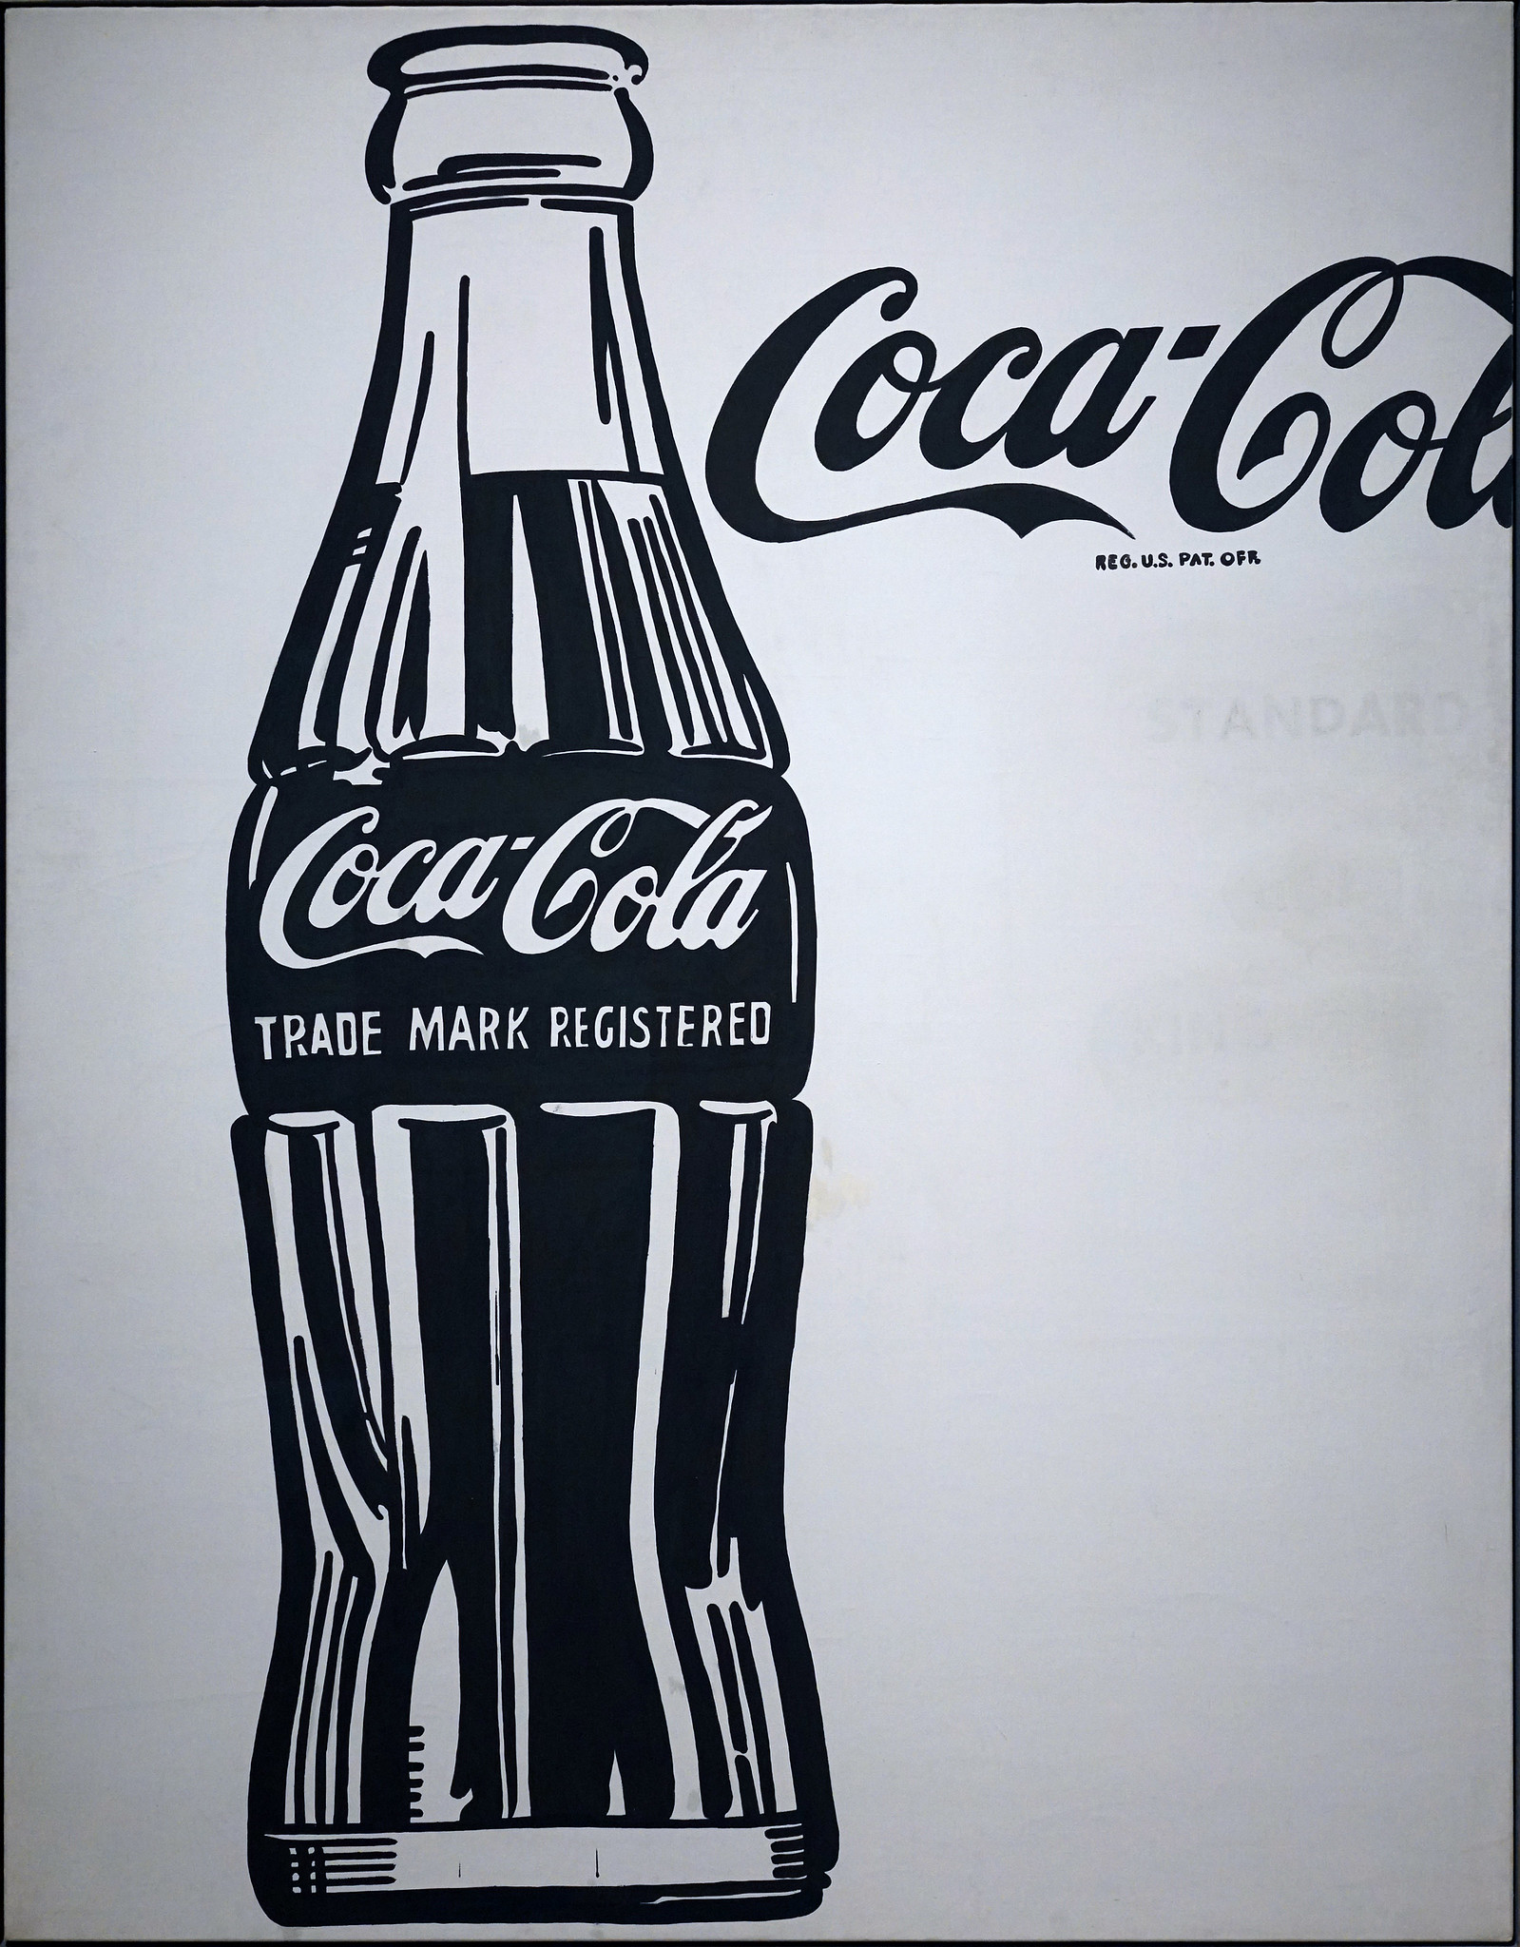
He began his career as a graphic designer. He moved from making art as advertisements to making advertisements as art.
Andy Warhol, Coca-Cola [3], 1962
Casein on canvas, Author: Steven Zucker, Source: Flickr, License: CC BY-NC-SA 2.0 (Crystal Bridges Museum of American Art, © The Andy Warhol Foundation for the Visual Arts)

Slide 10
“What's great about this country is that America started the tradition where the richest consumers buy essentially the same things as the poorest. You can be watching TV and see Coca-Cola, and you know that the President drinks Coke, Liz Taylor drinks Coke, and just think, you can drink Coke, too. A Coke is a Coke and no amount of money can get you a better Coke than the one the bum on the corner is drinking. All the Cokes are the same and all the Cokes are good. Liz Taylor knows it, the President knows it, the bum knows it, and you know it.”
-Andy Warhol
Andy Warhol, Coca-Cola [3], 1962
Casein on canvas, Author: Steven Zucker, Source: Flickr, License: CC BY-NC-SA 2.0 (Crystal Bridges Museum of American Art, © The Andy Warhol Foundation for the Visual Arts)

Slide 11
By painting a bottle of Coca-Cola, Andy Warhol paints a contemporary American icon.
He elevates an image that appears like an advertisement for a product to a gallery art level. By highlighting the product as art, he invites the viewer to reconsider it.
Andy Warhol, Coca-Cola [3], 1962
Casein on canvas, Author: Steven Zucker, Source: Flickr, License: CC BY-NC-SA 2.0 (Crystal Bridges Museum of American Art, © The Andy Warhol Foundation for the Visual Arts)

Slide 12
Although perhaps the Coca-Cola bottle was a daily sight for most viewers in 1962, it was an image that was exceptionally specific to the time period in which it was painted.
Looking at Warhol’s images over time, they communicate strongly about the cultural moment in which they were produced.
Andy Warhol, Coca-Cola [3], 1962
Casein on canvas, Author: Steven Zucker, Source: Flickr, License: CC BY-NC-SA 2.0 (Crystal Bridges Museum of American Art, © The Andy Warhol Foundation for the Visual Arts)

Slide 13
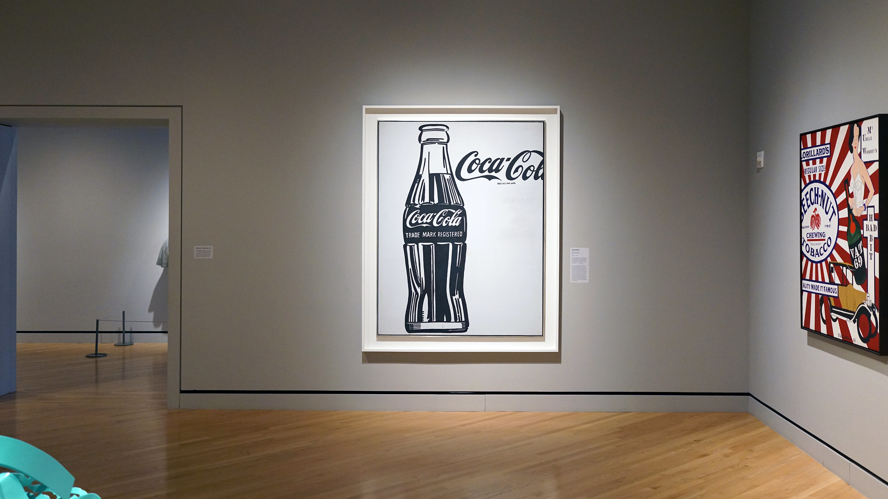
Andy Warhol, Coca-Cola [3], 1962
Casein on canvas, Author: Steven Zucker, Cropped from original, Source: Flickr, License: CC BY-NC-SA 2.0
(Crystal Bridges Museum of American Art, © The Andy Warhol Foundation for the Visual Arts)

Slide 14
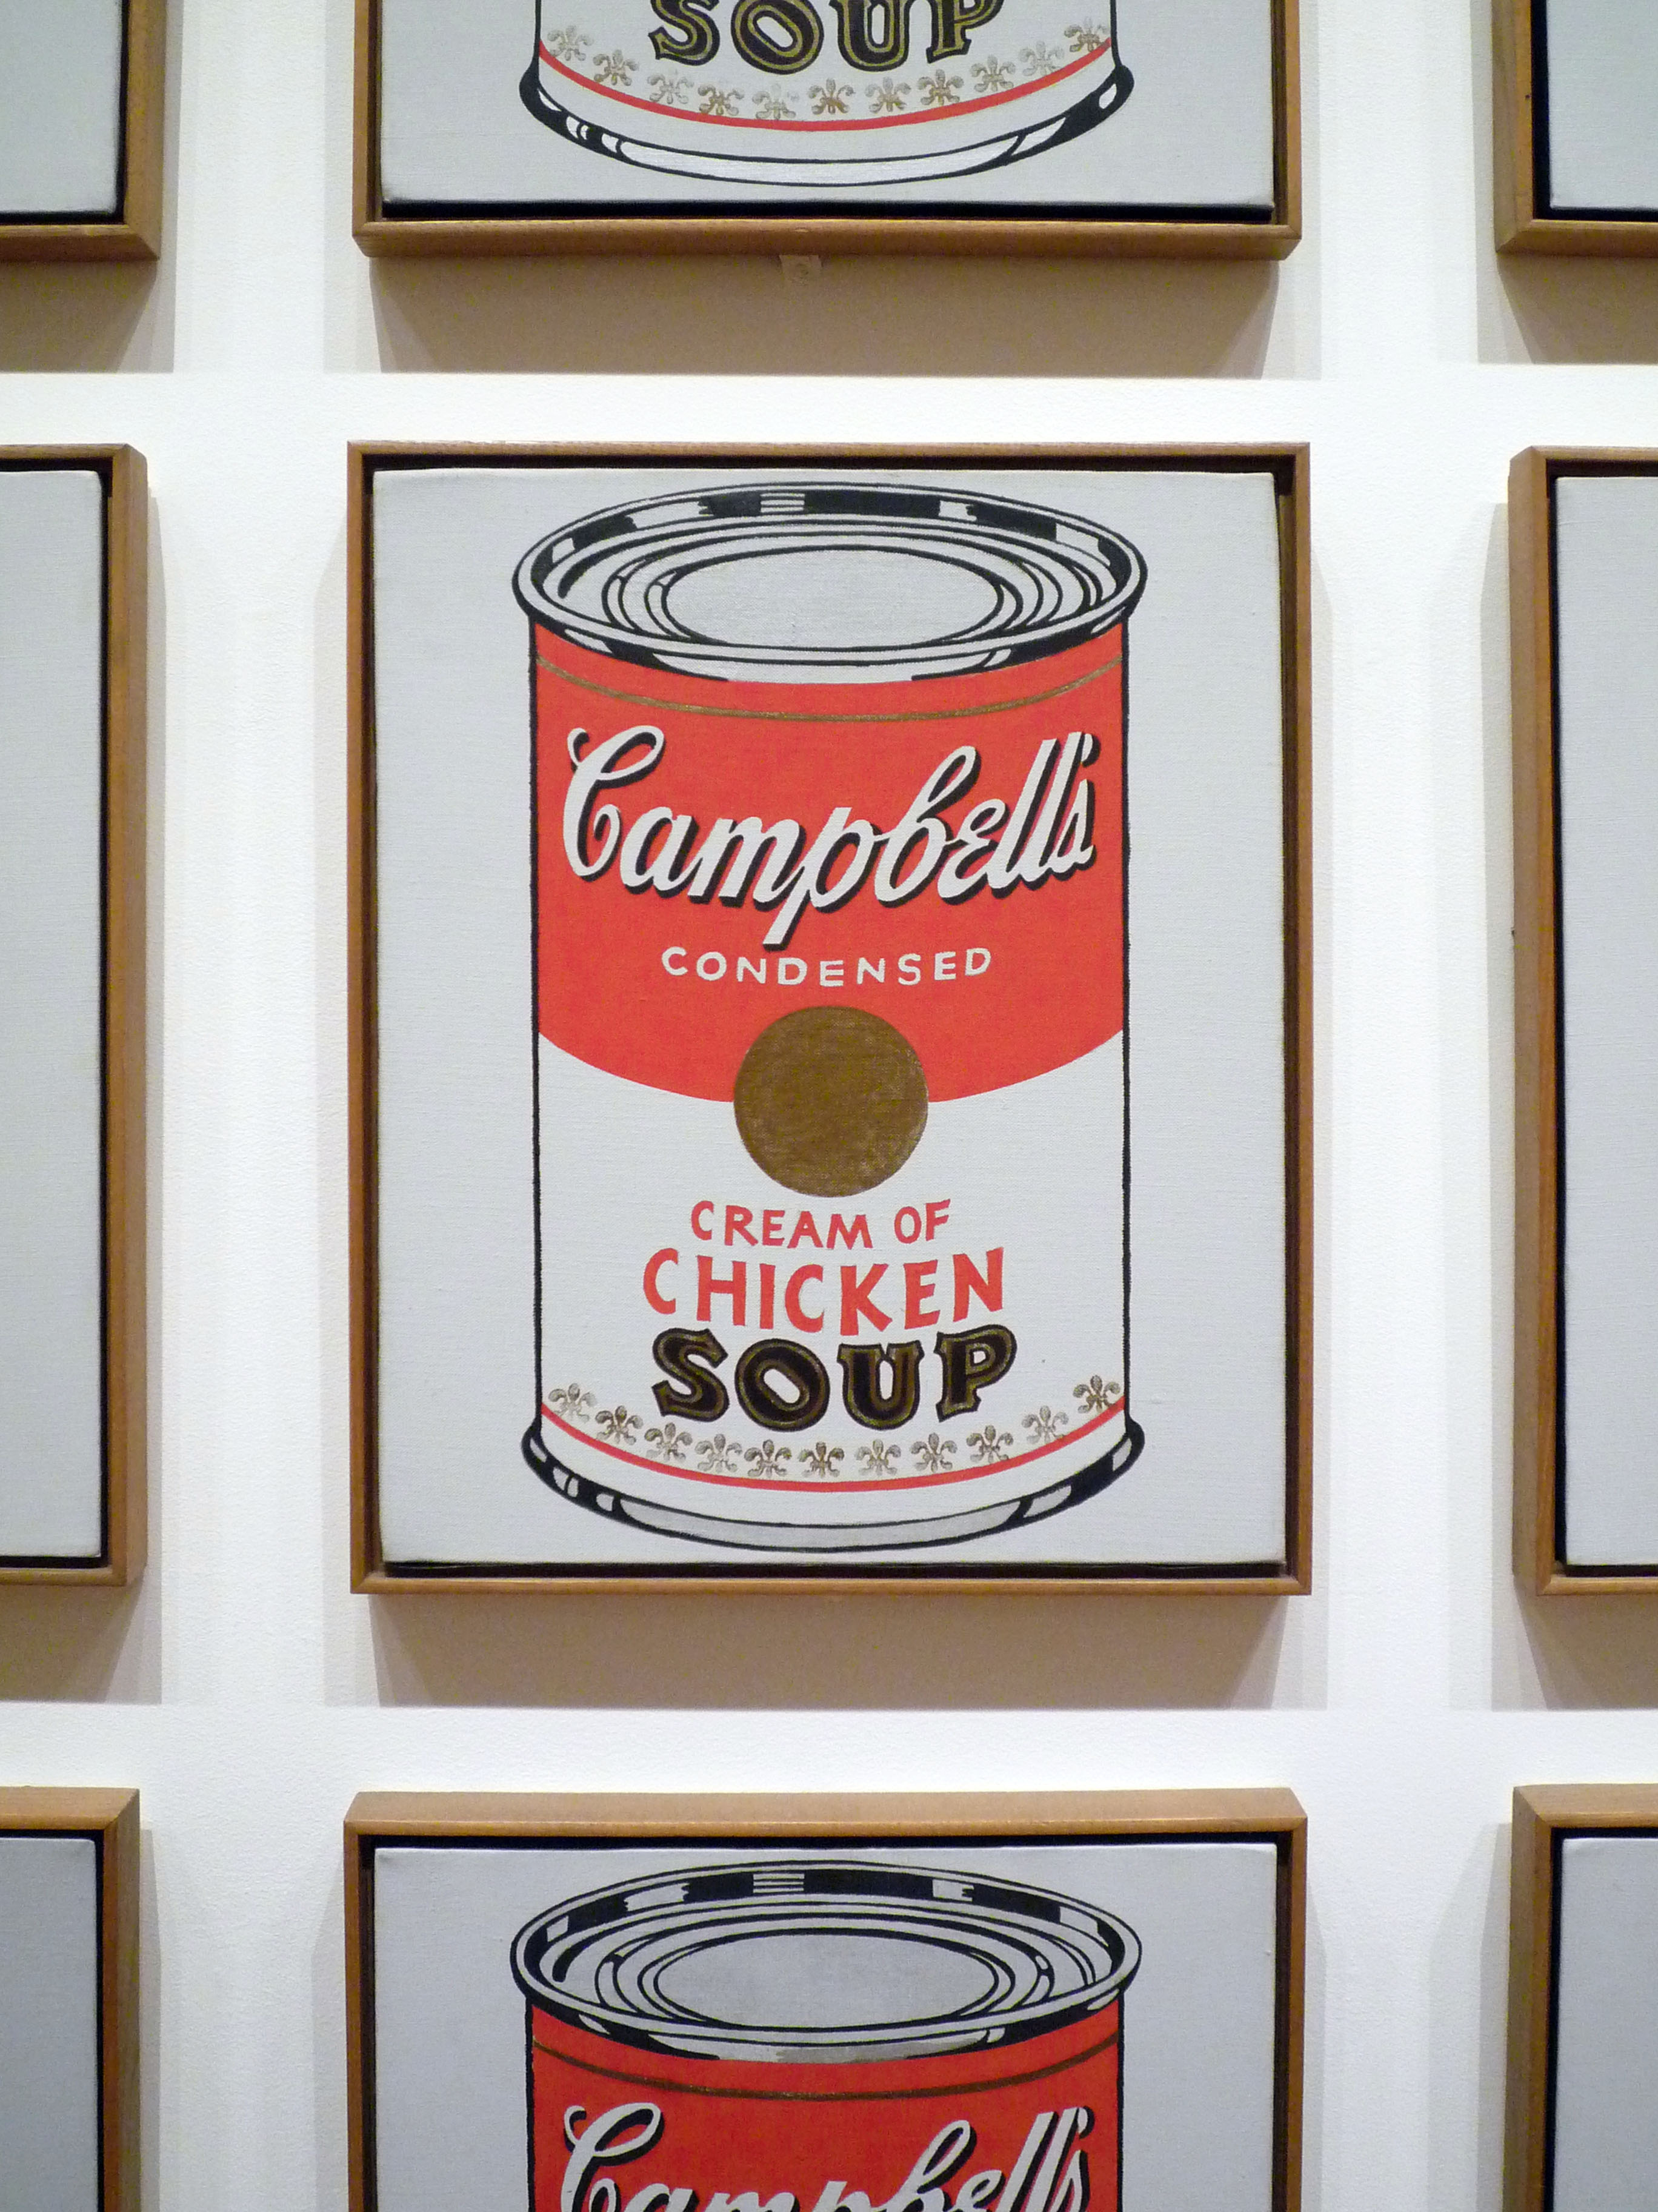
Some of Warhol’s most iconic images are from his series of Campbell’s soup can paintings.
Inspired by these commodities from daily life, with their elaborate, iconic label and mass-produced consistency, Warhol presents the viewer with an object seemingly utterly routine. But by framing the image and hanging it on the wall of the museum, the artist asks us to reconsider its meaning and significance.
Andy Warhol, Campbell’s Soup Cans, 1962.
Synthetic polymer on thirty-two canvases, Each canvas 20 x 16 inches. On view at MoMA. Author: Steven Zucker, Source: Flickr, License: CC BY-NC-SA 2.0

Slide 15
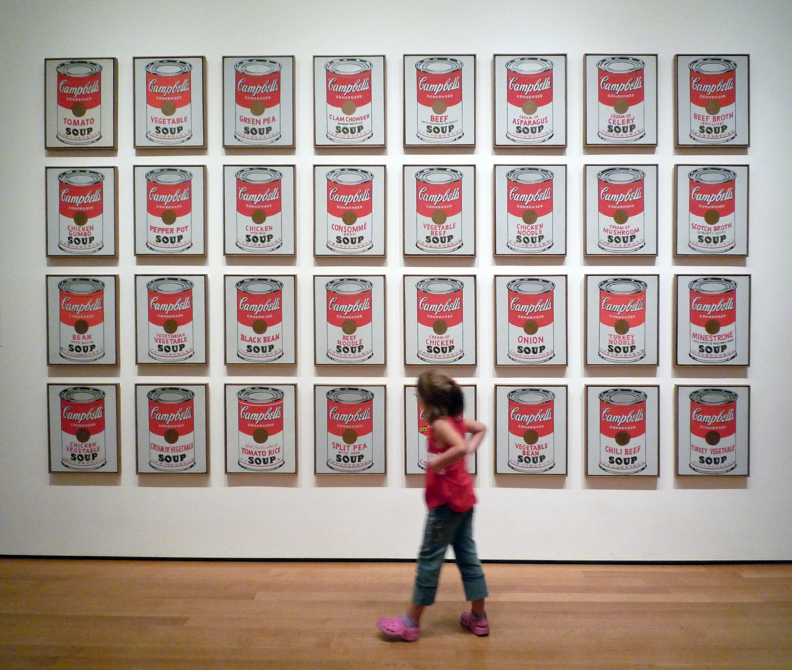
By making multiple versions of the same image (here, as soup cans of the same design with various flavors) Warhol references the rapid homogenization of daily life allowed by industrial production, encouraged by mass media, and fueled by consumerism.
Andy Warhol, Campbell’s Soup Cans with Viewer, 1962. Synthetic polymer on thirty-two canvases, Each canvas 20 x 16 inches. Author: Steven Zucker, Source: Flickr, License: CC BY-NC-SA 2.0

Slide 16
Warhol’s Campbell’s Soup Cans reveal the consumerist ideals of regularity, consistency, and familiarity, with the illusion of choice within the framework of a trusted brand.
Andy Warhol, Campbell’s Soup Cans with Viewer, 1962. Synthetic polymer on thirty-two canvases, Each canvas 20 x 16 inches. Author: Steven Zucker, Source: Flickr, License: CC BY-NC-SA 2.0

Slide 17
These works of art evoke Warhol’s contemporary world and culture of consumerism.
The artist propelled art to match with the world around him.
Andy Warhol, Campbell’s Soup Cans, 1962.
Synthetic polymer on thirty-two canvases, Each canvas 20 x 16 inches. On view at MoMA. Author: Steven Zucker, Source: Flickr, License: CC BY-NC-SA 2.0

Slide 18
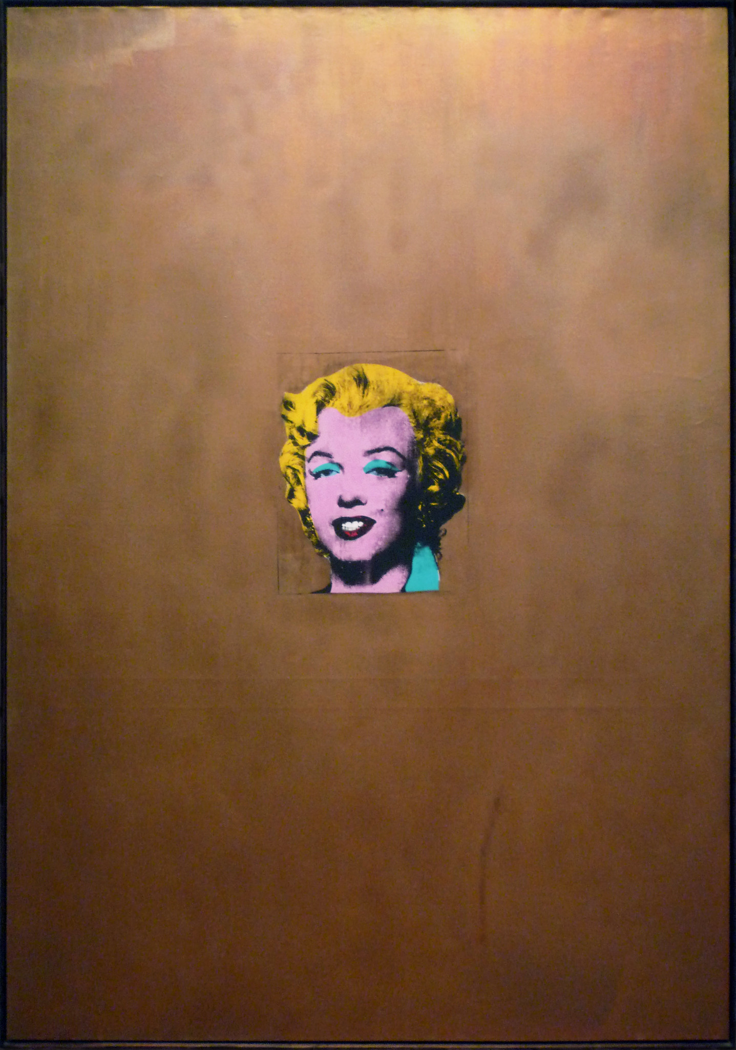
Warhol’s Gold Marilyn Monroe suspends the iconic face of the starlet in a field of shimmering gold.
Andy Warhol, Gold Marilyn Monroe, 1962.
Silkscreen ink on synthetic polymer paint on canvas, On view at MoMA. Author: Steven Zucker, Source: Flickr, License: CC BY-NC-SA 2.0

Slide 19
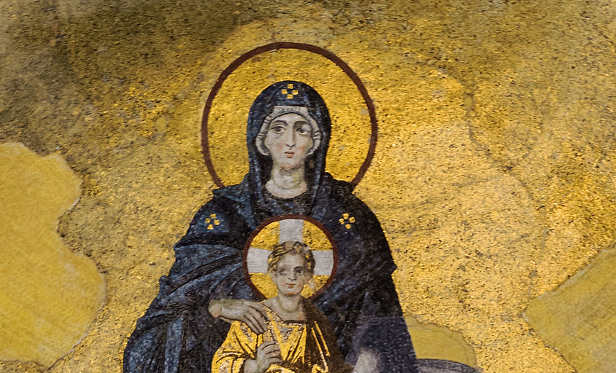
Painted shortly after her tragic death, this image of the American mid-20th century ideal of beauty elevates Marilyn Monroe to resemble a holy icon.
Above: Virgin and Child in the Apse of Hagia Sophia, dedicated in 867, Author: Myrabella, Source: Wikimedia Commons, License: CC0 1.0
Right: Andy Warhol, Gold Marilyn Monroe, 1962. Silkscreen ink on synthetic polymer paint on canvas, On view at MoMA. Author: Steven Zucker, Source: Flickr, License: CC BY-NC-SA 2.0

Slide 20
The portrait does not attempt to reveal the true person behind the fame. Instead, it presents the perfected mask of Marilyn Monroe.
Andy Warhol, Gold Marilyn Monroe, 1962.
Silkscreen on canvas, On view at MoMA. Author: Steven Zucker, Source: Flickr, License: CC BY-NC-SA 2.0

Slide 21
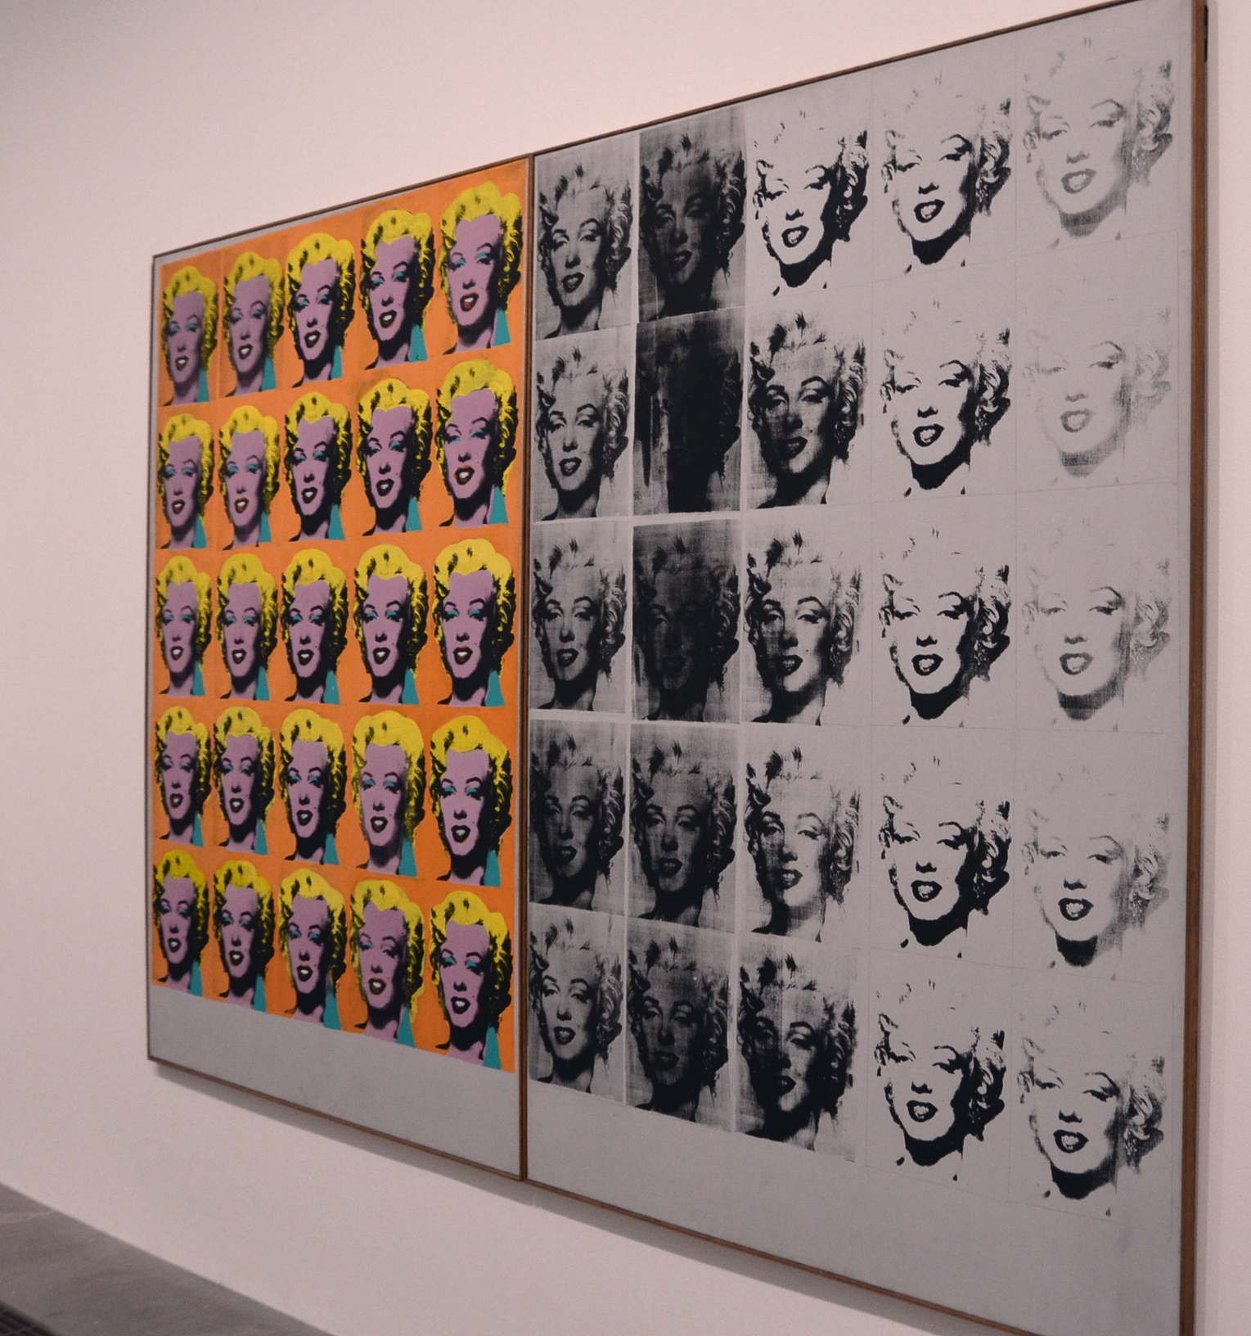
Andy Warhol’s interest in manufacturing led him to develop his artistic processes further. With Gold Marilyn Monroe and Marilyn Diptych (right) he began utilizing a silkscreen printing technique, imitating the industrial manufacturing process.
Andy Warhol, Marilyn Diptych, 1962 at Tate Modern, Author: Adam Fagen, Cropped with slight color corrections, Source: Flickr, License: CC BY-NC-SA 2.0.
© 2019 The Andy Warhol Foundation for the Visual Arts, Inc. / Artists Right Society (ARS), New York and DACS, London. Educational Fair Use, High quality image here.

Slide 22
Silkscreen printing allowed him to copy his own images using the same method as that used for the commercial printing of labels and package designs.
Andy Warhol, Marilyn Diptych, 1962 at Tate Modern, Author: Adam Fagen, Cropped with slight color corrections, Source: Flickr, License: CC BY-NC-SA 2.0.
© 2019 The Andy Warhol Foundation for the Visual Arts, Inc. / Artists Right Society (ARS), New York and DACS, London. Educational Fair Use, High quality image here.

Slide 23
In Marilyn Diptych, celebrity becomes commodity.
Warhol prints the image of the icon repeatedly in an investigation of the mass-production and consumption of celebrity. On the right panel of the diptych, the image loses its color and begins to fade.
With this repetition, the image begins to lose its specificity, individuality, and meaning. The person is lost within the barrage of repeated images.
Andy Warhol, Marilyn Diptych, 1962 at Tate Modern, Author: Adam Fagen, Cropped with slight color corrections, Source: Flickr, License: CC BY-NC-SA 2.0.
© 2019 The Andy Warhol Foundation for the Visual Arts, Inc. / Artists Right Society (ARS), New York and DACS, London. Educational Fair Use, High quality image here.

Slide 24
Made soon after her death, the diptych poignantly addresses the cult of celebrity and the starlet’s own mortality.
Andy Warhol, Marilyn Diptych, 1962 at Tate Modern, Author: Adam Fagen, Cropped with slight color corrections, Source: Flickr, License: CC BY-NC-SA 2.0.
© 2019 The Andy Warhol Foundation for the Visual Arts, Inc. / Artists Right Society (ARS), New York and DACS, London. Educational Fair Use, High quality image here.

Slide 25
Like the products and celebrities that so fascinated him, Andy Warhol made himself, too, a globally recognized brand.
He opened a studio, aptly named “The Factory” where he hired assistants to help complete his works of art in the style of the manufacturing that so fascinated him.
Andy Warhol, Gold Marilyn Monroe, 1962.
Silkscreen on canvas, On view at MoMA. Author: Steven Zucker, Source: Flickr, License: CC BY-NC-SA 2.0

Slide 26
ROY LICHTENSTEIN
Roy Lichtenstein, Rouen Cathedral Set V, 1969, oil and magna on canvas, at SFMOMA. Author: Steven Zucker, Cropped from original, Source: Flickr, License: CC BY-NC-SA 2.0

Slide 27
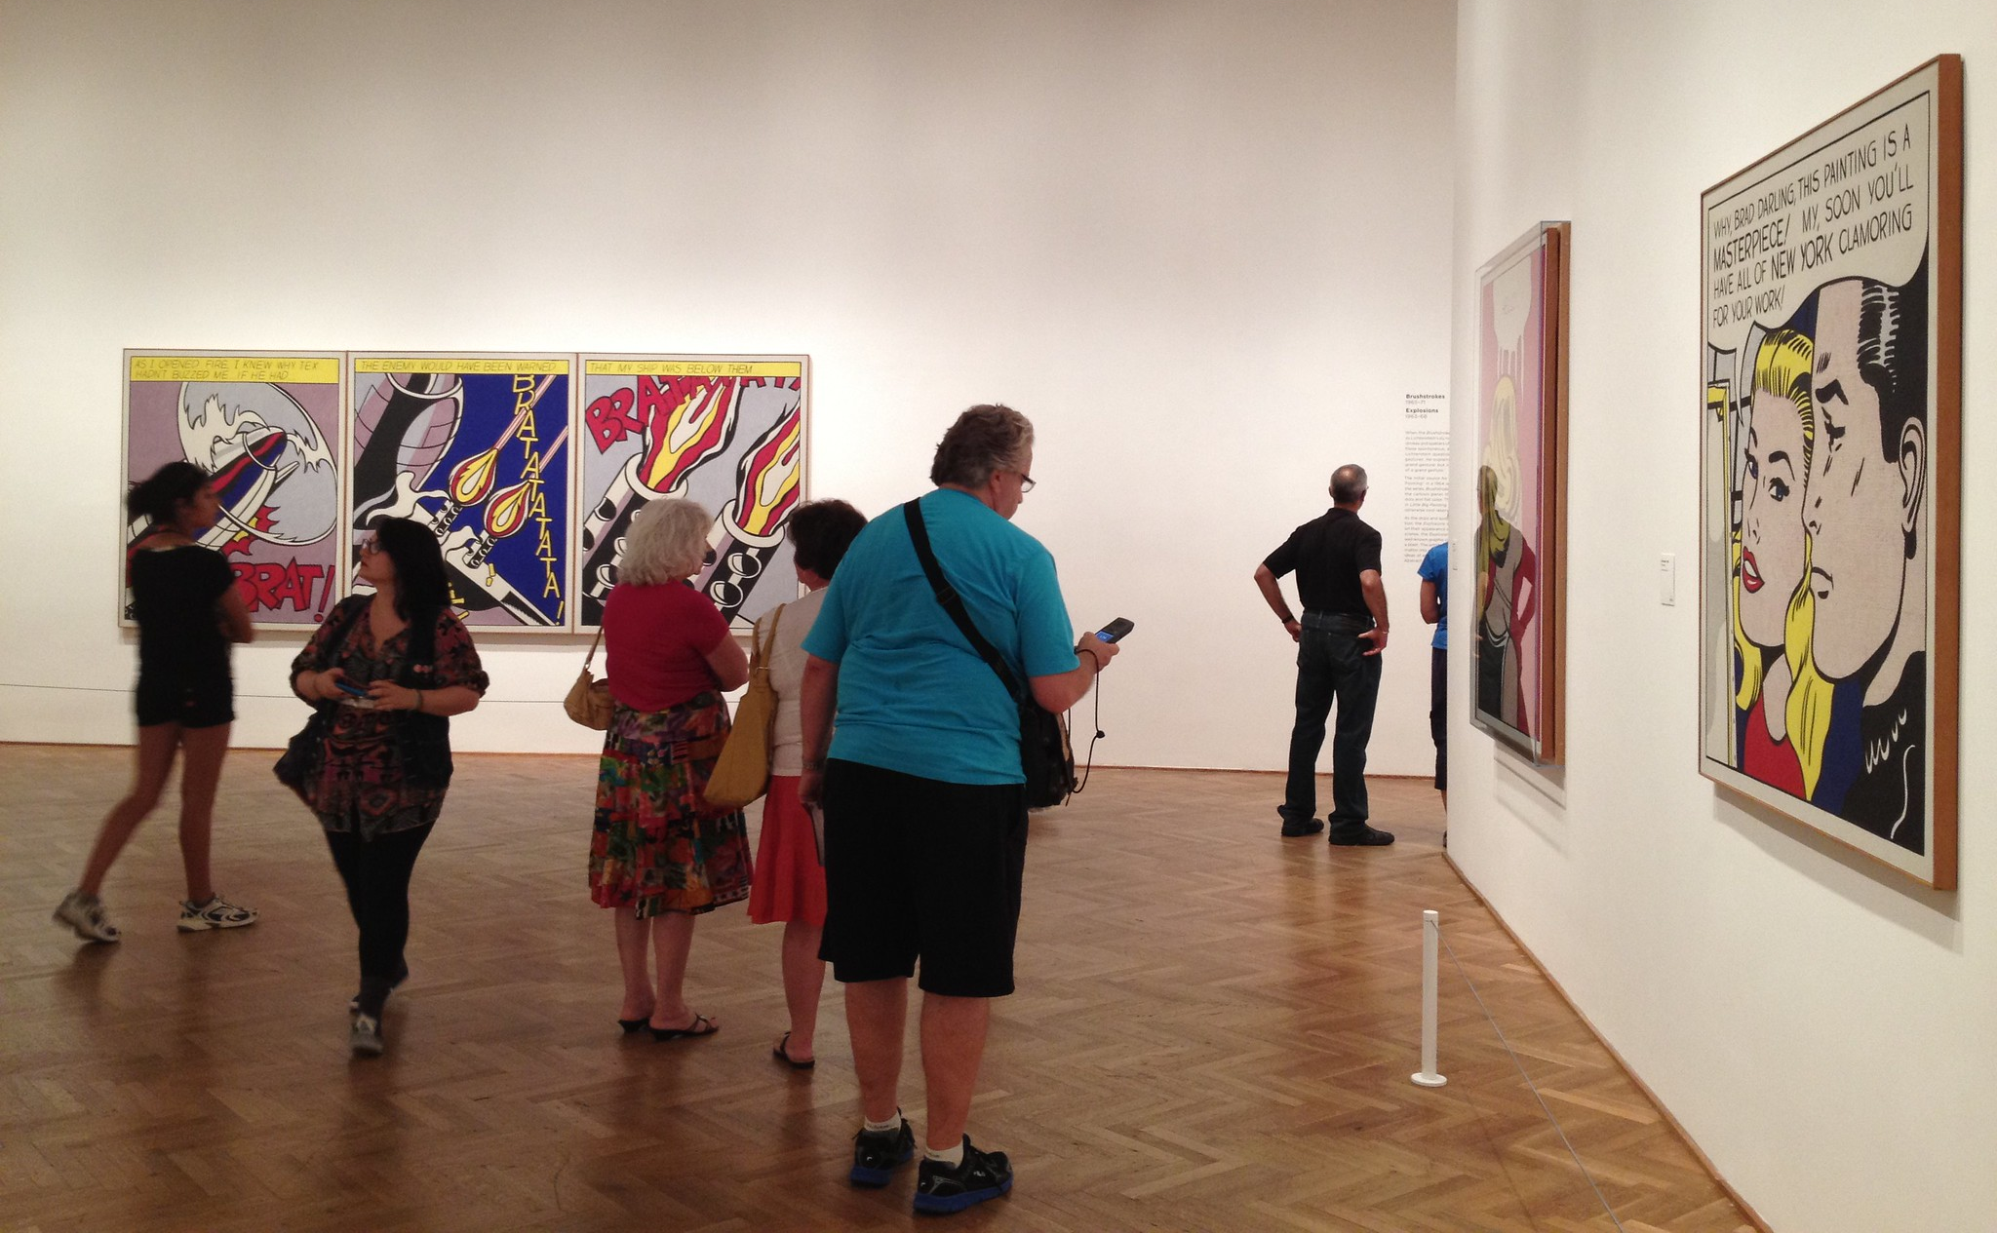
The pop artist Roy Lichtenstein is best known for painting enlarged comic book panels to create works of art that directly reference popular media culture.
Roy Lichtenstein Retrospective at Art Institute Chicago, Author: Arcticpenguin, Source: Flickr, License: CC-NC 2.0

Slide 28
Roy Lichtenstein, Masterpiece, 1962. Retrospective at Art Institute Chicago,
Author: Arcticpenguin, Source: Flickr, License: CC-NC 2.0 © Estate of Roy Lichtenstein

Slide 29
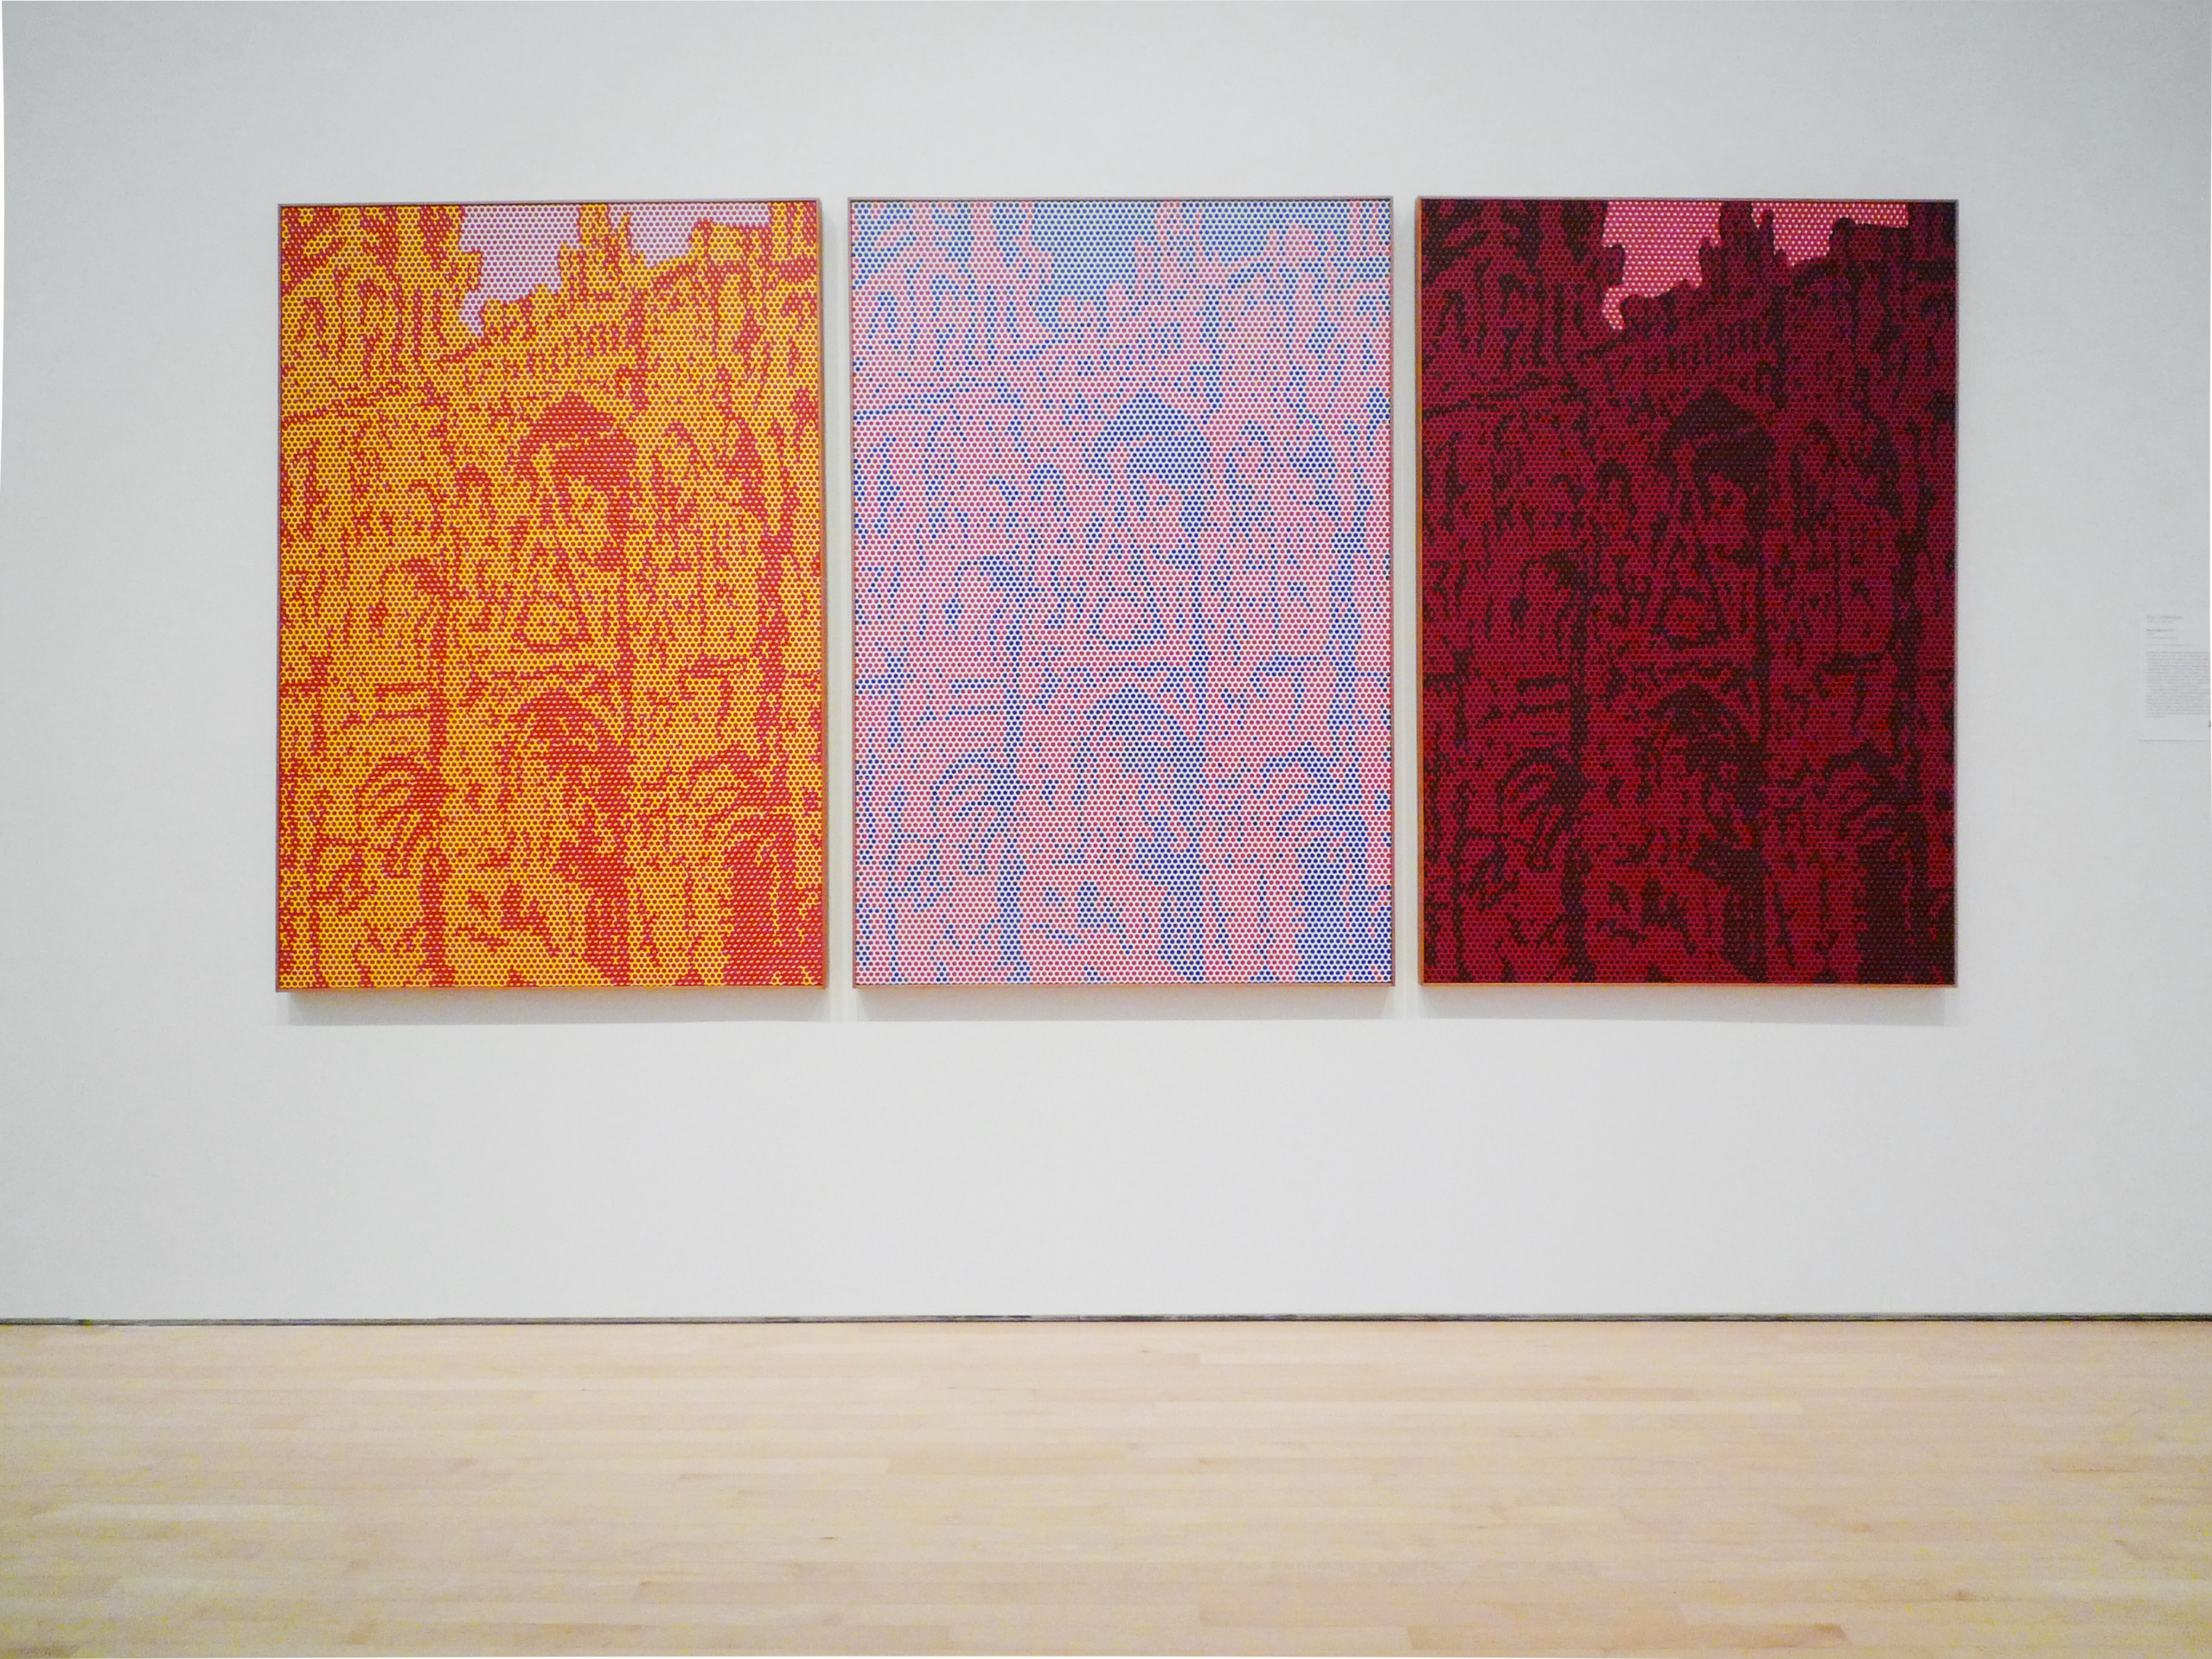
The Roy Lichtenstein triptych Rouen Cathedral Set V is a continuation of Claude Monet’s Impressionist series from 1894.
Roy Lichtenstein, Rouen Cathedral Set V, 1969, oil and magna on canvas, at SFMOMA
Author: Steven Zucker, Cropped from original, Source: Flickr, License: CC BY-NC-SA 2.0

Slide 30
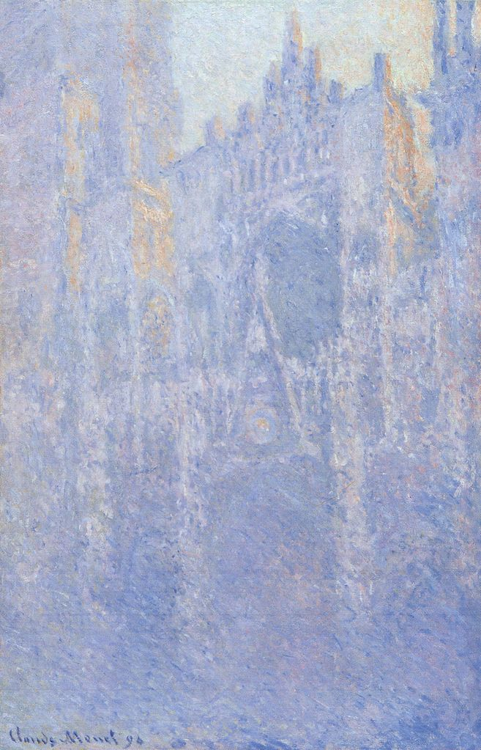
Lichtenstein pulled the composition of his Rouen Cathedral series directly from Monet’s paintings.
Claude Monet, Rouen Cathedral, Facade (Morning effect), Oil on canvas, 1894, Source: Wikimedia Commons, License: Public Domain
Roy Lichtenstein, Rouen Cathedral Set V, 1969, oil and magna on canvas, at SFMOMA
Author: Steven Zucker, Cropped from original, Source: Flickr, License: CC BY-NC-SA 2.0

Slide 31
These are painted using Lichtenstein’s signature method in which he uses paint and stencil to imitate the look of commercial printing. The shading and optical color mixing within the paintings are made by mimicking the Ben-Day dots of a mechanical printing method used in pulp comics.
Roy Lichtenstein, Rouen Cathedral Set V, 1969, oil and magna on canvas, at SFMOMA
Author: Steven Zucker, Cropped from original, Source: Flickr, License: CC BY-NC-SA 2.0

Slide 32
The surface of Lichtenstein’s Rouen Cathedral shows the Ben-Day dots mimicking the look of a mechanical printing processes.
Roy Lichtenstein, Rouen Cathedral Set V, 1969, oil and magna on canvas, at SFMOMA. Author: Steven Zucker, Cropped from original, Source: Flickr, License: CC BY-NC-SA 2.0

Slide 33
Lichtenstein’s Rouen Cathedral appropriates Monet’s work of art and gives it new meaning by applying a pop art technique to the rendering. By recreating a work by Monet, Lichtenstein highlights the way that image-making changes over time with new technologies.
Claude Monet, Rouen Cathedral, Facade (Morning effect), Oil on canvas, 1894, Source: Wikimedia Commons, License: Public Domain
Roy Lichtenstein, Rouen Cathedral Set V, 1969, oil and magna on canvas, at SFMOMA
Author: Steven Zucker, Cropped from original, Source: Flickr, License: CC BY-NC-SA 2.0

Slide 34

Monet’s tiny brushstrokes of color and Lichtenstein’s dots of color both utilize optical color mixing techniques. However, the paintings, made less than a century apart, are vastly different in their appearance.
Claude Monet, Rouen Cathedral, Facade (Morning effect), Oil on canvas, 1894, Source: Wikimedia Commons, Cropped from original, License: Public Domain
Roy Lichtenstein, Rouen Cathedral Set V, 1969, oil and magna on canvas, at SFMOMA. Author: Steven Zucker, Cropped from original, Source: Flickr, License: CC BY-NC-SA 2.0

Slide 35
The softness of Monet’s Rouen Cathedral, as light renders stone in paint, is dramatically contrasted by the hard-edged, manufactured Pop Art style of Lichtenstein.
Claude Monet, Rouen Cathedral, Facade (Morning effect), Oil on canvas, 1894, Source: Wikimedia Commons, Cropped from original, License: Public Domain
Roy Lichtenstein, Rouen Cathedral Set V, 1969, oil and magna on canvas, at SFMOMA. Author: Steven Zucker, Cropped from original, Source: Flickr, License: CC BY-NC-SA 2.0

Slide 36

Roy Lichtenstein, Rouen Cathedral Set V, 1969, oil and magna on canvas, at SFMOMA
Author: Steven Zucker, Source: Flickr, License: CC BY-NC-SA 2.0

Slide 37
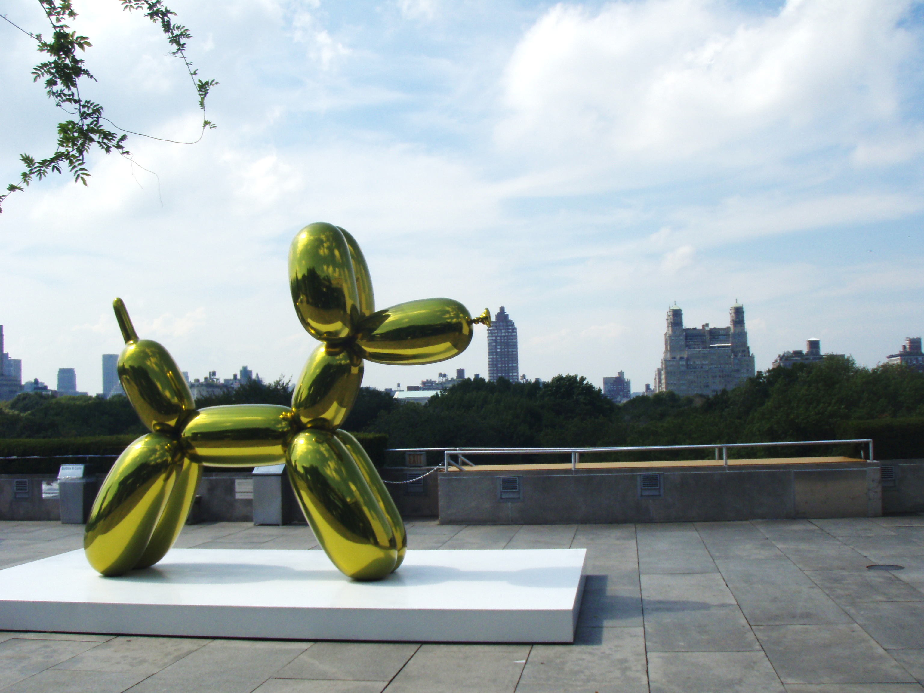
JEFF KOONS
& the legacy of Pop Art
Jeff Koons, Balloon Dog (Yellow), 1994–2000.
High stainless steel with transparent color coating. Author: Anthony Easton, Source: Flickr, License: CC BY 2.0

Slide 38
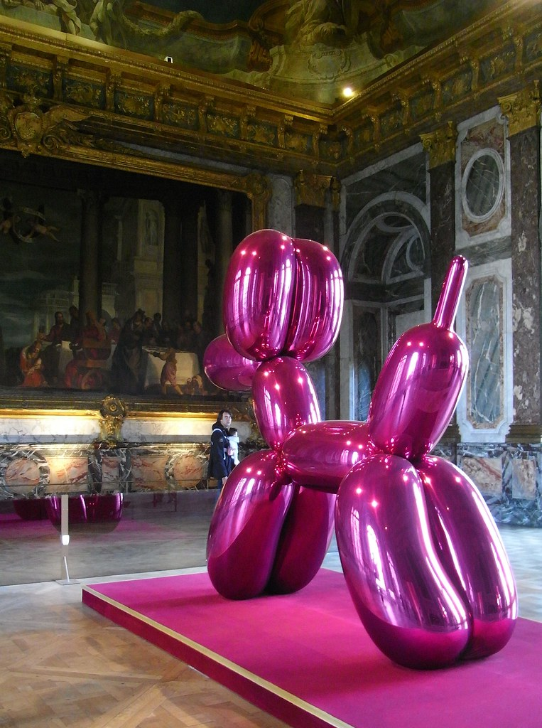
Contemporary artists working in the late-20th and 21st centuries have been deeply influenced by the Pop Art movement.
Jeff Koons
Balloon Dog (Magenta) at Chateau de Versailles, 1994–2000.
High chromium stainless steel with transparent color coating.
Author: Pierre Metivier
Source: Flickr, License: CC BY-NC 2.0

Slide 39
Embracing the imagery from our everyday life, contemporary artist Jeff Koons makes monumental sculptures based on common objects, such as Balloon Dog.
Jeff Koons
Balloon Dog (Magenta) at Chateau de Versailles, 1994–2000.
High chromium stainless steel with transparent color coating.
Author: Pierre Metivier
Source: Flickr, License: CC BY-NC 2.0

Slide 40
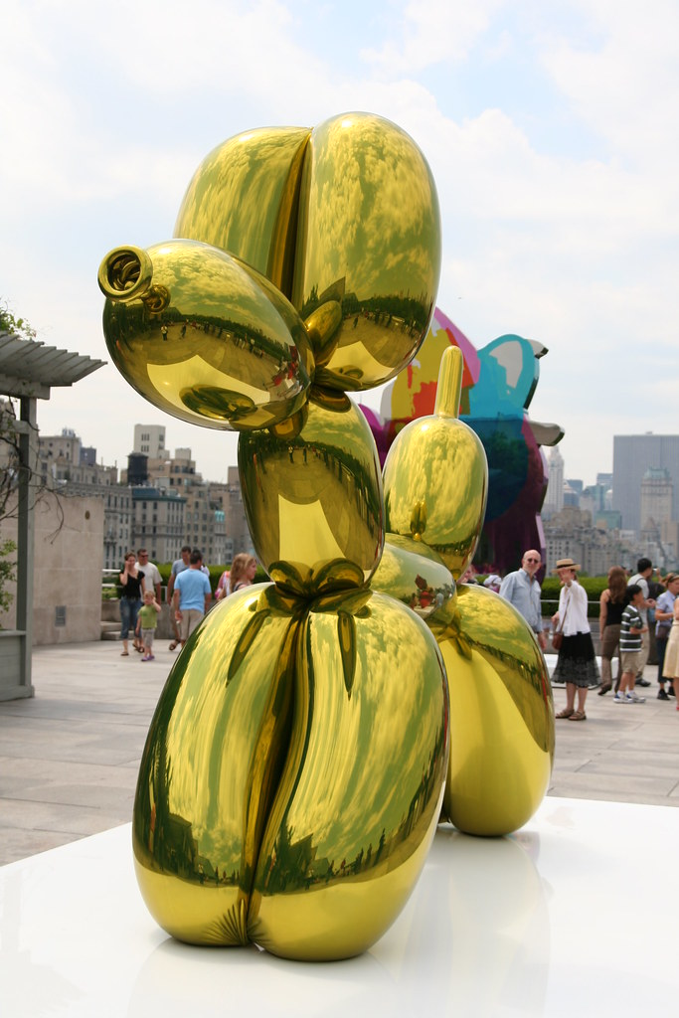
Often described as kitsch, or objects of questionable taste made to please the largest possible audience, the works of Jeff Koons are continuations of Pop Art’s direct dismissal of the pretensions of modern art.
Pop Art paved the way for Postmodernism, which embraces and includes imagery from lowbrow culture.
Jeff Koons
Balloon Dog (Yellow) on the roof of the Metropolitan Museum.
1994–2000.
High chromium stainless steel with transparent color coating.
Author: Kim, Source: Flickr, License: CC BY-SA 2.0

Slide 41
Like Warhol, Koons runs a large workshop with dozens of assistants to help him complete works of art that glisten with industrial-style perfection.
Jeff Koons
Balloon Dog (Yellow) on the roof of the Metropolitan Museum.
1994–2000.
High chromium stainless steel with transparent color coating.
Author: Kim, Source: Flickr, License: CC BY-SA 2.0

Slide 42
See inside the artist’s studio and listen to Jeff Koons explain Balloon Dog:
https://youtu.be/dYahe1-isH4
Jeff Koons
Balloon Dog (Yellow) on the roof of the Metropolitan Museum.
1994–2000.
High chromium stainless steel with transparent color coating.
Author: Kim, Source: Flickr, License: CC BY-SA 2.0

Slide 43
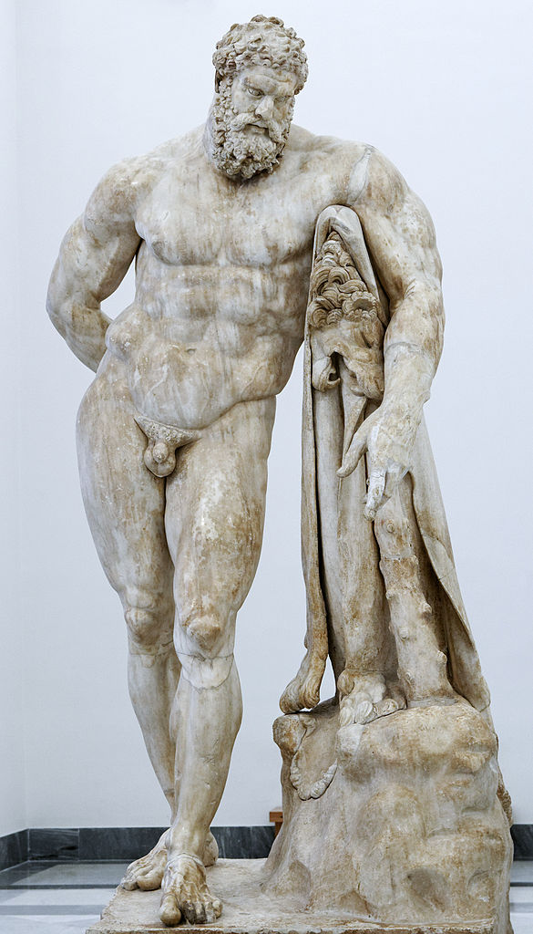
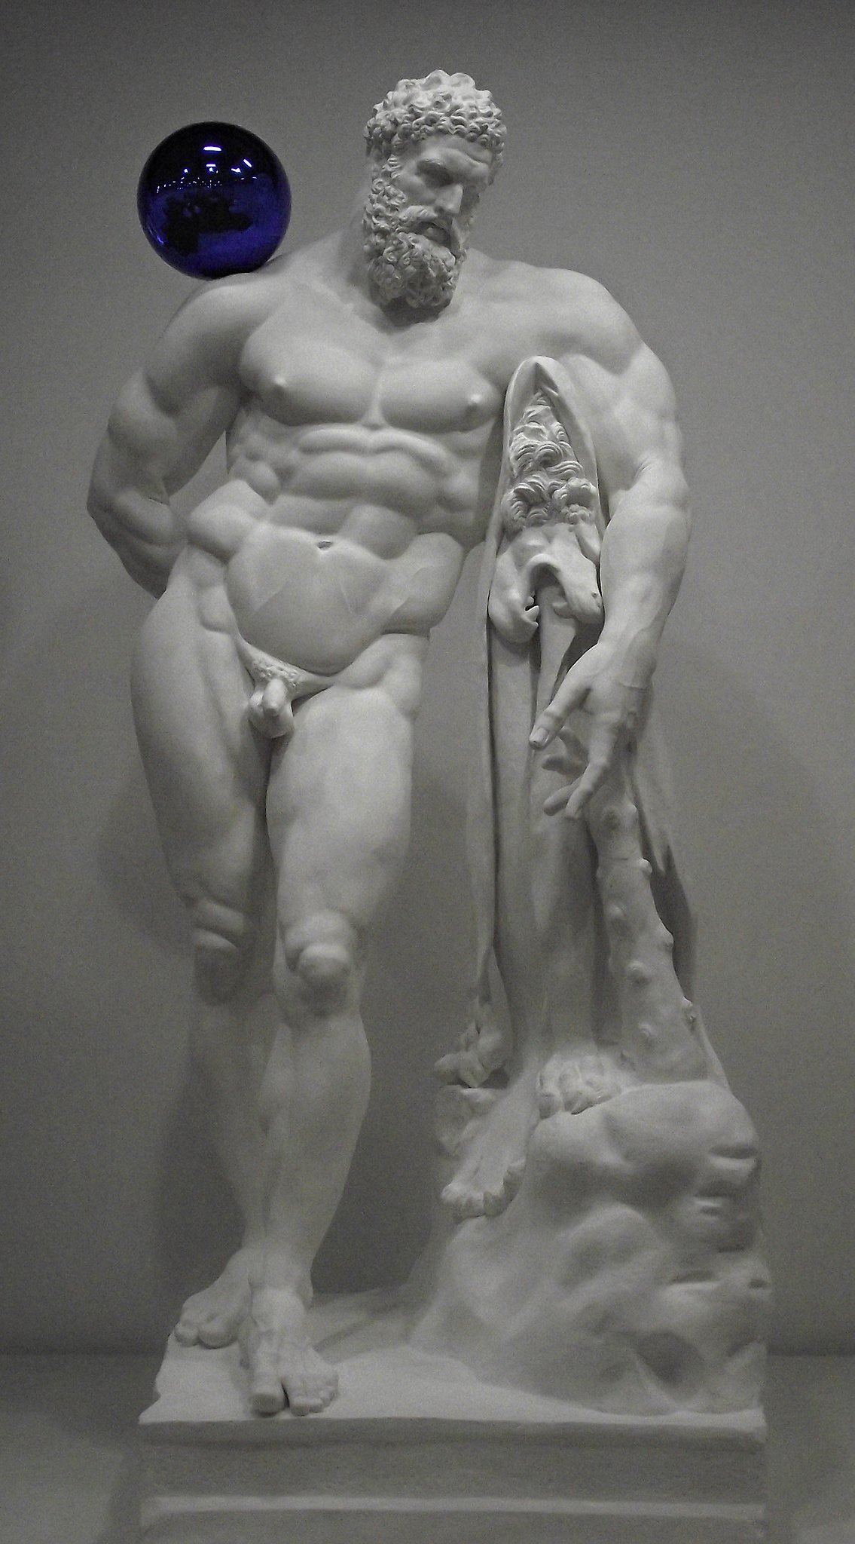
In a series called Gazing Balls, Jeff Koons appropriates classical sculpture, along with other works from the canon of European art to which he attaches a gazing ball.
Works such as the Farnese Hercules are meticulously recreated and then embellished with the reflective lawn ornament.
Glykon, copy of original by Lysippos, Farnese Hercules, c. 216 AD (copy of 4th century BC original). Author: Marie-Lan Nguyen Source: Wikimedia Commons, License: CC BY 2.5
Jeff Koons, Gazing Ball (Farnese Hercules), 2013. At Jeff Koons Retrospective in Paris 2014. Author: Fred Romero Cropped form original. Source: Wikimedia Commons, License: CC BY 2.0

Slide 44
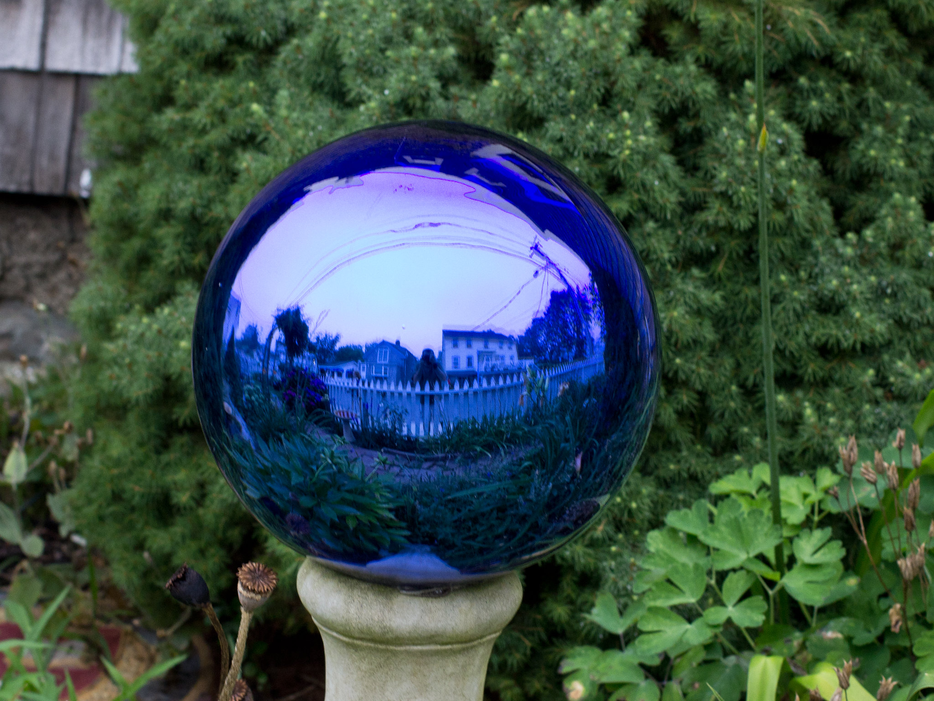
Koons’ gazing balls are based on kitsch lawn ornaments.
Garden Gazing Ball
Author: Rob Slaven
Source: Flickr
License: CC BY-NC-SA 2.0

Slide 45
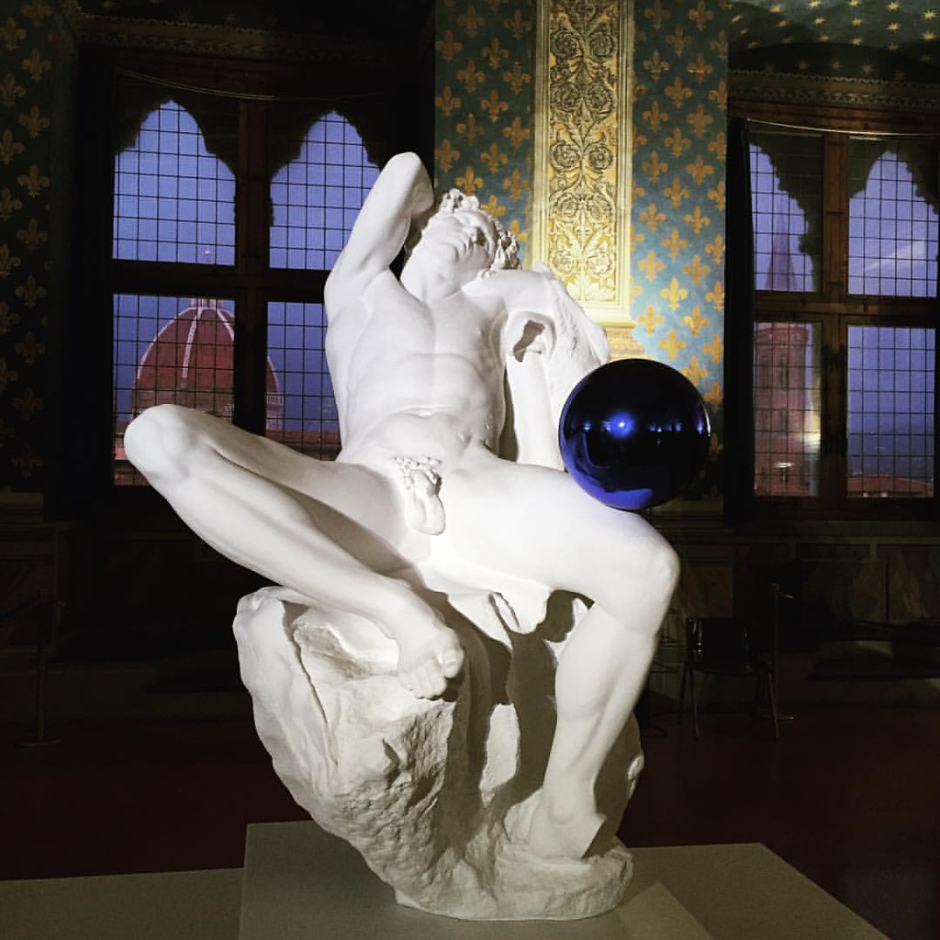
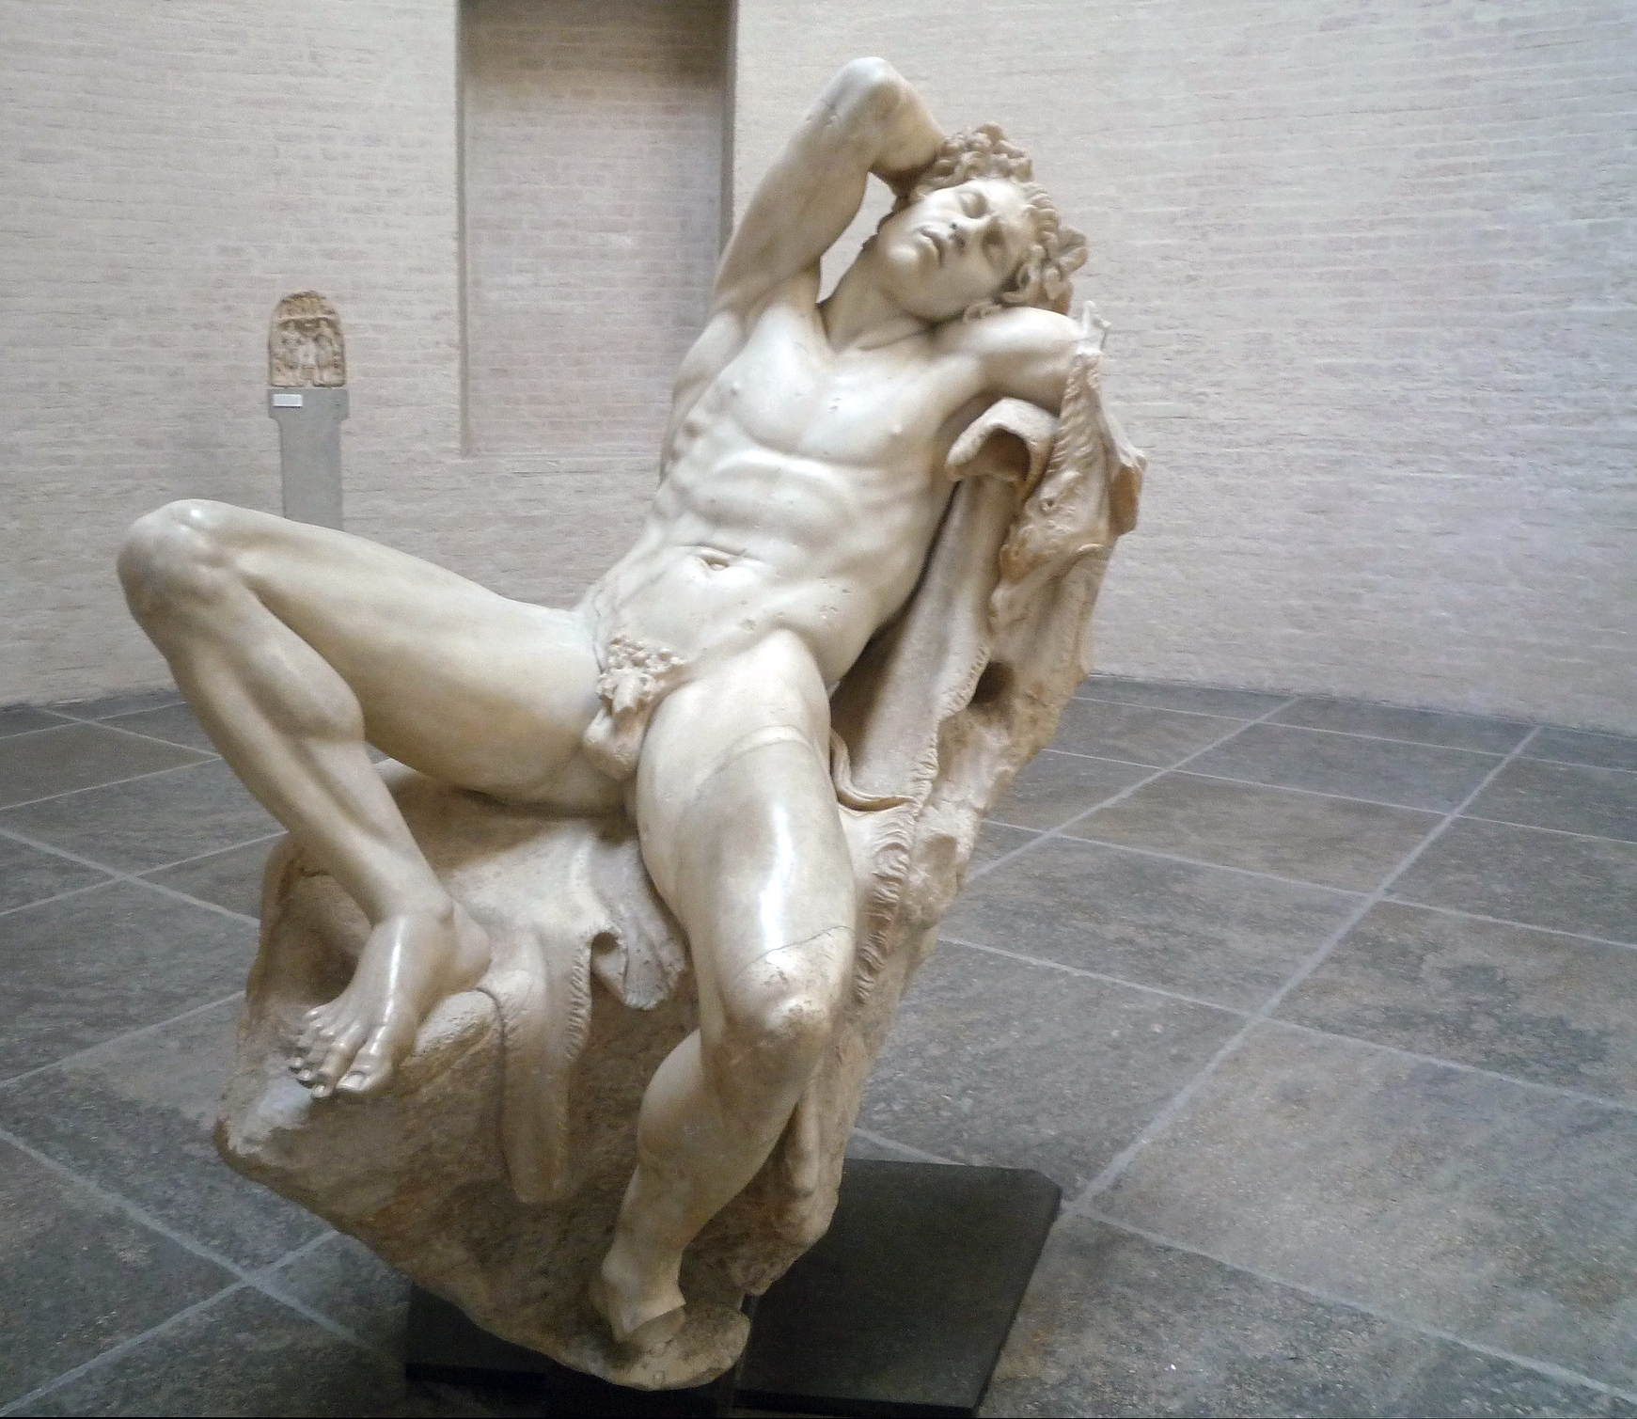
The gazing ball, here seen with a replica of the Barberini Faun, reflects and distorts the world around it. The viewer is forced to become part of the work. Consequently, the classical slumbering faun holds on his knee a tiny moving 21st century world.
Barberini Faun, Greek (Hellenistic), Marble, c. 220 BCE. Author: Steven Zucker, Source: Flickr, License: CC BY-NC-SA 2.0
Barberini Faun, Greek (Hellenistic), Marble, c. 220 BCE. (Found c.1620)
Author: Steven Zucker, Source: Flickr, License: CC BY-NC-SA 2.0

Slide 46
This blending of high and low culture and the appropriation of works of art history are hallmarks of Postmodern art.
Glykon, copy of original by Lysippos, Farnese Hercules, c. 216 AD (copy of 4th century BC original). Author: Marie-Lan Nguyen Source: Wikimedia Commons, License: CC BY 2.5
Jeff Koons, Gazing Ball (Farnese Hercules), 2013. At Jeff Koons Retrospective in Paris 2014. Author: Fred Romero Cropped form original. Source: Wikimedia Commons, License: CC BY 2.0

Slide 47
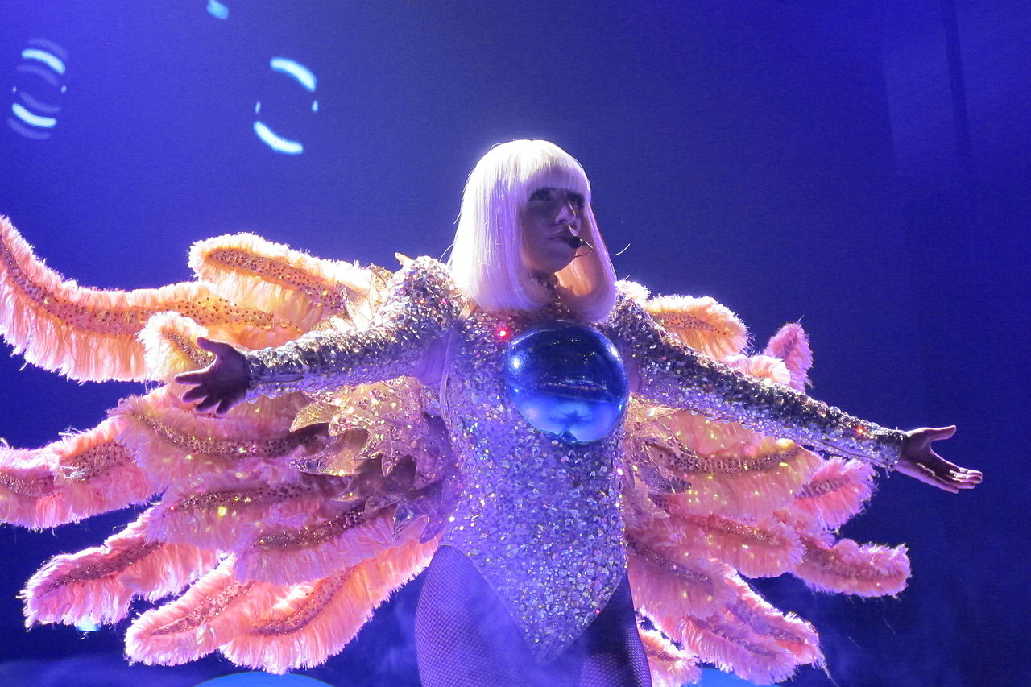
Much like Andy Warhol, Jeff Koons is open to collaboration with fashion and popular culture. He designed Lady Gaga’s ArtPop album cover, made a monumental nude statue of the pop artist with a gazing ball, and adorned her (or rather, perhaps, endorsed her adorning herself) in gazing balls. She sings, “One second I'm a Koons, then suddenly the Koons is me.”
Jeff Koons, Gazing Ball (Farnese Hercules), 2013. At Jeff Koons Retrospective in Paris 2014. Author: Fred Romero Cropped form original. Source: Wikimedia Commons, License: CC BY 2.0
Lady Gaga at ArtRave: The Artpop Ball of San Diego, Author: Alexis Martinez, Source: Wikimedia Commons, License: CC BY-SA 2.0

Slide 48


