Slide 1
Navigating Challenging Conversations
Workshop
Please do not share widely or reproduce without the permission of the Office for Equity and Diversity at the University of Minnesota. Contact oeded@umn.edu.
Notes:
Navigating Challenging Conversations PowerPoint: https://z.umn.edu/NavigatingChallengingConversations
Access Check: https://z.umn.edu/AccessCheck
Check out our Education Program Website for additional resources: https://diversity.umn.edu/education
Join our Education Program Email to stay up to date on our offerings: https://z.umn.edu/OEDEducationGoogleGroup
Feedback form:
https://z.umn.edu/OEDWorkshopFeedback

Slide 2
Meet the Facilitation Team
Notes:
Personal team Intros

Slide 3
Access Check
Notes:
Access Check: https://z.umn.edu/AccessCheck

Slide 4
Grounding Awareness
We acknowledge the complexity of exploring roles within majority white spaces, which are common in academia. We do not want to contribute to the heteronormativity, hypervisibility, tokenizing, and/or educative labor of participants who are Black, Indigenous, and/or People of Color, economically disenfranchised, disabled or gender non-conforming. Our goal today is to decenter whiteness and acknowledge the role of anti-Black racism that upholds and perpetuates white supremacy within our institution and beyond.
We encourage participants who have dominant identities to be aware of defensive and distancing strategies that may arise today, which can look like:
Deflecting accountability
Taking up all the space
Engaging in optical allyship for self-benefit
Exempting oneself by centering one’s own marginalized identities and experiences
Expecting People of Color to explain the impact of racism and white supremacy

Slide 5
Group Discussion:
What makes an effective educator/leader?
Notes:
Group Discussion:
What makes an effective educator/leader?
Options to share: unmute or raise your hand, share your name and your comment/question or use the zoom chat box
Please note: if you wish to share anonymously, please private chat myself or Kelly Collins.

Slide 6
Poll
What are your concerns about navigating challenging conversations about equity, diversity, and social justice?
Notes:
Kelly

Slide 7
Understanding
Intent and Impact
Notes:
Kelly

Slide 8
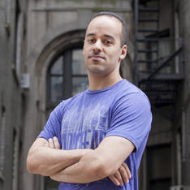
Video
Jay Smooth
Host of Underground Railroad
Ted Talk
(4 minutes and 40 seconds)
Notes:
Kelly
Jay Smooth, Host of Underground Railroad Ted Talk (11 minutes of 57 seconds): https://www.youtube.com/watch?v=MbdxeFcQtaU
Additional Resource:
How to Tell Someone They Sound Racist - https://youtu.be/-WrZytUux3I

Slide 9
Intent/Impact
Intent
Impact
Notes:
Paul

Slide 10
Intent/Impact
Feedback
Intent
Impact
Feedback
Notes:
Paul

Slide 11
Intent/Impact
Often intent is overemphasized when we receive feedback
On-going self-reflection and personal assessment
When impacted, understanding and checking for intent may help in the healing process
Ask for clarification with open-ended questions “can you say more what you meant by ….?”
Don’t require others to suppress their emotions in order for you to hear feedback
Focus on behavior
Notes:
Kelly

Slide 12
Intent/Impact (cont.)
Good intentions don’t sanitize bad impact
Listen for feelings
Be open to the complexity of your intentions
Our assumptions about intentions may be inaccurate
Hold your view as a hypothesis
Inquire about intentions
From Difficult Conversations: How to Discuss What Matters Most by Stone, Patton, and Heen
Notes:
Kelly

Slide 13
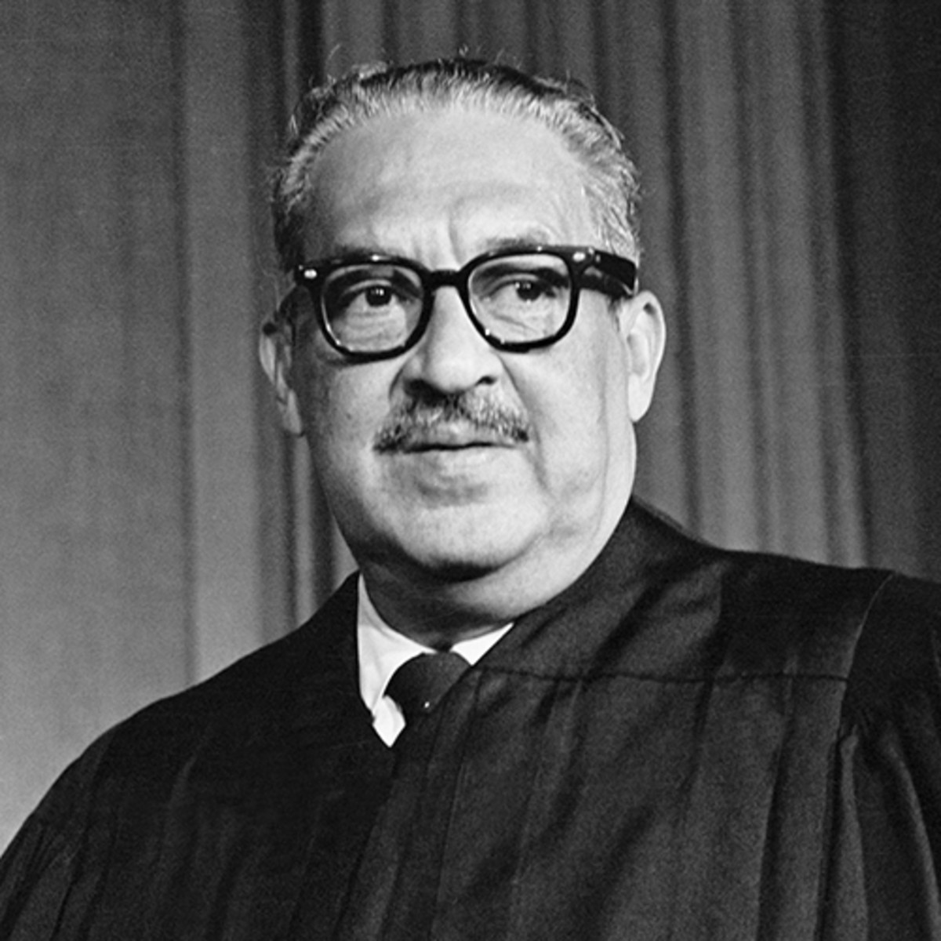
Quote
“What is the quality of your intent? Certain people have a way of saying things that shake us at the core. Even when the words do not seem harsh or offensive, the impact is shattering. . . What we owe to ourselves and everyone around is to examine the reasons of our true intent. My intent will be evident in the results.”
Supreme Court Justice Thurgood Marshall
Notes:
Paul

Slide 14
Self Reflection
Think about a time when your intent and the impact you caused did not match up. Maybe you were unexpectedly called out for something you said, or a program you created had a negative impact.
How did you respond? What feelings did you experience?
Notes:
Paul
Add to chat:
Self Reflection:
Think about a time when your intent and the impact you caused did not match up. Maybe you were unexpectedly called out for something you said, or a program you created had a negative impact.
How did you respond? What feelings did you experience?

Slide 15
Triggers and Activation
Notes:
Kelly

Slide 16
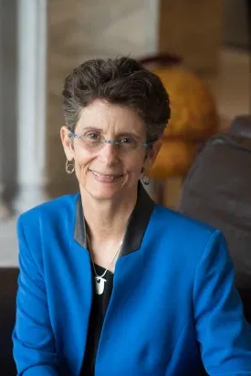
What is a Trigger or Activation?
“Any stimulus, either external or internal to the person, through which they experience an emotional reaction.”
From Dr. Kathy Obear, The Center for Transformation and Change
Notes:
Kelly

Slide 17
Characteristics of a Triggering Event
Unexpected and surprising
Strong intensity of feelings, overwhelming
Disorientating, “stopped in our tracks”
Feel out of control
Feel like you can not react effectively
Requires extra effort to manage situation
From Kathy Obear, The Center for Transformation and Change
Notes:
Paul

Slide 18
Triggering Event
Engage in response behavior.
An interpersonal issue, need, memory, past trauma, fear, etc.
Response
Root
Intention
Story
Interpretation of the event, assumptions, judgments, critical thoughts, evaluations.
Chose intention on how to respond - fight, flight, freeze, flounder, etc.
Emotional & Physical Reactions
Ex. pounding heart, tight throat, anger, shock, guilt.
From Kathy Obear, The Center for Transformation and Change
Notes:
Paul

Slide 19
Responses to a Triggering event
Less Satisfied
Cut off person
Use sarcasm
Interrogate person
Yell or raise voice
Shut down or become silent
Smooth over conflict
Engage in long arguments
Satisfied
Use self as instrument
Ask open ended questions
Actively listen to others
Paraphrase
Seek support from others
Breathe/take time out
From Kathy Obear, The Center for Transformation and Change
Notes:
Kelly

Slide 20
Calling Out /Calling In
Calling Out
When we need to let someone know that their words or actions are unacceptable and will not be tolerated
When we need to interrupt in order to prevent further harm
Will likely feel hard and uncomfortable, but necessary
Allows us to hit the “pause” button and break the momentum
Calling In
When there is an opportunity to explore deeper and make meaning together
When we are seeking to understand or learn more
When we want to help imagine different perspectives, possibilities, or outcomes
Provides for multiple perspectives and encourages paradigm shifts
Focused on reflection, not reaction
Notes:
Kelly

Slide 21
Activity

Slide 22
Scenario 1
In a staff meeting, a relatively new staff member raises her hand and asks about starting a small diversity committee within the unit. Someone mentions that there used to be one, but it hasn’t been very active for the past couple years. The Director of the unit says “I think that’s a great idea, but I’m concerned about capacity. We’re down 3 people now, so I just don’t know how we’re going to be able to pull this off. I suggest we talk about it next semester.”
How would you define the problem in this situation? What would you do in this situation? What might be your goal in this situation?
Notes:
Add to chat -
Scenario 1:
In a staff meeting, a relatively new staff member raises her hand and asks about starting a small diversity committee within the unit. Someone mentions that there used to be one, but it hasn’t been very active for the past couple years. The Director of the unit says “I think that’s a great idea, but I’m concerned about capacity. We’re down 3 people now, so I just don’t know how we’re going to be able to pull this off. I suggest we talk about it next semester.”
How would you define the problem in this situation? What would you do in this situation? What might be your goal in this situation?

Slide 23
Scenario 2
In a classroom, you mention something about women working to gain equity with men. A student says “Aren’t women already equal?” Another student jumps in, saying “Yeah, I don’t get why we even need feminism anymore. I’m female, and I’ve never faced any discrimination. In fact, more women are entering college than men. I think maybe we need to pay more attention to men’s issues.”
How would you define the problem in this situation? What would you do in this situation? What might be your goal in this situation?
Notes:
Add to chat -
Scenario 2:
In a classroom, you mention something about women working to gain equity with men. A student says “Aren’t women already equal?” Another student jumps in, saying “Yeah, I don’t get why we even need feminism anymore. I’m female, and I’ve never faced any discrimination. In fact, more women are entering college than men. I think maybe we need to pay more attention to men’s issues.”
How would you define the problem in this situation? What would you do in this situation? What might be your goal in this situation?

Slide 24
Scenario 3
In a departmental training about racism in MN, someone brings up the Black Lives Matter movement. You notice one of your colleagues is quiet and seems agitated. When the facilitator opens the discussion up and ask for comments from those who haven’t spoken yet, a staff member who is a white man says:
“I’m getting really frustrated hearing all this talk about ‘white privilege.’ I don’t have any privilege. My dad was unemployed half of my life and my brother just lost his house. I feel like every racial or diverse person will always get a job first, especially if they’re also a woman. So maybe we should stop beating up on white guys. Maybe we should focus on what we never talk about– class.”
How would you define the problem in this situation? What would you do in this situation? What might be your goal in this situation?
Notes:
Add to chat -
Scenario 3:
In a departmental training about racism in MN, someone brings up the Black Lives Matter movement. You notice one of your colleagues is quiet and seems agitated. When the facilitator opens the discussion up and ask for comments from those who haven’t spoken yet, a staff member who is a white man says:
“I’m getting really frustrated hearing all this talk about ‘white privilege.’ I don’t have any privilege. My dad was unemployed half of my life and my brother just lost his house. I feel like every racial or diverse person will always get a job first, especially if they’re also a woman. So maybe we should stop beating up on white guys. Maybe we should focus on what we never talk about– class.”
How would you define the problem in this situation? What would you do in this situation? What might be your goal in this situation?

Slide 25
Tips for Navigating Challenging Conversations
Notes:
Kelly

Slide 26
Assess your situation
What kind of risk will I be taking if I do this?
Is this particular action worth my time and effort?
Do I know what I want to achieve?
Remember that it’s ok to decide that the situation is not right for you
to confront a person or group of people.
Notes:
Kelly

Slide 27
Model the Behavior you Want from Others
When the goal is education:
It is also a good idea to stay away from being sarcastic, snide, mocking or arrogant (even though this can be very tempting).
However hurtful or discriminatory someone else’s comments or behaviors may be, it will be counterproductive to engage in language or actions that are demeaning, hurtful, or disrespectful.
Notes:
Paul

Slide 28
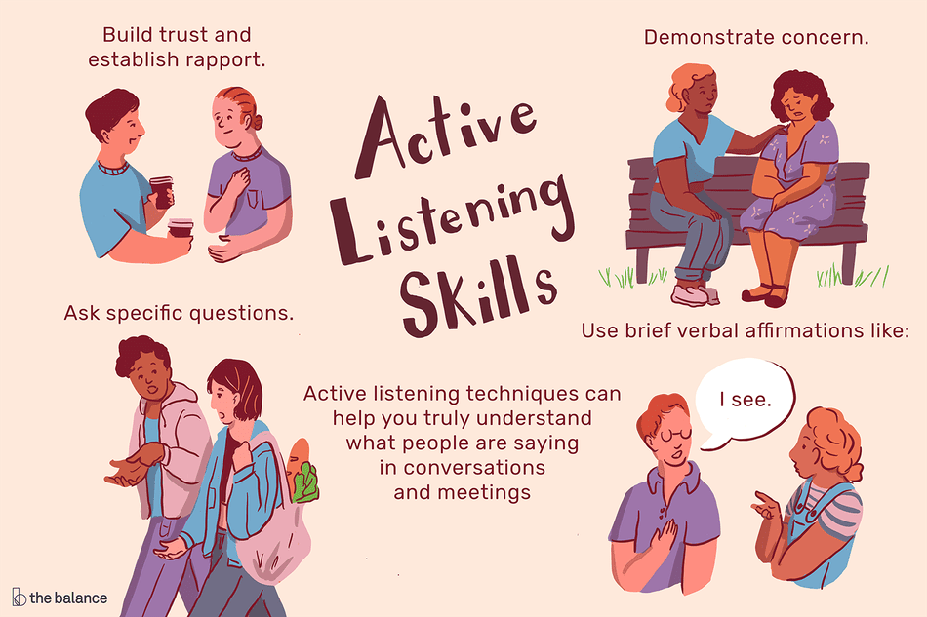
Actively Listen
Listen for facts, emotions, and values.
Sometimes comments that are overtly racist, sexist, ableist, heterosexist, etc. mask deeper feelings of anger, confusion, hurt, and shame.
Image by Colleen Tighe © The Balance 2019
Notes:
Kelly

Slide 29
Use Yourself as Instrument
Use your own stories of how you’ve “unlearned” certain hurtful, inaccurate, and misleading information.
"Evidence strongly suggests that humans in all cultures come to cast their own identity in some sort of narrative form. We are inveterate storytellers.”
- Owen Flanagan, Duke University
Notes:
Paul

Slide 30
Reframe. Reframe. Reframe.
Sometimes the most helpful education is when we are able to help someone understand a particular topic or issue using a different frame
Example: Affirmative action – it can be helpful to point out that the U.S. has a strong history of “preferential treatment” – college admission legacy preferences. What is new is WHO the preferential treatment benefits.
Notes:
Kelly

Slide 31
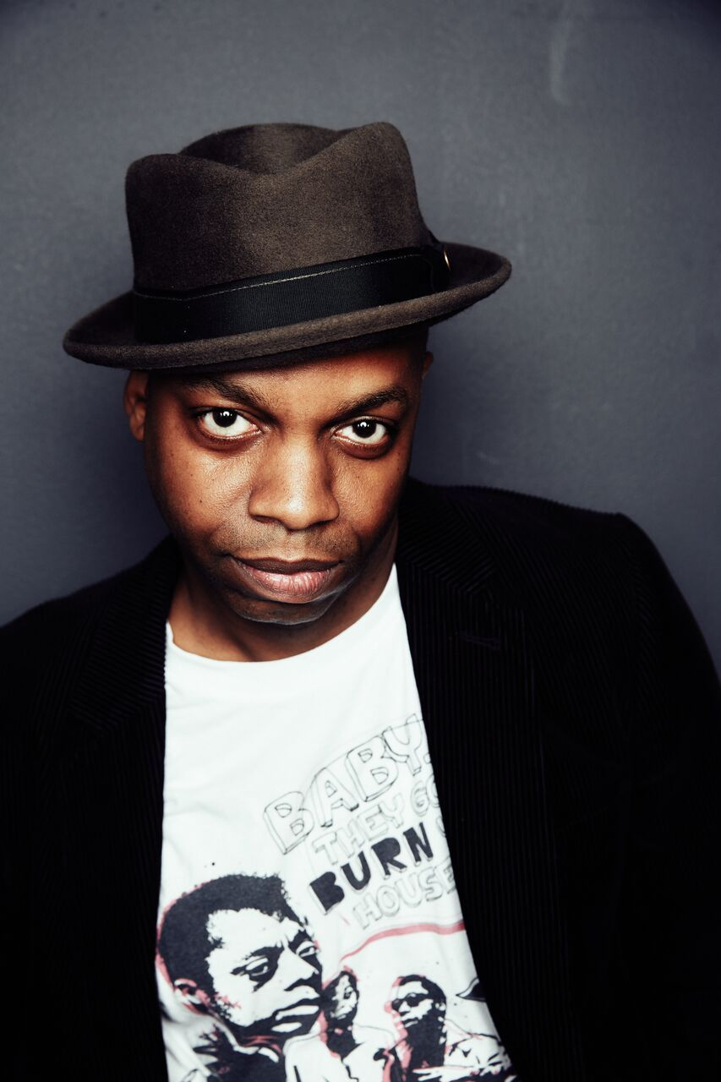
“We can disagree and still love each other unless your disagreement is rooted in my oppression and denial of my humanity and right to exist.”
- Robert Jones Jr. @SonofBaldwin
Photo of Robert Jones Jr., Author of The Prophets
by Deneka Peniston
Notes:
Paul to end

Slide 32
Thank you!
We welcome your feedback, please take a moment to complete our feedback form.
Visit our website at diversity.umn.edu/education.
Email us at oeded@umn.edu.

Slide 33

Office for Equity and Diversity
The University of Minnesota is an equal opportunity educator and employer.

