Slide 1
Activity: Post the Path
To create a shared understanding of the steps needed to get to a final project.

Slide 2
ACTIVITY Post the Path
Instructions
To start we will each consider individually the process of this project from beginning to end. Think about each step involved in creating this project.
We’ll come together and discuss these steps adding “sticky notes” to a slides to map out the path
Where are the points of confusion and agreement?

Slide 3
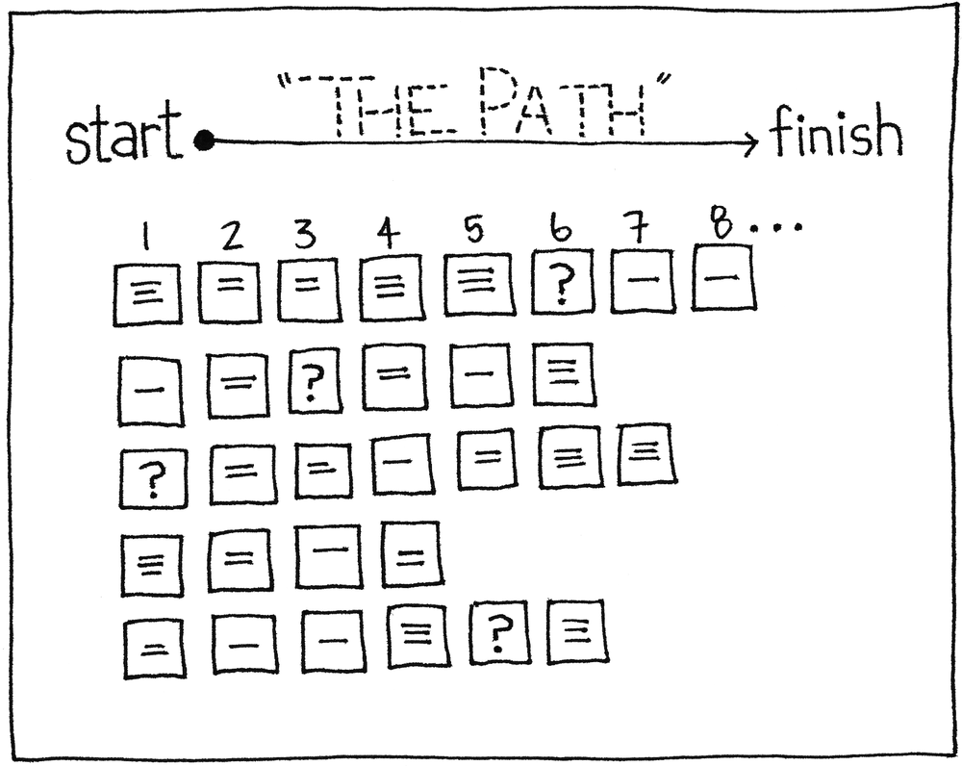
ACTIVITY EXAMPLE

Slide 4
Notes:
Goal: To name the steps needed in order to get to a final product
Instructions:
To use the sticky notes, drag and drop them from either side of the slide.
Click inside the note to add text
Use one note per idea / step

Slide 5
ACTIVITY DEBRIEF
Reflection
What are the points of agreement and confusion?
What steps can be consolidates?

