Slide 1
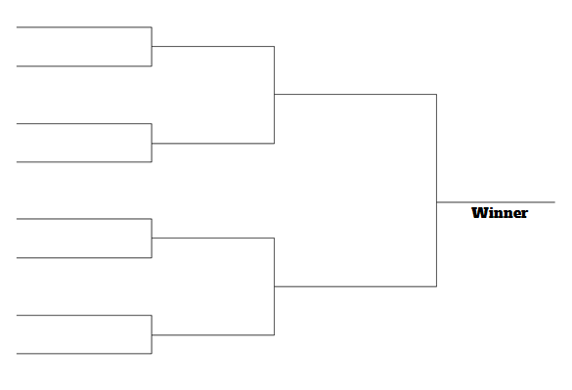
Golden 5 Brainstorming Activity!
First Round: Everyone will get 5 minutes to individually brainstorm as many as ideas as they can then will select their top 5 personal favorite ideas
Second Round: Pair up with a partner and share each others top 5. Then collectively, choose a new top 5 from the 10 ideas.
Third Round: Team up with another team of 2 and repeat the process:
Fourth Round: Everyone comes together and comes up with a collective top 5. This is our “Golden 5”
A
A,B
B
A,B,C,D
C
C,D
D
ALL
E
E,F
Golden 5
F
E,F,G,H
G
G,H
H
*You can come up with new ideas at any time during the process, just make sure at end of each round you have a top 5

