Slide 1
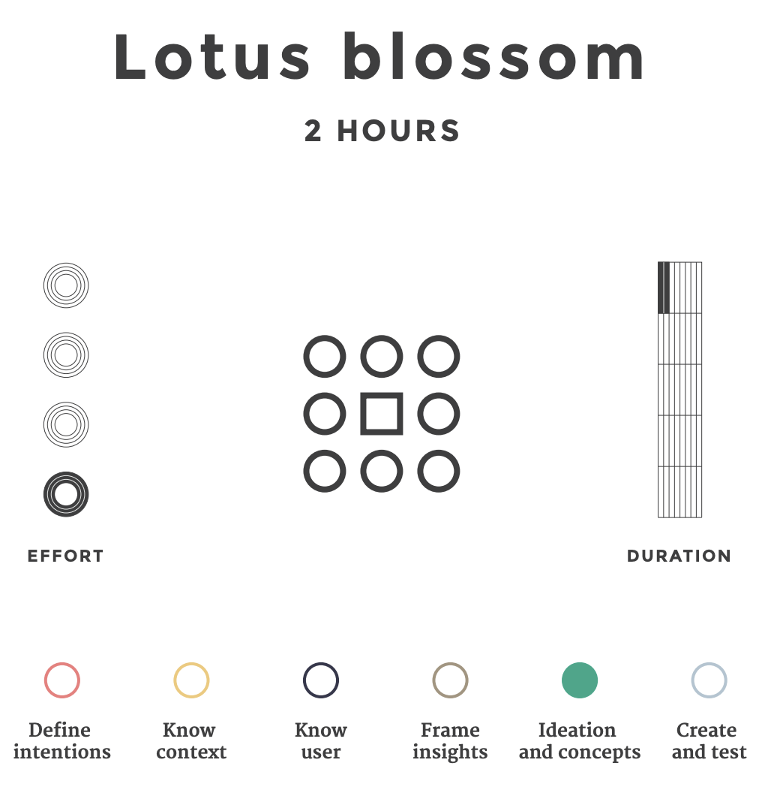
Lotus Blossom Activity
What: The lotus blossom is a creativity technique that consists of a framework for idea generation. It starts by generating eight concept themes based on a central theme or question. Each concept then serves as the basis for eight additional theme explorations or variations.
Why: To focus on the power of brainstorming through a structured visual representation of ideas; to push you to explore nuances of related concepts or ideas; to help the group develop areas of focus
Notes:
Image taken from https://medialabamsterdam.com/toolkit/files/2015/01/MediaLAB_design_methods_toolkit.pdf

Slide 2
Lotus Blossom Activity
As a group:
1. The next few slides are our lotus blossom and its petals. The lotus is made up of a square in the center of the diagram and eight other surrounding squares.
2. Our “How might we…” design question is centered in the diagram.
3. Our task is to brainstorm eight concepts or ideas that are related to or will otherwise inform the design question.
4. Each idea then becomes the central idea of a new theme or blossom in the remaining slides.
5. We must then brainstorm eight concepts or ideas that are related to these additional ideas.
Next session?: Stormdraining
Notes:
Image taken from https://medialabamsterdam.com/toolkit/files/2015/01/MediaLAB_design_methods_toolkit.pdf

Slide 3
Core Concept/Idea A
Core Concept/Idea B
Core Concept/Idea C
Core Concept/Idea D
Central theme
Core Concept/Idea E
Core Concept/Idea F
Core Concept/Idea G
Core Concept/Idea H
Notes:
Based on the Lotus Blossom activity: https://medialabamsterdam.com/toolkit/files/2015/01/MediaLAB_design_methods_toolkit.pdf & https://itk.mitre.org/lotus-blossom/
The lotus blossom is a creativity technique that consists of a framework for idea generation that starts by generating eight concept themes based on a central theme. Each concept then serves as the basis for eight further theme explorations or variations.
1. Draw up a lotus blossom diagram made up of a square in the centre of the diagram and eight circles surrounding the square.
2. Write the problem in the centre box of the diagram.
3. Write eight related ideas around the centre.
4. Each idea then becomes the central idea of a new theme or blossom.

Slide 4
Start running again
Cycle
Reactivate my gym membership
Join an intramural sports team
EXAMPLE:
How can I become more physically active?
Walk more
Bodyweight exercises at home
Do more hiking
Use an app to track my progress
Notes:
Example of the Lotus Blossom Activity

Slide 5
Start running again
Cycle
Reactivate my gym membership
Join an intramural sports team
EXAMPLE:
How can I become more physically active?
Walk more
Bodyweight exercises at home
Do more hiking
Use an app to track my progress
Notes:
Example of the Lotus Blossom Activity

Slide 6
Run after work
Run before work
Run TO work
Run on a treadmill
EXAMPLE:
Start running again
Run with my dog
Commit to a 10k
Join a running group
Use a Couch-to-5k App
Notes:
Example of the Lotus Blossom Activity

Slide 7
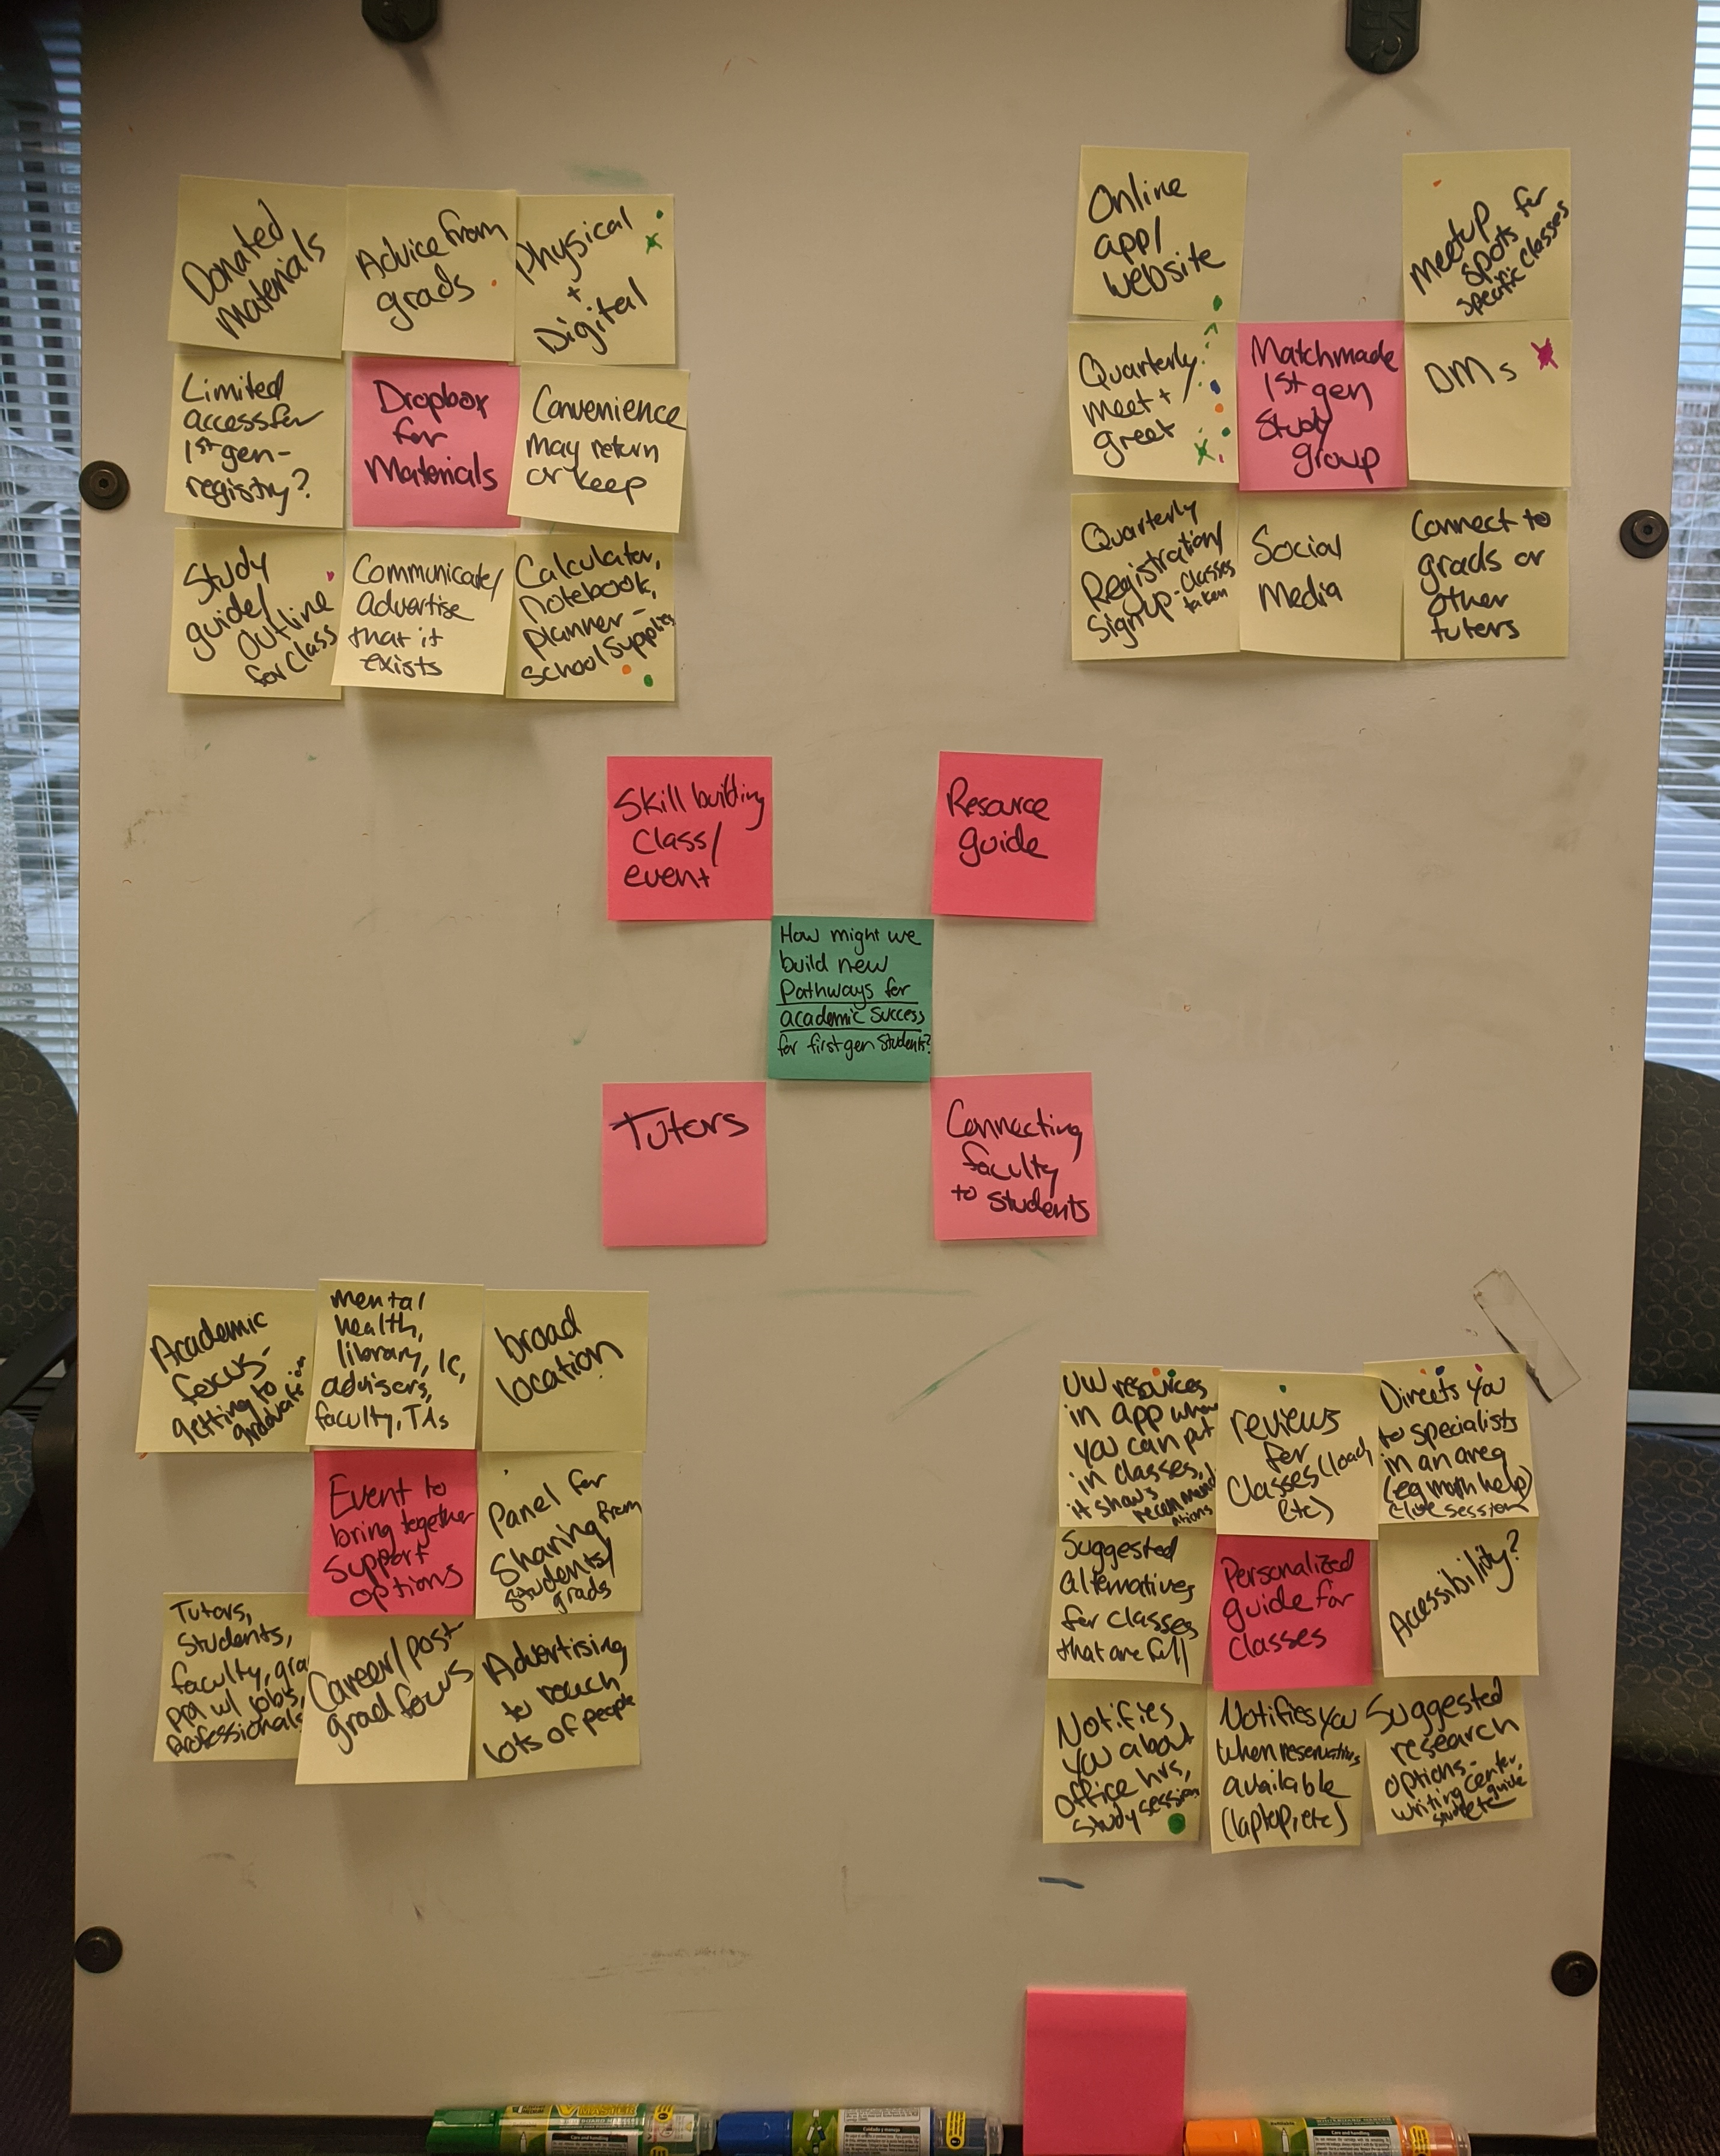
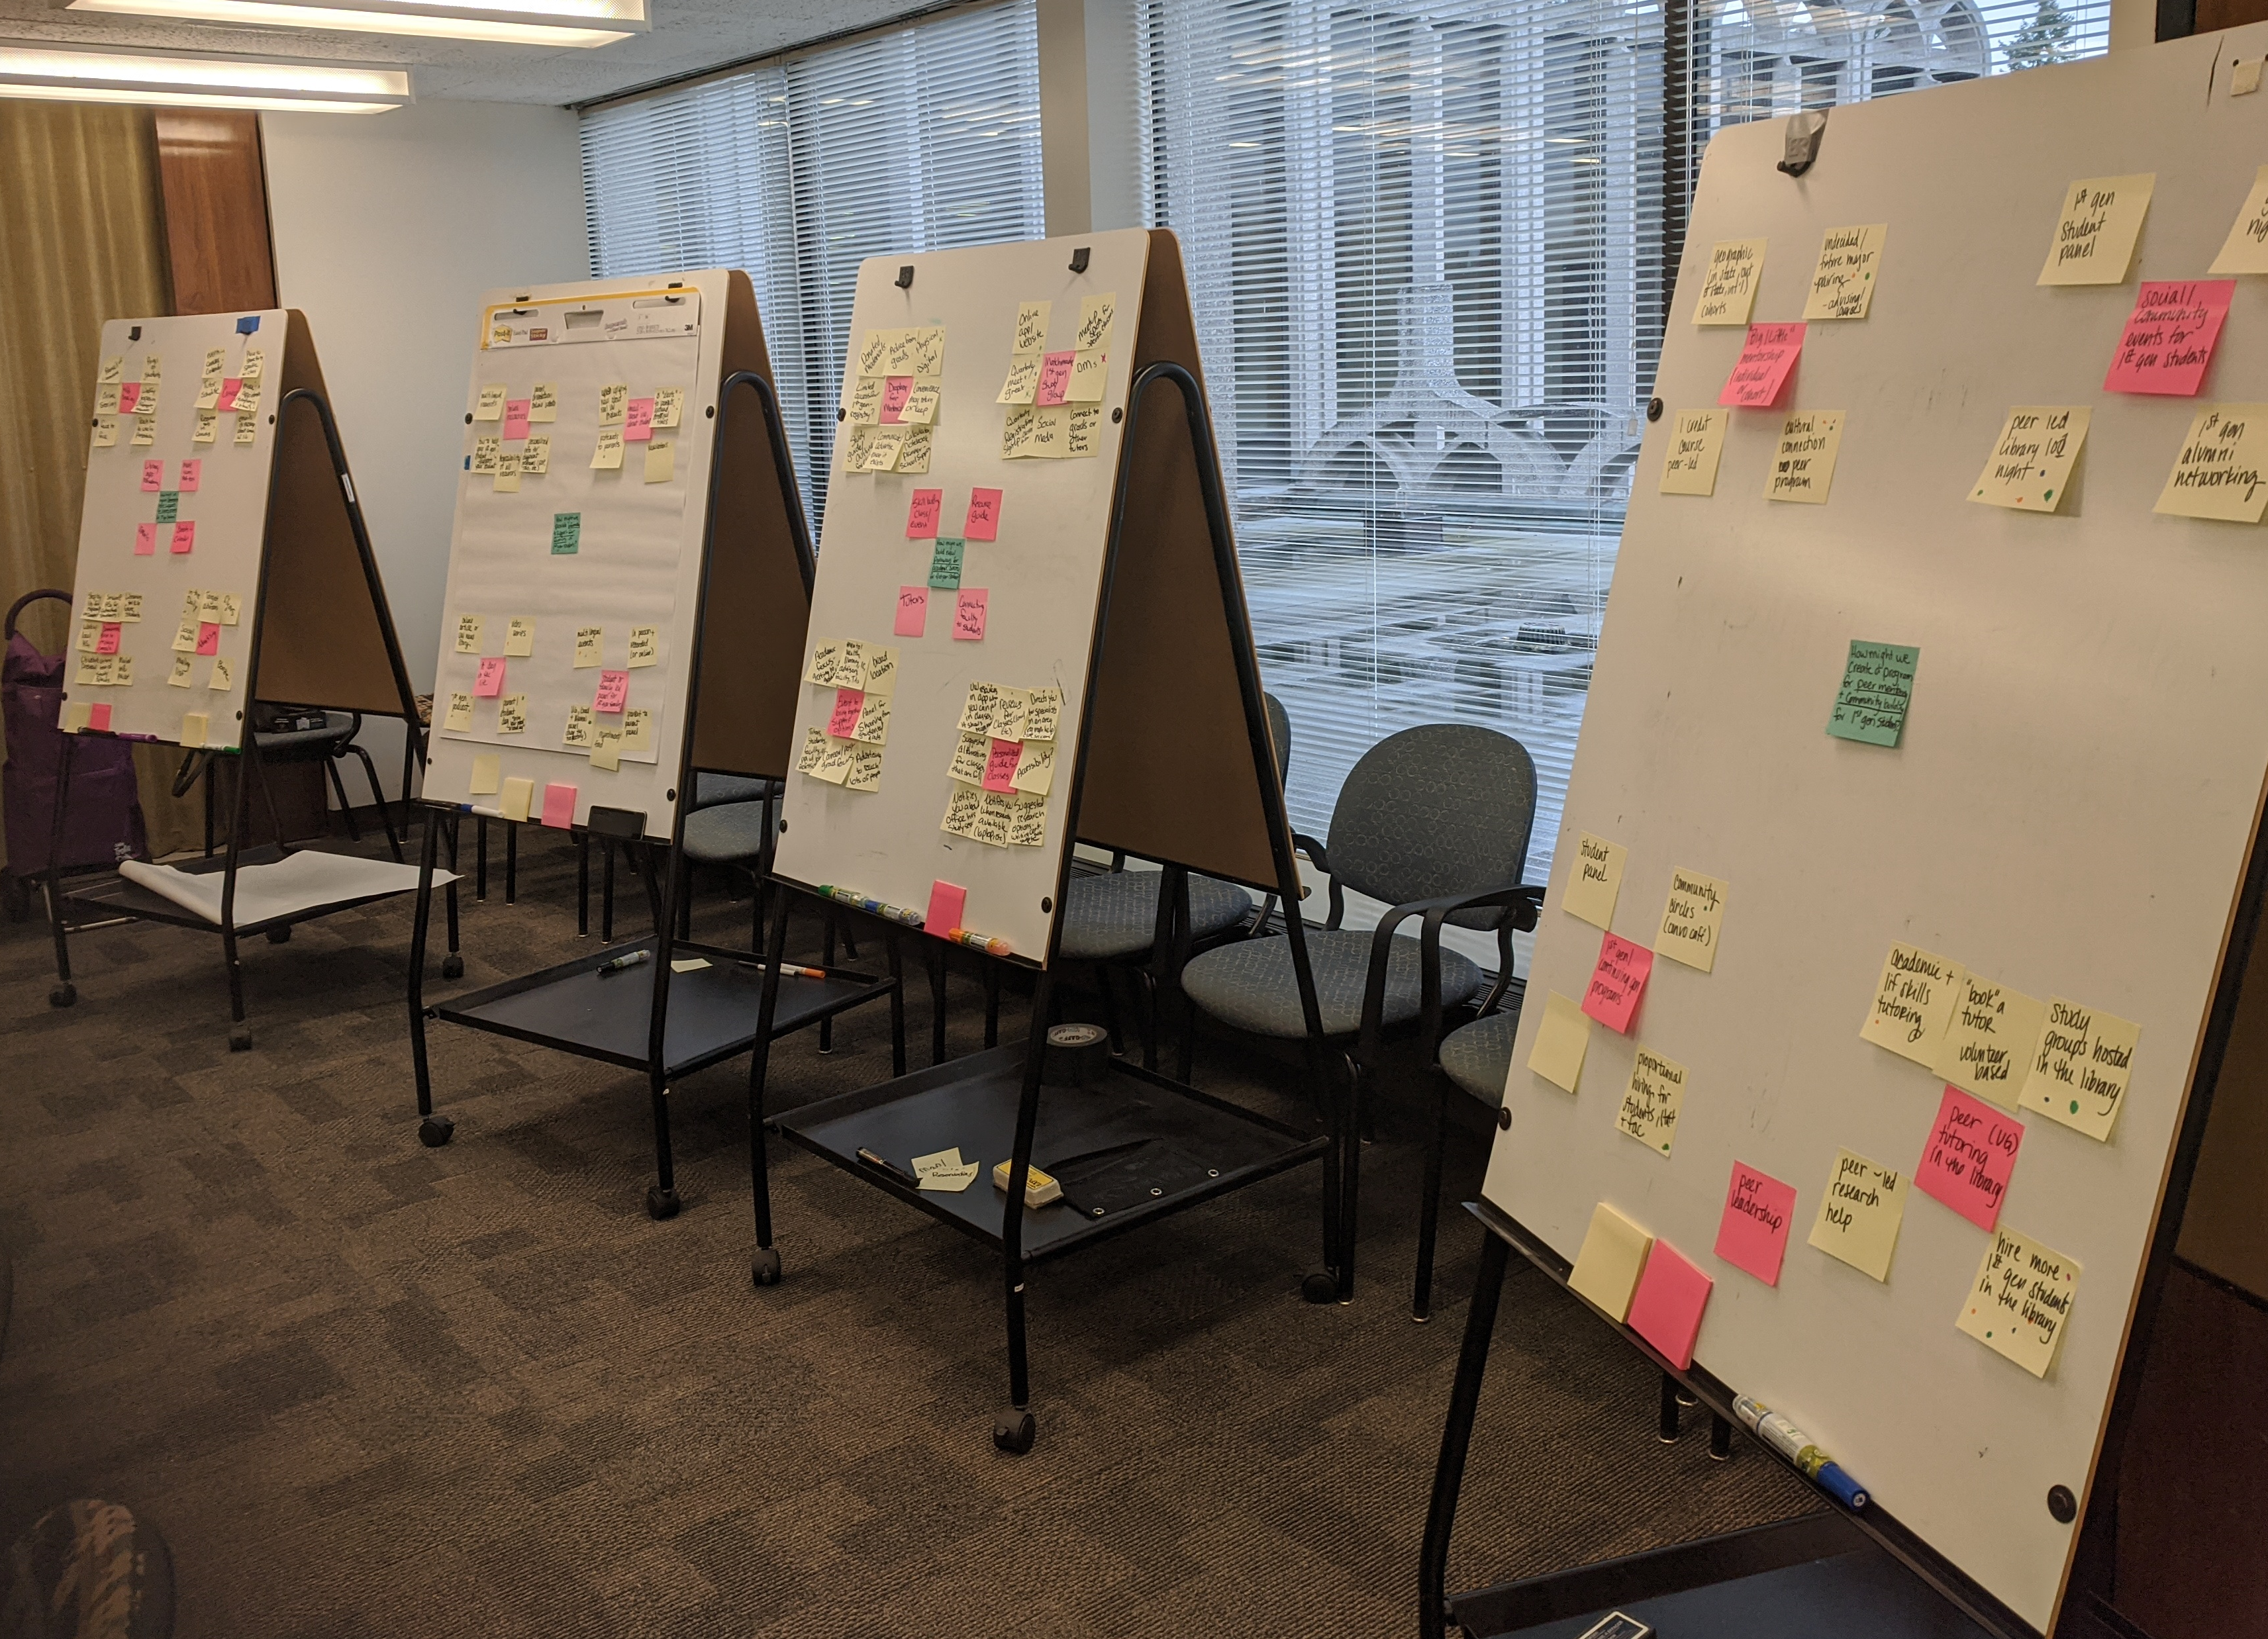

Slide 8

Expected Results
By the time we’re done, we will have 8 core ideas and 64 related ideas to explore.
During and after the exercise, we will have an opportunity to explore the following tasks:
Filtering:
We will read out the 8 core ideas and ask the team to call out any that don’t align with the project, vision, or audience. We have lots of ideas and not all of them are going to be great.
Highlighting:
We are going to take a page out of the dot-voting playbook and use a Shape in Google Slides to highlight the most compelling, valuable or exciting ideas on the board.

Slide 9
Run after work
Run before work
Run TO work
Run on a treadmill
EXAMPLE:
Start running again
Run with my dog
Commit to a 10k
Join a running group
Use a Couch-to-5k App
Notes:
Example of the Lotus Blossom Activity highlighting activity

Slide 10
Working in Google Slides
Before we begin, a quick primer to editing in Google Slides:
Editing text in a shape: lotus blossom
To insert text into an empty shape, double-click the shape.
To edit existing text in a shape, single-click on the text.
Inserting a new shape: highlighting / “dot-voting”
To choose a shape, go to the Insert → Shape → Shapes. You may choose any shape.
To insert a shape, click an area of the slide. Resize the shape so others may add their shapes.
To colorize a shape, select the shape and change the color using the paint bucket in the toolbar.
To reuse the same shape and color for your other dots, go to Edit → Duplicate (keyboard shortcut Command+D or ⌘+D).

Slide 11
Refresher
How might online students and the Libraries collaborate virtually to identify academic and professional needs and develop solutions to improve their success as students at UW?
The activity: Lotus blossom
Why: To focus on the power of brainstorming through a structured visual representation of ideas; to push you to explore nuances of related concepts or ideas; to help the group develop areas of focus
How: Generate related ideas and concepts based around our core “How might we…” design question
Notes:
Image taken from https://medialabamsterdam.com/toolkit/files/2015/01/MediaLAB_design_methods_toolkit.pdf

Slide 12
Ready to begin?

Slide 13
Core Concept/Idea 1
Core Concept/Idea 2
Core Concept/Idea 3
Core Concept/Idea 4
How might online students and the Libraries collaborate virtually to identify academic and professional needs and develop solutions to improve their success as students at UW?
Core Concept/Idea 5
Core Concept/Idea 6
Core Concept/Idea 7
Core Concept/Idea 8
Notes:
Based on the Lotus Blossom activity: https://medialabamsterdam.com/toolkit/files/2015/01/MediaLAB_design_methods_toolkit.pdf & https://itk.mitre.org/lotus-blossom/
The lotus blossom is a creativity technique that consists of a framework for idea generation that starts by generating eight concept themes based on a central theme. Each concept then serves as the basis for eight further theme explorations or variations.
1. Draw up a lotus blossom diagram made up of a square in the centre of the diagram and eight circles surrounding the square.
2. Write the problem in the centre box of the diagram.
3. Write eight related ideas around the centre.
4. Each idea then becomes the central idea of a new theme or blossom.

Slide 14
Additional Concept/Idea A
Additional Concept/Idea B
Additional Concept/Idea C
Additional Concept/Idea D
Core Concept/Idea 1
Additional Concept/Idea E
Additional Concept/Idea F
Additional Concept/Idea G
Additional Concept/Idea H
Notes:
Based on the Lotus Blossom activity: https://medialabamsterdam.com/toolkit/files/2015/01/MediaLAB_design_methods_toolkit.pdf & https://itk.mitre.org/lotus-blossom/
The lotus blossom is a creativity technique that consists of a framework for idea generation that starts by generating eight concept themes based on a central theme. Each concept then serves as the basis for eight further theme explorations or variations.
1. Draw up a lotus blossom diagram made up of a square in the centre of the diagram and eight circles surrounding the square.
2. Write the problem in the centre box of the diagram.
3. Write eight related ideas around the centre.
4. Each idea then becomes the central idea of a new theme or blossom.

Slide 15
Additional Concept/Idea A
Additional Concept/Idea B
Additional Concept/Idea C
Additional Concept/Idea D
Core Concept/Idea 2
Additional Concept/Idea E
Additional Concept/Idea F
Additional Concept/Idea G
Additional Concept/Idea H
Notes:
Based on the Lotus Blossom activity: https://medialabamsterdam.com/toolkit/files/2015/01/MediaLAB_design_methods_toolkit.pdf & https://itk.mitre.org/lotus-blossom/
The lotus blossom is a creativity technique that consists of a framework for idea generation that starts by generating eight concept themes based on a central theme. Each concept then serves as the basis for eight further theme explorations or variations.
1. Draw up a lotus blossom diagram made up of a square in the centre of the diagram and eight circles surrounding the square.
2. Write the problem in the centre box of the diagram.
3. Write eight related ideas around the centre.
4. Each idea then becomes the central idea of a new theme or blossom.

Slide 16
Additional Concept/Idea A
Additional Concept/Idea B
Additional Concept/Idea C
Additional Concept/Idea D
Core Concept/Idea 3
Additional Concept/Idea E
Additional Concept/Idea F
Additional Concept/Idea G
Additional Concept/Idea H
Notes:
Based on the Lotus Blossom activity: https://medialabamsterdam.com/toolkit/files/2015/01/MediaLAB_design_methods_toolkit.pdf & https://itk.mitre.org/lotus-blossom/
The lotus blossom is a creativity technique that consists of a framework for idea generation that starts by generating eight concept themes based on a central theme. Each concept then serves as the basis for eight further theme explorations or variations.
1. Draw up a lotus blossom diagram made up of a square in the centre of the diagram and eight circles surrounding the square.
2. Write the problem in the centre box of the diagram.
3. Write eight related ideas around the centre.
4. Each idea then becomes the central idea of a new theme or blossom.

Slide 17
Additional Concept/Idea A
Additional Concept/Idea B
Additional Concept/Idea C
Additional Concept/Idea D
Core Concept/Idea 4
Additional Concept/Idea E
Additional Concept/Idea F
Additional Concept/Idea G
Additional Concept/Idea H
Notes:
Based on the Lotus Blossom activity: https://medialabamsterdam.com/toolkit/files/2015/01/MediaLAB_design_methods_toolkit.pdf & https://itk.mitre.org/lotus-blossom/
The lotus blossom is a creativity technique that consists of a framework for idea generation that starts by generating eight concept themes based on a central theme. Each concept then serves as the basis for eight further theme explorations or variations.
1. Draw up a lotus blossom diagram made up of a square in the centre of the diagram and eight circles surrounding the square.
2. Write the problem in the centre box of the diagram.
3. Write eight related ideas around the centre.
4. Each idea then becomes the central idea of a new theme or blossom.

Slide 18
Additional Concept/Idea A
Additional Concept/Idea B
Additional Concept/Idea C
Additional Concept/Idea D
Core Concept/Idea 5
Additional Concept/Idea E
Additional Concept/Idea F
Additional Concept/Idea G
Additional Concept/Idea H
Notes:
Based on the Lotus Blossom activity: https://medialabamsterdam.com/toolkit/files/2015/01/MediaLAB_design_methods_toolkit.pdf & https://itk.mitre.org/lotus-blossom/
The lotus blossom is a creativity technique that consists of a framework for idea generation that starts by generating eight concept themes based on a central theme. Each concept then serves as the basis for eight further theme explorations or variations.
1. Draw up a lotus blossom diagram made up of a square in the centre of the diagram and eight circles surrounding the square.
2. Write the problem in the centre box of the diagram.
3. Write eight related ideas around the centre.
4. Each idea then becomes the central idea of a new theme or blossom.

Slide 19
Additional Concept/Idea A
Additional Concept/Idea B
Additional Concept/Idea C
Additional Concept/Idea D
Core Concept/Idea 6
Additional Concept/Idea E
Additional Concept/Idea F
Additional Concept/Idea G
Additional Concept/Idea H
Notes:
Based on the Lotus Blossom activity: https://medialabamsterdam.com/toolkit/files/2015/01/MediaLAB_design_methods_toolkit.pdf & https://itk.mitre.org/lotus-blossom/
The lotus blossom is a creativity technique that consists of a framework for idea generation that starts by generating eight concept themes based on a central theme. Each concept then serves as the basis for eight further theme explorations or variations.
1. Draw up a lotus blossom diagram made up of a square in the centre of the diagram and eight circles surrounding the square.
2. Write the problem in the centre box of the diagram.
3. Write eight related ideas around the centre.
4. Each idea then becomes the central idea of a new theme or blossom.

Slide 20
Additional Concept/Idea A
Additional Concept/Idea B
Additional Concept/Idea C
Additional Concept/Idea D
Core Concept/Idea 7
Additional Concept/Idea E
Additional Concept/Idea F
Additional Concept/Idea G
Additional Concept/Idea H
Notes:
Based on the Lotus Blossom activity: https://medialabamsterdam.com/toolkit/files/2015/01/MediaLAB_design_methods_toolkit.pdf & https://itk.mitre.org/lotus-blossom/
The lotus blossom is a creativity technique that consists of a framework for idea generation that starts by generating eight concept themes based on a central theme. Each concept then serves as the basis for eight further theme explorations or variations.
1. Draw up a lotus blossom diagram made up of a square in the centre of the diagram and eight circles surrounding the square.
2. Write the problem in the centre box of the diagram.
3. Write eight related ideas around the centre.
4. Each idea then becomes the central idea of a new theme or blossom.

Slide 21
Additional Concept/Idea A
Additional Concept/Idea B
Additional Concept/Idea C
Additional Concept/Idea D
Core Concept/Idea 8
Additional Concept/Idea E
Additional Concept/Idea F
Additional Concept/Idea G
Additional Concept/Idea H
Notes:
Based on the Lotus Blossom activity: https://medialabamsterdam.com/toolkit/files/2015/01/MediaLAB_design_methods_toolkit.pdf & https://itk.mitre.org/lotus-blossom/
The lotus blossom is a creativity technique that consists of a framework for idea generation that starts by generating eight concept themes based on a central theme. Each concept then serves as the basis for eight further theme explorations or variations.
1. Draw up a lotus blossom diagram made up of a square in the centre of the diagram and eight circles surrounding the square.
2. Write the problem in the centre box of the diagram.
3. Write eight related ideas around the centre.
4. Each idea then becomes the central idea of a new theme or blossom.

Slide 22

Filtering
Before we move on, let’s pause to filter our ideas:
Disclaimer: These core ideas will inform related ideas and concepts. While these core ideas are on the board, we should acknowledge that not all of them may be great (we may, in fact, have some average or terrible ideas).
Tasks:
Someone will read out the 8 core ideas.
The group will call out core ideas that don’t align with the project, vision, or audience.
As a group, we generate a new core idea that better fits into the current landscape being discussed.
Why are we doing this:
To build consensus
To avoid wasting time on misaligned ideas
This is the only time we will spend filtering ideas during the activity.

Slide 23

Highlighting
Lots of ideas. Now let’s highlight the best!
Disclaimer: Some of the ideas we generated might be awful. That’s OK.
Tasks:
We are going to take a page out of the dot-voting playbook and use a Shape to highlight the most compelling, valuable or exciting ideas on the board. See section for Google Slides refresher.
Parameters: You have two votes per slide (16 total). Use the same shape and color for each vote (we needn’t be anonymous here).
Why: to build consensus and to highlight exciting ideas

Slide 24
Refresher
Before we begin, a quick primer to editing in Google Slides:
Editing text in a shape: lotus blossom
To insert text into an empty shape, double-click the shape.
To edit existing text in a shape, single-click on the text.
Inserting a new shape: highlighting / “dot-voting”
To choose a shape, go to the Insert → Shape → Shapes. You may choose any shape.
To insert a shape, click an area of the slide. Resize the shape so others may add their shapes.
To colorize a shape, select the shape and change the color using the paint bucket in the toolbar.
To reuse the same shape and color for your other dots, go to Edit → Duplicate (keyboard shortcut Command+D or ⌘+D).

Slide 25
If this worked and you’d like to continue exploring (and narrowing) these ideas...

Slide 26
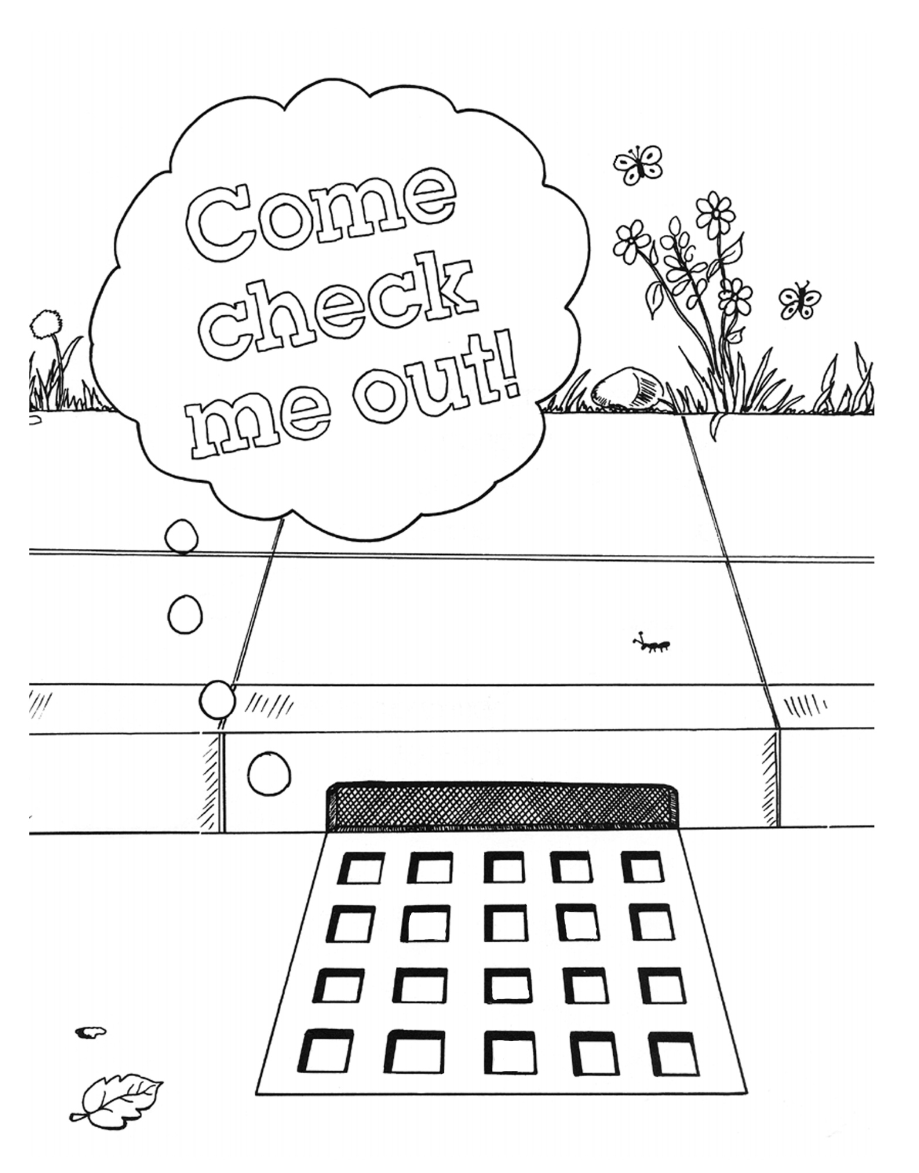
Stormdraining
What: Stormdraining is the inverse of brainstorming - the goal is to reduce a large collection of ideas and components to a smaller collection of the most valuable or promising ideas.
Why: To provide clarity and direction; to build consensus about the problem to be solved; to reduce wasted effort of misaligned and unproductive activities
How:
Invite the team to distill the large collection into a smaller, more focused set. Remove items from the collection by using the following Five Rules of Stormdraining:
RULE 1: Everything Is on the Table. No sacred cows, please. Every single item is fair game for going down the drain.
RULE 2: Delete Is the Default. Highlight, delete, and repeat. Not sure if something should be deleted? Only one way to find out.…
RULE 3: Build on Other People’s Deletions. Your teammate’s suggestion to remove one thing likely points to other parts to remove. The objective is to reduce quantity and hone in on the essentials, so practice “Yes, and.…”
RULE 4: Make It Fun. Celebrate and encourage the deletions. Compliment people’s creativity and courage when they propose sending something down the drain.
RULE 5: When You Delete Something, Really Delete It. Don’t set it aside and save it for posterity. Don’t take a photo to preserve the moment. Erase it. Drain it. Make it go away.
Notes:
Image taken from Dwayne the Storm Drain: http://www.mwra.com/02org/html/dwayne.htm

Slide 27
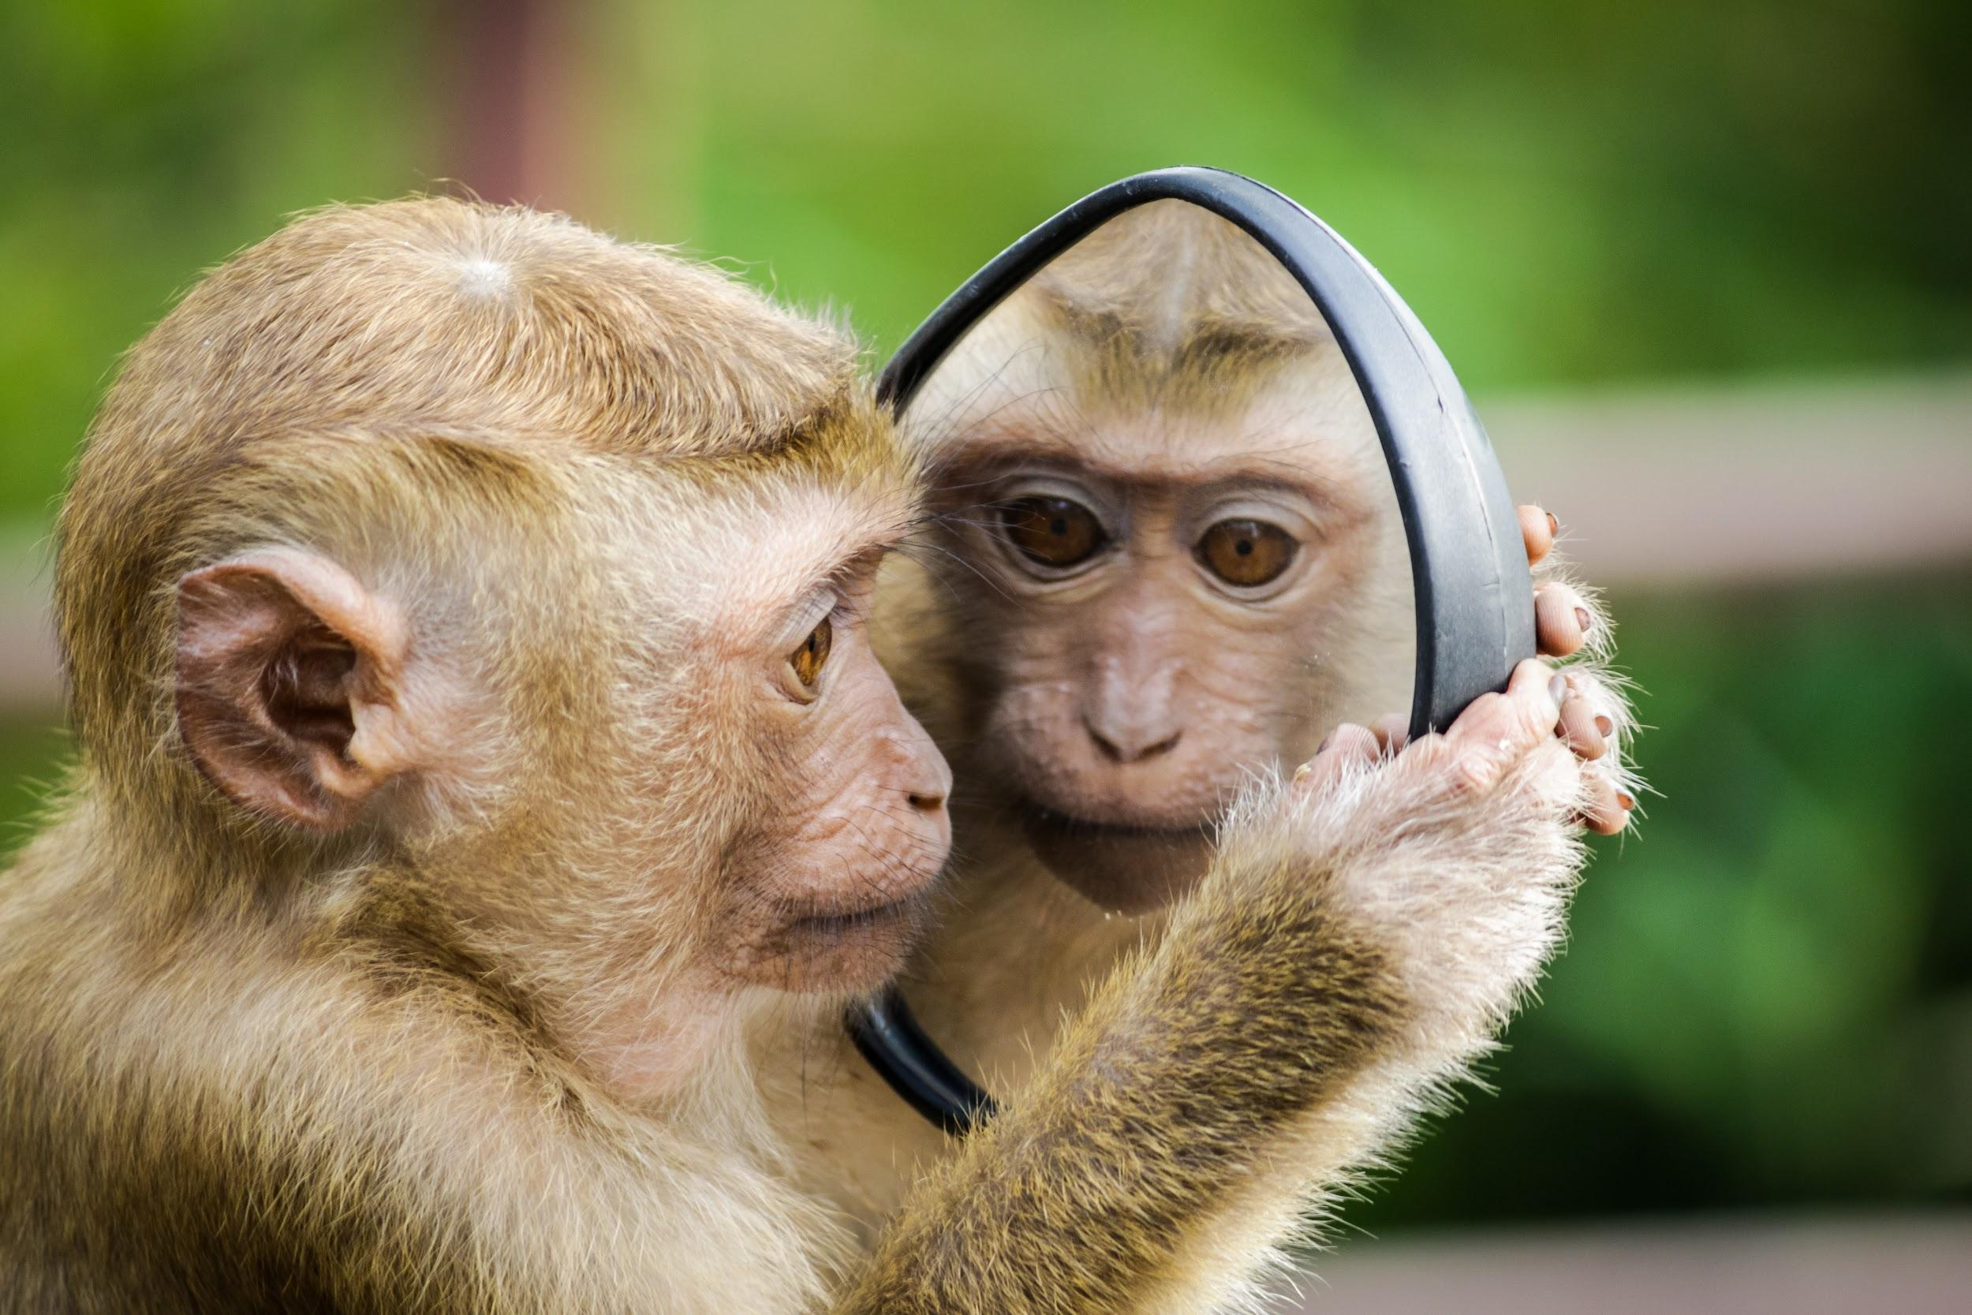
Reflection time!
Questions to consider: (see speaker notes for responses)
Now that it’s over, what are your first thoughts about adapting this activity for online?
What were interesting discoveries, opportunities or challenges you identified in this experience?
Were there powerful learning moments? What were they? What made them so?
What is the most important thing you learned or experienced today?
What most got in the way of our progress, if anything?
How well did we communicate in this online activity?
What were some things others in the group did to help overcome challenges?
What would you do different if we were to try this again?
How can the facilitator better support or encourage members during future activities?

