Slide 1



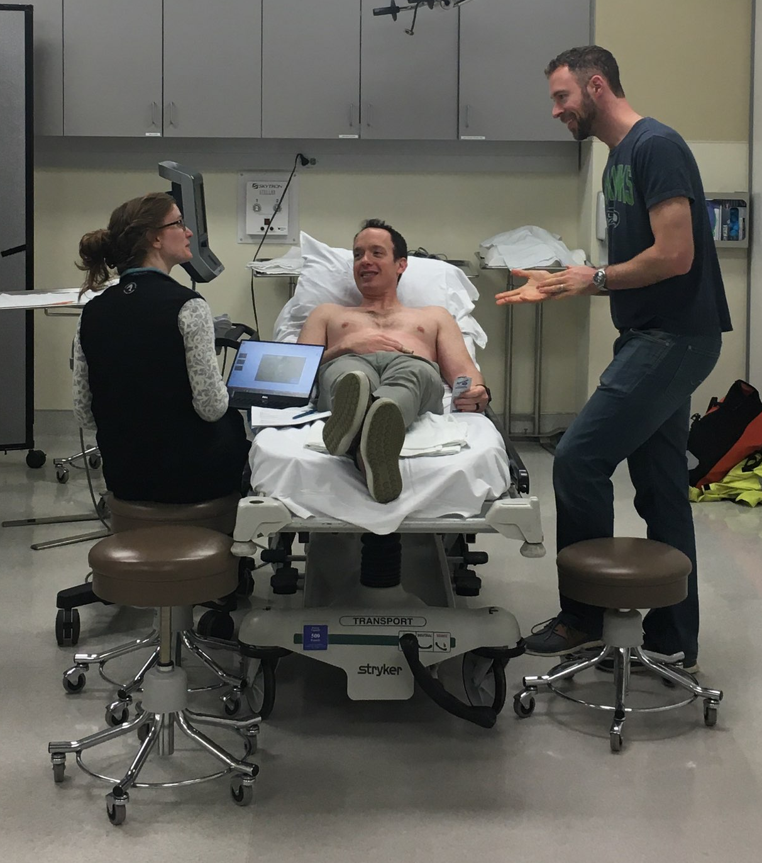
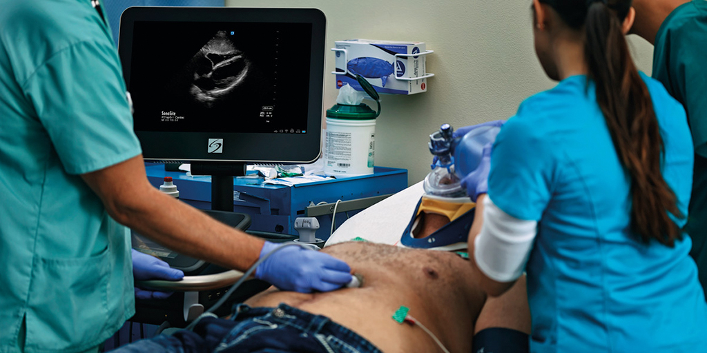
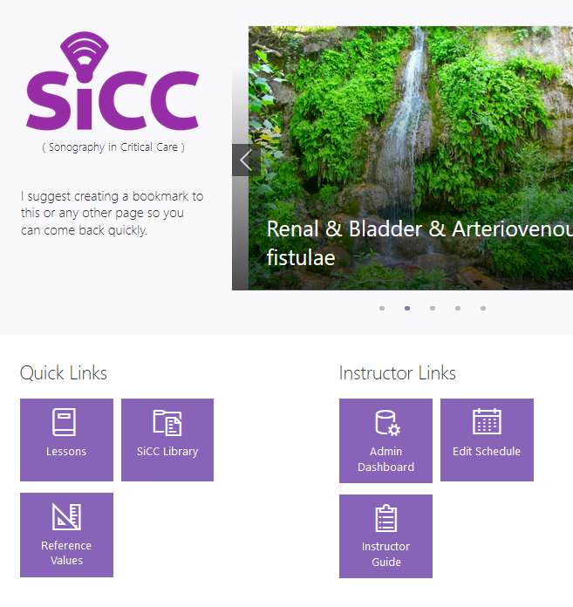

Developing an Academic Ultrasound Curriculum:
Hybrid Learning by and for Busy Clinicians
Alexander Vengerovsky, MD^{1,2}, James Town, MD¹, David Carlbom, MD¹
¹Harborview Medical Center, ²University of Washington Medical Center
BACKGROUND
METHODS
SURVEY RESULTS
Motivation and interest in learning CCUS is high
Lack of clear learning objectives
Online training resources exist, but they are not curated
Clinical demand interferes with learning
Insufficient faculty availability
No validated competency assessment
Flipped-classroom instruction was preferred by respondents
BY THE NUMBERS
Critical care ultrasound (CCUS) expedites the evaluation and management of critically ill patients
There are no standard curricula for CCUS training, nor metrics that measure competency
Training physicians in CCUS presents challenges
Current practice did not produce reliable results, and outcomes were not measured
National accreditation groups are considering a requirement to teach this skill
We conducted an anonymous online survey of faculty and fellows, soliciting opinions on importance and barriers to CCUS education
Relevant guidelines and literature were reviewed, extracting data on:
Topic selection
Quality assurance
Demonstration of proficiency.
We constructed a curriculum for CCUS training.
Data from 6 fellows who have completed a follow-up assessment at time of publication.
13%
RESULTS
Assessment session featuring, from left-to-right, instructor, willing model, learner.
CONCLUSIONS
Twenty-six fellows included
Survey results
Curriculum with ~80 learning objectives
A website was developed with multi-modal delivery of content, including:
  topic reviews
  embedded media
  references to existing content
In-person
  weekly instructor-proctored rounds
  semi-annual assessment
We created a novel hybrid curriculum using stakeholder survey, existing guidelines, and internet resources it is possible to construct a curriculum for CCUS training
Utilizing multiple modalities of instruction, it is possible to improve CCUS performance of fellows in clinical practice
The CCUS training website.
CCUS in progress. Source: Sonosite.
FUTURE DIRECTIONS
Train additional faculty
Ensure longitudinal assessment
Implement certification process

