Slide 1


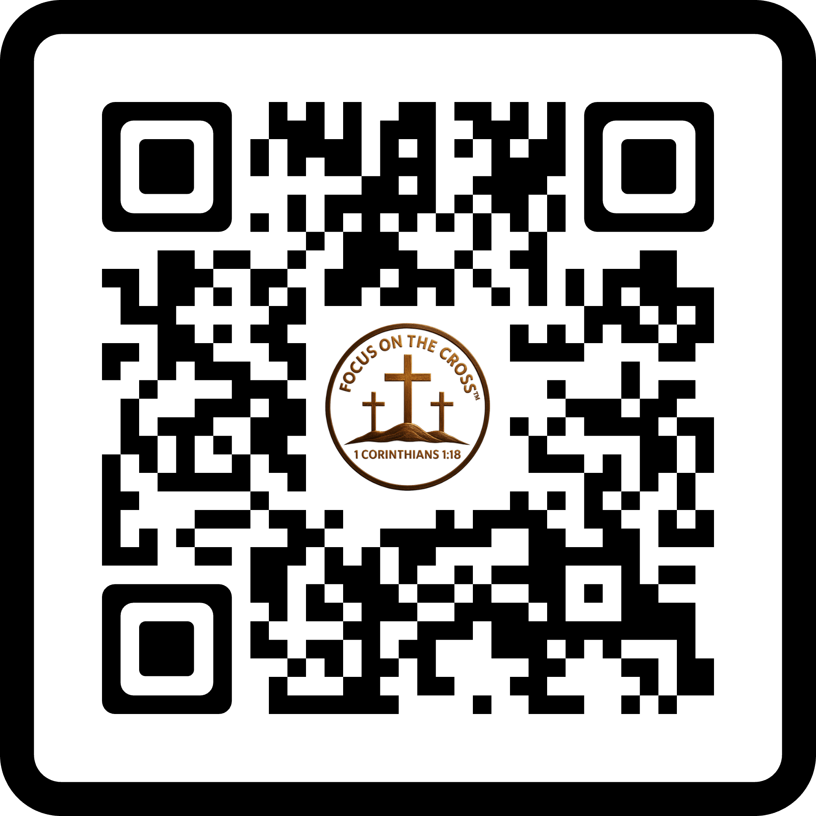
One Cross. One Message. One Mission.
Handmade wooden crosses delivered with purpose and compassion. Join us in sharing the gospel of Jesus Christ. One cross at a time.
Focus on the Cross
Share the Love…Spread the Word
FocusOnTheCross.com

Slide 2


One Cross. One Message. One Mission.
Handmade wooden crosses delivered with purpose and compassion. Join us in sharing the gospel of Jesus Christ. One cross at a time.
Focus on the Cross
Share the Love…Spread the Word
FocusOnTheCross.com

