Slide 1
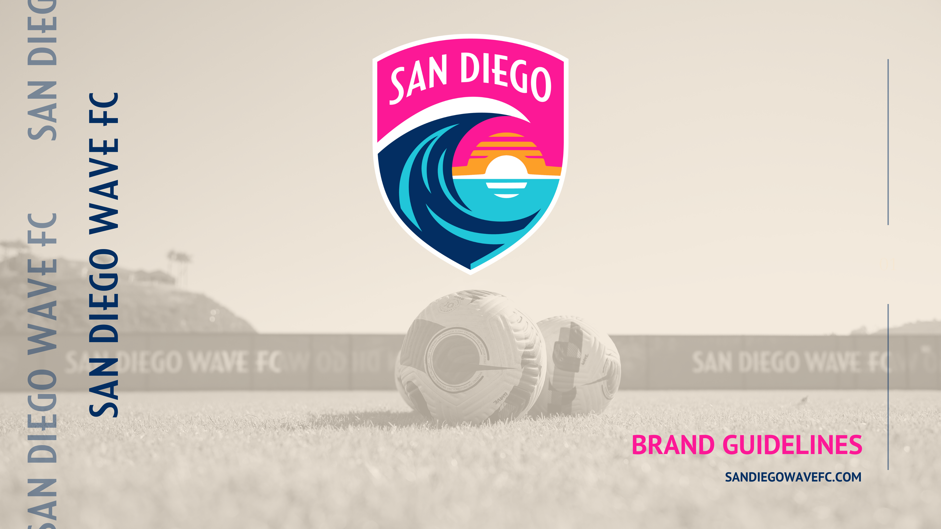

Slide 2
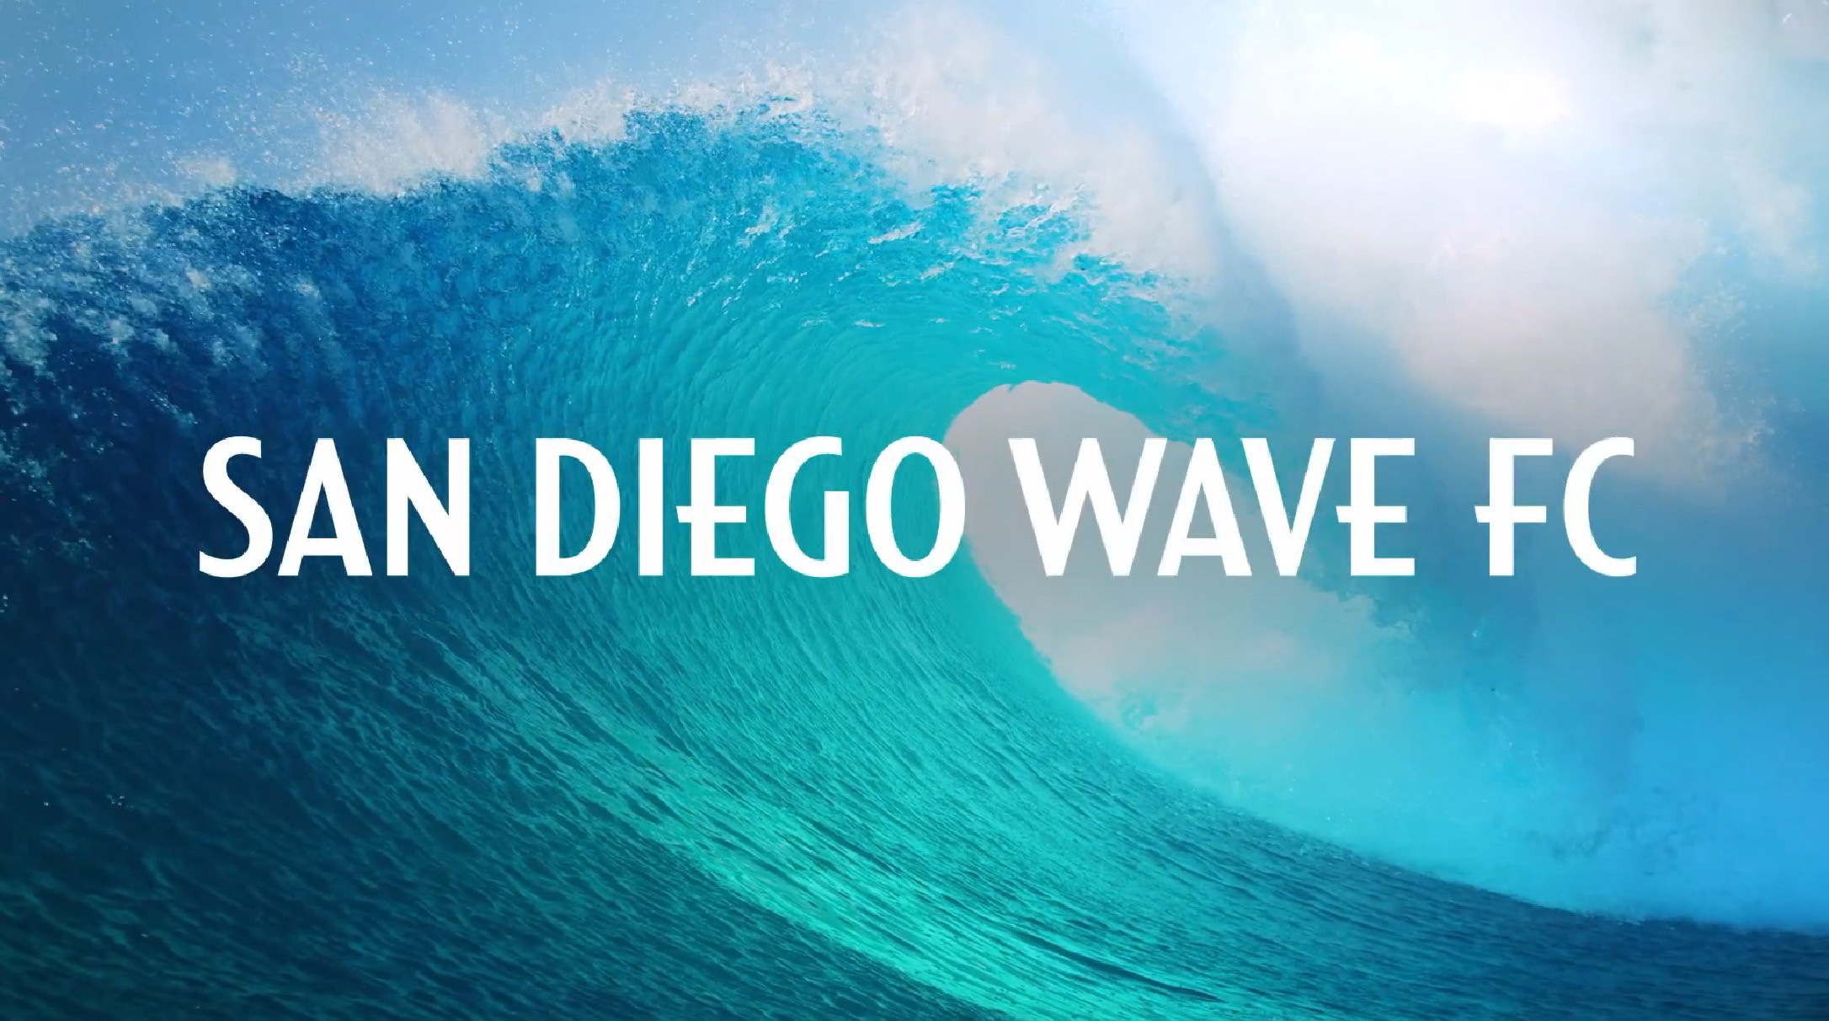
PLAY

Slide 3
CONTENTS
2 ANTHEM VIDEO
18 VISUAL IDENTITY
Primary Logo
Primary Logo Safety / Scale Color
Color Usage Brand Mark Don’t One & Two Color In Use Moodboard
Secondary Marks / Icons Word Mark
Lock Ups Typography Textures Uniform Kits
39 SOCIAL MEDIA
The Big Three
4 BRAND OVERVIEW
The Mission The Vision
Values & Behaviors Points of Difference Our Fans
Impact Focus
41 DIGITAL Web Safe Font UX Elements
Background / Texture Style Tile
11 VOICE & STRATEGY
Archetype Brand Character Tone of Voice Language
Brand DNA Pyramid
46 KEY STAKEHOLDERS
03
34 PHOTOGRAPHY Photography Talent
By Category Dont’s

Slide 4
BRAND OVERVIEW
02

Slide 5
THE MISSION
THE IMMEDIATE ACTIONS,​
THE “HOW” WE WILL ACHIEVE OUR LONG
TERM VISION.
Build a world class home for players and fans that will be loved locally and respected globally.

Slide 6
THE VISION
THE LONG TERM GOALS, THE “WHY” WE DO
WHAT WE DO.
To be a force for good through the game we love

Slide 7
VALUES &
BEHAVIORS
EXCELLENCE
Be the best, do your best
COMMUNITY
local pride, our San Diego roots stem from a rich and multicultural heritage
EQUITY
We proactively fight injustice, remove barriers, and provide opportunities
DIVERSITY
We seek and elevate diverse voices, backgrounds, and lived experiences
INTEGRITY
We do what we say, we are accountable, we walk the talk
GROWTH
Get better every day, learn from mistakes, prioritize progress

Slide 8
POINTS OF DIFFERENCE
FUNCTIONAL
We will play in a world stadium,
with a grass field
this space intended for photo
We have elite, world class leadership on
and off the field with deep ties to the sport
EMOTIONAL
Proactive force for change through the game joyful competition

Slide 9
OUR FANS
THE FUTURE
NEXT GEN OF PLAYERS, ADMINS AND SUPPORTERS OF THE GAME
THE LIFER
STAY CLOSE TO THE GAME THROUGH STORIES PASSED DOWN
CONTEXT
San Diego. 8th largest city in the US. Under served sports market.
New to the NWSL.
THE PLAYER
PLAYS THE GAME TO CONNECT WITH SELF AND OTHERS
THE SUPPORTER
DRIVES THE ENVIRONEMENT OF THE GAME THROUGH THEIR PASSIONATE FANDOME
THE CREATIVE
THE LOCAL
WAS BROUGH INTO THE GAME THROUGH A COMMON POINT OF CULTURE
ALL ABOUT SAN DIEGO – SHOWING UP FOR SO CAL IN THE WAY ONLY A LOCAL CAN

Slide 10
IMPACT FOCUS
WELLBEING
INCLUSION
EMPOWERMENT
this space intended for photo

Slide 11
02
VOICE & CREATIVE STRATEGY

Slide 12



THE HERO 75%
ARCHETYPE
FOCUS: MASTERY
THE HERO
STATEMENT: THERE’S A WILL THERE’S A WAY
We can make the world better. We have the grit and determination to outwork the rest.
BRAND VOICE
Mastery | Courage | Growth
DRIVE
Mastery | Courageousness
Growth | Development | Defence
FEAR
Incompetence | Cowardice Deterioration | Downfall | Incapability
STRATEGY
Become Stronger and Better Prove People Wrong
HERO BRANDS

Slide 13



THE CAREGIVER 25%
ARCHETYPE
FOCUS: SERVICE
SECONDARY
STATEMENT: LOVE YOUR NEIGHBOR AS YOURSELF
Everyone deserves care and we must all strive to bestow service upon one another.
BRAND VOICE
Service | Community | For the Greater Good
DRIVE
Support | Help | Service Recognition | Gratitude
FEAR
Anguish | Helplessness Ingratitude | Neglect | Blame
STRATEGY
Others Before Self
The Greater Good is Worth Sacrifice
CAREGIVER BRANDS

Slide 14
BRAND
CHARACTER
PRIMARY
Rooted: born out of the culture and community of San Diego
Relentless: fierce; determined; unstoppable
Inspiring: a beacon of light and a force for good;
takes real action as an agent of change
this space could be used for a photo
SECONDARY
Principled: walks the talk; rings the community along with us
Passionate: acts from the heart; driven and authentic
Caring: service-oriented; welcoming; empowering

Slide 15
TONE OF VOICE
WELCOMING WEAK
CONFIDENT ARROGANT
FIERCE RUDE
FUN FRIVOLOUS
CARING CLOYING
ASPIRATIONAL ELITIST
DETERMINED MEAN

Slide 16
LANGUAGE
PRONOUNS
Default to “they”
Honor self-assigned pronouns
MULTI-LINGUAL
We meet people where they are - if they speak to us in Spanish we respond to them in Spanish
CAPITALIZATIONS
Black, is always capitalized
We do not capitalize white
Indigenous is capitalized and the preferred way to refer to native peoples
SPECIFIC TERMINOLOGY
BIPOC, etc
LGBTQIA+ in the first reference

Slide 17
PROMISE
BRAND DNA PYRAMID
Use the game we love as a force for good in order to leave the game and our community better than we found it
ARCHETYPE & PERSONALITY
THE CREATOR
HERO
Mastery | Courage | Growth
CAREGIVER
Service | Community | For the Greater Good
POINTS OF DIFFERENCE
FUNCTIONAL
We will play in a world class stadium
and training facility, with a grass field
We have elite, female leadership on and
off the field with deep ties to the sport
EMOTIONAL
Proactive force for change through the game
Joyful competition
VALUES & BEHAVIOURS
EXCELLENCE
Be the best, do your best
COMMUNITY
Local pride, our San Diego roots stem from a rich and multicultural heritage
DIVERSITY
We seek and elevate diverse
voices, backgrounds,
and lived experience
INTEGRITY
We do what we say, we are accountable, we walk the talk
GROWTH
Get better every day, learn from mistakes, prioritize progress
EQUITY
We proactively fight injustice, remove barriers, and provide opportunities
MISSION
Build a world-class home for players and fans that will be loved locally and respected globally

Slide 18
VISUAL IDENTITY
03

Slide 19

PRIMARY LOGO
This is our Primary Logo & Team Crest.
It is inspired by the colorful people and place that is San Diego. It features the iconic shape of a wave rising up and cresting against the sky, a symbol of our commitment to elevating and lifting up both our beloved sport and our local community.
Use this mark as our Primary Branding element and do not manipulate
in any way.

Slide 20



PRIMARY LOGO / SAFETY & SCALE
Always adhere to the following Safety Rules & Minimum Sizes when using / placing the mark within / near any other content.
The San Diego Wave FC icon should never be smaller than:
50px (height) for digital
.75” (height) for print

Slide 21
COLOR
ONDA
SWELL
PODEROSA
Brand colors seek to evoke the colors of our community and surroundings. The sea, sun, sand and sky — along with complimentary colors to help round out
the palette and evoke a sense of powerful team of women inside a vibrant and diverse community.
PMS: 282 HEX: #032E62 | PMS: 3115 HEX: #21C6D9 | PMS: 213 HEX: #FC1896
RGB: 3, 46, 98 | RGB: 33, 198, 217 | RGB: 252, 24, 150
CMYK: 100, 90, 33, 24 | CMYK: 68, 0, 16, 0 | CMYK: 0, 96, 0, 0
POISE
LA JOLIA
GOLDEN HILL
All colors should be used in 100% saturation and opacity.
PMS: 2122 HEX: #BAD1F5 | PMS: 9064 HEX: #F5E7D3 | PMS: 137 HEX: #FD9F28
RGB: 186, 209, 245 | RGB: 245, a231, 211 | RGB: 253, 159, 40
CMYK: 24, 11, 0, 0 | CMYK: 3, 8, 17, 0 | CMYK: 0, 44, 100, 0
Black, white, and any shade of neutral gray are also acceptable.

Slide 22
COLOR USAGE
Only approved brand colors should be used in all assets, collateral and communications based on this Color Usage Chart.
GOLDEN HILL
LA JOLLA
POISE
ONDA
Furthermore, we have chosen PODEROSA to be the hero color for any community and cause based initiatives, posts and
designs. In these instances Poderosa will be the PRIMARY color, with Onda acting as the Secondary/Complimenting color.
PODEROSA
SWELL

Slide 23







BRAND MARK DONT’S
DO NOT RECOLOR
DO NOT ADD OUTLINE
DO NOT ALTER TEXT
DO NOT REMOVE ELEMENTS
DO NOT ROTATE
DO NOT OBSCURE
DO NOT CREATE UNAPPROVED LOCKUPS
DO NOT STRETCH

Slide 24


ONE &
TWO COLOR
This is our Secondary Mark in both ONE and TWO-COLOR applications.
This mark should be used when our Primary Mark and its bold colors may interfere with or complete with other colors.
The current authorized brand color in either design is Onda with always using 100% color saturation / opacity.
ONE COLOR
TWO COLOR
Other brand or general colors may be used for special events / instances but ONLY with Brand approval on a case by case basis; e.g.; Pride Day / Pride Flag Coloring.

Slide 25
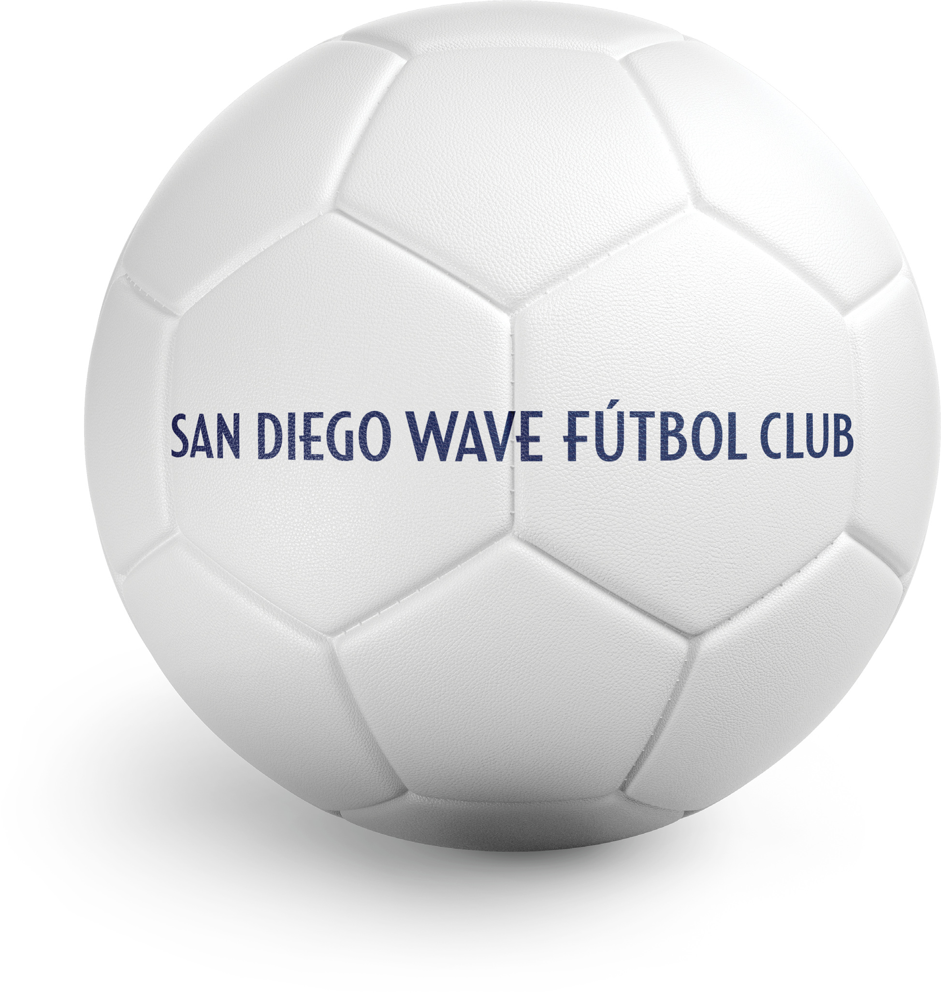
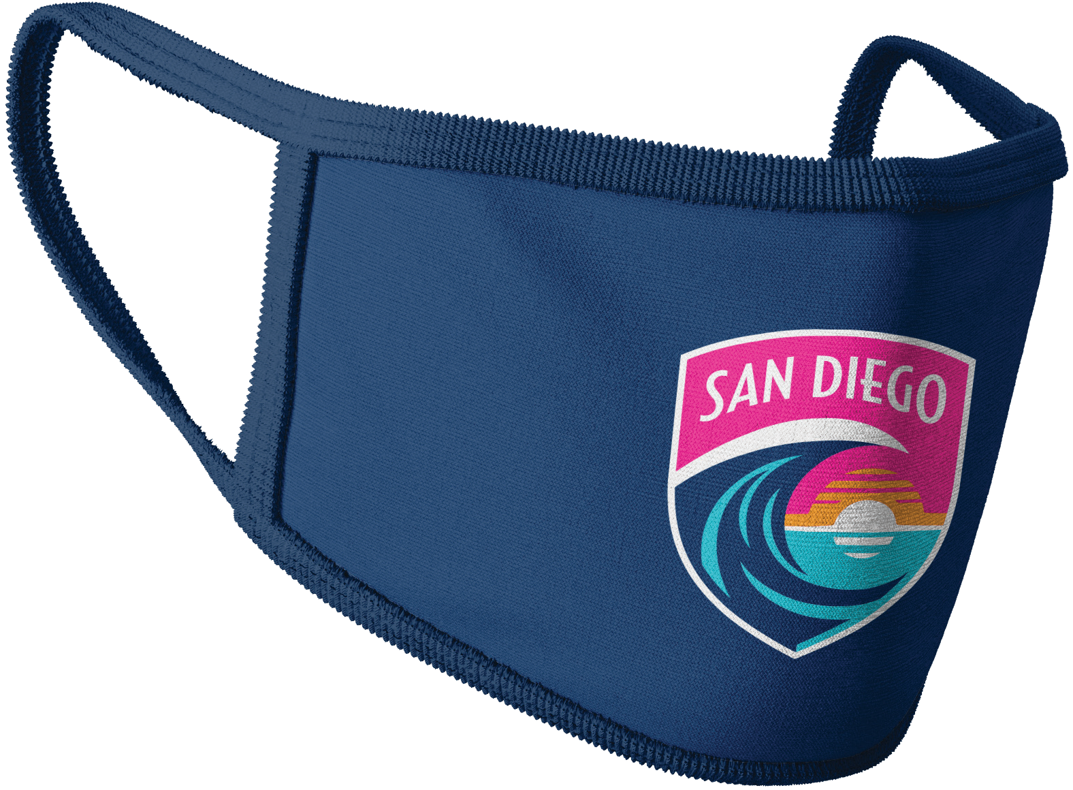
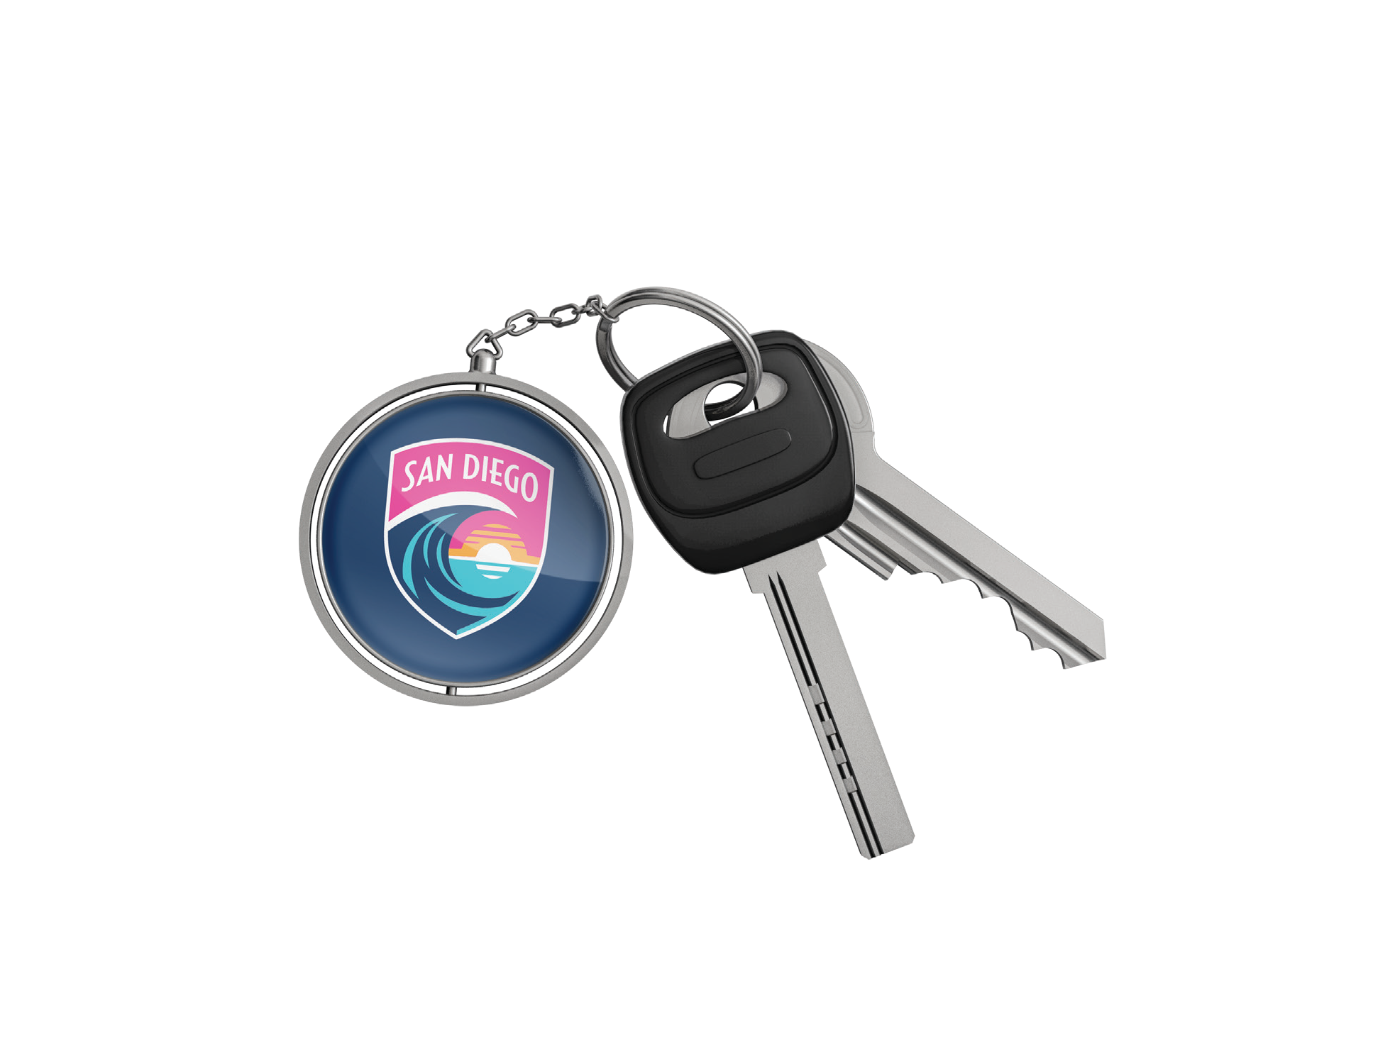
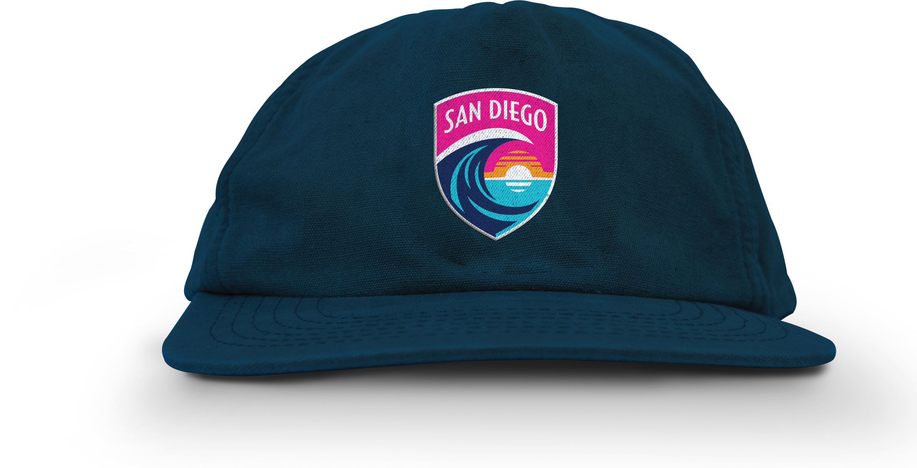
IN USE
MOODBOARD

Slide 26
SECONDARY
MARKS / ICONS
* *
Our secondary mark still look to honor the Crest shape to represent the Team, Brand Colors to represent the Brand and a simple ‘SD’ to represent San Diego, our community.
The following color combinations are authorized for general use based on overall design and allowing the mark to be visible against other colors.
OPTION 1
*
*
*Any icons using Poderosa are used for cause or community initiatives.

Slide 27
SECONDARY
MARKS / ICONS
*
Our secondary mark still look to honor the Crest shape to represent the Team, Brand Colors to represent the Brand and a simple ‘SD’ to represent San Diego, our community.
*
The following color combinations are authorized for general use based on overall design and allowing the mark to be visible against other colors.
OPTION 2
*
*Any icons using Poderosa are used for cause or community initiatives.

Slide 28
WORD MARK
Our word mark is a critical element to all communications understanding that our Crest alone does not say our Team name.
Preferred / Full name
Condensed Converting Futbol Club to FC / to save space or for optics | Name Only / We use WAVE FC without San Diego in rare instances where the SD is clearly on other elements or is clearly assumed given other context.
Short / Converting San Diego to SD and still using ‘FC’ / our most condensed linear version | We never use any Word Marks without key soccer team identifier, FC or Futbol Club.
Stacked / Simply, our Preferred full name, stacked for those times you just need a stacked logo

Slide 29
WORD MARK
Our word mark is a critical element to all communications understanding that our Crest alone does not say our Team name.
Preferred / Full name
Condensed Converting Futbol Club to FC / to save space or for optics | Do not SD and FC in the same name
 | We never use any Word Marks without key soccer team identifier, FC or Futbol Club.
Stacked / Simply, our Preferred full name, stacked for those times you just need a stacked logo
Name Only / We use WAVE FC without San Diego in rare instances where the SD is clearly on other elements or is clearly assumed given other context.

Slide 30




LOCK UPS
Currently we feature two lock ups of our Primary Mark / Crest & the Word Mark.
These are to be used as a logo file (and not built using the Mark and Word Mark as separate files), ensuring the size, spacing and proportions.
Currently, while there are other approved Word Mark — we only use the ones shown here as the Official Lock Ups.

Slide 31
TYPOGRAPHY
PRIMARY
AA
Only use for community or cause
PRIMARY HEADINGS
PT Sans Bold
All caps
ABCDEFGHJKLM NOPQRSTUWXYZ
1234567890+/()-%&
We use PT Sans (Google Font) as our primary font across Headers, Sub Headers, and body copy while adhering to the guidelines here.
Primary
SUB HEADING
PT Sans Bold
All caps
Use sparingly and always 25% smaller
AA
ABCDEFGHIJKLM NOPQRSTUVWXYZ
1234567890+/()-%&
BODY COPY
PT Sans Reg
All caps or sentence case
ABCDEFGHIJKLM NOPQRSTUVWXYZ
abcdefghijklm nopqrstuvwxyz 1234567890+/()-%&
Aa

Slide 32
TYPOGRAPHY
ACCENT
For a bit more human, editorial or rally cry tone in the course of typography — we offer DejuVu as our accent font.
This font is used sparingly to allow PT Sans to be the lead font — while keeping the accent font truly for short, impactful statements or quotes.
ACCENT FONT
DejuVU
All caps or sentence case
AA
Only use for community or cause
ABCDEFGHIJKLM NOPQRSTUVWXYZ
abcdefghijklm nopqrstuvwxyz 1234567890+/()-%&
Primary

Slide 33




TEXTURES
To be used as a background or textural element for digital, social and physical assets. Only to be modified on a
case-by-case basis.
Cropping of the file is allowed
based on the application and intent.

Slide 34
UNIFORM KITS
Our current kits are for TEAM use only. Never adopt, transfer, or use KIT patterns on other textures for consumer marketing.
Certain Brand / Digital use of the KIT pattern is authorized.
Other opportunities to apply these patterns can be reviewed case-by-case.

Slide 35
PHOTOGRAPHY
04

Slide 36
PHOTOGRAPHY
PRIMARY
Vibrant, saturated colors Action and energy Emotion
Authentic
SECONDARY
As background/texture: duotone/monotone treatment with brand blue

Slide 37
TALENT
WAVE FC PLAYERS
TALENT:
Diverse: skin tone, age, gender, body type Real
Joyful Energetic

Slide 38
BY CATEGORY
PHOTO
PHOTO
PHOTO
TEAM / PLAYERS
GAMES / FANS
IMPACT / COMMUNITY
Full body portraits
Diverse
Diverse
Club & Sponsor branding visible
Authentic
More intimate / emotional
Authentic to sport but no awkward expressions
Appropriate for younger eyes
Human stories
About competition / not just winning
Warm & Welcoming
Powerful & Pure
Fun, Full, & Fan-first (those dressing the part)

Slide 39
DONT’S
Objectify / Cut off
Overly Manipulate(d)
Be too close or too far away Feel like stock
Be muted or soft

Slide 40
SOCIAL MEDIA
05

Slide 41



THE BIG THREE
Need to draft general rules of content strategy perm platform
Need to draft general rules of content strategy perm platform
Need to draft general rules of content strategy perm platform

Slide 42
06
DIGITAL

Slide 43
WEB SAFE FONT
All brand typography guidelines remain for DIGITAL use. See pg 30.
However, when working with partners, v endors or third parties within marketing efforts, they should be aware that our DIGITAL REPLACEMENT / WEB SAFE font is Verdana.
H1
Verdana Bold
Aa
ABCDFGJKLNOPQRSTUVXYZ
abcdefghijklmnopqrstuvwxyz
1234567890+/()-%&
H2 / H3 / H4 / TEXT / LINKS
Verdana Reg
Aa
This will ensure our site and its content will be viewed using fonts we expect, even if our primary font is not available to be served online in the
market / vendor.
ABCDFGJKLNOPQRSTUVXYZ
abcdefghijklmnopqrstuvwxyz
1234567890+/()-%&

Slide 44

UX ELEMENTS
Button Styles
Button Text
Button Text
Button Text
Solid
Hover
Active
Button Text
Button Text
Button Text
Solid
Only use for community or cause
Hover
Active
Button Sizes
Small
Large
Border Radius: 5px
Button Text
Button Text
Button Text
Button Text

Slide 45
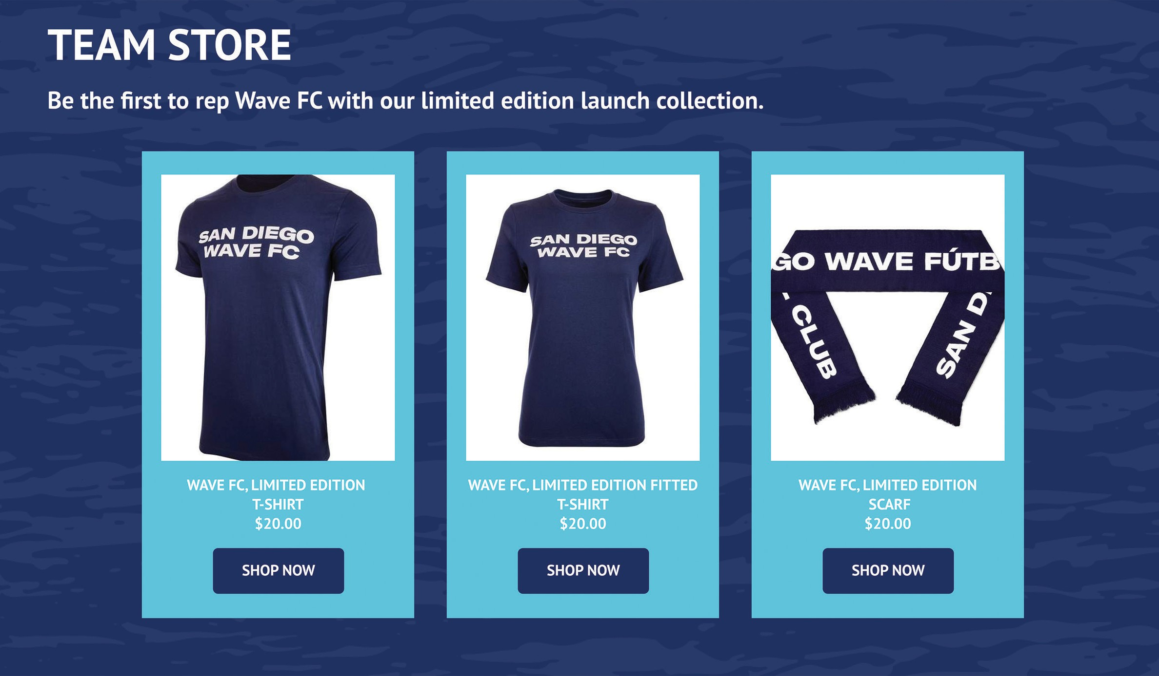
STYLE TILE

Slide 46
KEY BRAND
STAKEHOLDERS

Slide 47
THE FUTURE
WE LEAD WITH A FIERCELY HUMBLE MENTALITY
We’re here to be the best team in America, and, ultimately, in the
world. It’s what the San Diego soccer
community expects and deserves.
WE’RE A SOCCER CLUB FIRST.
Here to win championships and leave the game better than we found it.
We are coming to serve this region, highlight our shared history, and shape the path forward.

Slide 48
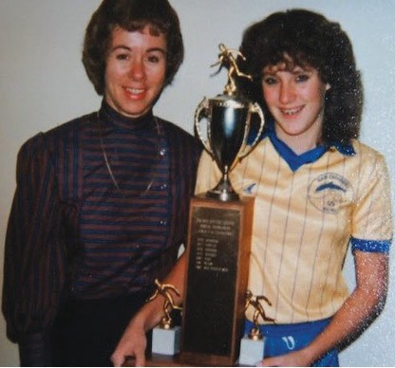
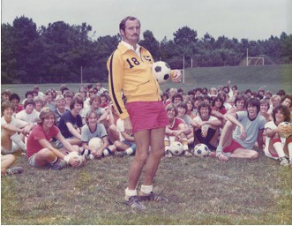
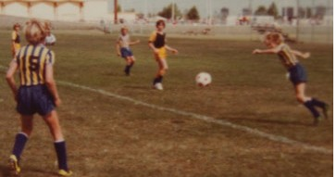
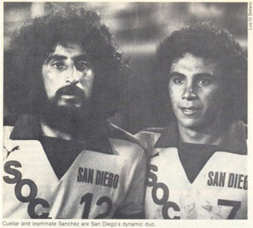
THE PAST
SAN DIEGO IS ONE OF AMERICA’S GREAT
FOOTBALLING CITIES
The community around and within the game in San Diego is tight, welcoming, visionary and passionate.
The city has made American soccer better for decades just by loving the game for exactly what it is:
A source of pride, unity and a really good time.

Slide 49
BACK COVER

